Slide 1
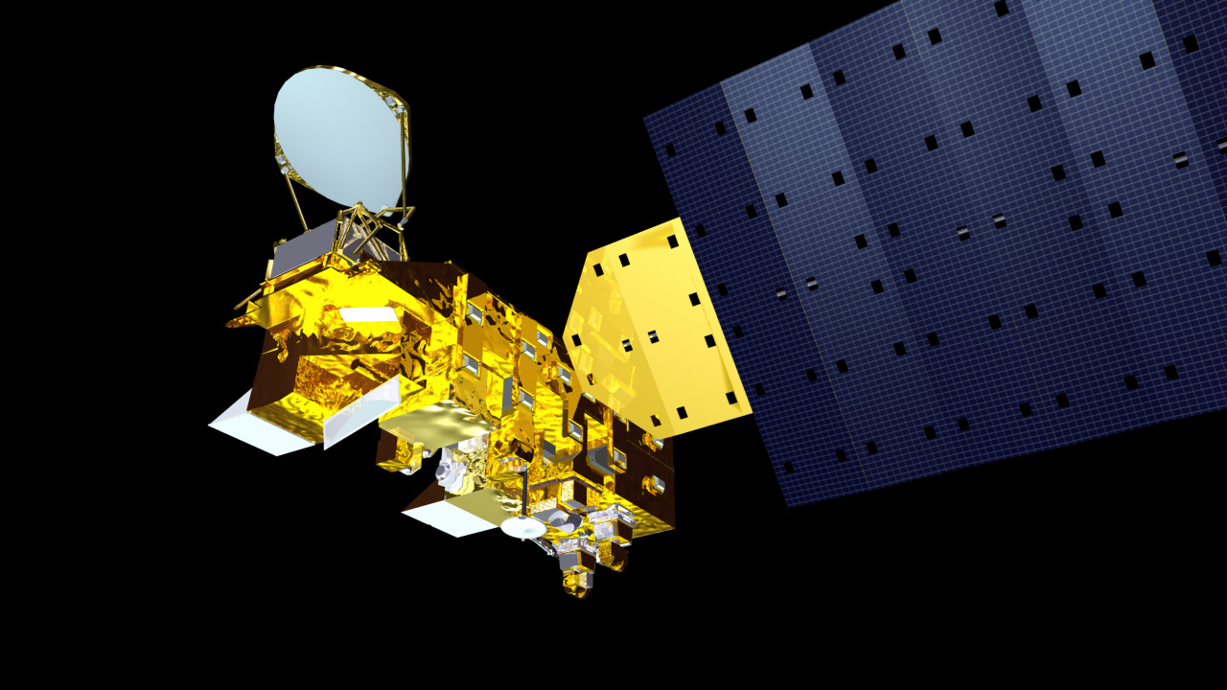
EOS Aqua
Mission Operations Status at the
Earth Science Constellation (ESC)
Mission Operations Working Group
(MOWG) Virtual
Meeting
November 16, 2022
Bill Guit
Aqua Mission Director - Code 584/428
Mission Validation and Operations Branch
Earth Science Mission Operations Project
NASA/Goddard Space Flight Center
William.J.Guit@nasa.gov

Slide 2
Topics
Changes since May 2022 MOWG Meeting are in blue
Mission Summary
Spacecraft Subsystems Summary
Recent and Planned Activities & Process Improvements
  Aqua A-Train Constellation Exit – Passing/Crossing Events Summary
  Refer to separate FDS Presentation for more details
Propellant Usage & Lifetime Estimate & Orbital Decay
  Aqua 2022 Lifetime and Decommissioning Analysis (Due: 10/14/2022)
  Aqua End of Mission Plan (EOMP) – Rev E (December 2021)
After-the-A-Train Extended Mission (ATAT) Timeline
Aqua Decommissioning (August 2026)***
Summary
Additional Slides:
  Orbit Maintenance Maneuvers
  Conjunction Assessment High Interest Events
  Ground Track Error & Mean Local Time History
  Spacecraft Orbital Parameters Trends & Predictions
*** NOTE: Budget uncertainties for FY24 and beyond are not addressed

Slide 3
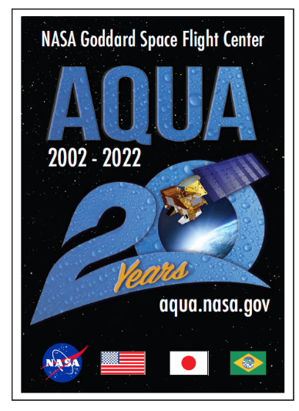
EOS Aqua Mission Summary
Changes since May 2022 MOWG Meeting in blue – NONE***
05/04/2002: Launch (6-Year Design Life)
12/02/2008: End of Prime Mission Review
12/08/2015: End of AMSR-E Operations
11/17/2016: A-Train PS Teleconference
  Maintain tight Mean Local Time (MLT)
10/02/2018: Aqua Decommissioning Review
03/06/2020: Senior Review Proposal #7
  Reliability Estimates thru end of CY 2026
  Consumables through early CY 2022
  Proposed After the A-Train Extended Mission
07/08/2020: NASA Earth Science Senior Review Subcommittee Panel Presentation
10/20/2020: Received HQ Guidance
  Continue as baselined through at least FY23
03/24/2021: Updated Aqua Phase F Plan
02/01/2022: ESMO Annual Review #15
05/04/2022: Aqua 20-Year Anniversary
*** NOTE: Budget uncertainties for FY24 and beyond are not addressed

Slide 4
Aqua Spacecraft Subsystems
All subsystems configured to primary hardware
Changes since May 2022 MOWG Meeting in blue – NONE !
Command & Data Handling (CDH) – Nominal (Solid State Recorder (SSR) holds ~2 orbits of data)
  12/2/2007: FOT SSR Operations Error Anomaly – fully recovered 1/28/2009
  8/16/2020: A Formatter Multiplexer Unit (FMU)/SSR anomaly – Fully Recovered on 9/2/2020
  2/22/2022: SSR Anomaly – Fully recovered 3/23/2022
Communications (COMM) – Nominal
Electrical Power System (EPS) – Nominal (Numerous solar array string failures)
  3/31/2022: Power Controller A (PC-A) Anomaly, Swapped to PC-B, Spacecraft transitioned to Safe Mode, Instruments to Safe, Unable to maneuver (Recovered maneuver capability 4/2/2022)
    Recovered full spacecraft and instrument operations on 4/14/2022
  Solar Array Regulator Electronics (ARE) power drops and current fluctuations have occurred since 2004
  Most recent power drops: ARE-1A: 7/27/2021 (1 string), ARE-6C: 8/19/2021 (cracked cell)
  Summary: Estimated that Aqua has lost up to 23 strings of solar cells out of a total of 132 strings.
    Aqua continues to have significant power margin out until August 2026
  Battery Cell Anomaly (9/2/2005)
  Solar Array (SA) Panel #8 Thermistor #6 Failure (8/3/2009), SA Offset (Reported 1/17/2009, Corrected 6/29/2010)
Flight Software (FSW) – Nominal
Guidance, Navigation & Control (GN&C) – Nominal
Propulsion (PROP) – Nominal
  Dual Thruster Module (DTM-2) Heater Anomaly (9/8/2007)
Thermal Control System (TCS) – Nominal

Slide 5
Spacecraft Activities Summary
(May 2022 – 10/31/2022)
Changes since May 2022 MOWG Meeting in blue
Aqua ESC/A-Train Member Mission Passing-Crossing Events
  04/03/2022: GCOM-W1 – Covered during May 2021 ESC MOWG Meeting
  05/17/2022: OCO-2 – occurred during May 2021 ESC MOWG Meeting
  06/30/2022: Landsat-7
  09/15/2022: Terra
  09/26/2022: Landsat-9
  Future Events see FDS Presentation – Aqua “Free Exit” Passing Analysis
19 CRMS High Interest Orbital Debris Events (HIEs): see slide 24
  19 Debris Avoidance Maneuvers (DAMs) PLANNED: 159 Maneuvers Screened
  19 Self-mitigated, No DAMs Executed
1 Ongoing Spacecraft Bus Anomaly: Solar array (SA) string losses
  No new string losses since last MOWG Meeting
    Aqua has lost up to 23 of 132 strings (Future Power Margin on slide 12)
0 Instrument Anomalies:
0 Spacecraft Maneuvers: Last DMUM on 12/1/2021, IAM on 3/18/2021
4 Instrument Calibration Maneuvers: 5/11, 6/10, 7/9, summer gap & 11/4

Slide 6
2022 Completed Activities
(May MOWG thru October 2022)
Completed since May 2022 MOWG Meeting in blue
05/04/2022: Aqua 20-Year Anniversary
  In-person Celebration at GSFC Visitors Center
06/21/2022: FDS Aqua 2022 Lifetime Analysis Status
  Aqua can delay PLMs until Aug. 2026 and meet 25-year reentry requirement
07/11/2022: Start of 8-week Test Period for 2-Controller Operations
  Weekly Status Reports with ESMO Management
08/17/2022: Aqua 2022 Lifetime Analysis Presentation (Plots & Tables)
09/01/2022: 2-OCE Ops Operations Readiness Review (ORR)
09/22/2022: Fall EPS ARE State-of-Health Test
10/23/2022: Supplemental EPS ARE State-of-Health Test
10/14/2022: 2022 Aqua Decommissioning/Lifetime Analysis (V1.0)
  Update from 08/17/2022-v3 Lifetime Analysis Presentation (Charts and Tables)
11/01/2022: EOS (T/A/A) Drifting Orbits Workshop (2-days)
11/16/2022: ESC MOWG Meeting (TODAY)

Slide 7
Planned Activities
(Mid-to-Long-Term)
Changes since May 2022 MOWG Meeting in blue
Aqua/Aura Retrograde Maneuver (RGM) Working Group – Ongoing
  January 2022: Limited on-orbit retrograde capability (Emergencies)
  Free-Drift/Drag-Down Retrograde RMMs (Emergencies)
  Focus is on Aura CEMs and PLMs – to be ready by January 2023
11/01/2022: EOS (Terra/Aqua/Aura) Drifting Orbits Workshop
December 2022: EPS Performance Working Group Meeting
  Model Solar Array Strings losses using Weibull distribution.
  Estimate a probability Aqua Spacecraft Bus will function past 2026.
December 2022: Decommissioning/Passivation Review
- - - - - - - - - - - 2023 - - - - - - - - - - - - - - - - - - -
January 2023: Extended Mission Reliability Assessment for 2023 – 2026
January/February 2023: ESMO Annual Review
March: Senior Review Proposal due (TBD – Hopefully)
Spring 2023: ESC MOWG Meeting (Date/Location are TBD)
November – December: PLMs, Passivation & Disposal (In-Guide Budget)
  See Slides 20 and 21

Slide 8
Ongoing
Process Improvements
Completed since May 2022 MOWG Meeting in blue
Aqua/Aura Maneuver Working Group: Reestablished in May 2016
  Develop retrograde maneuver capability [DONE – Limited emergency use only]
  Develop more fuel-efficient propulsive maneuvers (IAMs, CEMs & PLMs) [DONE]
  Next Step: Finalize Aura CEMs & PLMs to be ready by January 2023
EOS Automation (EA): Multi-year/Multi-phase development
  2-Controller (OCE) Operations Implemented [DONE] – Delayed by COVID-19
Collision Risk Management System (CRMS) – Initiated in 2015
  Operating with CRMS Release 10.0 [DONE], Next Step: Release 11.0 March 2023
CARA Devolution: ESMO quasi-devolved since October 2019
  ESMO Pilot Program Parallel Operations: 3/26/2019 – 10/2/2019 [DONE]
NASA Guidance on Collision Avoidance: December 9, 2020
  NASA Interim Directive (NID) 7120.132 CA for Space Environment Protection
  Spacecraft CA and Collision Avoidance Best Practices Handbook
  11/23/2021: NASA Policy Requirement (NPR) for “NASA Spacecraft Conjunction Analysis and Collision Avoidance for Space Environment Protection”, intended to replace NASA Interim Directive (NID) 7120.132 (May 2022 Draft 43 under review)
  05/12/2022: Final ESMO MOCA CONOPS signed off

Slide 9
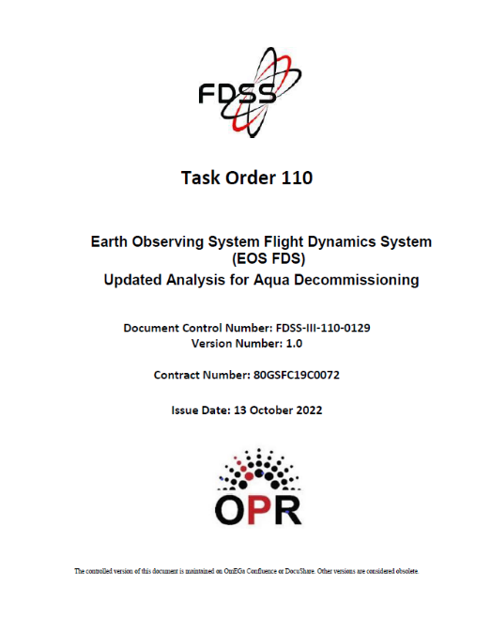
Aqua Propellant Usage
(October 2022)
Changes since May 2022 MOWG Meeting in blue
2006: Initial Aqua lifetime fuel analysis
2008: Detailed Aqua & Aura lifetime analyses
  Presented to A-Train MOWG and at Aqua EOPM Review
September 2012: Initial Aqua Decommissioning Plan
August 2013: Updated Decommissioning Plan
  Updated Constellation Exit Plan
September 2014: Updated Decommissioning Plan
December 2016: Updated Decommissioning Plan (V1.1)
November 2017: Updated Decommissioning Plan (V1.1)
July 2018: Updated Decommissioning Plan (V1.0)
  08/02/2018 IAM required update to document and IAM Plans
November 2018: Updated Decommissioning Plan (V2.0)
July 2019: Updated Decommissioning Plan (V1.0)
  10/02/2019 IAM required update to plots and figures only
July 2020: Updated Lifetime Analysis Presentation
  Updated DAS Solar Flux Models
February 2021: Updated 2020 Decommissioning Plan (V1.0)
Summer 2021: Updated Lifetime Analysis Presentation
February 2022: Updated 2021 Decommissioning Plan (V1.0)
Summer 2022: Updated Lifetime Analysis Presentation
  08/17/2022: 2022 Lifetime Analysis (v3) – Plots & Tables (v4 on 8/18)
  10/13/2022: 2022 Lifetime Analysis Final Full Document
Annual updates will be provided each Fall (started in 2017)
  Final will be produced 60 days before start of decommissioning
Version 1.0
Updated: 10/13/2022
(Full Document)

Slide 10
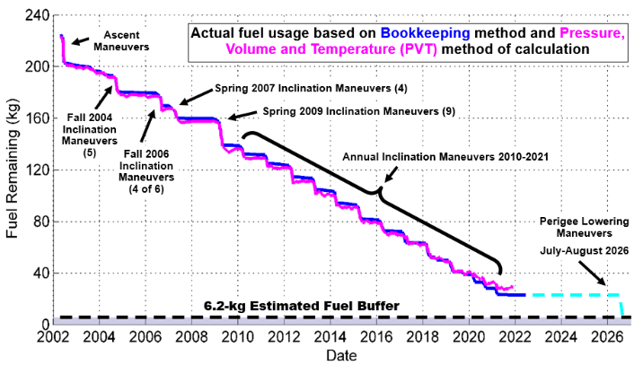
Fuel Usage: Actual & Predicted
(Updated September 2022)

Slide 11
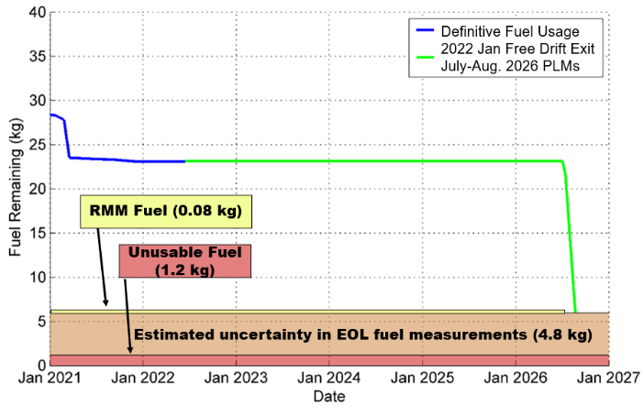
Fuel Usage: Predicted Available
No Exit in 2022, Free-Drift, PLMs in June 2026
(Updated September 2022)

Slide 12
Solar Array Strings Required
Free-Drift, Drag-Down Constellation Exit
(Updated August 2022)
The number of strings required depends on what power is need to meet the Power per String requirement
The Strings Remaining projection comes from the Code 371 Weibull Analysis.
2773 W is the Minimum Required Power for Loads and Battery Charging
Power Generation Limit for this power load occurs with ~101 strings
Power generation limitations are not reached before September 2026
Reflects the 23 string losses observed to date and confirmed by the 9/22/2022 ARE State of Health Test
Sep 2026

Slide 13
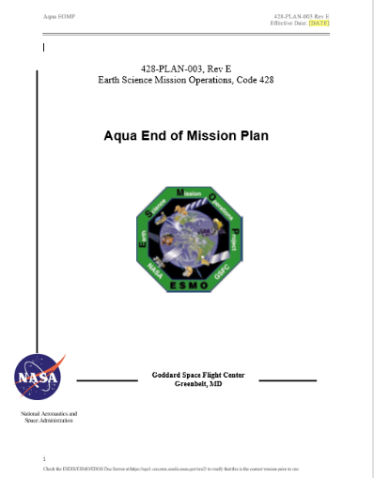
Aqua End of Mission Plan
KEY: Updates since May 2022 MOWG Meeting in blue – NONE
Initial draft February 2009
“Interim” End of Mission Plan: May 2011
End of Mission Plan (Rev A): February 2013
End of Mission Plan (Rev B): June 2015
  Safely exit the A-Train Constellation (19 km)
  Passivate to the extent possible for uncontrolled reentry
  Aqua has five (5) approved waivers for passivation
    Pressurant Passivation
    Large Object Collision Probability
    Small Object Collision Probability
    Orbital Lifetime (30-Year)
    Re-entry Risk (Un-controlled)
  Waivers were approved in May 2013
End of Mission Plan (Rev C): August 2017
  Includes ~4.4 km exit from A-Train in early 2022
End of Mission Plan (Rev D): November 2020
  Latest Annual Lifetime Estimate (November 2019)
  Retrograde maneuver slews on reaction wheels
  A-Train Exit January 2022, Immediately lower perigee
End of Mission Plan (Rev E): December 2021
  January 2022 Free-Drift Exit, Perigee Lowering June 2024
    End of Science Mission August 2026 (Decommissioning and Disposal)
Final 90 days before Decommissioning Review
OSMA indicated they do not need to review the Aqua End of Mission Plan since no new non-compliances are triggered by the extension.

Slide 14
– This version reflects the Aqua Over-Guide Budget Request –
Aqua After-the-A-Train
Extended Mission Timeline
Aqua 20-Years
Senior Review Proposal (SRP)
SRP
SRP
2020
2021
2022
2023
2024
2025
2026
2027
Q1
Q2
Q3
Q4
Q1
Q2
Q3
Q4
Q1
Q2
Q3
Q4
Q1
Q2
Q3
Q4
Q1
Q2
Q3
Q4
Q1
Q2
Q3
Q4
Q1
Q2
Q3
Q4
Q1
Q2
Q3
Q4
2017 SRP
FY18 – FY20
2017 SRP: FY21 – FY23
2020 SRP: FY21 – FY23
2020 SRP: FY24 – FY26
2023 SRP: FY24 – FY26
Operate WITHIN the A-Train
Operate slightly BELOW the A-Train
Free-drift, drag-down A-Train Exit
Power Concerns
August 2026 due to
Beta Angle Drift
4
IAMs
3
IAMs
4
IAMs
Last
DMUM
(PLMs) July - August 2026
Inclination Adjust Maneuvers
(IAMs)
Instruments OFF
(See slide #18)
Passivate
Spacecraft Disposal
KDP-F
5/17/2021
A-Train Exit
Review
DR
DRR
After the A-Train Extended Science Mission
Operate Instruments below A-Train operational orbit – Power Limited
TODAY
11/16/2022
DR – Decommissioning Review
KDP-F – HQ Key Decision Point to proceed with Phase F
DRR – Disposal Readiness Review

Slide 15
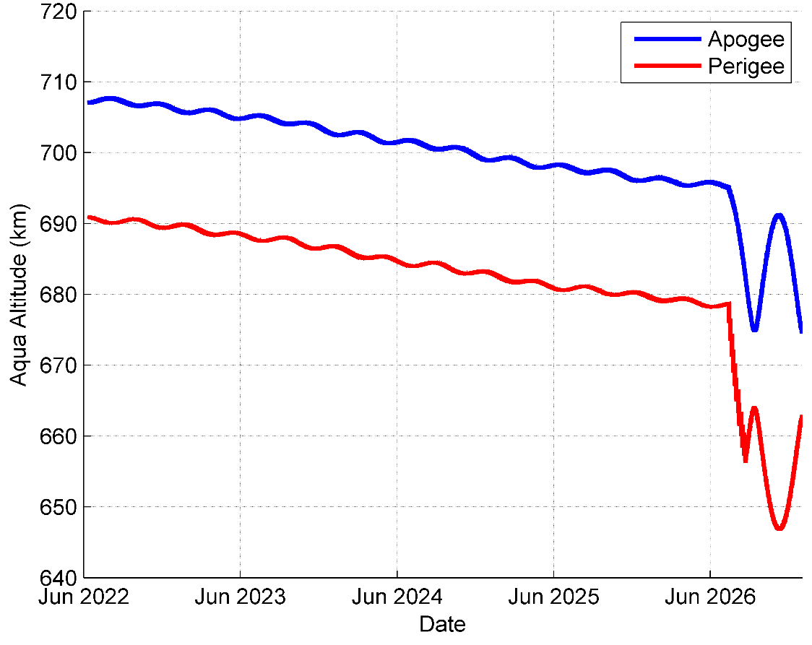
January 2022 Free-Drift/No-Exit
July – August 2026 PLMs (12)
Passivate/Decommission August 2026
Schatten Solar Flux Model (SFM)
DAS
SFM
12 Perigee
Lowering
Maneuvers
(PLMs)

Slide 16
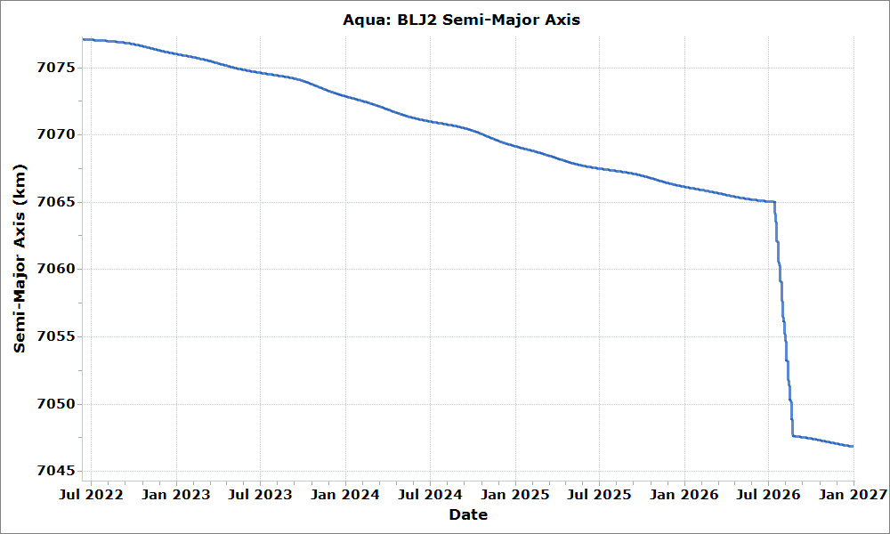
Semi Major Axis (SMA)
Free-Drift, Drag-Down Constellation Exit
July – August 2026 PLMs

Slide 17
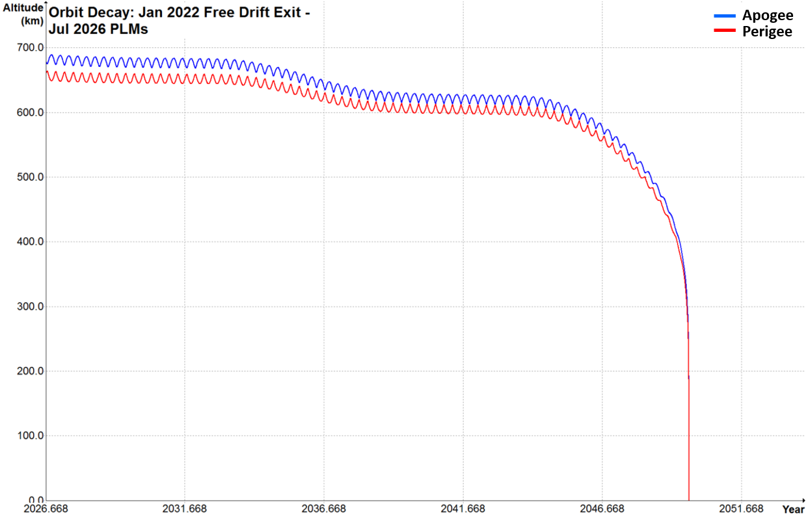
January 2022 Free-Drift/No-CEMs
July – August 2026, PLMs
End of Science Mission: August 2026
DAS predicts that Aqua will re-enter in October 2049.
23.1 years after passivation in August 2026.
In August 2026, during passivation and the end of the fuel life, we will perform fuel depletion burns with the fuel being held as uncertainty (4.8 kg) and any remaining fuel allocated for RMMs. This may provide additional perigee lowering to what is planned for the July-August 2026 PLMs.

Slide 18
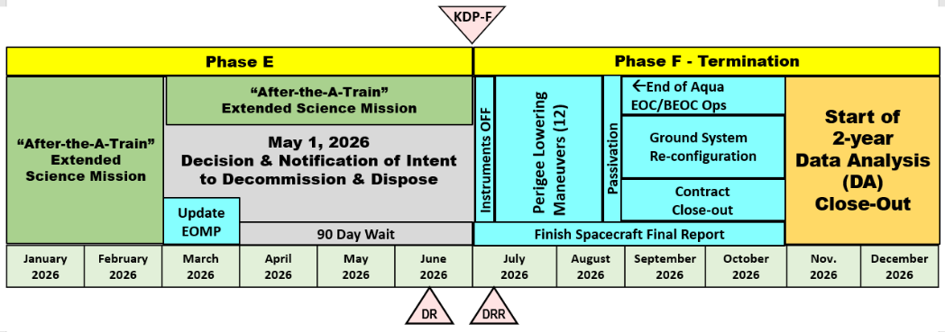
Aqua Decommissioning
(September 2025 → August 2026)
KEY: Updates since May 2022 MOWG Meeting in blue
Aqua Decommissioning Engineering Peer Review (DRAFT): October 2, 2018
Overview presented at Fall 2020 ESC Mission Operations WG Meeting
Aqua A-Train free-drift, drag-down Constellation Exit in January 2022
  Planned 4 plus years of extended science operations after A-Train constellation exit
  Planned Perigee lowering in summer 2026 (Reentry in 23.1-years)
  Project Scientist and ESMO Management agree to hold some fuel in reserve for Debris Avoidance Maneuvers (DAMs) during the extended “After the A-Train” science mission
Decommissioning and Disposal in late 2026 (see figure below)
  Aqua Spacecraft Decommissioning and Disposal outlined in End of Mission Plan
  Current EMOP: Revision E, December 2021
  Decommissioning and Passivation Readiness Review (Nov/Dec 2022) → Early 2023 TBC
  Figure below updated to reflect PLMs in July – August 2026

Slide 19
Summary
KEY: Updates since May 2022 MOWG Meeting in blue
Spacecraft Status – GREEN
Instrument Status – GREEN
  AIRS and MODIS: Nominal Operations
  AMSU: Nominal Operations except for Channels 1, 2, 4, 5 and 7
  CERES: Nominal Operations except for CERES-Fore instrument
  AMSR-E: Powered Down 3/3/2016
  HSB: Survival Mode since 2/5/2003
Data Capture/L0 Processing Status – GREEN
  SSR Data Capture September 2022 100%
  SSR Data Capture to 09/30/2022: 99.83+%
Data Latency – Excellent
Ground Systems:
  Responding to new security requirements and upgrades to obsolete hardware or COTS systems, as required
Flight Operations:
  06/24/2022: FOT EOS Automation (EA) Status – 2-OCE Operations Concept Review (OCR)
  06/30/2022: Test Readiness Review (TRR), 07/11/2022: Start of 8-Week Test Period
  09/01/2022: Operations Readiness Review (ORR)

Slide 20
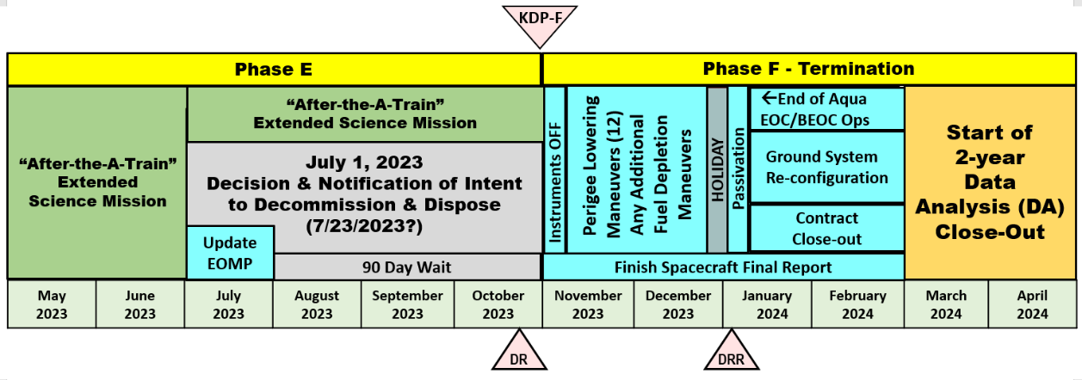
Aqua 2023 Decommissioning
(If No Extension to Current Mission)
Decommissioning outlined in End of Mission Plan (Rev E Dec 2021)
  Decommissioning and Passivation Readiness Review
    Target was Nov/Dec 2022 → Early 2023 Date To Be Determined
    02/01/2023: Final Passivation Plan
  Perigee Lowering Maneuvers (PLMs) 11/7/2023 – 12/21/2023 (12 PLMs)
    07/01/2023: Intent to Decommission
    10/20/2023: Decommissioning Review
    10/27/2023: KDP-F
    11/02/2023: End of Science Data Collection
    01/04/2024: Disposal Readiness Review
    01/10/2024: Passivation
  DAS predicts that Aqua will re-enter in August 2049, over 25 years after passivation in Jan 2024. Dwell Time of 25.6 years.

Slide 21
Fall 2023 Decommissioning
Aqua Maneuver Schedule
Sunday | Monday | Tuesday | Wednesday | Thursday | Friday | Saturday
29 OCT | 30 | 31 | 1 NOV | 2 | 3 | 4
5 | 6 | 7 PLM #1 | 8 | 9 PLM #2 | 10 | 11
12 | 13 | 14 PLM #3 | 15 | 16 PLM #4 | 17 | 18
19 | 20 | 21 | 22 | 23 HOLIDAY | 24 | 25
26 | 27 | 28 PLM #5 | 29 | 30 PLM #6 | 1 DEC | 2
3 | 4 | 5 PLM #7 | 6 | 7 PLM #8 | 8 | 9
10 | 11 | 12 PLM #9 | 13 | 14 PLM #10 | 15 | 16
17 | 18 | 19 PLM #11 | 20 | 21 PLM #12 | 22 | 23
24 | 25 HOLIDAY | 26 PLM Back-up | 27 | 28 PLM Back-up | 29 | 30
31 | 1 HOLIDAY | 2 | 3 | 4 | 5 | 6

Slide 22
Additional Slides
  Orbit Maintenance Maneuvers
  Inclination Adjust Maneuver Performance
  Conjunction Assessment High Interest Events
  Ground Track Error & Mean Local Time History
  Spacecraft Orbital Parameters Trends & Predictions

Slide 23
Orbit Maintenance
– No Changes –
Mission Requirement: Perform Drag Make-Up Maneuvers (DMUMs) to maintain Aqua’s ground track error (GTE) with respect to the World Reference System (WRS-2) within +/-10 Km at the Descending Node (A-Train Requirement/Goal)
  Changed from +/-20 Km Mission Requirement with DMUM #19 (1/12/05)
  162 DMUMs have been performed to date. Last DMUM #162 on 12/1/2021 was FINAL DMUM for Aqua
  Variation in performance from –20.9% (cold) to +27.1% (hot) #108 was 20.9% COLD, #162 was 35.2% HOT
Control Box Excursions: Since 2012 there have been 7 Control box Excursions
  4 on +10km front-side:
    11/4/12 to 11/14/12, 10/23/13 to 10/24/13, 3/6/14 to 3/10/14 and 3/16/2015 to 4/2/2015
  3 on -10km back-side: 11/7/13 to 12/14/13 (Emergency DAM on 10/24/13 and DAM on 11/28/13)
    4/2/2016 to 5/7/2016 and 7/29/2018 to 8/21/2018 (DAM on 7/12/2018)
Mission Requirement: Perform inclination adjust maneuvers (IAMs) to maintain the Mean Local Time (MLT) as measured at the Ascending Node between 1:30 and 1:45 MLT (Mission Goal starting in 2011: 13:35:45 +/- 45 seconds)
  73 Inclination Adjustment Maneuvers (IAMs) performed to date
    Fall 2003 (1), Spring 2004 (1), Fall 2004 (5), 2005 (NONE)
    Fall 2006 (4 of 6 - cancelled final 2 burns), Spring 2007 (4 - interrupted 2-weeks), Spring 2008 – NONE (per PARASOL request)
    Spring 2009 (9), Spring 2010 (3), Spring 2011 (3), Spring 2012 (4)
    Spring 2013 (4 with #3 being delayed 1-week), Spring 2014 (4), Spring 2015 (5)
    Spring 2016 (4 with one having to be re-scheduled), Spring 2017 (4)
    Spring 2018: (5 with one having to be re-scheduled due to PMCOC), Summer 2018 #61 on 8/2/2018
    Spring 2019: (4 planned on: 3/7 (#62), 3/14 (#63), 3/22 → 4/4 (#64), 3/28 → 4/11 (#65), Fall 2019: 10/02/2019 IAM #66
    Spring 2020 (4): 3/5 (67), 3/12 (68), 3/19 (69) →3/26 (PMCOC), 4/2 (70) – Yaw slew performed with reaction wheels
    Fall 2020 (3): 8/20 (#71), 8/27 → 9/10 (#72) & 9/3 → 9/17 (#73) – Yaw slew performed with reaction wheels
    Spring 2021 (4): 2/25 (#74), 3/4 (#75), 3/11 (#76) and 3/18 (#77) – FINAL IAMs for the Aqua Mission

Slide 24
Aqua Conjunction Assessment High Interest Events (HIEs) – 2022
2022 | Jan | Feb | Mar | Apr | May | Jun | Jul | Aug | Sep | Oct | Nov | Dec | Total
TOTAL | 3 | 0 | 5 | 8 | 5 | 2 | 3 | 5 | 4 |  |  |  | 35
Tier 1 | 0 | 0 | 0 | 0 | 0 | 0 | 0 | 0 | 0 |  |  |  | 0
Tier 2 | 0 | 0 | 0 | 0 | 0 | 0 | 0 | 0 | 0 |  |  |  | 0
Tier 3 | 3 | 0 | 5 | 8 | 5 | 2 | 3 | 5 | 0 |  |  |  | 35
Tier 4 | 0 | 0 | 0 | 0 | 0 | 0 | 0 | 0 | 0 |  |  |  | 0
2013: 28 CARA HIEs – 9 required significant action
2014: 34 CARA HIEs – 14 required significant action
2015: 26 CARA HIEs – 16 required significant action
2016: 21 CARA HIEs – 4 required significant action
2017: 16 CARA HIEs – 11 required significant action
2018: 19 CARA HIEs – 13 required significant action (T3 & T4), 18 DAMs Planned, 1 DAM Executed, 1 Maneuver (IAM #60) postponed (T4)
2019: 14 CARA HIEs – 11 required significant action (T3 & T4), 9 DAMs Planned, 1 DAM Executed, 1 Maneuver (IAM #64) postponed (T4)
2020: 16 CRMS HIEs – 12 required significant action (T3 & T4), 12 DAMs Planned, 0 DAMs Executed, 1 Maneuver (IAM #67) postponed (T4)
2021: 23 CRMS HIEs – 21 required significant action (T3 & T4), 21 DAMs Planned, 0 DAMs Executed, 2 Maneuver postponed (T4)
2022 thru 9/30/2022: (35 CRMS HIEs – 35 that required significant action (Tiers 3 & 4)
08/09/2022: CA vs. 40502 at 04:49:29 GMT – DAMs planned and screened (19), Self-mitigated (T3)
08/12/2022: CA vs. 30238 at 20:03:48 GMT – DAMs planned and screened (3), Self-mitigated (T3)
08/27/2022: CA vs. 19311 at 06:43:49 GMT – DAMs planned and screened (2), Self-mitigated (T3)
08/31/2022: CA vs. 39554 at 18:43:46 GMT – DAMs planned and screened (11), Self-mitigated (T3)
09/04/2022: CA vs. 37093 at 07:46:08 GMT – DAMs planned and screened (5), Self-mitigated (T3)
09/08/2022: CA vs. 87741 at 04:43:56 GMT – DAMs planned and screened (9), Self-mitigated (T3)
09/23/2022: CA vs. 81372 at 00:35:36 GMT – DAMs planned and screened (10), Self-mitigated ((T3)
09/28/2022: CA vs. 270102 at 00:14:16 GMT – DAMs planned and screened (12), Self-mitigated (T3)
Tier 1 – Notify (email/phone), Tier 2 – Conduct Briefing,
Tier 3 – Plan Maneuver, Tier 4 – Execute Maneuver
Tier 4 – Postponed and/or replanned Maneuver

Slide 25
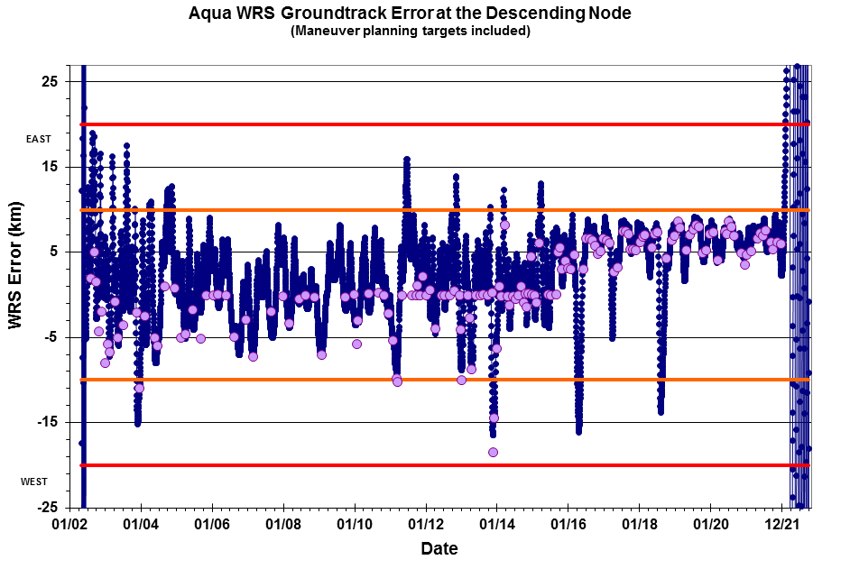
WRS Ground Track Error (GTE)
(As of September 30, 2022)

Slide 26
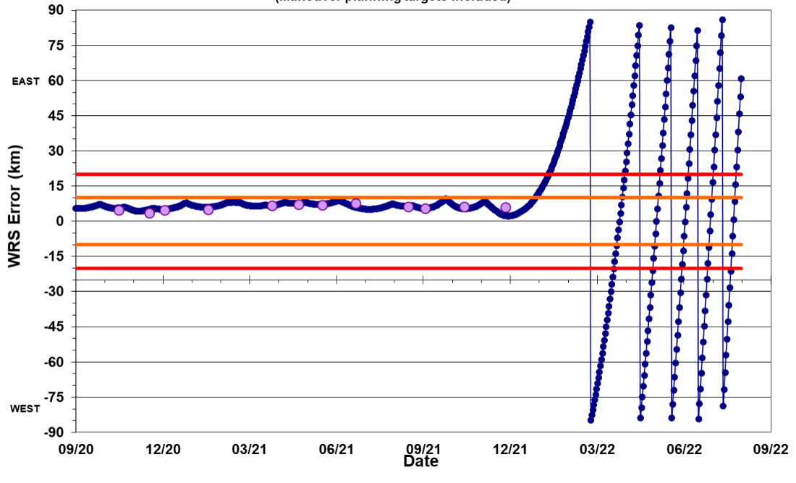
Aqua WRS Ground Track Error
@ Descending Node As of September 1, 2022

Slide 27
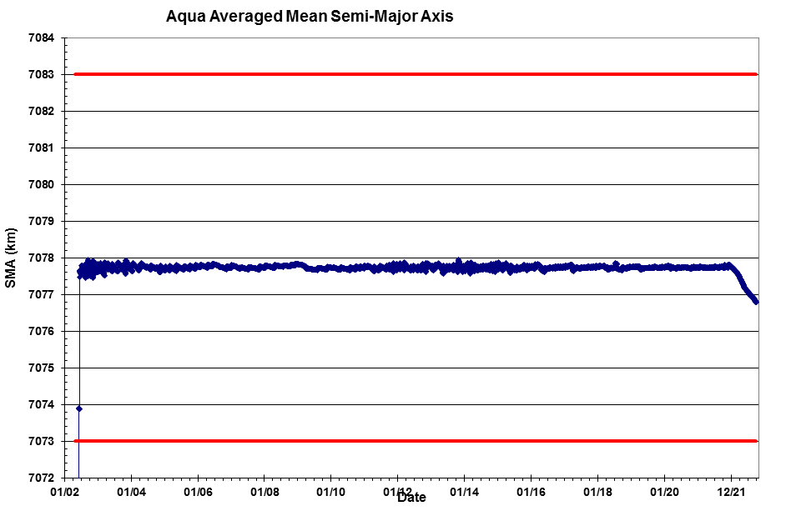
Aqua Mean Semi-Major Axis
(Updated September 30, 2022)

Slide 28
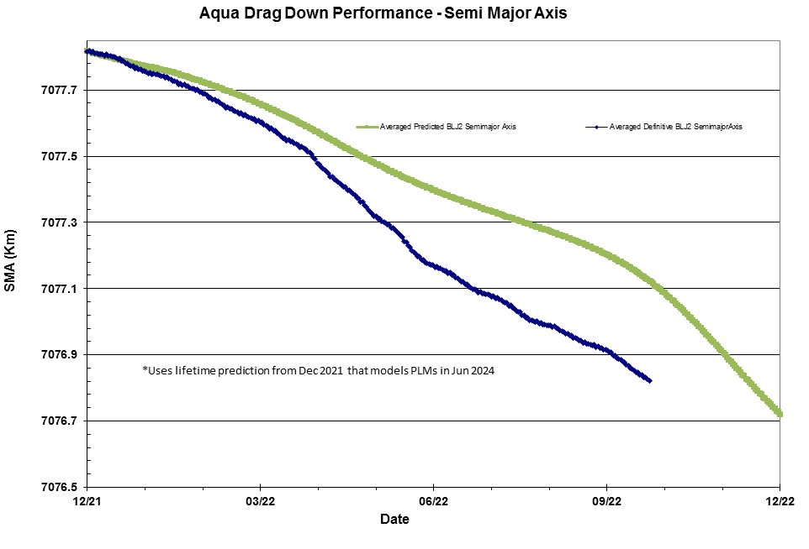
Semi Major Axis (SMA)
Free-Drift, Drag-Down Performance as of 9/26/2022
- NEEDS UPDATING -

Slide 29
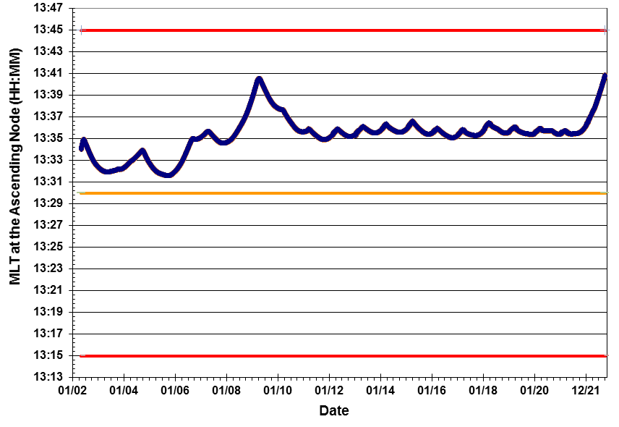
Aqua Mean Local Time (MLT)
@ Ascending Node as of September 30, 2022
Mission Operations Range for Aqua MLT is 13:30 – 13:45
MLT Mission Requirement 13:30 +/- 15 minutes

Slide 30
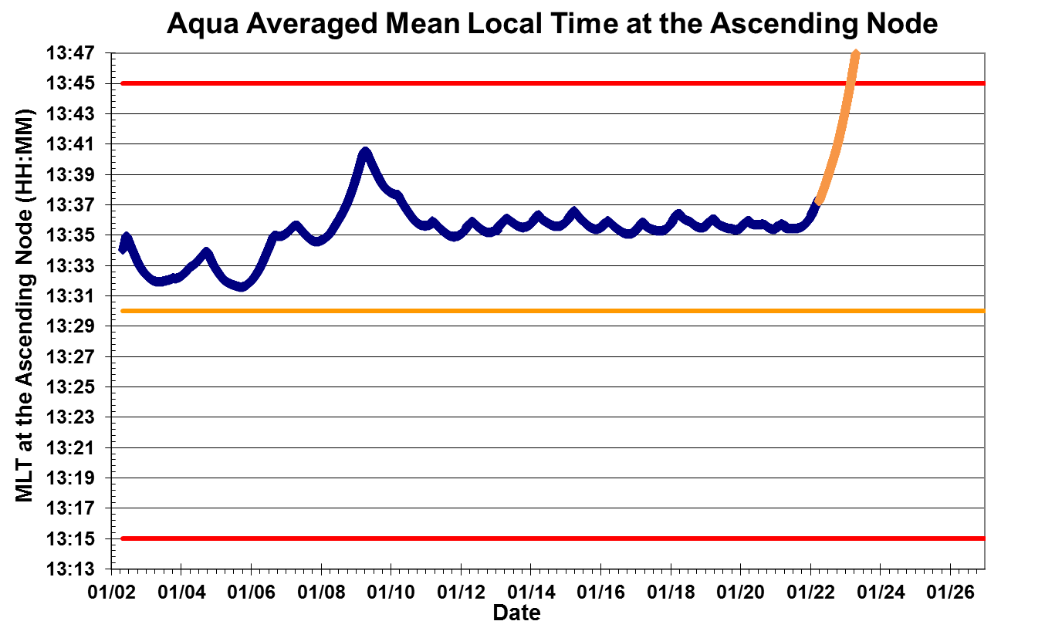
Aqua Definitive and Predictive MLT @ Ascending Node
(Updated April 2022)
Mission Operations Range for Aqua MLT is 13:30 – 13:45
Predicted
Data
See next slide
The current target MLT range for Aqua is 13:35:45 +/- 45 sec
Definitive Data
MLT Mission Requirement 13:30 +/- 15 minutes

Slide 31
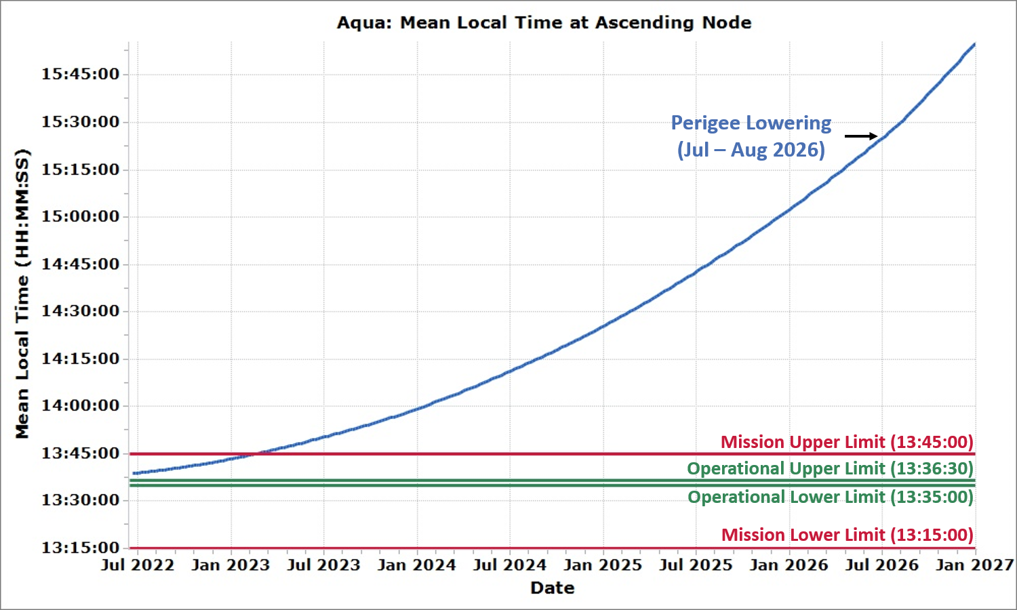
Aqua Predicted Mean Local Time (MLT) at Ascending Node
(Updated September 2022)
Aqua’s MLT was maintained within the operational bounds through Jan 30, 2022.
The upper mission bound is predicted to be violated in Feb 2023.
This plot shows MLT drift according to the "Free-Drift, Drag-Down" plan.
Feb 24, 2023

Slide 32
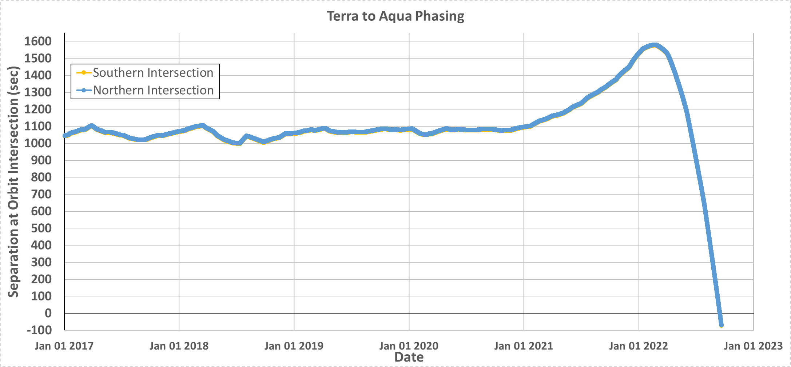
Terra to Aqua Phasing
(Updated September 2022)
Terra used to go through the orbital intersection point about 17.5-minutes (~1050-seconds) prior to Aqua.
Aqua under-flight of Terra: 9/15/2022 at 22:03:26z

Slide 33
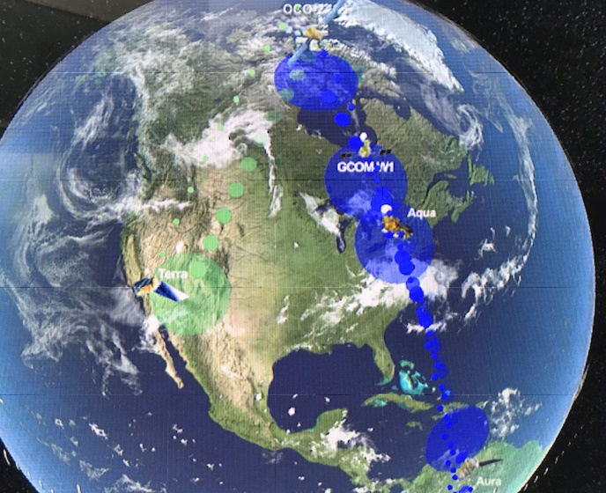
Questions ?
A-Train on Nov 19, 2022, at 1:30pm EST (Constellation Visualization Tool)

Slide 34
Abbreviations / Acronyms List
  AIRS – Atmospheric Infrared Sounder
  AMSR-E – Advanced Microwave Scanning Radiometer for EOS
  AMSU – Advanced Microwave Sounding Unit
  ARE – Array Regulator Electronics
  BEOC – Backup EOC
  BP – Best Practices
  CA – Conjunction Assessment
  CAM – Command Authorization Meeting
  CARA – Conjunction Assessment Risk Analysis
  CDH – Command & Data Handling
  CEF – CERES Fore
  CEM – Constellation Exit Maneuver
  CERES – Clouds and the Earth’s Radiant Energy System
  COTS – Commercial Off the Shelf
  CRMS – Collision Risk Management System
  CVT – Constellation Visualization Tool
  DA – Data Analysis
  DAM – Debris Avoidance Maneuver
  DAS – Debris Assessment Software
  DMUM – Drag Make-up Maneuver
  DTM – Dual Thruster Module
  EA – EOS Automation
  EDT – Eastern Daylight Time
  EOC – EOS Operations Center
  EOL – End of Life
  EOM – End of Mission
  EOMP – End of Mission Plan
  EOPM – End of Prime Mission
  EOS – Earth Observing System
  EPS – Electrical Power System
  ESC – Earth Science Constellation
  ESMO – Earth Science Mission Operations
  FDS – Flight Dynamics System
  FDSS-III – Flight Dynamics Support Services III Contract
  FOT – Flight Operations Team
  FSW – Flight Software
  FY – Fiscal Year
  GCOM-W1 – Global Change Observation Mission for Water (1)
  GMT – Greenwich Mean Time
  GN&C – Guidance Navigation & Control
  GTE – Ground Track Error
  HIE – High Interest Event
  HQ – Headquarters
  HSB – Humidity Sounder for Brazil
  IAM – Inclination Adjustment Maneuver
  JAXA – Japan Aerospace Exploration Agency
  kg – kilogram
  km – kilometer
  L0 – Level-Zero
  m – meter
  min – minute
  MLT – Mean Local Time
  MMOD Micrometeorite Orbital Debris
  MOCA – Mission Operations Conjunction Assessment
  MODIS – Moderate Resolution Imaging Spectroradiometer
  MOU – Memorandum of Understanding
  MOWG – Mission Operations Working Group
  NASA – National Aeronautics & Space Administration
  NID – NASA Interim Directive
  OCE – Operations Control Engineer
  OCO-2 – Orbiting Carbon Observatory-2
  Ops – Operations
  ORR – Operational Readiness Review
  PLM – Perigee Lowering Maneuvers
  PMCOC – Post Maneuver Conjunction of Concern
  PROP – Propulsion
  PS – Project Scientists
  PVT – Pressure, Volume, & Temperature
  RMM – Risk Mitigation Maneuver
  RW – Reaction Wheels
  s or sec – second
  SA – Solar Array
  S/C – Spacecraft
  SEU – Single Event Upset
  SME – Subject Matter Expert
  SSR – Solid State Recorder
  TBC – To Be Confirmed
  TBD – To Be Determined
  TCS – Thermal Control System
  TRR – Test Readiness Review
  US – United States
  USGS – United States Geological Survey
  WRS – World Reference System

