Slide 1

NASA ASDC Distributed Active Archive Center (DAAC)
Earth Venture Sub-Orbital Support Team
Megan Buzanowicz; megan.e.buzanowicz@nasa.gov
ACTIVATE Science Team Meeting

Slide 2
ASDC’s Role in ACTIVATE
Sole post project data portal for distribution of data products
  Active stewardship
  High public visibility to broad user communities
  User support
Responsible for long-term preservation and stewardship
ACTIVATE data holdings
  Archive the latest versions of publication quality data, including observational, derived, and value-added data products
  Contextual information to facilitate data use by research community at large
  Documentation to maintain reprocessing capability and openness
Assign DOIs to data products tailored to support manuscript and presentation development

Slide 3
Data Archival Update
ASDC has completed ingest, archival, and distribution of all currently available publication quality data for all deployments
Data is available through all the ASDC’s search mechanisms (which will be highlighted later in the presentation)
Complete periodic checks of field repository for newly updated or publication quality data
Notes:
The ASDC has completed ingest, archival, and distribution of all currently available publication quality data for all deployments and continues to check the field repository for file revisions, or newly available publication quality data. Data is available through all the ASDC’s usual search mechanisms, which will be highlighted later in the presentation.

Slide 4
Data Organization and DOIs
DOIs are assigned at the project level and collection level
Project level DOI (all ACTIVATE observational, derived and value-added data products): 10.5067/SUBORBITAL/ACTIVATE/DATA001
Notes:
DOIs are assigned at both the project level and collection level (collections represent logically meaningful groups of data with the same basic characteristics). The project level DOI encompasses all ACTIVATE data and is listed here.

Slide 5
Data Organization and DOIs
Data collections and associated DOIs:
  ACTIVATE_Aerosol_AircraftInSitu_Falcon_Data_1 Collection:
    In-situ observations of aerosol microphysical, optical, and chemical properties
    DOI: 10.5067/ASDC/ACTIVATE_Aerosol_AircraftInSitu_Falcon_Data_1
  ACTIVATE_Cloud_AircraftInSitu_Falcon_Data_1 Collection:
    In-situ observations of cloud physical, optical, and chemical properties
    DOI: 10.5067/ASDC/ACTIVATE_Cloud_AircraftInSitu_Falcon_Data_1
  ACTIVATE_TraceGas_AircraftInSitu_Falcon_Data_1 Collection:
    In-situ observations of O3, CH4, CO, and CO2
    DOI: 10.5067/ASDC/ACTIVATE_TraceGas_AircraftInSitu_Falcon_Data_1
  ACTIVATE_MetNav_AircraftInSitu_Falcon_Data_1 Collection:
    Navigational parameters, temperature, water vapor, and 3-D winds
    DOI: 10.5067/ASDC/ACTIVATE_MetNav_AircraftInSitu_Falcon_Data_1
Notes:
ACTIVATE data is organized into 9 collections, including 4 in-situ collections for data collected onboard the Falcon. DOIs for each of the collections are listed.

Slide 6
Data Organization and DOIs
Data collections and associated DOIs:
  ACTIVATE_MetNav_AircraftInSitu_KingAir_Data_1 Collection:
    Navigational Parameters, dropsondes
    DOI: 10.5067/ASDC/ACTIVATE_Aerosol_AircraftInSitu_Falcon_Data_1
  ACTIVATE_AerosolCloud_AircraftRemoteSensing_Falcon_KingAir_1 Collection:
    RSP and HSRL remote sensing of cloud and aerosol properties
    DOI: 10.5067/ASDC/ACTIVATE_AerosolCloud_AircraftRemoteSensing_KingAir_Data_1
Notes:
There are 2 collections for the King Air/HU-25: one in-situ, and one remote sensing collection. DOIs are listed.

Slide 7
Data Organizations and DOIs
Data collections and associated DOIs:
  ACTIVATE_Miscellaneous_Data_1 Collection:
    Camera forward cloud masks
    DOI: 10.5067/ASDC/SUBORBITAL/ACTIVATE_Miscellaneous_Data_1
  ACTIVATE_Merge_Data_1 Collection:
    Project generated merge files
    DOI: 10.5067/ASDC/ACTIVATE_Merge_Data_1
  ACTIVATE_Model_Data_1 Collection:
    MERRA-2 Reanalysis Model Data
    DOI: 10.5067/ASDC/SUBORBITAL/ACTIVATE_Model_Data_1
Notes:
Finally, we have 3 collections for the related datasets – including project generated merge files and merra-2 reanalysis model data. DOIs are listed. All datasets are covered by the ACTIVATE project DOI.

Slide 8
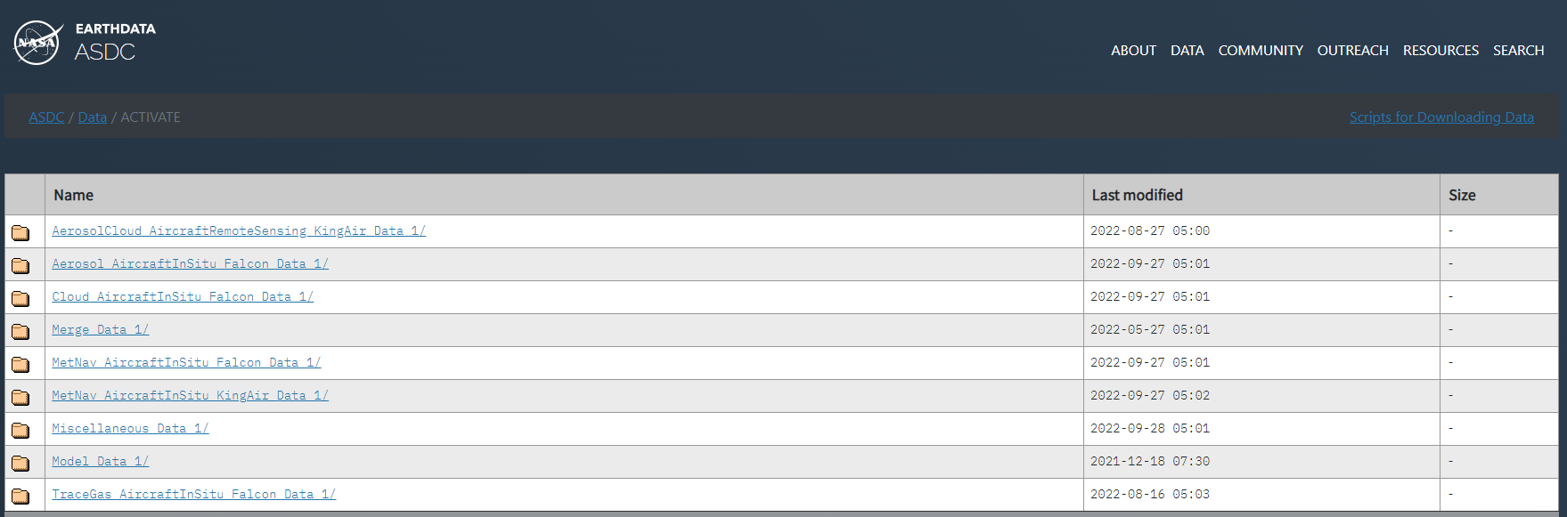
Data Distribution Options: ASDC Website/DDD
ACTIVATE Direct Data Download
Direct Data Download (DDD) provides the ability to access and download all ASDC publicly available data collections via https;
Scripts for downloading data are available
Notes:
As I mentioned earlier, ACTIVATE data is available through all ASDC’s search mechanisms. All of these mechanisms do require an Earthdata Login. If you need any assistance with getting an account set up please reach out to the ASDC. The first mechanism is Direct Data Download, or DDD. DDD provides the ability to access and download all ASDC publicly available data collections via https; scripts for downloading data are available.

Slide 9
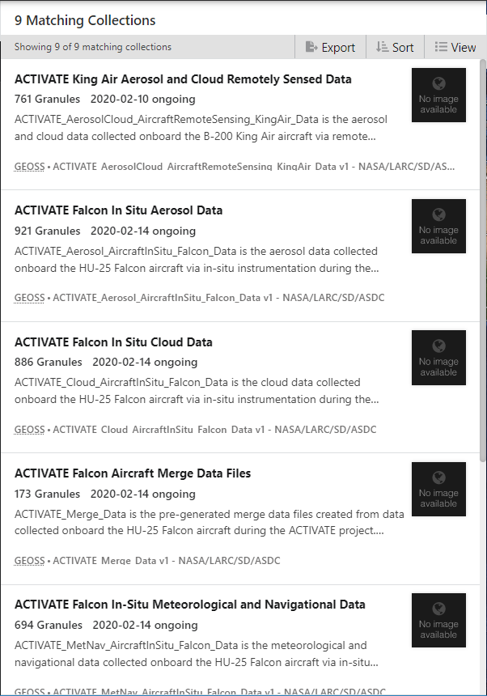
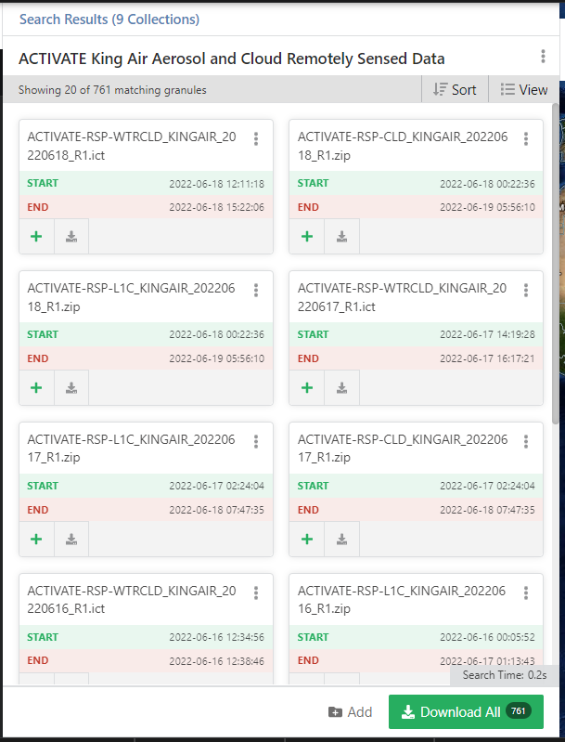
Data Distribution Options: Earthdata Search
Explore and retrieve data via collections
Notes:
The next option is Earthdata Search. Earthdata Search allows users to explore and retrieve data via collections.

Slide 10
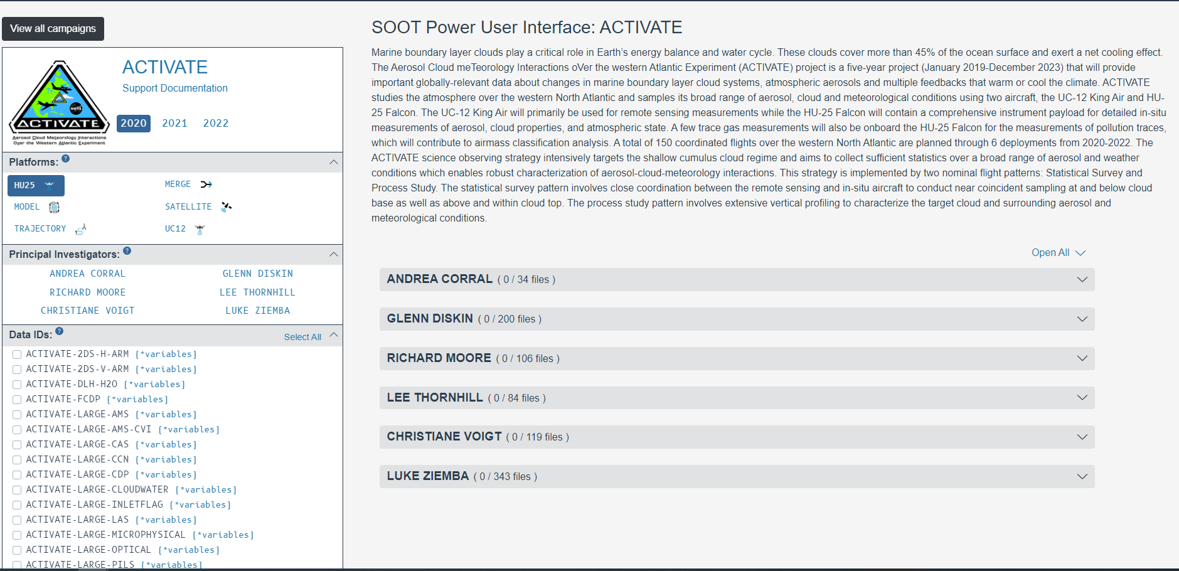
Data Distribution Options: SOOT
Notes:
The final option is the ASDC’s Sub-Orbital Order Tool, or SOOT. SOOT was designed to promote sub-orbital research and analysis. SOOT supports field campaign data that is currently archived at the ASDC. Currently, the Power User Interface is available, which is intended for experienced airborne data users and science teams. Future development includes merge capabilities, and a general user interface, The general user interface will be designed for both power users and those who may not be as familiar with suborbital data. One of the primary features of this interface will be the ability to search by variables. Development is underway for both the merge and general user interface.

Slide 11
Outreach Materials
ASDC creates outreach materials to support the discovery of ACTIVATE data
Materials include:
  ACTIVATE Microarticle (campaign overview)
  Armin Sorooshian Researcher Profile
  Hosting materials for ACTIVATE data webinars: ACTIVATE Webinar Materials
Documenting ACTIVATE Publications
Notes:
Finally, the ASDC creates various outreach materials to highlight the ACTIVATE campaign and promote data discovery and accessibility. Materials created so far include an ACTIVATE microarticle, which provides a campaign overview. We are actively working on creating a researcher profile highlighting Armin Sorooshian, and the websites to host materials for ACTIVATE data webinars. The ASDC also documents ACTIVATE publications, so if there’s any publications you’d like listed on our site, please feel to reach out and we can get them added.

Slide 12
Contact Us
Megan Buzanowicz: megan.e.Buzanowicz@nasa.gov
Sean Leavor: sean.leavor@nasa.gov
Earthdata Forum

