Slide 1

Radio Frequency Mass Gauging (RFMG) Automation
2022 NASA Data Science Summit
November 15-17, 2022

Slide 2
Acknowledgments
MSFC CE – Kathryn Henkel
Glenn Research Center (GRC) RFMG Team members:
  Dr. Greg Zimmerli
  Marius Asipauskas
  Nick Lantz
  Dr. David Fischer
MSFC EV – Dr. Brian Bae and Sanjog Gururaj (Pathways Intern)
MSFC ER – Kris Mcdougal and David Gillespie
MSFC ES – Scott Tashakkor, Chris Whetsel, Anthony Maenza, Bill Larson, Jason Stelly
Thank You!
Notes:
GRC did this because they were interested, not because they had to

Slide 3
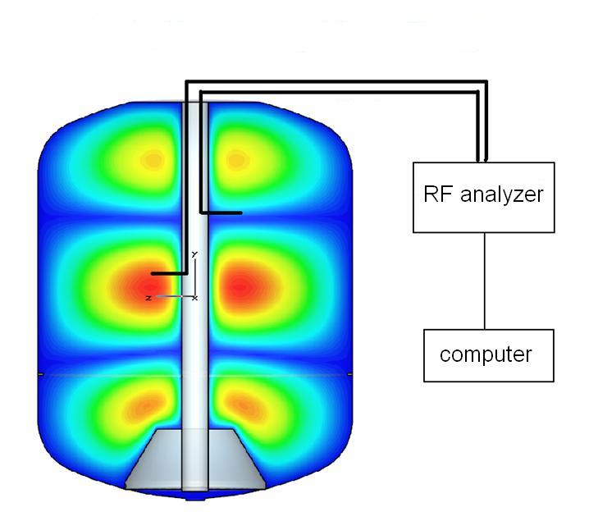
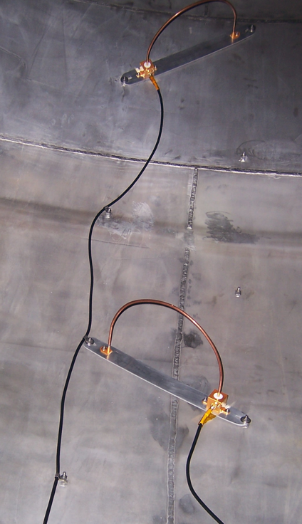

RFMG Overview
$$f_{full} \sim {f_{empty}}/{\sqrt{ε}}$$
Antennas placed in the tank measure the RF spectrum, which changes with fill level since the dielectric fluid (e) slows the speed of light
The basis of the RFMG is that these changes can be accurately predicted via RF/fluid simulations (e.g., Comsol or CST Studio)
  NESC-RP-20-01603 page 50, the NASA Engineering and Safety Center (NESC) identified an area of complex development for RFMG to be “Generation of simulations for all fluid configurations expected during gauging operations”.
Notes:
Discuss the technology
The dips on the right graph are example of frequencies
Highlight the simulation aspect is critical, NESC identified this as well

Slide 4
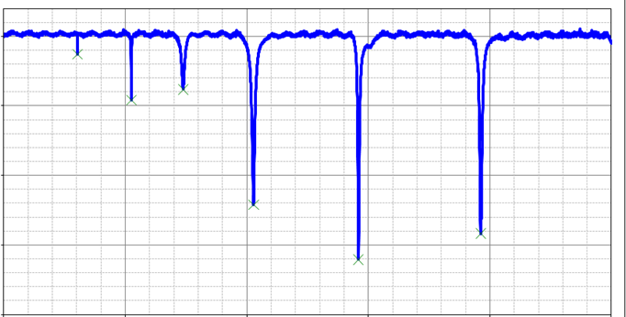
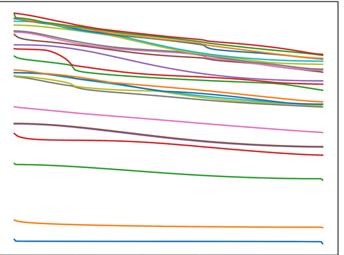
Data Analysis
Sweep Data (representative)
Resonant Frequencies (representative)
Data is generated through “sweeps” during which the antenna emits a range of signals, from lower to higher frequencies, then measures the response
Dips in response frequencies occur at resonant frequencies based on the tank dimensions and the fluid
By tracking the resonant frequencies (also referred to as peaks or eigenfrequencies), the entire sweep can be reduced into a few dozen datapoints

Slide 5
Data Analysis (Cont.)
Structural Heat Intercept, Insulation and Vibration Evaluation Rig (SHIIVER)
  Ground data, two different fluid tests (Hydrogen and Nitrogen)
Robotic Refueling Mission 3 (RRM3)
  Ground and Micro-gravity Data from ISS
  Fluid is CH4 (Methane)
  Multiple configurations of fluid in Micro-gravity
Truth data considered to be simulations
  No new simulations run
Not all information was measured during experiments
ML models work best training on the same data set they’ll predict on
  Models will introduce some error, but if sims already have error this will be captured
Notes:
Measured information did not always include true mass levels
Tanks have stratification (noticeable gradient) in properties from high to low end
This is same phenomenon that SLS Cryo Tanks have
Given only frequency peaks measured, not amplitude

Slide 6
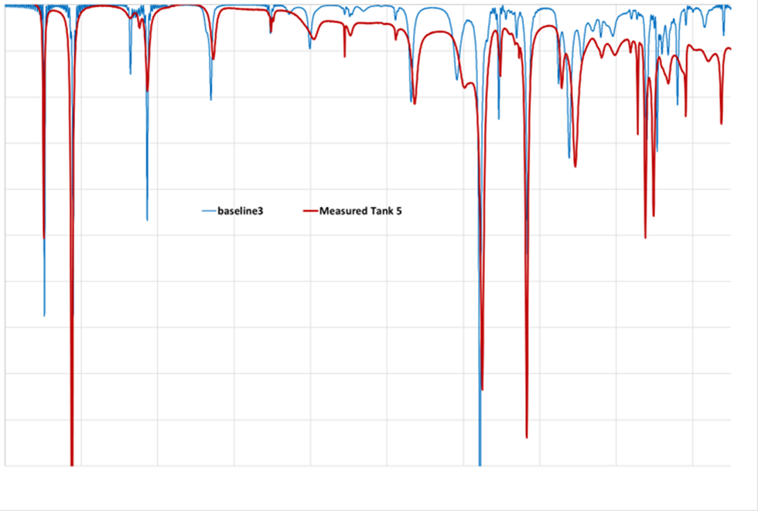
Example of Simulation vs Real
Not all simulated peaks will be measured
Peaks can be present but simulation and measurement error show differences
  Some drift in measured data
  Amplitudes different (not given)
Time is not considered
  No linking from point to point only snapshots
Amplitude difference
Peak Simulated but not measured
Notes:
Drift is noticeable at Higher frequencies (right hand side of the graph)
Discuss challenge of varying number of peaks

Slide 7
Methodology
Original (GRC)
  RFMG analysis software finds the peaks, compares the frequencies to a database of simulations, and returns the best match %fill-level information
    This is a “bucket” methodology while automated, looks for nearest neighbor matches
    Low computational need but large amount of data
    Deterministic
Machine Learning (ML) technique
  Let the computer learn from the simulation results
    Simulations already being run
    Interpolation between simulations
  Higher computational load, but lower memory need
  Non-deterministic (Statistical)
Notes:
Original methodology
can work but has resolution based on simulations
Does not handle unknowns well
ES ML
Still verification issues
Provides fidelity between simulation points
Possibility of ML model (only) being model of Simulations

Slide 8
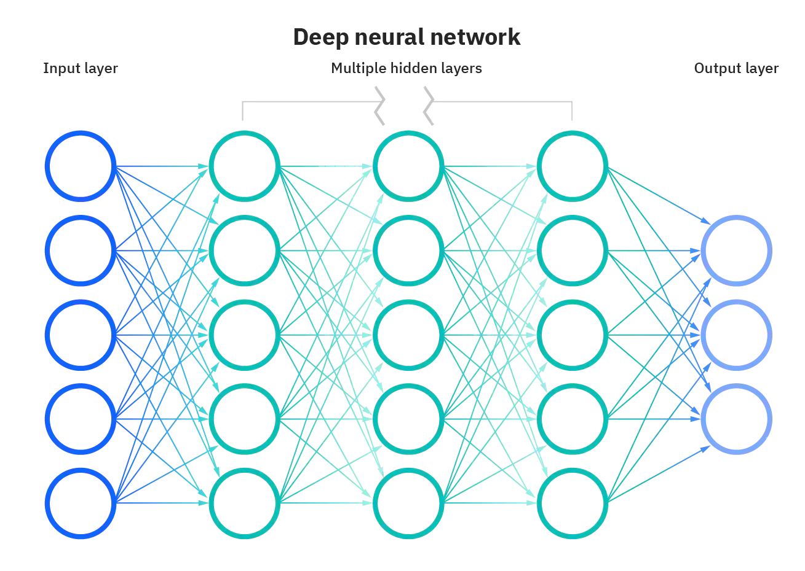
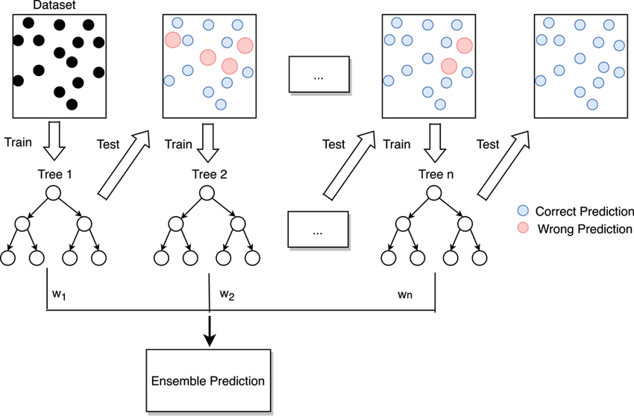
Machine Learning Philosophy
Unknown which ML model will work best for this scenario
  Dense Neural Network
  Ensemble methods
    Multiple gradient boosted decision Trees
  Multiple Regressors
    Decision Tree, Kernal Ridge, k-Nearest Neighbor …
  Test Tuning of the models to see better results
    Ensure independence of model to outcome
Notes:
DNN – each layer is connected to all previous layers
Ensemble – multiple methods working together (ie voting)
Gradient boosted decision trees- multiple weak decision trees that are built dotegher
Regressors (from statistics) – estimate the relationships between variables (curve fitting)
Discuss images on side

Slide 9
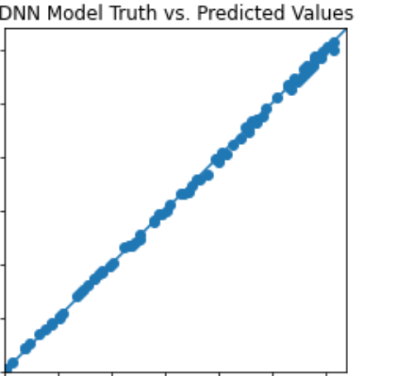
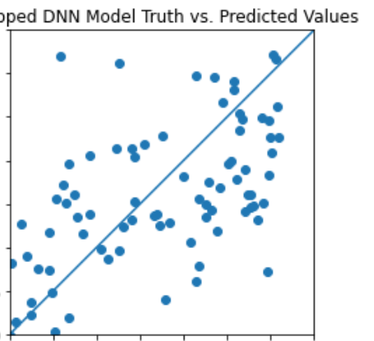
Results (SHIIVER)
#2 Trained with random dropped frequencies and full data, plotting predictions on data with dropped frequencies only
#1 Trained only on full data, predicting on full data
Sanity check
Simulation perfect but real measurements missing

Slide 10
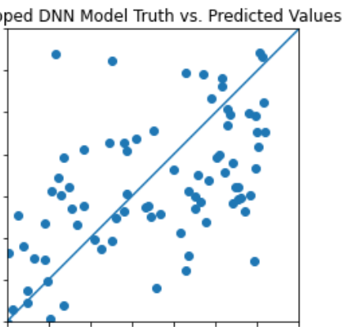
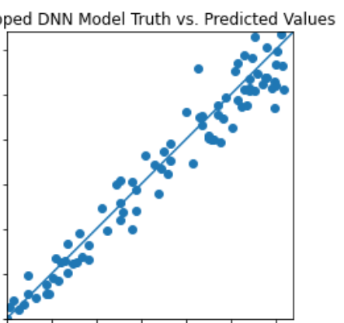
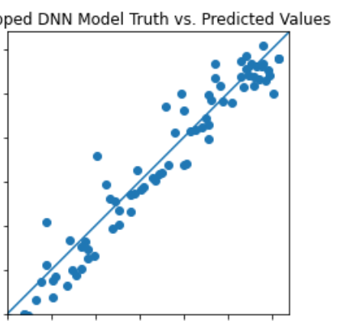
Results (SHIIVER)
#2 Trained with random zeros and full data
#3 Trained with padding zeros and full data
#4 Trained with padding zero data only
Notes:
Intended to show examples of testing/ and improvement and variations

Slide 11
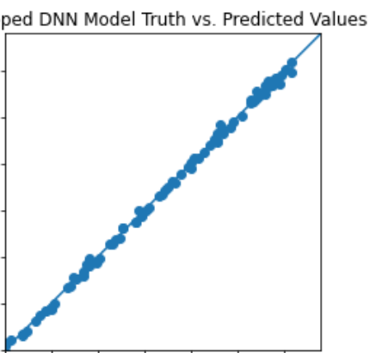
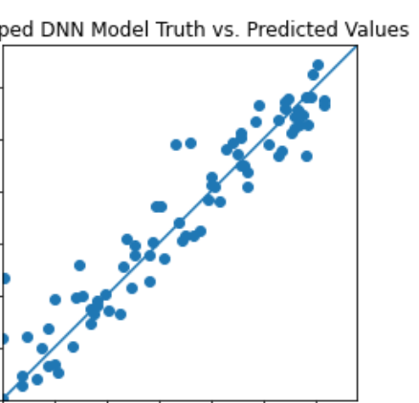
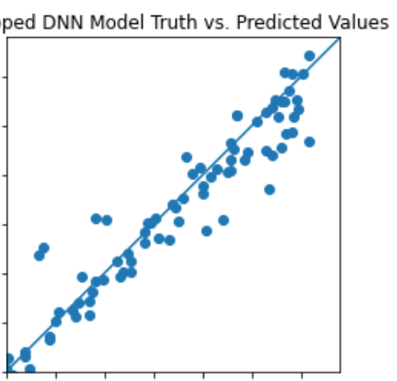
Results (SHIIVER)
#7 Pre-normalized (overall mean and std) data with padding zeros
#5 Pre-normalized (per frequency min-max) data with padding zeros
#6 Pre-normalized (overall min-max) data with padding zeros

Slide 12
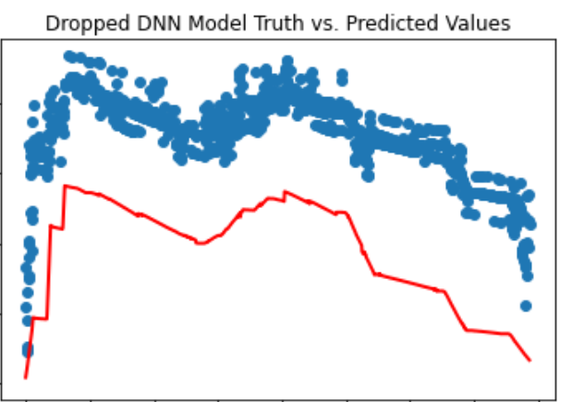
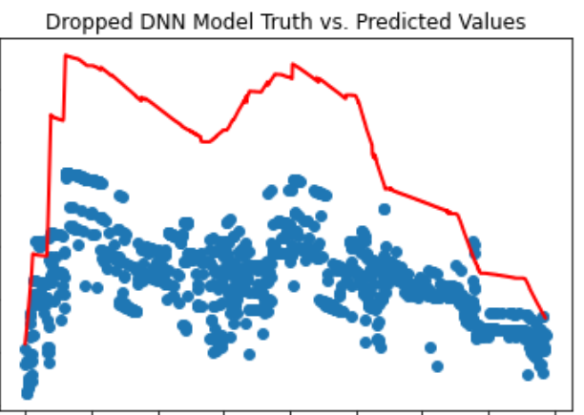
Results (SHIIVER)
Model #6 trained using the overall max and min frequency of the training data and predicted the combined peaks LN2 experimental SHIIVER data by normalizing it using the overall max and min of the experimental data
Model #7 on the right normalized the training data using the overall mean and std of all frequencies of the training data and predicted LN2 data by normalizing it using training mean and std.

Slide 13
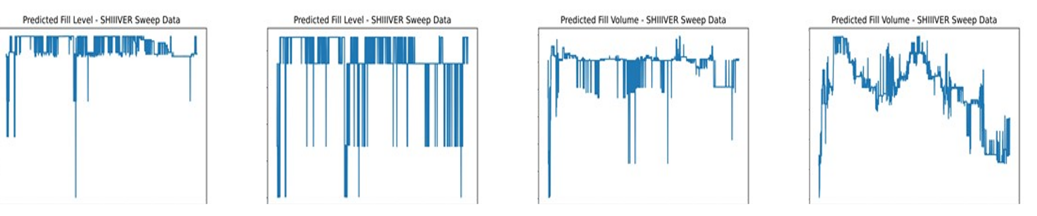
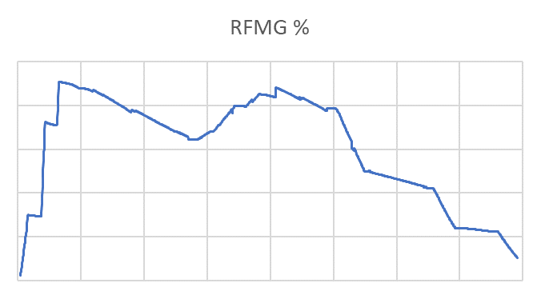
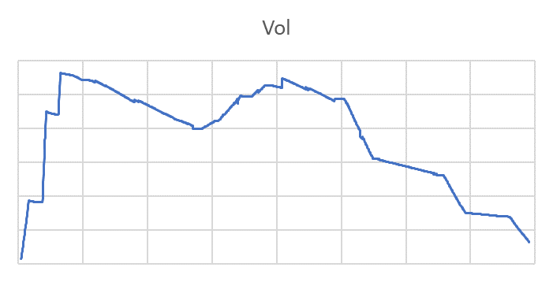
Results (SHIIVER)
XGBoost – Gradient Boosted Decision Trees Ensemble Method

Slide 14
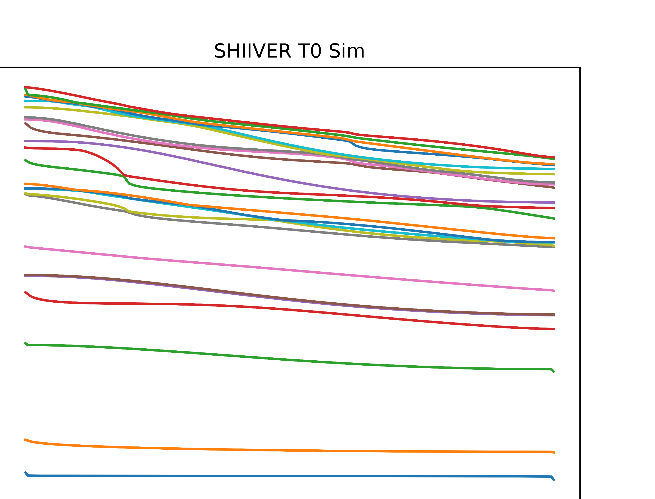
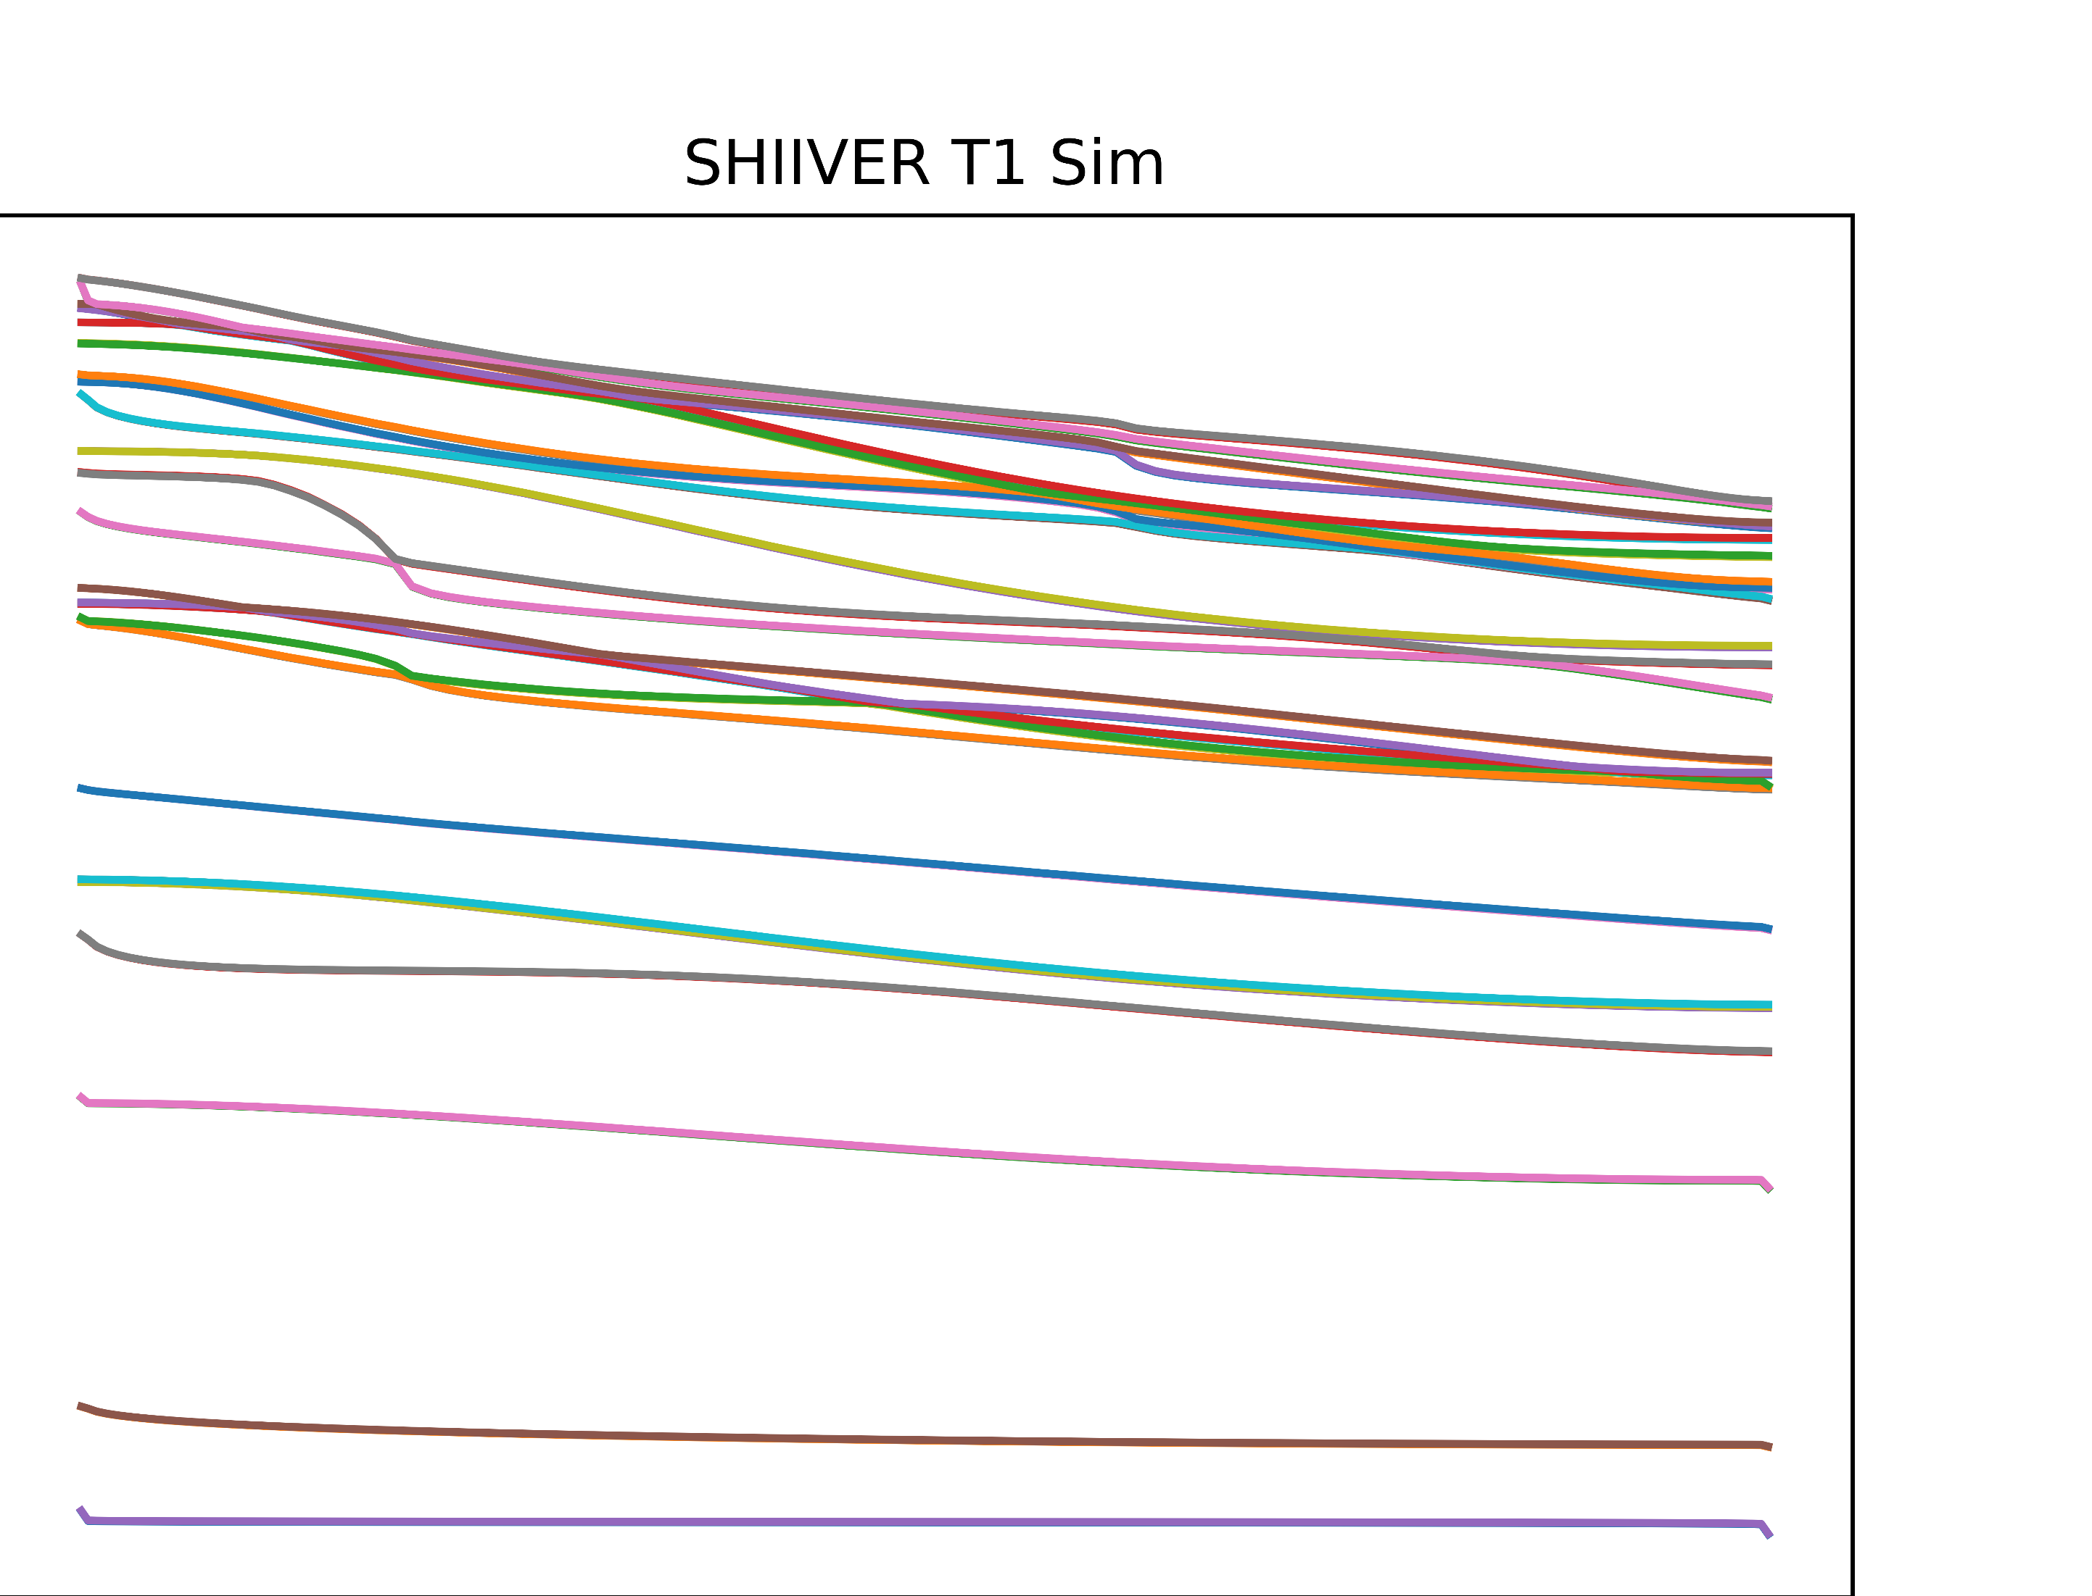
Results (SHIIVER)
Consistent problem with data offset and understanding…
Spent time with GRC understanding data and limitations
  Discovered that we should only consider a certain frequency response range

Slide 15
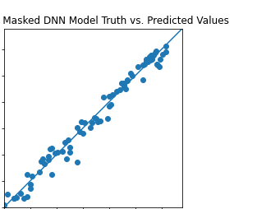
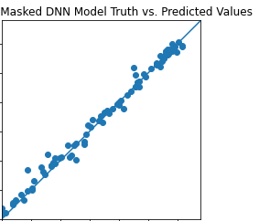
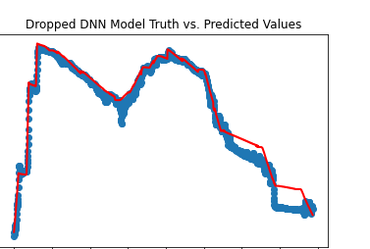
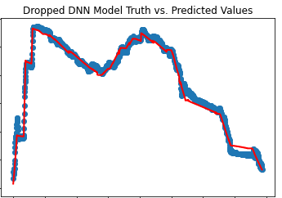
Results (SHIIVER)

Slide 16
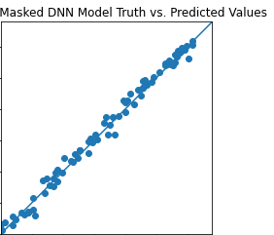
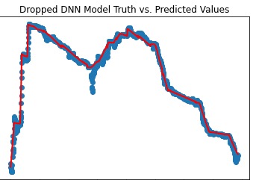
Results (SHIIVER)
Best results after tuning

Slide 17
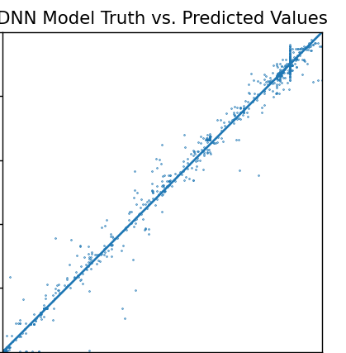
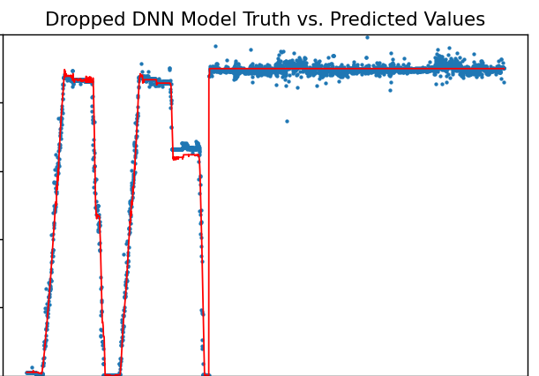
Results (RRM3)
Microgravity was all at ~90% fill but different configurations
Ground
Microgravity
Notes:
Imperfect results but this is by binning and surprising due to multiple configurations, one worry is ML model is trained to always output a specific value based on configuration

Slide 18
Conclusions/Summary
ML models are specific to the configuration
  ML model is not calculating new information
  Each Tank/antenna configuration will have different frequencies
ML models were mostly independent of tuning parameters
ML predictions at least as good as original GRC method
  More automated as well
Limited Data set
  Was still able to provide results
  No time dependency in results
  Unknown, at this time, if frequencies are always unique
  Validation of results to truth data was limited
    Depended on simulations
ML validation and explain-ability
  Research needed on this topic
    Especially in Human Rated Class A software applications
NPR 7150.2D
NASA-STD-8739.8A

Slide 19
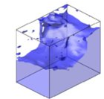
Future Work
GRC personnel are interested in future collaboration
  RFMG technology is still being developed
  Focus was on the hardware and simplified algorithm
    MSFC development has been complimentary and provided expertise in area not present
New Data from RFMG experimental Dewar Test will be available soon
  More complete data set (Team had input to improve information for models)
  Simulations and compilation of data is in progress
Continue evaluating model performance and exploring new methods
  Select the most promising algorithms to continue investigating and optimizing
  Try new approaches with strong potential for success
Possibly extend the technology to provide improved slosh dynamics
  Partner with other teams to continue the development for controls
    Sloshing of fluid causes change in Center of Mass of vehicle
    Measurement provides explicit GNC input for proactive control
      Opposed to current implicit measurement/reactive
  Socialized the idea and seems possible
    Working on proposal in the background
  RFMG implicitly determines “configuration” of fluid
    Same data used for the fluid level calculation

Slide 20
Questions?

