Slide 1
Moon to Mars Surface Systems and Technologies
Shawn B. Maynor, ST03
10/25/22

Slide 2
Moon to Mars Objectives: Common Themes
RT-2: Industry Collaboration: partner with U.S. industry to achieve common goals and objectives.
RT-5: Maintainability and Reuse: when practical, design systems for maintainability, reuse, and/or recycling to support the long-term sustainability of operations and increase Earth independence.
RT-7: Interoperability: enable interoperability and commonality (technical, operations and process standards) among systems, elements, and crews throughout the campaign.
RT-9: Commerce and Space Development: foster the expansion of the economic sphere beyond Earth orbit to support U.S. industry and innovation.

Slide 3
Moon to Mars Objectives: Infrastructure
Moon: Create an interoperable global lunar utilization infrastructure where U.S. industry and international partners can maintain continuous robotic and human presence on the lunar surface for a robust lunar economy without NASA as the sole user, while accomplishing science objectives and testing for Mars.
  LI-1: Develop an incremental lunar power generation and distribution system that is evolvable to support continuous robotic/human operation and is capable of scaling to global power utilization and industrial power levels.
  LI-2: Develop a lunar surface, orbital, and Moon-to-Earth communications architecture capable of scaling to support long term science, exploration, and industrial needs.
  LI-3: Develop a lunar position, navigation and timing architecture capable of scaling to support long term science, exploration, and industrial needs.
  LI-4: Demonstrate advanced manufacturing and autonomous construction capabilities in support of continuous human lunar presence and a robust lunar economy.
  LI-6: Demonstrate local, regional, and global surface transportation and mobility capabilities in support of continuous human lunar presence and a robust lunar economy.
  LI-7: Demonstrate industrial scale ISRU capabilities in support of continuous human lunar presence and a robust lunar economy.
  LI-8: Demonstrate technologies supporting cislunar orbital/surface depots, construction and manufacturing maximizing the use of in-situ resources, and support systems needed for continuous human/robotic presence.
Mars: Create essential infrastructure to support initial human Mars exploration campaign.
  MI-1: Develop Mars surface power sufficient for an initial human Mars exploration campaign.
  MI-2: Develop Mars surface, orbital, and Mars-to-Earth communications to support an initial human Mars exploration campaign.
  MI-3: Develop Mars position, navigation and timing capabilities to support an initial human Mars exploration campaign.
  MI-4: Demonstrate Mars ISRU capabilities to support an initial human Mars exploration campaign.

Slide 4
Moon to Mars Objectives: Science-Enabling
Develop integrated human and robotic methods and advanced techniques that enable high-priority scientific questions to be addressed around and on the Moon and Mars.
SE-2: Enable Earth-based scientists to remotely support astronaut surface and deep space activities using advanced techniques and tools.
SE-3: Develop the capability to retrieve core samples of frozen volatiles from permanently shadowed regions on the Moon and volatile-bearing sites on Mars and to deliver them in pristine states to modern curation facilities on Earth.
SE-4: Return representative samples from multiple locations across the surface of the Moon and Mars, with sample mass commensurate with mission-specific science priorities.
SE-5: Use robotic techniques to survey sites, conduct in-situ measurements, and identify/stockpile samples in advance of and concurrent with astronaut arrival, to optimize astronaut time on the lunar and Martian surface and maximize science return.
SE-6: Enable long-term, planet-wide research by delivering science instruments to multiple science-relevant orbits and surface locations at the Moon and Mars.
Notes:
Science objectives give insight into what future architectures will need, how to focus strategic developments. Landers that land in wide range of orbits. Need to have techniques for deep space science / autono,y. Retrieve and return samples / MSR / Launch Vehicles. Preserve samples – freezer.

Slide 5
Moon to Mars Objectives: Transportation and Habitation
Develop and demonstrate an integrated system of systems to conduct a campaign of human exploration missions to the Moon and Mars, while living and working on the lunar and Martian surface, with safe return to Earth.
TH-3: Develop system(s) to allow crew to explore, operate, and live on the lunar surface and in lunar orbit with scalability to continuous presence; conducting scientific and industrial utilization as well as Mars analog activities.
TH-5: Develop transportation systems that crew can routinely operate between the Earth-Moon vicinity and Mars vicinity, including the Martian surface.
TH-6: Develop transportation systems that can deliver a range of elements to the Martian surface.
TH-7: Develop systems for crew to explore, operate, and live on the Martian surface to address key questions with respect to science and resources.
TH-9: Develop integrated human and robotic systems with inter-relationships that enable maximum science and exploration during lunar missions.
TH-10: Develop integrated human and robotic systems with inter-relationships that enable maximum science and exploration during Martian missions.
TH-11: Develop systems capable of returning a range of cargo mass from the lunar surface to Earth, including the capabilities necessary to meet scientific and utilization objectives.
TH-12: Develop systems capable of returning a range of cargo mass from the Martian surface to Earth, including the capabilities necessary to meet scientific and utilization objectives.

Slide 6
Moon to Mars Objectives: Operations
Conduct human missions on the surface and around the Moon followed by missions to Mars. Using a gradual build-up approach, these missions will demonstrate technologies and operations to live and work on a planetary surface other than Earth, with a safe return to Earth at the completion of the missions.
OP-5: Operate surface mobility systems, e.g., extra-vehicular activity (EVA) suits, tools and vehicles.
OP-9: Demonstrate the capability of integrated robotic systems to support and maximize the useful work performed by crewmembers on the surface, and in orbit.
OP-10: Demonstrate the capability to operate robotic systems that are used to support crew members on the lunar or Martian surface, autonomously or remotely from the Earth or from orbiting platforms.
OP-11: Demonstrate the capability to use commodities produced from planetary surface or in-space resources to reduce the mass required to be transported from Earth.

Slide 7
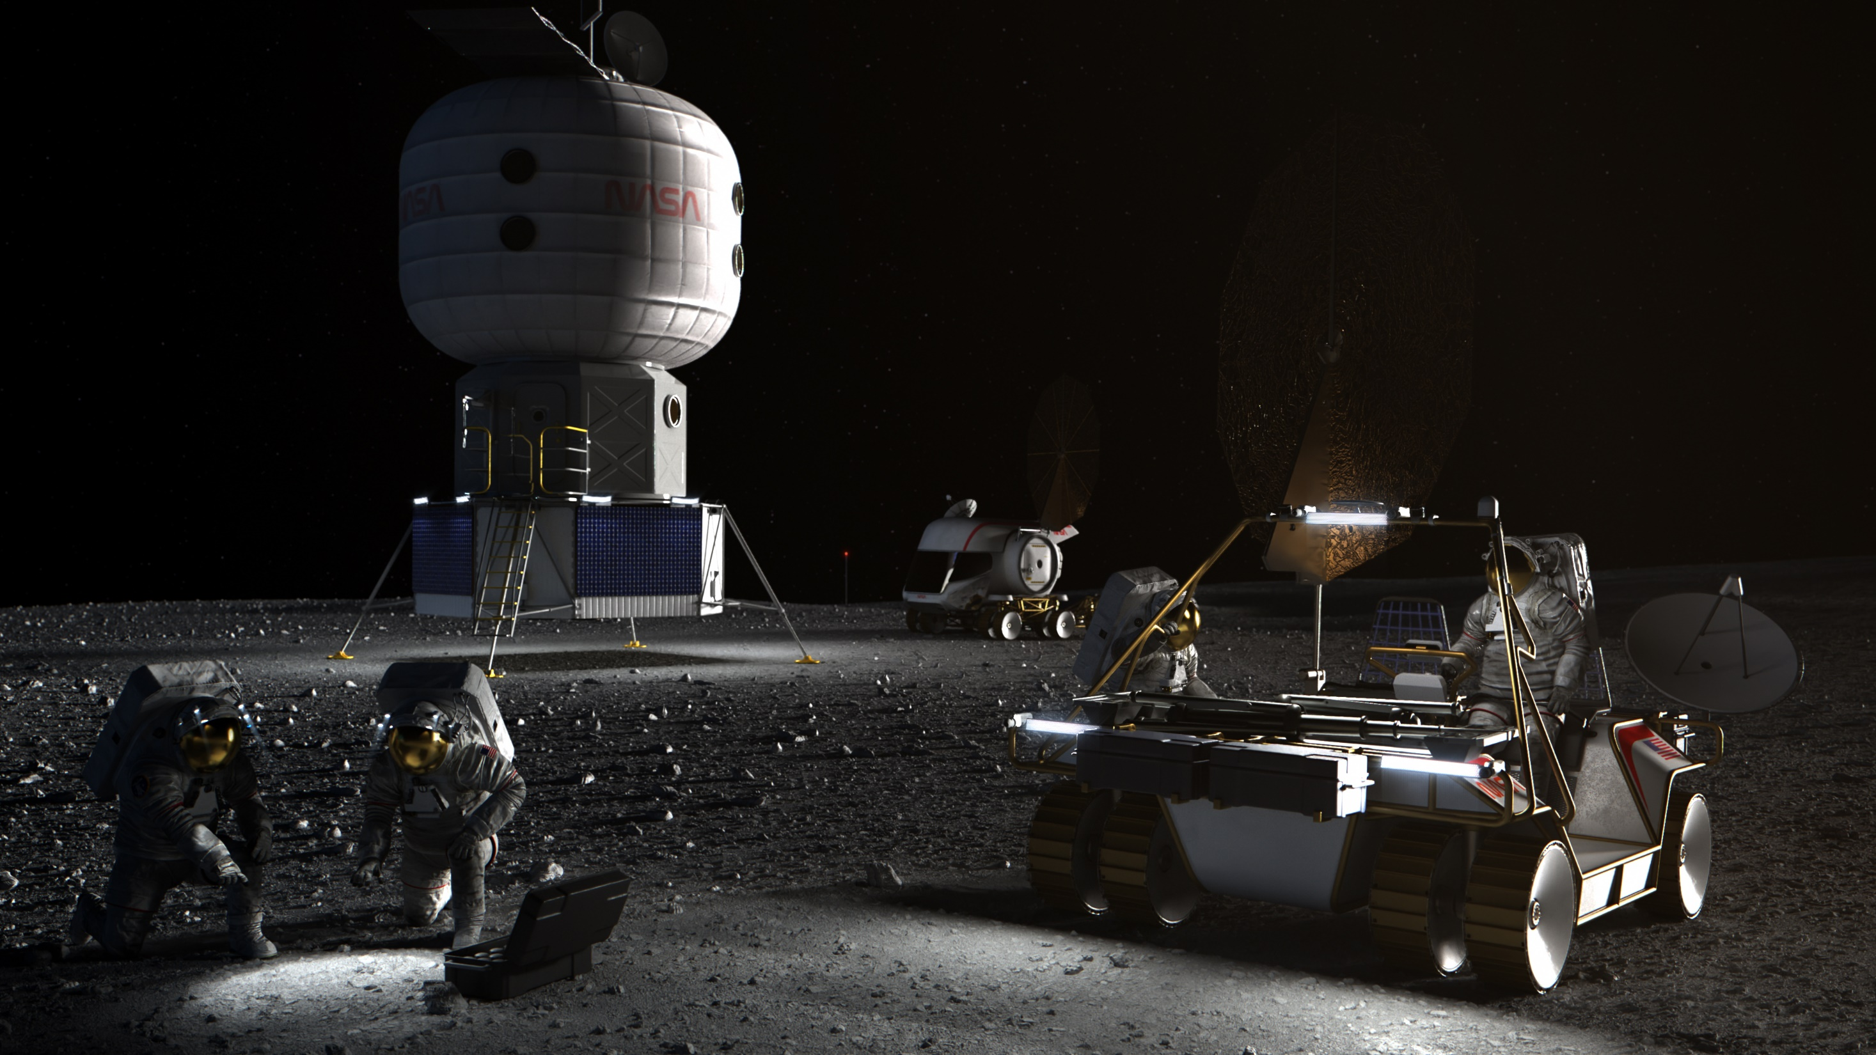
Artemis Base Camp

Slide 8
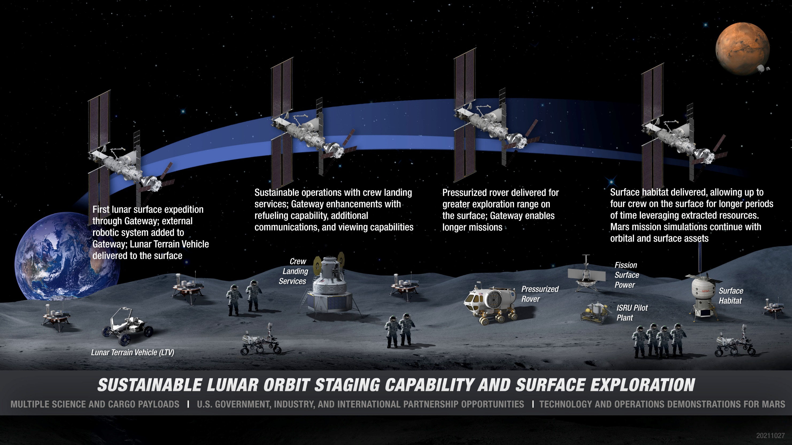
Artemis Base Camp Buildup

Slide 9
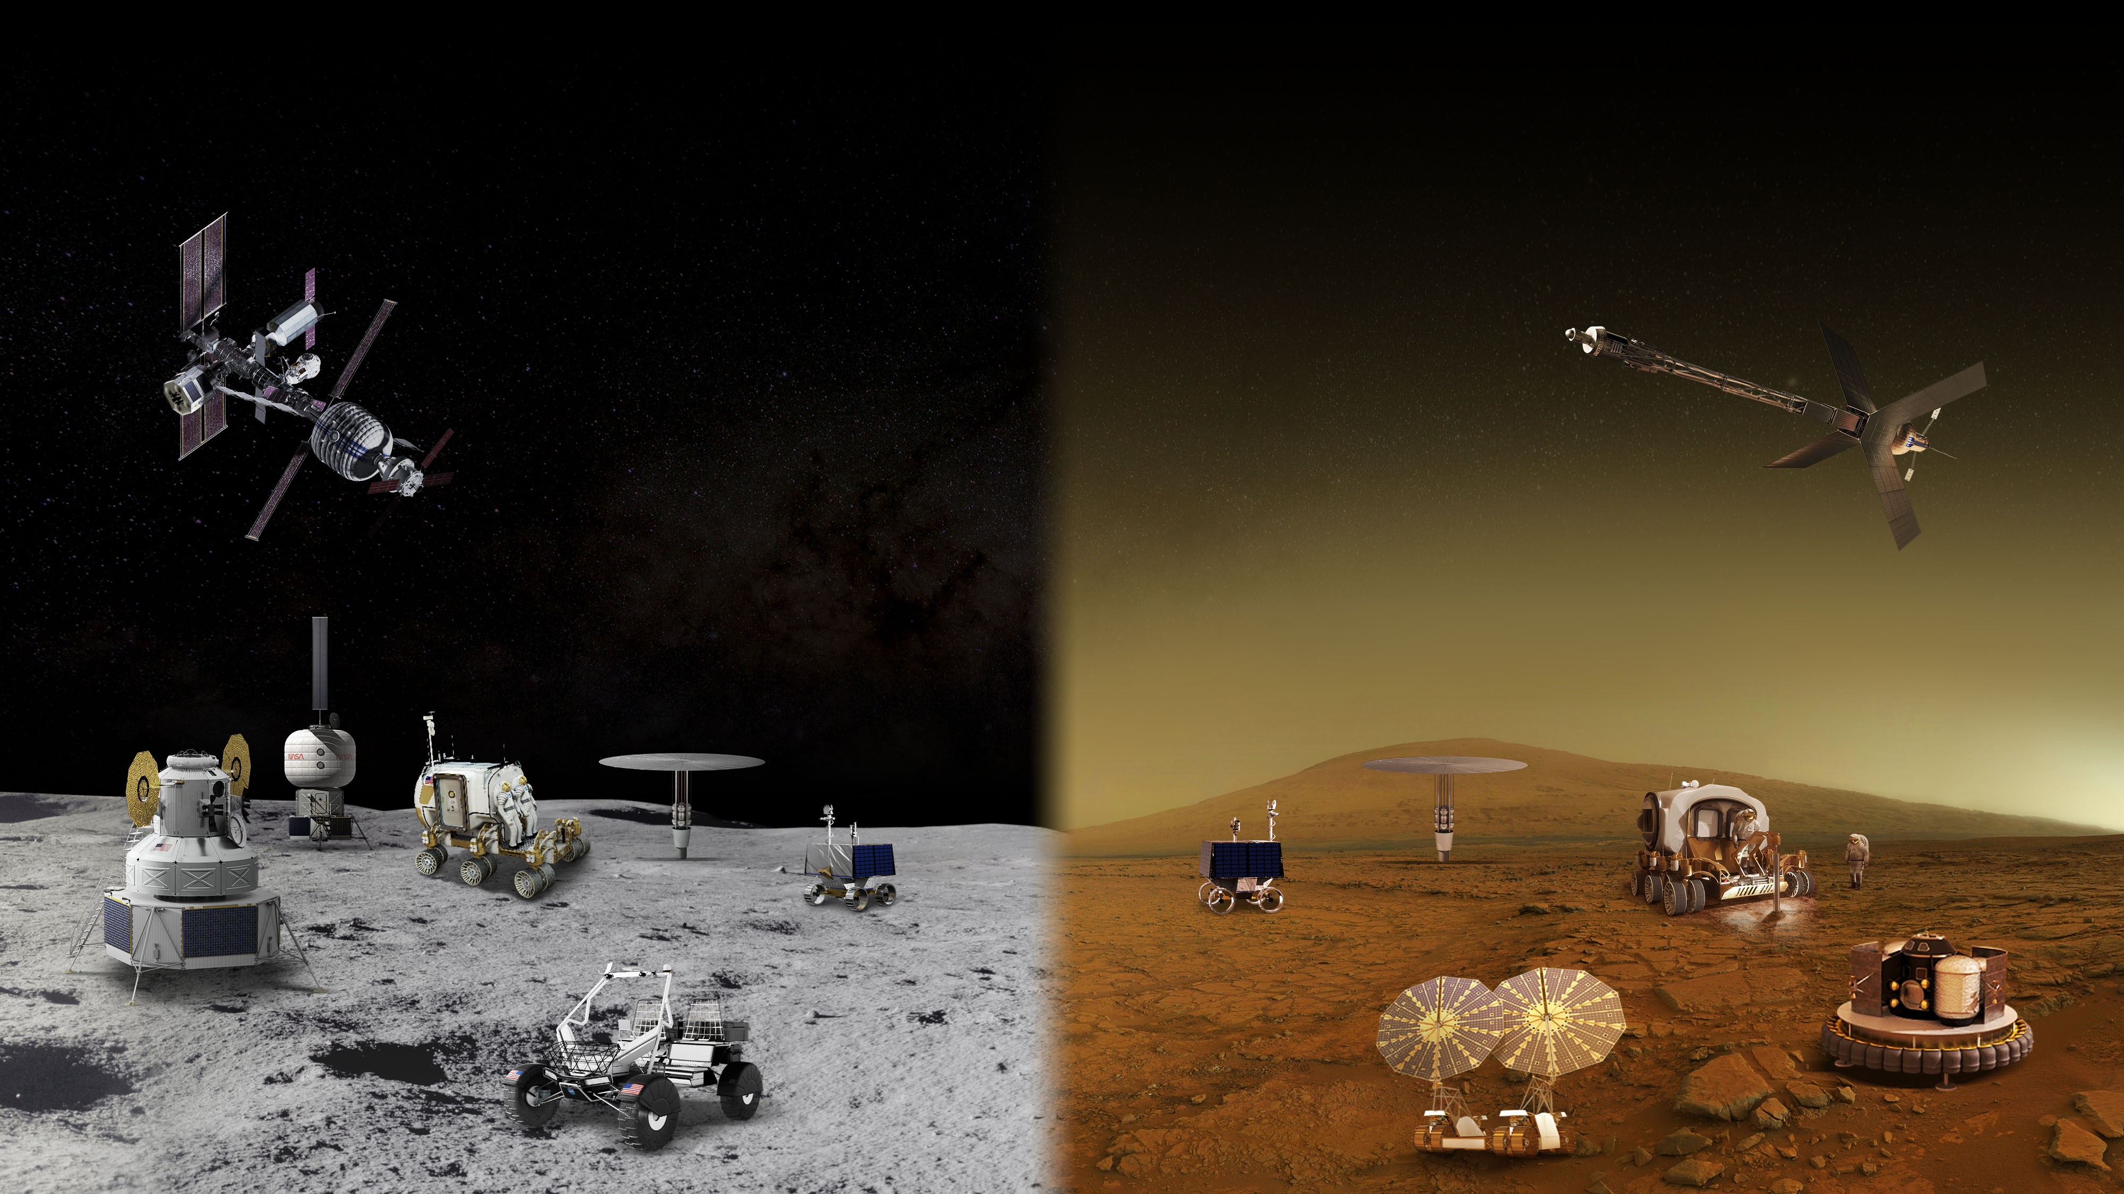
MOON AND MARS EXPLORATION
Operations on and around the Moon will help prepare for the first human mission to Mars
GATEWAY
Long Durations in Zero Gravity
TRANSIT HABITAT
and mars transit
Crew Size
Mobile Expedition Duration
Mobile Exploration Range
Foundation
Surface
Habitat
Habitable mobility platform
Surface Fission Power
In-Situ Resource Utilization
Partial Gravity Operations
Human Lander system
Lunar
Terrain
vehicle
Autonomous Robotics Systems & Contingency Crew Transportation

Slide 10



ESDMD Top Near-term Capability Needs
Capability Need
Area Details
Lead
Destinations
ECLSS Carbon Dioxide Capture and Oxygen Generation
Increase ECLSS Oxygen recovery beyond ISS capability to reduce resupply burden and enable long-duration exploration missions with dormancy periods.
ESDMD
Integrated water recovery and purification for ECLSS
Develop a water recovery systems with higher-reliability than ISS systems to reduce spares and maintenance mass and allow for dormancy periods.
ESDMD
High-speed, High-bandwidth, communication
Reliable, secure high-data-rate surface (5G) and deep-space communication systems to support EVA crew, surface and orbital assets, and deep-space exploration.
SOMD
Legend
Position, Navigation, and Timing
Navigation systems to allow for both crewed and uncrewed surface navigation and hazard avoidance as well as enabling high-precision landing.
ESDMD
Radiation prediction, monitoring, and countermeasures
SPE prediction and modeling in conjunction with alert and warning systems. Includes SPE shielding, passive GCR shielding, monitoring, and other countermeasures.
ESDMD
Integrated Mars Transportation System
Assessment and selection of potential advanced propulsion systems for Mars exploration and development of long-lead capabilities.
STMD
EDL Modeling and validation
Multi-disciplinary, coupled EDL performance models validated by flight data and high-end computing systems to drastically reduce run time.
STMD
Plume Surface Interaction Modeling and Prediction
Validated models with the ability to predict, lander induced environments, ejecta size and velocity, and optical sensor/dust interactions.
ESDMD
Autonomous monitoring and fault detection
Full system/mission integrated monitoring , fault detection, prognosis, and management including robust V&V of autonomous decision making.
ESDMD/
STMD
Dust tolerant systems and mitigation
Dust tolerant docking mechanisms, quick-connects, to support umbilicals, suit-ports, potential surface element docking, mitigation techniques and human health concerns.
STMD
Cryogenic fluid storage and transfer
Modeling and development of Integrated CFM systems that allow for long-duration storage and transfer of cryogenic fluids both in space and on planetary surfaces.
STMD

Slide 11
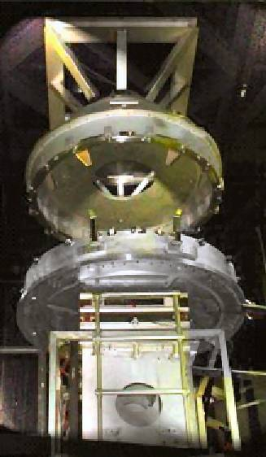
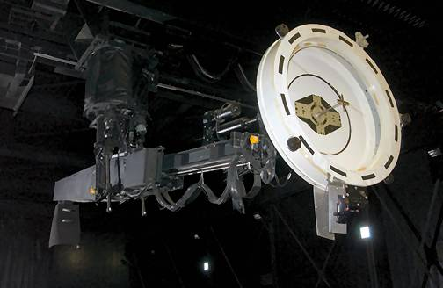
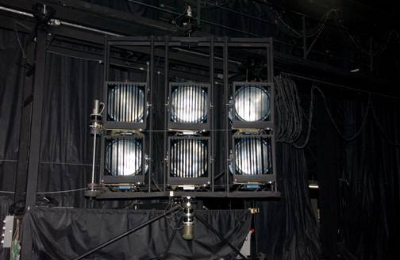
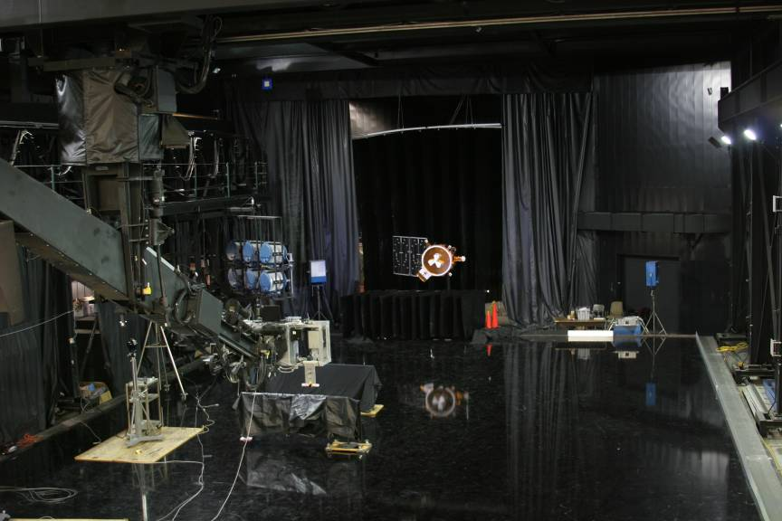
MSFC Capabilities to Enable M2M: Flat Floor Robotics Lab
Provides a full scale, integrated simulation capability to support the design, development, test, integration, validation, and operation of orbital space vehicles and lunar surface systems.
The facility is centered around a 44 foot by 86 foot precision air bearing floor - the largest of its kind.
Collaboration areas for sensor testing, system testing, multi-vehicle algorithm simulation and testing, orbital debris tracking, automated capture and manipulation, and lunar terrain lighting & sensing.
Dynamic Overhead Test Robot (DOTR)
8 DOF
800-pound payload capability
Continuous roll for simulating relative motion with respect to a fixed target
6 DOF Facility
6 DOF
20,000 lbs contact force
Hardware in the loop contact dynamics
Dynamic Orbital Solar Simulator
2 DOF carriage
Five 6 KVA lights
One 12 KVA light

Slide 12
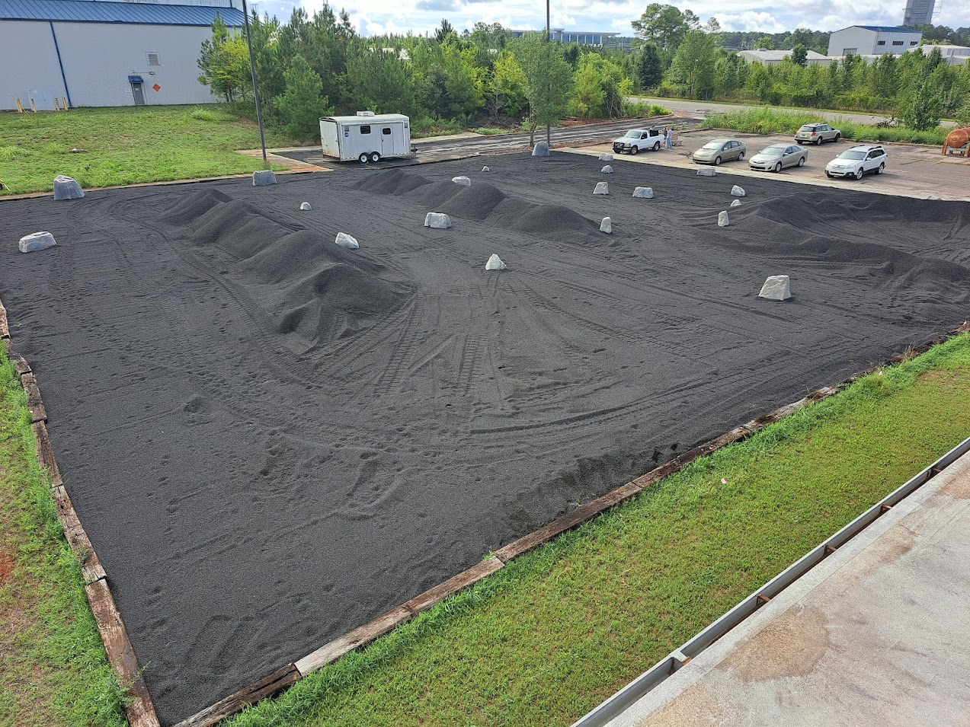
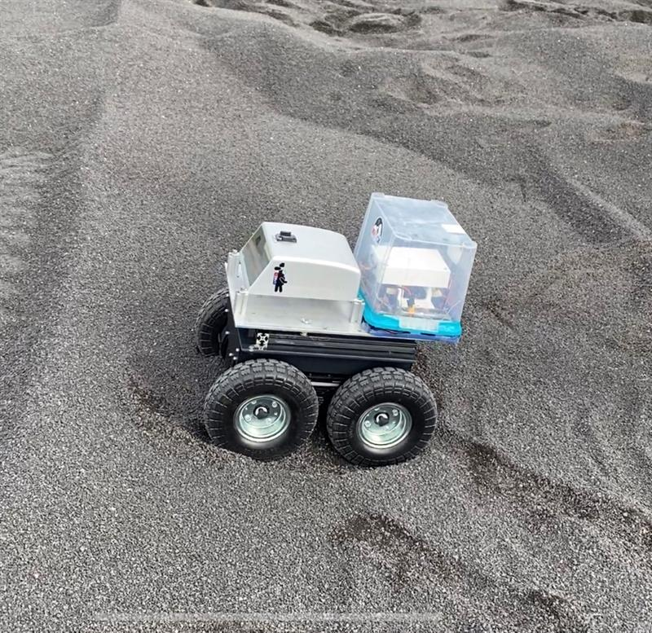
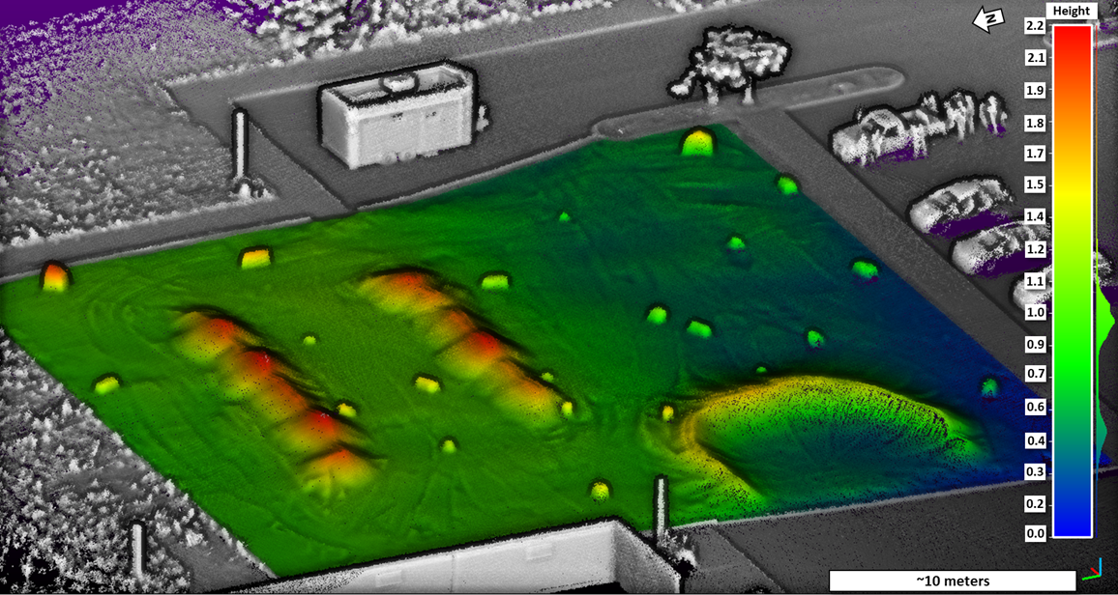
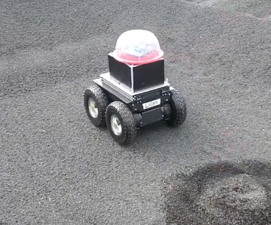
MSFC Capabilities to Enable M2M: LTR
Lunar Regolith Terrain (LTR) Description:
The Lunar Regolith Terrain field is an outdoor planetary analog environment facility located on base at MSFC:
Applies a lunar regolith simulant of JSC-1A feedstock material (volcanic cinder sand sourced from Meriam Crater, Flagstaff, AZ) with representative geotechnical, geochemical, and optical properties of lunar mare basalt.
Contains 500 tons of lunar regolith simulant confined within a 125 ft x 125 ft (38 m x 38 m) area with a depth range between ~5 in - ~4 ft (~13 cm – 1.2m) that can be modified to suit user needs.
Current Features of the LRT:
The LRT was designed to allow rapid modification of the terrain’s topography obstacles in the field:
The terrain can be reshaped to suite specific testing requirements that may require flat-expanses, steep hills, or heavily cratered and rocky landscapes.
Large rocky obstacles in Fig. 1 are artificial landscape boulders (faux-rocks) that can be easily placed by users or removed entirely.
Meets the needs of visiting research groups:
Equipped with on-site office space: an air-conditioned and heated trailer with 120/240V power and lighting.
Wi-Fi and Cellular signal coverage.
On-site workspaces and secure equipment storage is available in adjacent buildings.
Accessibility for on-site parking and delivery of instruments, payloads, and additional equipment.
Designed for expansion into new research domains:
Areas of the field contain buried fiducials, large sheets, bar stock, and pipes of various composition and dimensions to allow for possible ground penetrating radar and shallow seismic studies
~50% over natural ground which can be developed into subterranean or deep crater simulation environments.
Open air placement can allow future outdoor flight-based testing.
Figure 1. Oblique view of MSFC’s Lunar Regolith Terrain (LRT) field
Currently Available to the Community:
The LRTF provides an accessible planetary analog surface environment for surface mobility testing, autonomous roving operations, developing advanced navigation techniques and operations development.
Upcoming Features of the LRT:
Development of the LRT’s capabilities continues with:
Rapid modification capabilities for burial of additional user-specific materials to enable in-situ resource utilization detection (e.g., burial of hydrogen sources for neutron detection or other materials).
Direct radio frequency communication with the Huntsville Operations Support Center (HOSC).
Images gathered from an autonomous vehicle development project. Left: The Kinematic Navigation and Cartography Knapsack(KNaCK) rover. Middle: LIDAR map of LRT as created by KNaCK. Right: Smart Video Guidance Sensor (SVGS) rover.

Slide 13
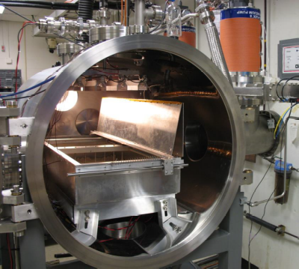
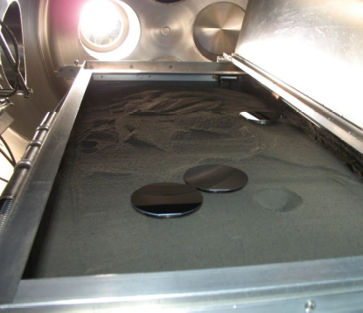
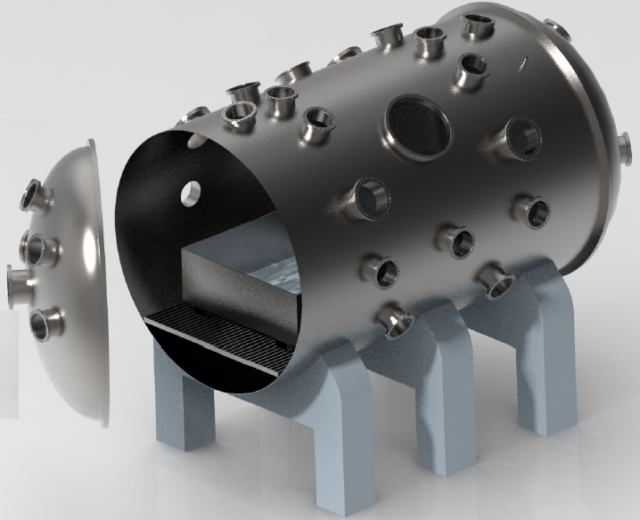
MSFC Capabilities to Enable M2M: Space Environmental Effects
Planetary, Lunar, and Asteroid Natural Environment Testbed (PLANET)
  High vacuum (10−7Torr), low density plasma, or planetary atmosphere
  2 m x 3 m chamber
  Charged particle radiation
    Electrons up to 100 keV
    Protons up to ~20 keV
  Thermal extremes
    Cryogenic to -180C/95K with LN2 system
      Potential future upgrade to helium
    Heating to >140C
  Ultraviolet radiation (NearUV and VacuumUV)
  Regolith simulant bed (lunar mare or highlands, Martian)
  Lunar Environment Test System (LETS)
  30” diameter, 3’ x 4’ chamber
  Materials, components, and small mechanisms
  Combined effects:
    High vacuum
    Cryogenic shroud
    IR heating
    Low energy electrons & protons
    UV (NUV/VUV)
    Particle Imaging Velocimeter
    Simulant / regolith box with cover
Coming in 2024!

Slide 14
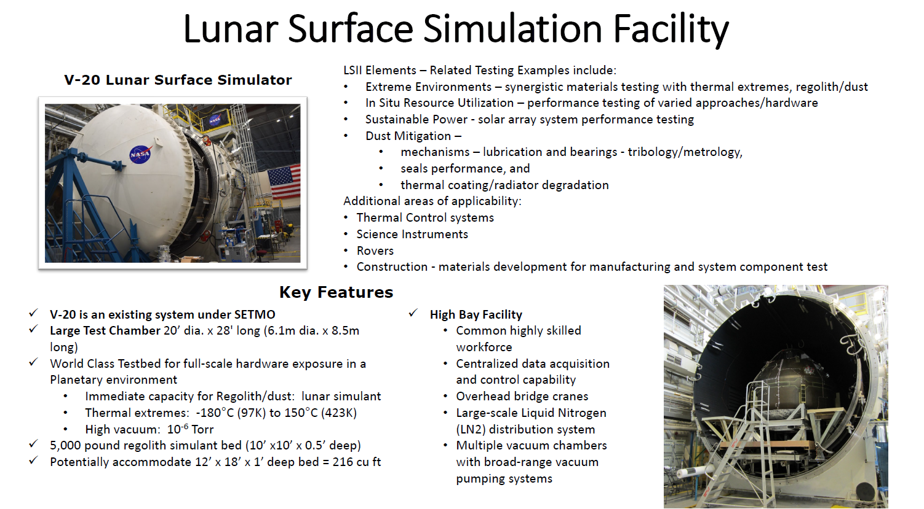
MSFC Capabilities to Enable M2M

Slide 15
Backup

Slide 16
Points of Contact
Facility | Name | Email
Flat Floor Robotics Lab | Thomas Bryan | tom.bryan@nasa.gov
Lunar Regolith Terrain Field | Alex Summers Michael Zanetti | Alex.w.summers@nasa.gov Michael.r.Zanetti@nasa.gov
Space Environmental Effects | Erin Hayward Mary Nehls | Erin.g.hayward@nasa.gov Mary.Nehls@nasa.gov
Lunar Surface Simulator | Richard Cooper | Richard.a.cooper@nasa.gov

Slide 17
