Slide 1
Entry Systems and Vehicle Development Branch
(Code TSS)
Antonella Alunni, TSS Branch Chief
24 August 2022

Slide 2
Overview
TSS was established in 2009 to work with discipline-oriented branches (TSA, TSM, TSF) and provide a leadership approach for sub-system design and hardware components that comprise entry systems.
Currently, branch comprises 11 civil servants and 11 contractors.
  19 NASA Honor Awards in Exceptional Service (2), Achievement (2), Engineering Achievement (5), Early Career Achievement (5), and Outstanding Leadership (5).
In the last decade, TSS has built up core competencies that enable the branch to deliver end-to-end entry systems and vehicle development capabilities.

Slide 3
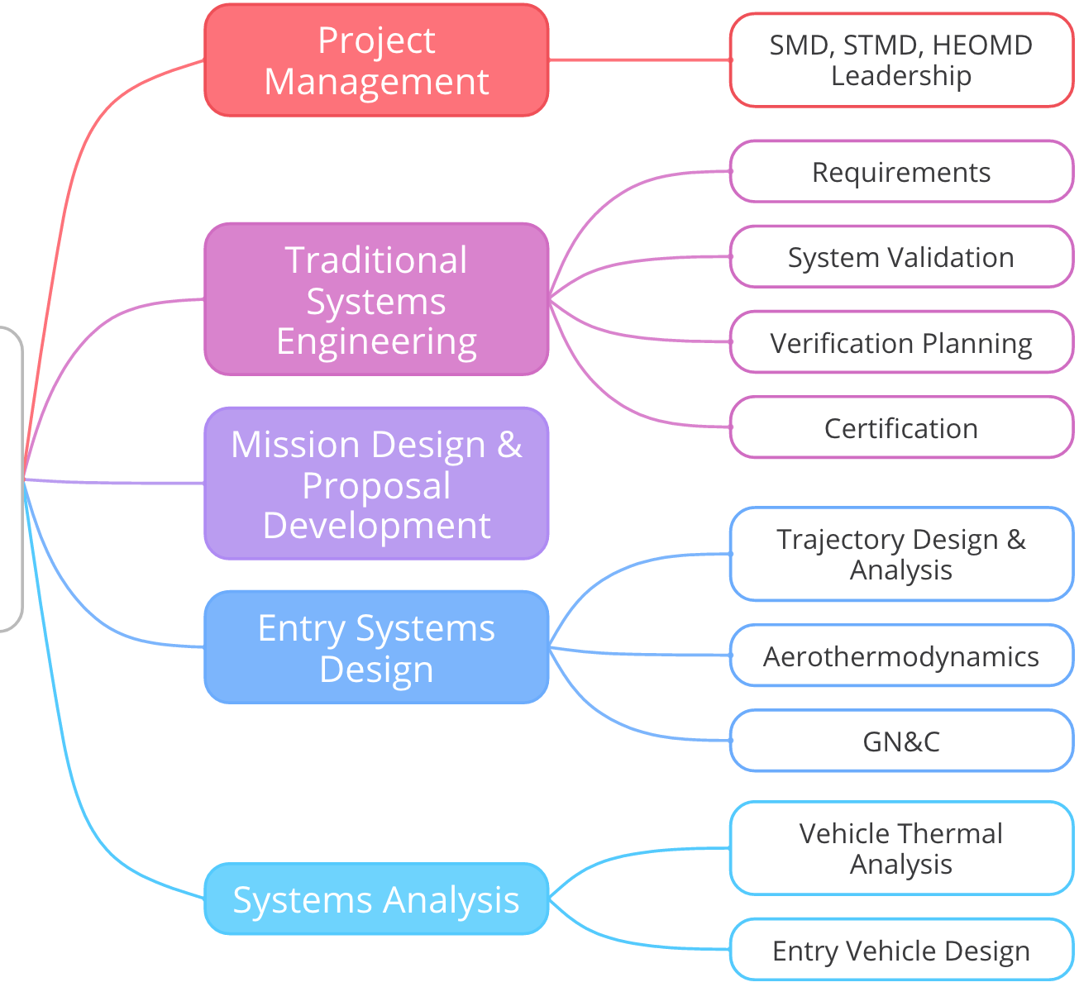
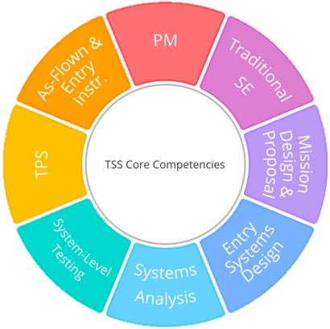
Management of Disciplines

Slide 4
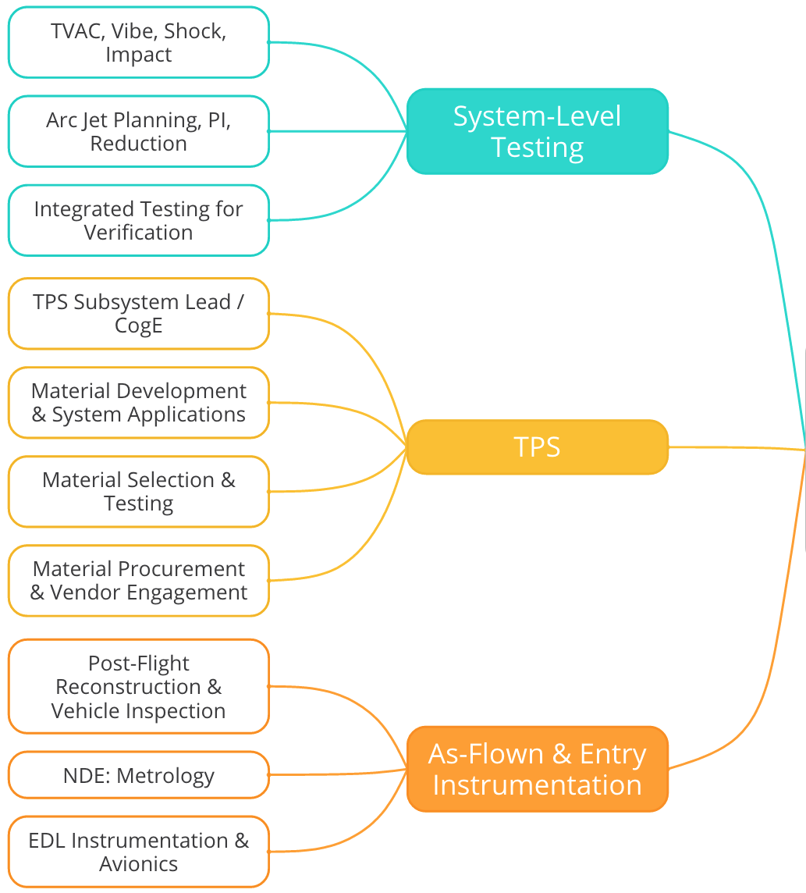
Development & Delivery of Flight HW
You’ll see a healthy mix of these competencies highlighted in the projects we support

Slide 5
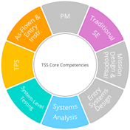

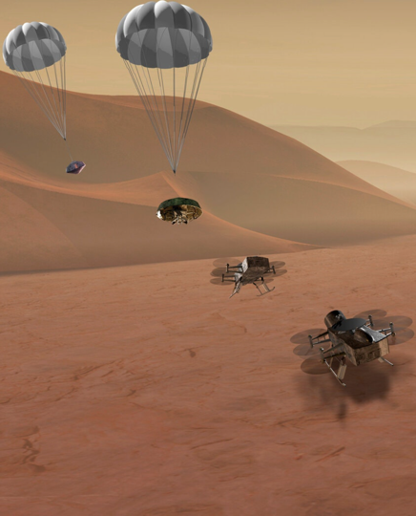
Dragonfly & DrEAM
New Frontiers mission to send an aerial lander to understand Titan’s complex organic chemistry
Currently in Phase B (2027 launch)
Ames co-leads with LaRC the design, development, and verification of the EDL Assembly
  Ames has not served a role this prominent on an EDL mission since Galileo
Roles in TSS
  TPS Lead: Oversight of TPS design, sizing, material procurement, testing, integration, and verification
  Lead and deputy EDL systems engineers: Development of EDL requirements, interface oversight, EDL V&V
  Support roles for TPS, capsule dynamics, avionics, parachute descent system, and DrEAM (Dragonfly Entry Aerosciences Measurements) SE
Anticipated Future Work
  Arcjet test support and data analysis
  Additional V&V support for EDL Assembly
  Support for DrEAM instrumentation development, system testing, and V&V
  Entry reconstruction after landing
Growth Areas:
  Additional lead roles on future Class A missions
  Mission proposal and implementation with APL as partner
Support for early phase proposals can lead to high ROI with significant roles on prominent missions
5

Slide 6
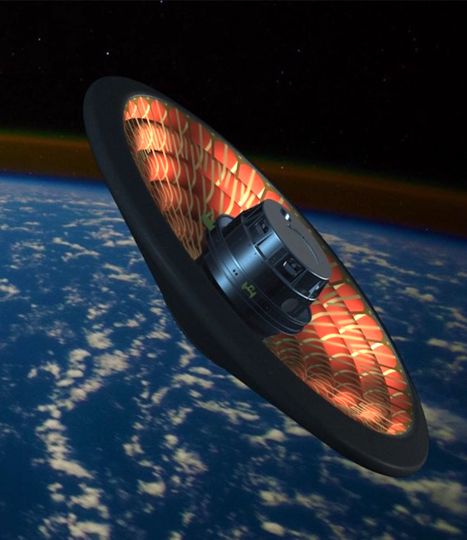
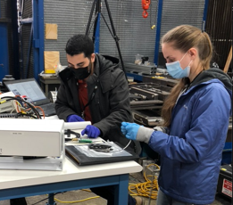
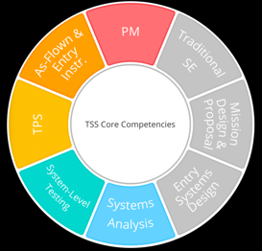
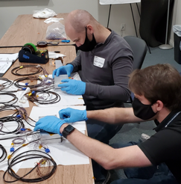
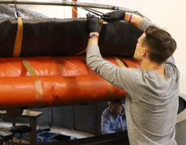
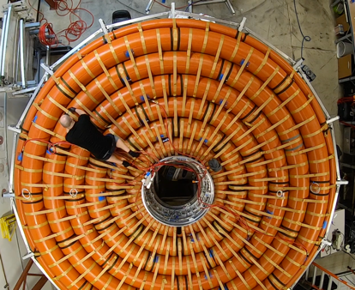
LOFTID
LeO Flight Test of an Inflatable Decelerator
Orbital Flight Test of a 6m HIAD – Launch Fall 2022
ARC leading Flight Test Instrumentation & Aeroshell Fabrication Oversight
  Develop/Design, Test & Deliver Ground and Flight Instrumentation
  Ownership of Master Measurements List (400+ measurements)
  Aeroshell Fabrication Oversight at Jackson Bond Enterprises (Dover, NH) & Airborne Systems (Santa Ana)
  Design, Fabrication, Test, & Delivery Recovery Lights System
  System AI&T Support
  Manage Budget and Schedule at Ames
  Collaboration at Ames with QS, STAR labs, & EEL
Key Roles in TSS
  Ames Lead, Instrumentation Lead, Aeroshell Instrumentation Lead, Inflatable Structure CogE
  TSS Disciplines engaged are TPS, As-flown and Entry Instrumentation, System Level Testing, System Analysis, Project Management
Follow On Work and Growth Areas
  FTPS and Instrumentation Investigations, Integrated System Test Support, & Flight Test Support
  Team uncovered many instrumentation issues/unknowns. Investigations underway & additional forward work is being scoped to address these subjects.
  LOFTID is a stepwise development & test approach for a ~11m HIAD to be used by ULA & other interested commercial partners. ARC will be deeply integrated in development of the ~11m structure at both aeroshell vendors.
  HIAD is currently the leader for the hypersonic phase of Humans to Mars. Many instrumentation & aeroshell development tasks will be required to reach Mars-scale entry vehicle.
Sensor Calibration
NTS TVAC
FTPS Integration
Inflatable Structure Fab
6
6

Slide 7
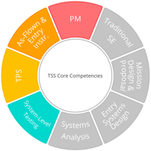

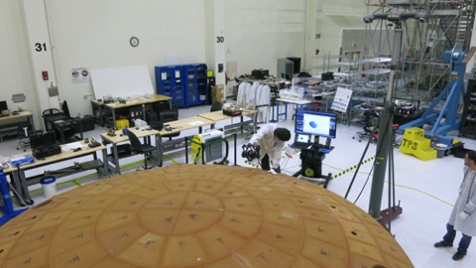
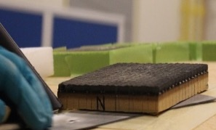
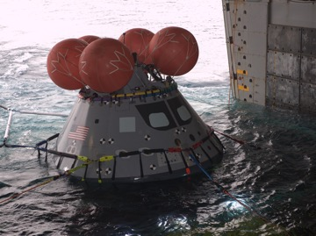
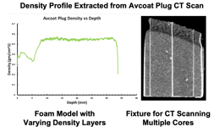
Orion TPS Insight / Oversight
Phase D/E Orion TPS Insight / Oversight at Ames
  Performs oversight of the overall Lockheed Martin Orion TPS effort (analysis, design, build, & flight)
  Plans and executes the Orion arc jet test program
  Plans and executes Heat Shield Post-flight inspection, sampling, and analysis
  Oversees and approves verification closures in support of Artemis 1
  Collaboration with TSA, TSM, TSF, AA, RE, and JAI
Key Roles in TSS
  Orion TPS Deputy System Manager, Post-Flight Lead, and ~half of the post-flight team
  TSS disciplines engaged are Project Management, TPS, System Level Testing, and As-flown and Entry Instrumentation
Incoming work, growth areas, mission infusion potential, or follow-on work
  Exposure to ATLO and operations support is providing growth opportunities
    Class A hardware hands-on work for post-flight
    Tight coordination with the Orion Program, Exploration Ground Systems (EGS), and Lockheed Martin
  Post-flight work is ground-breaking and could be applied to other Earth entry vehicle evaluations, both in and outside of NASA
    Sampling and inspection techniques
    CT-based density measurements
Artemis 1 Heat Shield Scan Support
Avcoat sampling
Artemis 1 Recovery Support

Slide 8







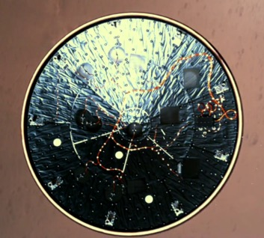
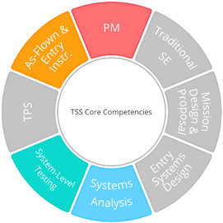
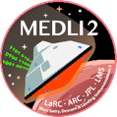
MEDLI2
Flight Instrumentation: Design > Develop > Demonstrate > Discern
MEDLI2 is the entry instrumentation suite on Mars 2020
  MEDLI2 project is collaboration with LaRC and JPL.
  MEDLI2 project has been funded through STMD (GCD), HEOMD (AES),
  & SMD (MPO).
  At Ames, collaboration is with TSA, TSM, TSF, and QS.
MEDLI2 Roles and Support in TSS
  TSS Provides Leadership and Key Technical Roles:
    MEDLI2 Principal Investigator and former deputy Project Manager.
    Responsibility and expertise for transforming flight temperature measurements into high-value sources for future Entry vehicle design.
  TSS played extensive role in sensor development, testing, and
  “Do No Harm” acceptance on flagship-class mission.
  TSS (and TSM) leadership key to successful Ames 2019
  QAAR (Quality Audit, Assessment, and Review) featuring MEDLI2.
Ongoing and Follow-on Work for MEDLI2
  Continued Reconstruction of MSL & M2020 Flight Data funded through Entry Systems Modeling (FY21-FY23).
  Feed forward into MSR Sample Retrieval Lander (SRL) Mission Design.
  Feed forward into next generation of EDL Instrumentation
    MEDLI3 for MSR SRL, DrEAMS on Dragonfly,
    Entry Instrumentation evaluation required on all future SMD Discovery and NF proposals.
Our advocacy of EDL instrumentation has led to the SMD requirement that all vehicles entering an atmosphere must carry instrumentation.
Ames MEDLI2 Hardware Descends to Mars

Slide 9
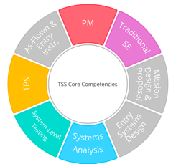
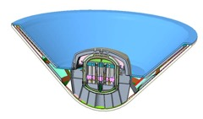
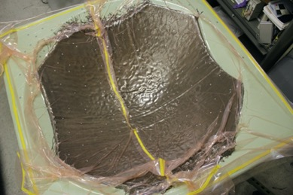
MSR EES
Mars Sample Return Earth Entry System
Phase B MSR EES at Ames
  End-to-end analysis, design, and test support at the EES level
  Provides flight TPS hardware
  Collaboration with TSA, TSM, TSF, RE, JAI, QS
Key Roles in TSS
  EES TPS Lead, Systems Analysis Lead, multiple test PIs and analysts
  Nearly all TSS disciplines are engaged, providing the core EES leadership at Ames
TSS EES support showcases the ‘whole-mission’ capabilities of TSS
  Past experience on Orion, MSL, M2020, & the HEEET Project has created a strong cross-discipline capability in the branch for applied EDL
  The experience of bringing HEEET to TRL 6 is enabling for seeing 3MDCP through to flight
  EES experience positions the branch to learn and extend into broader mission leadership and support moving forward
  Success with EES demonstrates that continued growth and investment in ‘whole mission’ support is a priority, benefitting the entire division
MSR EES
Manufacturing development
9

Slide 10
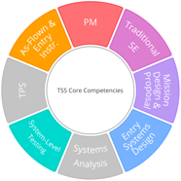
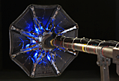

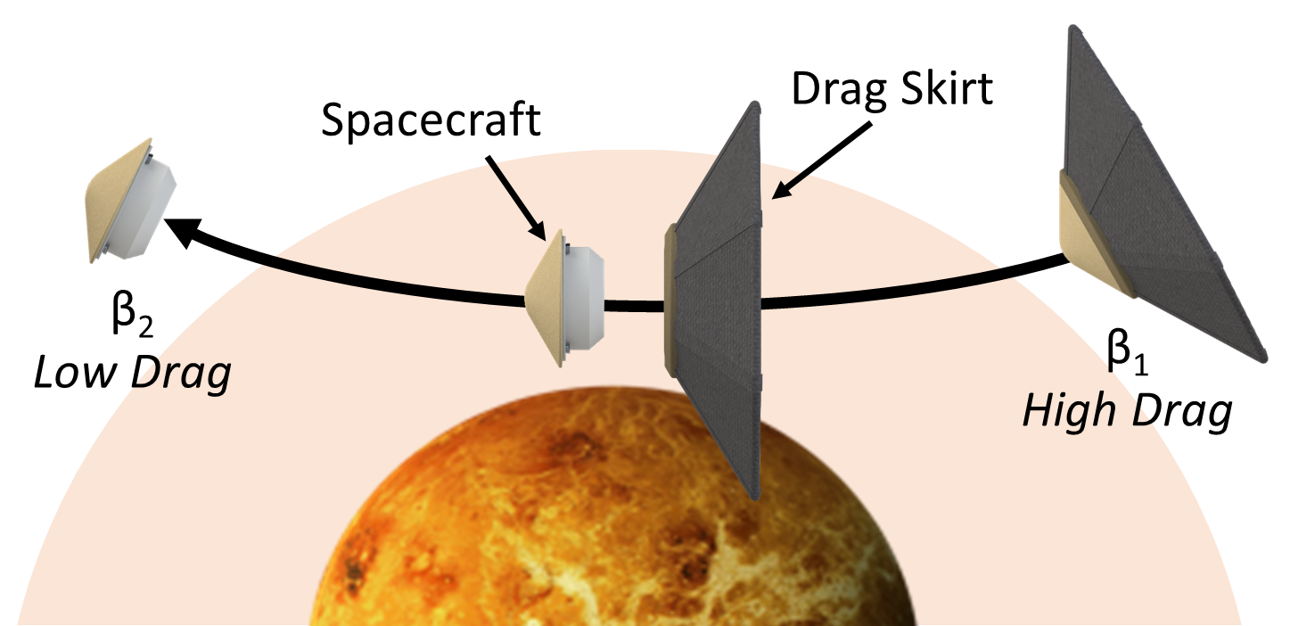
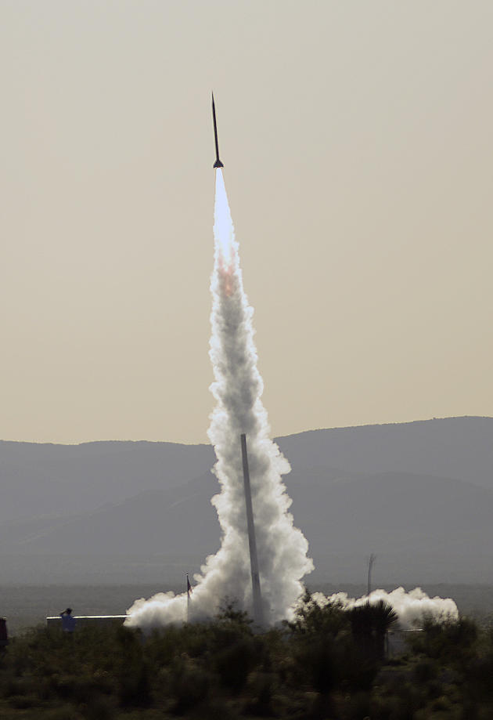
ADEPT
Adaptable, Deployable Entry and Placement Technology
Started under 2010 NASA-funded study and later became an Ames-led STMD project since 2012
TSS led and supported prototyping, ground testing, sub-orbital flight test (SR-1) that matured ADEPT to TRL 5 and demonstrated major technological benefits:
  Overcoming entry vehicle packaging and volume constraints in LV shroud or as secondary payload
  Deployed configuration achieves low ballistic coefficient (m/CdA), reducing peak heating and dynamic pressure loads
  Woven carbon fabric tested up to 250 W/cm²
Supported JPL on drag modulated aerocapture (DMA) development to modulate time of ADEPT drag skirt jettison and enable targeting to a specified orbit
We’ve also partnered with JPL’s DMA team for a proposed Technology Demonstration Mission Earth flight test for SmallSat class missions
ADEPT
Wind Tunnel Test
Arc Jet Test
SR-1 Test
DRAG MODULATED AEROCAPTURE

Slide 11
Summary
TSS is key to the success of many of NASA’s entry technologies and missions
  Since 2009 inception, Branch has built up strong experience in systems, hardware, flight projects
  TSS staff is cross-trained and has strong leadership in high-profile NASA missions
    Holding major entry vehicle technical and programmatic roles
    Best representation in Entry Systems for Ames since Galileo
The future for TSS is to:
  Provide continued leadership in Entry Systems at Ames and across the agency,
  Continue to expand our experience within our core competencies.

