Slide 1

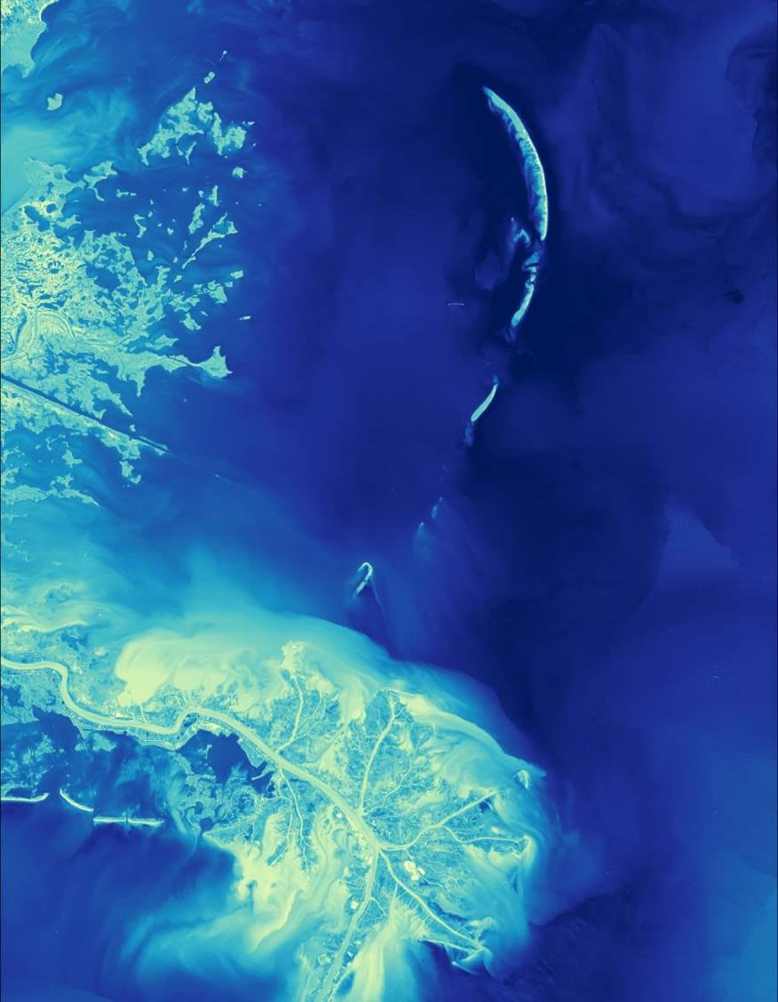
A Brief Introduction to
Applied Sciences’ Capacity Building
DEVELOP
October 25, 2022

Slide 2
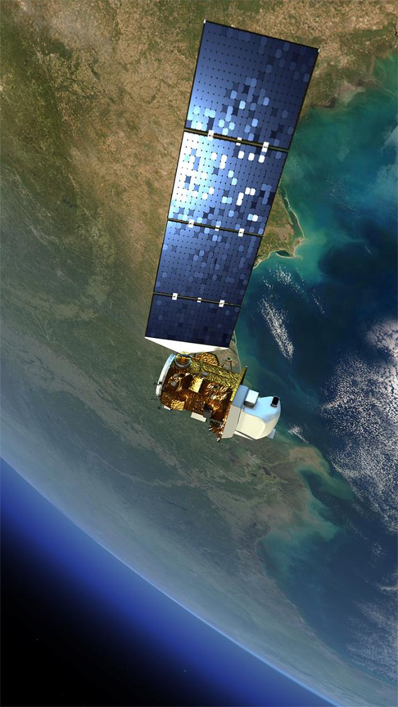
NASA EARTH SCIENCE
Earth Science Division
Advancing understanding of the Earth and developing technologies to improve the quality of life on our home planet.
Using the global vantage point of space, ESD builds fundamental, scientific knowledge about Earth and how it is changing. ESD advances understanding of Earth as an integrated system and develops and tests applications that deliver direct societal benefit. It has five lines of business:
Technology
Flight
Research & Analysis
Data & Computation
Applications

Slide 3
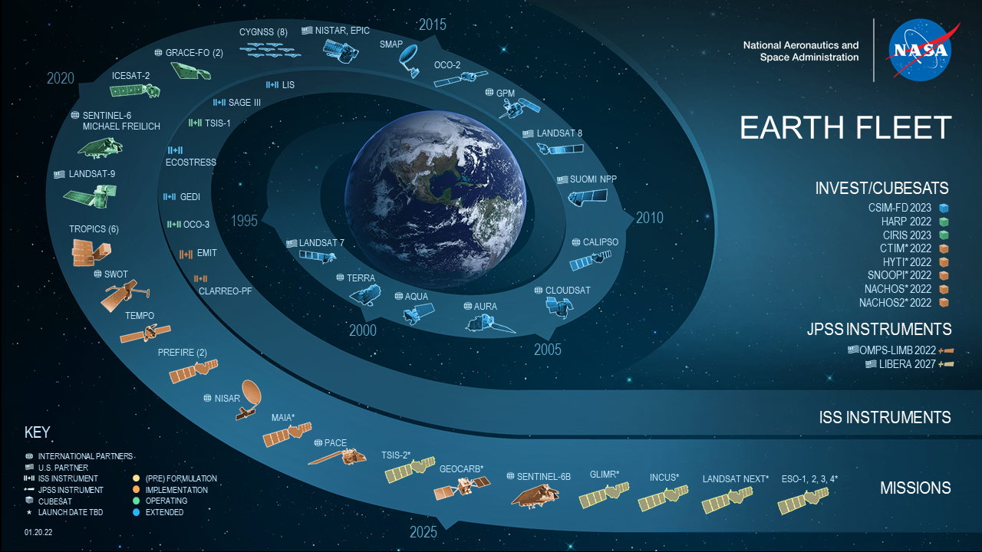
INTRODUCTION TO NASA EARTH SCIENCE

Slide 4
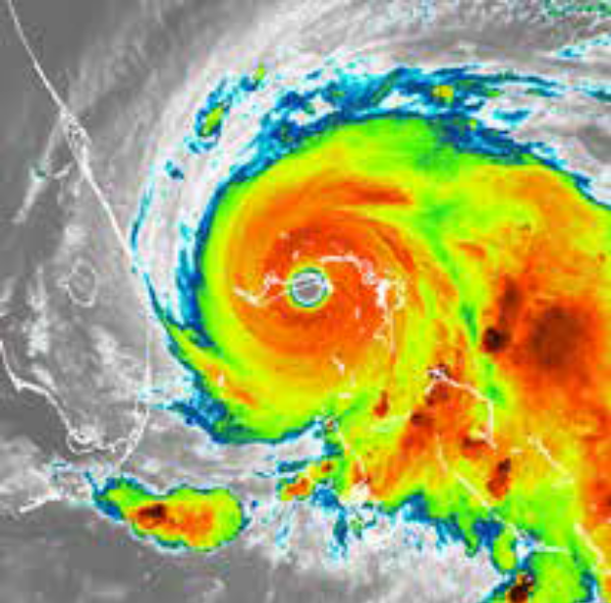


EMPOWERING PEOPLE & COMMUNITIES
Making Earth Data Accessible to All
Part of NASA’s Applied Sciences, the Capacity Building Program provides individuals and institutions with workforce development, training activities, and collaborative projects to strengthen understanding of Earth observations and expand their use around the world.
Through our ARSET, DEVELOP and SERVIR programs and our Indigenous Peoples Pilot project, we work with everyone at every level — from first-time users to long-time professional users of Earth observation data.
We work through global networks like CEOS, GEO, and professional societies like AGU, to promote open data access and coordinate capacity building activities focused on users needs.

Slide 5
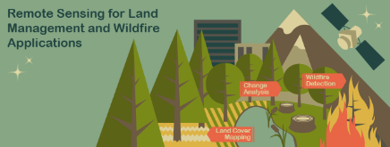

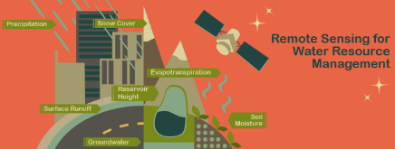
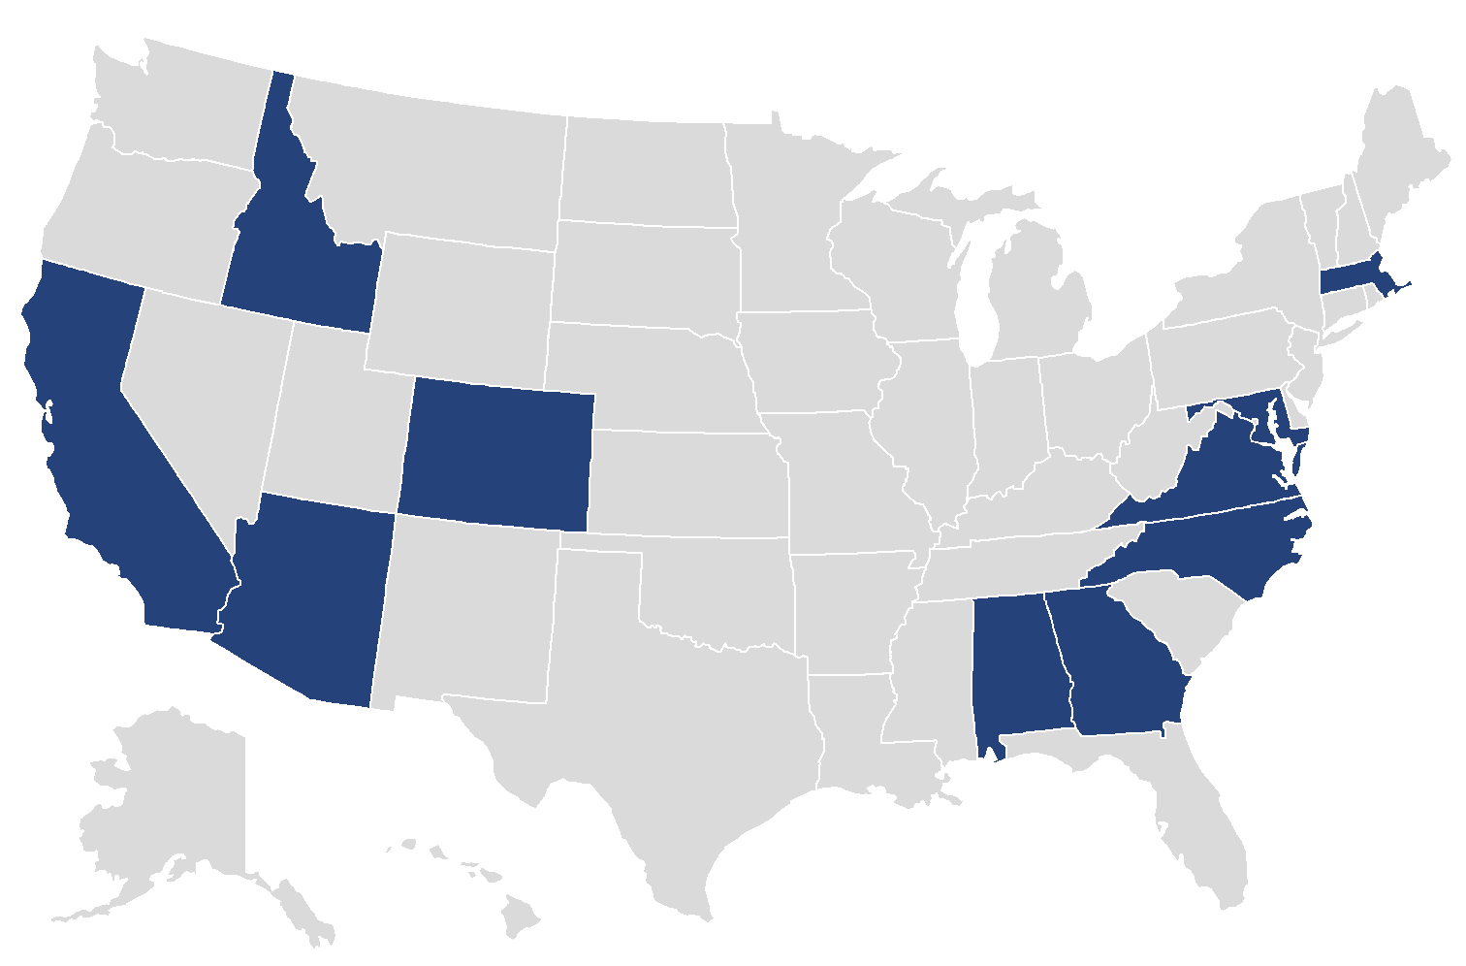

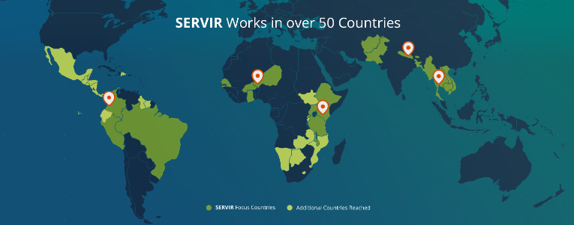
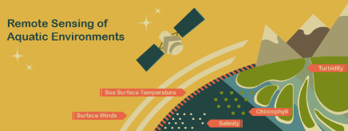

CAPACITY BUILDING ELEMENTS
ARSET
DEVELOP
SERVIR
ARSET offers satellite remote sensing training that builds the skills to integrate NASA Earth Science data into decision-making activities. Through its decade of trainings, ARSET has reached over 40,000 participants from 160 countries and more than 5,000 organizations worldwide.
DEVELOP addresses decision-makers’ needs through interdisciplinary feasibility studies that apply the lens of NASA Earth observations to environmental issues around the globe.
Projects build capacity to use Earth observations in participants and partner organizations through eight thematic areas during three terms a year.
SERVIR connects space to village by helping developing countries use satellite data to address critical challenges in food security, water resources, weather and climate, land use, natural disasters, and air quality.
A partnership of NASA, USAID, and leading technical organizations around the world, SERVIR develops innovative solutions to improve livelihoods and foster self-reliance in Asia, Africa, and the Americas.

Slide 6
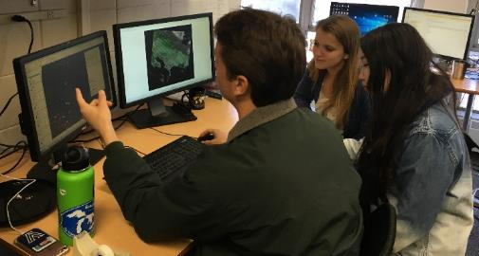
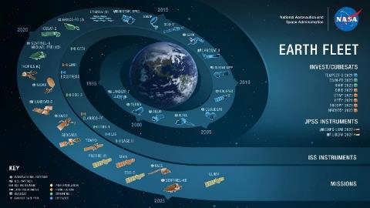
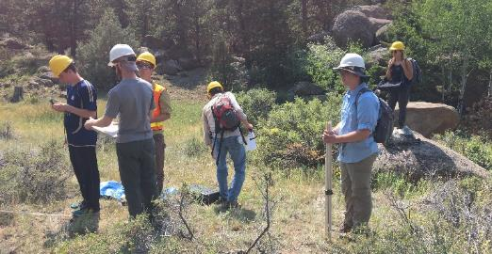
ABOUT DEVELOP
Empowered Participants + Earth Observations + Engaged Decision Makers
“Shaping the future by integrating Earth observations into global decision making”
DEVELOP bridges the gap between NASA Earth Science and society, building capacity in both its participants and end-user organizations to better prepare them to use remote sensing to address environmental challenges that face society.
Part of NASA’s Applied Sciences’ Capacity Building Program, DEVELOP addresses these challenges by conducting interdisciplinary feasibility projects that apply the lens of NASA Earth observations to community concerns around the globe.

Slide 7
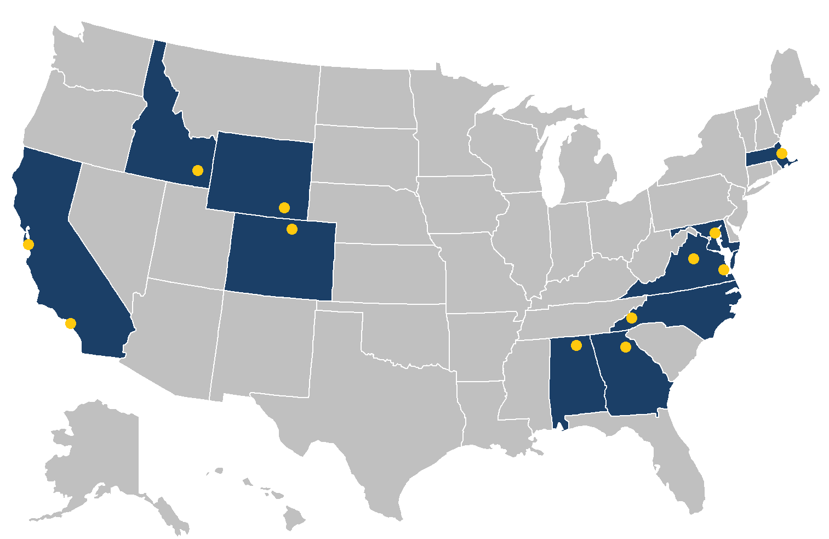
ABOUT DEVELOP
DEVELOP NASA & NOAA Offices*
Alabama – Marshall
California – Ames
California – JPL
Maryland – Goddard
Virginia – Langley
North Carolina – NCEI
Where is DEVELOP?
10
9
12
4
DEVELOP Regional Offices*
7. Colorado – Fort Collins
8. Georgia – Athens
9. Idaho – Pocatello
10. Massachusetts – Boston
2
7
11
5
3
6
1
8
DEVELOP Pop-Up Offices*
11. University of Virginia
12. University of Wyoming
DEVELOP Virtual Offices*
Virtual Environmental Justice
* Some locations offer both in-person & virtual projects, some only offer in-person or virtual. This varies by term.

Slide 8








ABOUT PROJECTS
Project Characteristics
50+ projects take place each year – at their core they share these characteristics:
Highlight the applications and capabilities of NASA Earth observations
Address community concerns relating to decision-making for real-world environmental issues
Partner with organizations who can benefit from using NASA Earth observations to enhance decision making by providing decision support tools
Conducted in 10-week terms (spring, summer, and fall) by small teams with diverse backgrounds
Align with at least one of the eight NASA Applied Sciences Program’s National Application Areas
Create a consistent set of deliverables
Research is conducted under the guidance of Science Advisors and mentors from NASA and partner organizations

Slide 9
PROJECT DEVELOPMENT
Project Development Process
Idea Generation & Partner Engagement
Proposal Writing & Approvals
Project Execution & More Iteration
Initial engagement w/potential partner – listen to their interests, priorities, needs, and understand their decision-making process.
Generate project idea – identify: study area, thematic focus area, actionable decision, potential end-products
Initial ideas reviewed by DEVELOP National Program Office.
If approved, Fellows draft a proposal – including the partner in review and iteration.
Proposals reviewed and approved by HQ, those selected are scheduled for a specific term and listed in the DEVELOP application.
Communication lines are reopened with partners following approvals.
Partners regularly meet with DEVELOP team during the term to discuss progress and results.
Project results and methods are handed off at the end of the term.

Slide 10



Engage with DEVELOP →
Prospective Participants:
Summer 2023 Term
Application Window: Jan 16, 2023 – Feb 24, 2023
Term Dates: Jun 5, 2023 – Aug 11, 2023
Thank You.
Prospective Partners:
DEVELOP accepts project ideas on a rolling basis
Questions? Ideas?
Articles & Important Events: Tweet @NASA_DEVELOP or #NASADEVELOP
http://twitter.com/#!/nasa_develop
Lauren.M.Childs@nasa.gov
DEVELOP National Program:
Features projects, node highlights & accomplishments, VPS announcements www.facebook.com/developnationalprogram
https://appliedsciences.nasa.gov/nasadevelop
NASA DEVELOP National Program:
Project and promotional videos www.youtube.com/user/NASADEVELOP

