Slide 1
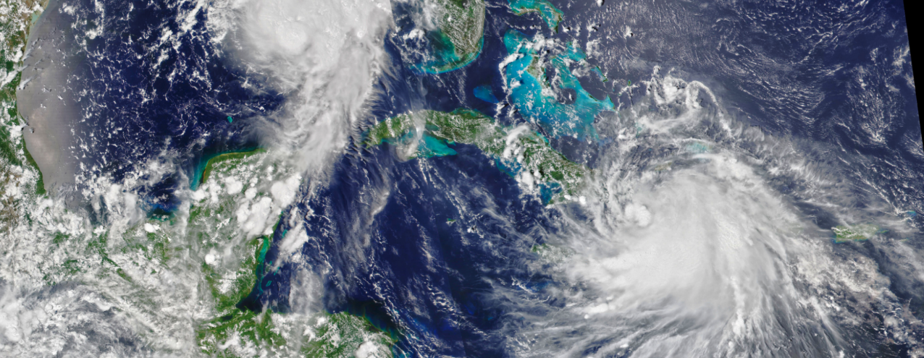

LANCE – NASA’s Land, Atmosphere Near Real-time Capability for EOS
Jenny Hewson, LANCE Outreach and Implementation Manager (Jennifer.H.Hewson@nasa.gov)
Karen Michael, LANCE Manager (Karen.Michael@nasa.gov)
Diane Davies, LANCE Operations Manager (Diane.K.Davies@nasa.gov)

Slide 2

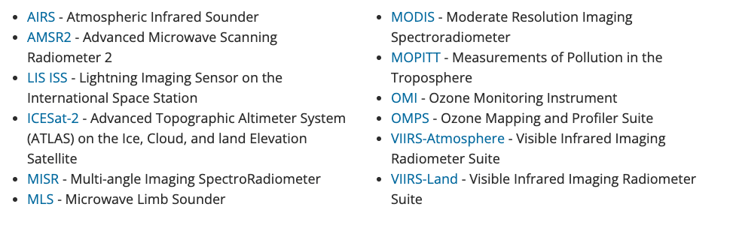
Land, Atmosphere Near Real-time Capability for EOS
Goal: provide global near real-time (NRT) data products within 3 hours of observation to meet the timely needs of applications users
Data and imagery from 12 instruments (SMAP coming soon) much quicker than routine processing allows
Over 280 image and derived data products
Distribute
40-75 TB of data/week
Users in over 200 countries
Virtual system: leverages existing Science Processing and Archive Components
Supports multiple NRT applications
2

Slide 3
Original Concept of LANCE
Leverage existing SIPS and DAACs
  Initially the SIPS were the preferred distributors for LANCE:
    every “hop” → impacted the latency (even if 10 min delay)
    NRT data is not archived → no need to transfer to DAACs
Leverage the current science teams for algorithms and QA
  Initially all the NRT products had standard products associated with them
  Flood Mapping product → first approved without a standard product/associated science team
Gather all the NRT (3 hr) data under one umbrella
  Easier for users to find the NRT data
  Looks like all the data is coming from one location
  Uses “umbrella” set of core requirements – consistency, coordination, collaboration
Establish a User Working Group
  Overall guidance for the evolution of LANCE on behalf of applications user communities

Slide 4
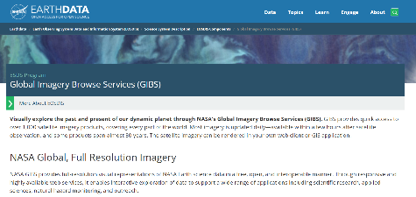
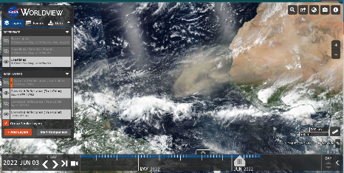
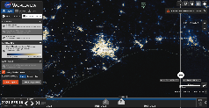
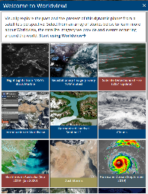
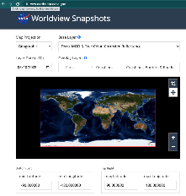
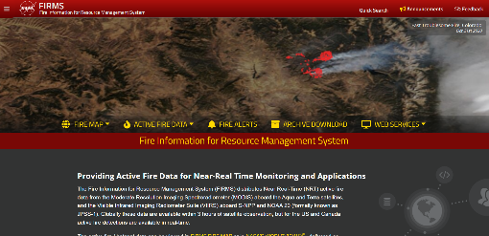
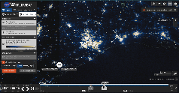
LANCE Continues to Evolve
https://earthdata.nasa.gov/earth-observation-data/near-real-time
In addition to distributing NRT data
  Global Imagery Browse Services (GIBS)
  Worldview (and Worldview Snapshots)
  Fire Information for Resource Management System (FIRMS)
  Flood mapping tool was incorporated as a part of LANCE in 2021
    MODIS NRT flood product (replaces legacy flood product generated since 2012)
  Most recently Ultra Real Time
  “Lower” latency
    ICESat-2 products (added, 2022)
      Includes: Sea Ice Freeboard as well as Atmosphere Cloud Layer Characteristics and 5 other products
      Added through → Satellite Needs Working Group process

Slide 5
Precursor to LANCE & NASA’s Long-standing collaboration with USFS
Following the large wildfires in Montana in 2000, the US Forest Service reached out to scientists at NASA and the University of Maryland to request near real-time data and imagery to support wildfire suppression and response.
This led to the development of the Moderate Resolution Imaging Spectroradiometer (MODIS) Land Rapid Response System which was a precursor to LANCE and Worldview.

Slide 6
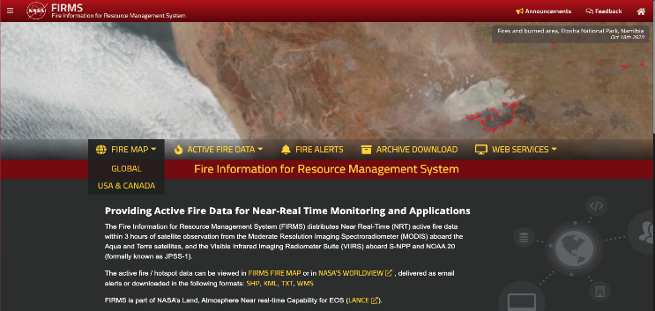
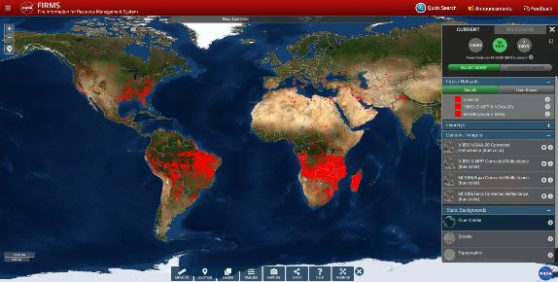
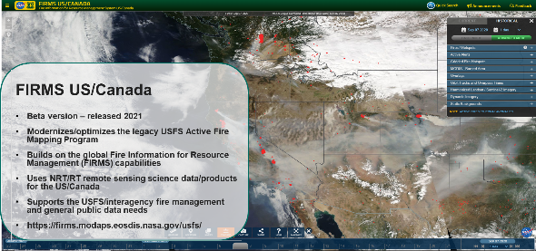
Fire Information for Resource Management System (FIRMS)
Originally developed at the University of Maryland. It was funded by NASA’s Applied Sciences and the United Nations (UN) Food and Agriculture Organization (FAO) using data from MODIS Rapid Response
FIRMS became part of LANCE in 2012
https://earthdata.nasa.gov//firms https://firms.modaps.eosdis.nasa.gov/ - https://firms.modaps.eosdis.nasa.gov/usfs

Slide 7
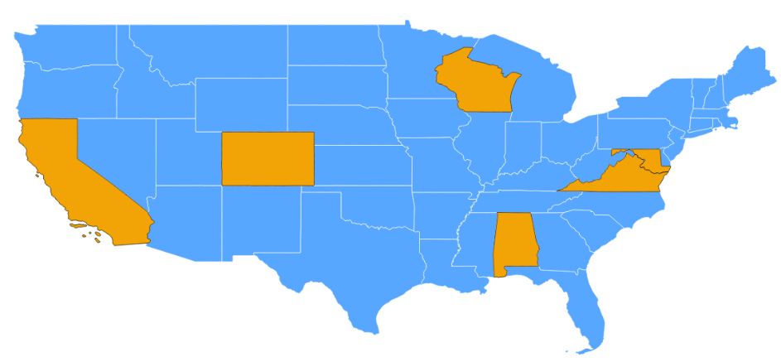
Current LANCE Facilities
SSEC UW-Madison
Atmosphere SIPS
VIIRS (S-NPP)
GES DISC
AIRS &MLS
GSFC
OMI SIPS
NCAR
MOPITT SIPS
MODAPS/Land SIPS
MODIS (Terra & Aqua) & VIIRS (S-NPP)
JPL
MLS SIPS
SMAP SDS
AIRS SCF
MISR SCF
NSIDC DAAC
SMAP
ICESat-2
GSFC
ICESat-2 SIPS
ASDC
MISR
Data Center
SIPS, SCF, SDS
GHRC
AMSR SIPS
LIS (ISS)
The LANCE elements are located at the following facilities
GSFC Earth Sciences Data and Information Services Center (GES DISC) is providing AIRS with support from the AIRS Science Computing Facility (SCF) at JPL , and MLS data via the MLS SIPS at JPL
Atmospheric Science Data Center (ASDC) is providing MISR data with support from the MISR SCF at JPL
AMSR Science Investigator-led Processing System (SIPS) is providing AMSR2 and LIS data
MODIS Adaptive Processing System (MODAPS) and Land SIPS are providing MODIS and VIIRS Land data
OMI Science Investigator-led Processing System (SIPS) is providing OMI and OMPS data
MOPITT SIPS (National Center for Atmospheric Research (NCAR)) is providing MOPITT data
Atmosphere SIPS (Space Science and Engineering Center (SSEC) University of Wisconsin) is providing VIIRS Atmosphere data
The Jet Propulsion Lab (JPL) Science Data System (SDS) is providing SMAP data for distribution by the National Snow and Ice Data Center (NSIDC)
The Ice, Cloud and land Elevation Satellite-2 SIPS is providing the ICESat-2 data for distribution by the National Snow and Ice Data Center (NSIDC)

Slide 8

LANCE Org Chart
NASA SMD Chief Scientist Data Officer
Kevin Murphy
NASA SMD Deputy Science Data Officer
Katie Baynes
LANCE Program Manager
David Green
LANCE Liaison
Tian Yao
Disasters Program Manager
Shanna McClain
NASA ESDS Program Executive
Cerese Albers
APPLIED
SCIENCES
NASA ESDS Project Manager
Andy Mitchell
LANCE Manager
Karen Michael
LANCE Operations Manager
Diane Davies
LANCE Outreach & Implementation Manager
Jenny Hewson
GIBS/Worldview
Minnie Wong / Ryan Boller
ESDIS
interfaces
UWG
Miguel Roman (Chair)
SMAP
SMAP SDS
Nga Chung
JPL
CMR/EDSC
Valerie Dixon
SMAP/ICESat-2
Michael Sutherland
Lisa Kaser
NSIDC DAAC
ICESat-2
ICESat SIPS
Suneel Bhardwaj
GSFC
LANCE
ELEMENTS
EMS
Drew Kittel
MLS
MLS SIPS
Brian Knosp
JPL
AIRS/MLS
Feng Ding
GES DISC
GSFC
AMSR/LIS ISS
AMSR SIPS/GHRC
Leigh Sinclair
MSFC
MISR
MISR SCF
Earl Hansen
JPL
MISR
ASDC DAAC
Ingrid Garcia-Solera
LaRC
MOPITT
MOPITT SIPS
Dan Ziskin
UCAR
OMI/OMPS
Ozone SIPS
Phil Durbin
GSFC
MODIS/VIIRS Land
MODAPS/Land SIPS
Sudipta Sarkar
GSFC
VIIRS Atmos.
Atmosphere SIPS
Jessica Braun
UWM
AIRS
AIRS SCF
Sharon Ray
JPL

Slide 9
LANCE UWG Members 2022
Name | Affiliation
Miguel Roman/Chair | Leidos Senior Director and Chief Scientist of Climate and Environment
Robert Brakenridge | Colorado/Dartmouth Flood Observatory
Arlindo da Silva | NASA/Goddard
Vanessa Escobar | NOAA/NESDIS
Mike Fromm | NRL/Washington DC
Sean Helfrich | NOAA/NESDIS/OSPO
Steve Miller | Colorado State University
Maggi Glasscoe | UAH/MSFC
Brad Quayle | USFS
Josh Cossuth | NRL/Monterey/Washington DC
Mark Trice | MD DNR
Mike Budde | USGS
Patrick Duran | NASA/MSFC/SPoRT
Lori Schultz | NASA/MSFC/Disasters
Fred Stolle | WRI

Slide 10









LANCE Architecture
Data Acquisition
Data Capture & Processing
Data to SIPS
Science Data Processing & Distribution
Distribution & Access
EOS Spacecraft
GES DISC
AIRS (L1 & L2)
Terra
MLS SIPS
MLS (L2)
TDRSS
WAN Transfer
Ozone SIPS
Aura
Aqua
OMI & OMPS (L2)
Data via HTTPS
EDOS Front End Processing: data capture
SMAP SDS
NSIDC
SMAP
SMAP & ICESAT-2 (L1,L2, L3)
ICESat-2
SIPS
EDOS Level Zero Processing Facility (LZPF)
ASDC
GIBS
ICESat-2
Ground
Stations
MISR (L1,L2)
Format: S-PDS or RBD
NCAR
Users
MOPITT (L2)
Worldview
NOAA – NASA Spacecraft
JPSS SMD Hub (JSH)
MODAPS
CMR
MODIS
(L1, L2, L2G*L3*)
Suomi NPP, NOAA-20
Format:
S-PDS
JAXA Spacecraft
Land SIPS PDR Server
VIIRS Land SIPS
FIRMS
Format:
S-PDS
VIIRS
VIIRS Atmosphere SIPS
GCOM-W1
VIIRS
Earthdata Search
Client
AMSR2 Format: L1R via Aspera service
AMSR SIPS
/
Hunstville HOSC & POCC
LIS Format: L0 Data
AMSR2 (L2, L3) &LIS ISS
International Space Station
RBD: Rate Buffered Data, S-PDS: Session Based Production Data Set
*MODIS & VIIRS L2G and L3 products are 27 – 48 hours, ICESat-2 L3 has a latency of 3 days
SIPS: Science Investigator-led Processing Systems, TDRSS: Tracking and Data Relay Satellite System, SDS: Science Data System
Direct Broadcast / Readout Stations

Slide 11
LANCE in a Nutshell
LANCE Secondary
EMS
EOSDIS Metrics System
Algorithms
Metrics
Science Team
QA
Development,
I&T,
Production
FIRMS
Imagery
GIBS
Global Imagery Browse
Services
Worldview
Input Data
Level Zero
Metadata
CMR
Common
Metadata Repository
Earthdata Search
Ancillary
LANCE
Primary
GOAL OF LANCE:
Reliable Near Real
Time Data < 3 hrs from
Observation time
Real-time (NRT) data products to meet the timely needs of applications users.
Earthdata
Login
Authentication
Product
Distribution
https,subscription
Archive
7-14 day Rolling
Users
User
Services
8am-5pm weekdays
Support,
Notifications

Slide 12
Latency Defined
Data latency is defined here as the elapsed time between satellite observation and the time data are available to the end user. The definitions were adopted by NASA EOSDIS in May 2018.
Recommend these definitions be used in NASA Proposal calls to ensure consistent terms are used
Ultra real-time¹ data added recently
Term | Latency* | Purpose
Real-time | Less than 1 hour | These terms are often used to refer to data that are made quicker than routine processing allows. They are used for a range of applied sciences, decision and tactical support, monitoring and early warning of events.
Near real-time (NRT) | 1-3 hours
Low latency | 3-24 hours
Expedited | 1-4 days
Standard routine processing | Generally, 8 – 40 hours but up to 2 months for some higher-level products | Standard products provide an internally consistent, well-calibrated record of the Earth’s geophysical properties to support science
Earthdata article on latency (https://earthdata.nasa.gov/learn/articles/data-latency)

Slide 13
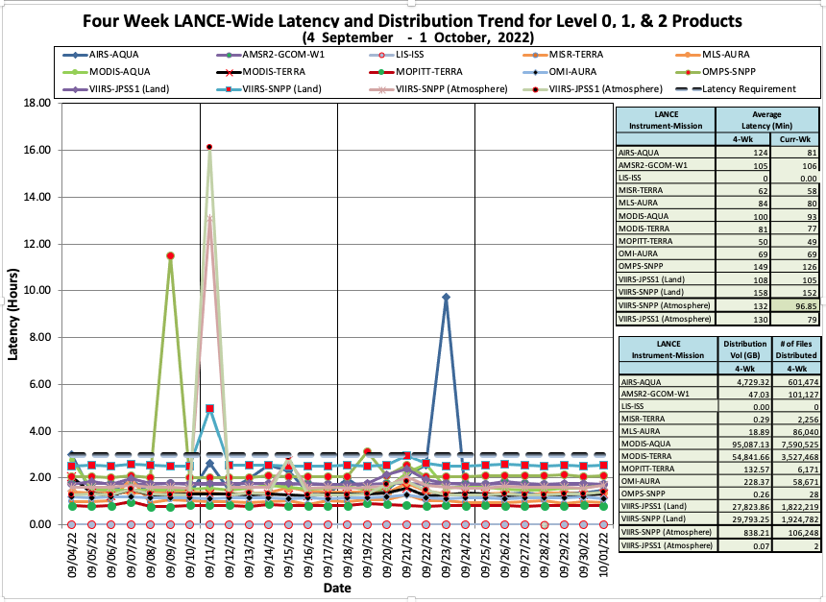

Slide 14
LANCE Users
LANCE products are routinely used by direct users, who access data for their own purposes and by brokers who add value to the data by combining it with other specialist knowledge and serve it to targeted end users.
Weather / Aerosols
European Centre for Medium-Range Weather Forecasts
NASA’s Global Modeling and Assimilation Office
Naval Research Laboratory
Flood
Federal Emergency Management Agency
Dartmouth Flood Observatory
United Nations Satellite Centre
Disasters monitoring
NASA Disasters Program
NASA Short-term Prediction Research and Transition Center
Agricultural Monitoring
USDA /USAID – FEWSNet
USDA Foreign Agricultural Service
Fires, Smoke and Air Quality
US Forest Service
US Climate Resilience Toolkit
Conservation International
World Resources Institute
Governments in India and Thailand
Greenpeace
Breezometer
Various News Outlets e.g. The Washington Post, The New York Times, BBC, CNN

Slide 16
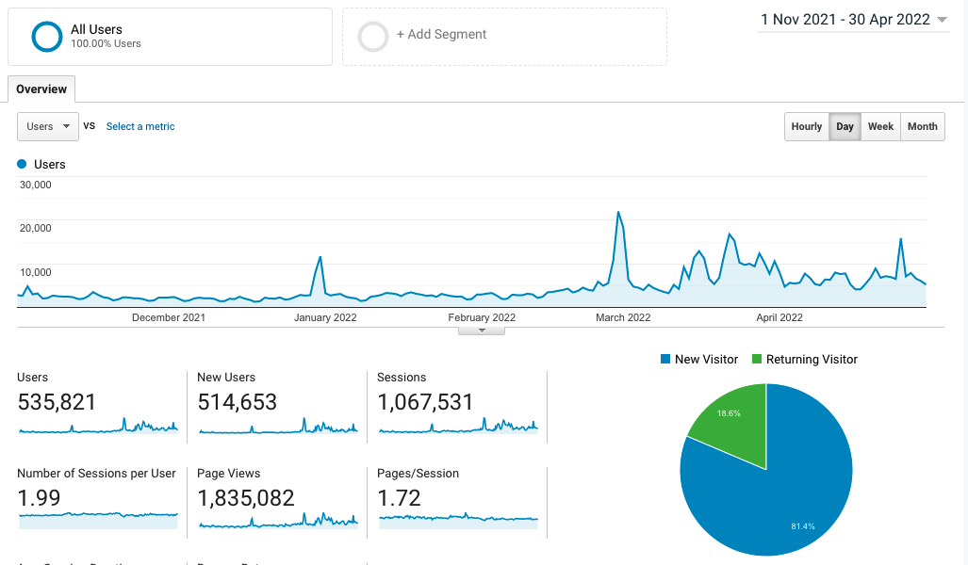
Google Analytics for all LANCE Web Pages (incl. FIRMS: 1 Nov 21 – 30 April 2022
Russian invasion of Ukraine
Fires in Corrientes, Argentina
Forest fires in Jammu region of India
Marshall Fire, Colorado

Slide 17
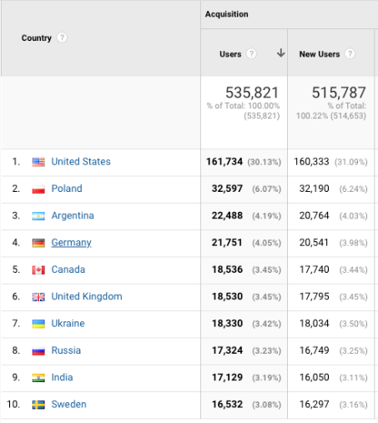
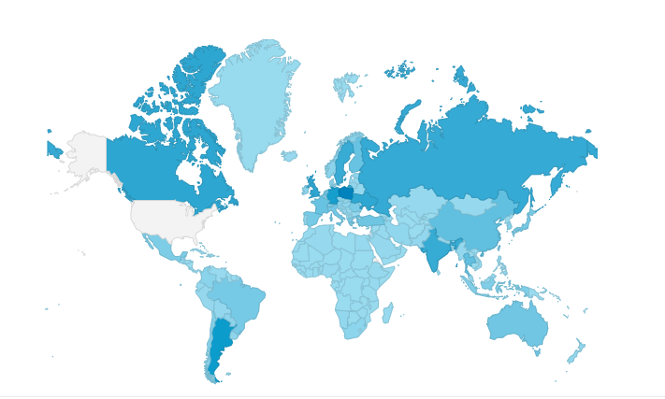
Google Analytics for all LANCE Web Pages including FIRMS: 1 Nov 21 – 30 April 22
May overlay showing where users are from excluding the United States

Slide 18
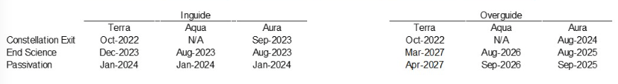
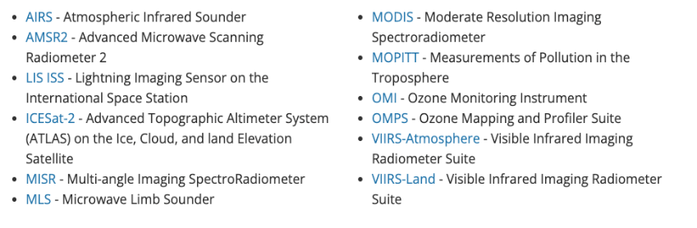
Decommissioning of Terra, Aqua, Aura
Current plan per the ESMO project:
Decommissioning of Terra, Aqua and Aura → loss of LANCE data
  VIIRS data is available in LANCE for continuity with MODIS (PM)
  OMPS data is available in LANCE for continuity with OMI
  ATMS and CrIS data: available in NRT to a limited customer base from NOAA; would there be value in obtaining permission to re-distribute the NOAA products through LANCE?
  Sentinel 3: some potential for continuity with MODIS (AM); LANCE pilot study underway (Fire product from EUMETSAT for FIRMS; Corrected Reflectance and Land Surface Reflectance for Worldview).

Slide 19
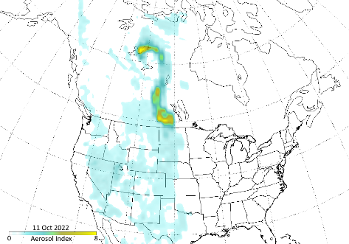
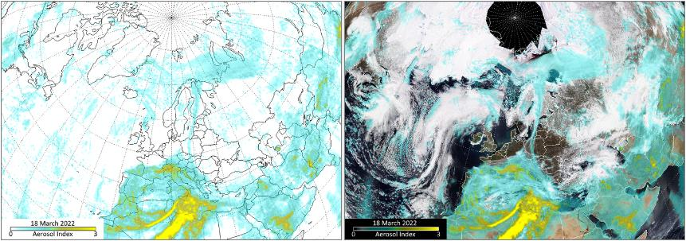
ICAP Relevant Products
SNPP OMPS AI (11/10/22)
Smoke plume from PyroCumulus event over NW territories
NOAA-20 OMPS AI (03/18/22)
Dust-Infused Baroclinic storm
transporting dust over Europe and Artic Ocean

Slide 20
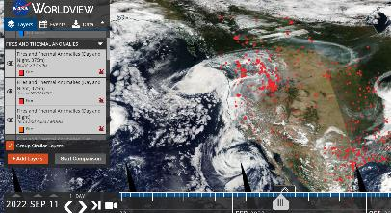
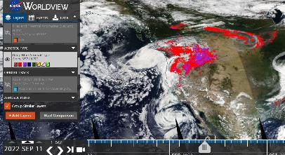
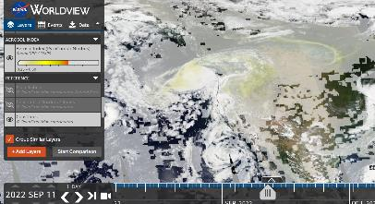
ICAP Relevant Products
NOAA-20 VIIRS; SNPP VIIRS, A/T MODIS (09/11/22)
Fires and Thermal Anomalies - Idaho
SNPP VIIRS Aerosol Type (09/11/22)
Smoke and high-altitude smoke
SNPP OMPS AI (09/11/22)
PyroCumuloNimbus layer

Slide 21
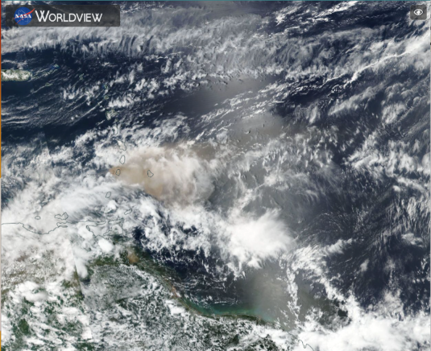
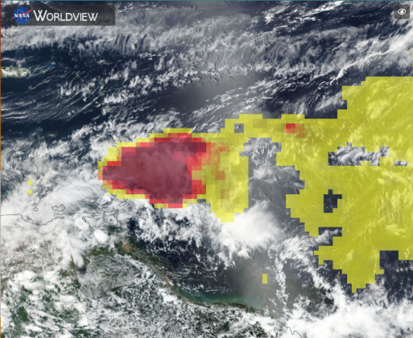
ICAP Relevant Products
SNPP VIIRS Corrected Reflectance (04/10/21)
Soufrière St Vincent Volcano Eruption
SNPP OMPS AI (04/10/21)
Soufrière St. Vincent Volcano Eruption

Slide 22
Other Potential LANCE Products
TROPICS (Time-Resolved Observations of Precipitation structure and storm Intensity with a Constellation of Smallsats) Constellation-cost capped mission
  Pathfinder launched June 30th 2021; Production at UWM and archive at the GES DISC
  Three more launches in the near future which will introduce 6 more CubeSat's (3 pairs)**
  NOAA funded a Pathfinder latency demonstration to reduce latency from 12 hrs to 1-2 hrs
TEMPO (Tropospheric Emissions: Monitoring of Pollution) Mission-cost capped mission
  NRT products have been requested through the SNWG to assist in forecasting and modeling efforts. Air quality products identified were NO₂, HCHO,SO₂ as well as adapting OMI algorithms for some additional trace gas products
  Ways to reduce the latency and funding are being explored by NASA and NOAA
SNWG (Satellite Needs Working Group) Products
  Many additional products will be coming through the SNWG and some will not be NRT but may still serve the LANCE user community well e.g. ICESat-2 lower latency freeboard & ice thickness (>45 days to 3-5 days)
  SNWG products will be considered for inclusion into LANCE on a case-by-case basis

Slide 23
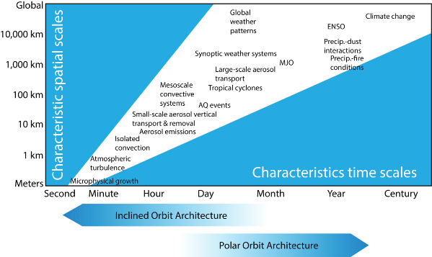
Other Potential LANCE Products (part 2)
AOS (Atmospheric Observing System)
  NRT needs have been identified by the AOS application’s team for weather forecasting and time critical decisions
    Current AOS latency requirements:
      75% of radiometer data downlinked in <3 hours
      85% available in <4 hours
      95%-100% available in <5-6 hours
SBG (Surface Biology and Geology)
  The SBG application team indicated that latency less than 24 hrs would be sufficient for most applications although lower latency would add substantial benefit for some applications
  Considering having a NRT processing stream in addition to the standard processing stream
    Current SBG latency requirements:
      <24 hours from collection through processing L2+ products
Notes:
https://https://aos.gsfc.nasa.gov/timeline.htm

Slide 24
ICAP Recommendations?
Are there any NRT products that you would like to see in LANCE?
  For example: would ICAP members like to see the NRT NOAA produced ATMS and CrIS NRT products available in LANCE to replace AIRS when decommissioned?
What is the process for requesting new products in LANCE?
  A LANCE Enhancement request needs to be filled out and provided to the LANCE Manager
    The enhancement request includes information about the product, why it is needed, who at HQ endorses the effort, the level of support needed for implementation, and letters of endorsement from the community
  The request is reviewed by ESDIS, HQ and the LANCE UWG
    If approved and funding is secured, implementation proceeds

Slide 25
LANCE Related URL’s
LANCE: https://earthdata.nasa.gov/LANCE
FIRMS: https://firms.modaps.eosdis.nasa.gov/map
FIRMS US/Canada: https://firms.modaps.eosdis.nasa.gov/usfs/map/
Flood Mapping: https://www.earthdata.nasa.gov/learn/find-data/near-real-time/modis-nrt-global-flood-product
Worldview: https://worldview.earthdata.nasa.gov/

