Slide 1
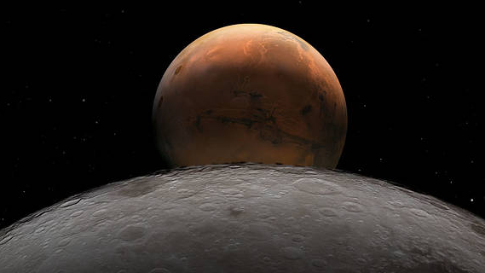

Scaleup of Microwave Powder Bed Fusion for Lunar Infrastructure Construction
ASTM International Conference on Additive Manufacturing – 2022
Orlando, Florida
October 31 to November 4, 2022
Michael Effinger¹, Ryan Wilkerson¹, Gerald Voecks², Furman Thompson¹, Holly Shulman³, Doug Rickman⁴, Mihail Petkov², Quinn Otte⁵, Robert Mueller⁶, Aaron King⁵, Hal Kimrey⁷, John Gerling⁷, Ron Hutcheon³, Ralph Bruce⁷, Martin Barmatz², & Bobby Atkins¹.
¹ NASA Marshall Space Flight Center, ² Jet Propulsion Laboratory, ³ DrHollyShulman Sole Proprietorship, ⁴ Jacobs Engineering, ⁵ Radiance Technologies, ⁶ NASA Kennedy Space Center, ⁷ RWBruce Associates, LLC
NASA / George C. Marshall Space Flight Center
www.nasa.gov

Slide 2
Agenda
Background
Small Scale Testing
Multimode Applicator
Near Field Coupler Applicator
Site Preparation
Demonstration Article
Summary

Slide 3
Background
Microwave Structure Construction Capability (MSCC) element of the Moon to Mars Planetary Construction Project (MMPACT) started in late 2020
Goal
Mature the technology and capability to emplace in-situ-based construction process on the Moon to form horizontal infrastructure elements (e.g., landing pads, roads, etc.)
Objectives
Develop microwave sintering protocols/processes/CONOPs using lunar simulants in thermal vacuum
Develop microwave applicator designs, hardware, and instrumentation
Fabricate plates for property testing & Demonstration Mission 1’s demonstration article fabrication
Approach
Characterize simulants for off-gassing and mass loss enabling creation of high temperature bakeout to remove non-lunar like materials
Develop simulants to accurately reflect glass and mineral contents
Use small scale microwave & vacuum furnace sintering & simulant characterization to feed large scale microwave sintering protocol development
Screen applicator designs and processing protocols (e.g., paving with horn, array, leaky waveguide, Multimode (MM), Near Field Coupler (NFC) and brick making)
Develop solid state microwave sources
Develop simulant bed to simulate lunar response to microwaves

Slide 4
Partners
Organization | Role/Responsibility
NASA Marshall Space Flight Center/Jacobs/Aerie Aerospace | Overall lead, full scale and large-scale microwave sintering in vacuum, fabrication & testing, conops, integration & testing, thermal gravimetric with mass spectrometry, morphology testing, particle size analysis, carbon & sulfur chemical analysis, microscopy, computed tomography, and simulant design and development
RWBruce Associates LLC | Microwave specification lead, microwave system design
JFGerling Microwave Applications Consulting | Microwave specification, Multimode and window design
Microwave Materials Technologies | Microwave specification, microwave energy modeling
The Crown College | Microwave sintering advisement, thermal conductivity testing
DrHollyShulman Sole Proprietorship | Microwave sintering lead, Large scale & brick microwave sintering, synthetic mineral fabrication, surface area testing, different thermal analysis, Raman
Microwave Properties North | High temperature dielectric property testing
Jet Propulsion Laboratory | Small scale sintering and bonding, frequency test system dev and testing, HFSS microwave coupling modeling, microscopy, vacuum testing with mass spectrometry, Airline Permittivity Characterization, Solid state horn array, simulant characterization
Radiance Technologies | Microwave applicator design (Near Field Coupler), frequency testing, EMI compatibility, HFSS microwave coupling modeling
Compass Technology Group | Frequency test system dev and testing
NASA Kennedy Space Center | Site preparation (tools, conops, design, testing, fabrication), bear strength instrumentation (cone penetrometer)
Kratos Southern Research Engineering | Mechanical and thermal property testing
NASA Langley Research Center | Instrumentation, NDE, critical flaw size determination
Colorado School of Mines | Proof load instrument, simulant delivery, systems engineering/conops
Harrop Industries, Inc. | Bake out large volume of materials at high temperature and Ar/5%H environment
Washington Mills | Make glass for simulants and fabricate NUW-LHT-5M and NUW-LHT-6M for more accurate high temperature processing behavior
Iowa State University | Microwave imager instrument
Texas Research Institute | Microwave imager instrument

Slide 5
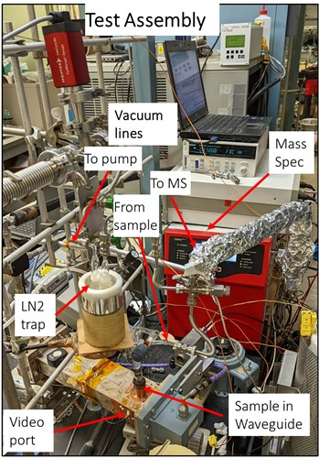
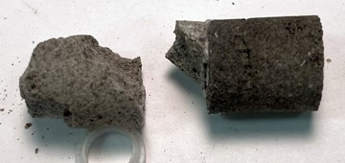
Small Scale Microwave Testing
Correlation of several factors relevant to understanding the dynamics of microwave sintering
Vacuum/pressure in material – rapid responses and with respect to duration of condition
Mass spectrometry – volatile species identity and release with respect to power and temperature of material
Applied microwave power – absorbed and reflected power (Duration of power at any given level & range of applied power can cover wide range up to 25 W)
Video – observe any hot spot or plasma generation during test
Sample removal can be weighed, densified, selectively removed (correlate w/re to location in waveguide and shrinkage) to compare degree/extent of sintering or melting relative to test conditions
NU-LHT-2M
Sintered at 1200°C/10 min
NU-LHT-4M
Sintered at 1200°C/10 min
Microwave Joining of Layers
(Cohesive/Adhesive Failure)
This research depicted in graphs was carried out at the Jet Propulsion Laboratory, California Institute of Technology, under a contract with the National Aeronautics and Space Administration (80NM0018D0004).

Slide 6
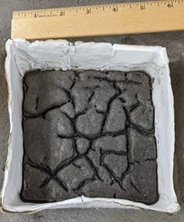
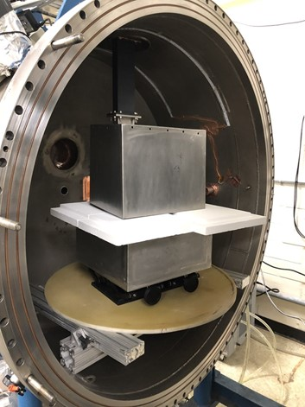
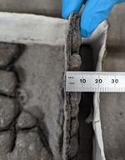
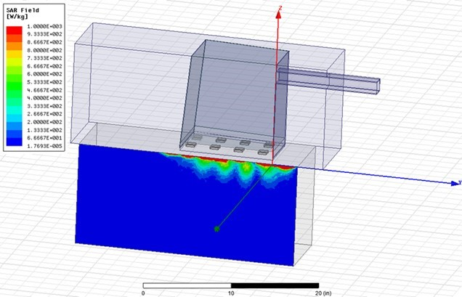
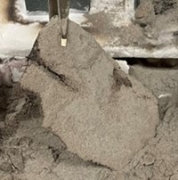
Multimode (MM) Applicator
MM microwave provides more uniform electric field for sintering lunar surface paving & brick making
6 kW magnetron
Process Development, Testing, Results
Modeling shows good surface heating of regolith simulant using radiant heat to “kick start” microwave absorption
Experimental multimode system set up in vacuum chamber
Proof of concept demonstrated: sintered tile removed from top of simulant powder bed
MM Applicator
Simulant Box
HFSS Model with Combined Radiant and Microwave Heating
Vacuum Microwave Sintered Samples

Slide 7
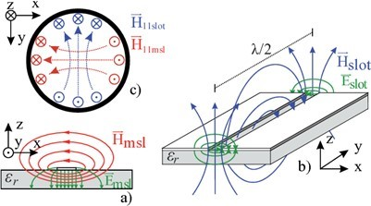
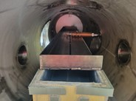
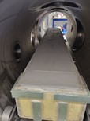
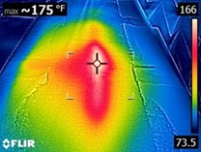
Near Field Coupler (NFC)
Uses near-field technology to contain energy in sintering target volumes
Design flexibility can be used to shape energy distribution
Simplifies RF hardening of surrounding equipment
Testing
Proof of concept with copper construction
Higher temperature testing using steel construction with 1 kW in open air
Currently testing in vacuum with up to 6 kW solid state source, intending to create sintered plates
Results
At 1 kW, the NFC heated simulant at a rate of 3°C/minute
In open air with a firebrick sandbox, heat loss to the environment could not be overcome with 1 kW
Heating pattern matches predictive models
Vacuum tests at 0.1 kW showed appropriate heating patterns, and the testbed is being prepared for higher power tests
NFC Electromagnetic Field Distribution
6 kW NFC & Simulant Tray in Vacuum Chamber
Steel NFC Heating Area 1 kW

Slide 8
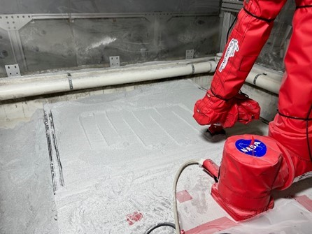
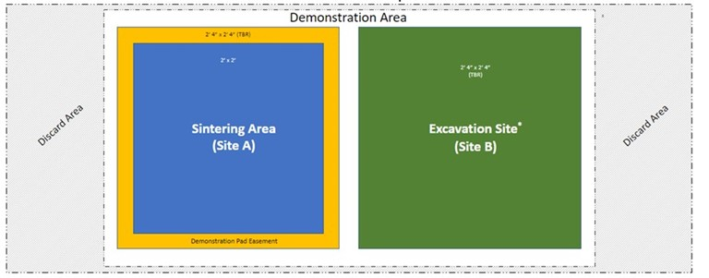
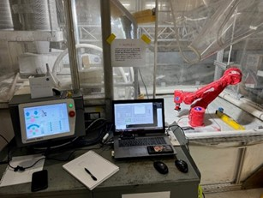
Site Preparation
Requirements
Rough Grading for Leveling: level the surface of the demonstration site to +/- 2 degrees [TBR] levelness.
Fine Grading for Flatness: grade the demonstration site to +/- .5 cm [TBR] flatness
Final Pad Density: compact regolith within the demonstration site to 1800 kg/m3 [TBR] to a depth of 4 inches (10 cm) [TBR].
Robot arm testbed showing site preparation & compaction testing

Slide 9
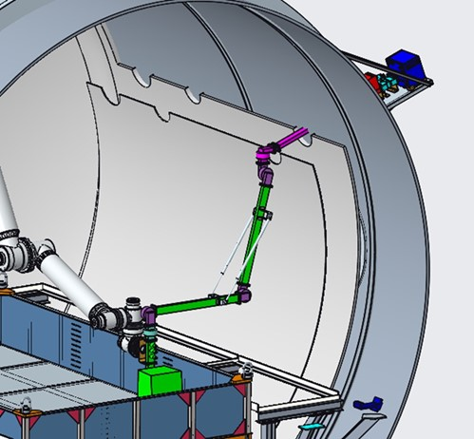
Demonstration Mission 1: Demonstration Article Fabrication
Objectives
Fabricate 4ft² of any shape by 4” thick with minimum of two vertical layers
Increase fidelity of hardware, processing protocols, and CONOPs with each test series
Approach
Use 20’ diameter vacuum chamber to demonstrate hardware and full-scale process
Prototype: Use existing hardware with electronics outside of the chamber to fabricate demonstration article
Engineering Unit: Develop and use vacuum compatible hardware inside of chamber to fabricate demonstration article
Qualification and Flight Units: Develop and use flight hardware inside of chamber to fabricate flight like article
Design
Multimode will use waveguide for energy transmission
NFC will use transmission cable for energy transmission
Prototype Hardware Design using Multimode Applicator with a Magnetron (simulant bed is empty).

Slide 10

www.nasa.gov/spacetech

