Slide 1
Expectation vs. Reality
The Sunrise Problem Applied to Probabilistic Risk Assessment
November 2022
Joseph Osowski, QD35, Bastion Technologies
Notes:
Abstract: The Sunrise Problem is succinctly stated as a question: “what is the probability that the sun will rise tomorrow?” Attempts to answer this seemingly simple question reveal unexpected incongruities between statistical/probabilistic estimates and “real-world” expectations. Rather than being a purely philosophical problem, similar incongruities can be found in reliability and probabilistic risk assessment (PRA) analyses. These differences between statistical predictions and demonstrated reliability can result in analysis shortcomings that should be addressed and resolved. This presentation will begin by discussing the nature of the Sunrise Problem and how it applies to PRA and reliability. Examples of the Sunrise Problem in a PRA estimate will also be included, along with tips to identify and resolve the shortcomings that result from these anomalous situations.

Slide 2
Introduction
The “problem”: What is the probability that the sun will rise tomorrow?
Evaluation of the sunrise problem shows the difficulty of using statistics for certain applications.
When applied to Probabilistic Risk Assessment (PRA), the sunrise problem illustrates a pitfall that analysts should recognize and avoid, when possible.
Notes:
Abstract: The Sunrise Problem is succinctly stated as a question: “what is the probability that the sun will rise tomorrow?” Attempts to answer this seemingly simple question reveal unexpected incongruities between statistical/probabilistic estimates and “real-world” expectations. Rather than being a purely philosophical problem, similar incongruities can be found in reliability and probabilistic risk assessment (PRA) analyses. These differences between statistical predictions and demonstrated reliability can result in analysis shortcomings that should be addressed and resolved. This presentation will begin by discussing the nature of the Sunrise Problem and how it applies to PRA and reliability. Examples of the Sunrise Problem in a PRA estimate will also be included, along with tips to identify and resolve the shortcomings that result from these anomalous situations.

Slide 3
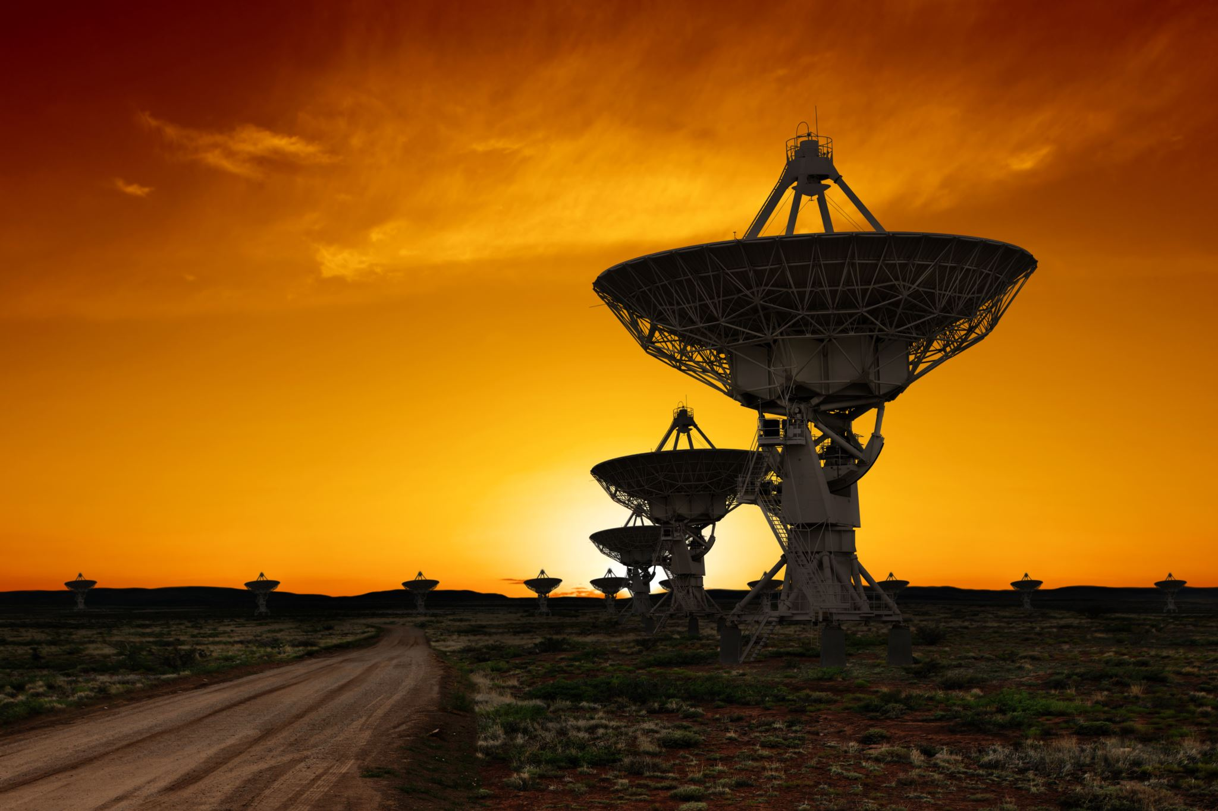
Agenda
Introduction to the Sunrise Problem
Further Statistical Analysis
Expectation vs Reality
Application to PRA
Other Applications
Avoiding the Pitfalls
Summary

Slide 4
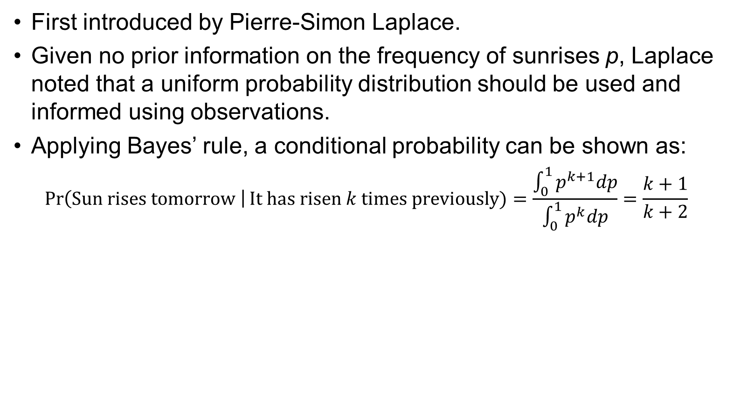
Introduction to the Sunrise Problem
First introduced by Pierre-Simon Laplace.
Given no prior information on the frequency of sunrises p, Laplace noted that a uniform probability distribution should be used and informed using observations.
Applying Bayes’ rule, a conditional probability can be shown as:
$$\operatorname{Pr}\left(Sun rises tomorrow \right|It has risen k times previously)=\frac{\int_{0}^{1}{p^{k+1}dp}}{\int_{0}^{1}{p^{k}dp}}=\frac{k+1}{k+2}$$
Observations (years) | Observations (days) | Pr(Sunrise) | Pr(No sunrise) | "1 in" Days | "1 in" Years
28 | 10,220 | 0.999902 | 9.78E-05 | 10,222 | 28.01
80 | 29,200 | 0.999966 | 3.42E-05 | 29,202 | 80.01
1000 | 365,000 | 0.999997 | 2.74E-06 | 365,002 | 1,000.01
5000 | 1,825,000 | 0.999999 | 5.48E-07 | 1,825,002 | 5,000.01
Notes:
Equation assumes that p has a prior distribution that is uniform over [0,1] and that the sun independently rises each day with probability p. This is Laplace’s rule of succession, which is both a notable and infamously misapplied (as we’ll soon see) connection between probability and frequency.
Note that the number of observations is the key metric, making this a reference class problem. The conditional probability can change drastically based on whether you use a single person’s (or all of humanity’s) recorded observations. Further, the years of observation matches the “expected time to failure”. Even taking all 5000 years of recorded human history, this method shows that we should expect the sun to NOT rise within the next 5000 years or so.

Slide 5
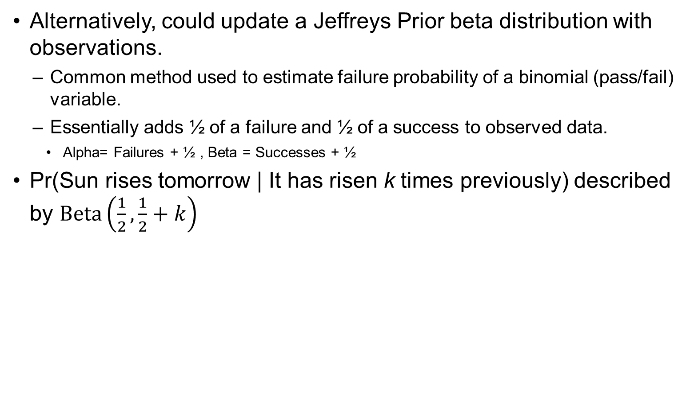
Further Statistical Analysis
Alternatively, could update a Jeffreys Prior beta distribution with observations.
  Common method used to estimate failure probability of a binomial (pass/fail) variable.
  Essentially adds ½ of a failure and ½ of a success to observed data.
    Alpha= Failures + ½ , Beta = Successes + ½
Pr(Sun rises tomorrow | It has risen k times previously) described by $Beta\left(\frac{1}{2},\frac{1}{2}+k\right)$
Observations (years) | Observations (days) | Pr(Sunrise) (median) | Pr(No sunrise) | "1 in" Days | "1 in" Years
28 | 10,220 | 0.999978 | 2.23E-05 | 44,931 | 123
80 | 29,200 | 0.999992 | 7.79E-06 | 128,371 | 351
1000 | 365,000 | 0.999999 | 6.23E-07 | 1,604,621 | 4,396
5000 | 1,825,000 | 1.000000 | 1.25E-07 | 8,023,101 | 21,981
Notes:
Note that the number of observations is again the key metric. The beta distribution with Jeffreys prior is less “conservative,” but has more reasonable predictions for this problem.
Also note that even though the probability of no sunrise “tomorrow” (4th column) is very low, the probability of having a “no sunrise” occurrence increases when you look far enough into the future. If you want to know the expected number of “no sunrises” over the next million years, it would be unreasonably high compared to our common sense.
It is also interesting to note that beta distributions used for this type of failure estimate have inherently high uncertainty when there are zero instances of failure. While additional ‘successes’ have little effect, the uncertainty decreases dramatically with even one observed failure, showing that, statistically, we “learn more” from failure than from success.

Slide 6
Expectation vs Reality
The sunrise problem, and attempts to “solve” it, show a dichotomy between what raw statistics predict and what we “know” to be true: the sun will continue to rise.
Some factors contributing to this dichotomy include:
  Reference class problem.
  Attempts to predict a low-probability event far in the future.
  Improper assumptions.
  Statistical solutions do not include the bulk of our prior knowledge.
Laplace recognized these shortcomings:
  But this number [the probability of the sun coming up tomorrow] is far greater for him who, seeing in the totality of phenomena the principle regulating the days and seasons, realizes that nothing at the present moment can arrest the course of it.
Notes:
Reference class problem – What data do we use? Do we only trust our personal observations? All of humanity’s? Extrapolate back to the earth’s formation?
Low probability event – Combined with the data problem above, attempts to “extrapolate” far into the future makes our estimates seem unreasonable.
Improper assumptions – Sun rises are not “random” coin flips. The analyses shown earlier are like trying to put a square peg in a round hole. We’re trying to make the question fit the analysis.
Generic or uninformed priors, while ‘proper’ for general applications, do not represent everything we know about the sunrise problem (i.e. science, physics, etc.)
Although famously ignored, Laplace’s own words explain that the sunrise problem is a misapplication of his rule of succession; there is additional prior information that the rule does not take into account. When recounting this problem in Probability Theory: The Logic of Science, E.T. Jaynes adds:
In this somewhat awkward phraseology, [Laplace] is pointing out to the reader that the rule of succession gives the probability based only on the information that the event occurred n times in N trials, and that our knowledge of celestial mechanics represents a great deal of additional information.

Slide 7

Application to PRA
Similar problems can arise in the reliability/PRA realm when analyzing failure risk.
Example:
A small boat manufacturer wants to know the probability that a rivet fails, creating a hole that could sink their boats.
Each boat uses 600 rivets, and the manufacturer has already built 6 boats with no occurrences of this failure.
_______________________________
Use Jeffrey’s prior & Beta distribution:
Alpha = 0 + ½ = ½
Beta = 600*6 + ½ =3600.5
Pr(single rivet failure)= 6.32E-05
Pr(at least 1 rivet failure on a boat) = 0.037
Notes:
Excel: Probability of a single rivet failure (median) = BETA.INV(0.5,0.5,3600.5) = P1
Failure probability for a boat with 600 rivets = 1-BINOM.DIST(0,600,P1,FALSE)
This example shows that, even with 3000+ successes, there is still about a 1 in 26 chance that a boat sinks due to a rivet failure.

Slide 8
Application to PRA (cont.)
Is this high (1 in 26) failure probability reasonable? Does the probabilistic expectation match reality?
Factors contributing to the analysis’ shortcomings:
  Reference class problem.
    Should more data be used from similar designs outside of the manufacturer history?
  Extrapolating a low-probability event.
    Low risk when looking at a single rivet, but risk increases due to the large number of rivets on each boat.
  Improper assumptions.
    Can we treat rivet failures as independent/random?
  Statistical solution does not include the bulk of our prior knowledge.
    Is the failure even possible barring external events? Has material strength/failure physics been analyzed?
Notes:
This example shows that, even with 3000+ successes, there is still about a 1 in 26 chance that a boat sinks due to a rivet failure.

Slide 9

Other Applications
The shortcomings that the sunrise problem illustrates can be found in various other types of statistical analyses:
Probabilistic Risk Analysis.
  Shown in earlier example.
  Similar outcomes may arise when analyzing long-duration reliability.
Population estimates.
  Extrapolating small local populations across large areas can be highly inaccurate.
Predictions of weather or geological events.
  Limited accuracy and obvious flaws of predictions across different locations or long time periods.
Notes:
PRA – already showed one example. Rather than looking at many different points of failure, similar outcomes may show up when looking at a low failure probability over very long time frames.
Population estimates – Example: Red Snappers are a type of fish that typically exist in large numbers near reefs and artificial submerged structures (shipwrecks, offshore rigs, etc), but the number of fish drastically decreases when moving towards open water. The large area of ocean that is “open water” means that even very small population density estimates can result in an unreasonably high overall population estimate. Likewise, an assumption of zero fish in open water may result in an unreasonably low population estimate.
Weather/geological predictions - What’s the likelihood of a hurricane in North Dakota, or a volcanic eruption in New York City? These kinds of analyses show an obvious case of when an analysis is unreasonable from the get-go.

Slide 10
Avoiding the Pitfalls
Failing to recognize (or explain) a sunrise problem can lead to faulty assessments and loss of trust in PRA methodologies.
Risk analysts should notice the “warning signs” of a sunrise problem:
  Low probability failure events evaluated over long durations or many points of failure.
  Risk estimations of failures that have no history of occurrence.
  Unexpectedly high risk of system failure compared to failure history.
  Simplified failure criteria used to streamline statistical analysis (pass/fail).
Most shortcomings can be addressed by taking a wider view of the analysis.
  Does the result pass the “sanity check”?
  What actually causes the failure to occur?
  Can more/better data be used as an input?
  Can extrapolation be limited?
Notes:
Does the result make sense? Is it common for 1 in 26 boats to sink from rivet failures?
What causes the failure? Is it truly a random event? Rivets don’t just magically pop out of their rivet holes. Engineering colleagues and stress/strain analysis may be used to improve the risk assessment.
Can more data be used? Are there similar designs that can inform the analysis? Should other data be trusted equally?
Extrapolation can amplify estimation errors. Limiting the scope of the analysis can keep results reasonable while acknowledging the inherent uncertainty in an overall system.

Slide 11
Summary
At its core, the sunrise problem illustrates a notable misapplication of statistical prediction methods.
PRA analyses similar to the sunrise problem often result in unusually high risk and typically occur when there is a combination of:
  Limited data.
  Many potential points of failure.
  Low failure probabilities.
  Misunderstood failure requirements.
Occurrences of such problems in a risk assessment should be reviewed for these shortcomings and overall plausibility. Assessments may be improved with the addition of:
  Additional physics/material properties analysis.
  Additional historical data.
  Limited analysis scope and acknowledgement of shortcomings.
Notes:
Risk analysts are not here to predict the future, and although our methods can be extremely valuable, they are not perfect. Acknowledging knowledge gaps and shortcomings is a key part of maintaining trust and transparency with stakeholders.
Failure to note a “sunrise problem” can easily lead to a boy-who-cried-wolf situation; insisting that there is high risk when the analysis is lacking can cause lack of trust when “true” risk drivers are brought to light.

Slide 12
POC & References
Joseph.J.Osowski@nasa.gov
  256-961-0751
E.T. Jaynes, Probability Theory: The Logic of Science, 2003.
Additional information can be found on Wikipedia:
  https://en.wikipedia.org/wiki/Sunrise_problem
Images from Excel stock image library

