Slide 1
Assuring Safety-Critical Machine Learning Enabled Systems: Challenges and Promise
Alwyn Goodloe
NASA Langley Research Center

Slide 2
Safety-Critical Systems
Safety-critical systems – failure can result in loss of life, significant property damage, or damage to the environment.
Safety-critical systems are often subject to strict government regulation.
Domains such as nuclear power and civil aviation have very stringent safety requirements.
  Automobiles, consumer products, medical devices typically have fewer safety criteria.
This talk primarily focuses on assurance of machine learning (ML) ultra-critical systems.
  Focus on civil aviation.

Slide 3
So You Want to Build an Airplane
Form a startup and start hacking?
Process starts off with a notification of intent to the FAA.
  A minuet begins between the company and the regulators.
  For a Part 25 aircraft they will tell you over 1500 safety criteria you must meet.
    Autos and medical devices are easy in comparison.
The FAA must certify the aircraft.
The cyber-physical component is one of the largest risk factors.
You can choose to do things your own way and make an argument to the FAA that the aircraft is safe OR you can follow approved guidelines.
Ongoing collaboration with the FAA on less process‒centric means of certification.

Slide 4
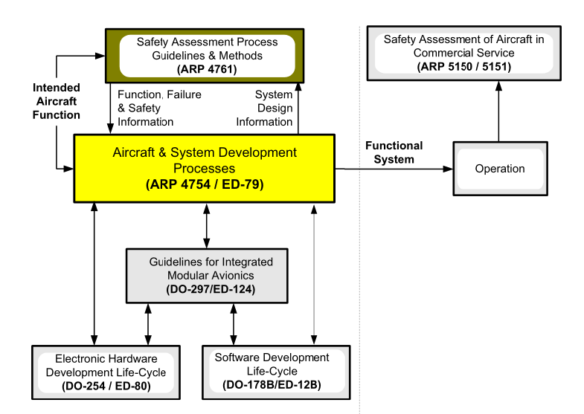
Guideline Documents
Notes:
From SAE ARP 4754A, Figure 1. Guideline Documents Covering Development and In-Service/Operational Phases

Slide 5
ARP 4761
Aerospace Recommended Practice for performing safety assessments on civil aircraft.
Guidelines and methods of performing the safety assessment.
  Functional Hazard Analysis (FHA)
  Preliminary Safety Assessment (PSA)
  System Safety Assessment (SSA)
  Fault-Tree Analysis (FTA)
  Failure Modes and Effects Analysis (FMEA)
  Common Mode Analysis (CMA)
  Zonal Safety Analysis (ZSA)

Slide 6
Functional Hazard Analysis
Identifies and classifies the failure conditions associated with the aircraft functions and combinations of aircraft functions.
  Classification Levels: Minor (D), Major (C), Hazardous (B), Catastrophic (A).
  Classifications establish safety objectives.
  Output starting point for generation and allocation of safety requirements.

Slide 7
4754A
Input is the function, failure, and safety information from 4761.
Functional Design Assurance Levels (FDAL) assigned.
FDAL assigned to systems from aircraft architecture based on Preliminary Aircraft Safety Assessment (PASA).
Item Design Assurance Level (IDAL) done in refinement.

Slide 8
Assurance
Assurance processes must demonstrate:
  The system meets future requirements.
  There is no unintended behavior.
  The system tolerates specified faults.
  Coverage metrics are used that measure how well test inputs exercise the code.
DO-333 allows formal methods to replace testing in some cases.
  Techniques must have a specified syntax, semantics, and soundness proof.

Slide 9
Takeaway 1
Safety-Critical systems development is driven by requirements and safety analysis.
Usually designed for predictability and testability.
Safety is a system-level property.
Hazards are often mitigated at the architectural level.
Implementations must maintain traceability to requirements.

Slide 10
Machine Learning
Machine learning algorithms build a model based on sample data, known as training data, in order to make predictions or decisions without being explicitly programmed to do so.
Machine learning is often the solution for problems we do not understand well enough to apply conventional development techniques.

Slide 11
10K Foot View of ML
Collect and label data.
Select training data and test data.
Fix hyperparameters that guide learning.
Learning algorithm transforms data into a model in an iterative process that updates model parameters.
Learning algorithm typically employs gradient descent to build an accurate model that generalizes.
Test using test data set.

Slide 12
What Makes ML Different
Traditionally requirements and safety analysis are refined into actionable specifications that get transformed into programs.
Programs consume data as input as they execute program logic.
Correctness is defined with respect to specification.
In ML data is the requirement, and the data is transformed into a program in an opaque fashion.
Traceability is difficult to establish.

Slide 13
ML Means Living with Failure
“Correctness of an ML component, even with respect to test data, is seldom achieved and it must be assumed it will periodically fail.”
An Analysis of ISI 26262: Using ML Safely in Automotive Software
Salay, Queioroz, Czarnecki

Slide 14
Why ML is Different
“Traditionally, in order to develop an algorithm, you had to find an invariant that distinguishes cases reliably. Machine learning, on the other hand, gives you an algorithm that might enforce a correct invariant for you at the possible cost of leaving you with no understanding of it.” Carl A. Gunter, Ph.D.

Slide 15
Safety and ML
We care about the safety of the system.
Whether it is ML enabled is not the paramount concern.
ML greatly complicates the assurance process.
Statistical techniques are often used in assuring cyber-physical systems. The key is validating that properties hold in the Operational Design Domain (ODD).
If the ODD is not a constrained space, then validation can become difficult.
  Confidence metrics.

Slide 16
Proposed Assurance Approaches
Testing - without an actionable specification, one cannot be sure what to test to ensure the system is safe.
Formal Methods – requires actionable specification to define what it means to be correct.
Runtime Verification – must have an actionable specification to check at runtime.
Explainability – explain what to who? Does not really assure a system is safe.
Licensing – traditionally assumes extensive life experience and assessment by mentors and evaluators.

Slide 17
Takeaway 2
In ML, the data is the algorithm.
The key to assurance is being able to transform a requirement into an actionable specification.
If all we have for a specification is a large data set, then we don’t have an actionable specification.

Slide 18
Safety Trumps Performance
Engineers of safety-critical systems will not abandon the requirements-driven processes that historically produces safe systems just because it doesn’t accommodate ML.
ML needs to accommodate the concerns of the safety engineers.
Yet we must be aware that some of the techniques, such as test coverage criteria, might not have the same meaning for a neural net as it does for testing conventional software and thus does not provide the same level of assurance.

Slide 19
Path To Deployment
ML enabled systems often replace conventionally built systems.
  Collision avoidance, fuel management, etc.
In these situations, there are actionable specifications.
Given a specification, testing, formal methods, runtime verification can all be applied to assure such a system.
These should be the ML enabled safety-critical systems that should be deployed.
  This is the path taken by SAE WG 34 on Artificial Intelligence and Aviation.

Slide 20
Math May Give Us Hope
Can large data sets yield actionable specifications?
  Functional correctness properties.
  Safety properties.
Topological Data Analysis (TDA) applies techniques from algebraic topology, algebraic geometry, differential topology, and differential geometry to ascertain the shape of data set.
  Topology is a branch of mathematics which deals with qualitative geometric information.
Persistent homology gives us tools for identifying holes and cycles in data.

Slide 21
TDA’s Promise
The mathematical tools in TDA can yield actionable specifications.
TDA can tell us that a data set simply cannot be used to create a ML system.
TDA techniques have the potential to yield invariants on the data that the implementation must satisfy if correct.
This work is still at the stage of basic research, there is a long way to go to transition to industrial practice.

Slide 22
Takeaway 3
When we know how to build the software using conventional techniques, that means there are actionable specifications and there is a path for assuring an ML implementation.
If your specification is data, how do you produce an actionable specification?
TDA provides a possible path to getting actionable specifications from data.
Sometimes we have wait on basic research to run its course.

Slide 23

Questions?

