Slide 1
Engineering Directorate
Materials & Processes Laboratory
Capabilities
Marshall Partnerships Forum
October 2022
Mark Cooper
Director
MSFC Materials & Processes Laboratory

Slide 2




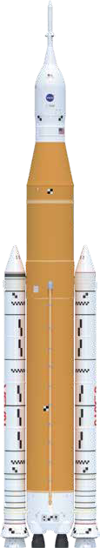







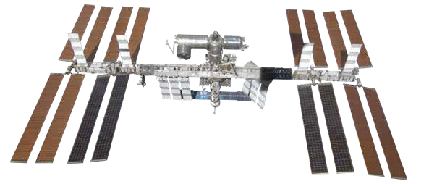
Marshall Space Flight Center
Materials & Processes Laboratory
M&P operates across the entire life cycle of space,
from lab-scale development to production of Full-Scale Flight Hardware
Capabilities Benefits
Hardware, Processes, and Materials Development
Combined Space Environmental Effects Testing
Full Scale Flight Hardware Manufacturing – composite, additive, metallic
Production support through Non-conformance resolution
Full suite of Materials Diagnostics, Non-destructive Evaluation, and Failure Analysis capabilities
World renowned aerospace materials, processes, and manufacturing expertise
Workforce and facility flexibility to meet customer needs
Track record of flight hardware delivered ahead of schedule and on-budget
Solutions to production and materials issues that support and maintain project schedules
M&P provides Products, Solutions, and Services for
Government, Commercial, and Academia

Slide 3
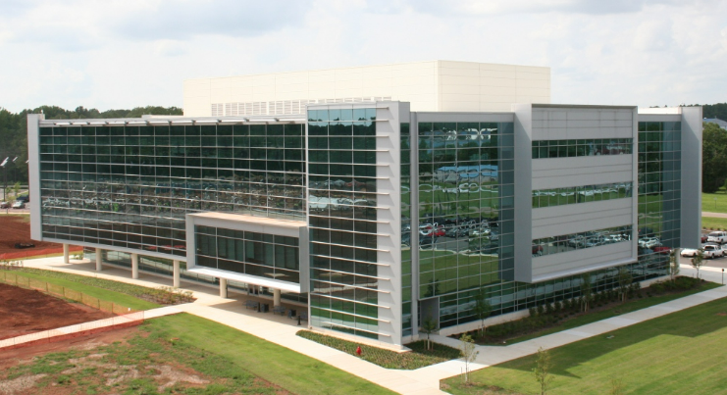
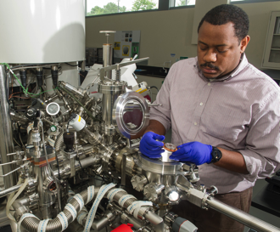
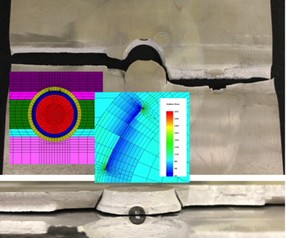
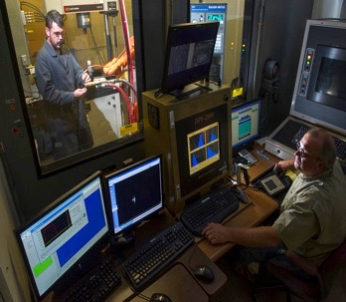
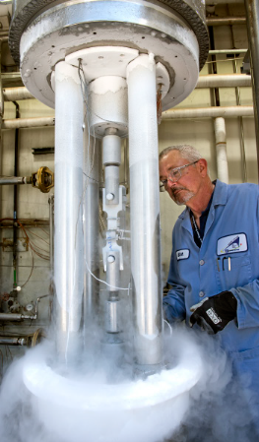
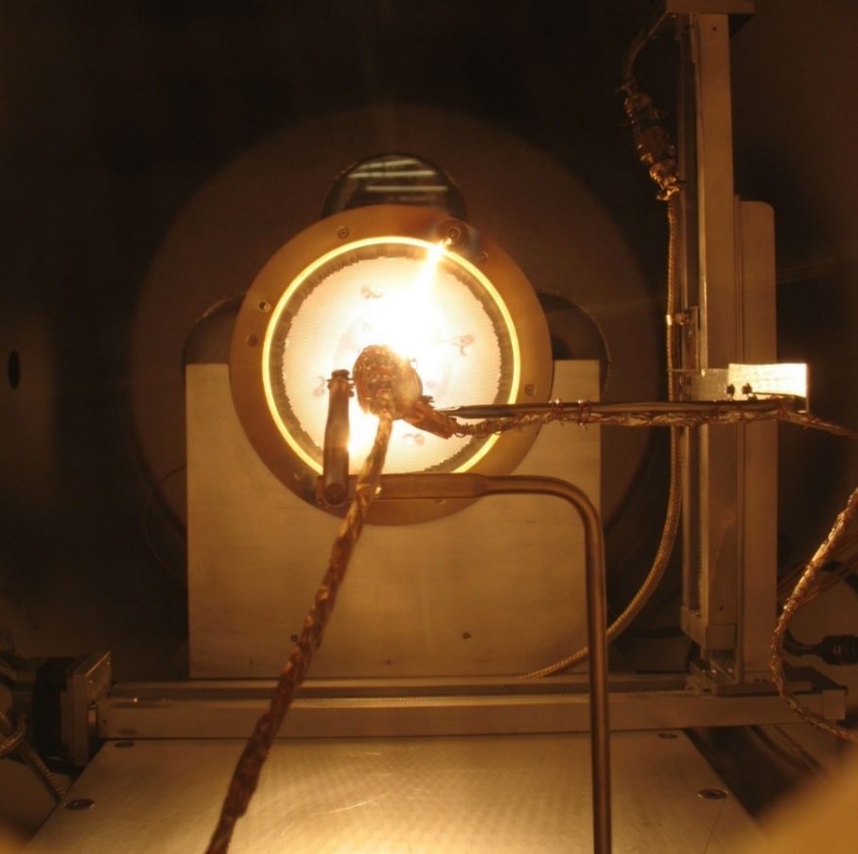
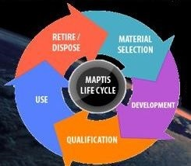
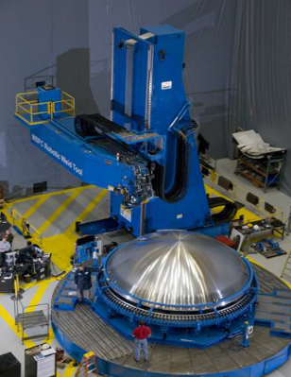
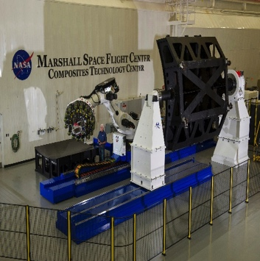
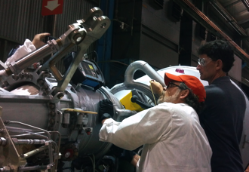
Materials & Processes Laboratory
Red Font = Agency uniqueness or leadership
Laboratory Metrics
Testing & Environmental
Effects
Damage Tolerance
Metallic M&P
Nonmetallic
M&P
Materials Selection, Control, & Engineering Support
Materials Requirements, MUAs, MIULs
Materials Selection
M&P Controls
Contamination & Foreign Object Debris Control
Materials Obsolescence
2 Offices
3 Divisions
6 Branches
~ 150 Civil Servants
~ 170 On-site Contractors
18 Unique Facilities
Metallurgical Engineering
Materials Diagnostics & Failure Analysis
Metals Process Development
  Corrosion
Damage Tolerance Determinations
Fracture Control Board
Fracture Control
& Analysis
Fatigue & Fracture Test Data Assessment
Polymers & Composites Test and Application
Ceramics & Ablatives
Cryogenic insulation
TPS Process Development
Metals Manufacturing
Materials Science
Composites Manufacturing
Non-Destructive Evaluation
Microgravity (μg) Flight Experiment Development
Space, Life and Physical Sciences /MaterialsLAB
Focus on: Metals, Glasses, Polymers, Semiconductors, Bio-materials, Ionic Liquids
μg Simulation Systems
  Electrostatic Levitator
  Furnaces
Mechanical Property Testing
Hydrogen Testing
Tribology
Metrology
Analytical Chemistry
Space Environmental Effects Testing
Debris & Weather Impact Testing
Flight Experiments
Materials Data Management & Availability
Non-Destructive Evaluation(NDE)
Inspection Process Development & Application
  Solid State Welding
  Large Scale Process Development / Tooling & Manufacturing
Fiber Placement Robot
Additive Mfg
Digital Mfg Support
MAPTIS – Agency asset
Physical Sciences Infomatics (PSI)
Materials Database Management

