Slide 1
Data-Driven Turbulence Modeling: Summary and Outcomes of the 2022 NASA Symposium
Chris Rumsey and Gary Coleman
NASA Langley Research Center

Slide 2
Outline
Introduction and overview of the symposium
State of Reynolds-averaged Navier-Stokes (RANS) modeling and role of Machine Learning (ML*)
Applications of ML to RANS
ML in transition modeling
The Collaborative Testing Challenge
Summary and next steps
*Note: throughout the talk, the terms ‘ML’ and ‘data-driven methods/modeling’ are used interchangeably. Although ‘ML’ is probably more widely used and recognized, ‘data-driven methods/modeling’ is broader, more inclusive, and more descriptive of the actual process.

Slide 3
Introduction and Overview
The 2022 NASA Symposium on Turbulence Modeling (Suffolk, VA) was a follow-on to an earlier 2017 turbulence modeling symposium (Ann Arbor, MI) (NASA/TM-2017-219682)
Purpose of both:
  Bring experts together to discuss the current state and future prospects/directions of turbulence modeling
  In 2017, a major emphasis was on the fundamental question of whether RANS modeling has reached an ultimate barrier; are substantial improvements possible? If so, what/how?
  In 2022, the emphasis was shifted more to: can data-driven techniques like ML play a role in accelerating turbulence modeling development and improvement? (transition modeling was also included)

Slide 4
Some details from 2017 Symposium
No clear consensus emerged regarding the ‘ultimate barrier’ question
RANS modeling efforts have significantly diminished in recent years, so better coordinated efforts are needed going forward
Better coordination is also generally needed between model developers and experimentalists
Improved Uncertainty Quantification (UQ) capability is needed
Turbulence research needs to be better positioned to take advantage of High-Performance Computing (HPC) breakthroughs
Data-driven efforts would benefit from benchmark datasets and results

Slide 5
Recommended next steps from 2017 symposium
Devise turbulence modeling research roadmap (particularly for RANS)
Establish common site for DNS/LES dataset repository
Better cataloging/tracking of experimental datasets
Establish benchmark problems/practices to help develop and evaluate data-driven turbulence models
Hold follow-up symposia and workshops
The AIAA Vision 2030 Integration Committee (IC) should look at needs and opportunities for RANS research, trying to maintain a balance between RANS and LES related research

Slide 6
Since 2017
HiFi-TURB effort in Europe
  Developing high-fidelity LES/DNS data for a range of benchmark flows
  Using it to train turbulence models with ML tools
Exponential explosion in use of ML in many fields
Number of
ML-related
publications
(notional)
Year

Slide 7
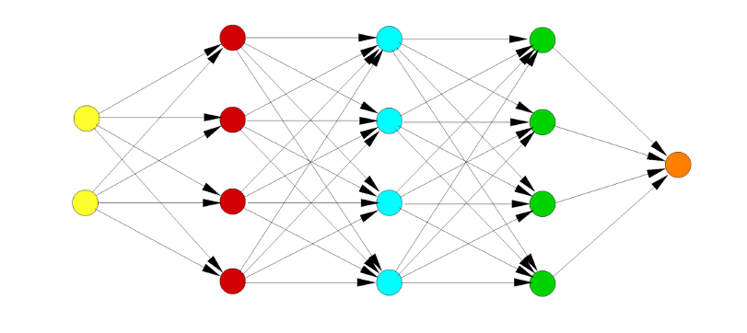
PRS2022*
All this led to the desire to hold the 2022 Symposium, which had two main themes:
  Identification of critical issues for RANS models, as well as possible ways forward
  A ‘Collaborative Testing Challenge’ for data-driven RANS models
*The 2022 Symposium was nicknamed ‘PRS2022’ because it was also held in honor of Philippe R. Spalart’s contributions to the turbulence modeling field.

Slide 8
PRS2022
Held July 27-29, 2022 in Suffolk, VA
25 participant talks
5 keynote talks
3 panel discussions
Total attendance: over 80, in-person only
  45% from academia
  45% from national or military labs
  10% from industry
Representation from US, Australia, Germany, Netherlands, Belgium, Japan, France, and South Korea
Website: https://turbmodels.larc.nasa.gov/turb-prs2022.html
  Includes slide presentations from the Symposium and (for a limited time) videos of some of the talks/discussions

Slide 9
Purpose of this talk
Distill key points from the symposium
Show some results from the Collaborative Testing Challenge
Suggest next steps (path forward) for Data-Driven Turbulence and Transition Modeling (DDTTM)

Slide 10
State of RANS modeling and role of ML

Slide 11
A central question
Still no agreement on whether an ‘ultimate barrier’ to RANS exists, and if so, if we have hit against it yet
However, most agree that RANS progress is incrementally slow
Since turbulence modeling progress via the human brain appears to be mostly incremental, can this impasse be overcome through the use of data-driven/machine-learning technologies?

Slide 12
Spalart Keynote #1
Purpose: provide guidance, from a turbulence modeler’s point of view, for ML practitioners, including describing pitfalls, needs, and constraints when creating or improving turbulence models
Specific advice:
  A general-purpose model that ‘tries to do everything’ is needed. Perfection is not required, but stability and sensible results are.
  The simple flat-plate/zero-pressure-gradient boundary layer should not be sacrificed.
  Any model should respect Galilean invariance and independence of the direction of the axes.
  Any model needs robustness, plus attention paid to the turbulence in a mature vortex and near the edge of a turbulent region.
  Avoid acceleration and pressure-gradient dependence.

Slide 13
Spalart Keynote #1 (cont’d)
Will ML be the ‘architect’ of a new model, or only in charge of subtasks (such as adjusting constants)?
To date, no general-purpose ML-based model has even been produced, much less found to be successful.
  The RANS application community needs fully published models that can be easily tested by others.
  There is a strong desire for universal models, in the sense that they can be used by anyone and applied to as many flows as possible without concern for unusual or detrimental behavior.
  To be clear, ‘universal’ in this context does not mean that the model can predict every type of flowfield well, but rather that it makes improvements in at least some key areas (such as for separated flows), while doing no harm in others.

Slide 14
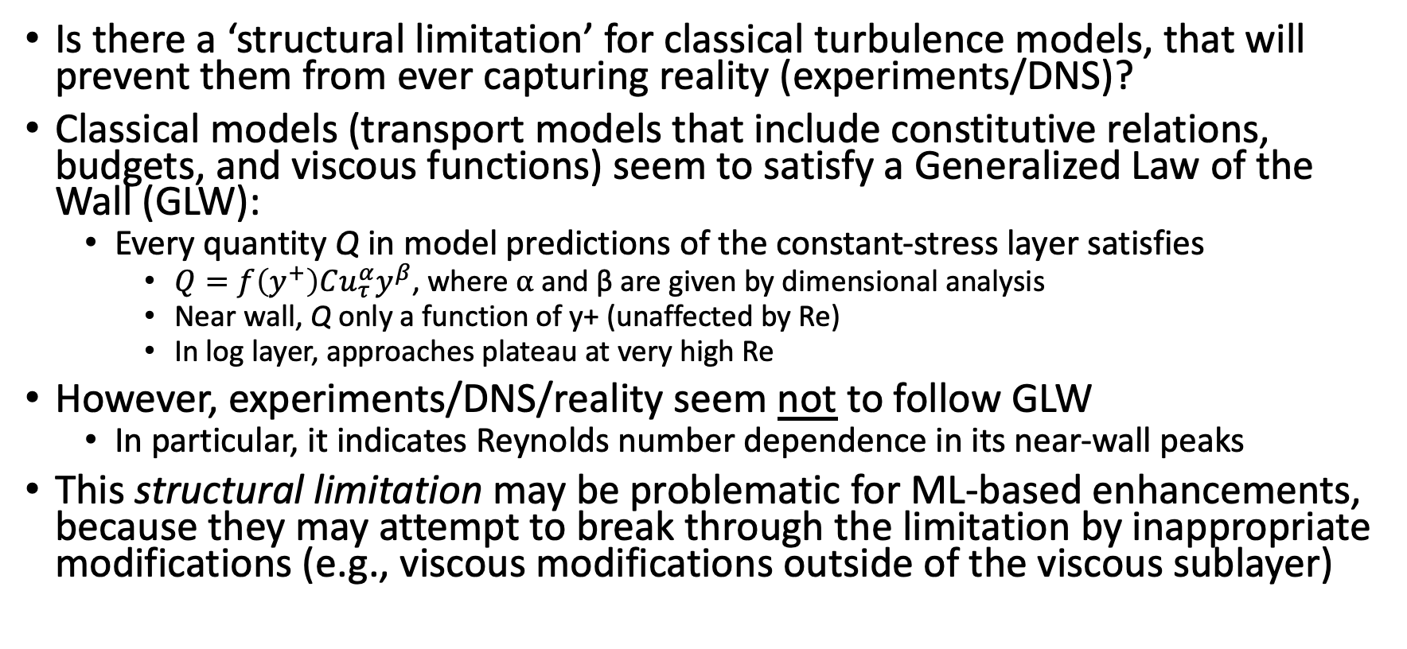
Spalart Keynote #2
Is there a ‘structural limitation’ for classical turbulence models, that will prevent them from ever capturing reality (experiments/DNS)?
Classical models (transport models that include constitutive relations, budgets, and viscous functions) seem to satisfy a Generalized Law of the Wall (GLW):
  Every quantity Q in model predictions of the constant-stress layer satisfies
    $Q=f\left(y^{+}\right)Cu_{τ}^{α}y^{β}$, where ⍺ and β are given by dimensional analysis
    Near wall, Q only a function of y+ (unaffected by Re)
    In log layer, approaches plateau at very high Re
However, experiments/DNS/reality seem not to follow GLW
  In particular, it indicates Reynolds number dependence in its near-wall peaks
This structural limitation may be problematic for ML-based enhancements, because they may attempt to break through the limitation by inappropriate modifications (e.g., viscous modifications outside of the viscous sublayer)

Slide 15
Spalart Keynote #2 (cont’d)
Q⁺
Re
Reality
y⁺
Q⁺
Same results near wall
Plateau in log layer
Re
Classical models / GLW
y⁺

Slide 16
Huang Keynote
Questions:
  Can ML be made less dependent on the geometry of the training flows?
  Can ML-based corrections be rationally extended to high Reynolds numbers (since DNS and LES only offer low-Reynolds-number training data)?
  Can ML retain its ‘memory’ (i.e., build on previous success, rather than having to retrain from scratch)?
  To what extent can ML capture actual flow physics?
  Can ML satisfy asymptotic behaviors of benchmark flows?
    E.g., the log law is an ‘anchor point:’ ML should always ensure that it is satisfied
Huang’s ‘Grand Challenge’:
Can ML-based models independently recreate the log law ‘from scratch,’ solely from experimental
or numerical data, with no a priori assumptions?

Slide 17
Huang Keynote (cont’d)
Flow Physics examples:
‘Slingshot effect’: DNS, LES, and experimental flow physics data indicate higher turbulent shear stress levels for smooth-body separated shear layers than predicted by RANS models
Vortex flows: turbulence in a rotating pipe

Slide 18
RANS modeling panel
Philippe Spalart, moderator
Paul Batten (Metacomp Technologies)
Paul Durbin (Iowa State University)
Charles Hirsch (Cadence-Belgium)
Brian Smith (Lockheed-Martin)
Offline comments from Florian Menter (ANSYS) and Michael Strelets (NTS)

Slide 19
RANS modeling panel: Questions
Is there stagnation in RANS turbulence modeling?
Some said yes, some said no
For those who said no, all agreed that RANS turbulence modeling progress has always been slow/incremental
  Menter: ‘RANS turbulence modeling is like a turtle – it does not move when you watch it, but over time it can cover significant distances.’

Slide 20
RANS modeling panel: Questions (cont’d)
Does it matter?
More researchers are moving toward the use of scale-resolving simulations (SRS)
  In general, more accurate than RANS, but more expensive
  SRS are increasingly affordable because of increasing computational power, but still out of reach for many applications, especially at very high Re
  RANS models are also an essential component of many SRS methods (near-wall region)
So yes, RANS models still do matter, and will for the foreseeable future

Slide 21
RANS modeling panel: Questions (cont’d)
What activities, including ML, can cause a breakthrough?
While most of the panelists agreed that data-driven methods offer the potential for some improvements, they typically gave ML little hope for producing a groundbreaking leap forward, particularly while remaining in the conventional (‘classical’) RANS modeling framework
Brute-force data crunching may not be sufficient for turbulence modeling; appropriate intelligence/wisdom needs to be ‘baked into’ the ML
Are we clinging to old, unnecessary RANS paradigms?
  If we did not already have RANS and instead were starting with ML, what would we do to create predictions for turbulent flows?

Slide 22
Applications of ML to RANS

Slide 23
Sandberg Keynote
Gene Expression Programming (GEP)
  Produces models that are interpretable, analytic functions
  Improvements in the form of a Reynolds-stress tensor model
  His examples were primarily for turbomachinery applications
  Assessment of training candidates involves a RANS CFD solution, so any unstable or unsuitable model functions are automatically eliminated

Slide 24
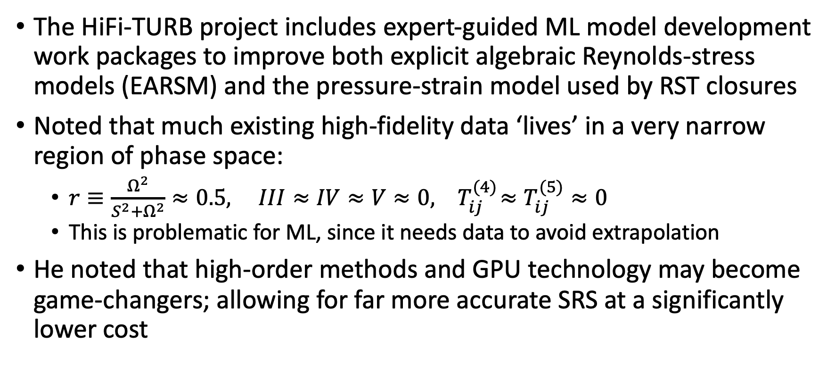
Hirsch Keynote
The HiFi-TURB project includes expert-guided ML model development work packages to improve both explicit algebraic Reynolds-stress models (EARSM) and the pressure-strain model used by RST closures
Noted that much existing high-fidelity data ‘lives’ in a very narrow region of phase space:
  $r≡\frac{Ω^{2}}{S^{2}+Ω^{2}}≈0.5, III≈IV≈V≈0, { T}_{ij}^{(4)}≈T_{ij}^{(5)}≈0$
  This is problematic for ML, since it needs data to avoid extrapolation
He noted that high-order methods and GPU technology may become game-changers; allowing for far more accurate SRS at a significantly lower cost

Slide 25
ML Panel
Karthik Duraisamy, moderator
Andrew Banko (West Point)
Paola Cinnella (Sorbonne University)
Richard Dwight (TU Delft)
Sharath Girimaji (Texas A&M University)
Robert Moser (University of Texas at Austin)
There were many questions, suggestions, and challenges raised by the moderator, shown in the following slides

Slide 26
ML Panel: Questions
Do we even have the right descriptors to have a chance at succeeding (do we need structure tensors)?
How can we rationally isolate/combine the impact of different nonlinear phenomena (e.g., separation, secondary flows, pressure gradients, curvature) in model construction?
How to identify the right set of (hard and soft) constraints that should be satisfied? (cannot be under- or overconstrained)
How to coordinate high-fidelity simulations and experiments with model development?
How can the community work together more cohesively?
What should be the role of NASA?

Slide 27
ML Panel: Suggestions
Set goals and expectations: address the dissonance between what researchers in data-driven turbulence modeling have actually been doing and what the community thought they have been doing
Do not oversell what can be done with ML
Try to use common terminology
Show bad results (things that did not work), not just good results
The community needs more emphasis on the importance of uncertainty quantification

Slide 28
ML Panel: Challenges
Incomplete data
Lack of convergence
Irrecoverable model discrepancies
Lack of identifiability, generalizability, or interpretability
Input and output constraints

Slide 29
ML Panel: Discussion
There was pushback regarding the need for a universal (generally applicable) turbulence model: it was noted that many people do use special models for specific classes of flows (‘goal-oriented’ RANS modeling)
Fundamentally, ML is only statistics and numerical analysis/linear algebra (‘curve-fitting’)
  As a new buzz-word, ML has raised unrealistic expectation regarding what it can do
  In turbulence modeling, blind data crunching will not work; an intelligent ‘guide’ or ‘supervisor’ is needed
In turbulence, some of the biggest roadblocks to generality are:
  Nonlocality
  Its huge range of scales, its nonlinearity, and its complexity

Slide 30
Miscellaneous observations, comments, suggestions
Even in the specific field of DDTTM, there are many niches and goals; also, many different methods and techniques
  This broadness could make collaboration more challenging
  Also, less likely for a researcher to repeat, verify, and learn from others’ work
Critical importance of choosing which features to use in training
  Limitations inherent to the constraint of local, single-point closure models (but much of modern CFD relies on this constraint)
  New and creative ideas on this topic are needed
Why is there resistance to fully publish ML-based model details?

Slide 31
ML in Transition Modeling

Slide 32
Transition Panel
Paul Durbin, moderator
Karthik Duraisamy (University of Michigan)
Heng Xiao (Virginia Tech)

Slide 33
Transition Panel: Questions
Must transition models be based on data correlations?
Are data-driven methods attractive for transition modeling?
There is no theory of transition. What does this mean for analysis and modeling of transition in practice?
Intermittency models suppress eddy viscosity; e^{N} methods purport to predict transition onset. Should the paradigm be predicting transition or suppressing the turbulence model?

Slide 34
Transition Panel: Discussions
Determining transition location seems to be amenable to data-driven discovery (as opposed to a need for physics-based methodologies)
However, feature selection is still very difficult
Transition modeling is different from turbulence modeling in that it includes many nonlocal and global parameters
On the plus side, transition test cases tend to have lower Re, more within reach of DNS
On the minus side, DNS of transition must deal with very wide parameter space of the transition-inducing perturbations

Slide 35
The Collaborative Testing Challenge

Slide 36
The challenge
Try to achieve a data-driven turbulence model that works well for a fairly wide range of simple test cases:
  2DZP: 2D Zero Pressure Gradient Flat Plate Validation Case
  2DFDC: 2D Fully Developed Channel Flow at High Reynolds Number Validation Case
  ASJ: Axisymmetric Subsonic Jet
  2DWMH: 2D NASA Wall-Mounted Hump Separated Flow Validation Case
  2DN00: 2D NACA 0012 Airfoil Validation Cases (4 separate cases)
8 participants signed up for the challenge
  7 submitted results (one submitted 2 sets)

Slide 37
The participants
Participant | Method
Fang (exp) | Gene Expression Programming (GEP) optimized based on experiment
Fang (theory) | GEP optimized based on theory
Bin | Data driven fix of SA model (do no harm… protect law of the wall)
Cherroud | Separately trained EARSM models aggregated
Dwight | Baseline SST model… then trained a classifier model
Parish | Ensemble of Neural Networks (NNs) with training data other than challenge cases
Stoellinger | Human-trained model
Viswanathan | Ground truth: SA model itself
Marepally | Field Inversion Machine Learning (FIML) on SA model (S809 airfoil for training)

Slide 38
What was submitted
(Green=submitted ; Red = not submitted)
Participant | 2DZP | 2DFDC | ASJ | 2DWMH | 2DN00
Fang (exp)
Fang (theory)
Bin
Cherroud
Dwight
Parish
Stoellinger
Viswanathan
Marepally

Slide 39
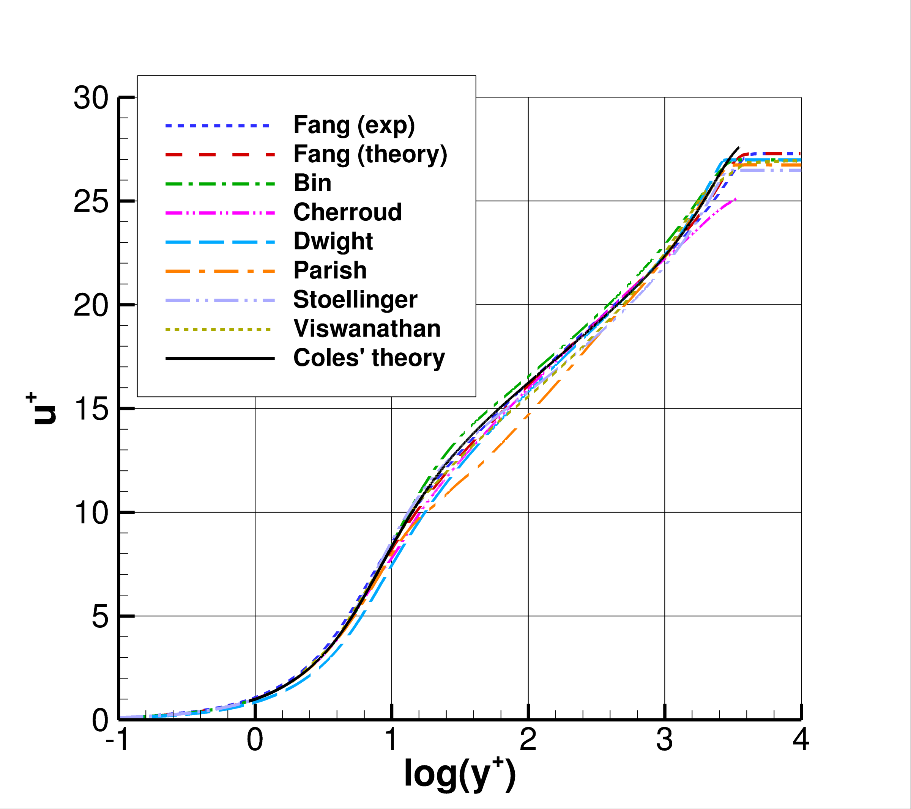
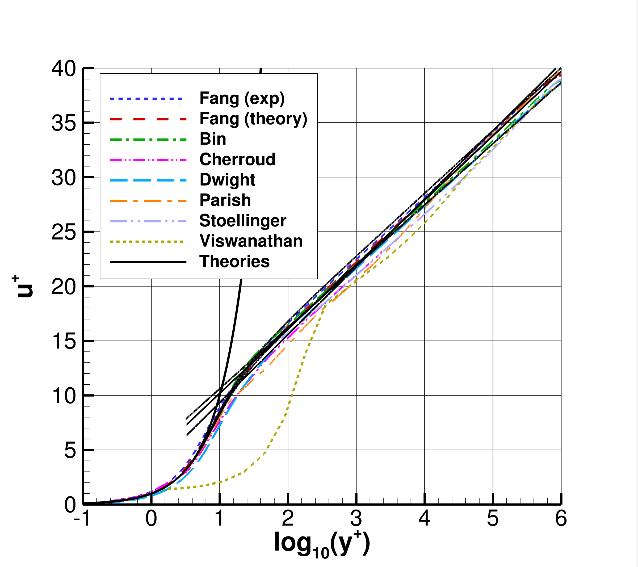
Capturing of log law behavior?
2DZP
2DFDC

Slide 40
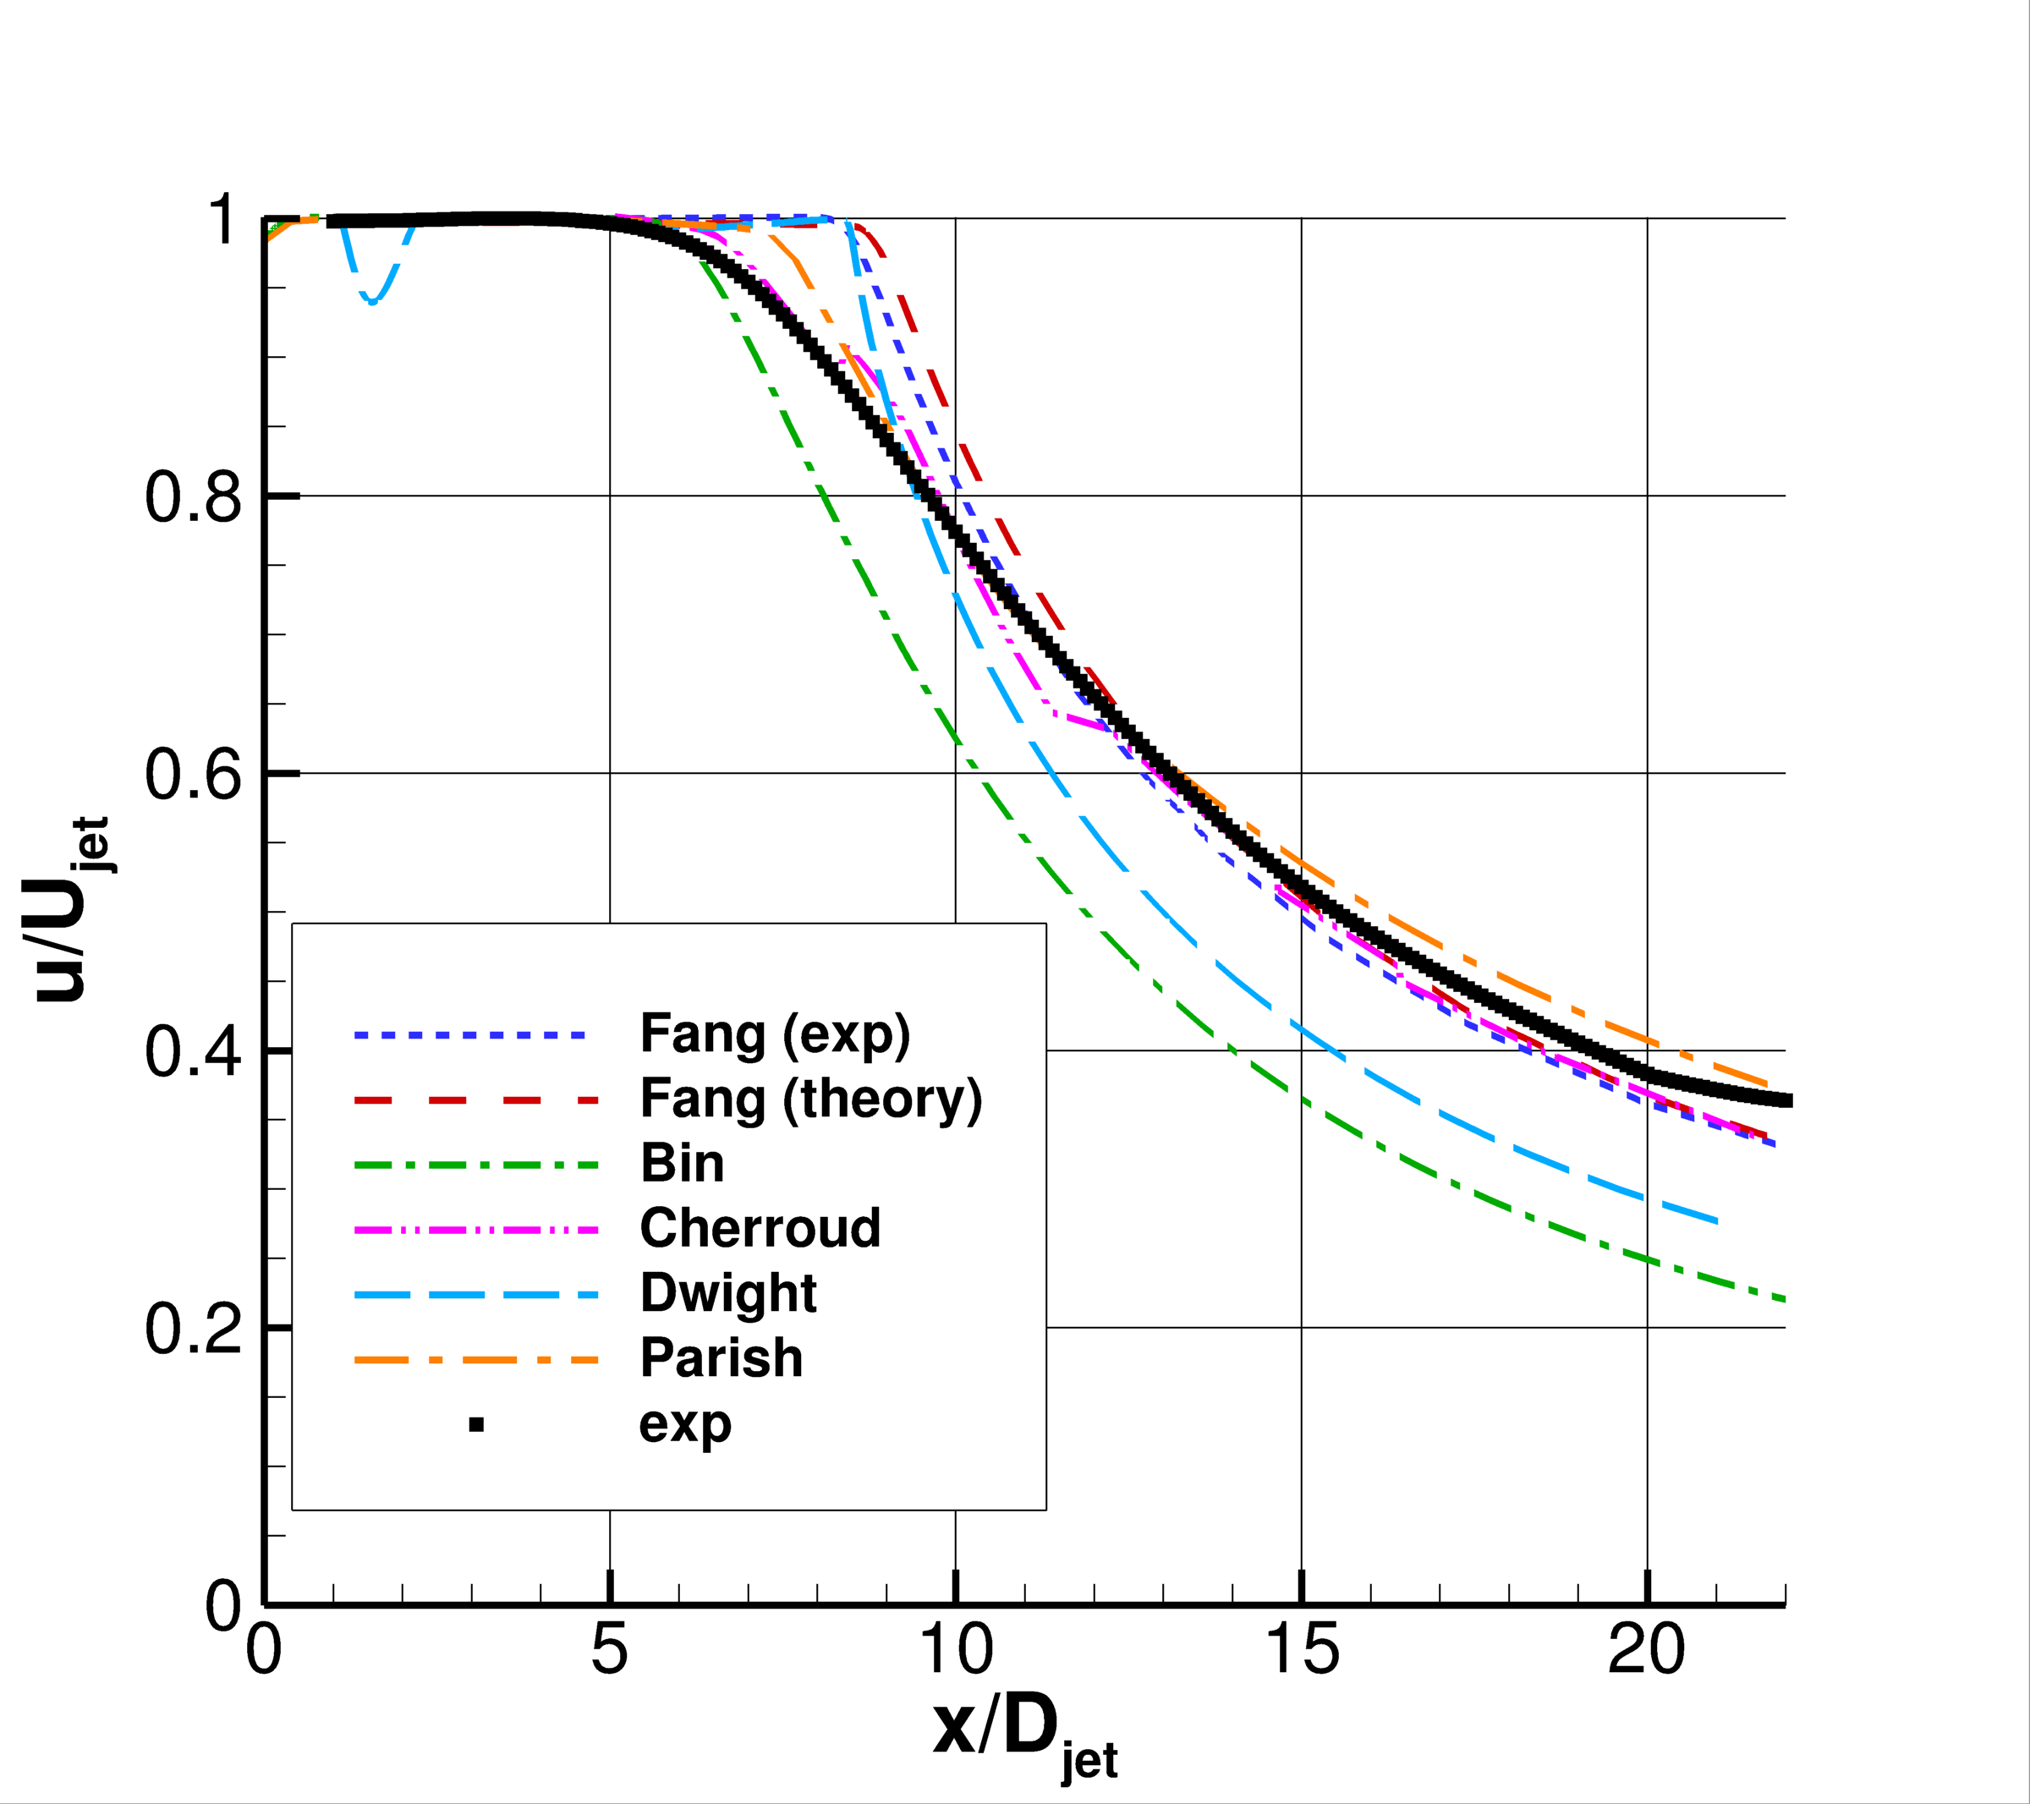
ASJ
Centerline velocity

Slide 41
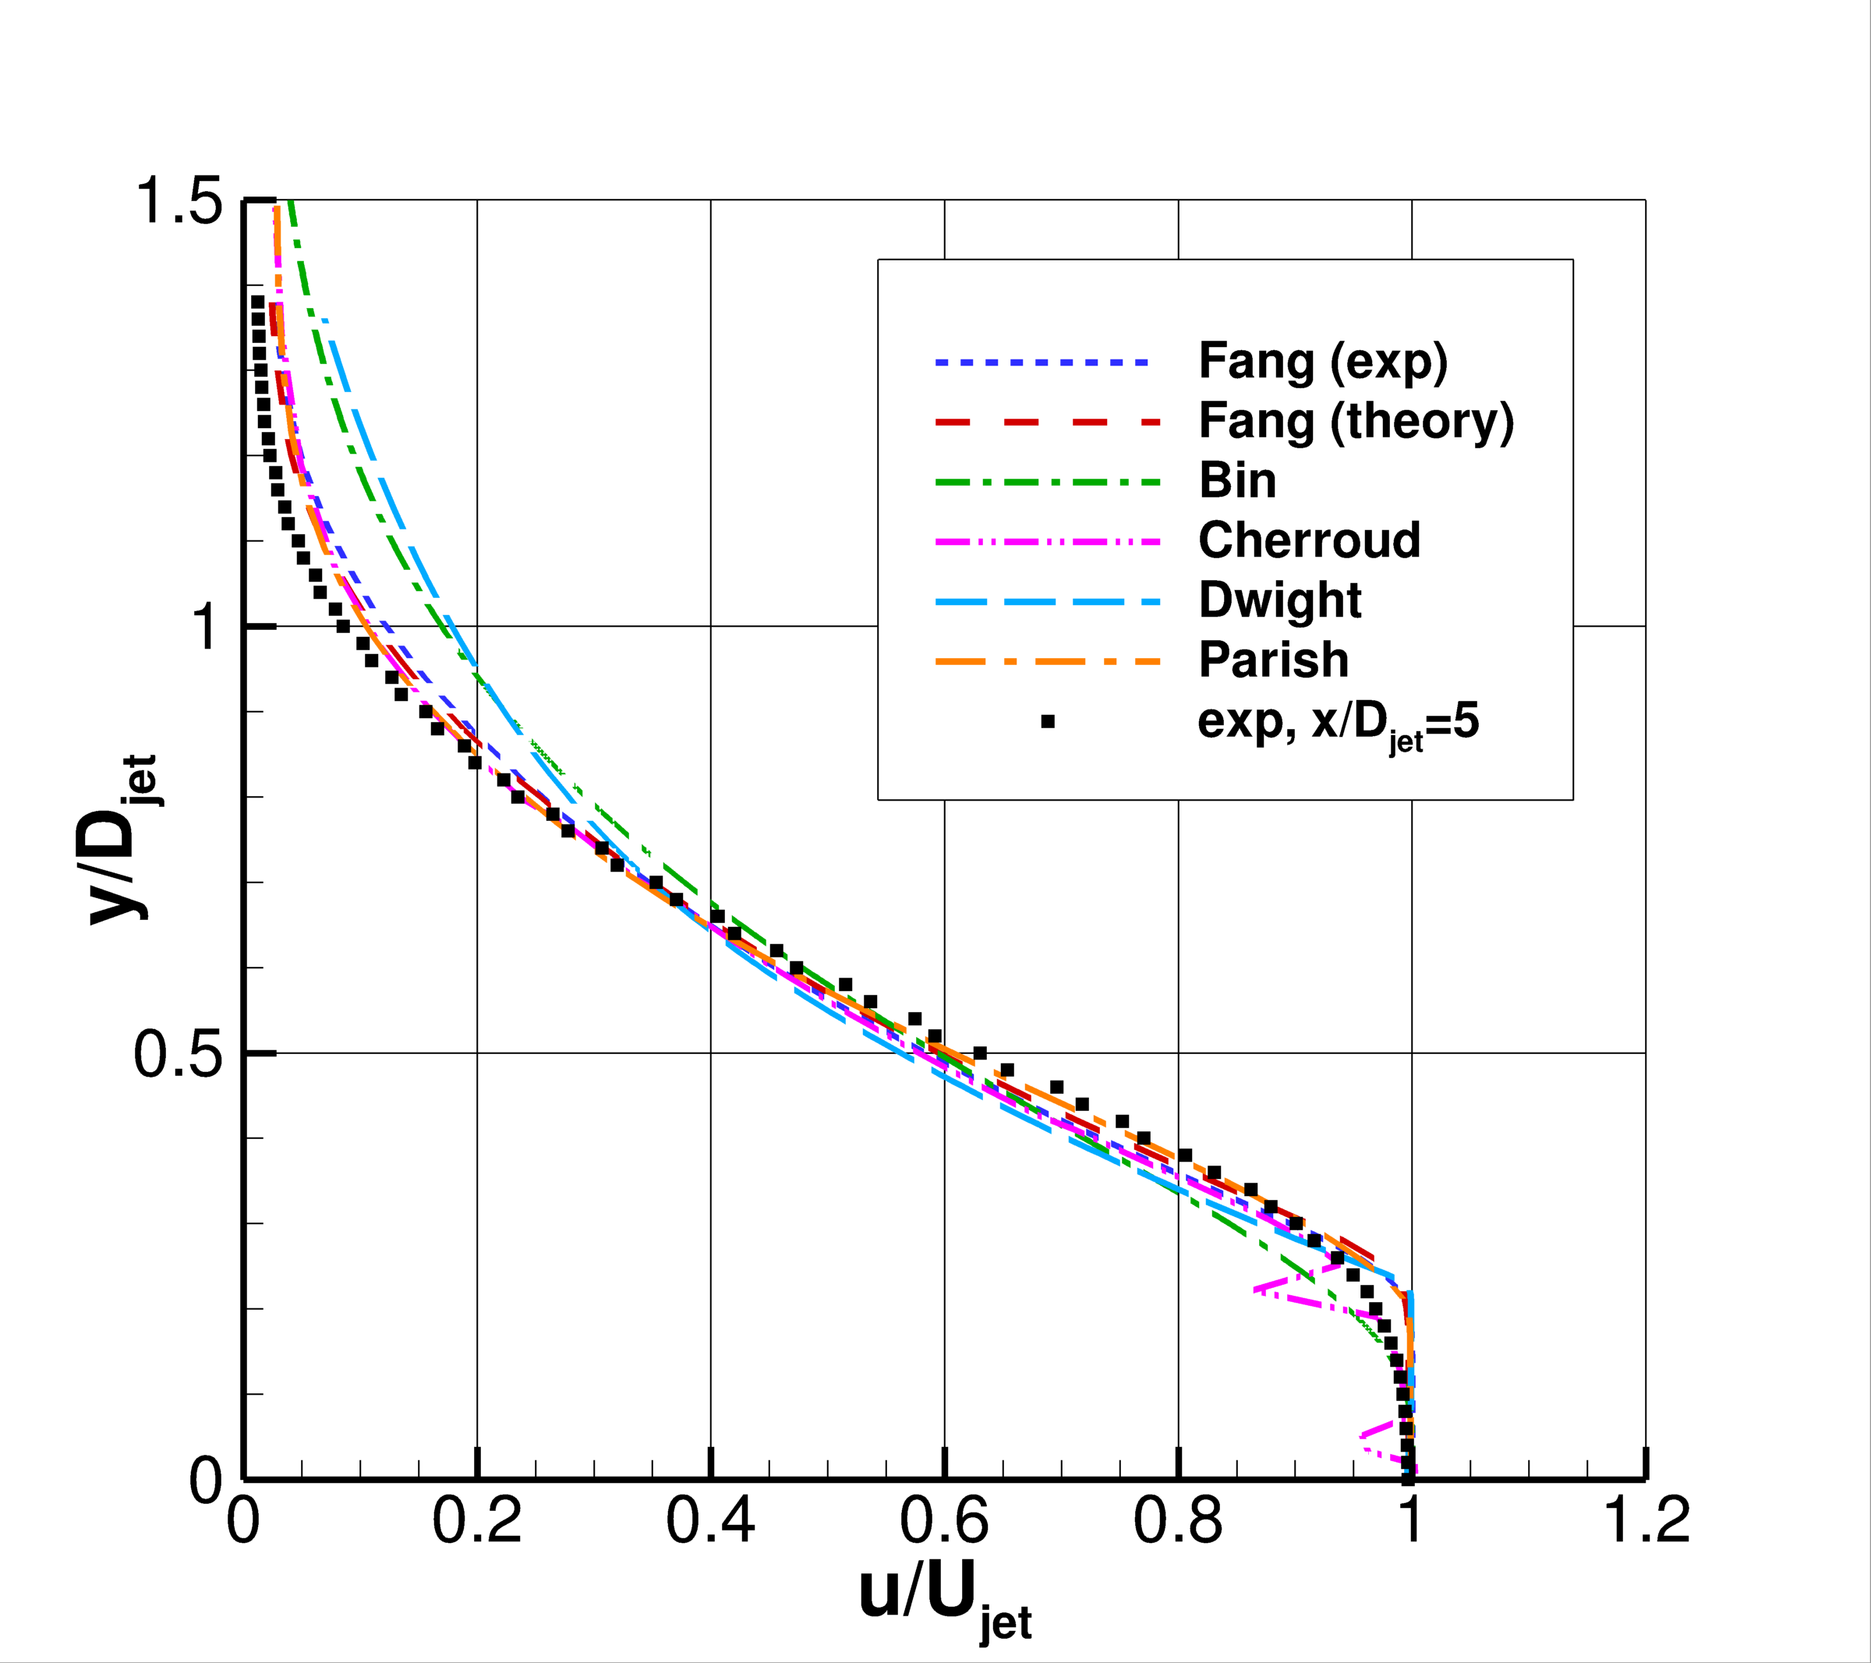
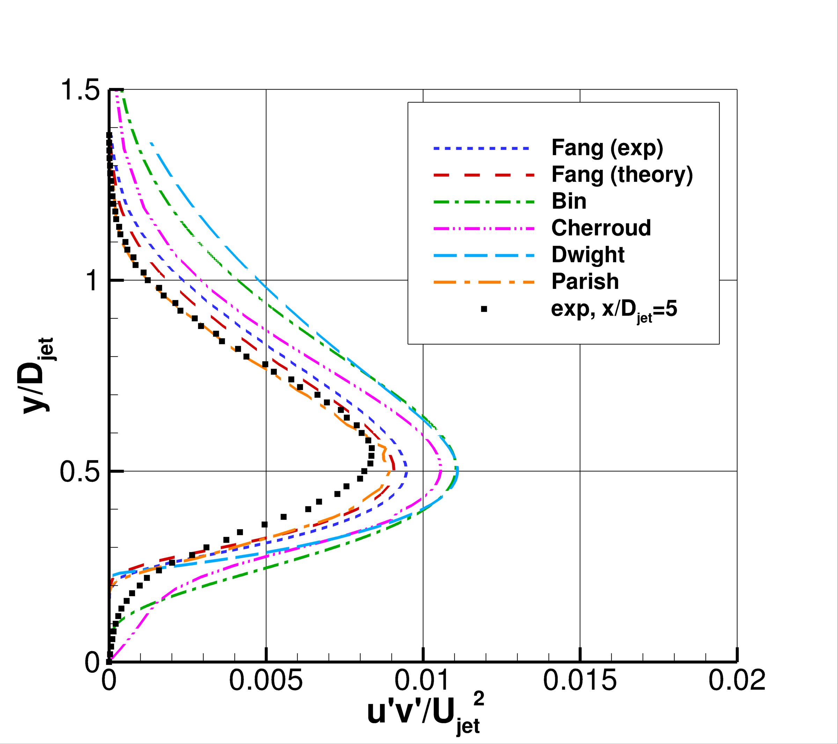
ASJ
Velocity profiles at x/D_{jet}=5
<u’v’> profiles at x/D_{jet}=5

Slide 42
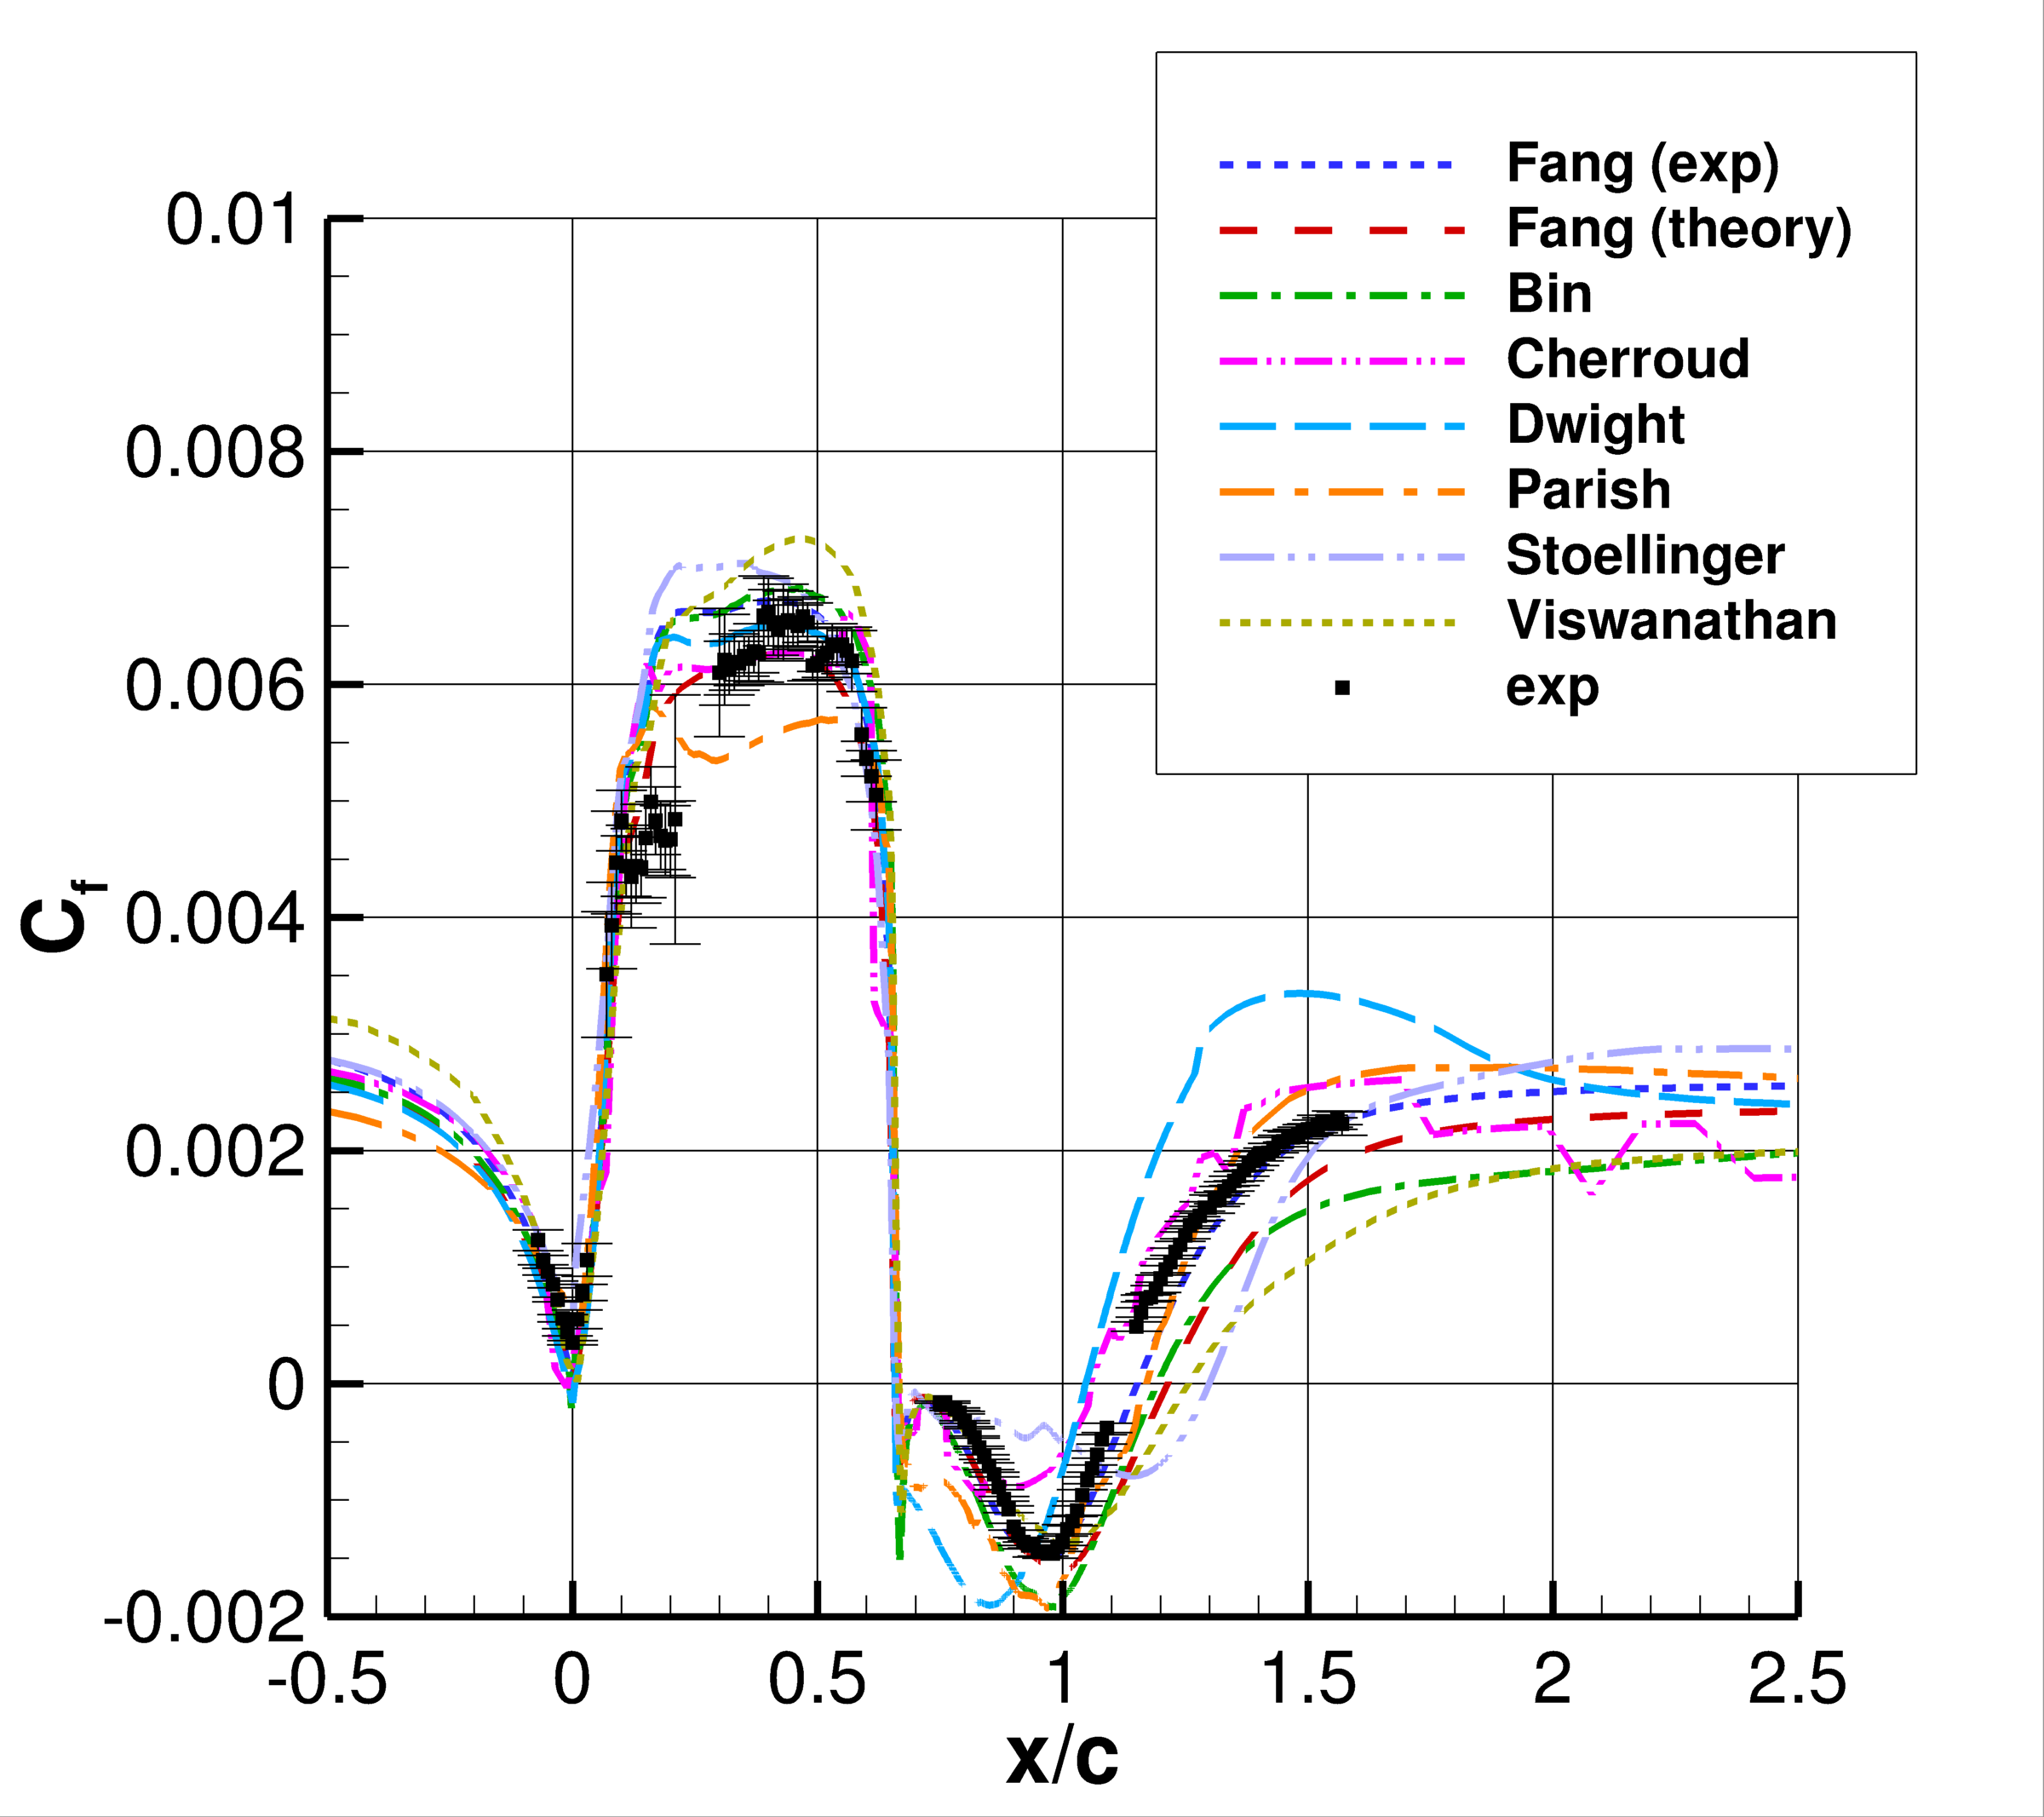
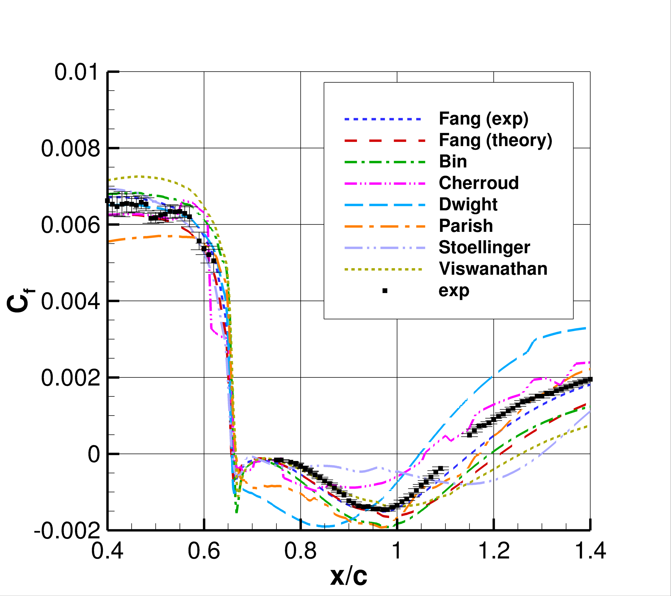
2DWMH
Skin friction coefficient
Zoom of skin friction coefficient

Slide 43
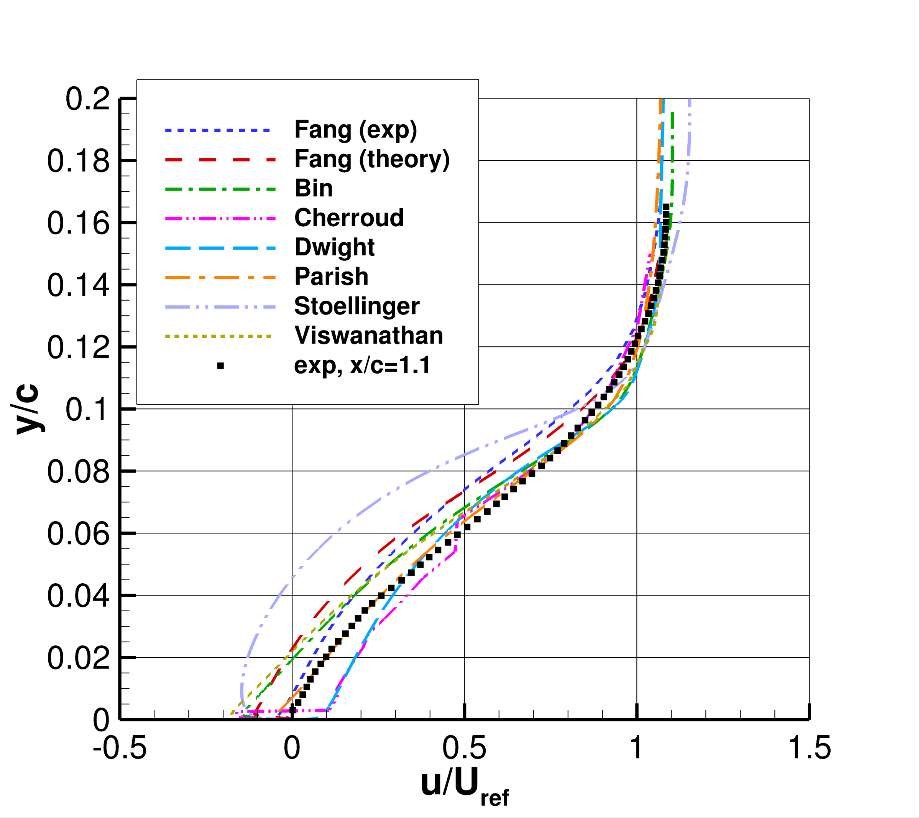
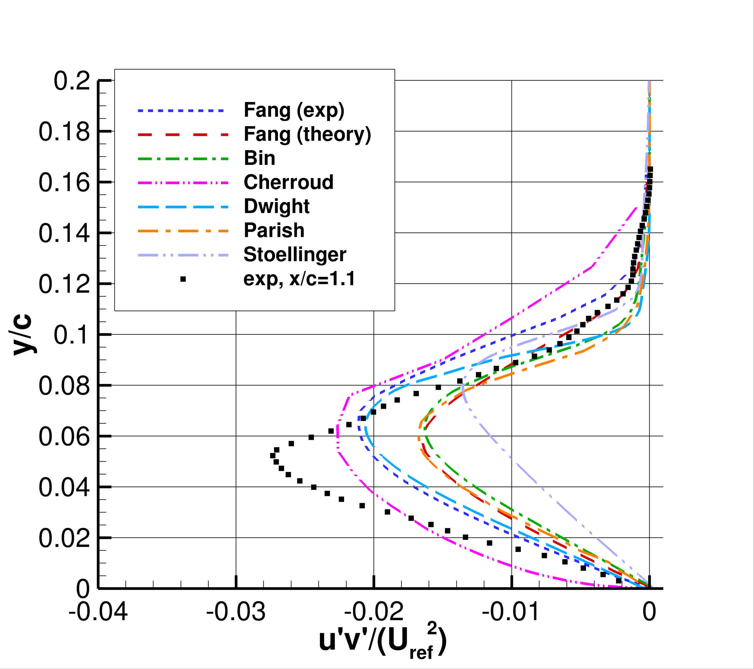
2DWMH
Velocity profiles at x/c=1.10
<u’v’> profiles at x/c=1.10

Slide 44
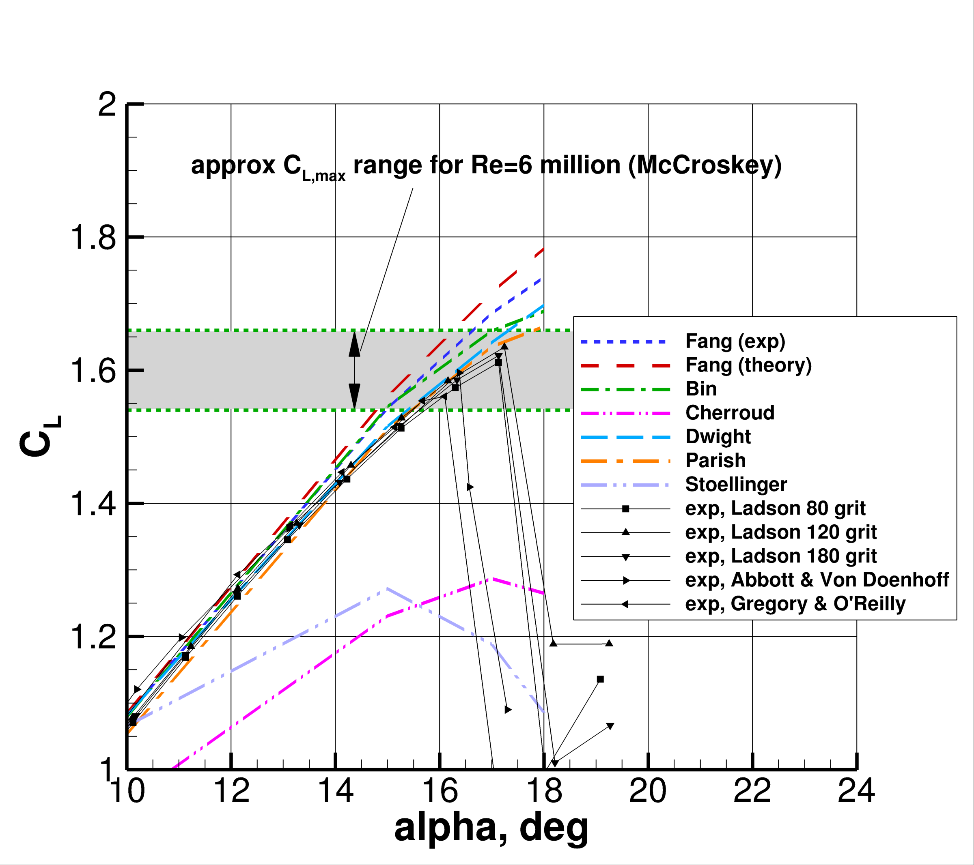
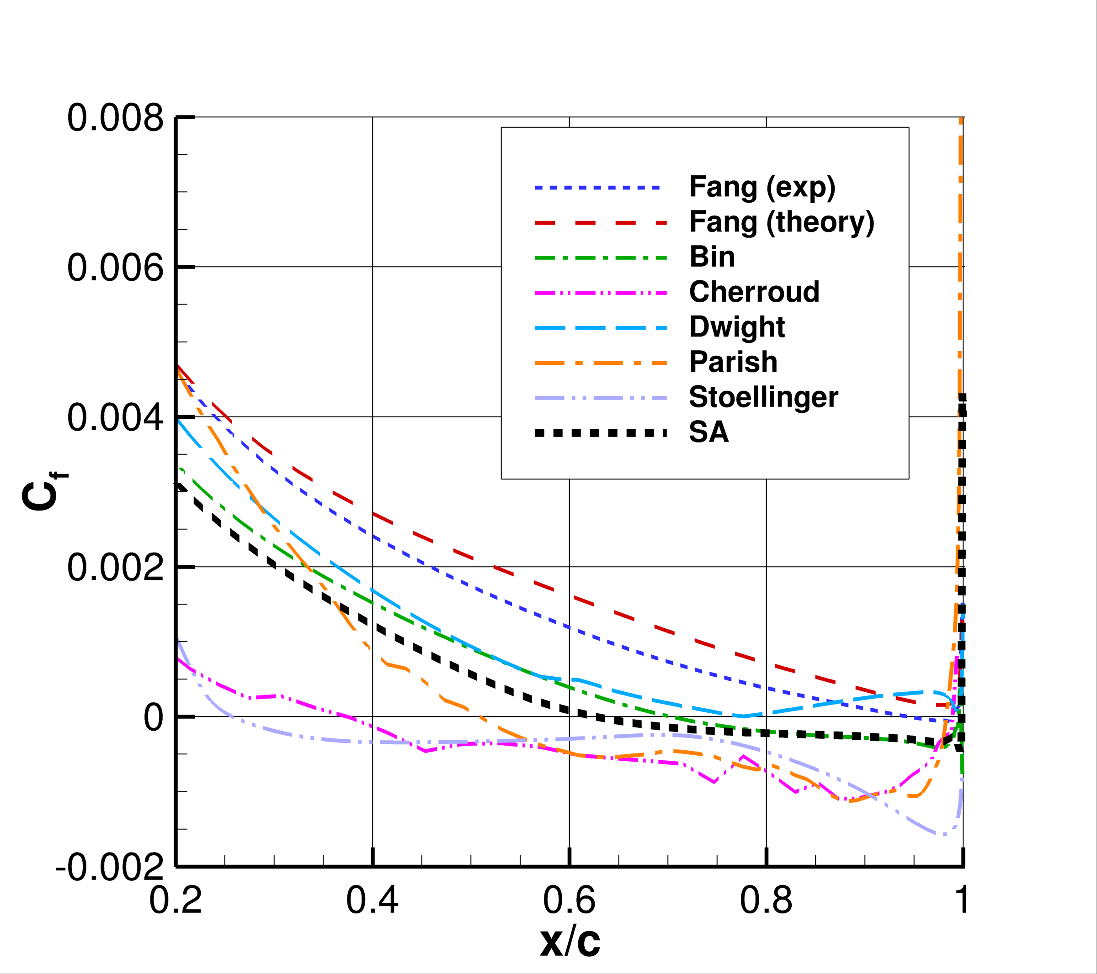
2DN00
Lift curve
Upper surface skin friction coefficient at AoA=18 deg.

Slide 45
General impressions*
Participant | 2DZP | 2DFDC | ASJ | 2DWMH | 2DN00
Fang (exp) | 🍏 | 🍏 | 🍋 | 🍋 | 🍋
Fang (theory) | 🍏 | 🍏 | 🍋 | 🌶 | 🍋
Bin | 🍏 | 🍏 | 🌶 | 🍋 | 🍏
Cherroud | 🍏 | 🍏 | 🍋 | 🌶 | 🌶
Dwight | 🍏 | 🍏 | 🌶 | 🍋 | 🍏
Parish | 🌶 | 🌶 | 🍋 | 🍋 | 🍏
Stoellinger | 🍏 | 🌶 | - | 🌶 | 🌶
Viswanathan | 🍋 | 🌶 | - | 🌶 | -
Marepally | - | - | - | - | -
🍏 = fairly good overall
🍋 = good in some aspects, worse in others
🌶 = generally less favorable
*qualitative assessment only

Slide 46
Summary of the Challenge
Difficult for the participants to perform well on all the test cases
On the plus side: participants were able to yield (generally) plausible results with a given model
But on the minus side, there was a broad range of very different solutions
In some cases, results were nonsmooth/nonphysical
Typically, a model that performed best for one case produced worse results for another
This was a valuable exercise, because seeing a variety of models and methods applied to the same problems (and plotted together) helps shed light on the state of the art

Slide 47
Summary and Next Steps

Slide 48
Summary
The emerging field of Data-Driven Turbulence and Transition Modeling (DDTTM) has a dedicated community of interested researchers
  Including turbulence modelers, ML experts, CFD coders, and practitioners
We are currently very far from speaking the same language
There have been many isolated successes of ML in turbulence modeling, but with very narrow focus
The turbulence modeling community has not received any useful ML-based model to date
  Best practices sometimes violated (out of expediency or lack of knowledge)
  Fully published details needed
  More ‘universal’ models needed

Slide 49
Next Steps
Keep symposium series going (every 2-3 years), involve new sponsors
Committee of leaders from different organizations needs to meet regularly to organize DDTTM-related events
Hold other meetings, workshops, etc. in conjunction with larger conferences
Continue the Collaborative Challenge in some form
Create online documentation website regarding this group’s activities
Start to share codes/models/architectures for better openness and reproducibility

Slide 50
Next Steps
Keep symposium series going (every 2-3 years), involve new sponsors
  Potential for a symposium to be held in Europe in 2024
Committee of leaders from different organizations needs to meet regularly to organize DDTTM-related events
  Small, informal group has initiated a few email exchanges
Hold other meetings, workshops, etc. in conjunction with larger conferences
  Possibility of new SIG in ERCOFTAC, possibility of a minisymposium at ETMM14
Continue the Collaborative Challenge in some form
  TBD
Create online documentation website regarding this group’s activities
  TMR website has page for the 2022 symposium, but not for general activities… TBD
Start to share codes/models/architectures for better openness and reproducibility
  TBD

