Slide 1
Propulsion Systems Department Capabilities
Thomas M. Brown Ph.D.

Slide 2
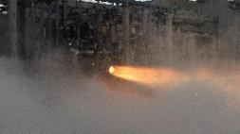

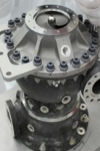
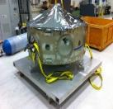

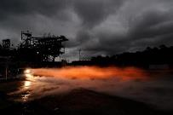
Liquid Propulsion Capabilities at MSFC
Liquid Systems Design & Integration Capability Areas
Spacecraft and Integrated Vehicle Propulsion Systems Design and Development
Engine Systems
Valve, Actuators, and Duct Design, Analysis, & Testing
Turbomachinery and Combustion Devices Design, Analysis and Advanced Development
Liquid Propulsion System Modeling and Simulation
Main Propulsion Systems and Cryogenic Fluid Management
Nuclear Thermal Engine Systems
Liquid Propulsion Capabilities:
Design, development, analysis and test expertise for spacecraft/stages systems (MPS, RCS, Tanks, Prop Management/Slosh) pump fed and pressure fed (monopropellant and bipropellant and green )
Design, development, engine/component analysis (steady and transient), and test expertise for various engine systems with multiple propellants
Pioneers in the use of advanced manufacturing techniques for propulsion applications (Vales, Ducts,Turbomachinery, Injectors, Chamber, Nozzles, Ducts, and CFM Components)
In-Depth Capabilities in component design, development, technology maturation for all types of propulsion systems ( Valves, Turbomachinery, Combustion Devices)

Slide 3

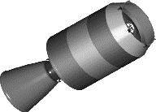
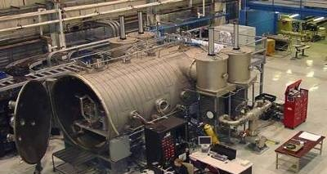
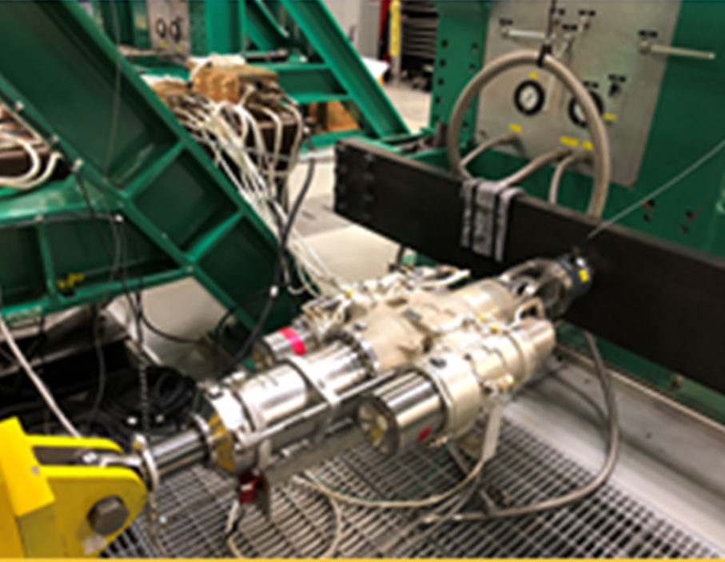
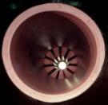
Solid Propulsion, Thrust Vector Control & Advanced Capabilities at MSFC
Solid Systems, TVC, & Advanced Propulsion Capability Areas
Solid Propulsion Systems Development and Integration
Solid Motor Design & Analysis
Separation & Maneuvering Solid Systems Design & Development
System Ballistic Analysis
Thrust Vector Control Systems, Components &Testing
Propulsion Research & Technology Including Test Capabilities
Nuclear Thermal Fuel Element Testing
Cryogenic Fluid Management Technologies
Solid Propulsion, TVC & Advanced Propulsion Capabilities:
Solid and Hybrid Propulsion Systems Design, Analysis, and Integration(Sounding Rocket DDTE, Launch Abort Motors, Tumbling Motor, Ullage Settling Motor, Ascent and Deorbit Motors, Radiation Effects on Propellant and Hybrids).
Detailed Design and Analytical Capabilities ( Conceptual Design/Trade Studies, Motor Component Design, Life Extension, System Ballistic Analysis, T&E, Anomaly Investigation.
Close Partnership with AMRDEC and Redstone Test Center for Solid Propellant Mixing and Motor Test Capabilities
Thrust Vector Control Systems Design, Development and Test (TVC Component/System Development and Testing in TVC Test Laboratory, and EMA’s).
Advanced Propulsion Development and Testing( NTREES Nuclear Fuel Element Test Facility and CFM Component and System DDT&E).
Orion SM Propellant Tanks

Slide 4



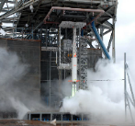
Structural, Thermal, & Fluids Analysis Capabilities at MSFC
Propulsion Structural, Thermal, & Fluids Analysis Capability Areas
Strength & Life Assessment
Dynamic Loads & Data Analysis
Flow Testing & Analysis
Computational Fluid Dynamics and Unsteady Fluid Dynamics
Thermal Analysis & Design
Detailed Design
Structural Fluids and Thermal Analysis Capabilities:
Detailed Design (Components, Subsystems, and Systems), Fabrication, Loads, dynamics, stress, fatigue, and fracture analyses for liquid engines, solid rocket motors, other propulsion components (COPV’s), and propulsion systems
Fluid Dynamics analysis and simulations for Liquid Engines, Solid Motors and Propulsion components using reduced order models, scaling, system identification, CFD, CAS and Boltzmann solvers. Products include loads environment, assessment and design solutions. (Specialty Analysis: Tank Slosh Plume Surface Interaction)
Development of vibration, acoustic, and shock design environments and test criteria
Development and integration of vibration-based engine health management algorithms and systems
Internal acoustic and combustion dynamics
Thermal analysis and design for liquid and solid systems and components, cryogenic systems, CFM & NTP modeling
Thermal imaging studies, IR assessments and diagnostics for Propulsion systems

