Slide 1
Solar Sails
John A. Carr, Ph.D.
MSFC Deputy Chief Technologist
MPF || October 25th 2022

Slide 2
Solar Photon Sails
Generating propulsion from radiation pressure – the exchange of momentum between an ultra-thin reflective ‘sail’ and electromagnetic radiation.

Slide 3
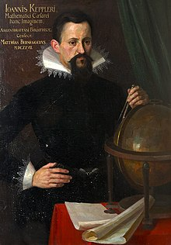
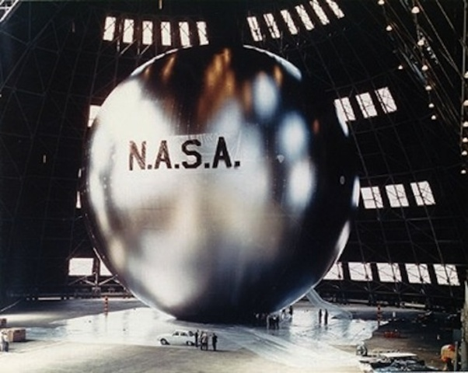
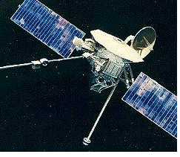
A History of Photon Sailing
a
In 1608 Kepler theorizes that ships could sail in space, powered by a solar breeze.
In 1873, James Clerk Maxwell first demonstrated that sunlight exerts a small amount of pressure as photons bounce off a reflective surface.
1970’s JPL Sail (cancelled)
1993 Znamya Mirror (fail)
1992 INSAT 2A T-Sail
2003 INSAT 3A T-Sail
1960 Echo 1
1974 Mariner 10
[and others]
A Brief History of Solar Sails | Science Mission Directorate (nasa.gov)

Slide 4
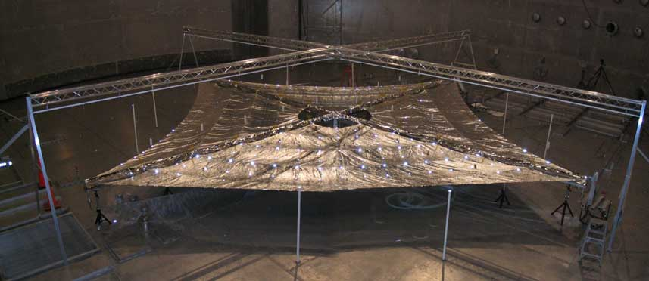
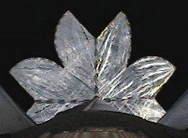
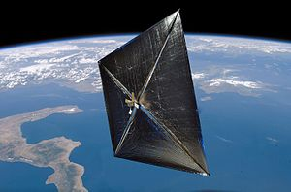
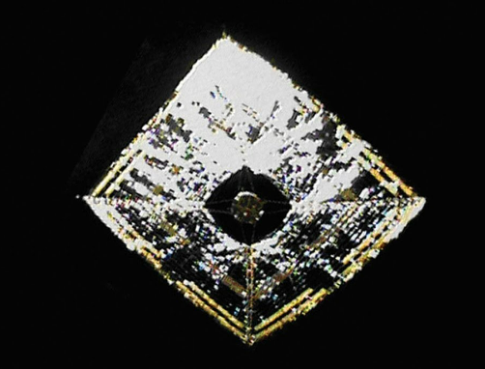
A History of Photon Sailing
2005 COSMOS 1 (600m²; vehicle lost)
2001 - 2006 NASA Ground Sails (20m² in Plum Brook)
2004 Japanese Sail (10m across; sub-orbital)
2010 Sunjammer (1200m²; Cancelled
2008 NanoSail-D (10m²; Launch Fail)
2015 LightSail-1 ; 2019 LightSail-2 (32m²)
2010 NanoSail-D2 (10m²; LEO Drag)
2010 IKAROS (196m²; heliocentric orbit)

Slide 5
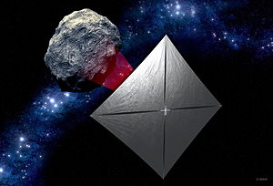
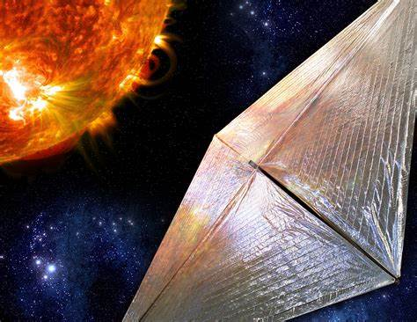
A History of Photon Sailing
a
2022 NASA NEAScout (85m² Asteroid 2020 GE – Artemis 1)
2022+ NASA Solar Cruiser (1,672m²; Sail Tech Development Only)

Slide 6
NASA+ Missions of Interest [not enabled by NEAScout or others]

Slide 7
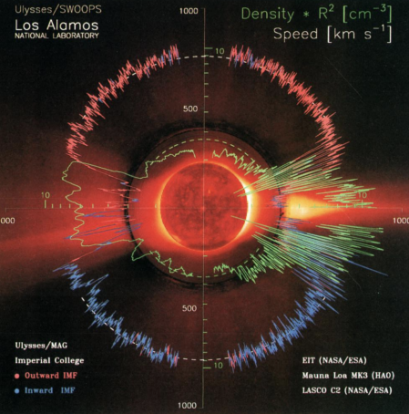
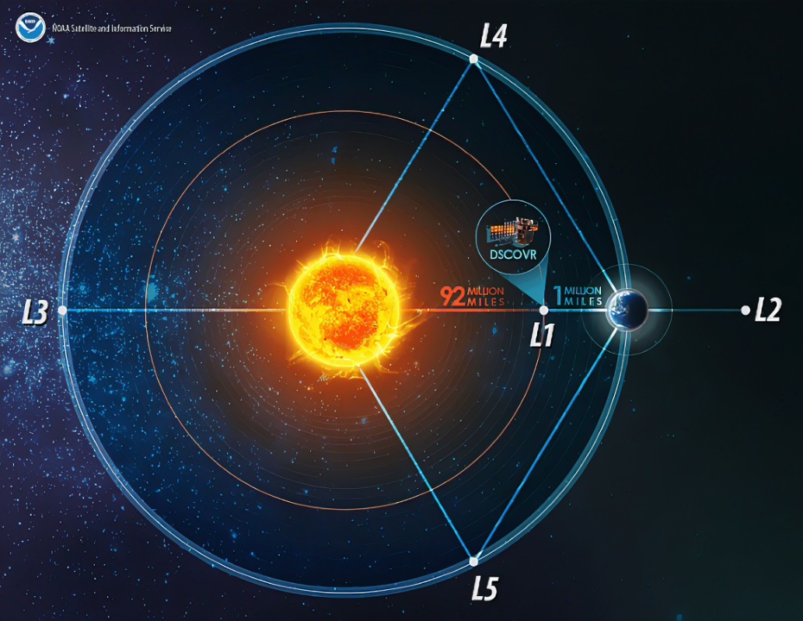
HelioPhysics
Distributed Asset High Inclination Solar: A_{c} = 0.12mm/s²
Single Asset High Inclination Solar: A_{c} > 0.17mm/s²
Sub-L1 Heliophysics and Solar Storm Monitoring: A_{c} > 0.11mm/s²

Slide 8
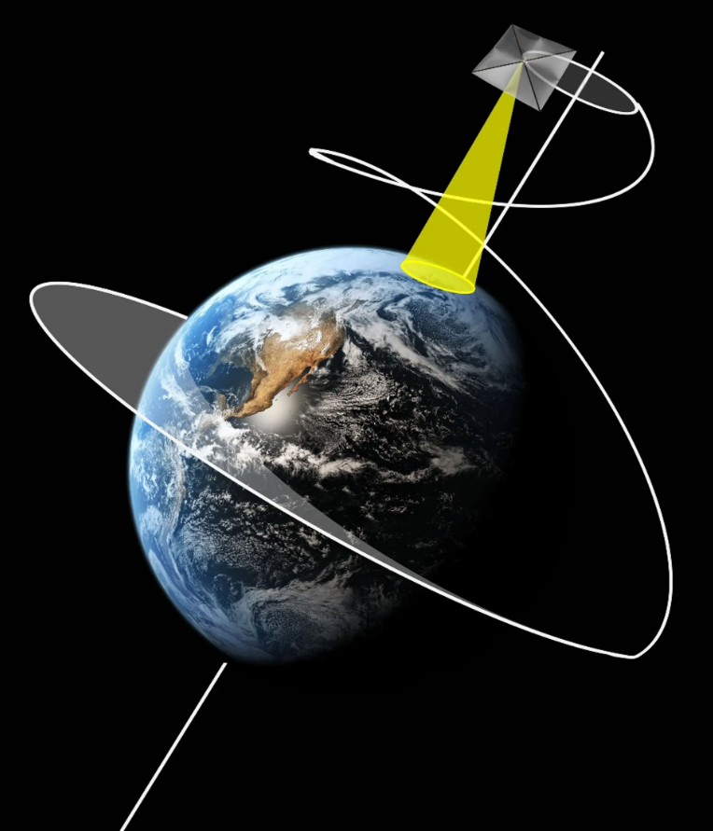
Long Duration Pole Sitters
Near-continuous Martian Polar observation: A_{c} > 0.11 mm/s²
Lunar South Pole Sitter: A_{c} > 0.11 mm/s²
Earth Polar Sitter / Magnetotail observation: A_{c} > 1.0 mm/s²

Slide 9
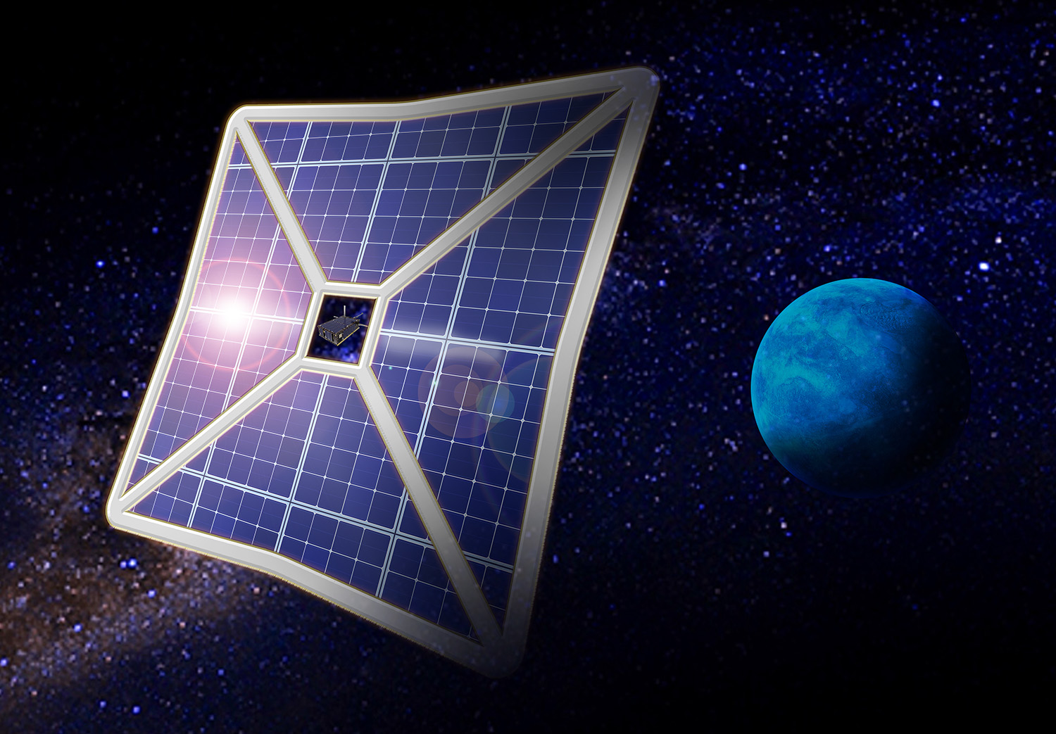
Fast Transit and Non-nuclear Science
Fast Transit to Heliopause and Beyond: >10AU/ year; A_{c} > 1.0mm/s²
Non-nuclear Ice Giant SailCraft: <10 Year Transit; A_{c} > 1.0mm/s²; >250W @ 40AU

Slide 10
Areas of need, interest, and potential collaboration

Slide 11
Sail Size (ultimately A_{c})
Sail Size, including area, mass, strength, and deployment among other key areas, is essential to meeting sail loading and characteristic acceleration.
NEAScout 85m² [Flight]
Solar Cruiser 1,672m² [Development]
Single Asset High Inclination: 7,000m² to 28,000m²
… and significantly larger to meet A_{c} >1.0mm/s²
Advanced booms: meet 70m, 140m, larger? Higher stiffness, lower mass.
Spin Stabilization: spin deployed and stabilized with de-spun platform?
Advanced Materials: graphene-oxide, others? Lower Mass, Higher strength.
SailCraft mass cannot be ignored..

Slide 12
Next Gen Attitude Control
Attitude Control is essential for stability and steerability alongside momentum management. Scaling of the sail (A_{c}), scales disturbance torques and moments of inertia.
NEAScout: Reaction Wheels, Active Mass Translation, and Axial thrusters.
Solar Cruiser: Adding the development of embedded reflective control devices
3rd generation RCD: larger reflectivity changes, larger or tailored temperature ranges, longer lifetime in operating environments.
Diffractive membranes: full or patched metamaterial sails, electro-optic beam steering.
Articulated Booms: change sail shape, create billowing, etc.
Mag coupling: Active mass translation via magnets
Other concepts exist: vanes, gimbal or traveling masses, etc.
Paper for 30th ISTS & 6th NAST (nasa.gov)

Slide 13
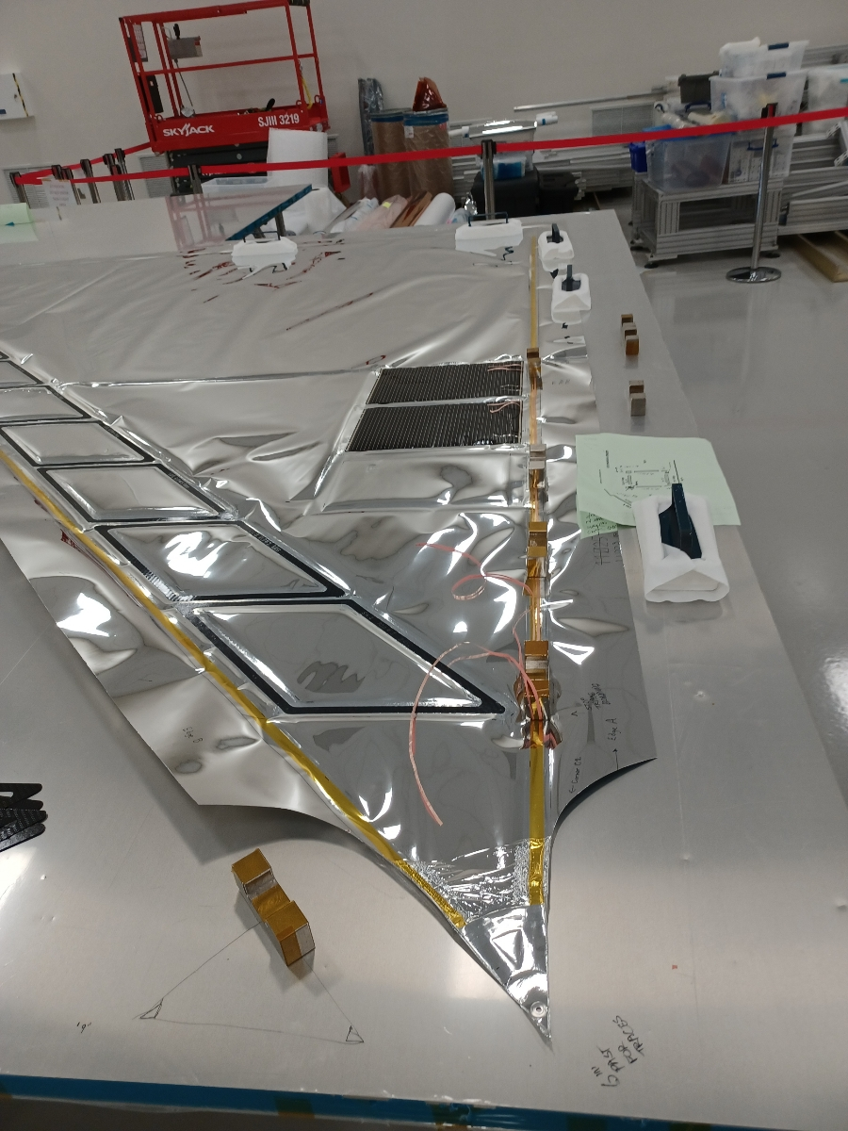
Sail Embedded Technologies
Embedded Tech will enhance solar sailing missions and will enable new capabilities for both sail craft and non-sailing spacecraft
LISA-T: Lightweight Integrated Solar Array >350W/kg and >450kW/m³
LiDIA: Lightweight Deployable Integrated Antenna
Long lifetime, low light, low temperature cells: thin-film cells to support missions to Ice Giants.
Scaled embedded arrays: reach >1,600m² sail-embedded thin-film solar array.
Large antenna arrays: reach >50dBi, >185dBi/kg, sail-embedded thin-film antenna arrays.

Slide 14
Back-up
MPF || October 25th 2022

Slide 15
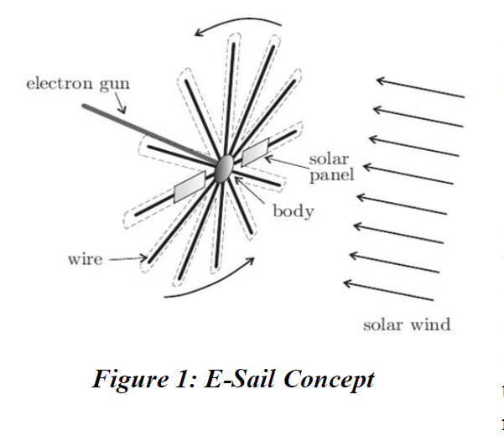
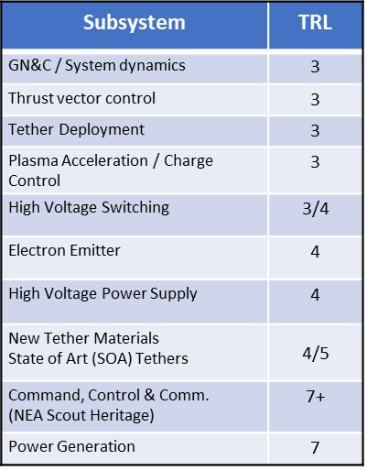
Electrostatic Solar Sail (E-Sail)
Electrostatic Solar Wind Sailing will enable fast transit to the heliopause and beyond – potentially faster than photon sails.
State of the Art
Voyager: 3.5AU/yr, Heliopause in ~35 years
Modem Chemical: 4.4AU/yr, Heliopause in ~28 years
E-Sail: HERTS; design work, low TRL tech dev for tethers, control systems, modeling, and electronics.
Future Need and MSFC Interest
GN&C system design and modeling, Dynamics Modeling
Thrust vector control design and modeling
Tether deployment; Tether charging and charge control
Hight voltage electronics, switching, electron emitters

