Slide 1

Equitable Letters for Space Physics
equitable.space.letters@gmail.com
https://equitableletterssp.github.io/ELSP/index.html
Angeline G. Burrell (Exec. Dir.), John Coxon, Alexa Halford, McArthur Jones Jr., and Kate Zawdie
AGU 2022 - Increasing Diversity in the Earth and Space Science Workforce IV Oral
Notes:
Hello everyone, today I will be talking about a new initiative to reduce the impact of unconscious bias in our field, ELSP, or Equitable Letters for Space Physics

Slide 2
Outline
Motivation
Introduction to Equitable Letters for Space Physic (ELSP)
  Online Resources
  Review Process
  Participation
Future Goals
Notes:
I’ll start by going into the reasons why we started this initiative, before going into the details of the orginazation, how you can participate, and our future goals.

Slide 3
Motivation
Encouraging merit-based recommendations and nominations in the space physics community by providing resources and reviews
Reduce the impact of the “leaky pipeline” on underrepresented populations in the space physics community
Provide resources for people to examine and reduce their implicit biases
Raise the profile of the use of subjective materials in hiring and promotion process
Notes:
I came up with the idea for ELSP during a DEI small group discussion at the 2020 CEDAR meeting. We were discussing the leaky pipeline and discussing ways to improve the number of people from underrepresented groups in our field. One way is address the impact of implicit bias on our field. This is a hard thing to do, since these biases are a result of our lives and our culture. ELSP does this by providing access to resources that allow individuals to examine and reduce their implicit biases, focusing on areas that affect hiring and promotion through recommendation and nomination letters. We also want to raise the profile of the impact that these subjective materials have in the hiring and promotion process.

Slide 4
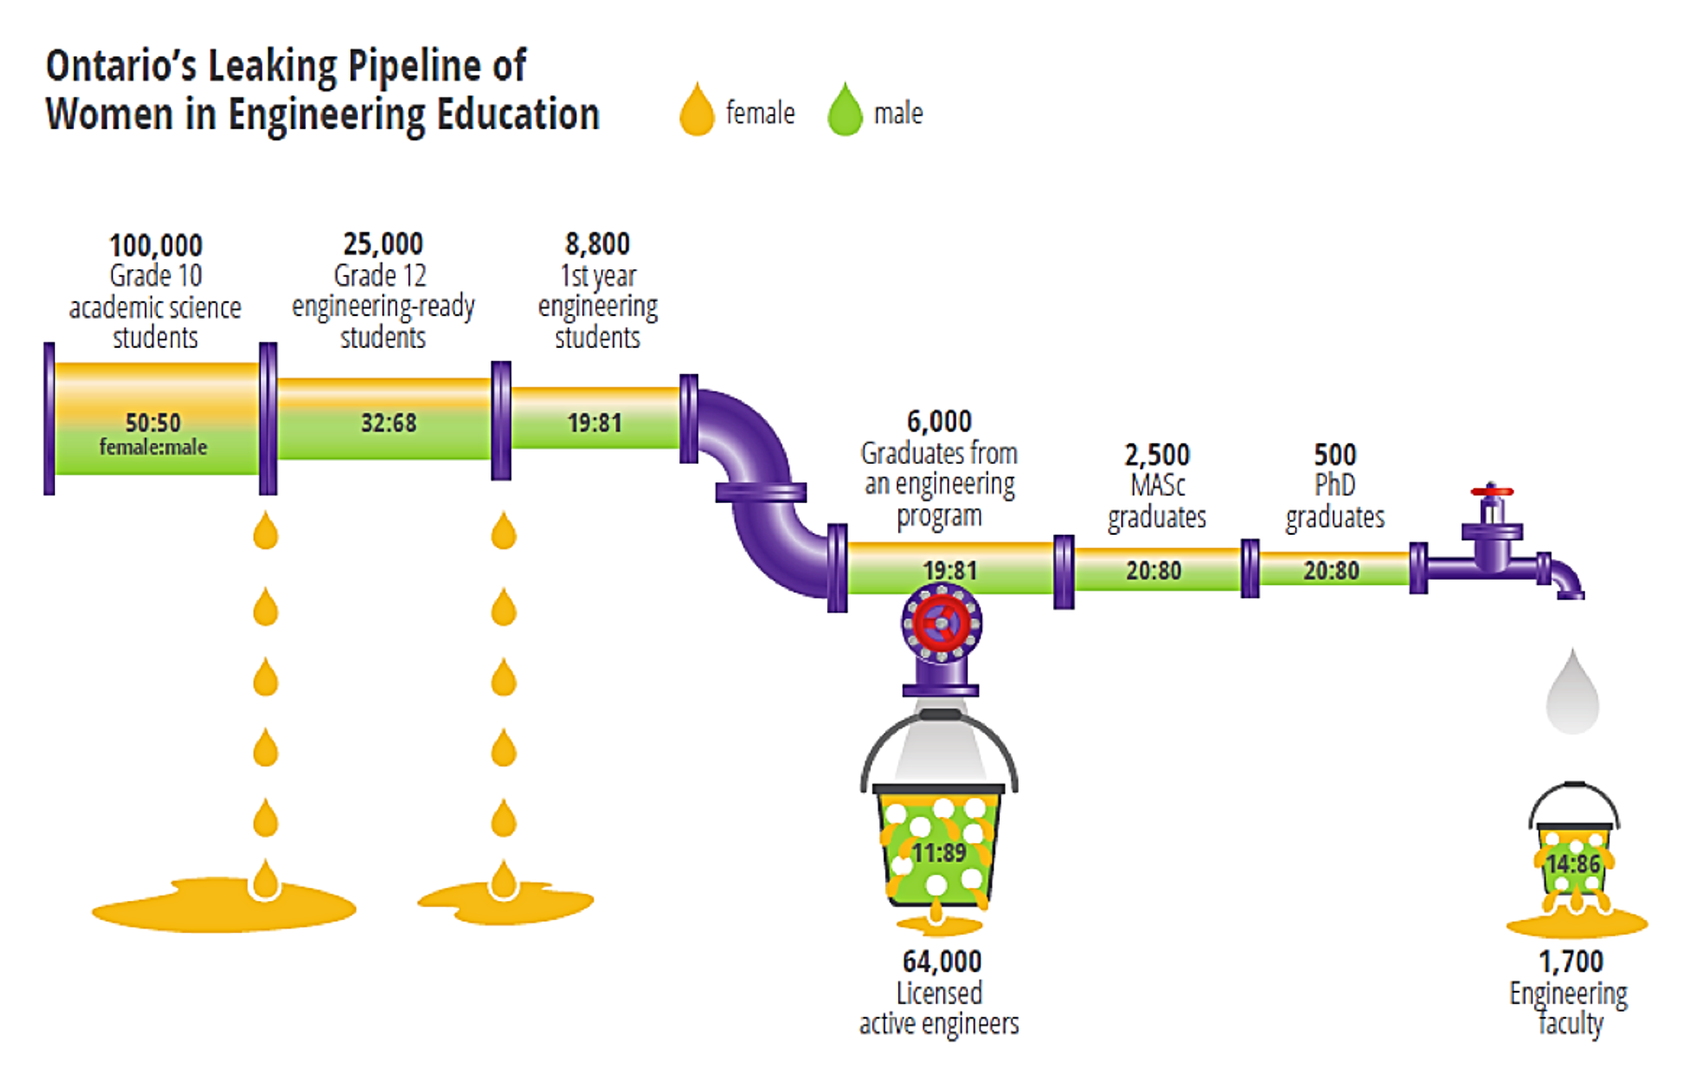
Motivation
Birth-Grade 10
Orientation
6,000
Engineering
Graduates
2,500
Engineering
Masters
500
Engineering
Ph.D.s
women
men
Gender
Class
Race
Ethnicity
Disability
100,000
Grade 10
Science
Focused
25,000
Grade 12
Engineering
Ready
8,800
1st Year
Engineering
64,000
Licensed, active
engineers
1,700
Engineering
faculty
Reduce the impact of the “leaky pipeline” on underrepresented populations in the space physics community
  The leaky pipeline concept is the idea that issues in representation are due to issues in retention at various stages
  Focus on outreach without addressing existing culture and retention create “leaks”
  ELSP focuses on the potential leak of recommendation and nomination letters
    Impacts many types of underrepresentation
    Does not require systematic change in the existing culture
    Improves understanding of internalized biases
Wells, 2018
Notes:
The leaky pipeline is a common paradigm used to explain the increasing deficit of underrepresented groups at higher and higher career levels. A lot of focus is put onto pouring more “water” into the pipeline through outreach. This is an important step, but not nearly enough. We also need to address the existing culture and retention issues that create the leaks to begin with. ELSP does this by focusing on the leaks caused by recommendation letters and award nomination letters. The implicit bias in these letters impacts many groups off people, and can improve representation across the board. It also does not require systemic change in the existing culture, it’s something we can implement today without large institutional buy-in. Identifying and addressing language that reveals implicit bias can also help people understand their own unconscious biases, and change the way they think.

Slide 5
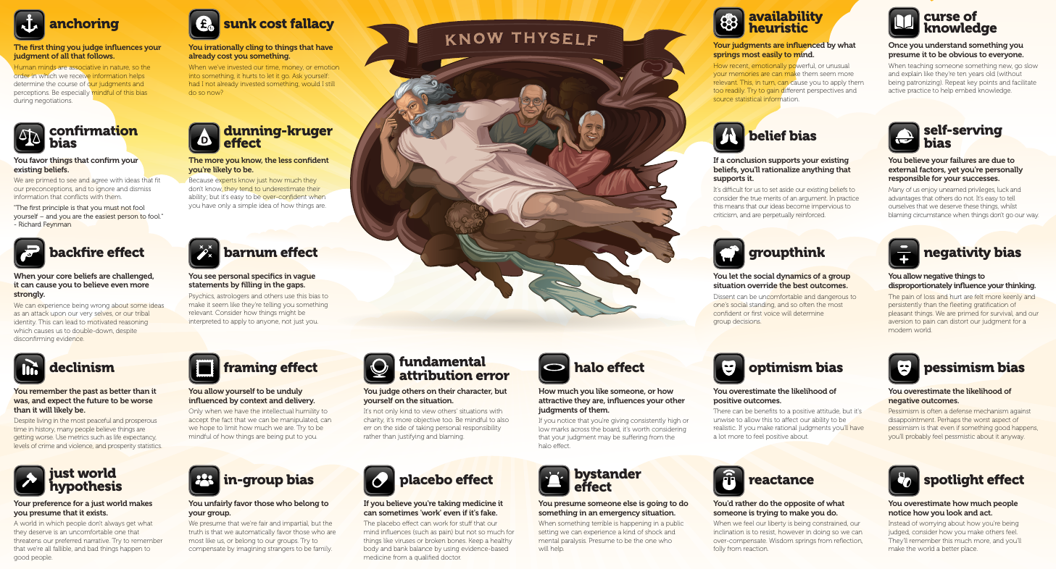
Motivation
Provide resources for people to examine and reduce their implicit biases
  Everyone has biases and everyone can change these biases
  People must learn they have an implicit bias and believe it’s important to change
    Defensiveness is usually a barrier that must be overcome
    Having easily available tools or steps to take improves likelihood of action
www.yourbias.is “Thou shalt not suffer cognitive biases”, Jesse Richardson, 2020, Creative Commons BY-NC-ND license
Notes:
Everyone has unconscious bias and engages in logical fallacies. Everyone is also capable of reducing their biases, so long as they know they exist and believe that it’s important to change. ELSP aims to help people address their biases in two main ways. First, we provide links to resources that allow people to easily access research on the topic and tools such as the implicit bias project, which measures different types of unconscious bias through online tests. Second, we provide an anonymous review service. This provides a private space to identify ways in which your may examine how your own biases are being expressed and see suggestions for more positive ways to say the same things. The safety provided by anonymity will hopefully provide the time and space needed for each of us to overcome our initial defensiveness. It also has the benefit of not exposing the people most negatively impacted by our biases to this defensiveness, which though natural and understandable can be taxing.

Slide 6
Motivation
Raise the profile of the use of subjective materials in hiring and promotion process
  Highlighting weak points in the system can drive change
    Individuals and programs may choose to modify selection criteria [e.g., Iwen, 2019]
    Cultural standards will change in response to numerous and noisy individuals
  Recommendation and nomination letters are a low value/high risk element of hiring, promotions, and awards
    Historically used as a method of gatekeeping against marginalized students [e.g., Thornhill, 2018]
    Frequent effusive language in letters encourages biased readings [e.g., Darnton, 2007]
Notes:
Our final motivation is to remove the need for ELSP altogether. We hope by raising the profile of the negative impact using subjective materials such as recommendation letters in hiring and promotions that institutions will take steps to modify their selection criteria.

Slide 7
Equitable Letters for Space Physics
Encouraging merit-based recommendations and nominations in the space physics community by providing resources and reviews
Founded in July 2020
Online resources published in March 2021
Anonymous review services available as of October 2021

Slide 8
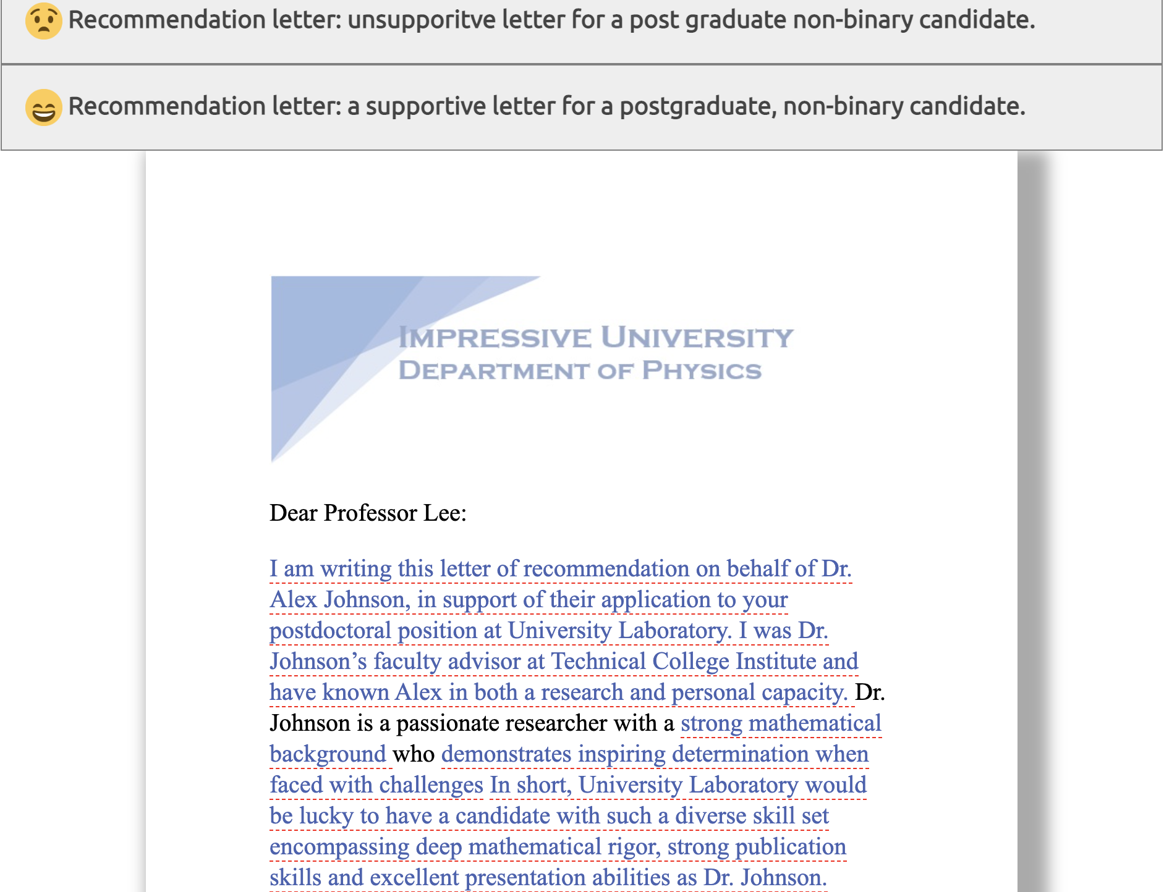
Online Resources
Gender Bias Studies
  Selection of gender bias studies, including a bibliography of scholarly literature
Letter Writing Resources
  Tools for reducing implicit bias in writing
  Guides for recommendation letters, nomination letters, and grammar
  US legal information on personally identifiable information
Addressing Bias
  Selection of organizations and projects dealing with implicit bias
Sample Letters
  Examples of good and bad recommendation and nomination letters for different types of candidates at different career stages
?
This is a positive way to present less common, transferable skills

Slide 9
Review Process
Write a letter
Accept review request
Prepare letter for review
Remove personal information
Run through a gender bias calculator
Run a final spell-check
Compile letter reviewers
Scan for personal reviewer information
Verify reviewer compliance with code of conduct
Review letter
Run a Gender-Bias calculator
Highlight potential problem areas
Fix typos and grammar
Identify why particular areas are less supportive
(Optional) Rewrite using positive adjectives suggested by the context of the letter
Identify areas where more or different examples would be helpful
Consider general formatting
Submit letter for review
Provide list of conflicted reviewers
Suggest reviewers
Agree to code of conduct
Return reviews
Apply appropriate reviewer suggestions
(Acting) Exec Dir receives letter
Check submission
Scan for PPI
Verify compliance with code of conduct
Submit a letter with less implicit bias
Return letter review
Write a different letter with less implicit bias
Identify two reviewers

Slide 10
Participation
Reviewer
  Community members may volunteer to be reviewers if they have a terminal degree
  Training is provided
  You are not required to accept any given review
Submitter
  Anyone may submit a letter for review
Additional avenues to volunteer
  Webpage designers: improve mobile version of site, address some GitHub issues
  Input on sample letters for additional underrepresented groups
Board Member
  Board members and the executive director are intended as temporary, rotating positions
  New board members must first have been reviewers for at least one year

Slide 11
Future Goals
Normalize the proof-reading of recommendation and nomination letters for unconscious bias
Determine impact of ELSP on success rates of applicants with reviewed letters in comparison to the control population
Reduce unconscious bias within the community by providing an avenue for members to identify and address their biases

