Slide 1
LAVA Predictions for JAXA/Boeing/NASA CFD Workshop
Jared Duensing, Scott Neuhoff, James Koch, Chase Ashby, Jeffrey Housman, and Emre Sozer
Computational Aerosciences Branch, NASA Ames Research Center
12 Dec. 2022
POC: jared.c.duensing@nasa.gov

Slide 2
Overview of Completed CFD Tasks
CFD simulations completed for all required and optional free-air cases
Data submitted for all requested pressure rail locations
Two solvers under the Launch Ascent and Vehicle Aerodynamics (LAVA) framework used for analysis
  LAVA Curvilinear
  LAVA Unstructured
Comparisons performed between solvers and with experimental data (where possible)
Structured Curvilinear | Unstructured
CFD Simulation | Rail | H/L | Mach | Grid(s) | Solution(s) | Grid(s) | Solution(s)
AS-2 (as-built) | #2, #7 | 1.5, 2.0 | 1.40 | Complete | Complete | Complete | Complete
AS-2 (as-built) | #2, #7 | 1.5, 2.0 | 1.45 | Complete | Complete | Complete | Complete
AS-2 (as-designed) | #2, #7 | 1.5, 2.0 | 1.40 | Complete | Complete | Complete | Complete
X-59 | #2 | 1.1, 1.2, 1.3, 1.4 | 1.40 | Complete | Complete | Complete | Complete
X-59 | #7 | 1.0 | 1.40 | Complete | Complete | Complete | Complete
W15 | #2 | 1.4 | 1.45 | N/A | N/A | Complete | Complete
Summary of completed workshop tasks using LAVA
POC: jared.c.duensing@nasa.gov

Slide 3
LAVA Framework Overview
Structured
Cartesian AMR
Unstructured
Arbitrary Polyhedral
Navier-Stokes
Structured
Curvilinear
Navier-Stokes
Navier-
Stokes
Lattice
Boltzmann
Post-Processing
Tools
LAVA
Space-Marching
Propagation
Object Oriented Framework
Far Field
Acoustic Solver
C++ / Fortran with MPI Parallel
Other Solvers
& Frameworks
Domain Connectivity/ Shared Data
Multi-Physics:
Multi-Phase
Combustion
Chemistry
Electro-Magnetics
……
Conjugate
Heat Transfer
Actuator Disk
Models
Structural
Dynamics
6 DOF
Body Motion
Other Development Efforts
Higher order and low dissipation
Curvilinear grid generation
Wall modeling
LES/DES/ILES Turbulence
HEC (optimizations, accelerators, etc)
Existing
Developing
Kiris at al. AIAA-2014-0070 & AST-2016
Connected
Not Yet Connected
Future
Framework
POC: jared.c.duensing@nasa.gov

Slide 4
Computational Methodology
Previously-determined best-practices for similar CFD problems were applied to simulations using both LAVA Curvilinear and Unstructured
Solution methods consistent where possible to eliminate potential sources of uncertainty
  Equations solved
  Turbulence model selected
  Approximate target cell size used
LAVA Curvilinear
Equations solved: Steady Reynolds-Averaged Navier-Stokes (RANS)
Solver formulation: Node-based finite difference
Convective flux discretization: modified Roe scheme (2nd order)
Flux limiter: Koren
Turbulence model: baseline Spalart-Allmaras (SA)
Convergence criteria: L₂ norm of N-S equation residual drops by 6 orders of magnitude (includes mass, momentum, and energy)
LAVA Unstructured
Equations solved: Steady Reynolds-Averaged Navier-Stokes (RANS)
Solver formulation: Cell-centered finite volume with MUSCL reconstruction
Convective flux discretization: AUSMPW+ (2nd order)
Flux limiter: Minmod
Turbulence model: baseline Spalart-Allmaras (SA)
Convergence criteria: L₂ norm of N-S equation residual drops by 6 orders of magnitude (includes mass, momentum, and energy)
POC: jared.c.duensing@nasa.gov

Slide 5
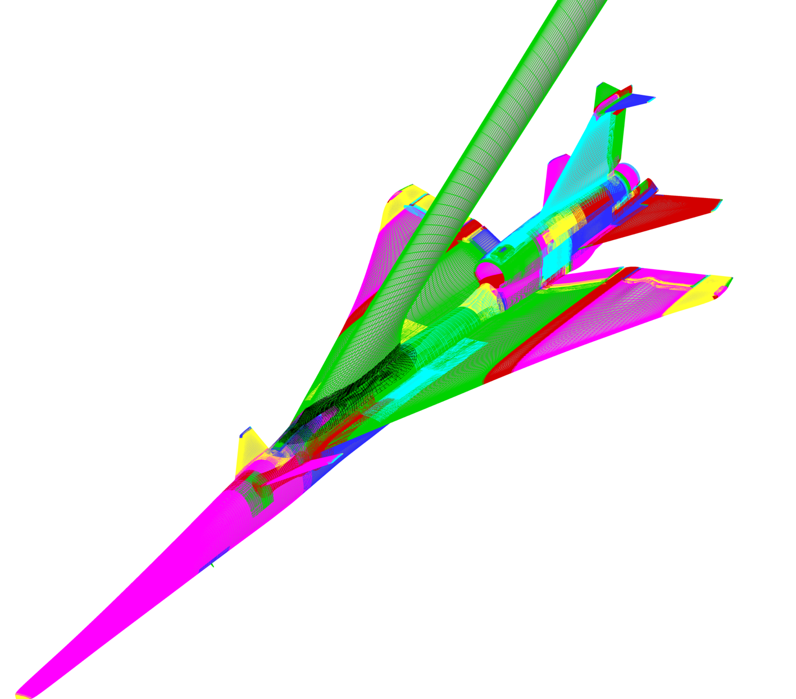
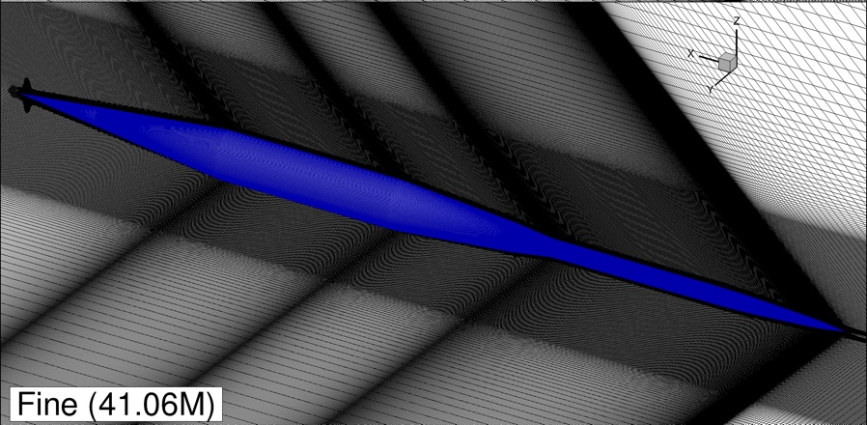
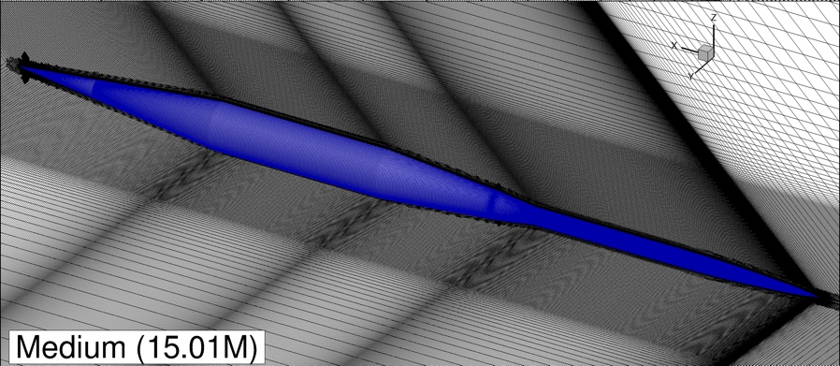
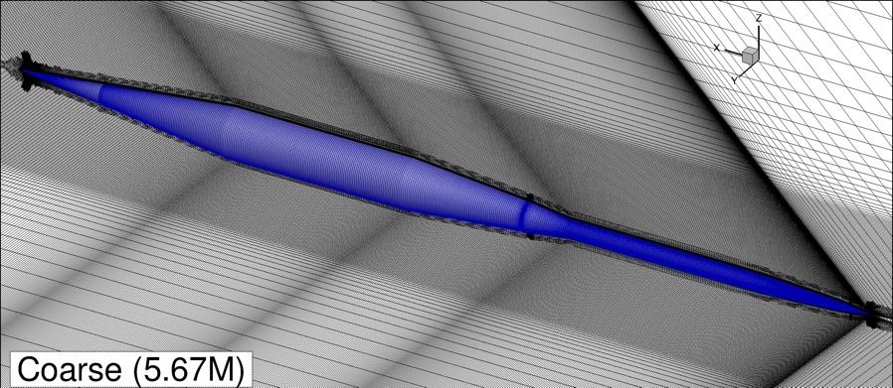
Mesh Generation Overview (Structured Curvilinear)
Mesh generation conducted using a combination of software
  Pointwise (surface mesh generation)
  Chimera Grid Tools (CGT) (volume mesh generation)
  LAVA (domain connectivity and implicit hole cutting)
Guidelines based on previous X-59 analysis and general best-practices
AS2
Coarse mesh statistics:
Stretching ratio: 1.2
Maximum (target) cell size: 2.5 mm
Circumferential resolution: 181 points
X-59
Stretching ratio: 1.2
Maximum (target) cell size: 1.14 mm
Solve points: 119.7 M
POC: jared.c.duensing@nasa.gov

Slide 6
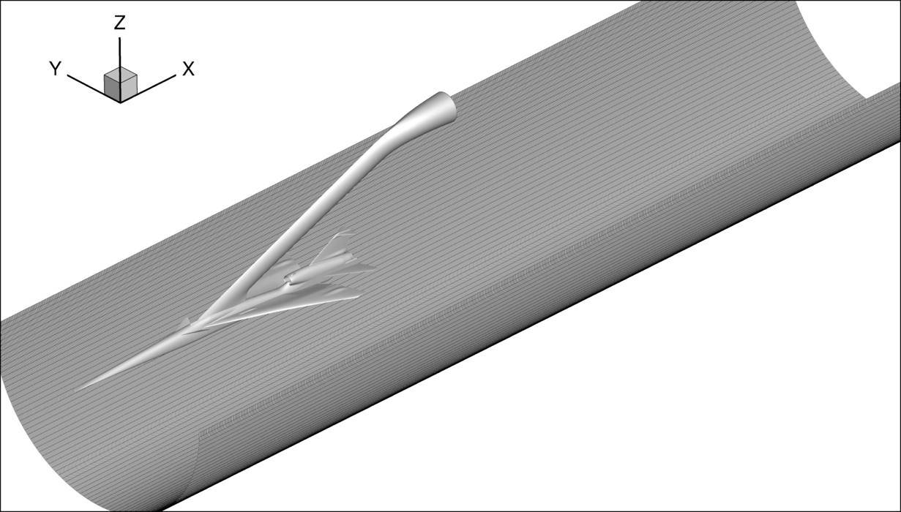
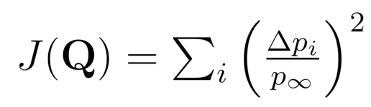
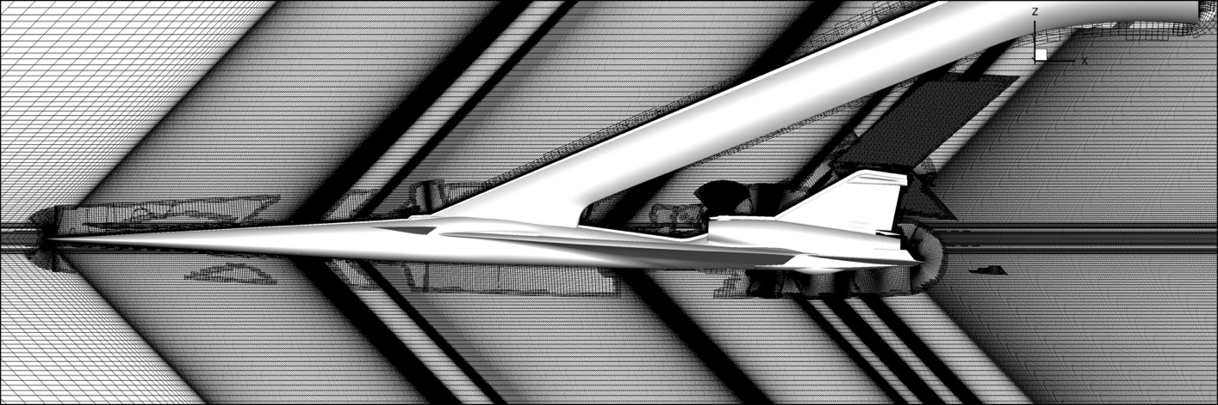
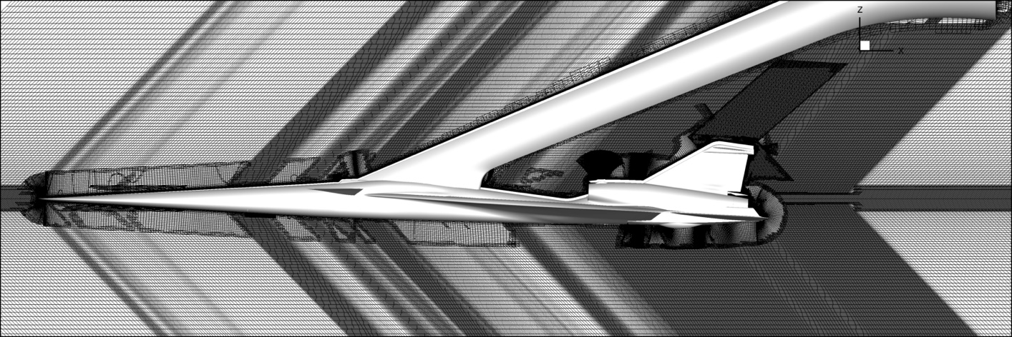
Mesh Generation Overview (Structured Curvilinear)
Automated adjoint-based mesh adaptation procedure was applied to the X-59 off-body grid in the streamwise direction
User-specified off-body refinement regions under-resolved nose and terminal shock locations
Adjoint-based adaptation of the off-body grid starting from uniform streamwise spacing resulted in refinement regions that resolved all known major flow features
Surface defining the discrete functional used for adjoint-based adaptation
Centerline slice of X-59 structured overset grid designed by hand
Centerline slice of X-59 adjoint adapted grid
POC: jared.c.duensing@nasa.gov

Slide 7
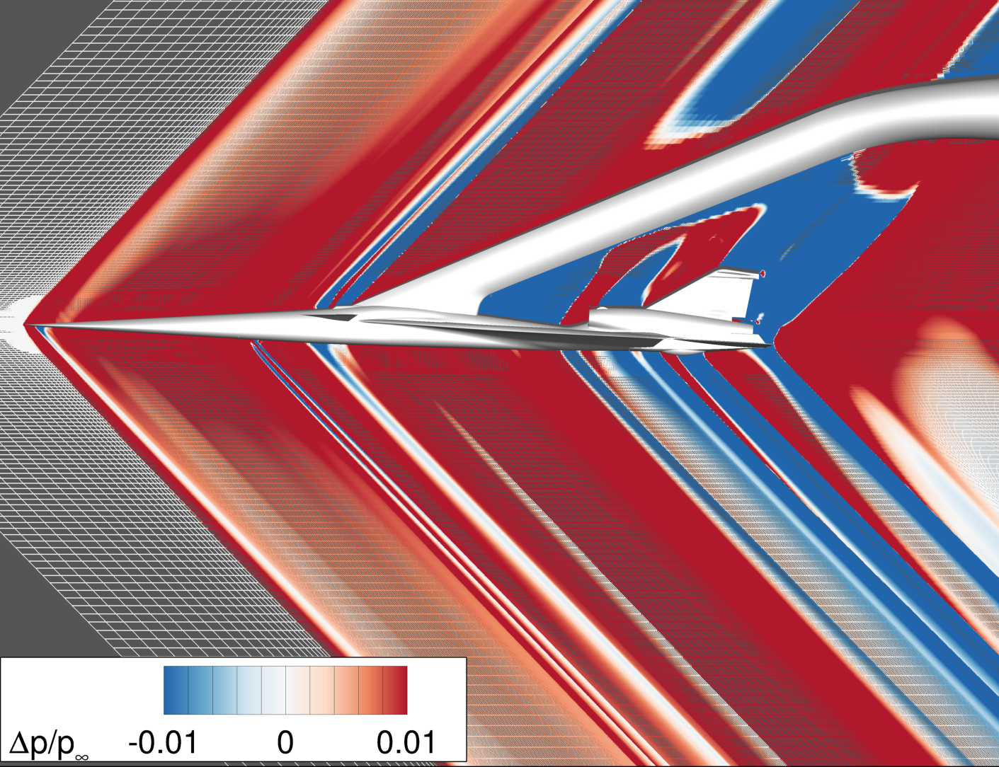
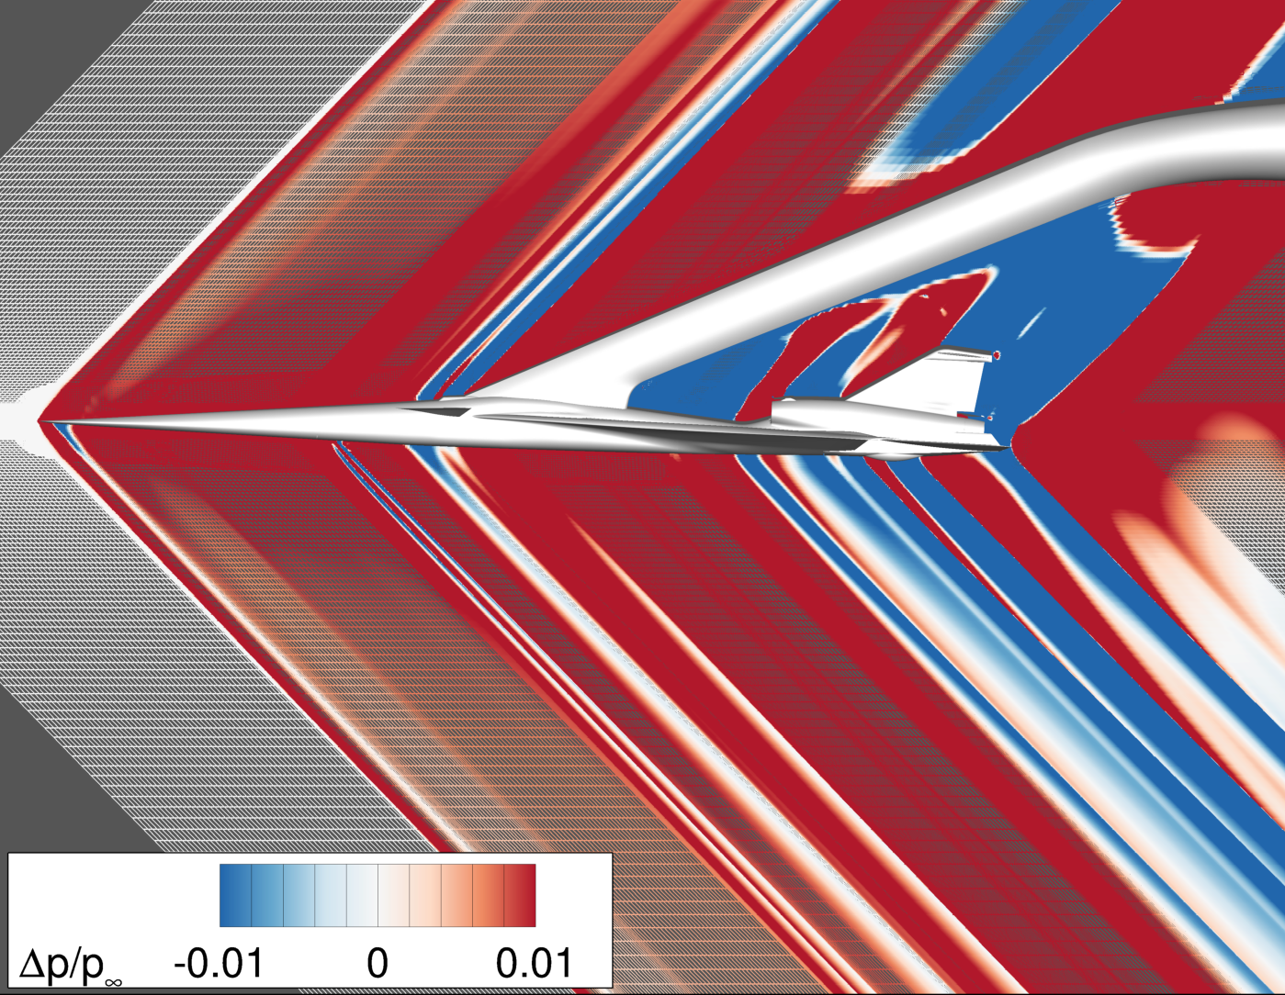
Mesh Generation Overview (Structured Curvilinear)
Centerline slice of X-59 structured overset grid designed by hand
Centerline slice of X-59 adjoint adapted grid

Slide 8
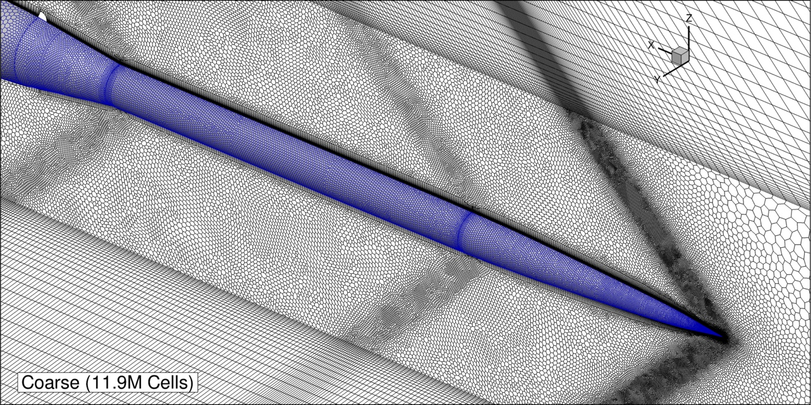
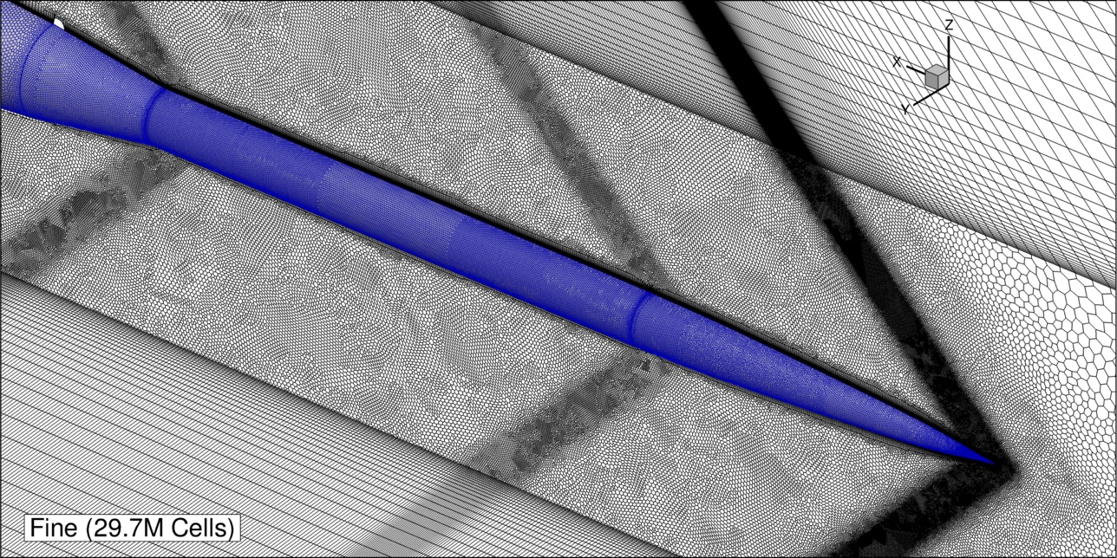
Mesh Generation Overview (Unstructured)
All unstructured meshes consist of three “layers”
  Near-body prism layer
  Near-field cylindrical region (unstructured arbitrary polyhedral elements)
  Mach-aligned (stretched) extrusion layers
Prism layer
Mach-aligned
extrusion layers
Arbitrary poly.
elements
*Refinements for AS-2 scale the coarse volume cell sizes by 0.5
AS-2
Volume growth rate: 1.2
Core cylinder radius: 100mm
Maximum (target) cell size: 1.25 mm
Cell count: 11.9 M
POC: jared.c.duensing@nasa.gov

Slide 9
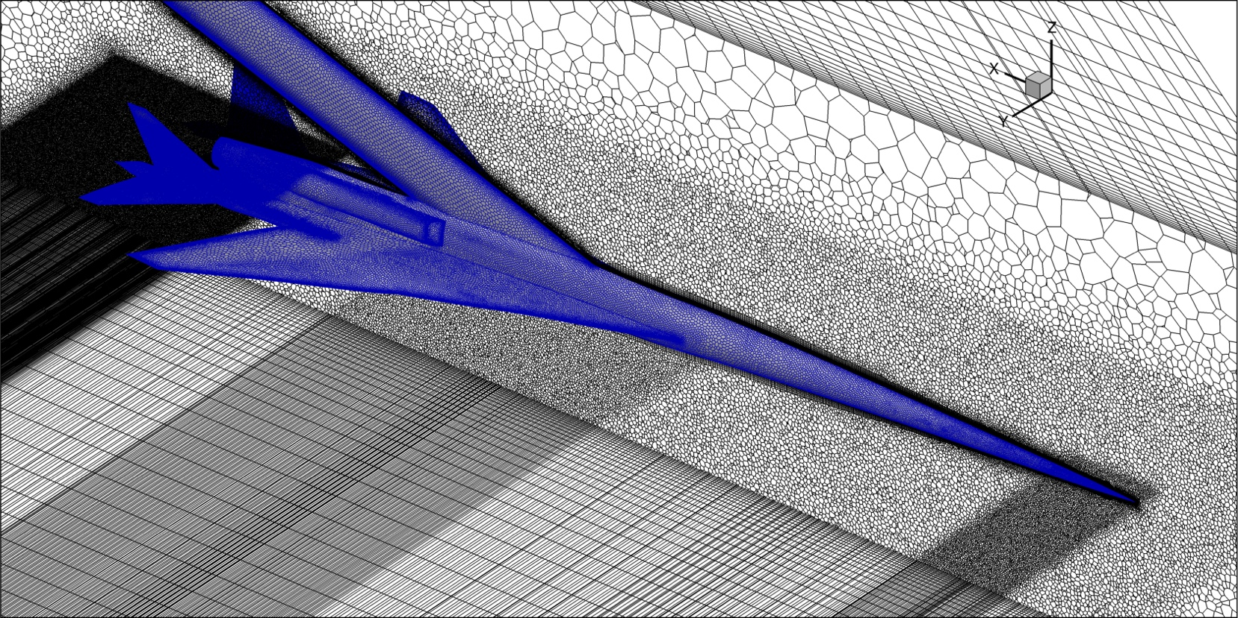
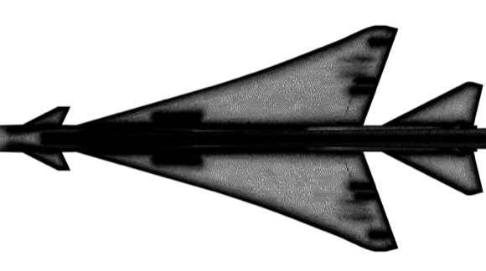
Mesh Generation Overview (Unstructured)
All unstructured meshes consist of three “layers”
  Near-body prism layer
  Near-field cylindrical region (unstructured arbitrary polyhedral elements)
  Mach-aligned (stretched) extrusion layers
X-59
Volume growth rate: 1.2
Core cylinder radius: 135mm
Maximum (target) cell size: 1.7 mm
Cell count: 63.9 M
W15
Volume growth rate: 1.2
Core cylinder radius: 85mm
Maximum (target) cell size: 2.0 mm
Cell count: 85.2 M
POC: jared.c.duensing@nasa.gov

Slide 10
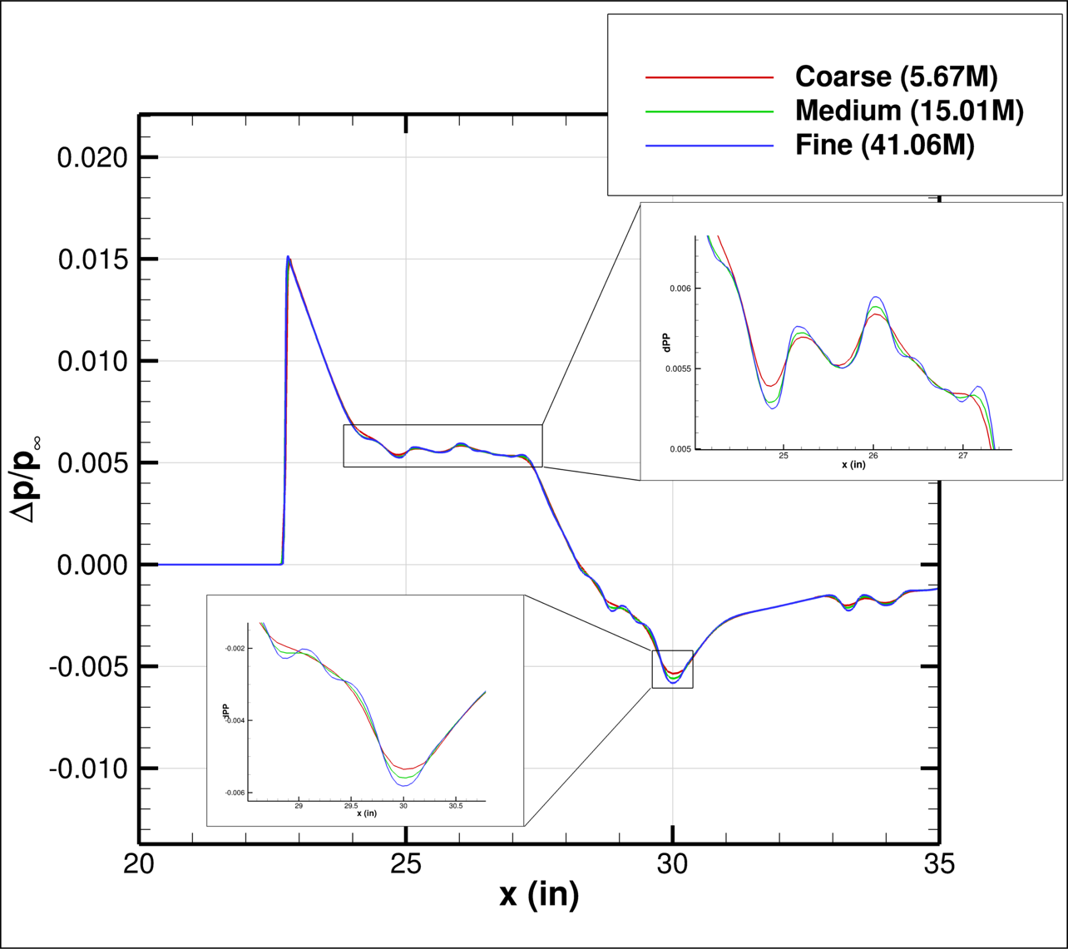
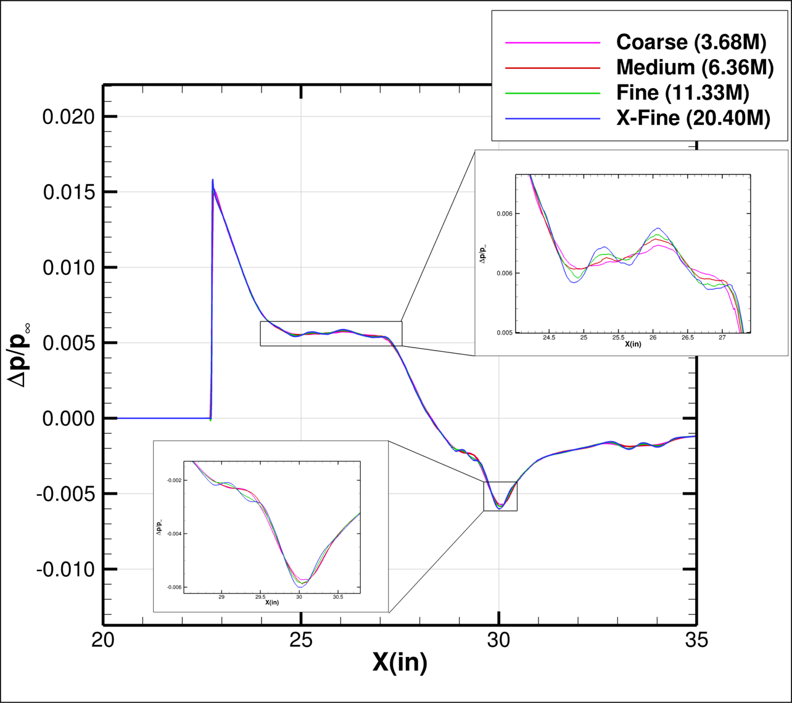
AS-2 (Mach 1.4) Results: Refinement Study
Initial refinement study performed to assess pressure signature sensitivity to mesh resolution (Rail #2 shown below)
LAVA Curvilinear
LAVA Unstructured
POC: jared.c.duensing@nasa.gov

Slide 11
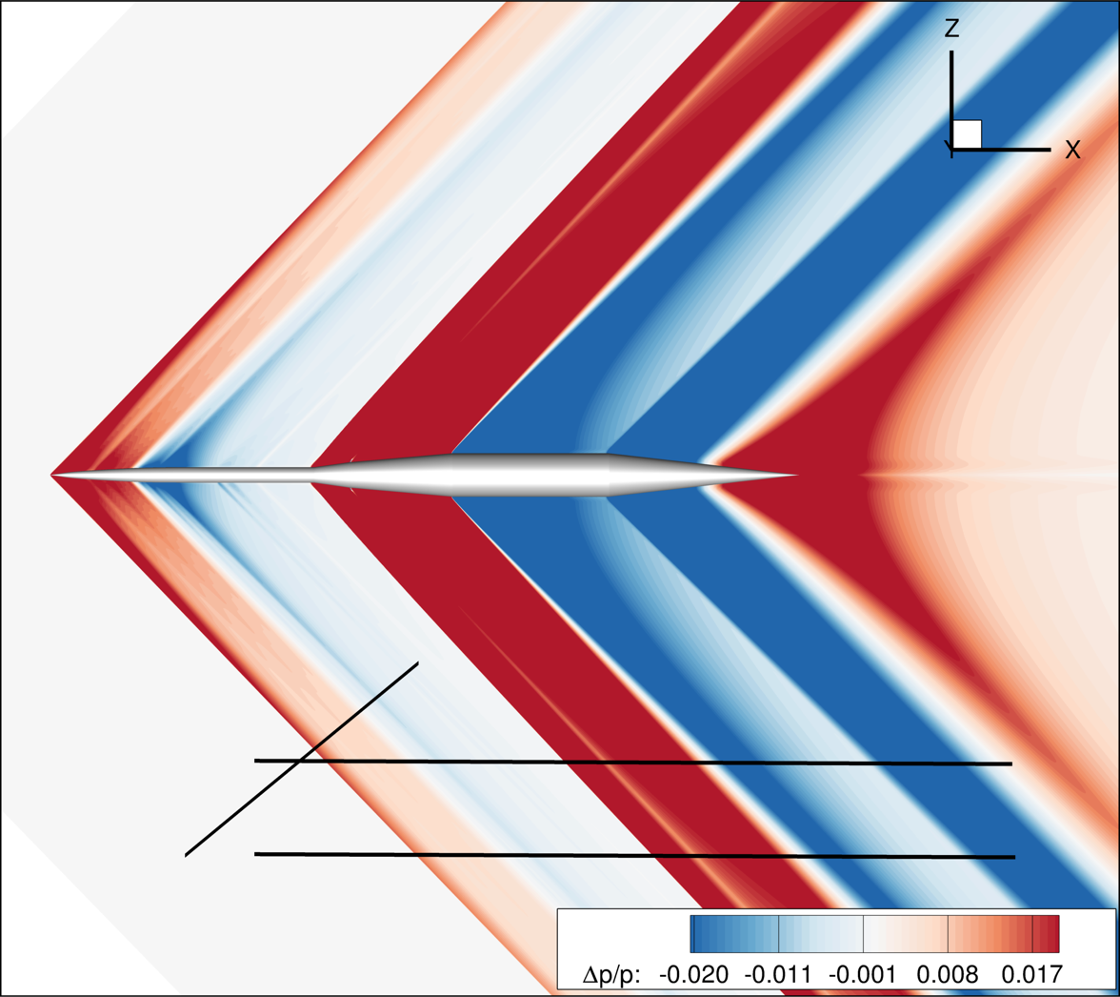

AS-2 (Mach 1.4) Results: As-Built vs. As-Designed
Symmetry plane visualization of pressure disturbance shown for as-built and as-designed
LAVA Curvilinear results compared below
Rail #2 (H/L = 1.5)
Rail #2 (H/L = 1.5)
Rail #2 (H/L = 2.0)
Rail #2 (H/L = 2.0)
Rail #7
Rail #7
As-Built Geometry
As-Designed Geometry
POC: jared.c.duensing@nasa.gov

Slide 12
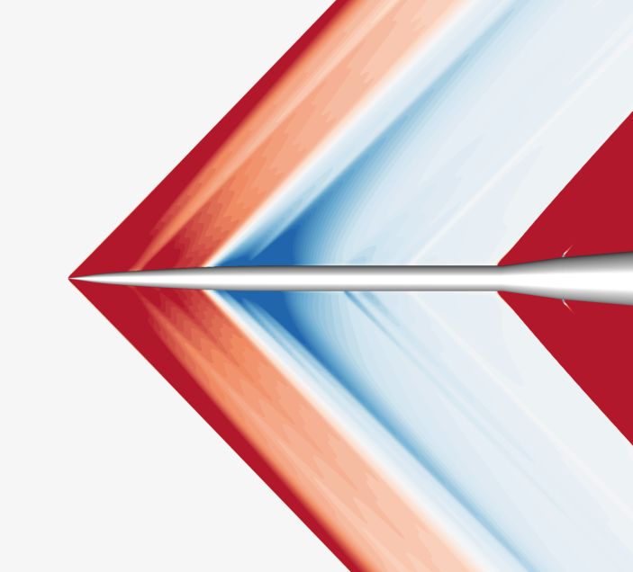
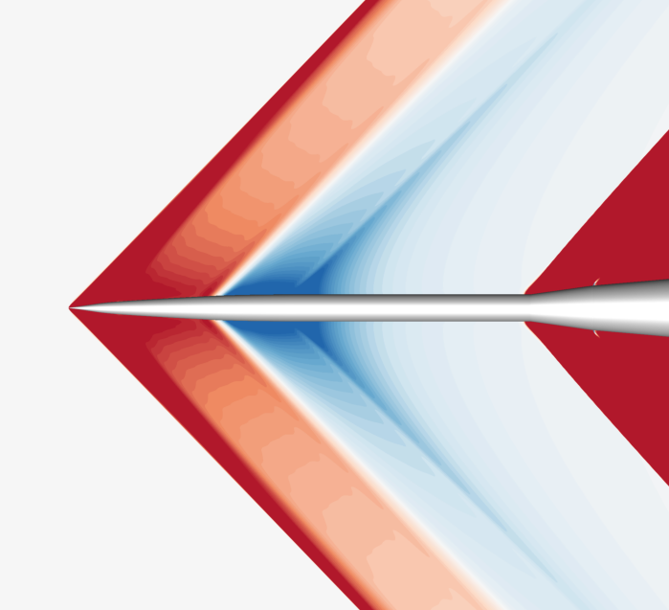

AS-2 (Mach 1.4) Results: As-Built vs. As-Designed
Symmetry plane visualization of pressure disturbance shown for as-built and as-designed
LAVA Curvilinear results compared below
As-Built Geometry
As-Designed Geometry
POC: jared.c.duensing@nasa.gov

Slide 13

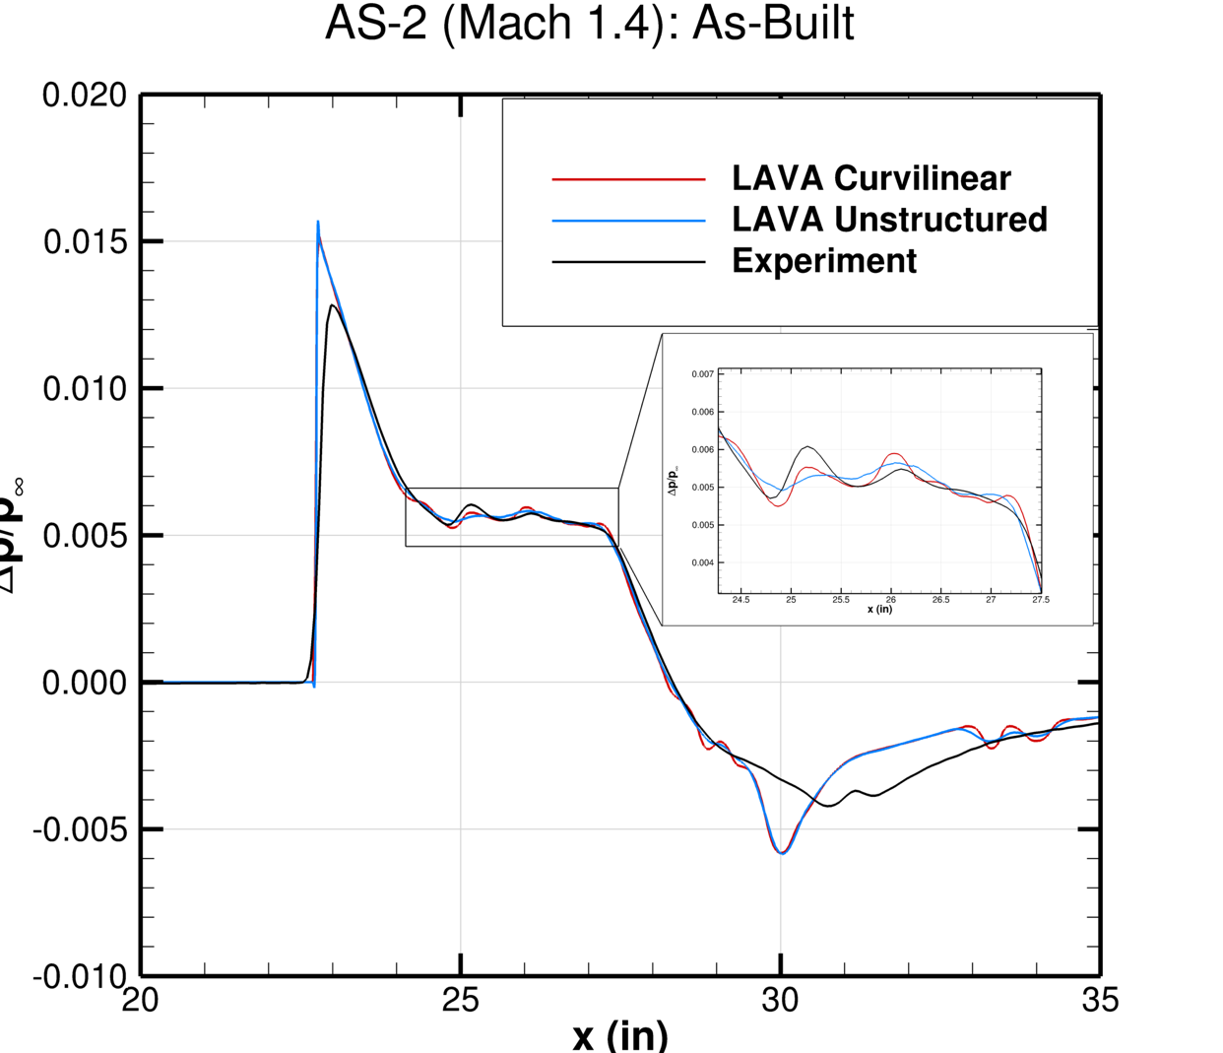
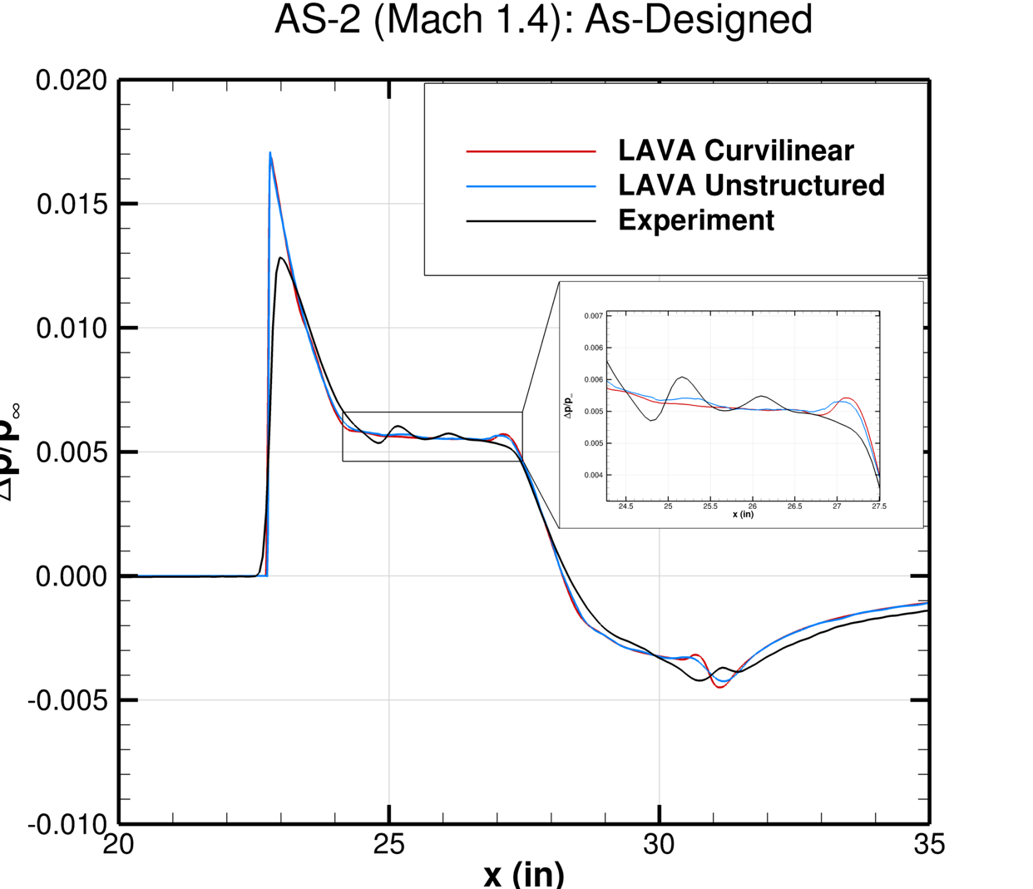
AS-2 (Mach 1.4) Results: Code Comparisons
Comparison of Rail #2 (H/L = 2.0) pressure signatures predicted by LAVA Curvilinear and LAVA Unstructured for the AS-2 as-built and as-designed geometry definitions
As-Built (Curvilinear)
Rail #2 (H/L = 2.0)
As-Built Geometry
As-Designed Geometry
POC: jared.c.duensing@nasa.gov

Slide 14
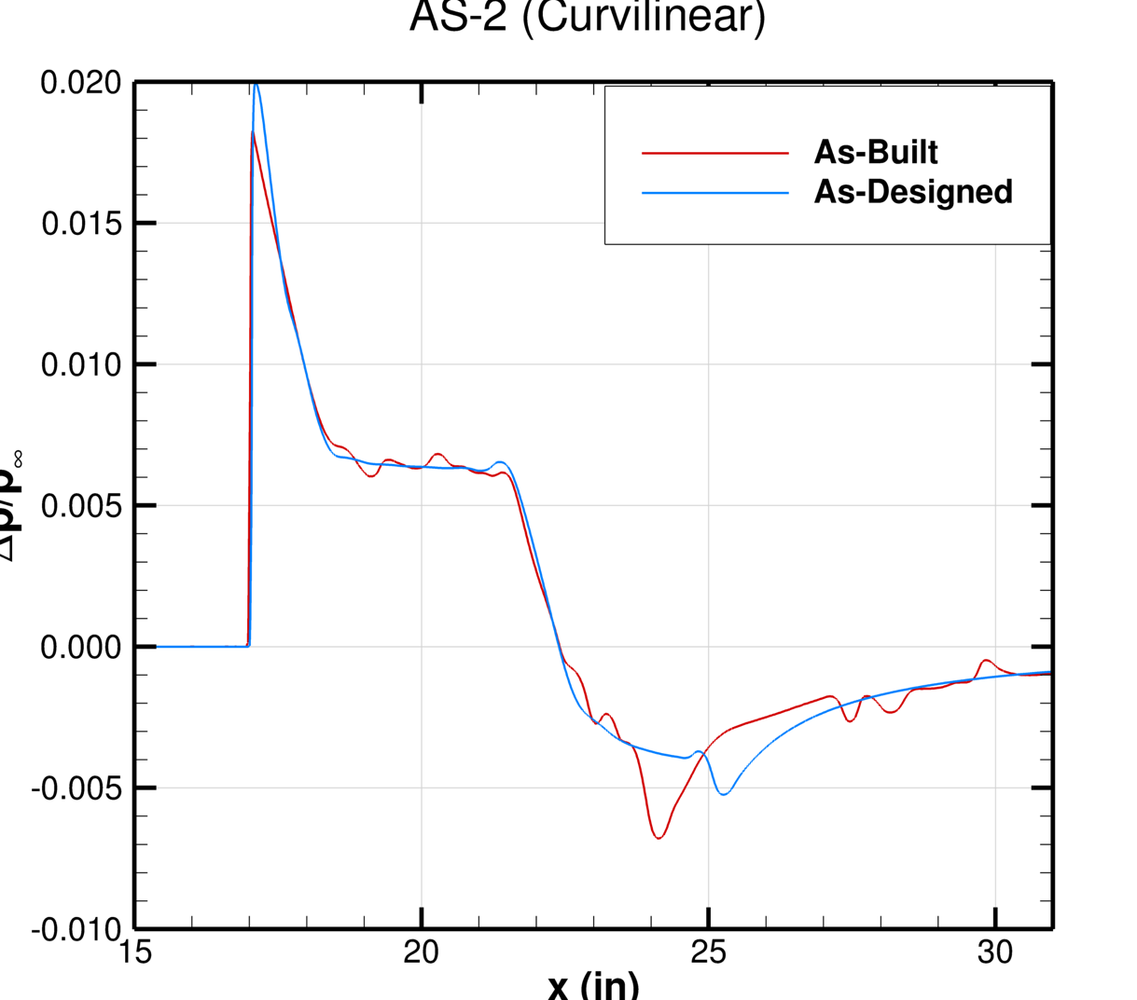
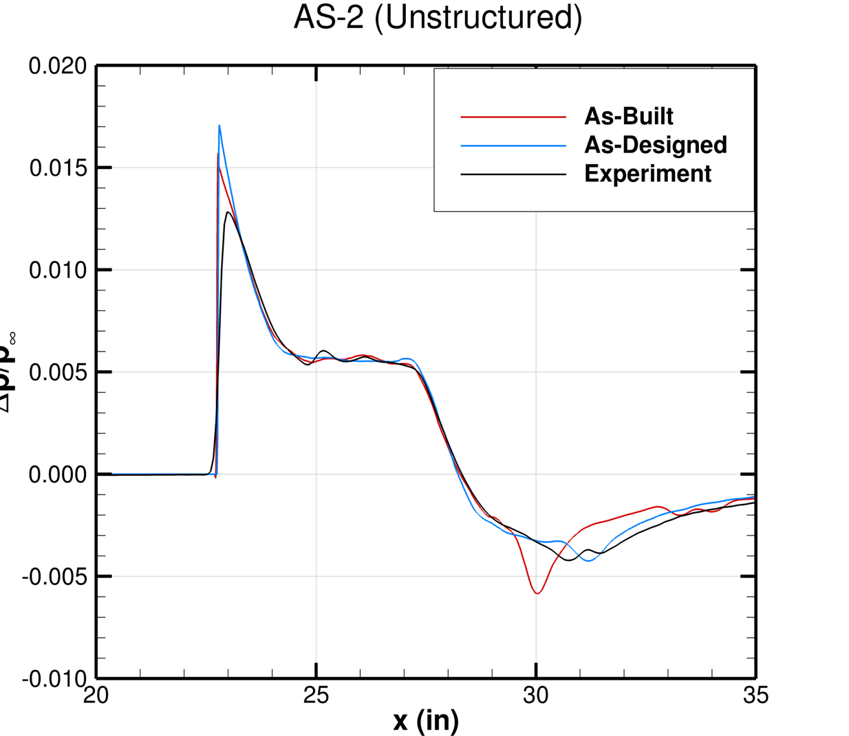
AS-2 (Mach 1.4) Results: As-Built vs. As-Designed
Comparison of Rail #2 (H/L = 1.5) pressure signatures for the as-built vs. as-designed AS-2 geometry definitions
Differences largely concentrated around peak values and signature oscillations
As-Built (Curvilinear)
Rail #2 (H/L = 2.0)
LAVA Curvilinear
LAVA Unstructured
POC: jared.c.duensing@nasa.gov

Slide 15
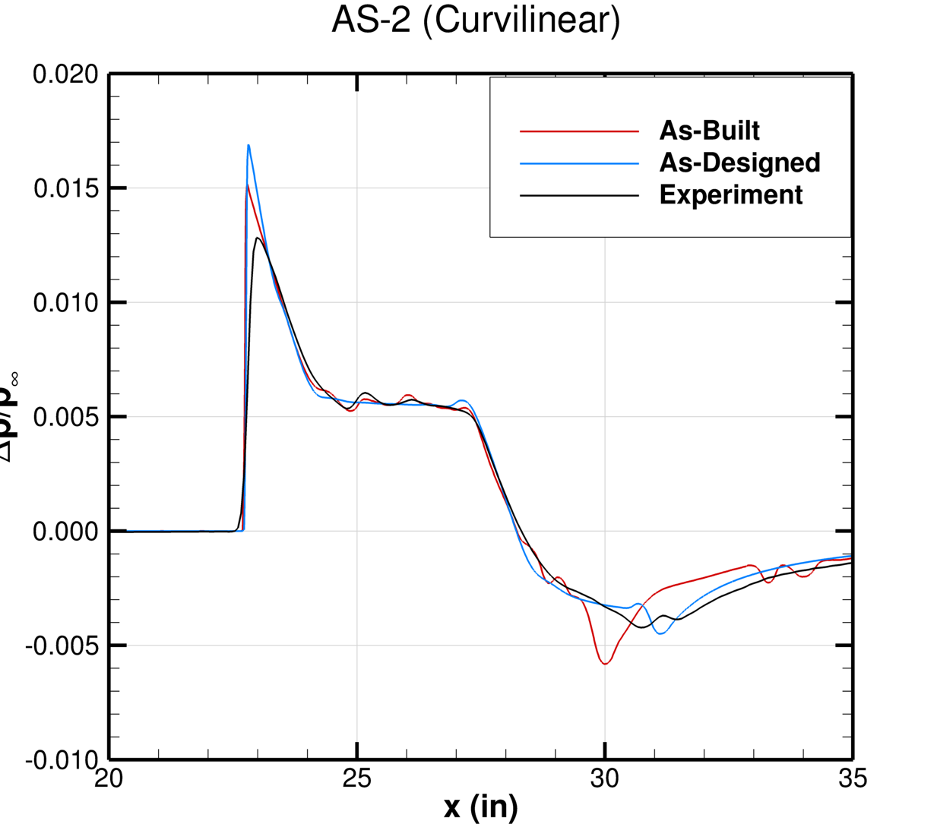
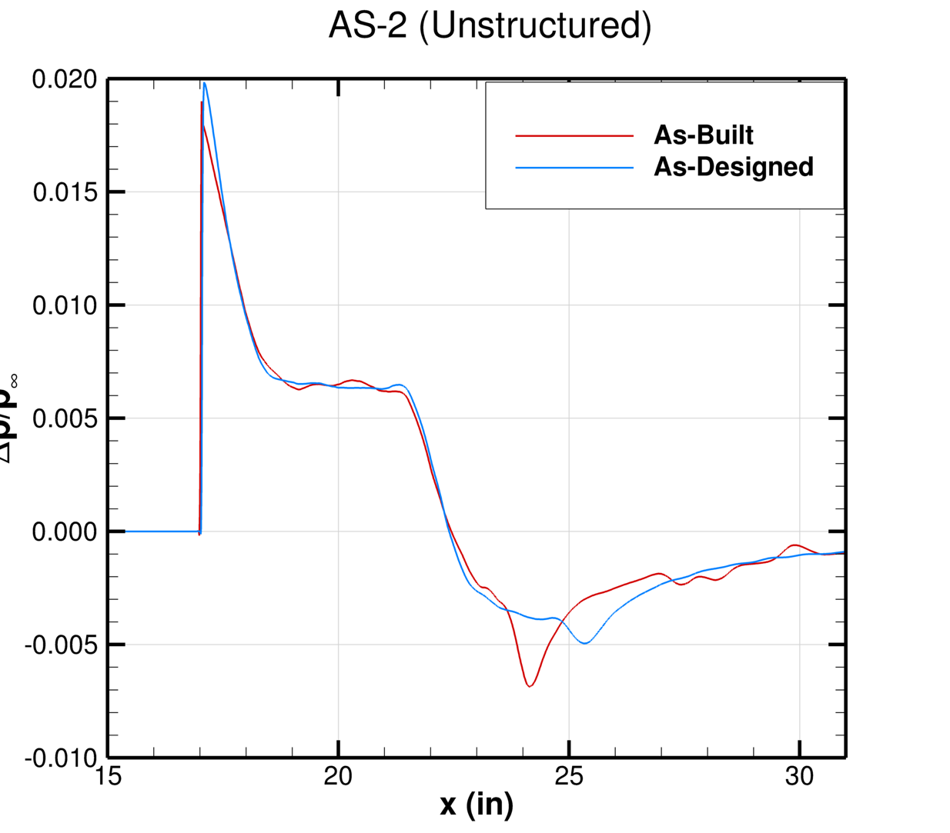
AS-2 (Mach 1.4) Results: As-Built vs. As-Designed
Comparison of Rail #2 (H/L = 2.0) pressure signatures for the as-built vs. as-designed AS-2 geometry definitions
Differences largely concentrated around peak values and signature oscillations
As-Built (Curvilinear)
Rail #2 (H/L = 1.5)
LAVA Curvilinear
LAVA Unstructured
POC: jared.c.duensing@nasa.gov

Slide 16
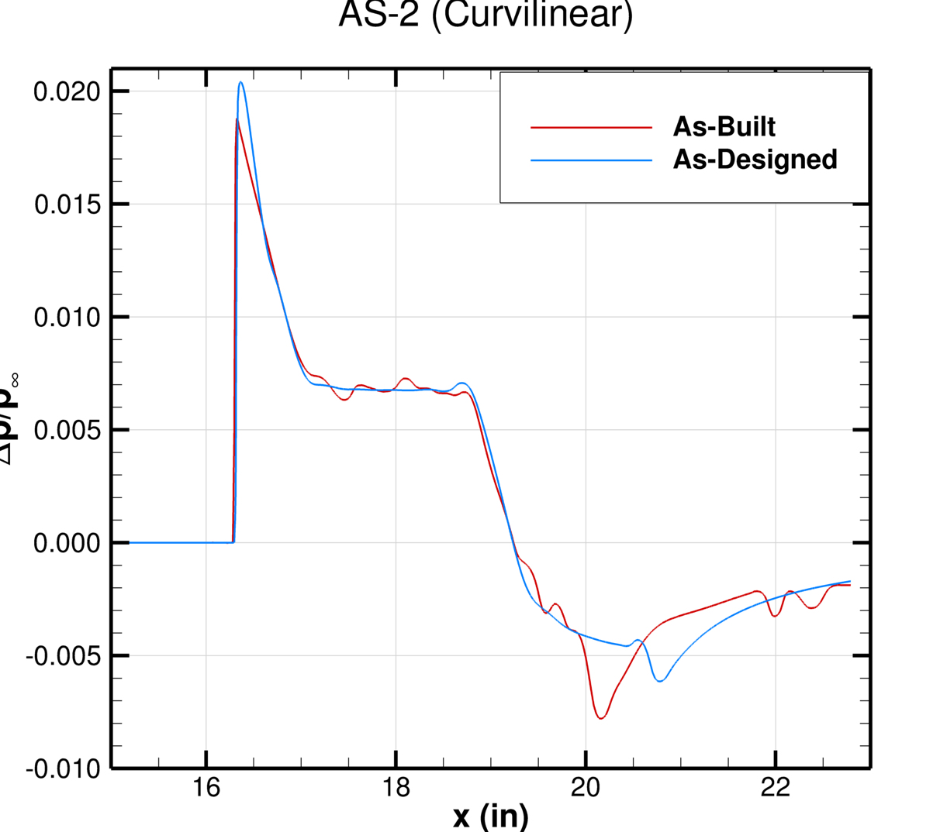
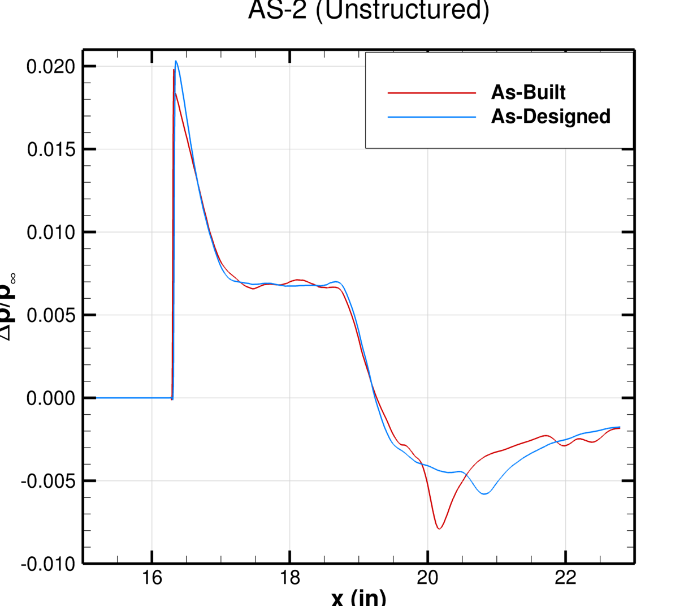
AS-2 (Mach 1.4) Results: As-Built vs. As-Designed
Comparison of Rail #7 pressure signatures for the as-built vs. as-designed AS-2 geometry definitions
Differences largely concentrated around peak values and signature oscillations
As-Built (Curvilinear)
Rail #7
LAVA Curvilinear
LAVA Unstructured
POC: jared.c.duensing@nasa.gov

Slide 17
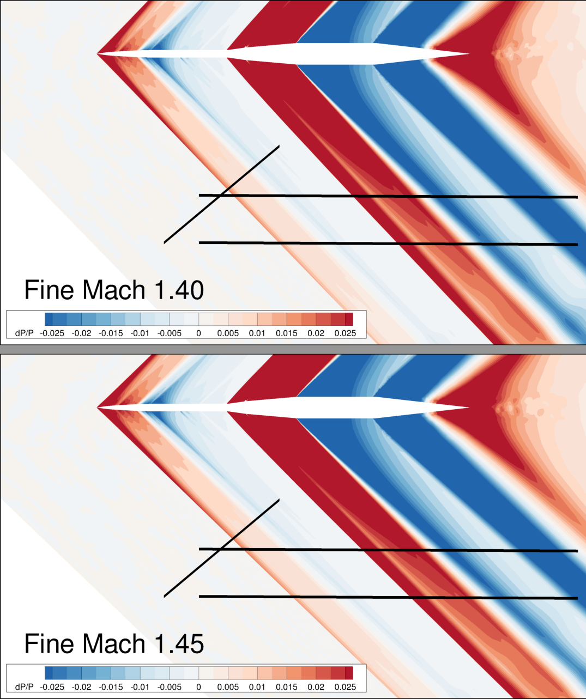
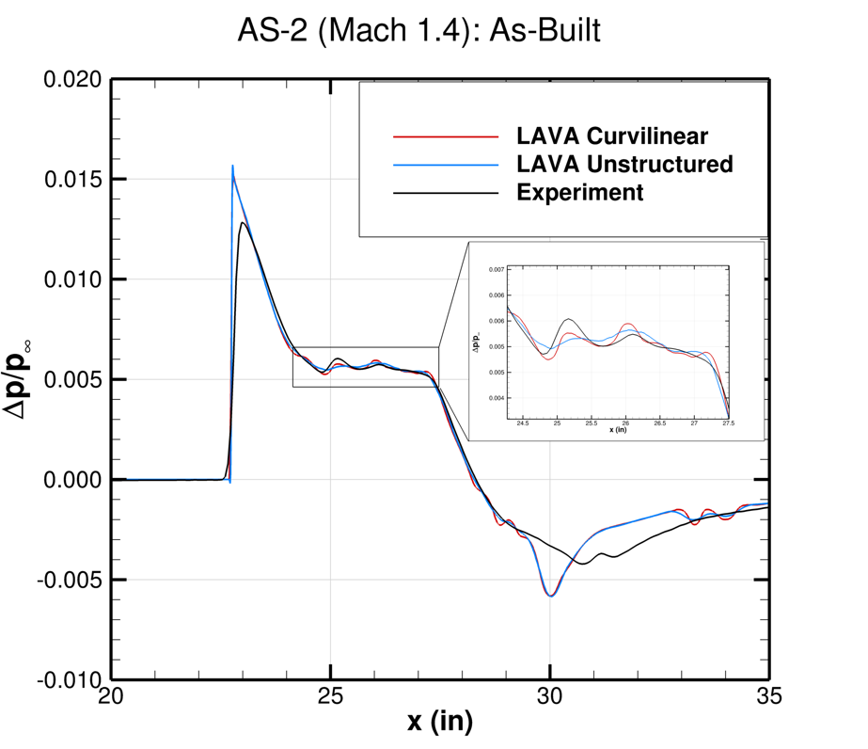
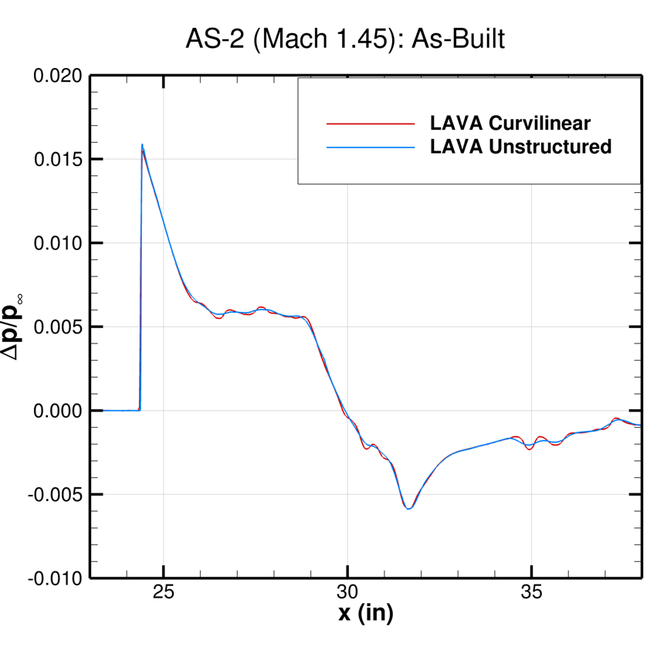
AS-2 (Mach 1.45) Results
Comparison of Rail #2 (H/L = 2.0) pressure signatures for the Mach 1.4 and 1.45 freestream conditions
Mach 1.45 wave structure is similar to Mach 1.40 case
POC: jared.c.duensing@nasa.gov

Slide 18
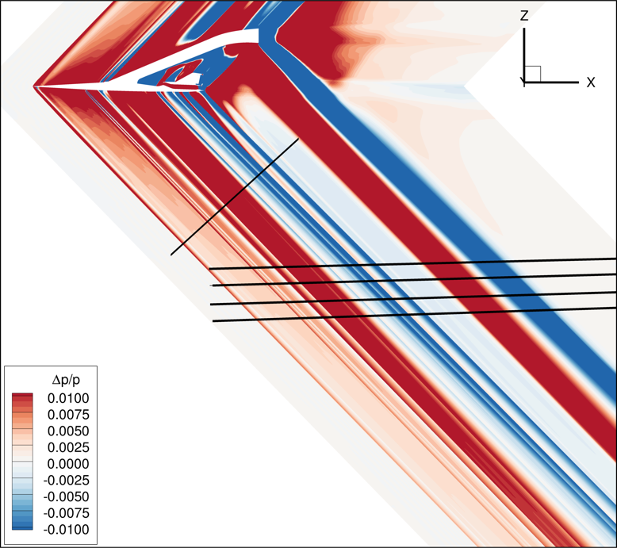
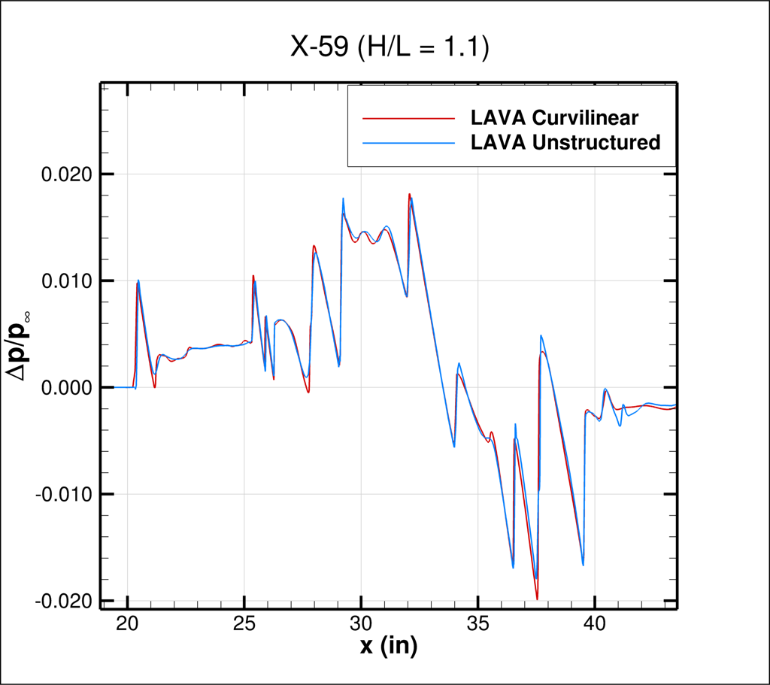
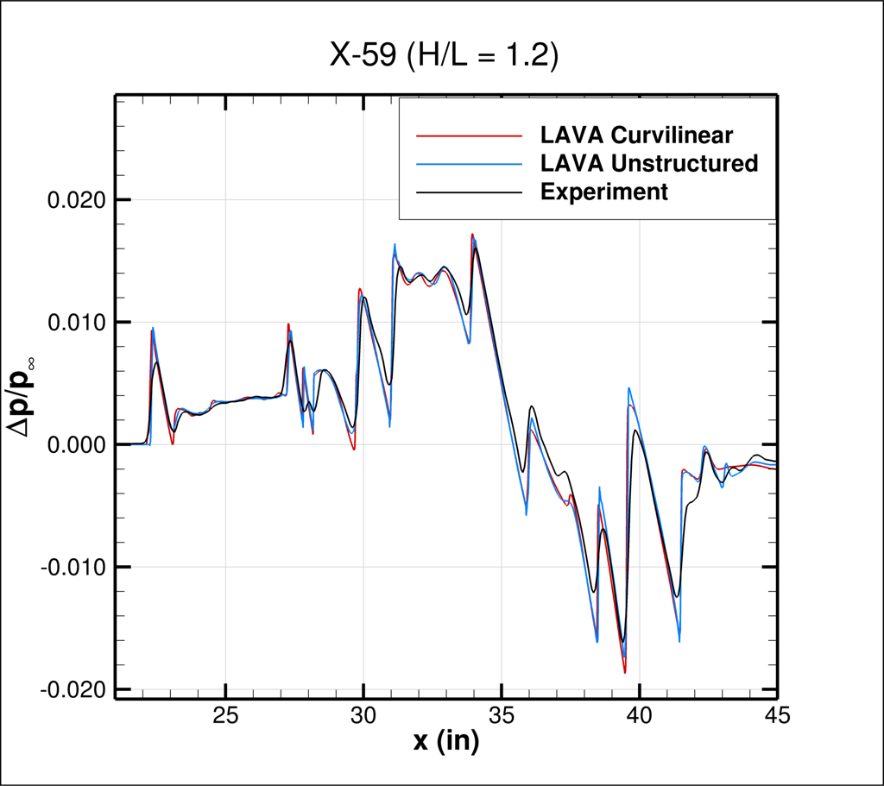
X-59 Results
Comparison of Rail #2 pressure signatures for the Mach 1.4 condition
LAVA Curvilinear and LAVA Unstructured exhibit strong agreement, with all shock features in experimental signature predicted
H/L = 1.1
H/L = 1.2
H/L = 1.1
H/L = 1.2
POC: jared.c.duensing@nasa.gov

Slide 19
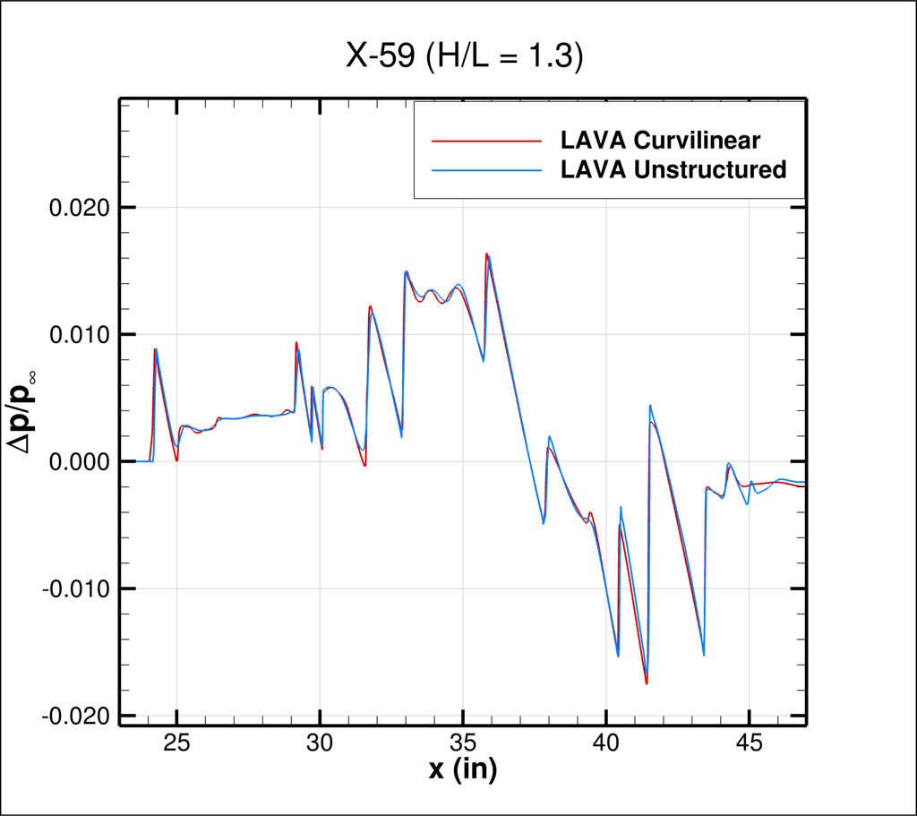
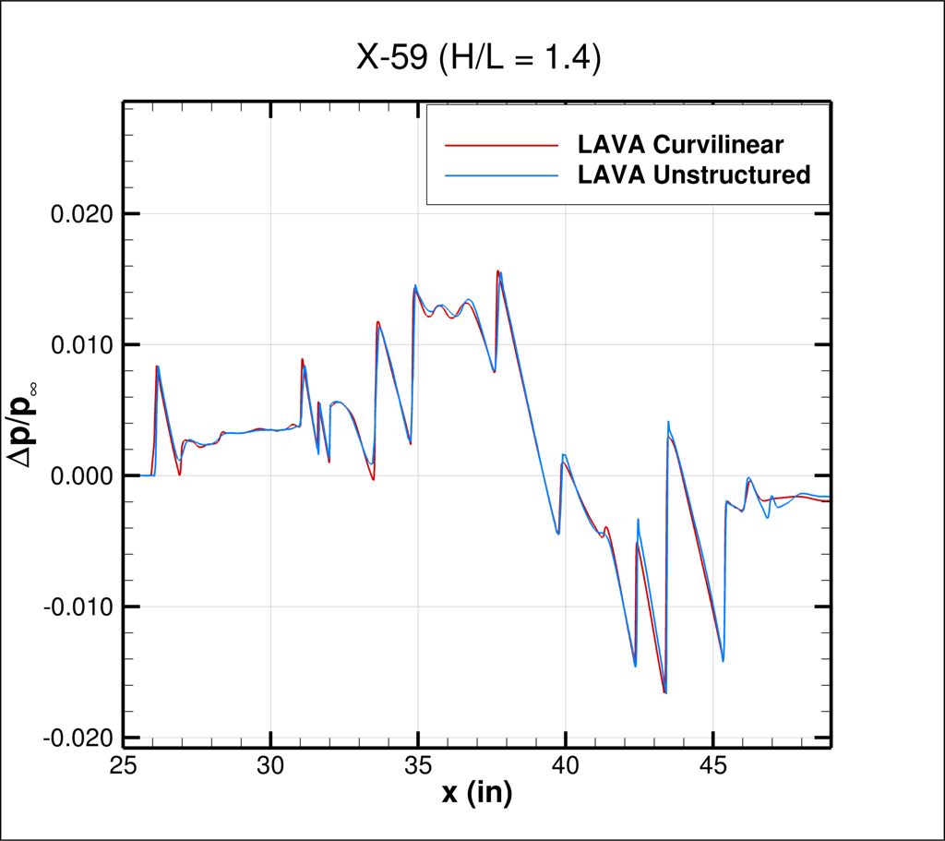
X-59 Results
Comparison of Rail #2 pressure signatures for the Mach 1.4 condition
LAVA Curvilinear and LAVA Unstructured exhibit strong agreement
Pressure disturbance magnitudes reduction observed at further locations
H/L = 1.3
H/L = 1.4
H/L = 1.3
H/L = 1.4
POC: jared.c.duensing@nasa.gov

Slide 20
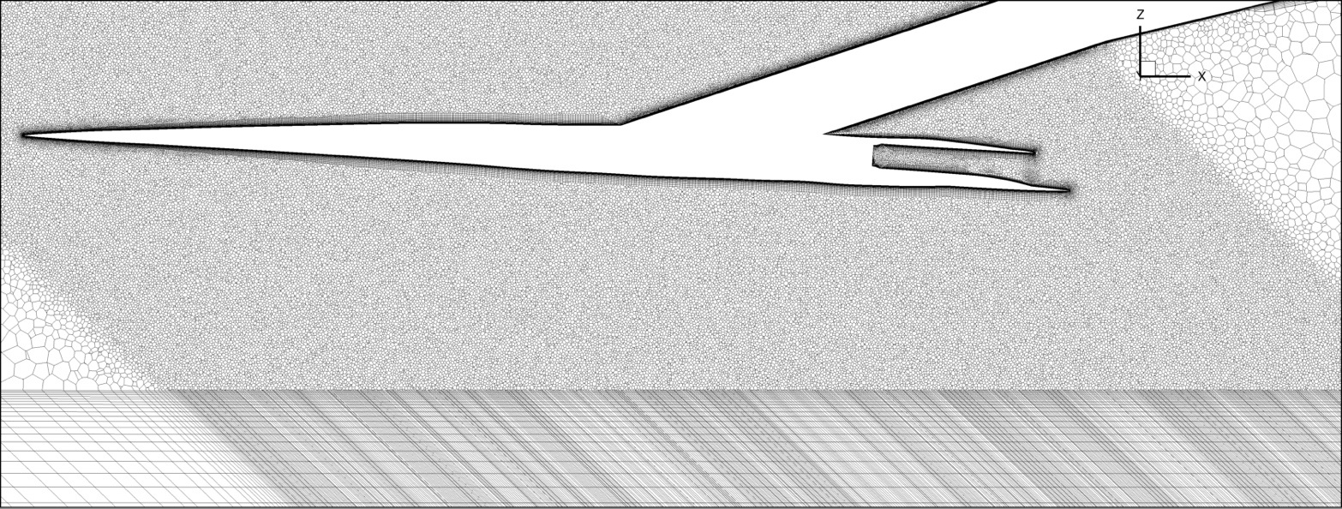
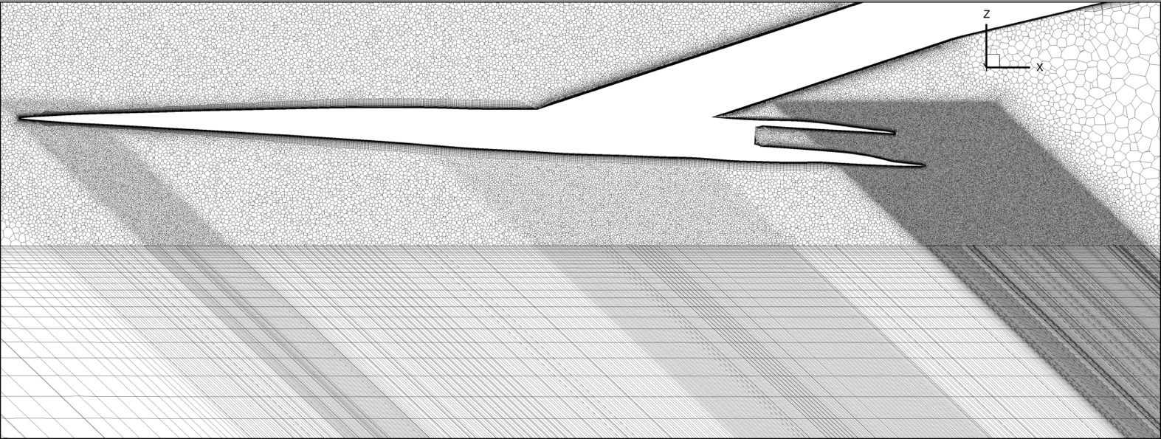
W-15 Grid Generation
Mesh resolution selected to be consistent with X-59 in terms of surface sizing and near field resolution (85.20M total cells)
Grid refinement regions placed around known regions of high gradient
Cylindrical core domain resized to be as close to the body as possible
Initial solution on W15 grid (top) informed grid development (bottom)
Symmetry slice of W-15 initial unstructured arbitrary polyhedral mesh
Symmetry slice of W-15 current unstructured arbitrary polyhedral mesh

Slide 21
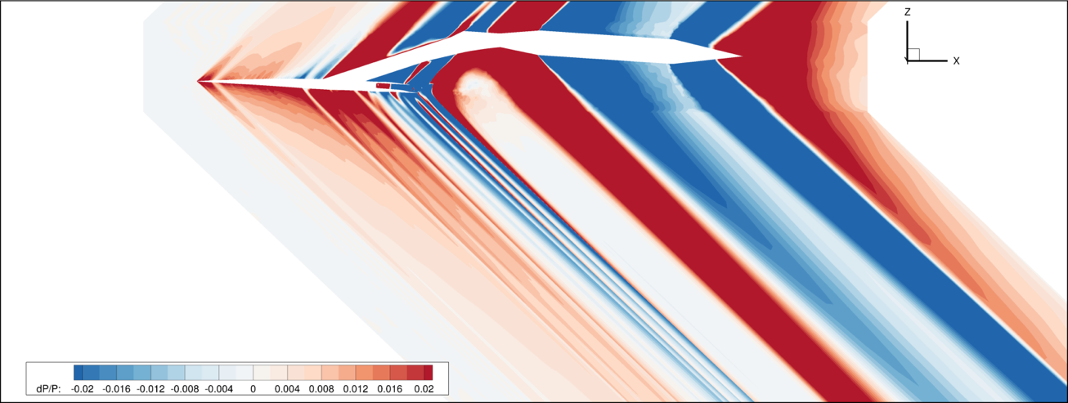
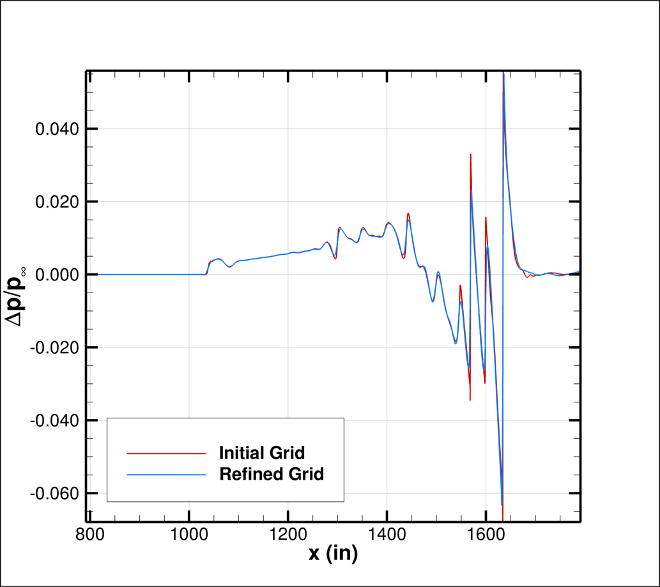
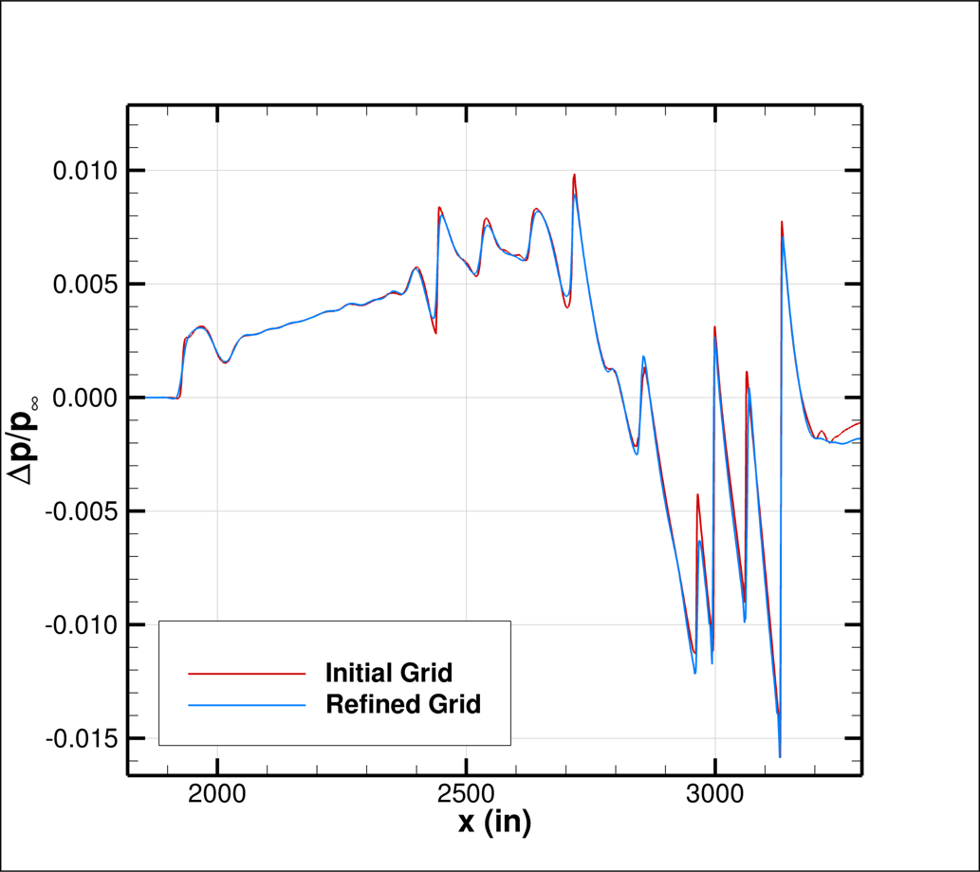
W-15 Results
Pressure signatures from initial grid generated for W15 generated compared with refined grid predictions
Extrema locations remain consistent, while local maximum and minimum values are affected by resolution
Rail 7
Rail 2

Slide 22


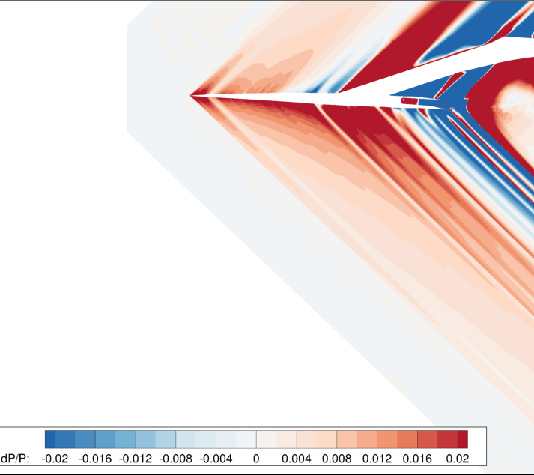
Summary of LAVA Results
Pressure signatures produced by the AS-2, X-59, and W15 have been extracted and compared from the LAVA Curvilinear and LAVA Unstructured CFD predictions
  Differences caused by AS-2 surface definition studied
  More complex X-59 and W15 geometries compared
Solvers produce highly consistent signatures, with comparisons to experiment also showing reasonable agreement

Slide 23
Acknowledgements
Analysis for this workshop was funded by the NASA Advanced Air Vehicles Program's Commercial Supersonic Technologies (CST) Project
Special thanks to James Jensen, Gaetan Kenway, Brandon Lowe, and other LAVA Team members for their technical contributions and valuable insight
Computing resources provided by NASA Advanced Supercomputing (NAS) division at NASA Ames Research Center

