Slide 1

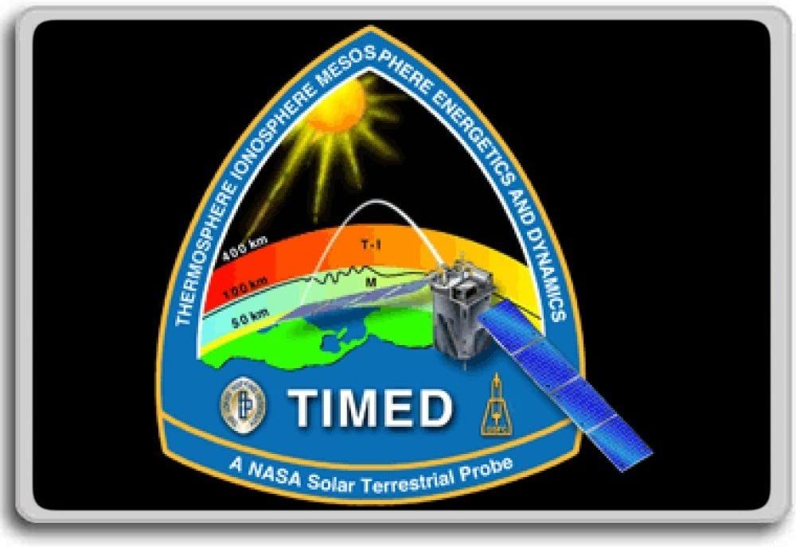

NO Concentration Derived from SABER Measurements
Ningchao Wang
Advisor: Martin Mlynczak
2022 ORAU Site visit

Slide 2
Introduction
Education Background
  Illinois Institute of Technology, 2013 – 2018 Ph.D.
Work experience
  NPP fellow, ORAU/NASA Langley Research Center, 2022.1 – present
  Post-doctoral scientist, Hampton University, 2020.2 – 2022.1
  Senior research associate, IIT, 2018.10 – 2020.2
Current project
  The behavior of Nitric Oxide Concentration in the Upper Atmosphere Derived from SABER Observations

Slide 3
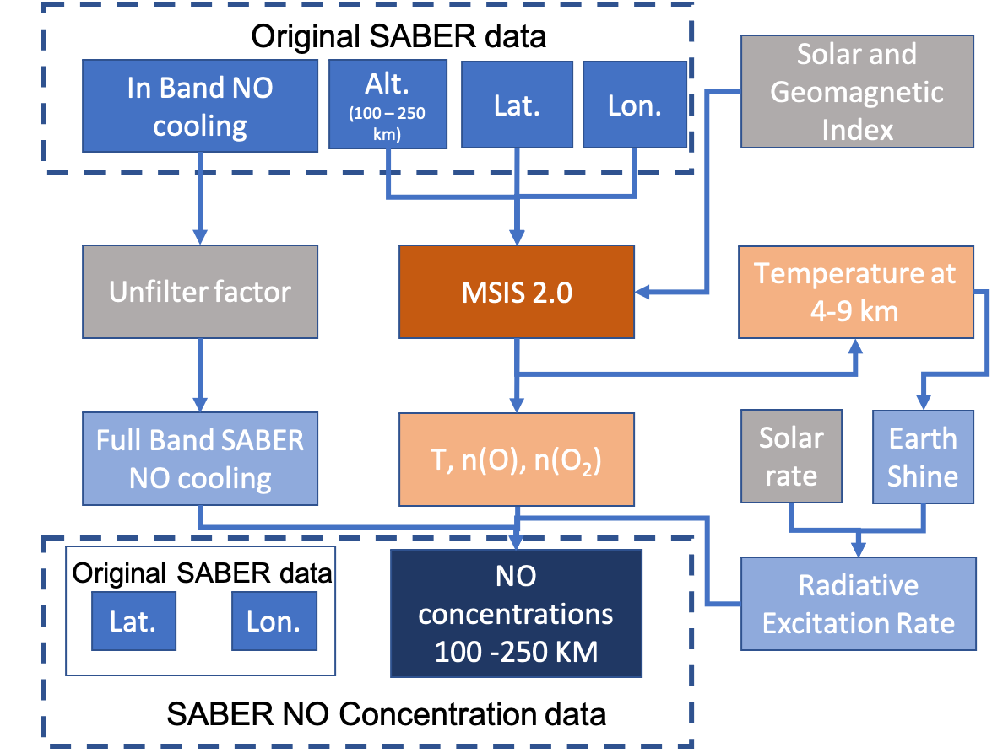
Road Map

Slide 4
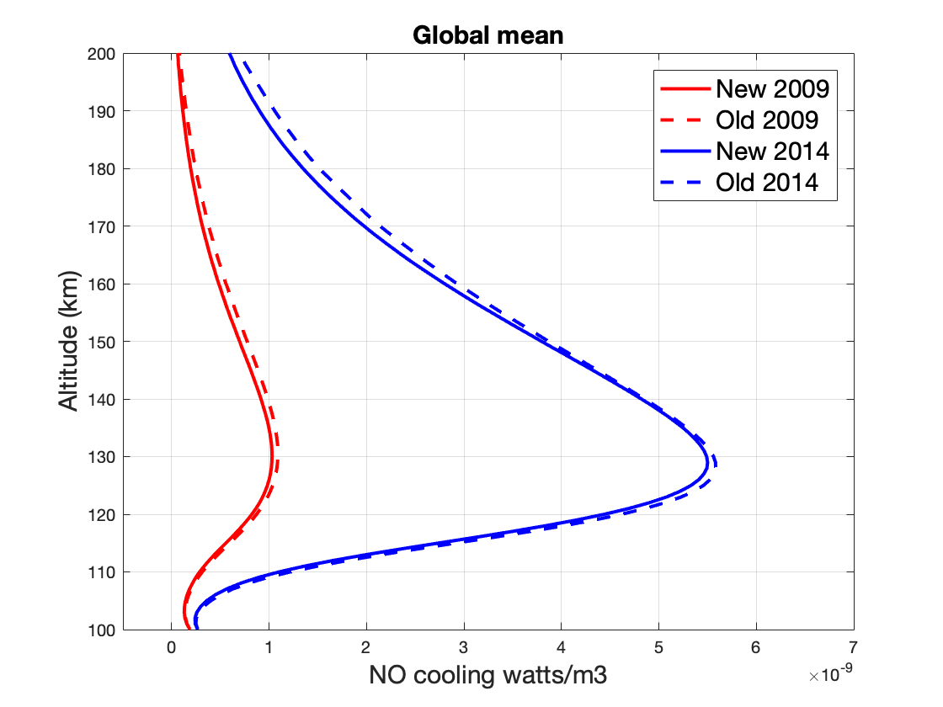
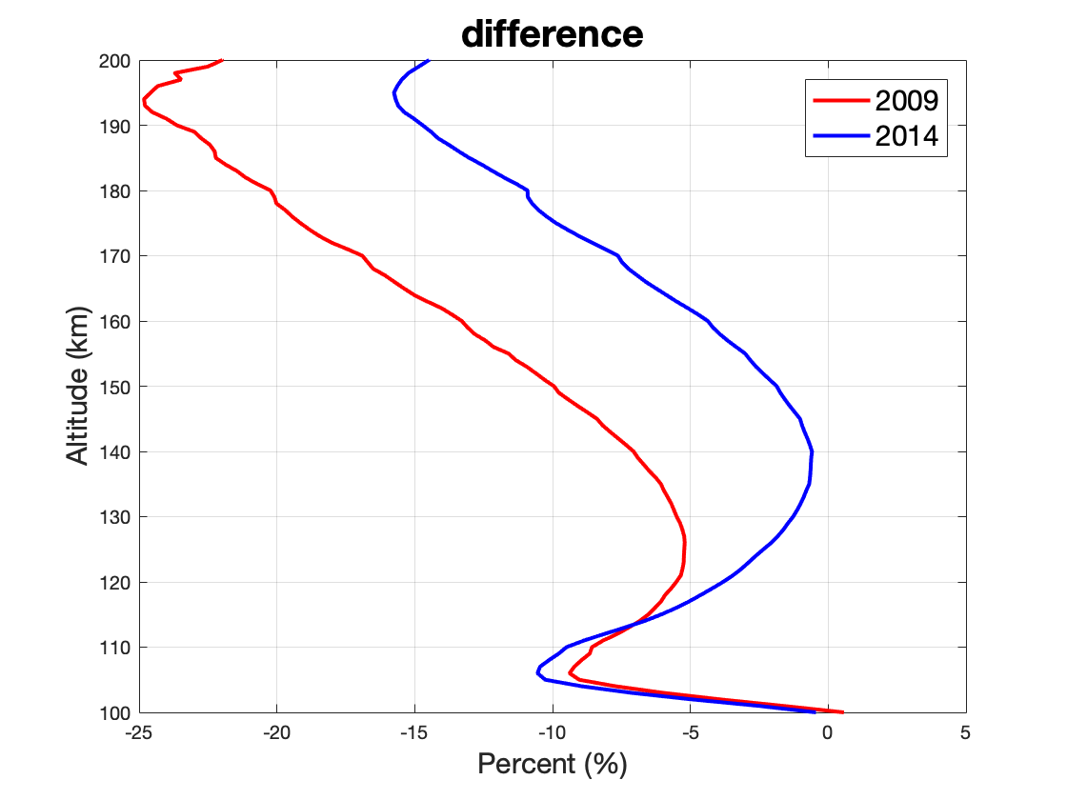
Road Map
Results

Slide 5
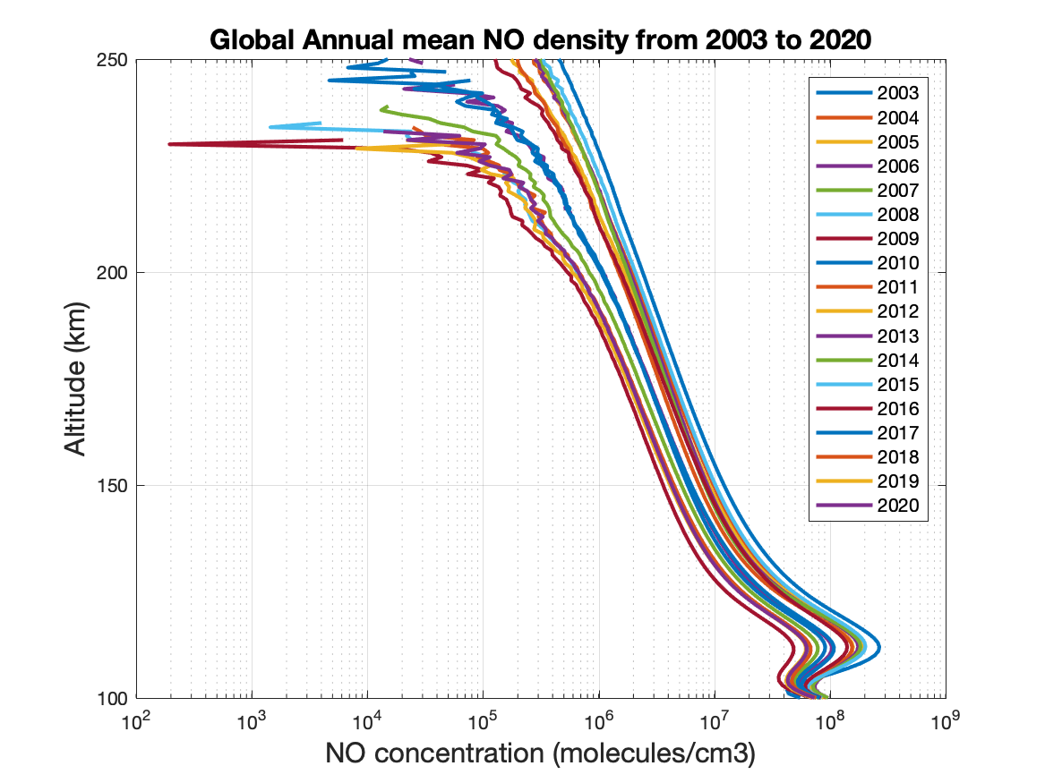
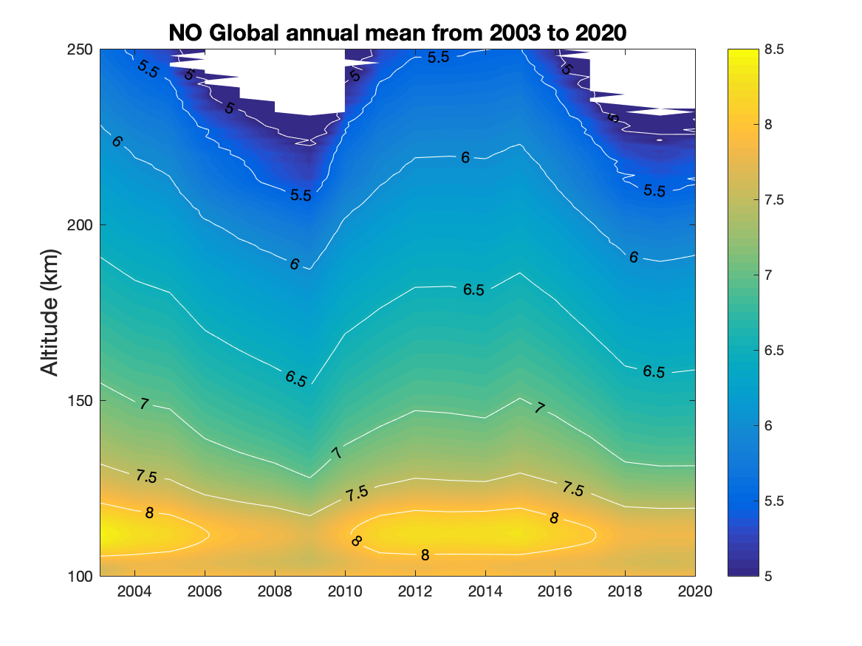
Road Map
Results
Log(n(NO))

Slide 6
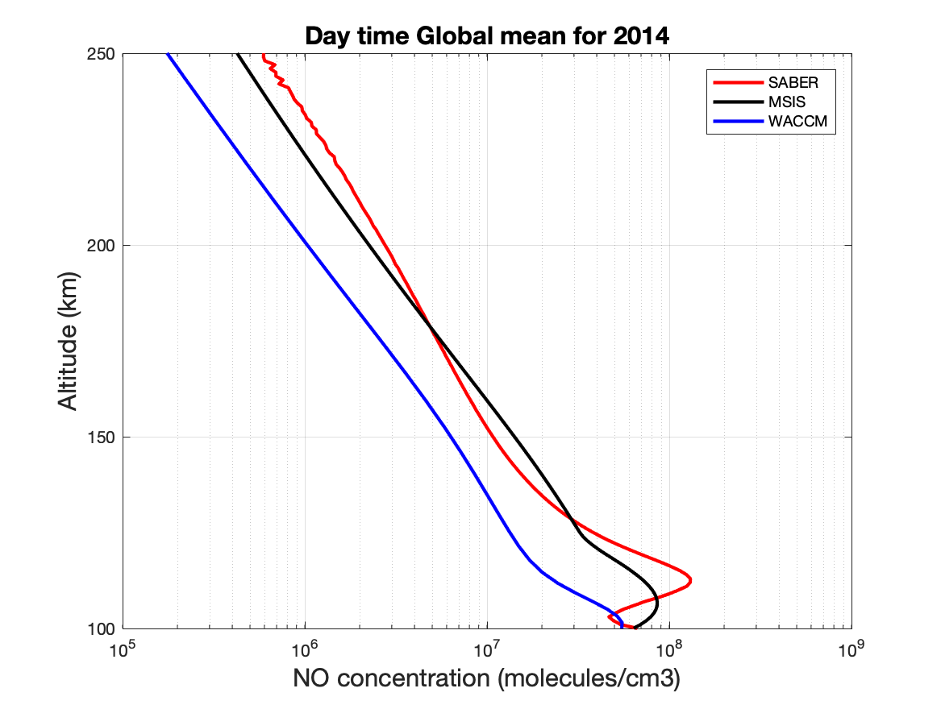
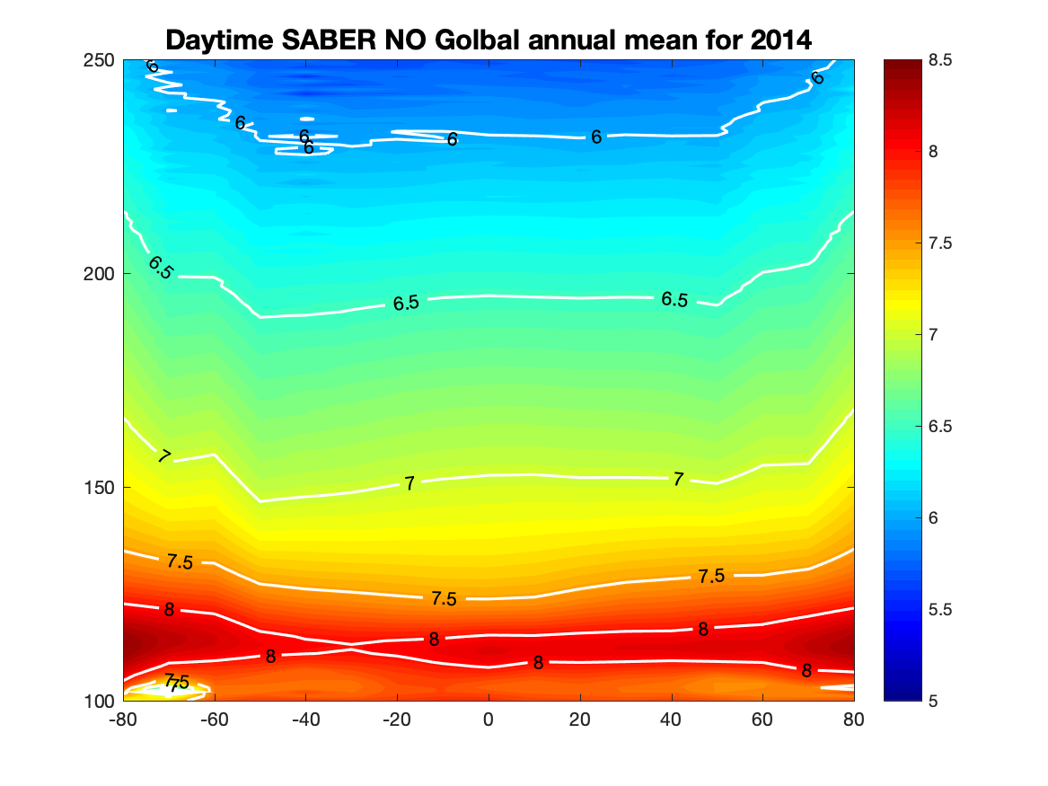
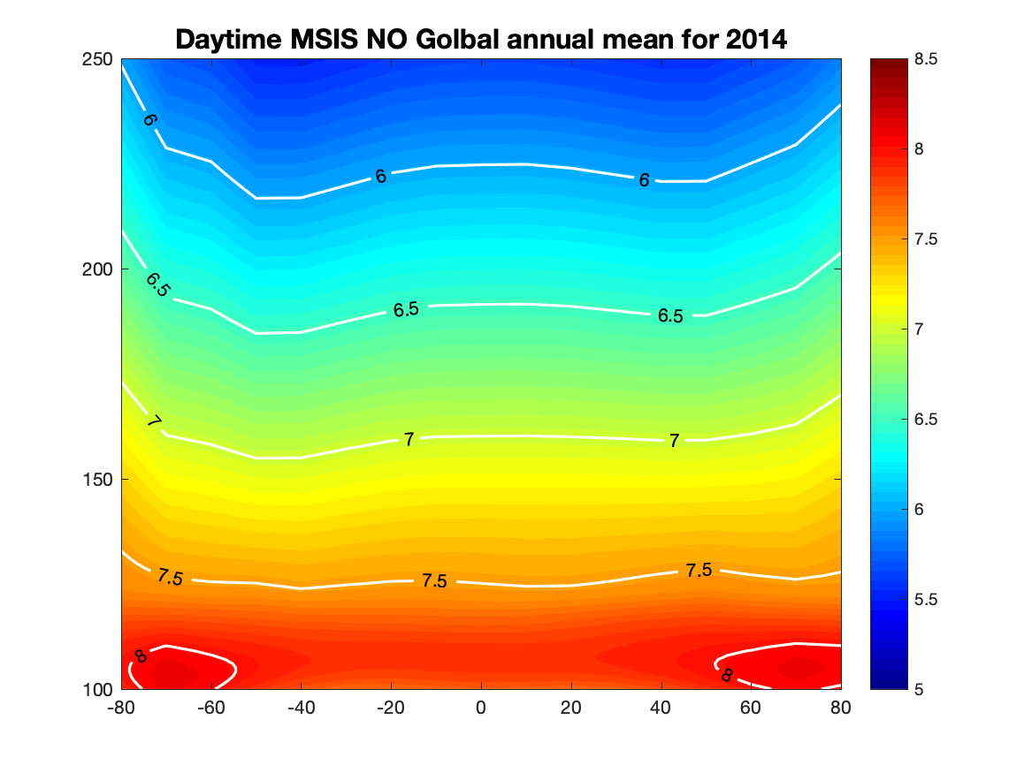
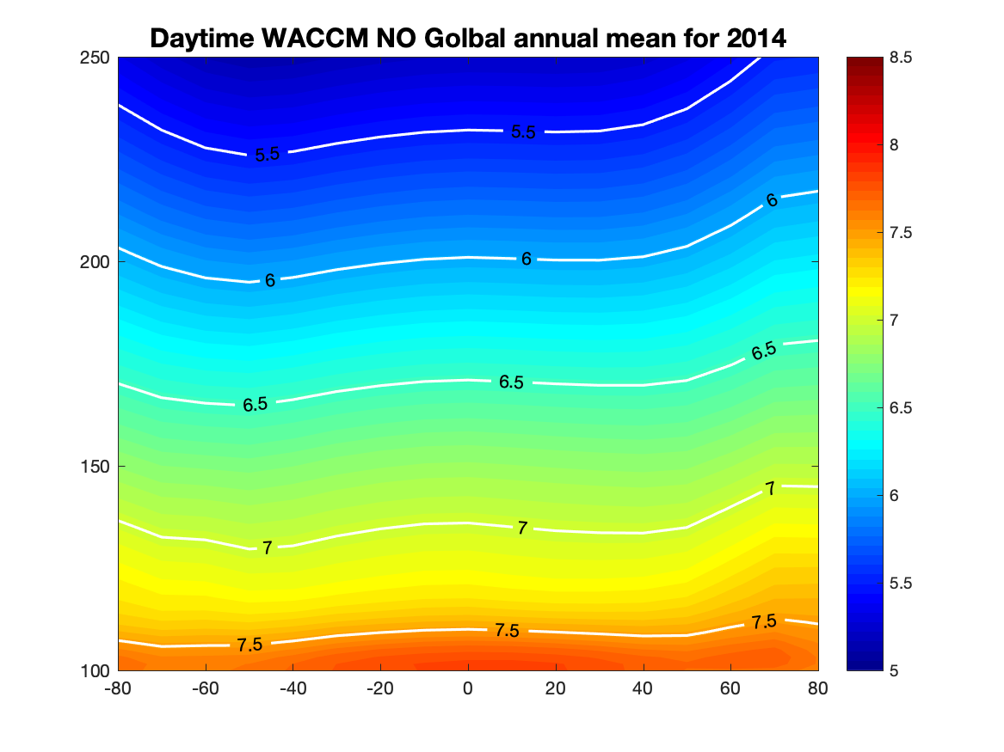
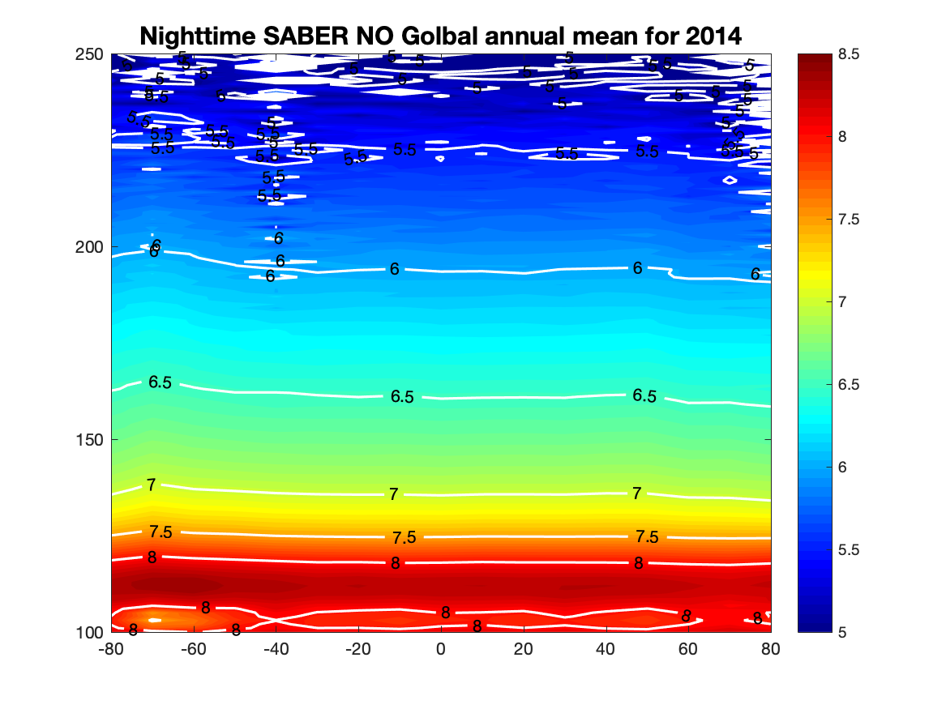
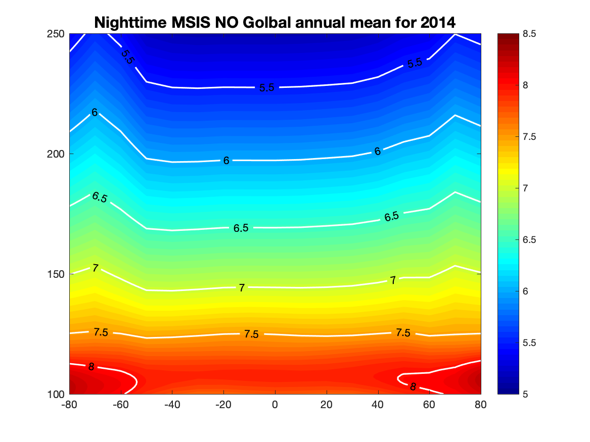
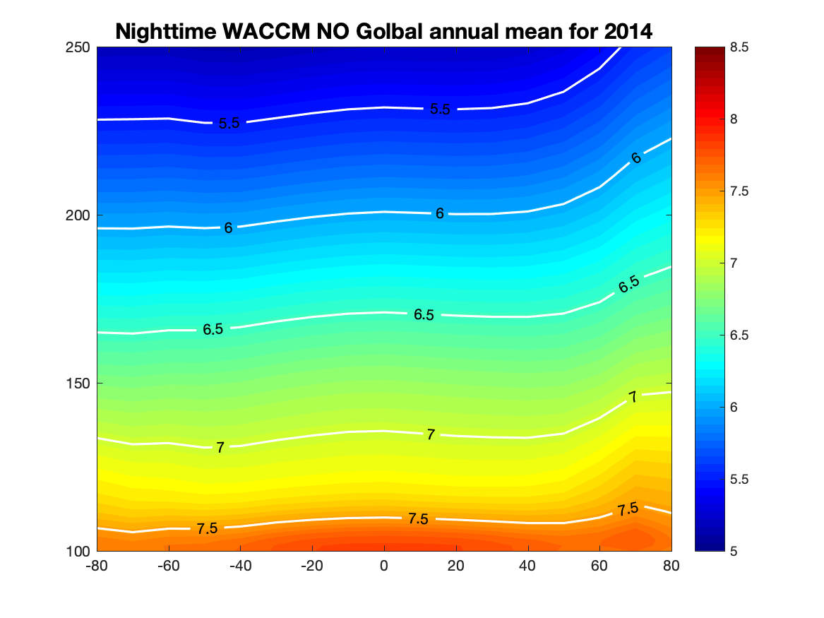
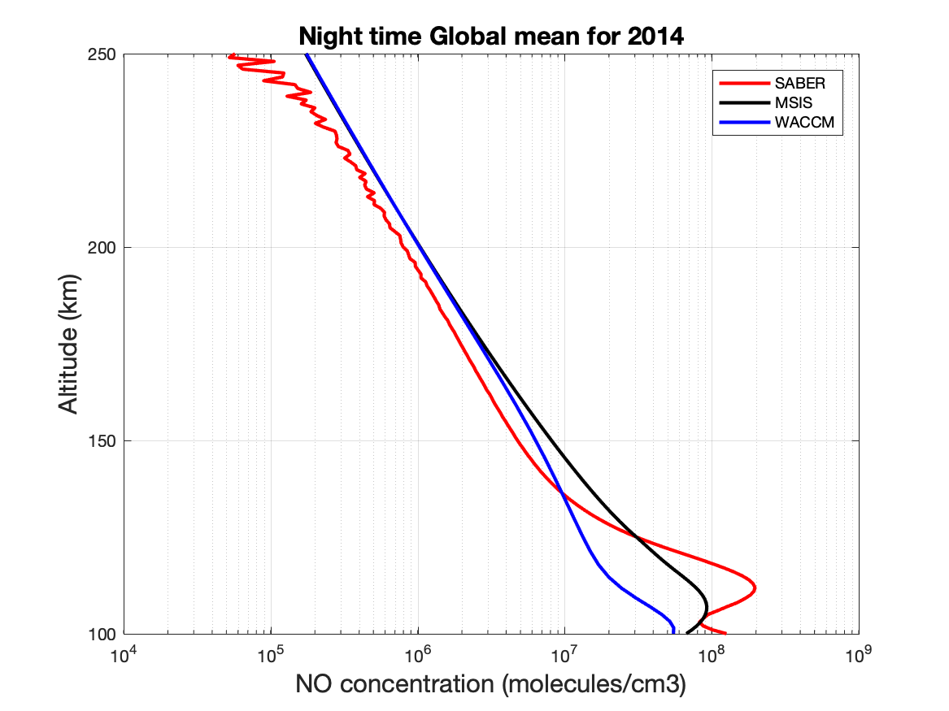
Validation and Next
Error analysis and sensitive study
Extend data to 70 km or lower
Make the data publicly available

