Slide 1
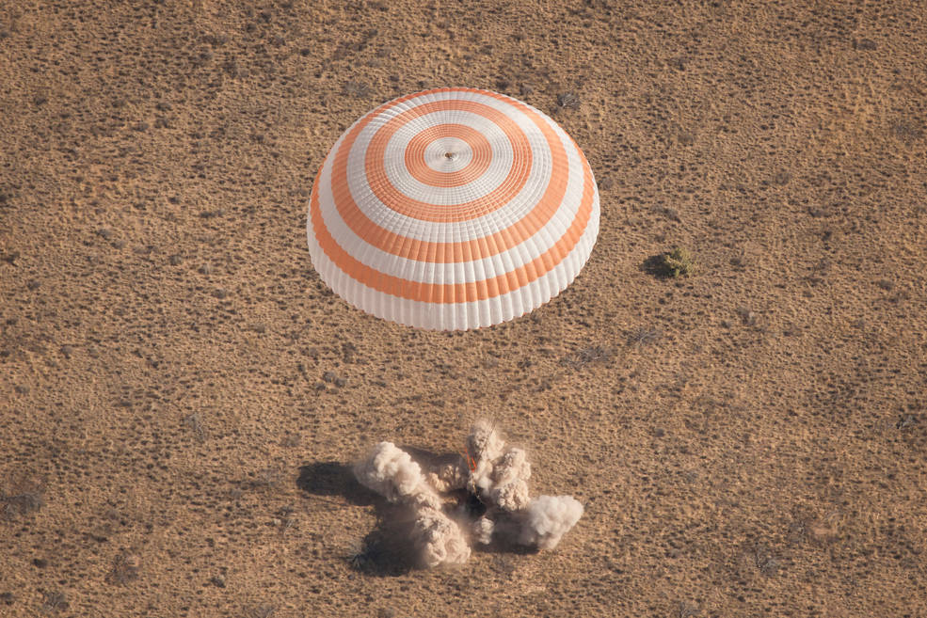
Soyuz Landing Reconstructions
Preston Greenhalgh¹, Jacob Putnam², Keegan Yates¹,
Nate Newby¹, Derek Jones³, Jeffrey Somers⁴
¹KBR - Houston, TX
²NASA (LaRC) - Hampton, VA
³Elemance LLC - Winston-Salem, NC
⁴NASA (JSC) - Houston, TX

Slide 2
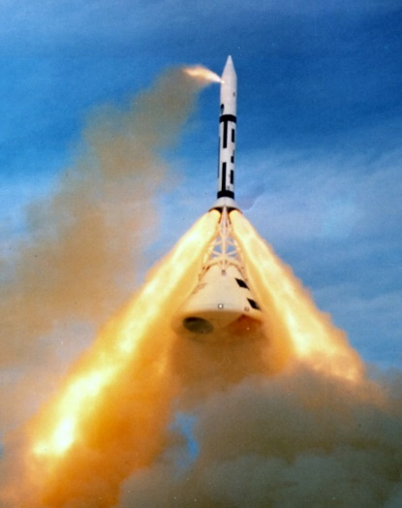
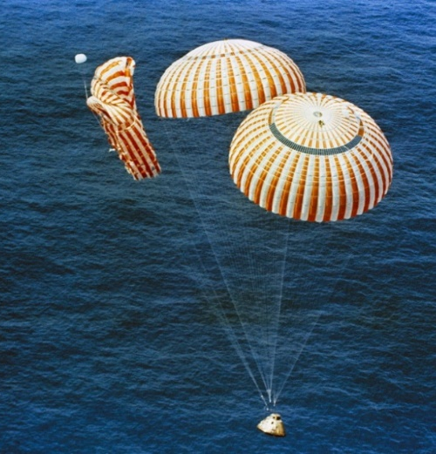
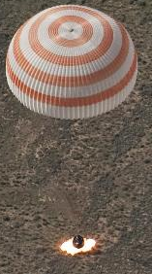
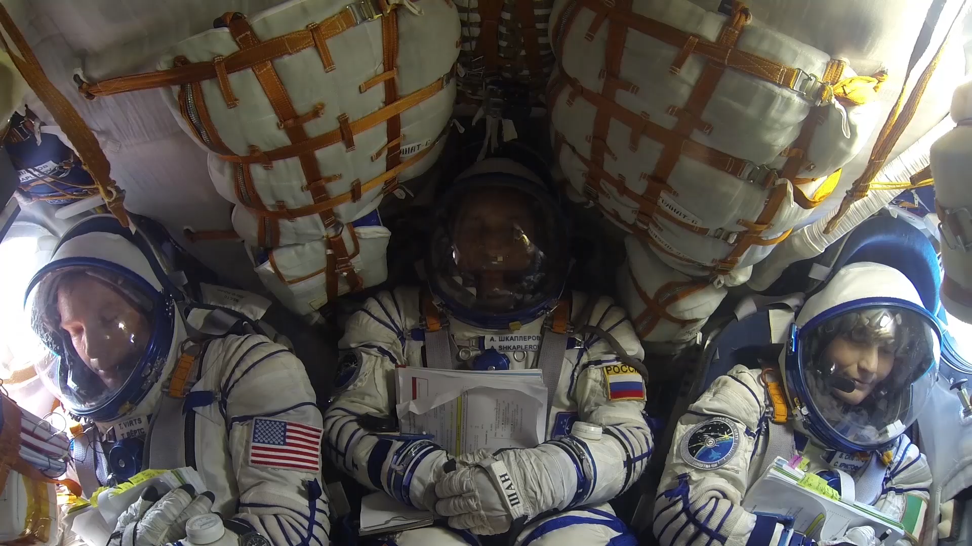
Background: Space Vehicle Dynamics
Dynamic Phases of Flight
  Launch
    All proposed vehicles launch with crew laying on their backs (eyeballs in accelerations)
  Abort
    Primarily X-axis loads (eyeballs in)
    May have significant oscillatory components
  In-Orbit
    Very benign loads
  Reentry
    Primarily X-axis loads (eyeballs in)
    May have transient dynamics due to parachute deploy
  Landing
    The landing mode is specific to the vehicle design
      Water Landing
      Land Landing
nasa.gov
nasa.gov
nasa.gov
youtube.com

Slide 3
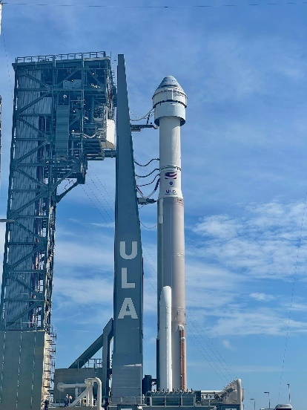
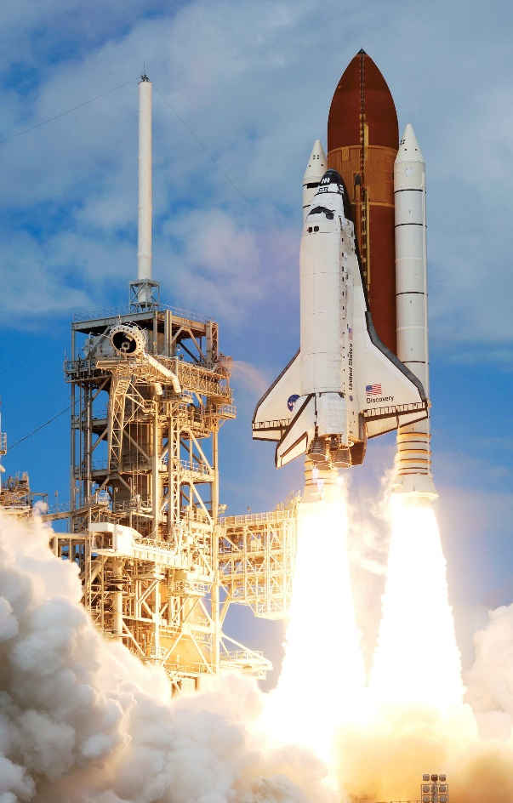
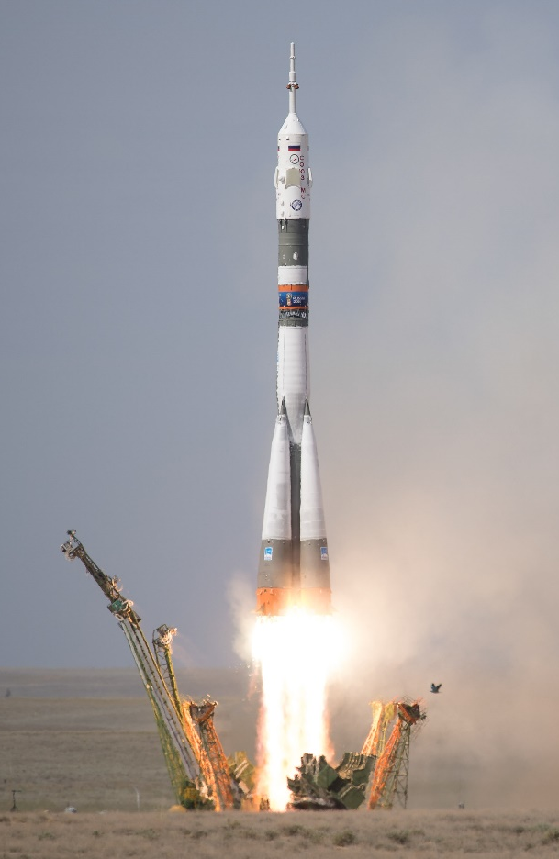
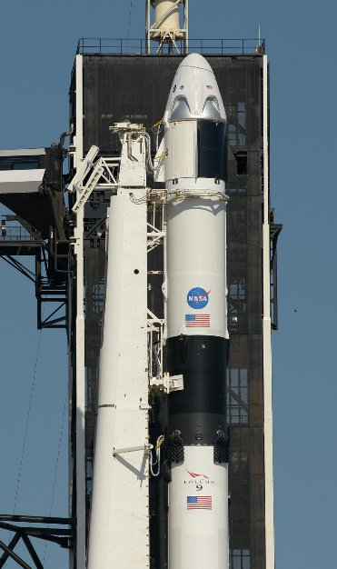
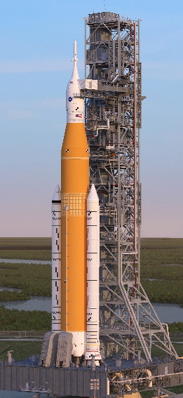
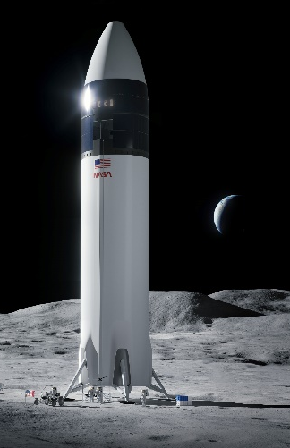
Modern Flight History
nasa.gov
nasa.gov
nasa.gov
1981—2011
2020—Current + Future

Slide 4
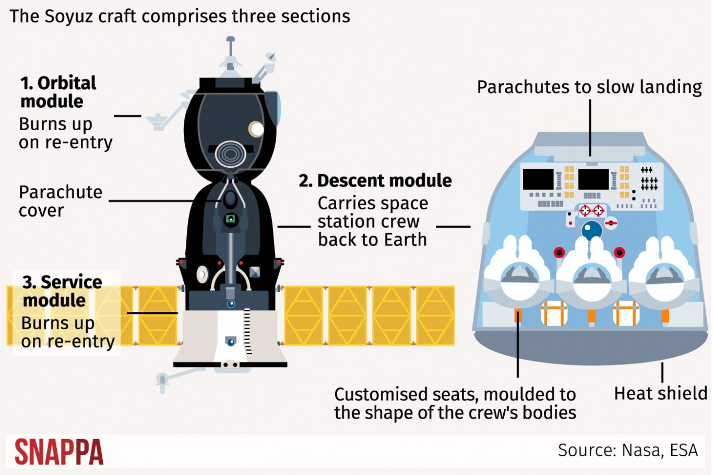
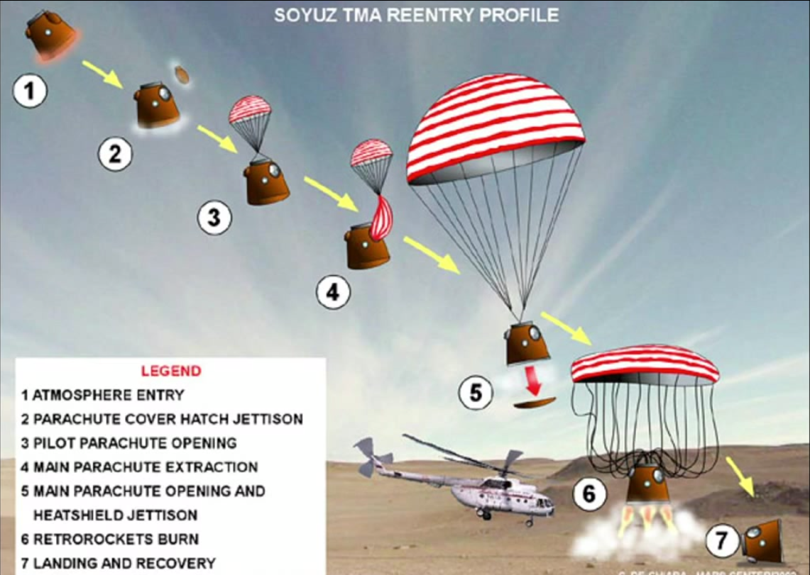
Soyuz Reentry
http://home.bt.com/news/science-news/tim-peakes-return-this-is-what-the-astronauts-journey-will-be-like-on-the-soyuz-tma-11364067838534
https://www.reddit.com/r/space/comments/2w5iw4/a_visual_representation_of_a_soyuz_reentry/

Slide 5
Soyuz Reentry & Landing Characteristics
Reentry friction slows the Soyuz from 17,000 mph to 500 mph
  Peak Gx ~4.5 for tens of seconds
  Ballistic reentry can result in ~7 Gx for tens of seconds
Main parachute slows the vehicle to ~19 mph
  Backup parachute is smaller, so higher but unknown velocity
Retro rockets fire ~3 ft above ground & slow the vehicle to ~3 mph
  Estimate peak loading of ~4-8 G
Horizontal vehicle velocity is driven by wind speeds
Ground conditions affect impact load
  Estimate ~4-8 G
Seat tilts under main chutes so crew are slightly head up
  Impact loads are mostly rear impact with some spinal loading
  Other impact directions are possible due to wind speeds & attitude at retro firing
  Seat can stroke to attenuate off-nominal loads
Vehicle often tumbles and can be dragged by parachutes
nasa.gov
nasa.gov

Slide 6
Operationally Relevant Injury Scale
The Operationally Relevant Injury Scale (ORIS) was developed to address NASA’s unique operational environment
  The new scale combines the injury severity from the AIS, a measure of a crewmember’s ability to self-egress, and a measure to estimate the time to return to flight status
Example: A clavicle fracture (AIS = 2) could prevent crewmembers from egressing (SE = 3), so it would be classified as a Class III Injury using the ORIS
Injury Severity (IS)
0 | 1 | 2 | 3 | 4 | 5 | 6
None | Minor | Moderate | Serious | Severe | Critical | Maximal
Self-Egress Capability (SE)
0 | 1 | 2 | 3 | 4
No Impact | Able with Minor Impact (within req) | Able with Major Impact (not within req) | Unable without assistance | Unable, requires rescue and/or stabilization
Return to Flight Status Estimate (FS)
0 | 1 | 2 | 3 | 4
No Delay in Return | Short Delay in Return (<3mo.) | Intermediate Delay in Return (<1y) | Long Delay in Return (>1y) | Ended Flight Status/ DQ'd
Operationally Relevant Injury Class
0 | I | II | III | IV
No Injury | Minor Injury | Moderate Injury | Severe Injury | Life-Threatening or Fatal Injury
Notes:
Weighting function, 2015 paper
SQRT(IS*0.25 + SE*0.5+FS*0.25)
The Operationally Relevant Injury Scale (ORIS) was developed to address NASA’s unique operational environment. Because the Abbreviated Injury Scale (AIS) was developed for passenger car incidents, it was determined
that a new injury classification system was needed for NASA. The new scale combines the injury severity from the AIS, a measure of a crewmember’s ability to self-egress, and a measure to estimate the time to return to flight status. All three factors are used to calculate the final classification of the injury.
Example: A clavicle fracture (AIS=2) could prevent crewmembers from egressing (SE = 3), so it would be classified as a Class III Injury using the ORIS

Slide 7
Soyuz Landing Injuries
Risk of Injury from Dynamic Loads
Metric
Injury Classification | Number of Crew Injured | Injury Rate [%] | Future Vehicle Injury Rate Requirements [%]
0 (Contusion/Abrasion) | 17 | 21.8 | <5
I (Minor) | 3 | 3.8 | <5
II (Moderate) | 3 | 3.8 | <1
III (Significant) | 0 | 0 | 0
IV (Severe) | 0 | 0 | 0
Newby N, Greenhalgh P, Somers J, “Soyuz Landing Injury Risk Characterization”, SAFE Journal 039, 1-6 (2020).
NASA/TP-2015-218578 Final NASA Panel Recommendations for Definition of Acceptable Risk of Injury due to Spaceflight Dynamic Events

Slide 8
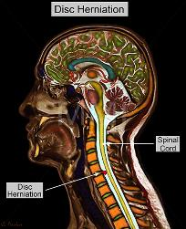
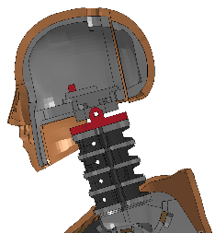
Injury Metrics
TBI
Head CG Accelerometer
Injury Metric: Transfer function between measurable mechanical response and probability of human injury
BDRC
  Estimate of injury risk based on seat acceleration
  Effectiveness predicated on similarity to seat used in development
  Injury risk calculated independently along each occupant loading direction
  Does not estimate injury location or severity
ATD Injury Metrics
  Estimate of injury risk based on ATD instrumentation
  outputs
  Account for combined axis loading on occupant system
  Estimates general injury location and severity
Cervical Fracture
Upper Neck Loadcell
ATD Metrics Used In Spacecraft Certification
Injury Metric | Human Injury | ATD Measurement
HIC (Head Injury Criteria) | Skull fracture | Head CG linear acceleration
Nij (Neck Injury Criteria) | Cervical spine fracture | Upper neck force and moments
Lumbar Load Criteria | Lumbar spine fracture | Lumber spine compressive force
Notes:
Mention limitations!

Slide 9
Problem Description
The OP team conducted a research study to quantify crew-reported and crew surgeon-documented injuries following Soyuz landings¹
  Injury rate exceeds 10% for nominal landings
  Unexpected results based on the certification analysis of Soyuz landings
The Soyuz-TMA was human-rated by NASA in the early 2000s
  Vehicle drop tests were conducted to verify crew accelerations to a variety of landing conditions
  The Brinkley Dynamic Response Criterion (BDRC) was used estimate crew injury risk for possible landing conditions
  Injury rate found in research study does not match predicted injury rate from vehicle certification analysis
Unclear why there is a discrepancy between the predicted and actual injury rates
  The Brinkley criterion underestimates the injury risk
  Spaceflight deconditioning decreases crewmember tolerance to landing impact
  The Soyuz landings are more dynamic than predicted
¹Newby et. al, Soyuz Landing Risk Characterization, SAFE Journal, 2020

Slide 10
Problem Description
All upcoming US crew vehicles (Orion, SpaceX Dragon, Boeing CST-100) are completing verification test campaigns based on the BDRC and Anthropomorphic Test Device (ATD) responses
This assessment is intended to provide data to help determine whether the current injury prediction metrics (BDRC and ATD) are adequate in predicting injury risk associated with spacecraft dynamic impact events

Slide 11
Scope of Assessment
Create a finite element model (FEM) of the Soyuz descent module (DM) using estimated outer dimensions and mass properties
Validate the Soyuz DM model using drop test data already obtained from the Engineering Data Management System (EDMS) database from the Soyuz-TMA certification
Create an FEM of Soyuz seat geometry and restraints using known dimensions
Use landing initial condition data gathered from EDMS to create distribution of landing conditions based on wind, vehicle condition, etc., to simulate Soyuz landings
  Include cases that represent actual crew landing initial conditions, prioritizing landings with known injuries
Extract estimated seat accelerations from landing simulations and drive occupant breakout simulations using various sizes of human and ATD FEMs in the Soyuz seat model
  Compare injury risk estimates with the injury outcome data from International Space Station (ISS) crew

Slide 12
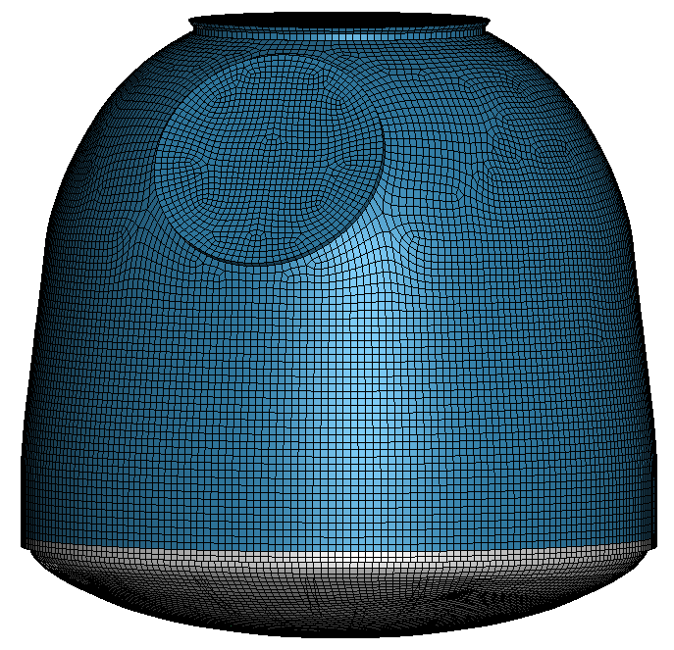
1. Development of Soyuz DM FEM – Structure
Geometry
Shape Isolation + Vectoring
3D Object + Dimensioning
FEM Mesh
Inkscape
Blender
Hypermesh
Semi-deformable vehicle model developed
  Upper bell structure – rigid shell
  Bottom hull – deformable w/internal structure explicitly modeled
Structural material identified in literature
Mass/CG tuned to match design specifications
Hull density + fixed point mass

Slide 13
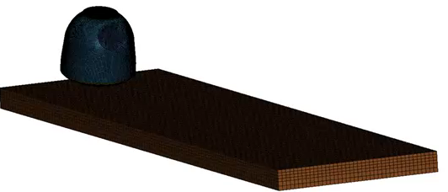
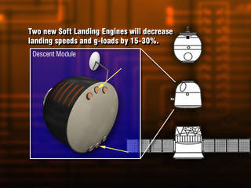
1. Development of Soyuz DM FEM – Landing Environment
Soyuz tested in controlled drop tests on various materials
  No retro rocket
Measured impact conditions used to recreate
test conditions through simulation and calibrate the FEM
  Acceleration
  Angular rotational velocity
  Hull deformation
  Video (kinematics)
Sensitivity analysis performed on soil environment model to quantify effect of parameter changes on landing acceleration
Soft Landing Engines (SLE) used during Soyuz landing
to limit landing impact acceleration
nasa.gov

Slide 14
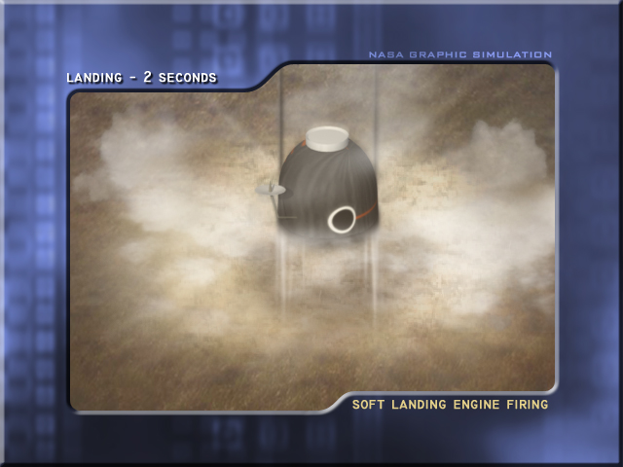
2. Validation of DM FEM
4 Airborne Drop Tests
  Known conditions
    SLE firing: Altitude, velocity, SLE acceleration
    Landing: Vehicle orientation, velocity, seat acceleration time histories
  Unknown conditions
    Vehicle orientation at SLE firing
Landing simulated from SLE firing initial conditions
  Prediction of SLE acceleration, impact velocity, and impact time used to evaluate SLE thrust models
  Prediction of seat acceleration used to evaluate vehicle and soil models
nasa.gov

Slide 15
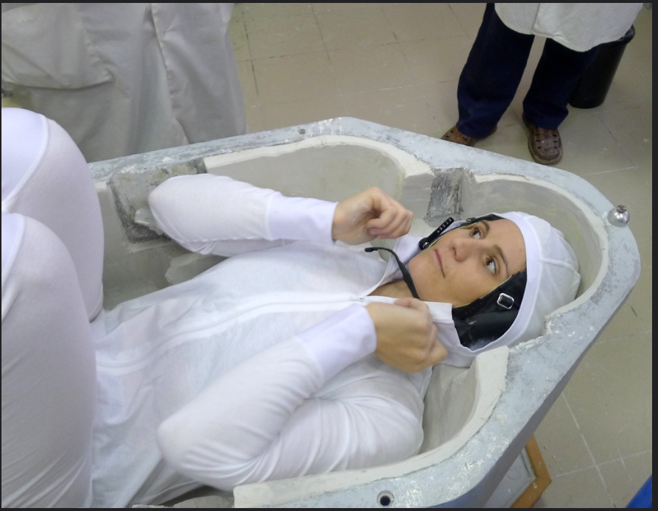
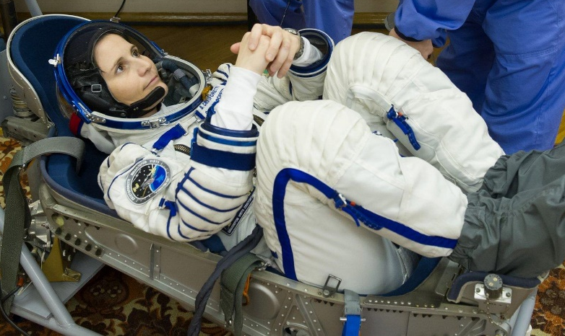
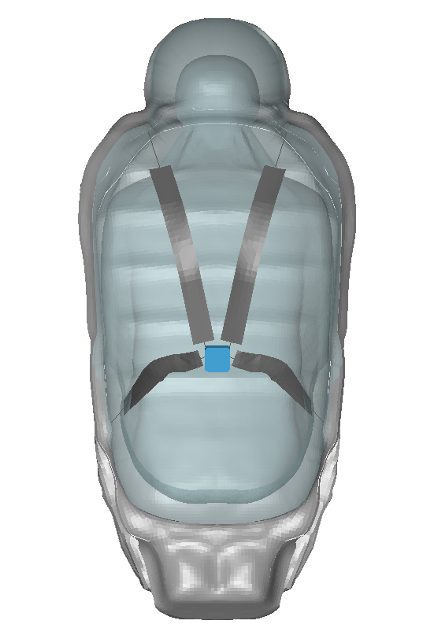
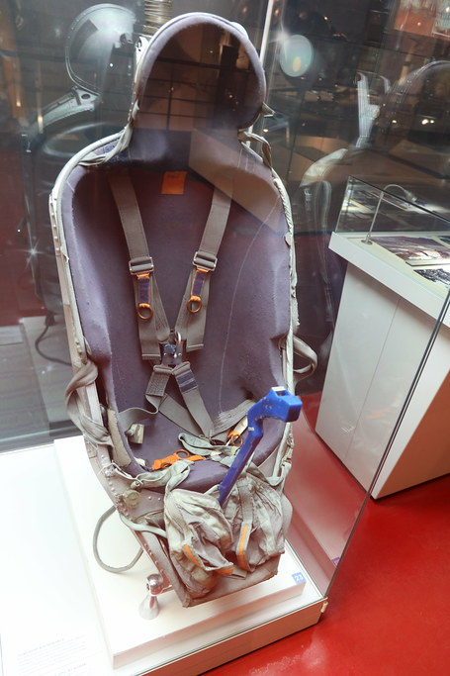
3. Development of Soyuz Occupant Model – Seat
Seat FEM generated from 3D scans taken of Soyuz trainer seat and liner (TM) and Soyuz mockup seats (TMA)
Component measurements used to verify scan data — scale to TMA configuration
www.flickr.com/photos/astrosamantha
www.flickr.com/photos/astrosamantha
www.flickr.com/photos/zaruka

Slide 16
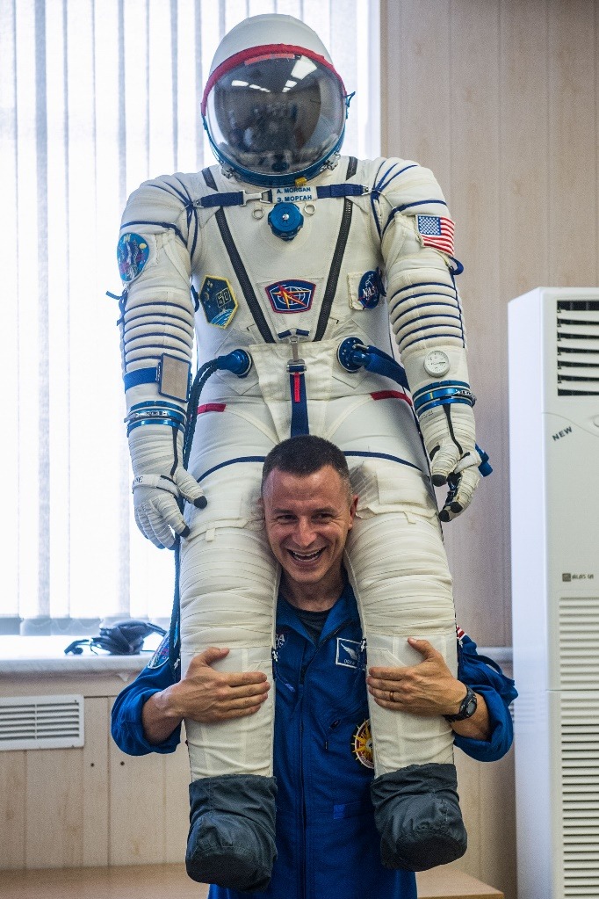
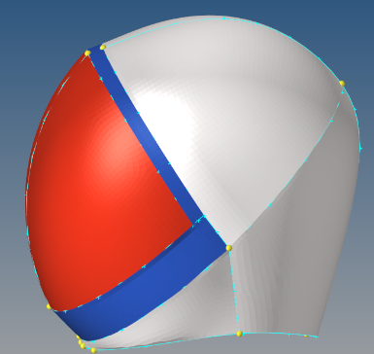
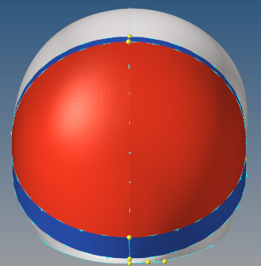
3. Development of Soyuz Occupant Model – Sokol Helmet
Sokol helmet FEM generated within occupant model to capture potential occupant-to-helmet interactions observed in Soyuz landing videos
Sokol Suit FEM Development:
  3D scans of Sokol suit provided by Aerospace Human Systems Lab Texas A&M
  Helmet geometry gathered from scan and converted into smooth continuous surface
  Converted from surfaces to shell element FEM
nasa.gov

Slide 17
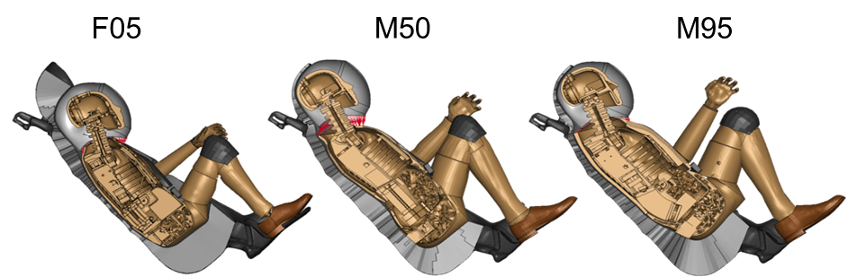
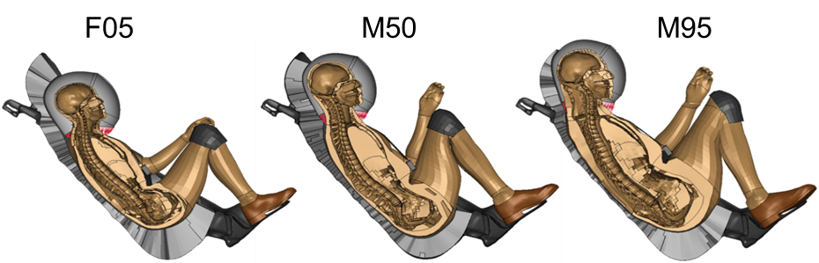
3. Development of Soyuz Occupant Model – Occupant Fit
Small Female (HIII-F05), Mid-Size Male (HIII-M50), and Large Male (HIII-M95) occupant sizes used in analysis
  Seat liner model conformed to match shape of each occupant model within seat
ATD F05 and M95, HBM M95 anthropometries were outside the height and weight limit requirements for flight on Soyuz
  Included to bookend anthropometric ranges and study seat fit effects on occupant response
ATD hip angle was adjusted beyond physical limitations to achieve the acute hip angle required to fit into the Soyuz seat
  Not determined to effect injury mechanism evaluated with ATD
Hybrid III ATD
GHBMC

Slide 18
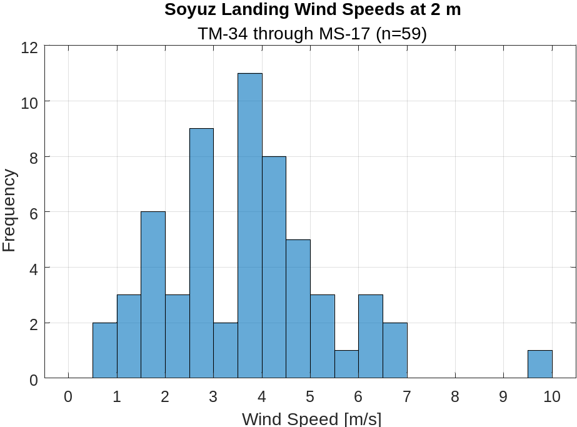
4. Simulation of Landing Impacts – Identification of Landing Variables
Variables needed to characterize the Soyuz landing environment at SLE firing state gathered using Soyuz documentation, test data, and historic weather data
Descent velocity
  Mean: Gathered from report on Soyuz crew impacts
  Range/Distribution: Estimated from landing velocity distribution data
Wind speed
  Mean/Range/Distribution: Computed from historic landing conditions gathered from NASA POWER Project weather data
SLE firing altitude
  Mean: Gathered from report on Soyuz landing equipment
  Range: Estimated from airborne drop test data
DM Condition: Pitch, roll, mass
  Mean/Range/Distribution: Gathered from analysis of crew landings and landing aid documentation

Slide 19
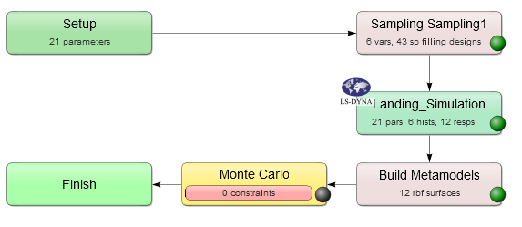
4. Simulation of Landing Impacts – Generalized Landing Distribution
Distribution analysis developed in LS-OPT
  6 input variables | space filling point selection | 43 simulations
    Velocity (descent & wind), height, angle (pitch & roll), mass
  6 histories – drive occupant simulations
    CG kinematics (linear acceleration
    and rotational velocity)
  12 responses – landing risk evaluation
    Directional peak seat acceleration

Slide 20
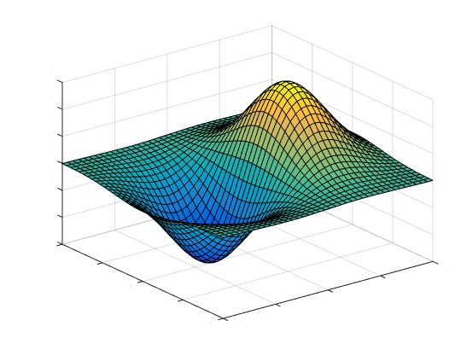
4. Simulation of Landing Impacts – Generalized Landing Distribution
Acceleration
Variable 1
Variable 2
Compare to Certification Results
mathworks.com

Slide 21
4. Simulation of Landing Impacts–Historic Landing Re-creation
Historic Soyuz landings with relevant injury outcomes were selected for landing model recreation analysis
Five landings with NASA ORIS relevant injury outcomes were identified
  Contusion/abrasion injuries not included–not considered relevant to prediction capability of current tools/metrics
  Injuries associated with pre-existing conditions not included
Reduced distribution analysis performed (23 simulations)
for each landing case identified
  Wind speed and vehicle roll angle estimated from weather data and landing video/images/descriptions
  Variable distributions developed for generalized landing distribution used for remaining variables
NASA Operationally Relevant Injury Scale (ORIS)
Class | Description
Class I | Minor injury that would not impede performance or egress; no long-term health risks
Class II | Moderate injury that may delay self-egress; possible short-term health risks
Class III | Significant injury that would require assisted egress and subsequent survival operations; possible long-term health risks
Class IV | Severe injury and possible threat to life; probable long-term health impacts
Flight Cases Selected for Re-creation
Flight Cases | Injury Description (ORIS)
1 | Class I neck
2 | Class I neck
3 | Class II back
4 | Class I neck
5 | Class I hip, Class II lower back

Slide 22
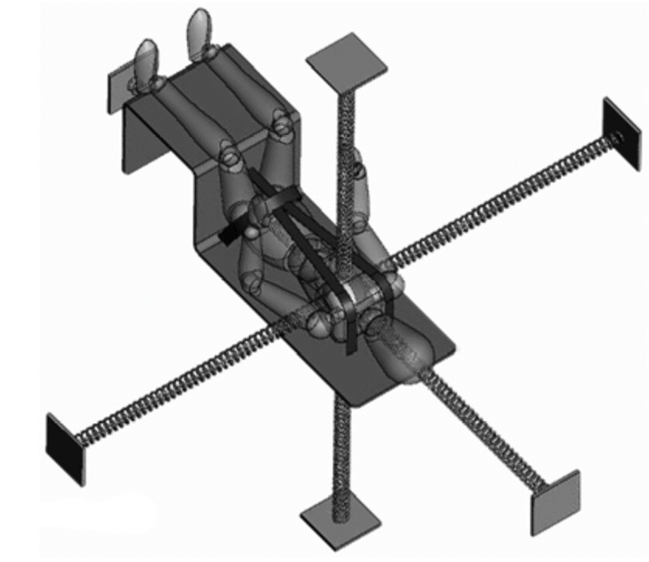
4. Simulation of Landing Impacts–Historic Landing Re-creation
Elevated injury risk was predicted in 3/5 historic injurious landing cases using the BDRC injury metric certification criteria for deconditioned crew
  Lack of elevated injury risk prediction in two cases indicate limitations of BDRC
  BDRC evaluates risk along individually loaded occupant axes, limited in complex multi-axis loading environments
Found trends of higher BDRC values in certain roll orientations
Lawrence et al. (2009)

Slide 23
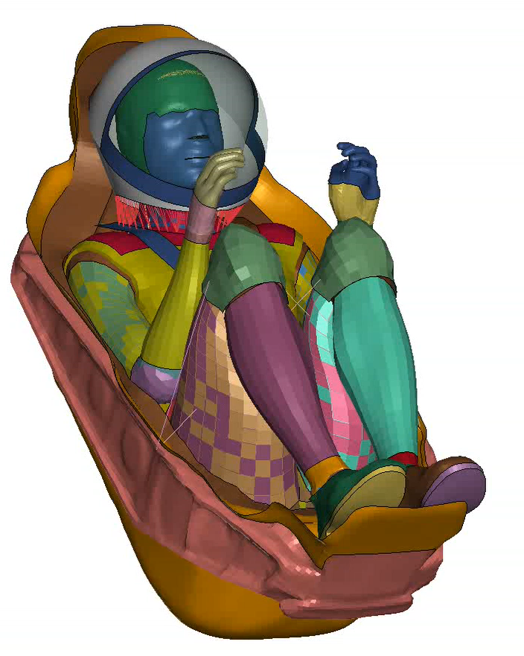
5. Occupant Model Simulation
Vehicle kinematics (linear acceleration + rotational velocity) predicted by the landing model were used to drive occupant breakout model simulations for each recreated landing case distribution
ATD M50 injury risk predictions used to evaluate current ATD injury metric criteria used in spacecraft certification
  F05 and M95 evaluation limited by anthropometries being outside flight requirements
HBM models included to study differences in occupant response prediction between HBM and ATD models within relevant spaceflight environment
  No spacecraft certification requirements currently include HBM injury metric criteria
  HBM injury metric criteria have not been validated for spaceflight relevant environments

Slide 24
5. Occupant Model Simulation–Comparison of Injury Risk Prediction
Spacecraft certification requirements evaluated against recorded crew landing injuries using predicted BDRC and ATD M50 occupant model outputs
Elevated injury risk was predicted in 5/5 historic injurious landing cases using the ATD M50 injury metric certification criteria for deconditioned crew
Spinal injury risk correctly identified
  ATD limited in prediction of location along spine
Results indicate capability of current injury metric tools to identify landing cases with elevated injury risk
  Injury metrics predict risk of injury not guaranteed occurrence
  Further assessment of injury risk precision would require measured Soyuz landing accelerations

Slide 25
Findings
Discovered primary contributors to peak acceleration
Peak vehicle acceleration does not directly correlate with BDRC injury risk due to differences in musculoskeletal tolerance over each loading direction
Elevated injury risk was predicted in three of five historic injurious landing cases, recreated through landing distribution simulations using the BDRC injury metric certification criteria for deconditioned crew
Elevated injury risk was predicted in five of five historic injurious landing cases, recreated through landing distribution simulations using the ATD injury metric certification criteria for deconditioned crew
The ATD models are limited in their ability to predict detailed injury location
Measured Soyuz landing accelerations are required to quantify the precision of current injury metric criteria using historic Soyuz landing injury data

Slide 26
Thank You!

