Slide 1
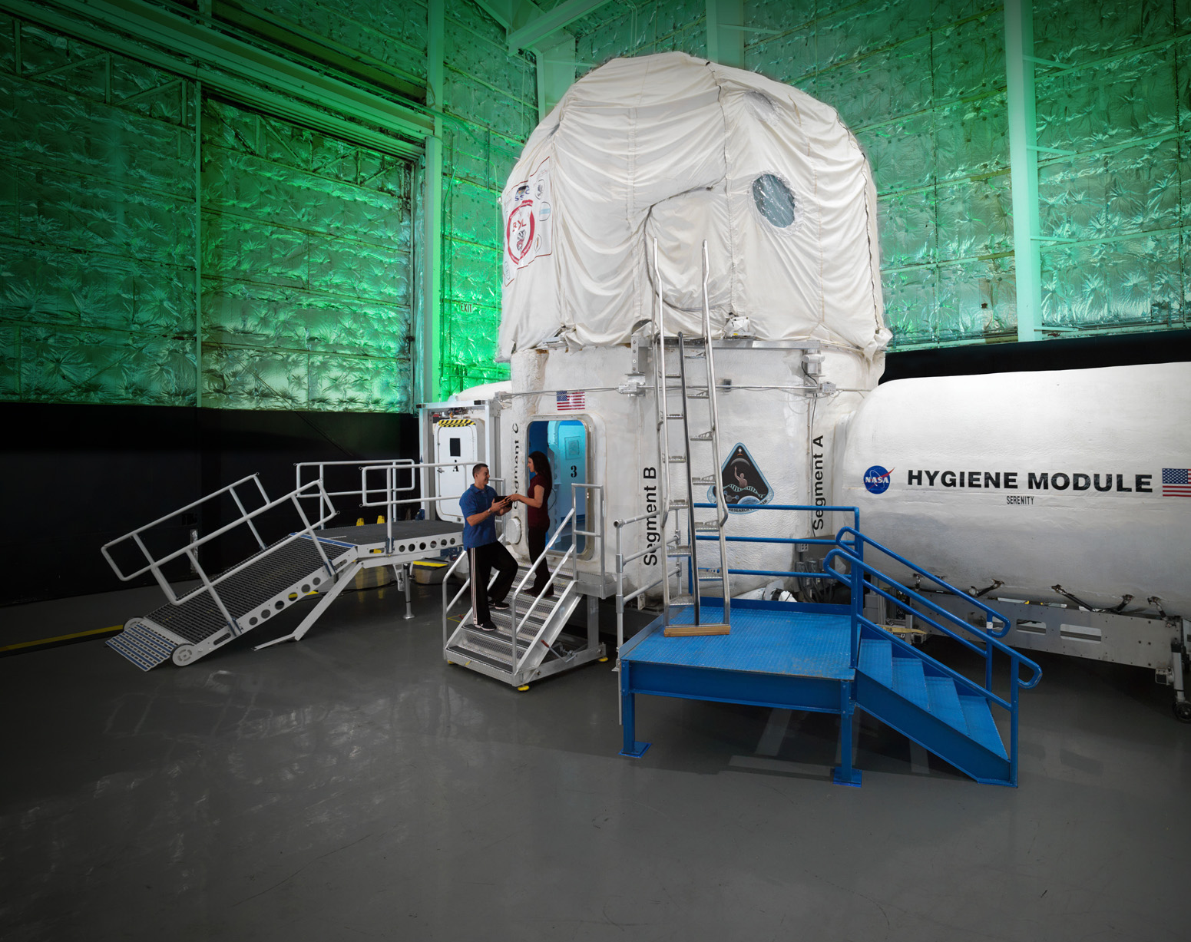
Spaceflight Analogs
Sara Whiting & Lorrie Primeaux
Research Operations & Integration
NASA Human Research Program
Sara.Whiting@nasa.gov
Lorrie.L.Primeaux@nasa.gov

Slide 2


My Background - Sara
B.A. Psychology (2006)
Smith College
Research Coordinator (2006-2009)
MGH & Hartford Hospital
Ph.D. Clinical Psychology (2015)
Louisiana State University
Residency (2014-2015)
Mississippi Medical Center/VA Hospital
Neuropsychology Fellowship (2015-2017)
Baylor CoM/Texas Children’s Hospital
Private Practice Owner (2017-2020)
Summit Neuropsychology and Behavioral Health, PLLC

Slide 3
Behavioral Medicine Scientist (KBR Inc.) (2020-2022)
  Behavioral Health & Performance Lab
  HFBP Element – Discipline Scientist
  BMed Risk Custodian – Human System Risk Board
Deputy Element Scientist, Flight Analogs (NASA) (Current)
  Scientific & technical oversight of flight analogs and the ops team
  Collaborations with international partners
  Screening and selection for flight analog crew
  NASA Institutional Review Board
  Internal SME in behavioral and cognitive health
    ROBoT-r & Cognition Test Battery

Slide 4
My Background - Lorrie
Staff Accountant
(1993-1999)
Private Firm
B.S. Biology (2002)
University of Houston – Clear Lake
Wyle/KBR
(2003-Present)

Slide 5
Experiment Support Coordinator (Wyle/KBR) (2003-2005)
  Cellular Biotechnology/Biological Systems Office
Flight Analogs (Wyle/KBR) (2005-Present)
  Analog Science Lead (Current)
  Project Manager
  Operations Lead
  Project Planning and Support Lead
  Integration Coordinator

Slide 6
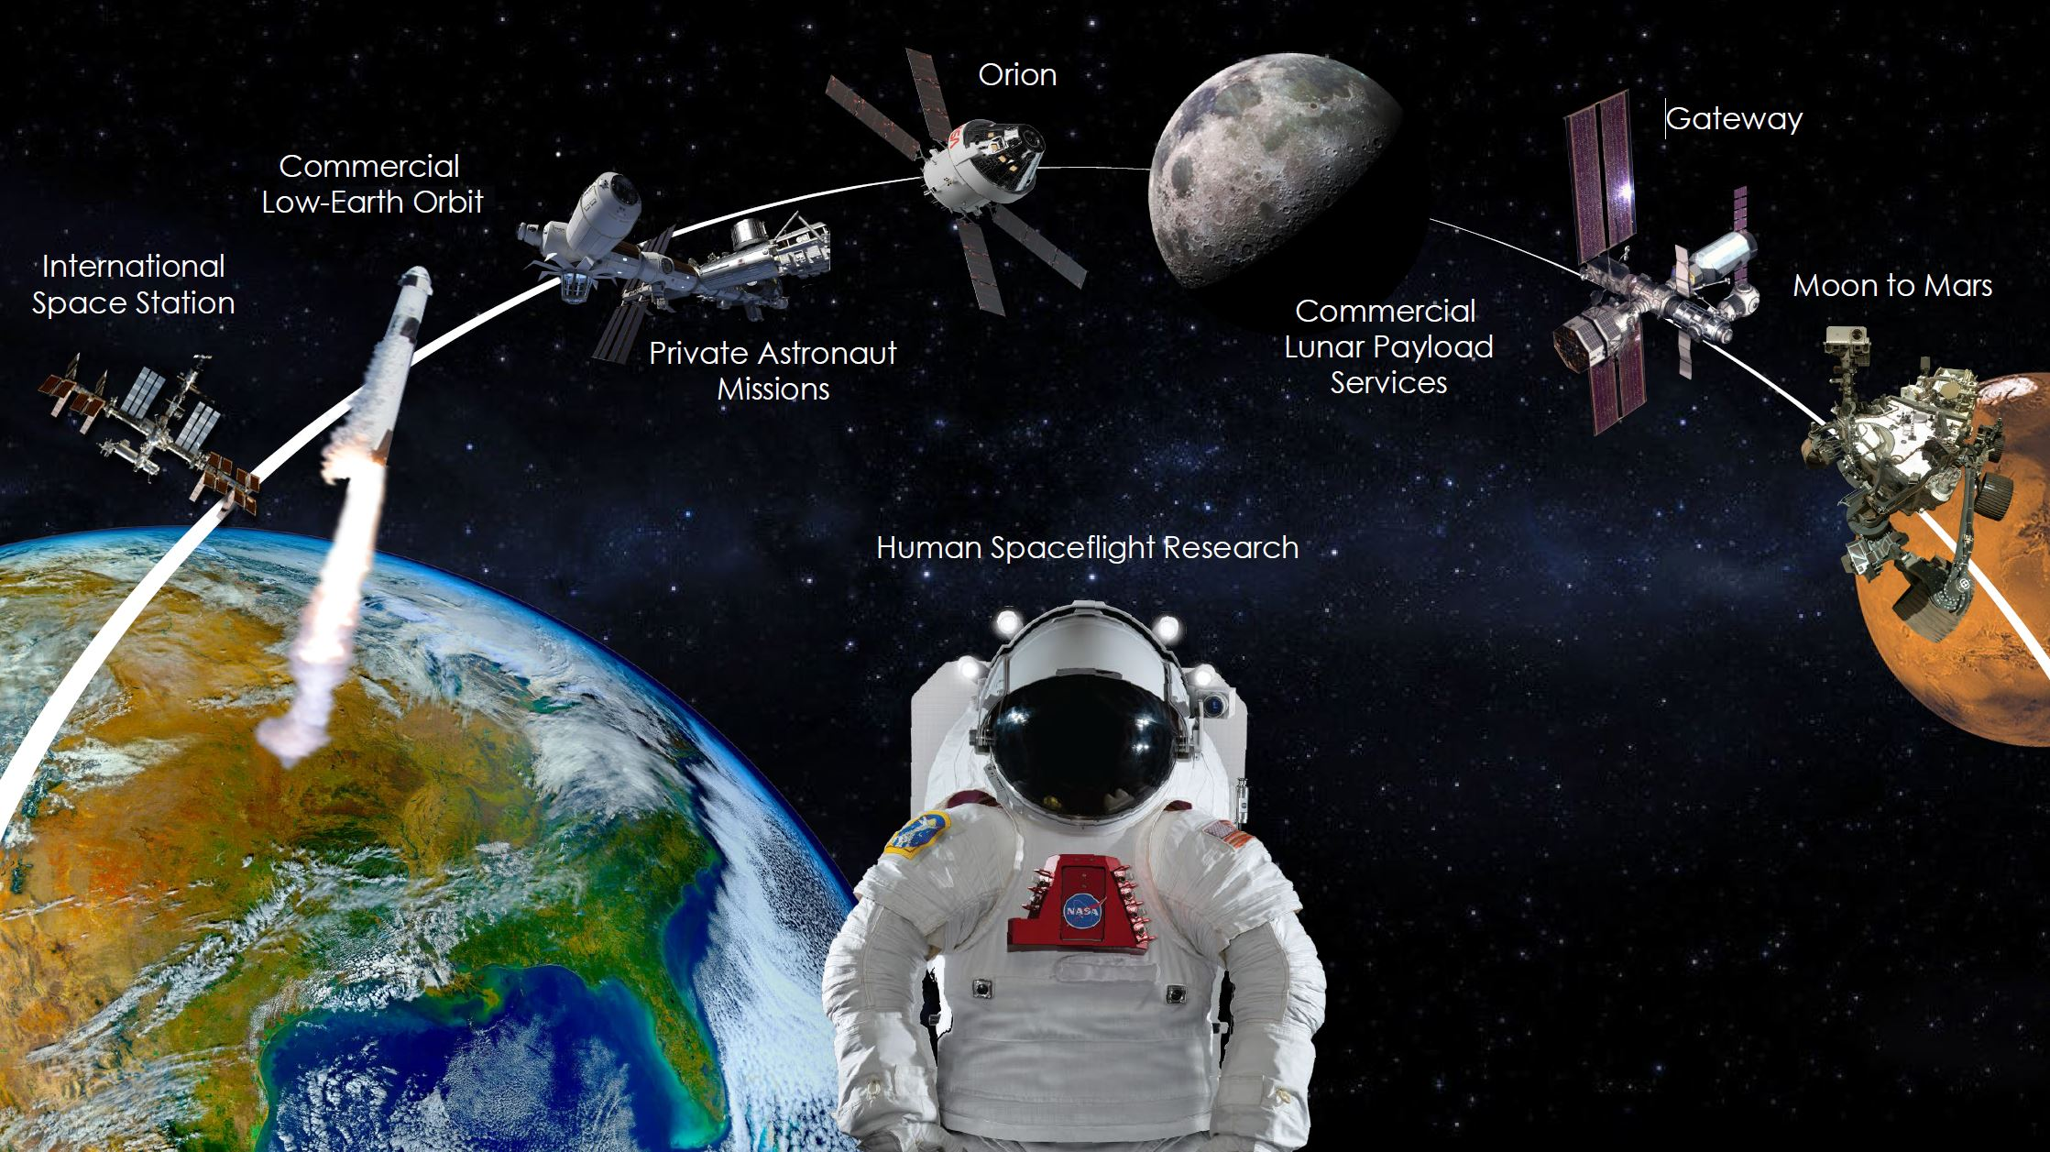
Credit: NASA

Slide 7
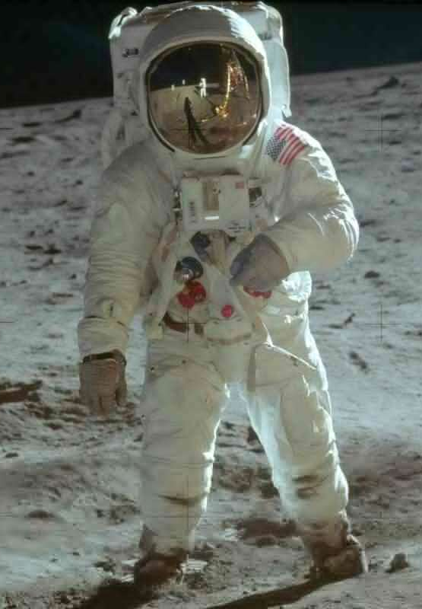
Spaceflight Hazards
Altered Gravity
Distance from Earth
  Vestibular Functioning
  Fluid Shifts
  Cardiovascular Deconditioning
  Muscle Atrophy
  Bone Loss
Communication Delay
Limited Ability to Resupply and Rescue
Drives the need for more “autonomous” operations and medical care capacity
Hostile/Closed Environment
Space Radiation
Vehicle and Habitat Design
Acceleration/Vibration/Noise
Environmental – CO₂ Levels, Toxic Exposures, Water, Food
  Decreased Immune Function
Acute In-flight effects
Long-term cancer risk
Central Nervous System-cognitive risk
Credit: NASA
Isolation & Confinement
Behavioral Health
Sensory Deprivation
Sleep Disorders (Circadian Dysregulation)
Team Communication, Coordination, and Adaptation

Slide 8
What are Flight Analogs?
Environments that produce similar effects on the human body as those experienced in spaceflight
Experimentally test:
  Current and future mission parameters
    Gravity, COM-delay, food system, crew-size, habitable volume
  Development and validation of new countermeasures
Integrate studies on a non-interference basis and run together as one “experiment”

Slide 9
Why not just study spaceflight?
Time
  Larger N (throughput) in a shorter duration
  Astronaut crew time is limited!
Cost
  Expensive to launch and return biosamples and hardware
    Analogs are a “proving ground” before implementing new ideas inflight
Experimental Control
  Isolated Confined and Extreme (ICE) – naturalistic
  Isolated Confined and Controlled (ICC) – experimental
Lab
Analog(s)
Flight

Slide 10
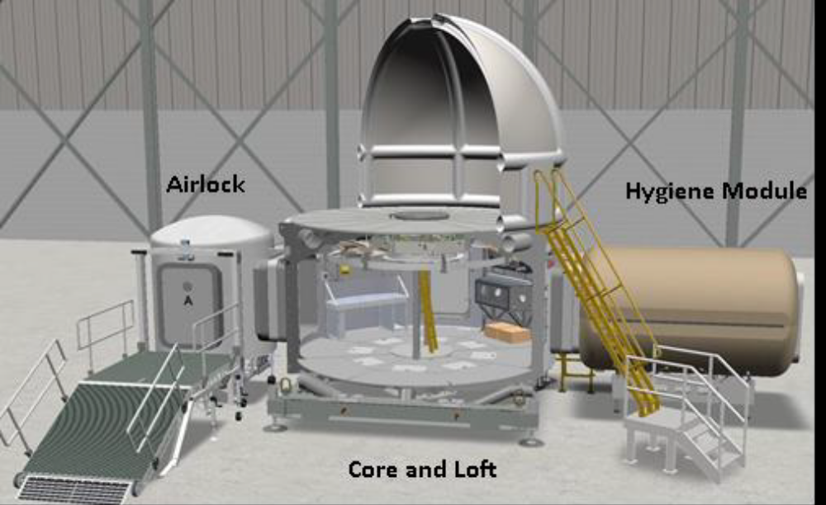
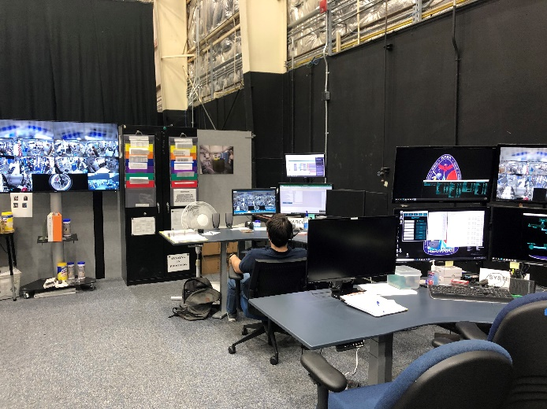
Human Exploration Research Analog (HERA)
Credit: NASA
Credit: NASA
Area: ~636 ft²

Slide 11
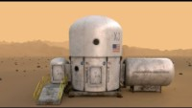
Human Exploration Research Analog (HERA)
The Aerospace Corporation. (2022, May). What's it like living in space ... on Earth? We take a look inside NASA's HERA module [video]. YouTube. https://youtu.be/GPvjpmB0RJ8

Slide 12
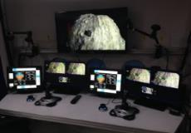
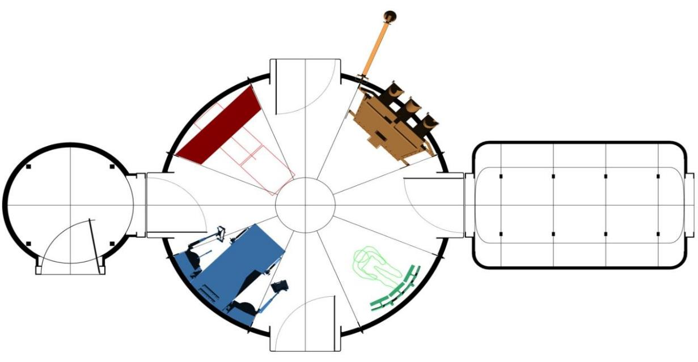
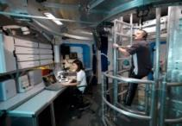
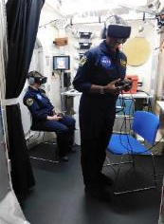
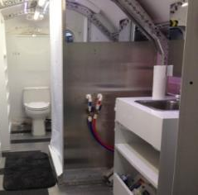
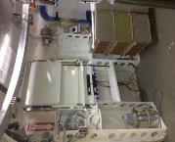
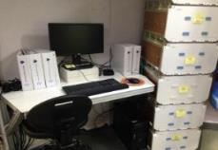
HERA Level 1
47’ (14.3 m)
Medical Science Station
19.3’ (5.9 m)
Flight
Deck
13.25’ (4.0 m)
8.5’ (2.6 m)
Hygiene Module
Airlock
Core
Toilet
Sink
Shower
To porch and ramp
Maintenance Workstation
Operations Console
Hygiene Module
Credits: NASA

Slide 13
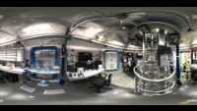
HERA Level 1
Credit: NASA

Slide 14

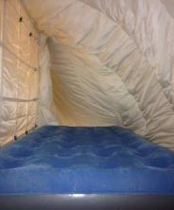
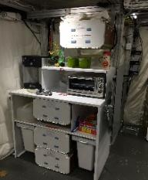
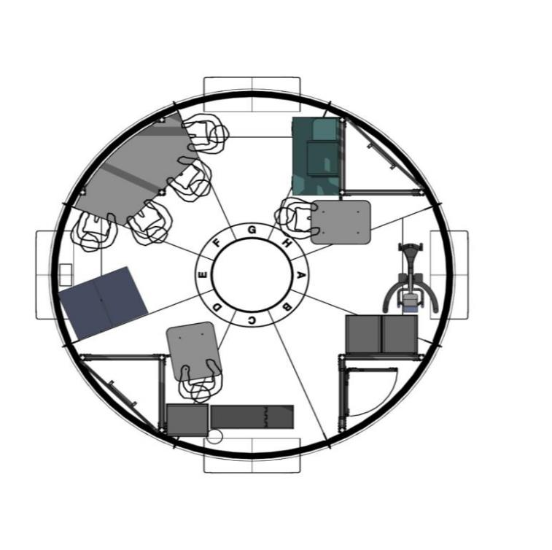
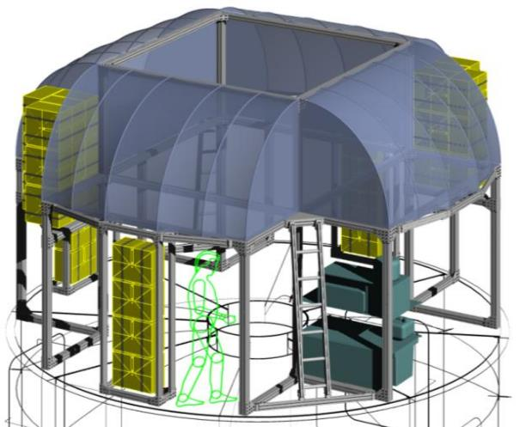
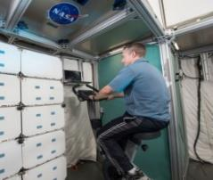
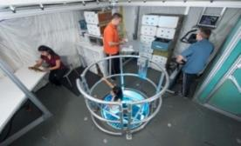
HERA Level 2 & Loft
Galley
Wardroom table
Crew Quarters
Crew Quarters
Aerobic exercise device
2nd floor
Loft
Credits: NASA

Slide 15
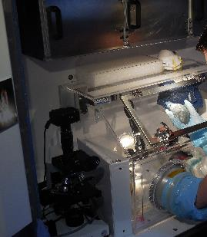
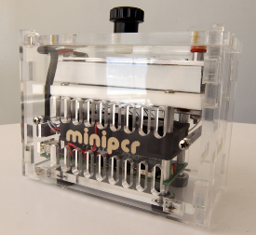
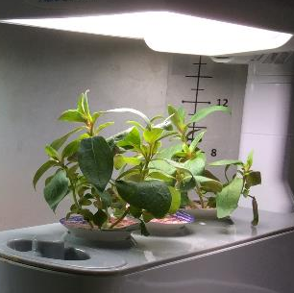
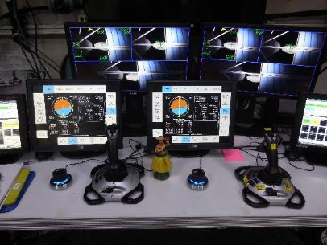
HERA Mission Design
HERA Campaigns
2014: 7 days
2015: 14 days
2016: 30 days
2017-2022: 45 days
Mission Fidelity
Flight-like timeline, equipment, stowage, procedures
No internet, TV, phone
Surveillance video and audio system
Work activities & operational tasks similar to flight
  Payload operations
  Public Affairs Office (PAO) events
  Virtual reality simulation capability for extra-vehicular activity (EVA)
    Planetary geology
  Housekeeping & maintenance
  Phased duration of com-delay
  Tasks and timelines built with realistic ambiguities, intermittent extended duty days, and time pressure
Credits: NASA

Slide 16
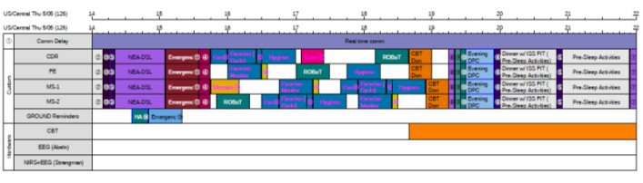

HERA Mission Design
  Standardized Conditions
  Realistic mission scenario & narrative
  Cabin air (temp, humidity)
  Light/Dark Cycle: standardized schedule, no napping
    Mix of dynamic (intensity, color temp) and binary (on/off) lighting units
  Exercise requirements, specifics are study dependent
  Food System and Dietary Conditions
  Provided at least 3 meals per day, shelf-stable packaged food
  Dietary needs are assessed by a nutritionist
  Hot water and food warming, but no cooking or baking
Credit: NASA
Credit: NASA

Slide 17
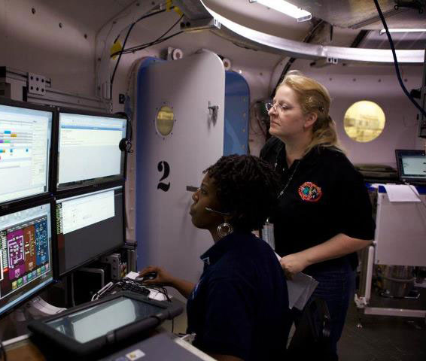
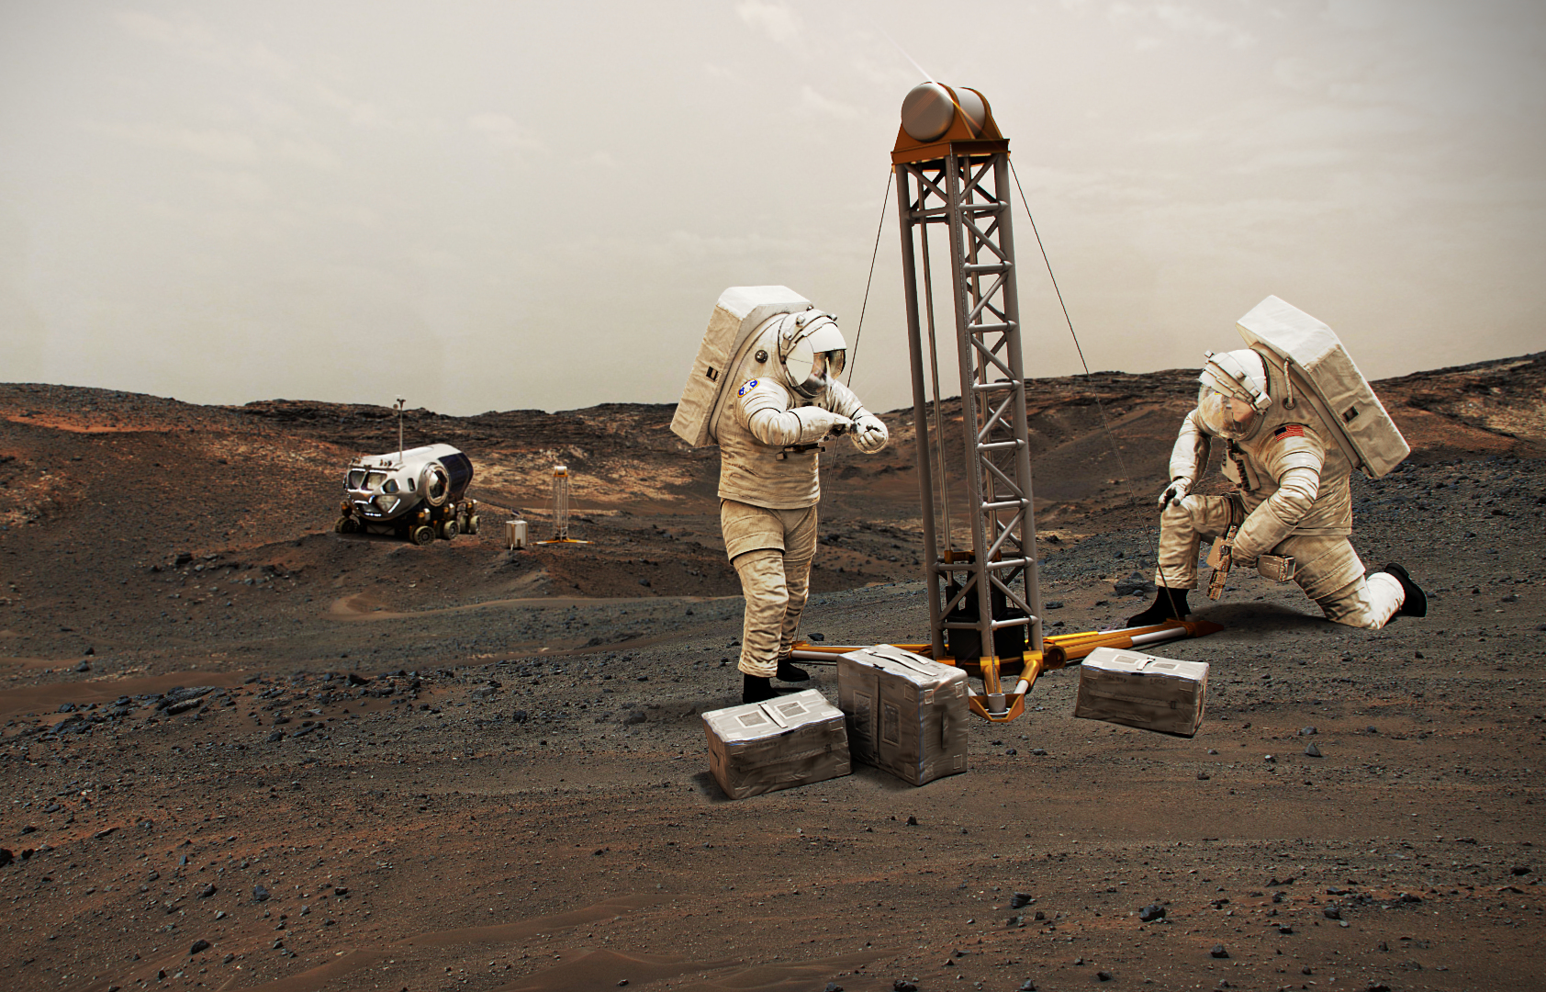
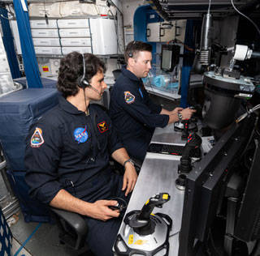
HERA Mission Design
Mission Scenario:
Determines type and procedures of operational activities
Promotes “immersion” and task context
Credit: NASA
Credit: NASA
Credit: NASA

Slide 18
HERA Subject / Crew Selection
Subject Selection:
4 prime per mission, occasionally backups
Goal is 50/50 male:female ratio
Age 30-55 years
Height 6’2” maximum
Advanced STEM degree or equivalent years of military or civilian experience
Professionally demonstrated technical skills
Demonstrated motivation and work ethic that is ‘astronaut like’
Medically qualified via NASA long-duration space flight physical
Psychological assessment for astronaut-like personality traits and resilience factors

Slide 19
HERA Research & Development Uses
Currently used and identified for research in…
  Behavioral Health and Performance
        Crew hierarchy, team cohesion, stress, cultural factors, etc.
        Sleep and circadian issues in isolation and confinement
        Drives long duration (45-days) requirement
    Human Systems Integration Architecture (Human Factors and Habitability)
      Comm. delay = crew autonomy from MCC
        Crew self-scheduling and other procedural tests
        VR and AR tools to supplement limited ground support
      Controlled environmental conditions, usable volume, and privacy
  Mission-enabling capabilities validation
    Food, scheduling tools, procedures, operational concepts
  Exploration Medical Capability
    Telemedicine operations

Slide 20
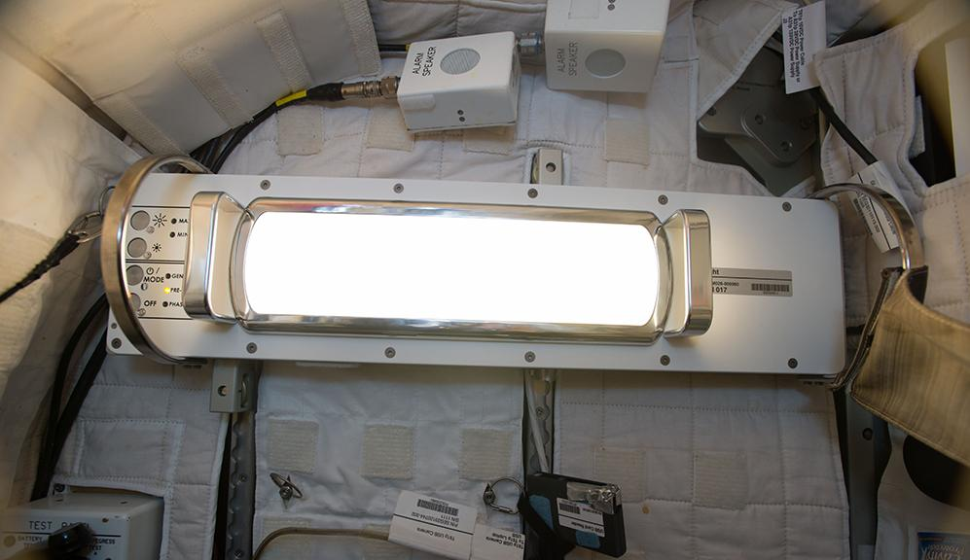
HERA Findings
Effects of a Dynamic Lighting Schedule
  Chronic partial sleep deprivation (5hr weekdays, 8hr weekends)
  Bright, blue-hued daytime light (~6000K), reduced ~96% at 3hr before bed (~4000K)
  Results:
  Biomarkers of circadian rhythm were more consistent
  Self-reported better alignment between time and circadian phase
  Improved abstract reasoning test performance
Credit: NASA
Rahman, S. A., Kent, B. A., Grant, L. K., Clark, T., Hanifin, J. P., Barger, L. K., ... & Lockley, S. W. (2022). Effects of dynamic lighting on circadian phase, self‐reported sleep and performance during a 45‐day space analog mission with chronic variable sleep deficiency. Journal of Pineal Research.

Slide 21
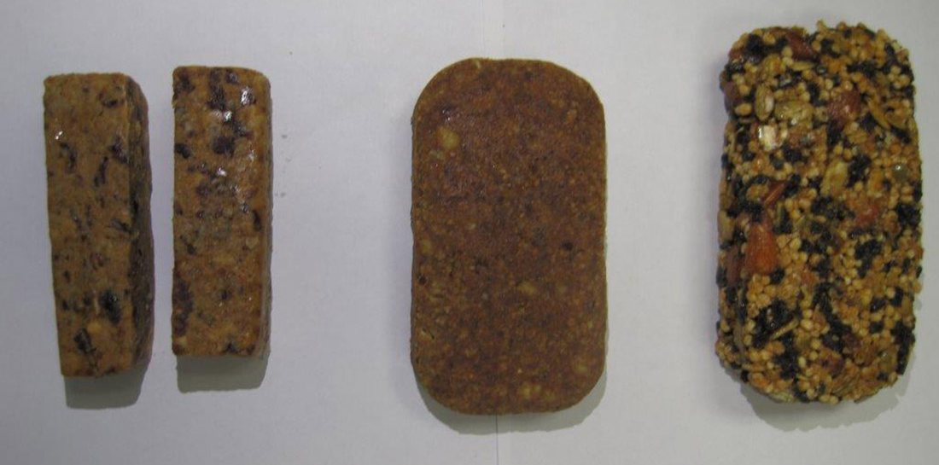
HERA Findings
Meal Replacement Bars
  Replaced breakfast with a nutrient-dense meal replacement bar (~750 calories each)
    Daily first 15 days, every 3 days last 15 days (intermittent schedule)
  Results:
  Less caloric intake and mild weight loss
    Greater with daily vs intermittent
  Morale decrements
  Drivers of limitations:
    Taste
    Texture
    Limited variety
    Duration/Frequency
Credit: NASA
Sirmons, T. A., Roma, P. G., Whitmire, A. M., Smith, S. M., Zwart, S. R., Young, M., & Douglas, G. L. (2020). Meal replacement in isolated and confined mission environments: Consumption, acceptability, and implications for physical and behavioral health. Physiology & behavior, 219, 112829.

Slide 22
HERA Findings
Cognitive and Team Performance Monitoring Tools
Cognition Test Battery
Lexical stress and team dynamics detection tool
Habitability Design Evaluation Tool
Spaceflight Habitability & Acceptability Questionnaire (SHAQ)
Usability & Acceptability Testing – operations community integration
Medication tracking & inventory app
Asynchronous communication approaches for health and well-being
Casario, K., Howard, K., Cordoza, M., Hermosillo, E., Ibrahim, L., Larson, O., ... & Basner, M. (2022). Acceptability of the Cognition Test Battery in astronaut and astronaut-surrogate populations. Acta Astronautica, 190, 14-23.
Driskell, T., Salas, E., Burke, C. S., & Driskell, J. E. (2021). A Lexical Approach to Assessing Stress: Development and Proof-of-Concept. Human Factors, 00187208211045167.
Roma, P. G., Blackwell Landon, L., Spencer, C. A., Whitmire, A. M., & Williams, T. J. (2022). The Subjective Habitability & Acceptability Questionnaire (SHAQ): Development and Validation. Human Factors, 00187208211053462.

Slide 23
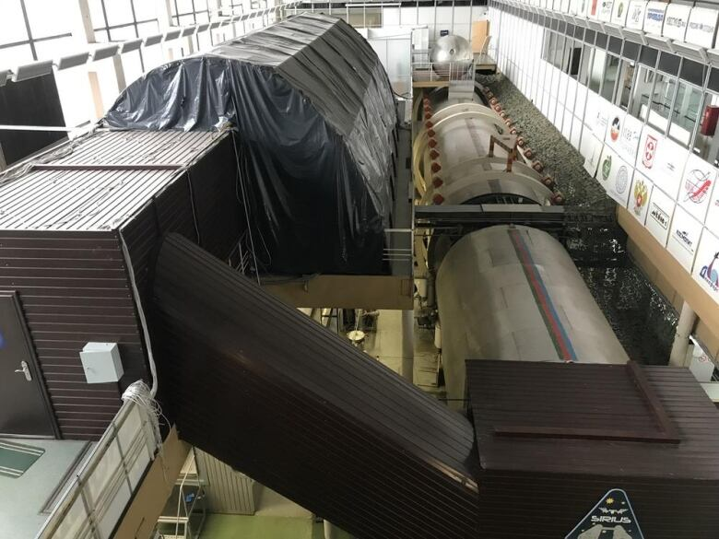
Nazemnyy Eksperimental’nyy Kompleks (NEK)
Credit: NASA

Slide 24
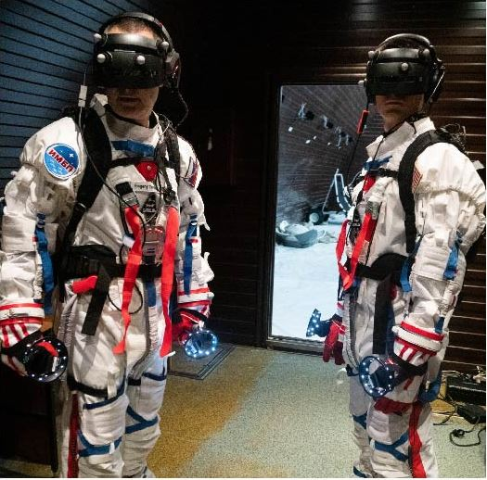
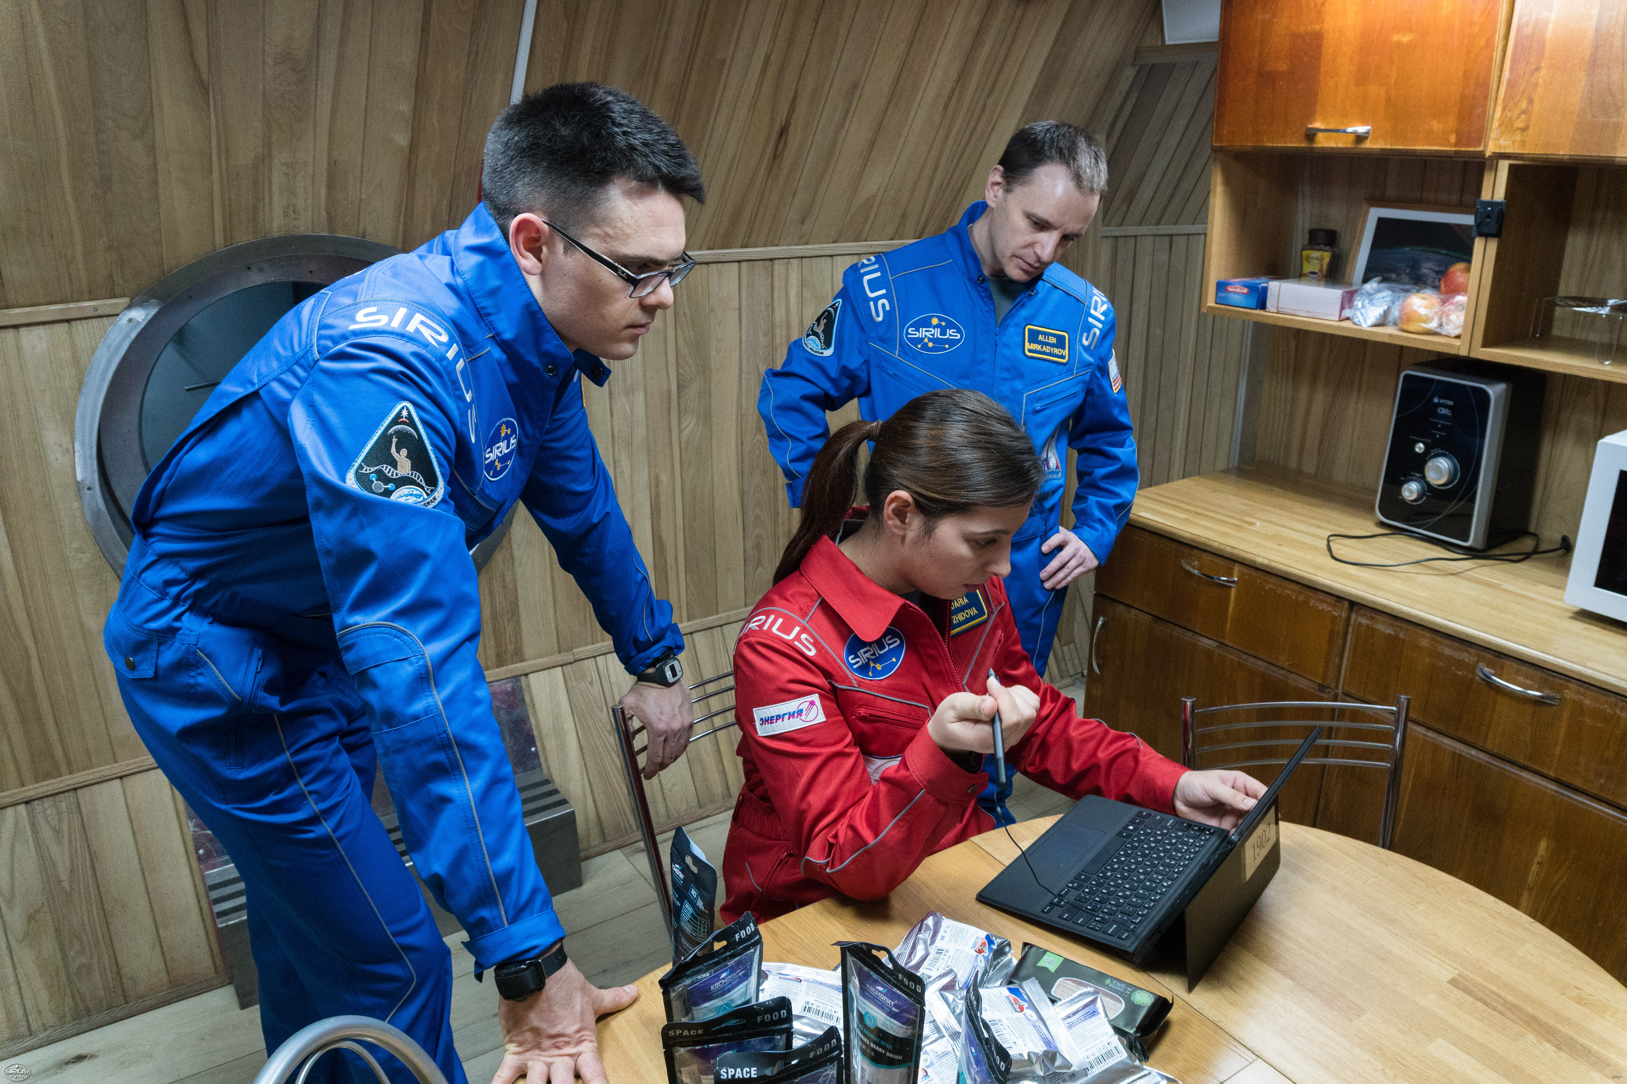
Scientific International Research In a Unique terrestrial Station (SIRIUS)
SIRIUS Campaigns
19: 4 months – 6 crewmembers
21: 8 months – 5/6 crewmembers
  ~70 studies total (9 NASA-funded)
Mission Fidelity
Flight-like timeline, equipment, stowage, procedures
No internet, TV, phone
Surveillance video and audio system
Work activities & operational tasks similar to flight
  Payload operations
  Human health science
  Public Affairs Office (PAO) events
  Surface EVA mission phase
  Housekeeping & maintenance
  Com-delay
  Tasks and timelines built with realistic ambiguities, intermittent extended duty days, and time pressures
Credits: NASA

Slide 25
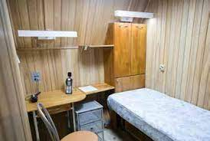
SIRIUS Subject/Crew Selection and Science
Subject Selection:
Criteria similar to HERA
  Russian language skills
International partners for multinational crew
  NASA objectives:
  Team processes & performance,
  Cultural factors
  Food system
  Sleep/circadian biomarkers
  Exercise device demonstration
  Physiological, behavioral & cognitive health
Differences:
Interior hab design
MCC – less involvement than HERA
Pressurized environment, isolated from outside conditions
Food system:
  Canned and pureed-like packaged foods
  Experimental baking bread
Credits: NASA

Slide 26
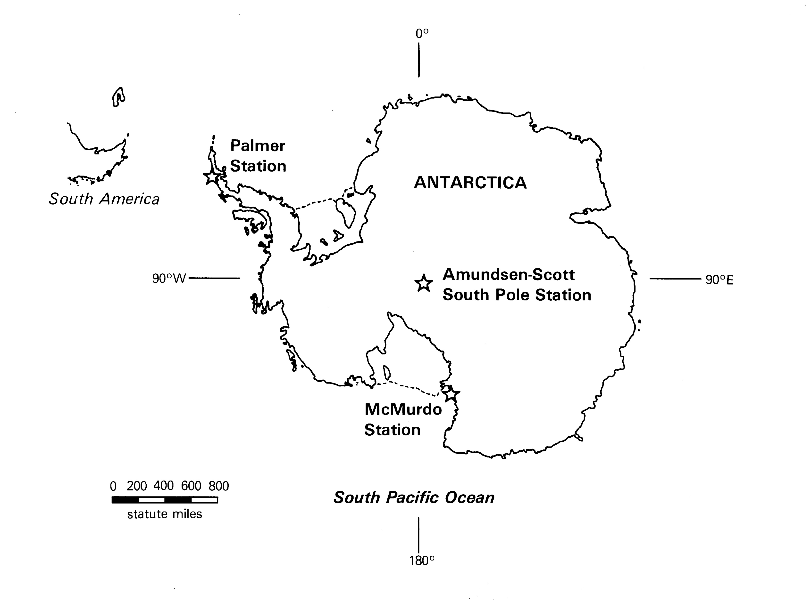
Antarctic Research Stations
Credits: National Science Foundation

Slide 27
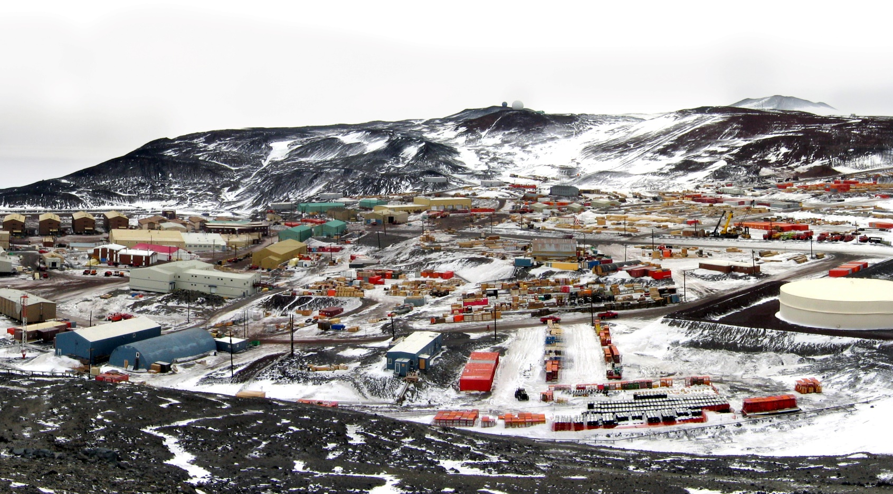
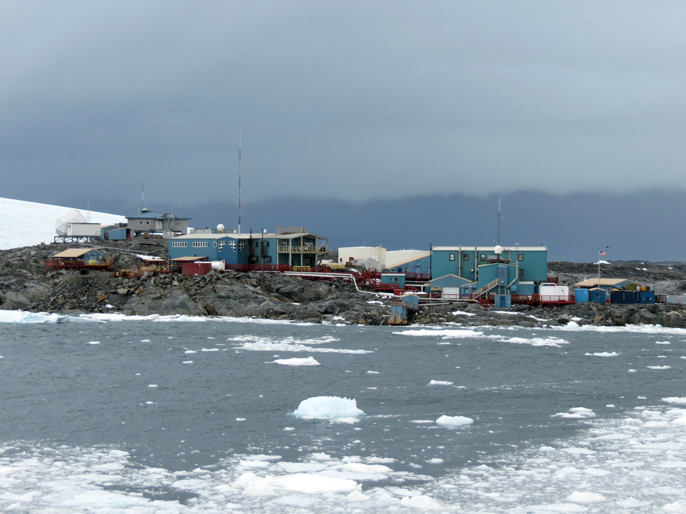
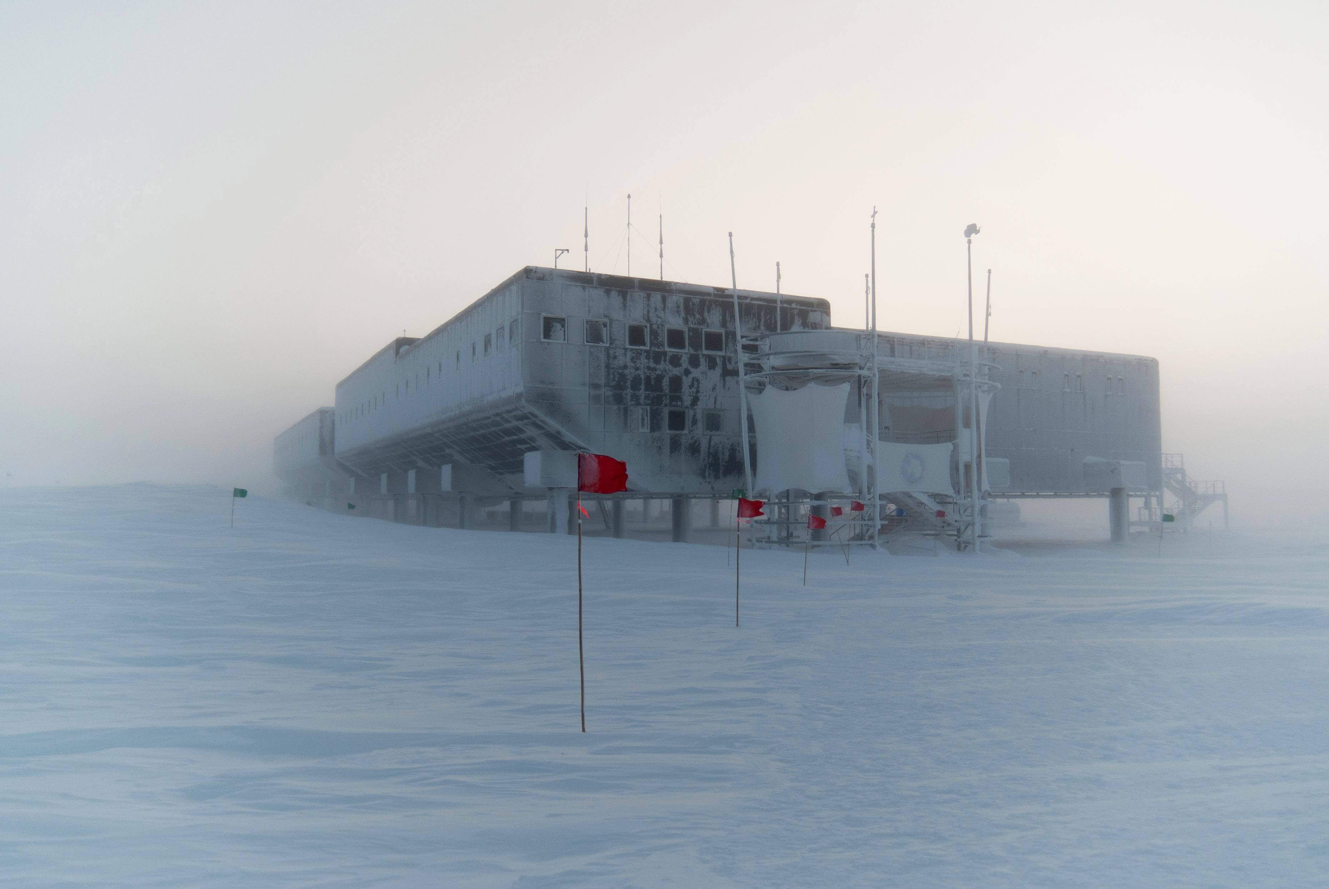
Antarctic Research Stations
McMurdo
Coastal, large!
Population: ~1000 summer;
100 winter
Access: year-round (winter for emergency only typically)
No psychological screening for summer
Diverse skillsets/jobs
Palmer
Coastal, small
Winter light: ~5h/day
Population: ~50 summer;
15-20 winter
Access: year-round (routine)
Psychological screening
Amundsen-Scott South Pole
Interior, small, higher altitude
9,301 ft
Population: ~100 summer;
~50 winter
Access: summer only
Psychological screening
Credits: National Science Foundation
Credits: National Science Foundation
Credits: National Science Foundation

Slide 28
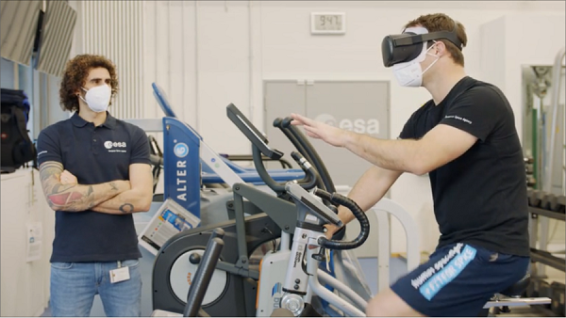
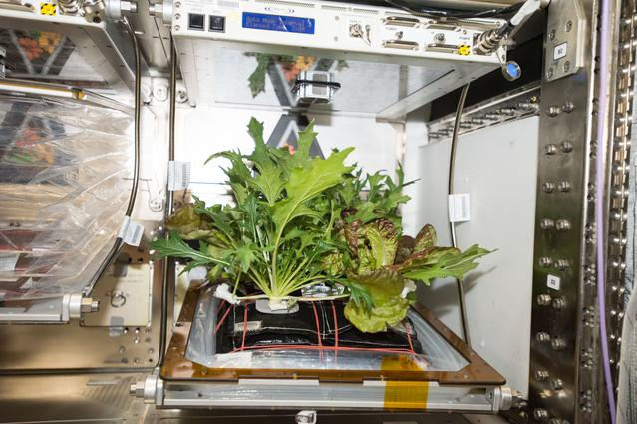
Antarctic Research Stations
Virtual Reality
Hybrid Training (PI: Mathias Basner)
  Exercise augmentation with VR and gaming
  Neumayer III (controls from Concordia & Halley)
VR Sensory Stimulation for Relaxation and Therapeutic Release (PI: Alexandra Stankovic)
  Amundsen-Scott South Pole Station
Crop Growth
Veggie on Ice (PI: Alexander Stahn)
  Eden ISS Project at Neumayer III
    Surveys of plant interactions, fresh food consumption, and associated behavioral health outcomes
  Companion study to ISS
Credits: ESA
Credits: NASA

Slide 29
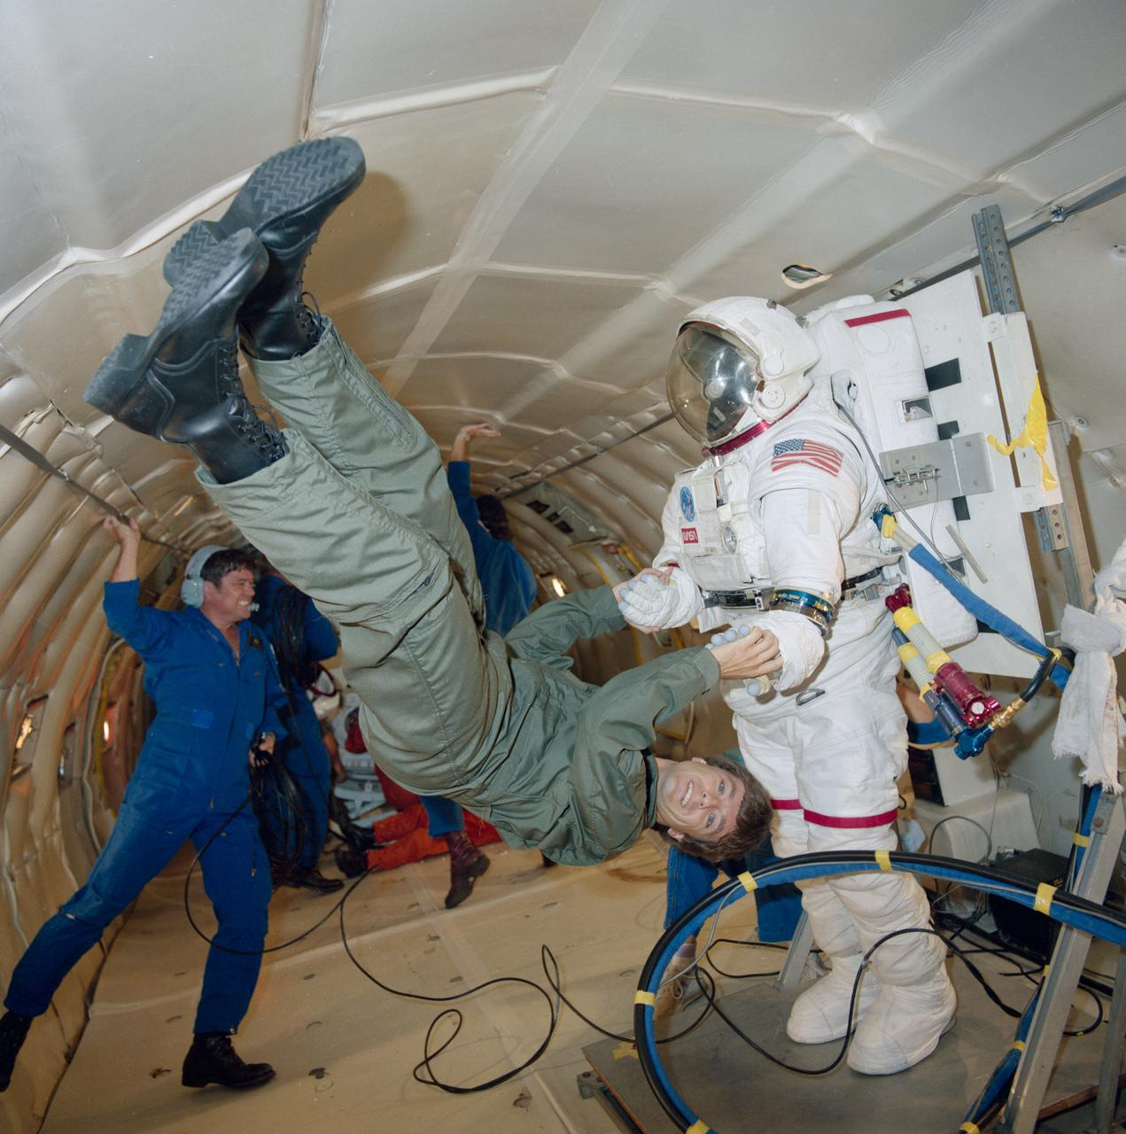
Parabolic Flight
Short-Duration Altered Gravity
~20-30 seconds per parabola
Testing three g levels
Science:
  Physiology
  Sensorimotor function
  Operational performance
Location: Bordeaux, France
Subjects: science-driven, largely astronaut-like
Unique challenges: motion sickness!
Credits: NASA

Slide 30
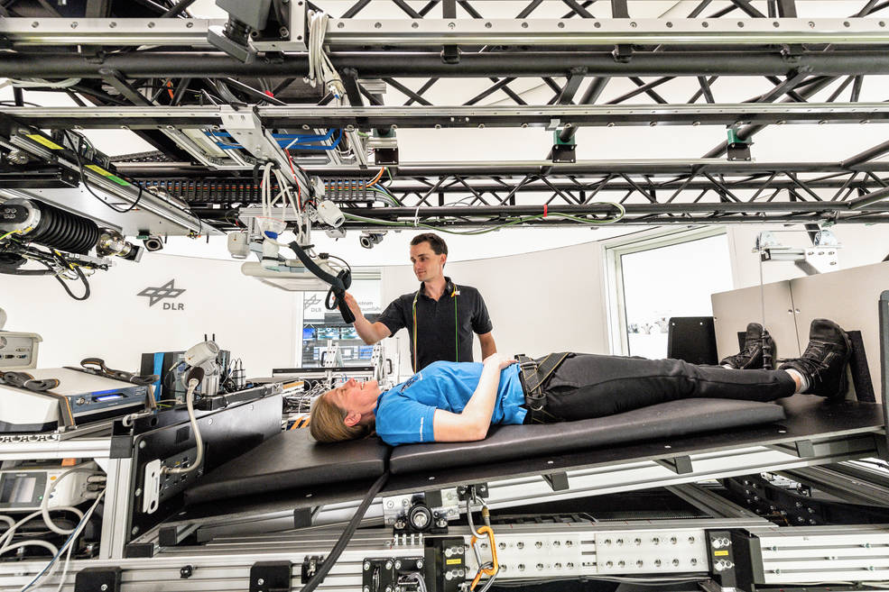
:Envihab
DLR Institute for Aerospace Medicine
Cologne, Germany
Simulated spaceflight conditions:
  Altered gravity: Headward fluid shift
  Elevated CO2 concentrations
Duration: 30-60 days
N = 12 simultaneously
Capabilities:
  MRI
  Lab and testing support
  Short-arm centrifuge
Science:
  Characterization of SANS, bone, cardiovascular, cognitive, sensorimotor, and muscle risks
  Countermeasure testing: artificial gravity, lower-body negative pressure
Credits: DLR

