Slide 1
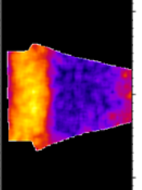
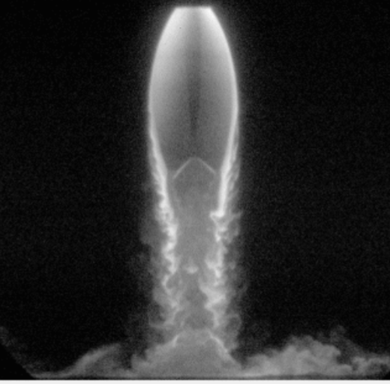
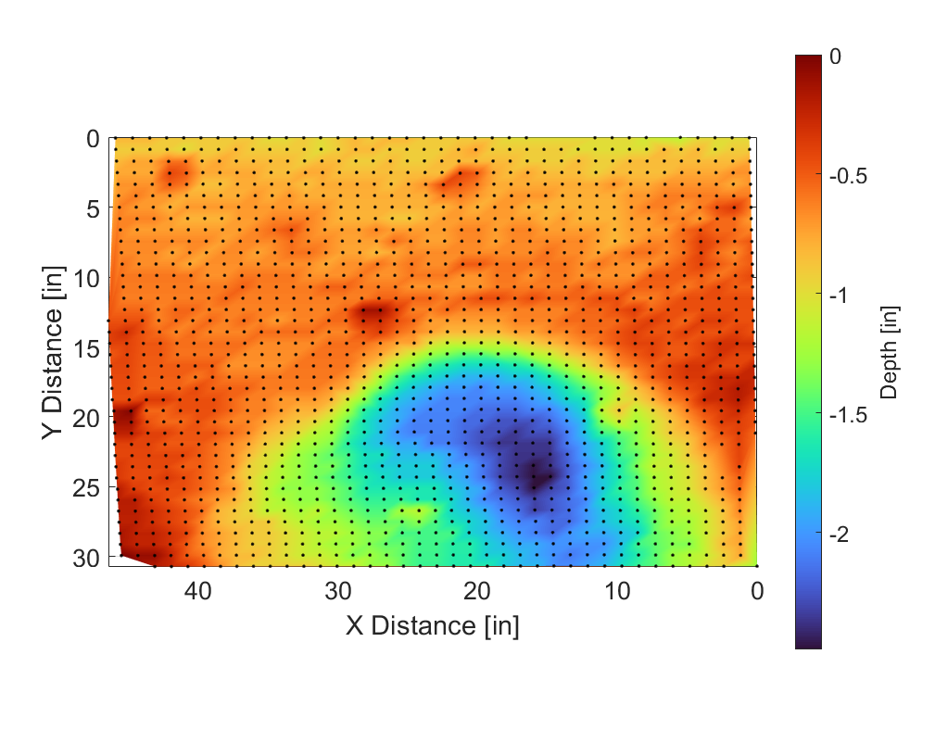
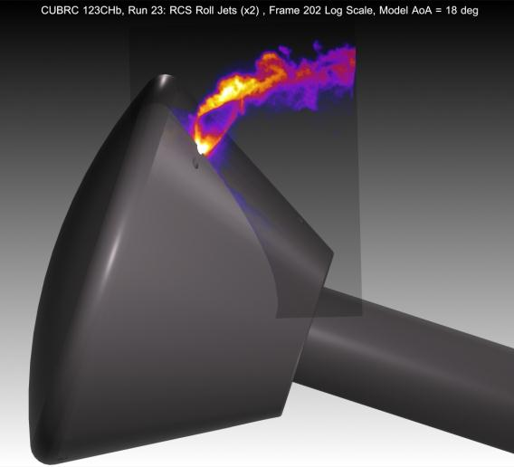


Optical and laser-based measurements for NASA’s Artemis Program
Paul M. Danehy
Senior Technologist for Adv. Meas. Systems
Advanced Meas. and Data Systems Branch
NASA Langley Research Center
Hampton, Virginia, USA
Work sponsored by NASA’s STMD, HEOMD, ARMD (AETC & TTT), HTP, SMD
Presented at the University of Virginia, 10-24-2022

Slide 2
List of key collaborators
Work presented herein:
  Brett Bathel, Josh Weisberger, Jennifer Inman, Neil Rodrigues, Ashley Korzun, Scott Splinter (NASA Langley)
  Ross Burns, Jon Retter (NIA, Hampton VA)
  Manish Mehta (NASA Marshall)
  Chris Combs (UTA/UTSA)
  Ron Parker and co-workers (CUBRC)
  Craig Johansen (Calgary)
  Ryan Thompson, William Hutchins (UVa)
  Chris Ivey (Stanford)
  Many others…

Slide 3
Outline
Introduction
  Artemis Program: Vehicles, Timeline, Challenges
  Utility of optical and laser-based measurements
Launch: SLS
  Flow vis with Manish at CUBRC
  Quantitative Thermometry
Earth Entry: Orion
  Orion RCS Jets
    Flowfield structure
    Comparison with CFD (computational flow imaging)
  Laminar Turbulent Transition
Descent:
  Orion Landing transonic/subsonic
Landing on the moon
  PSI PLIF
  SCALPSS
Disclaimer: I don’t want to overstate our team’s contributions to the Artemis program. Meaningful contributions were made in a few cases and have had impact but many of these are recent activities and have not had impact yet.
Planar laser induced Fluorescence(PLIF)
Femtosecond Laser Electronic Excitation and Tagging (FLEET)
PLIF
Stereo Photogrammetry

Slide 4
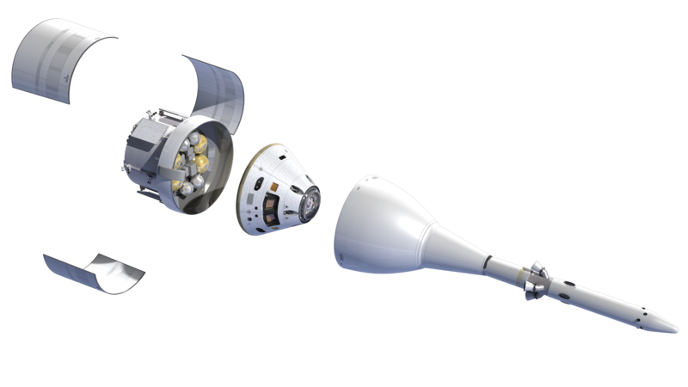
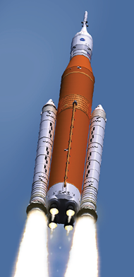
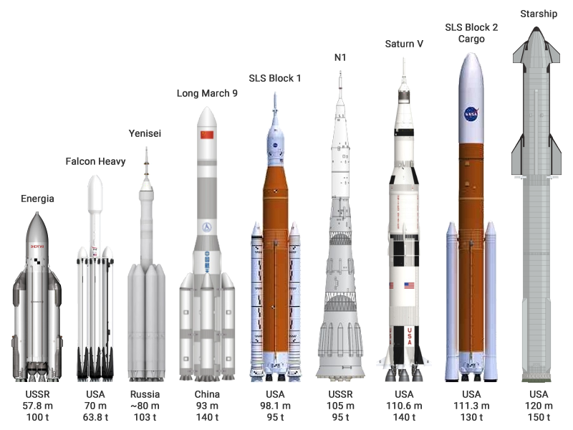
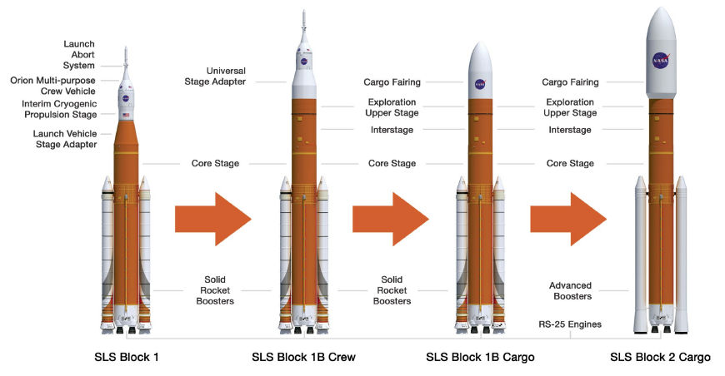
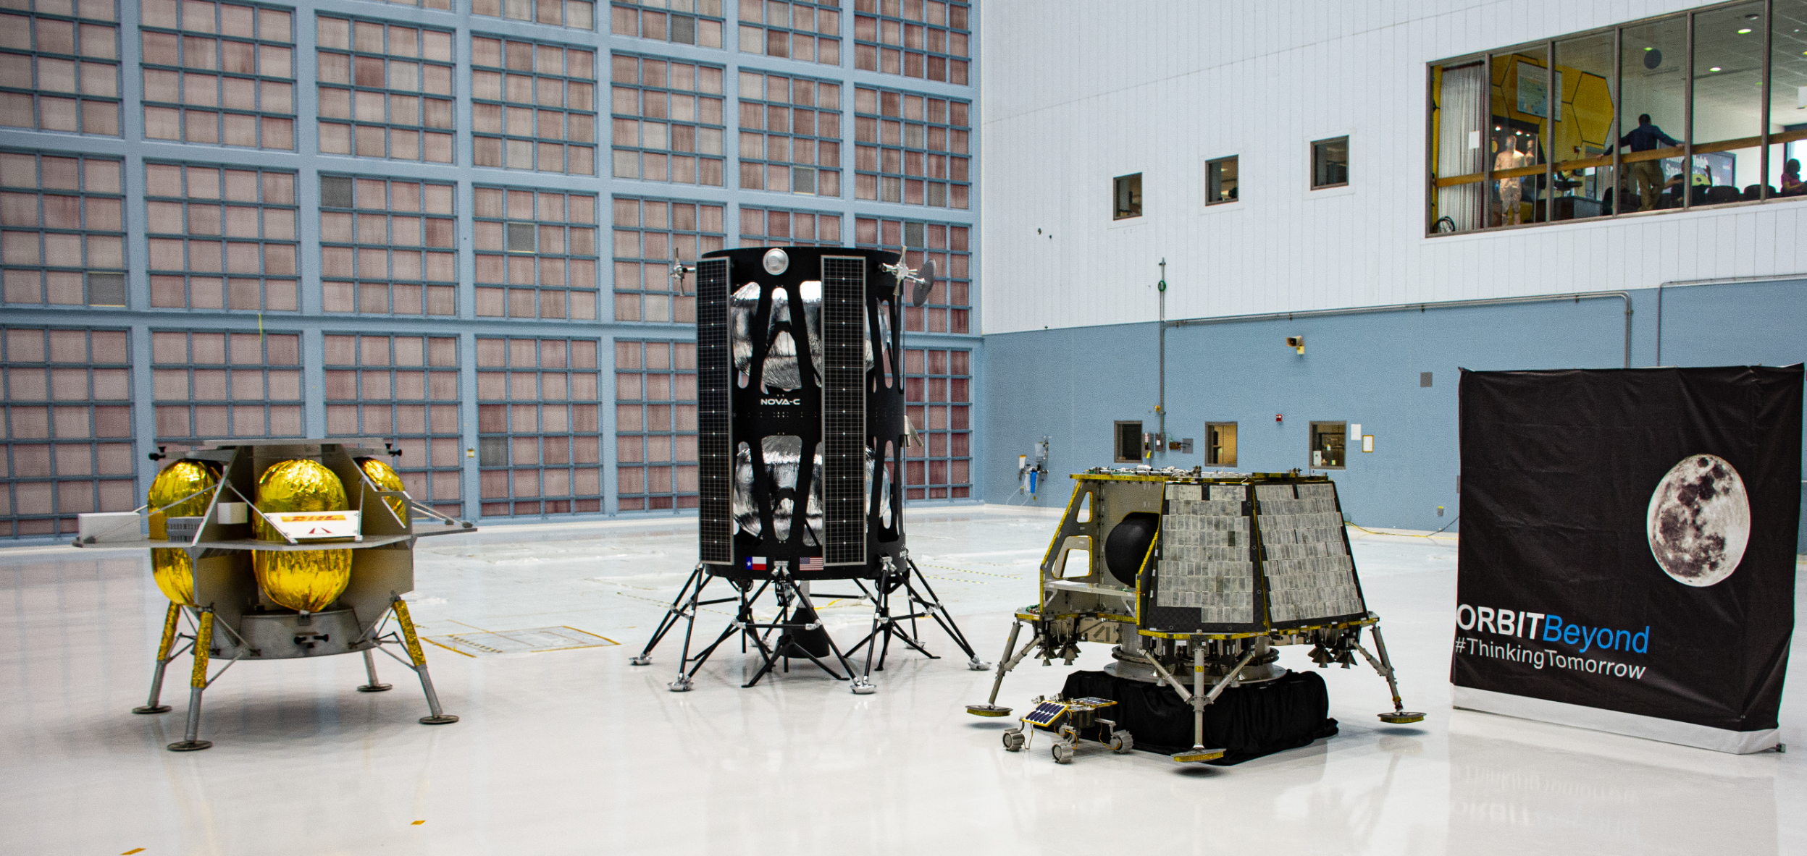
Artemis Program: Vehicles and Timeline
Orion MPCV
ESA Service Module
Launch Abort System
First flight | Artemis I (NET Nov. 2022)
First crewed flight | Artemis II (NET May 2024)
First Lunar Landing | Artemis III (NET April 2025)
Core stage
+HLS Demo (Spring 2024)
CLPS
https://commons.wikimedia.org/wiki/File:NASA_Selects_First_Commercial_Moon_Landing_Services_for_Artemis_Program_(47974915261).jpg
Notes:
NET = Not Earlier Than

Slide 5
Aeroscience Challenges for the Artemis Program
Launch:
  Core stage plume-induced base heating on SLS
  Buffet between core stage and SRB in SLS
  Supersonic Stage Separation (non-contact)
Entry:
  Transition/heat shield performance
  Orion Reaction Control System (RCS) Jets
    Aero performance
    Backshell heating
Descent:
  Orion heat shield roughness aero performance
  Earth: Parachute deployment
Earth Landing: Splashdown
Lunar Landing: Plume-surface interaction (PSI)
Many, many other challenges…
NASA has developed detailed understanding, predictive capability for these phenomena; work with / advise partners
(Mars entry has a separate list of problems! It has a thin atmosphere.)

Slide 6
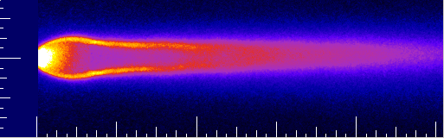
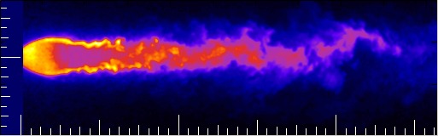
The utility of optical and laser measurements
Laser and optical measurements to study flow in ground test and flight
- nonintrusive, spatially and temporally resolved, quantified accuracy.
Walter Lempert (d. 2015): “It’s amazing what you see… if you look”
Dick Whitcomb (1922-2009) [Area rule, winglets, supercritical wing]:
“My 3 biggest innovations came from studying schlieren images”
Understand flow physics
  Why does the vehicle (e.g. lift/drag) behave that way?
  Identify flow features (laminar/turbulent, attached/separated).
  Ideation of new vehicle or control concepts.
Understand facility operation
  Inflow conditions → scale to flight
  Boundary conditions (wall boundary layers)
Benchmark Data for Code Validation
  Measurements of parameters like T, P, ρ, V, etc. → eval/develop models?
    NASA efforts: simulate the vehicle and the wind tunnel facility
    Interest in non-equilibrium effects for entry flows
  Trend from time-averaged RANS CFD → unsteady (LES, etc)
    Pushes measurement techniques towards higher speeds: kHz-MHz

Slide 7
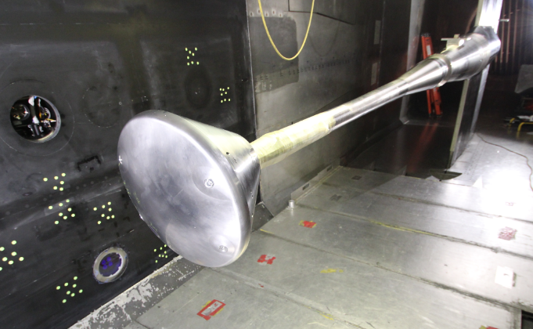
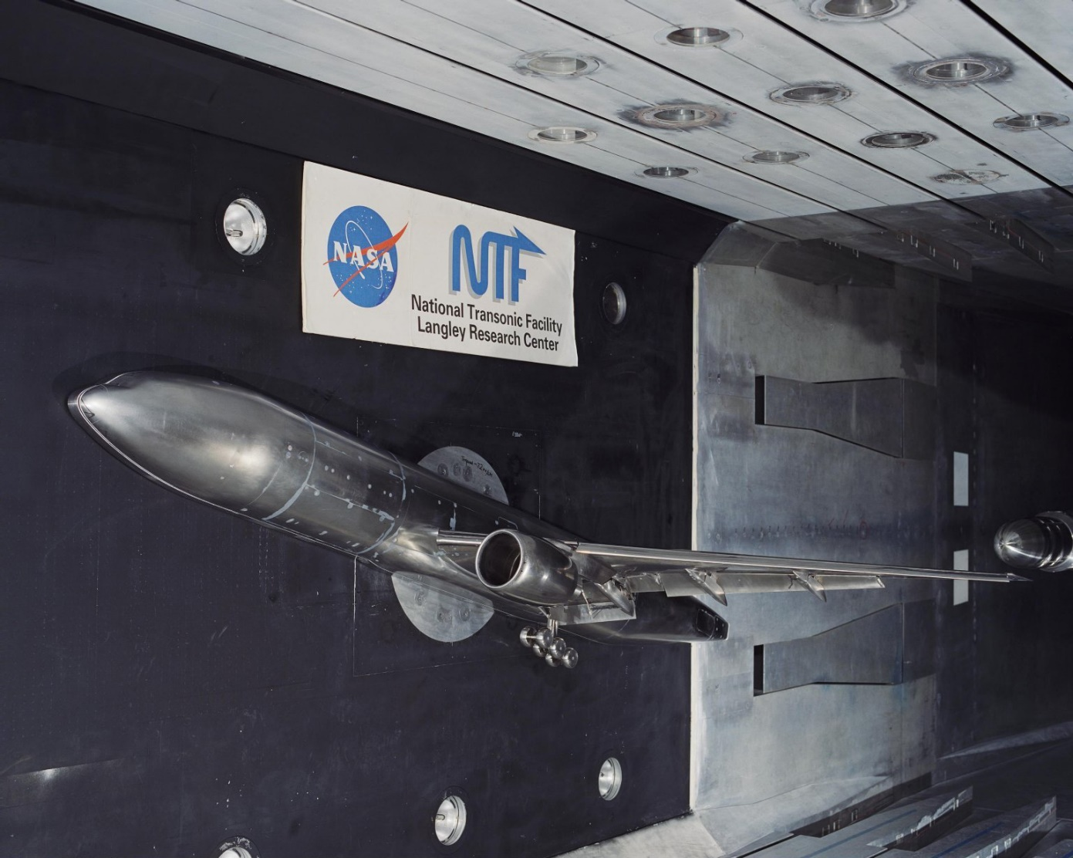
Measurement Challenges 1
Subsonic-Transonic Wind Tunnel
National Transonic Facility
High Reynolds Number Testing
  Large scale (8 foot =2.4 m)
  High pressure (10 atm) plenum
  Low temperature cryogenic gaseous N₂ (100 K): frost
  High density: refraction
  No external optical access; limited internal access
  Remote operation required
  Expensive operation and expensive models
  No H₂O or particle seeds
Image Credits: NASA

Slide 8
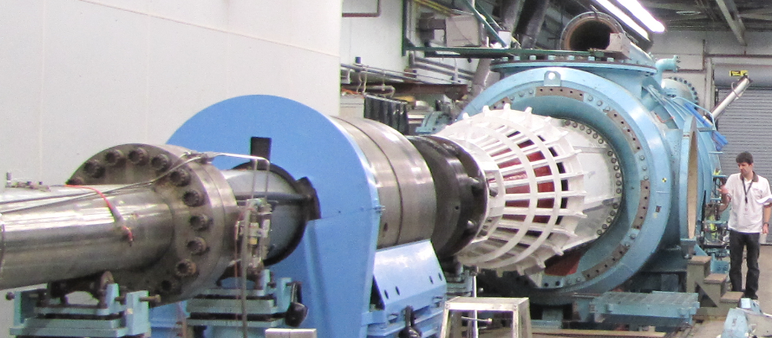
Measurement Challenges 2
Hypersonic Shock Tunnel
Image Credit: NASA
CUBRC LENS Shock Tunnel LENS 1 (Mach 6-20, scramjet, entry vehicle, launch vehicle, hypersonic testing)
  Large scale, short run duration (10’s of ms), 1 or 2 runs per day, tunnel moves, remote operation

Slide 9
Launch – Entry – Descent - Landing

Slide 10
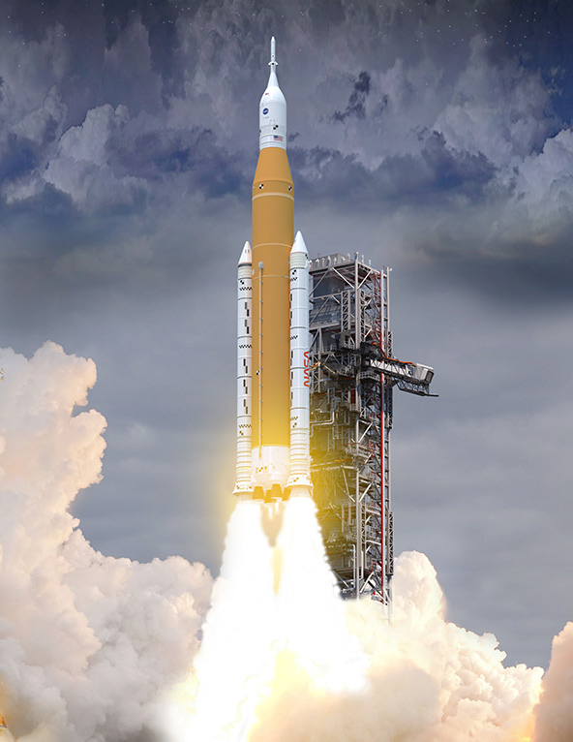
Launch
https://www.nasa.gov/specials/artemis/

Slide 11
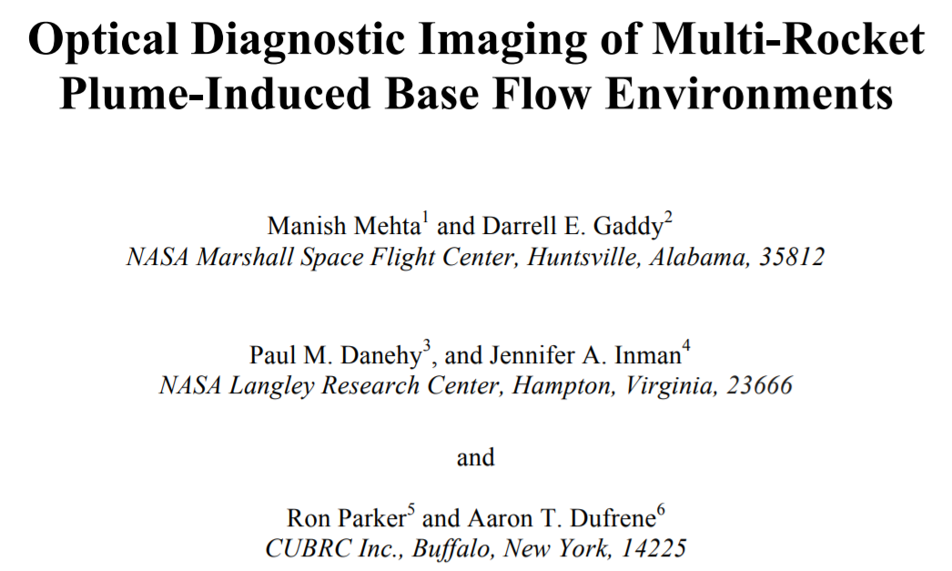
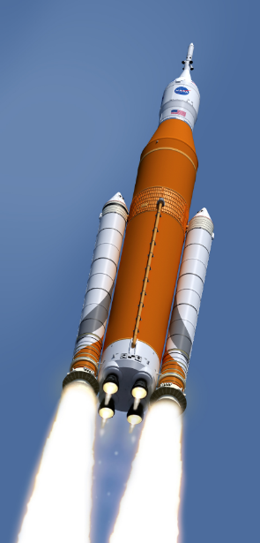

OH PLIF Visualization and Thermometry for NASA Space Launch System (SLS) Base Flow Heating
Measurements at CUBRC in Buffalo
Using NASA Mobile PLIF system
JANNAF Conference, Newport News, Dec 2018

Slide 12
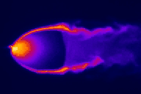
What is Planar Laser-Induced Fluorescence (PLIF)?
Tunable Laser
Laser sheet
excites molecules
Excited molecules fluoresce
Excited state
Gas flow
CCD camera detects
Ground state
LIF ~ n_{NO (or OH)}
Notes:
Changed PLIF image to an animated gif

Slide 13
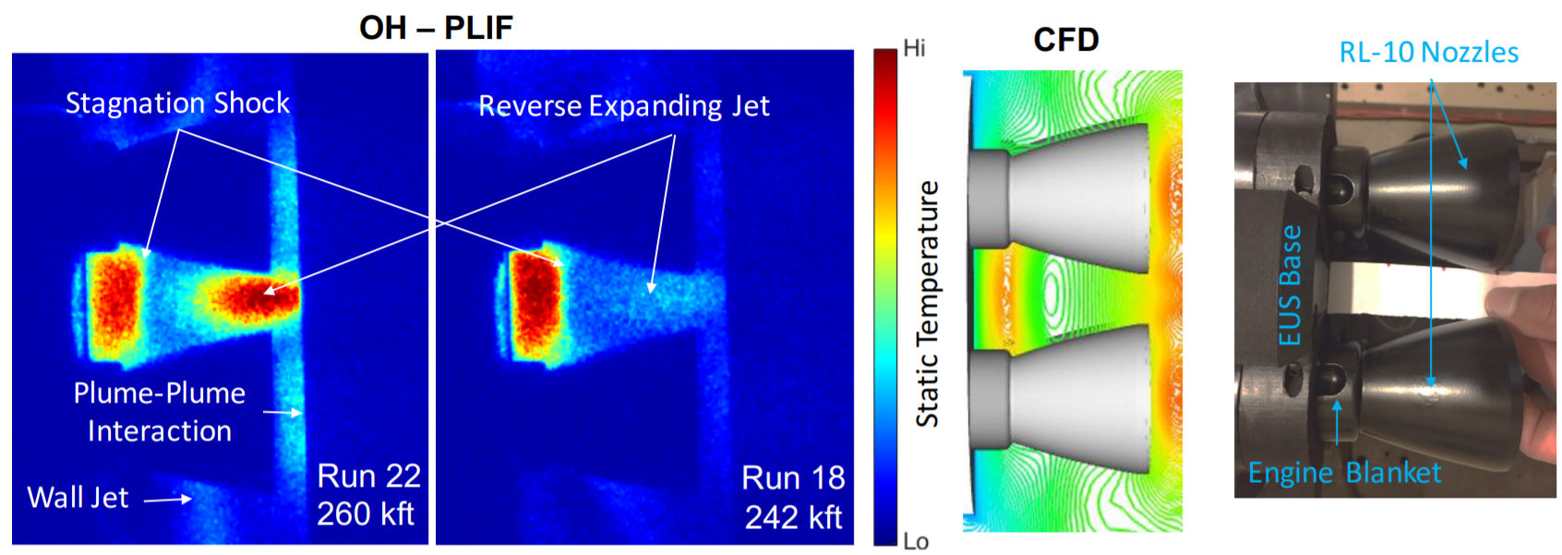
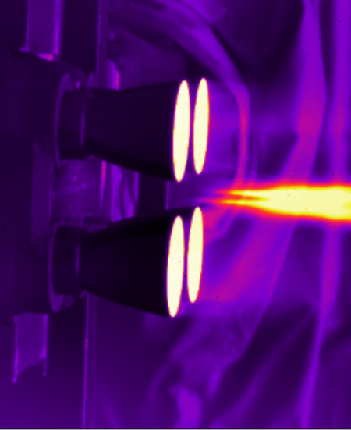
OH PLIF Visualization and Thermometry for NASA Space Launch System (SLS) Plume Induced Base Heating
At high altitudes, flow leaving engines impinges on base
Prior to PLIF: no direct experimental evidence of shock formation
Wind tunnel tests: Use OH Planar Laser-Induced Fluorescence (PLIF)
  Naturally-occurring OH present in plume and plume-induced base flow
OH PLIF flow visualization clearly showed stagnation shock.
  Neither Schlieren nor IR showed base flow structures
Position of shock agreed with CFD, increasing confidence in CFD.
Mid-IR OH PLIF

Slide 14
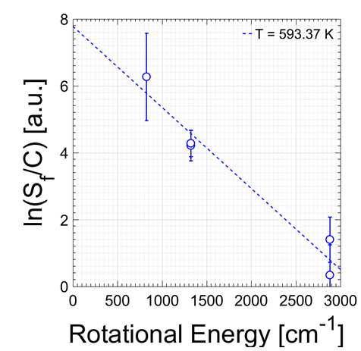
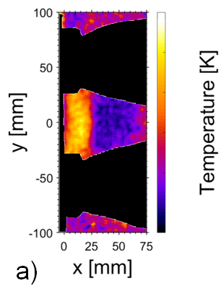
OH PLIF Thermometry of SLS Base Flow
Probe different ground state transitions: measure rotational temperature
“Recovery temperature” measurement is needed to determine flight-scaled convective heat transfer coefficient
Quantity critical in determining flight-scaled heat transfer rates
  Previously used a few thermocouples protruding into flow: 50-80% uncertainty
  Using PLIF for the first time, measured with uncertainty of 10-30% with only 5 images
Used to design base thermal protection system (TPS) thickness
High
Low
QUANTITATIVE, MULTI-LINE, OH-PLIF THERMOMETRY TO EXAMINE BASE HEATING IN THE SPACE LAUNCH SYSTEM CORE AND EUS STAGES
Ross A Burns et al, JANNAF 2017

Slide 15
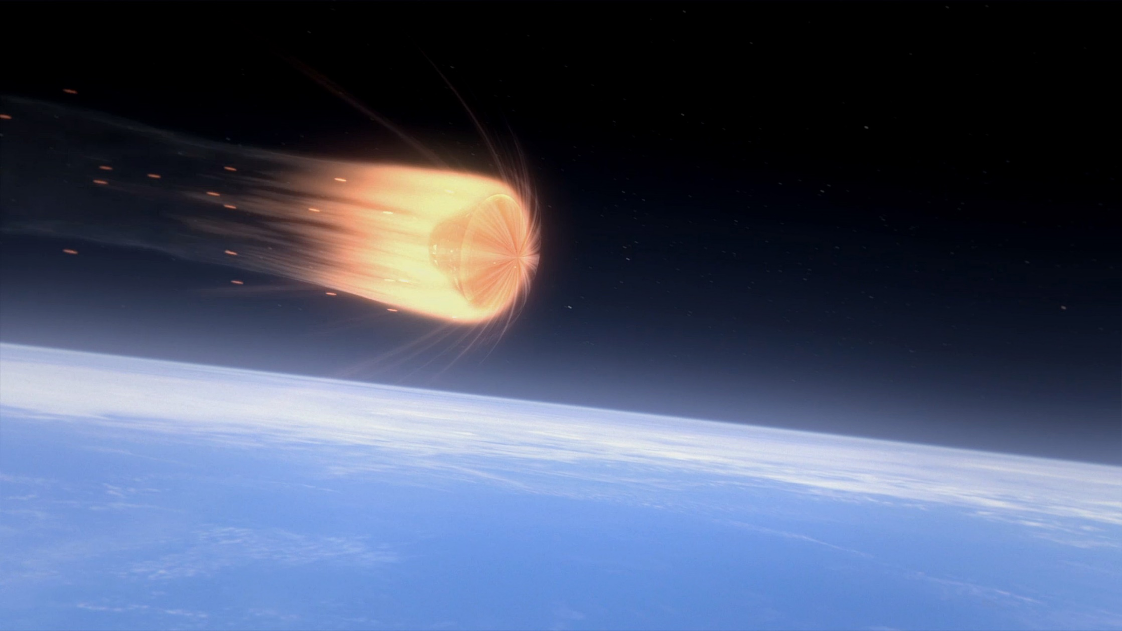
Entry

Slide 16
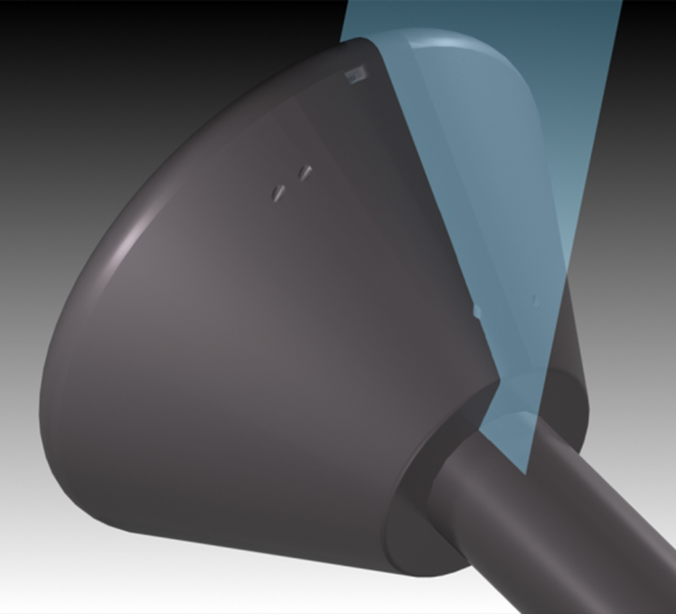
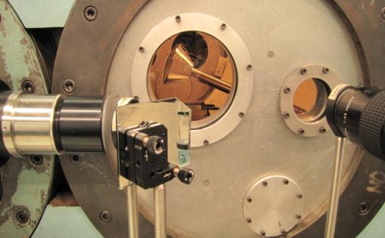
Typical setup: PLIF Imaging in CUBRC Lens-1 Facility
Optics direct laser sheet directed into flow
Imaged by cameras

Slide 17
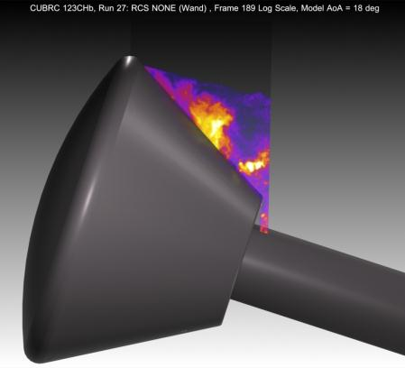
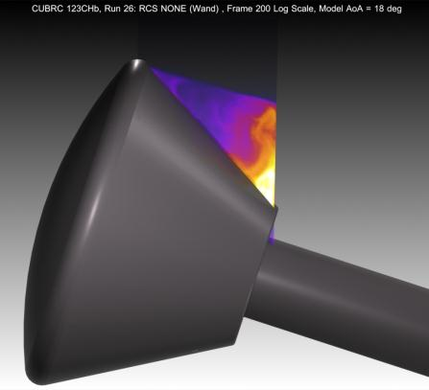
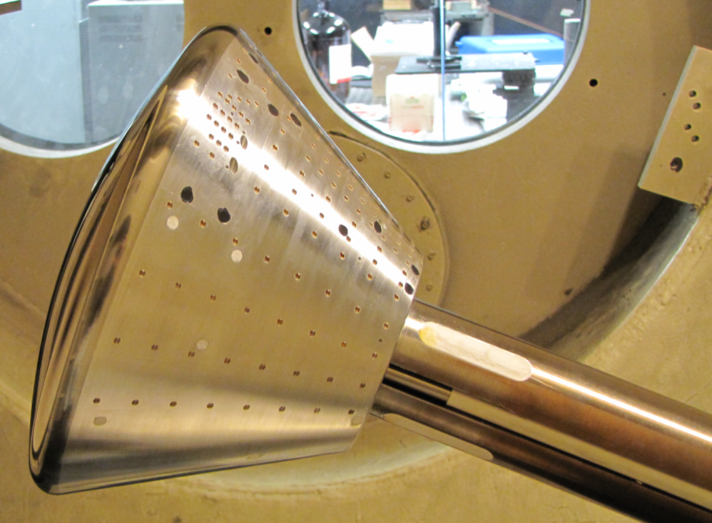
Orion MPCV - Testing at CUBRC
Short duration shock tunnel testing (LENS-1) at Mach 8
Primary goal: Determine backshell heating environment with gauges
Visualize shear layer, Reaction Control System (RCS) Jets with 1% NO
No Jets
No Jets, Re_{D} x7 higher
Roll RCS
Schlieren didn’t show jets
Combs et al. J. of Spacecraft and Rockets (2015): Vol.52: 243-252

Slide 18
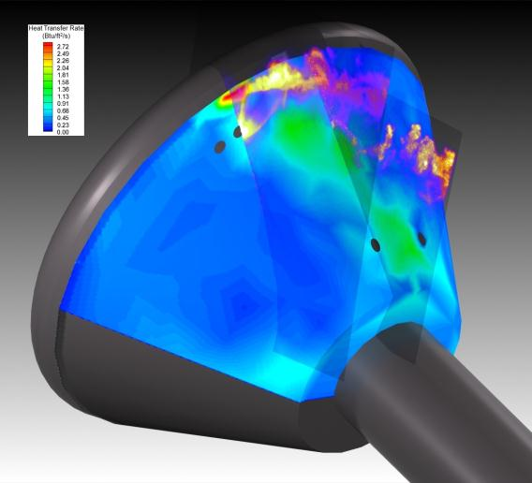
PLIF imagery helps interpret conventional data
Composite of two PLIF images taken at different image planes plus heating map generated by discrete gauges
Clear that roll jet fluid is not heating the model
Possibly a horseshoe vortex wrapping around roll jet structure is heating surface
Separation shock may be cause of high heating near capsule lip

Slide 19
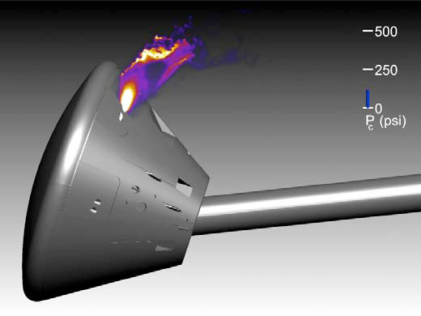
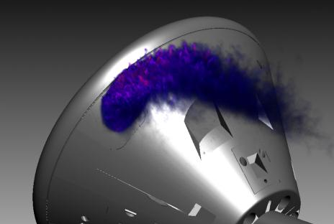
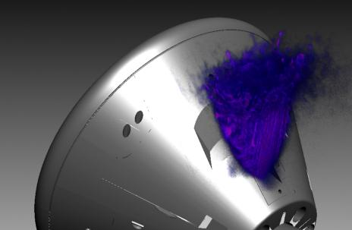
Volumetric Imaging at Mach 10: Orion
Pair of Roll RCS Jets
P_{jet} = 132 psi
Pitch Jet
P_{jet} = 132 psi
1 minute runs in NASA Langley’s 31” Mach 10 facility
Single shot images of NO-seeded RCS jet fluid; scan laser sheet
Multiple images displayed simultaneously to show 3D trajectory of jet
J. A. Inman, P. M. Danehy, et al. AIAA Journal Vol. 47, No. 4, April (2009)

Slide 20
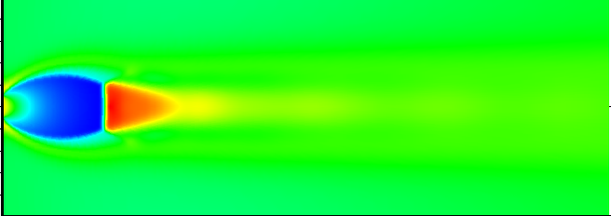
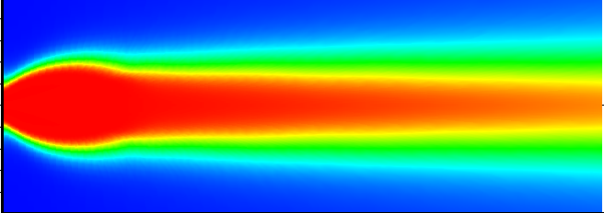
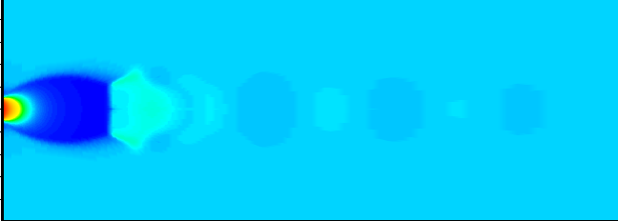
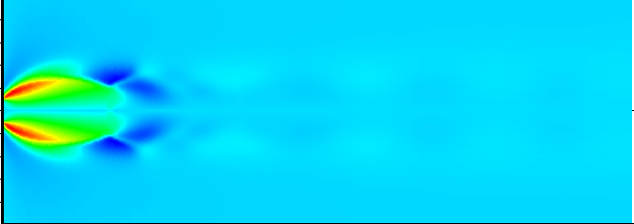
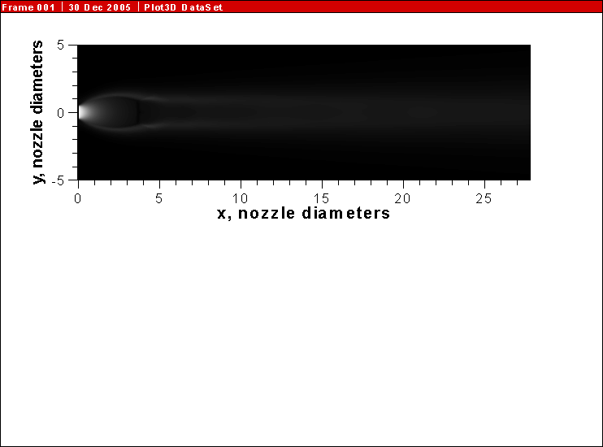
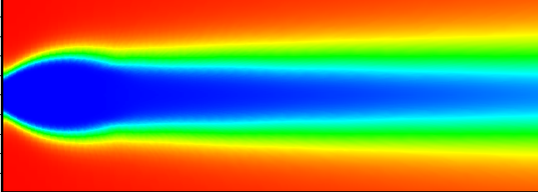
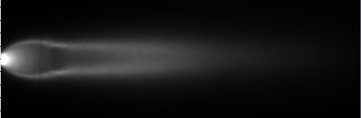
Computational Flow Imaging (CFI)
Compute PLIF Images based on CFD and spectroscopic data (broadening, shift, quenching)
  More direct comparison between PLIF and CFD
T
Y_{NO}
P
λ, Δλ
v
J. A. Wilkes, C. Glass, P. M. Danehy and R. J. Nowak, “Fluorescence Imaging of Underexpanded Jets and Comparison with CFD” AIAA Paper 2006-910, Jan. 9-12, 2006.
CFI
Y_{O2}
Originally in support of Space Shuttle Return to Flight (RTF) after Columbia accident.
Recent improvements in support of Mars missions.
PLIF
Overlap Integral, G
Laser, Doppler, Pressure Broadening, Shift

Slide 21
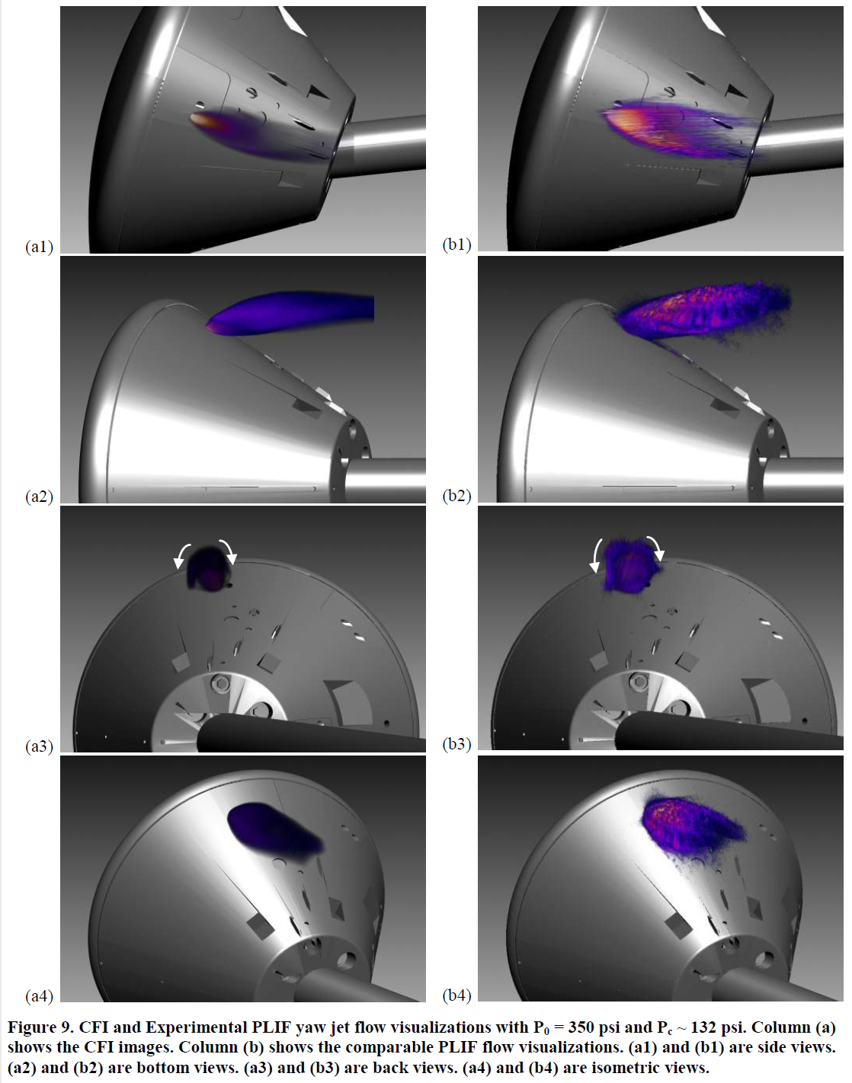
CFI comparison for Orion tested at Mach 10
(Ivey et al, AIAA Conference, 2011-713)

Slide 22
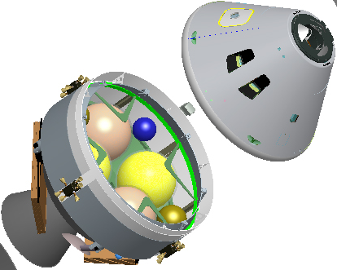
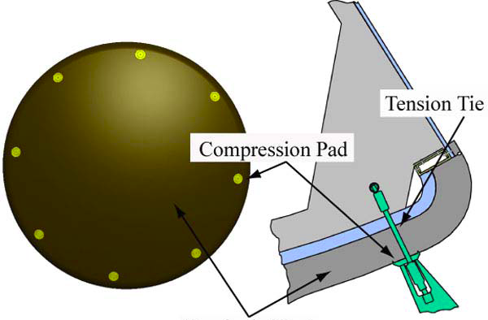
Motivation for M=10 flow over discrete roughness study
Orion MPCV Compression Pads / Tension Ties
Crew
Module
Service
Module
Liechty
AIAA-2008-1240
3x higher heating downstream of tension tie:
Why?
Understand the laminar-to-turbulent transition process induced by a discrete protuberance
Many other researchers using cylinders for fundamental trip studies (Schneider, Choudhari, Goldstein)
Freestream
Turbulent BL
Transitional BL
Forebody Heat Shield
Laminar BL
Flow Visualization: 10 Hz and MHz
Velocimetry

Slide 23
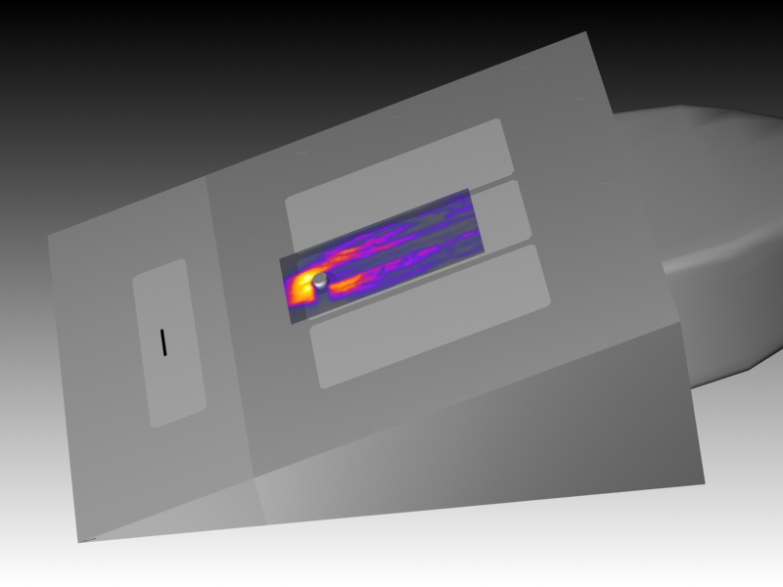
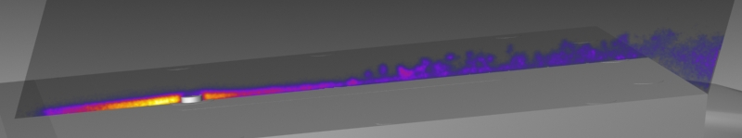
Flow over discrete roughness: Flow Vis
Flow visualization can provide information about BL behavior
Tripped, transitional flow
NO seeded from 11-mm wide spanwise slot
Laminar flow
Cylinder Trip (and shadow)
Sting
Sharp leading edge
Camera FOV
Length Scale
(1/4” increments)
Freestream
Turbulent BL
Transitional BL
Laminar BL
M_{e} ≈ 4.2
Re_{kk} ≈ 5,000
k/δ = 1.4

Slide 24
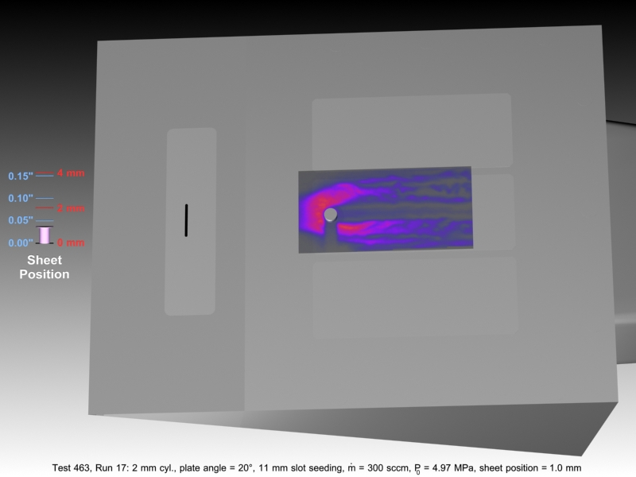
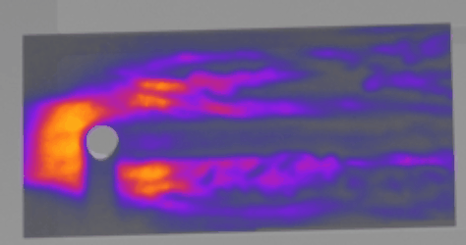
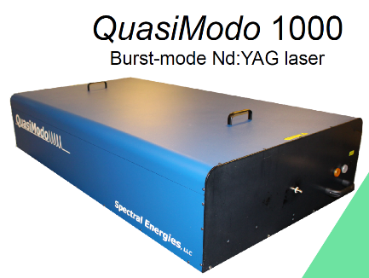
1 MHz NO PLIF System
Jiang et al, Applied Optics Vol. 50, Issue 4, pp. A20-A28 (2011)
1 million FPS – time resolve these flows, compare with time resolved CFD
More coming soon: NASA just procured a similar system through SBIR program (Spectral Energies, Dayton OH)

Slide 25

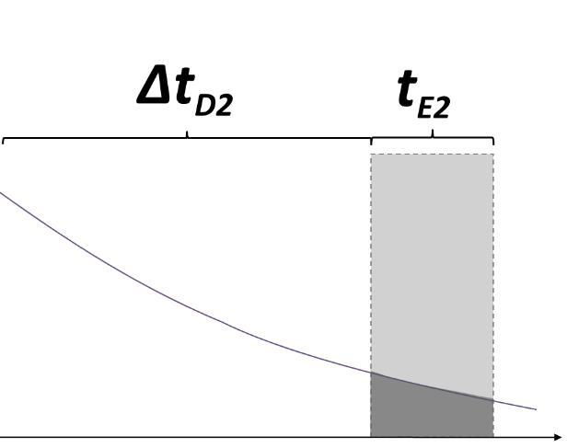
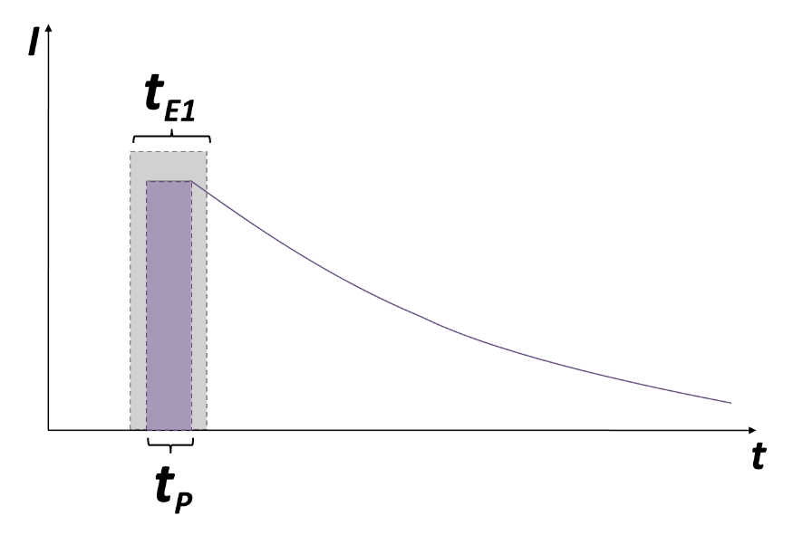
Single-laser Molecular Tagging Velocimetry (MTV)
Excited state
Tunable Laser
Gas flow
Sheet-forming lenses
Ground state
Lens array
LIF ~ n_{NO}
Flow Direction
Laser excites lines of molecules
Molecules move, fluoresce
Camera captures image
25
BF Bathel, et al, AIAA journal 49 (9), 1883-1896, 2011

Slide 26
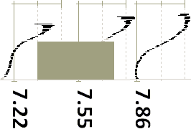






Applications: Single-laser MTV
0.41 cm
0.00 cm
Trip
No Trip
cm
cm
cm
M_{e} ≈ 8.1
Velocity Measurement
  Single-component
  Developed thorough uncertainty analysis methodology
  Data used in subsequent CFD study by Iyer et al. of Univ. of Minnesota (AIAA 2011-566)
BF Bathel, et al, AIAA journal 49 (9), 1883-1896, 2011

Slide 27


Descent
Transonic Phase will have an ablated heatshield: How will aero perform?

Slide 28



Femtosecond Laser Electronic Excitation Tagging (FLEET)
Molecular Tagging Velocimetry in Transonic Cryogenic Tunnels
0.3 m demonstration experiments
Orion in the National Transonic Facility

Slide 29

What is FLEET?
Femtosecond Laser Electronic Excitation and Tagging
70 fs laser focused down excites N₂ which fluoresces for 10’s of μs
  Acquire image pairs or sequences and determine velocity from displacement (Δt = 1 μs, 5 μs, … 50 μs)
  Can perform precise velocity measurements in air and N₂ flows
(Princeton)
Laser (1 kHz)
-1 ms = 1000 usec
between pulses
Camera (200 kHz)
-5 usec between images
FLEET Raw Data obtained in 0.3 m transonic cryogenic tunnel at NASA Langley
(use slideshow mode)
Single, robust laser
Single camera, 200 kHz
800 nm laser, 1 kHz
Visible fluorescence
Multi-exposure
No seeded gas
V = Δx/Δt

Slide 30


Transonic Cryogenic Wind Tunnel
Flow Facility – NASA Langley 0.3-m Transonic Cryogenic Tunnel (0.3-m TCT)
Continuous, closed-circuit wind tunnel operating with air or N₂
Mach number range: 0.2 to 0.9
Total pressure range: 100 kPa to 500 kPa
Total temperature range: 95 K to 320 K
Reynolds number range: 4$×$10⁶ 1/m to 300$×$10⁶ 1/m

Slide 31



Transonic Cryogenic Wind Tunnel
Flow Facility – NASA Langley 0.3-m Transonic Cryogenic Tunnel (0.3-m TCT)
Continuous, closed-circuit wind tunnel operating with air or N₂
Mach number range: 0.2 to 0.9
Total pressure range: 100 kPa to 500 kPa
Total temperature range: 95 K to 320 K
Reynolds number range: 4$×$10⁶ 1/m to 300$×$10⁶ 1/m
Double-shelled construction
Pressure shell
Inner ‘D’-window
Flow direction
Plenum
Inner rectangular window

Slide 32

Transonic Cryogenic Wind Tunnel
Flow Facility – NASA Langley 0.3-m Transonic Cryogenic Tunnel (0.3-m TCT)
Continuous, closed-circuit wind tunnel operating with air or N₂
Mach number range: 0.2 to 0.9
Total pressure range: 100 kPa to 500 kPa
Total temperature range: 95 K to 320 K
Reynolds number range: 4$×$10⁶ 1/m to 300$×$10⁶ 1/m
Double-shelled construction
Optical access: outer pressure shell window + two windows in turntable
Pressure shell
Inner test section
Flow direction
Outer window
Plenum

Slide 33


Optical Setup
Within plenum, laser passed through an evacuated conduit/periscope to alleviate wavefront distortion caused by density fluctuations
Beam focused at center of test section with $f$ = + 200 mm PCX lens
High-speed intensifier lens-coupled to CMOS camera
Quasi-boresight imaging perspective
Acquisition rate: 200 kHz in bursts of 15 frames (100 bursts/s)

Slide 34

Characterization of FLEET velocimetry
Data Sample
FLEET signal takes on a nearly-circular intensity distribution due to boresight imaging
Burst imaging allows the simultaneous measurement of signal position and intensity as a function of time
  Immunity to vibration-based errors in velocity calculations
  Signal intensity- /lifetime-based measurements
Raw data
Scaled data
Centroid data
(processed)

Slide 35


Characterization of FLEET velocimetry
Measurement Accuracy
Accuracy assessed by comparing FLEET velocity measurements to those calculated by the 0.3-m TCT data acquisition system (DAS)
Standard error found to lie between 0.5% and 1.5% of measured velocity
Measurement Precision
Standard deviation of velocity measurements compared to wind-off values
  Measurement precision consistently less than 1% of measured velocities
Burns, Danehy, Halls, Jiang, “Application of FLEET Velocimetry in the NASA Langley 0.3-m Transonic Cryogenic Tunnel,” Aviation 2015, AIAA-2015-2566.
Burns, Danehy, Halls, Jiang, “Femtosecond Laser Electronic Excitation Tagging Velocimetry in a Transonic, Cryogenic Wind Tunnel,” AIAA Journal, 2016.

Slide 36

Implement FLEET in NTF: Application to Orion
National Transonic Facility
  High pressure cryo facility
  Unique National asses
  High Reynolds number testing
Built a beam transmitting system
  Evacuated beam path
  Articulating mirrors
  Remote operation
Camera acquisition System
  Intensified high speed camera
Orion test:
  Vary Mach, Reynolds, AoA, Heat shield
Abort Fenced IDAT Fenced with grit
Free Transition
Fixed Transition

Slide 37



FLEET Measurement Arrangement
Sweep Pattern
Simulated Velocity Planes
To avoid damage to model, measurements were obtained at +/- 90 degree roll.

Slide 38



Orion Results: Mach Dependence
(Also found strong Reynolds Number Dependence)
Full Vertical Bin
Data recently delivered to Orion program for code validation.
Data set will be made available to wider community (Retter et al, SciTech 2023)

Slide 39



Lunar Landing: Plume Surface Interaction
PSI leads to surface erosion (vehicle tilt), plumes of dust (reduced visibility), ejecta (damage nearby installations) and other issues
What are the plume physics at lunar conditions?
How deep, how large will the craters be? Can we measure them as they erode?

Slide 40
SCALPSS: Measure Plume-Surface Interaction
NASA Stereo CAmeras for Lunar Plume Surface Studies (SCALPSS) missions would measure craters.
Measurement Technique: Stereo Photogrammetry
Currently supporting two CLPS missions. Future?
SCALPSS 1.0
Intuitive Machines’ Nova-C lander
4-camera system
Target fully eroded craters
1 plume-surface interaction
1.5 m primary cratering region
1 lens type used
SCALPSS 1.1
Firefly Aerospace’s Blue Ghost lander
6-camera system
Target pre-disturbed regolith and full eroded craters
8 plume surface interactions
3 m primary cratering region
3 lens types used
Nova-C
Blue Ghost
(R Thompson, AIAA SciTech 2021)
(O Tyrrell, AIAA SciTech 2022)

Slide 41
Use CAD tools to fully simulate the optical system
Combined lab experiments (by NASA Marshall) with extensive CAD analysis to perform trade studies resulting in system design.
For SCALPSS 1.1 (Firefly Blue Ghost) we have a 6 camera system with long (50 mm) and short (3.37 and 5.4 mm) focal length lenses
Knowledge base allows us to simply predict accuracy of proposed measurement systems on future landers.
Wide view of cratering region
Limited, higher resolution view of cratering region

Slide 42


Constructing simulated crater (2019)
(built by some special students…)
Wet latex paint Concrete mix
Need 48” diameter arbitrary shape depression 2-3” deep.
Need uniform color similar to lunar surface.
Need ability to mount vertically and rotate.
Need to hold shape.

Slide 43




Crater with solar illumination
Final product →
Rocks epoxied to surface create brightness and shadows to be used as photogrammetry “targets”
Different angles simulate landing or measuring at different times of day.

Slide 44



SCALPSS laboratory testing (ongoing)
Camera data
Use CAD-designed 2 camera system on crater in lab
Assess measurement uncertainty by comparison to COTS VSTARS which uses ~50 images and has sub mm accuracy.
Refine accuracy prediction model
Improve speed and accuracy of image processing
See paper by O. Tyrrell at SciTech 2023.

Slide 45

PSI Test at MSFC within 20-ft Vacuum Chamber
Performed 10 Hz NO PLIF within large-scale facility in July 2022
Objective: obtain plume structure measurements in rarefied (lunar-relevant) and continuum (Martian relevant) environments
  Mach 5 plume of heated N₂ seeded with NO impinging normal a flat instrumented plate
Even at very rarefied conditions, PLIF shows flow features of interest
  Concave surface shock vs. triangular surface shock
  Large-scale structures within wall jet
  Rarefied jet vs. jet boundary
  Shear layers
Rodrigues et al (In preparation)
Lunar-relevant, lower lander altitude
Lunar-relevant, higher lander altitude
Martian-relevant, higher lander altitude

Slide 46
Conclusions
Launch, Entry, Descent, Landing
Optical and Laser based measurements are making contributions
  Insight into flow physics
  Explain why
  Code validation
Three measurement techniques described here
  PLIF
  FLEET
  Stereo Photogrammetry
Our research team is doing more…
  Similar series of studies towards Mars entry …and subsonic aircraft.
    LOFTID, COBRA, Propulsive Descent, etc
NASA has opportunities for students, and early career faculty to get involved
  Summer or semester program
  Grant opportunities for students and faculty
  Post-doctoral opportunities
  Contractor or Civil Servant employment (USA Jobs)

Slide 47
Thanks for your attention!

Slide 48
Backup

Slide 49

EFT-1 Dec 5, 2014
http://www.nasa.gov/pdf/631631main_12-03_HEOC.pdf

Slide 50


Slide 51

SpaceX/NASA Artemis III mission: 2025+
https://en.wikipedia.org/wiki/Starship_HLS#/media/File:Artemis_III_CONOPS.svg
Notes:
Starship HLS, or Starship Human Landing System, is a lunar lander variant of the Starship spacecraft that will transfer astronauts from a lunar orbit to the surface of the Moon and back. It is being designed and built by SpaceX under contract to NASA as a critical element of NASA's Artemis program to land a crew on the Moon in the 2020s.
The mission plan calls for a Super Heavy booster to launch a Starship HLS into an Earth orbit, where it will be refueled by multiple Starship tanker spacecraft before boosting itself into a lunar near-rectilinear halo orbit (NRHO). There, it will rendezvous with a crewed Orion spacecraft that will be launched from Earth by a NASA Space Launch System (SLS) launcher. A crew will transfer from Orion to HLS, which will descend to the lunar surface for a stay of several days which is to include five or more EVAs. It will then return the crew to Orion in NRHO.
In the third phase of its HLS procurement process NASA awarded SpaceX a contract in April 2021 to develop, produce, and demonstrate Starship HLS. A crewed flight will occur as part of the Artemis 3 mission, no earlier than April 2025, after an earlier uncrewed test flight successfully lands on the Moon and returns to NRHO.
On 23 March 2022, NASA announced its intention to procure a second crewed Starship HLS demonstration mission to the Moon, with the HLS design updated to meet new sustainability requirements. NASA intends to negotiate a sole-source award to SpaceX by exercising an option under the 2021 HLS contract. The updated Starship HLS would be used for the Artemis V mission and would compete with landers to be procured from other vendors for later landings.

Slide 52
SLS Configurations
www.nasa.gov/sls
Notes:
Which ones tested?

Slide 53

https://commons.wikimedia.org/wiki/File:NASA_Selects_First_Commercial_Moon_Landing_Services_for_Artemis_Program_(47974915261).jpg

Slide 54
https://commons.wikimedia.org/wiki/File:Super_heavy-lift_launch_vehicles.png

Slide 55



Higher Speed (100 kHz) Measurements: PLEET
Deployment of a high-repetition rate PLEET (picosecond-LEET) system
Make similar velocity measurements at up to 100 kHz using pulse burst laser
MST Manuscript (under review): Burns, Danehy, Jiang, Slipchenko, Felver, Roy, “High-Speed, Unseeded Velocimetry for Transonic Cryogenic Tunnels Using Pulse-Burst PLEET.”
PLEET Experiment performed at 0.3 m TCT in collaboration with Spectral Energies LLC
NASA Langley purchased a PB laser from SE
-Delivered February 2018
- Upgraded to include narrow seed laser
- PLEET, PIV, Rayleigh, DGV…
- NO, OH PLIF…
…many images per tunnel run

Slide 56


Current Flow Measurement in TCTs
What are they doing now in TCTs?
  Physical probes (hotwire; pitot-static)
    bulky, slow, perturb the flow.
    Typically mount on main sting or model.
    Not always available in National Transonic Fac. (NTF)
Current flow measurement approach in NTF uses rakes attached to model:
PIV
Milholen, Jones, et al, 2013

Slide 57

Laser Setup in the NTF: Details
Please consult for more information
AIAA 2019-3380
Reese et al., Exp Fluids 62, 99 (2021).

Slide 58


Measurement Strategy
Mobile measurement systems
  Test in lab;
  Get set up quick and get out
  1-2 week tests
Automated operation
  Acquire thousands of measurements if possible
  Remote operation
Hardened hardware
  Cooled / Heated, SSD, Robust construction
Prefer simple methods
  Fewer lasers the better
  Fewer laser beams the better
Setup for Orion Testing in CUBRC, Buffalo NY

Slide 59


Role of Advanced Measurement Techniques in Aerospace Vehicle Development
Flight Test
(X-planes)
Evaluate new concepts: Tailcone Thruster
Planned X-plane: QueSST
Ground Test of Components and Vehicles
Design based on Computational Fluid Dynamics (CFD)
Measurement Needs:
Force + Moment
Surface:
  Pressure
  Temperature
  Shape, Deflection
  Shear Stress
Off-body (gas)
  Flow visualization
  Velocity
  Density
  Pressure
  Temperature
  Concentration
Computational Methods predict:
Cruise at Mach 0.85
Turbulence
Flow separation
Boundary layer (BL) transition
Shock BL Interaction
Aeroelasticity
Plumes / Jet flows
Fuel-air mixing
Combustion
Inability of computational methods to reproduce ground test results (wind tunnel)
  Could be inflow conditions!
Many of the models in these codes have not been assessed / validated at relevant conditions
In some cases, detailed flow data are needed for physics based modelling:
Requirements drive spatial, temporal resolution, multi-parameter measurement
ρu’v’, T ’χ_{i}’
Notes:
https://www.nasa.gov/aero/nasa-moves-to-begin-historic-new-era-of-x-plane-research
Quiet Ultra Efficient SuperSonic Transport
Three-Legged Stool
The second leg of the stool – a semi-span model (half of a configuration) undergoes flutter testing in a NASA Langley wind tunnel.
Credits: NASA Langley/Sandie Gibbs
But in this age of high-speed computers capable of generating sophisticated simulations, and with the availability of world-class wind tunnels to test high-fidelity models, why still the need to fly something like an X-plane?
“It’s a valid question,” Waggoner said.
The answer has to do with what Waggoner describes as the necessity of a “three legged stool” when it comes to aviation research.
One leg represents computational capabilities. This involves the high-speed super computers that can model the physics of air flowing over an object – be it a wing, a rudder or a full airplane – that exists only in the ones and zeros of a simulation.
A second leg represents experimental methods. This is where scientists put what is most often a scale model of an object or part of an object – be it a wing, a rudder or an airplane – in a wind tunnel to take measurements of air flowing over the object.
Measurements taken in the wind tunnel can help improve the computer model, and the computer model can help inform improvements to the airplane design, which can then be tested again in the wind tunnel.
“Each of these is great on its own and each helps the other, but each also can introduce errors into the inferences that might be made based on the results,” Waggoner said. “So the third leg of the stool is to go out and actually fly the design.”
Whether it’s flying an X-plane or a full-scale prototype of a new aircraft, the data recorded in actual flight can then be applied to validate and improve the computational and experimental methods used in developing the design in the first place.
“Now you’ve got three different ways to look at the same problem,” Waggoner said. “It’s only through doing all that together that we will ever get to the point where we’ve lowered the risk enough to completely trust what our numbers are telling us.

Slide 60


The National Transonic Facility at NASA Langley RC
The NTF is NASA Langley’s largest, most expensive facility.
Minimal off-body measurement capability
Contributions to civilian aero, aerospace, DOD missions
Could be used for high Reynolds number code validation experiments

Slide 61

MSL NO PLIF vs CFD (CFI), Mach 10
Mars Science Lab (MSL) vehicle delivered Curiosity:
  Do we understand RCS jet wake flow and interactions? Predict?
OVERFLOW
(CFI Model)
NO PLIF
(with smoothing)
C.T. Johansen et al. AIAA-2012-594

