Slide 1
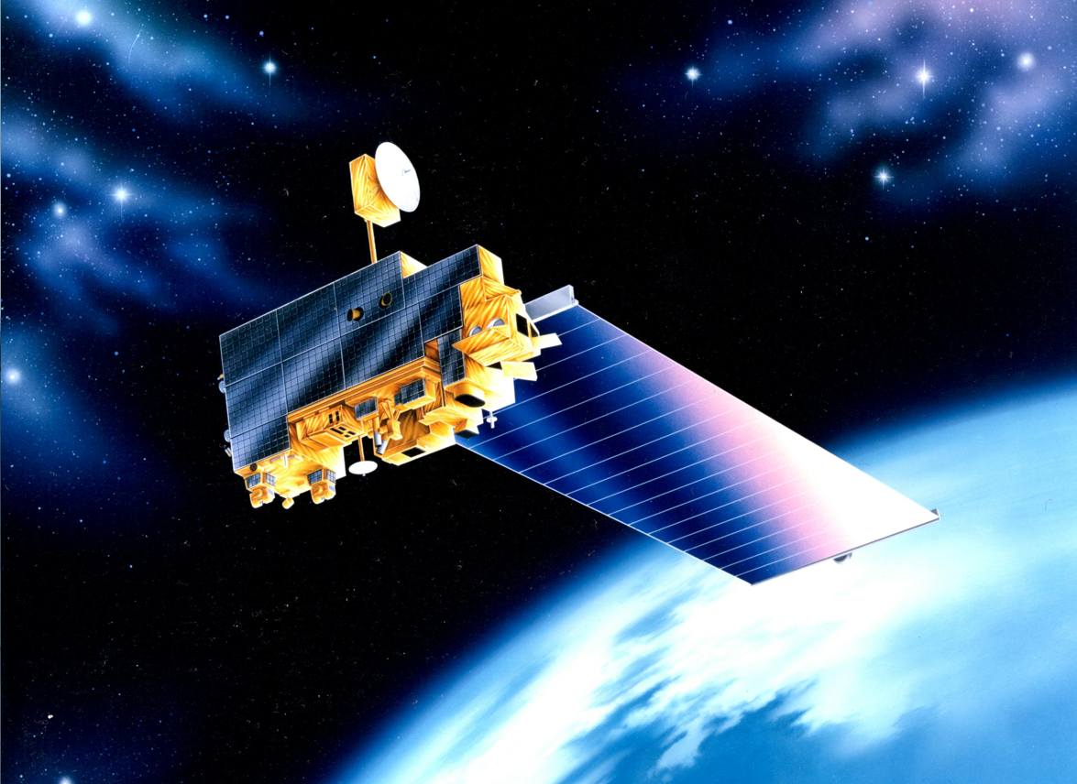
EOS Terra
Mission Status
Constellation MOWG
Virtual (GSFC)
November 16-18, 2022
Dimitrios Mantziaras
Terra Mission Director - Code 428
Phone: (301) 614-5234
Dimitrios.C.Mantziaras@nasa.gov

Slide 2
Topics
Mission Summary
Spacecraft Subsystems Summary
Recent Activities
Inclination Adjust Maneuvers
Conjunction History
End-Of-Mission Plan
Upcoming Activities
Summary
Backup Slides

Slide 3
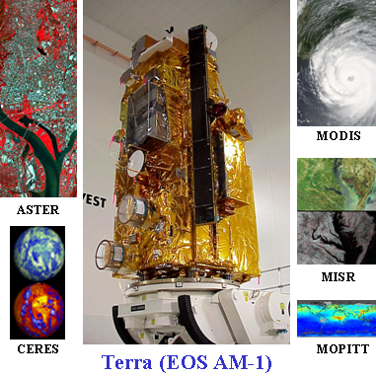
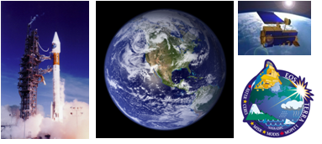
Terra Mission Overview
Terra Features
Launch Date: December 18,1999 (Atlas IIAS, VAFB)
Orbit: 705 km, Sun-synchronous polar, 98.2º Inclination, 10:30 AM MLT descending node
Instrument Payload:
  ASTER (SWIR, TIR & VNIR) - Advanced Spaceborne Thermal Emission and Reflection Radiometer (Japan)
  CERES (Fore & Aft) - Clouds and the Earth's Radiant Energy System (USA – Langley)
  MISR - Multi-angle Imaging Spectro-Radiometer (USA – JPL)
  MODIS - Moderate Resolution Imaging Spectro-radiometer (USA – GSFC)
  MOPITT - Measurement of Pollution in the Troposphere (Canada)
Project Management: Earth Science Mission Operations (ESMO)
Spacecraft Flight Operations: Contracted by GSFC to KBR team and supported by NASA NENs and TDRSS
Instrument Operations and Science Data processing: Performed at respective Instrument Locations where developed
Mission Duration: Successfully completed Prime mission of 5 years. Currently in Extended Operations.
Distributed Active Archive Centers: LP DAAC – MODIS, ASTER; Langley DAAC – CERES, MISR, MOPITT
Science
The primary objective of the Terra Mission is to simultaneously study clouds, water vapor, aerosol, trace gases, land surface and oceanic properties, as well as the interaction between them and their effect on the Earth’s energy budget and climate.

Slide 4
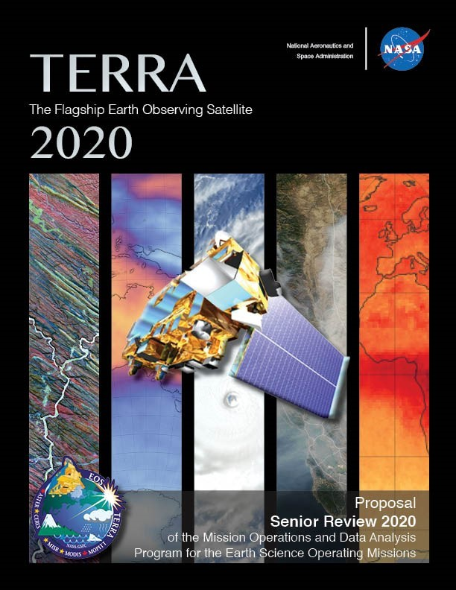
EOS Terra Mission Summary
2020 Inclination Adjust Maneuvers (Final)
  IAM #57 – February 20th, 2020
  IAM #58 – February 27th, 2020
March 2020: Mission Extension Senior Review Proposal Delivered to NASA HQ
  Mission extension through FY26 recommended
  Results from Panel Review received:
    Terra #1 Earth Science Mission – “The Senior Review Science Panel unanimously supports Terra's extension in FY 2021-2023 and FY 2024-2026 with the proposed over-guide budget.”
    “Terra is the most important Earth Observation mission of the 21st century.”
12/18/20: Terra 21-Year Anniversary
EOS Flight Operations Annual Review #15 – Jan 26-27, 2021
Updated Phase-F and EOMP generated for delivery to NASA HQ (Mar/Apr 2021)
12/18/21: Terra 22-Year Anniversary
EOS Flight Operations Annual Review #16 – Feb 1-2, 2022
Constellation Exit executed successfully - October 2022
12/18/22: Terra 23-Year Anniversary
EOS Flight Operations Annual Review #17 – Jan/Feb 2023
Senior Review 2023 ??

Slide 5
Terra Spacecraft Status
All subsystems on Primary Hardware except as noted
Command & Data Handling (CDH) – Nominal
  Solid State Recorder (SSR) – holds ~1 orbit of data
  58 of 58 SSR Printed Wire Assembly now operational (All 16 offline boards were recovered)
    SSR Reset successfully performed on 09/22
Communications (COMM) – Nominal
  DAS Modulator Failure on 05/29/2008 (Operating on Redundant)
  Use K-Band primarily, X-Band as needed for Science Playback
Electrical Power System (EPS) – Good
  Battery Cell and Heater Controller Anomaly (10/13/2009)
  3 of 24 Solar Panel Failed (9/24/2000, 01/17/2022 & 03/22/2022)
    Remaining ASTER SWIR electronics and SWIR CPHTS were shutdown in Sept 2022 – offsets the loss of one shunt
Flight Software (FSW) – Nominal
Guidance, Navigation & Control (GN&C) – Nominal
  IRU-B powered down due to rising temp and current trend (recommendation from Kearfott)
    Not used for nominal operations (IRUs A & C used for ops and no signs of degradation)
    Audit of all references to IRU-B completed, prime updates completed prior to turn-off, remaining items being worked
  Minor loss of sensitivity in SSSTs – updated tracker biases to compensate
Propulsion (PROP) – Nominal
Thermal Control System (TCS) – Nominal
Instruments (INST) – Nominal
  Only ASTER SWIR failed, all other instruments are taking science

Slide 6
Spacecraft Component Status
Subsystem | Component | Design | Current | Capability | Comments
EPS | Solar Array | 24 Shunts | 21 Shunts | 88% | No impact to operations. Additional failures will require reducing load or EPS configuration change. Fully capable of supporting mission thru 2027 unless multiple future failures occur
 | Batteries | 108 Cells | 107 Cells | 99% | BBAT cell #50 failed on 10/15/09.
 | Batteries | 36 Heater Controls | 28 Heater Controls | 77% | BBAT heater control failed on 4 of 9 heater groups on primary, redundant, and survival. Battery cell charging/discharging and the remaining heater groups are preventing cells from freezing. PBAT heater control performance is nominal.
TCS | MOPITTCPHTS | 2 | 2 | Full | Performance is nominal
 | SWIR CPHTS | 2 | 2 | Full | Performance is nominal
 | TIR CPHTS | 2 | 2 | Full | Random temperature fluctuations. Performance within requirements.
SCC | SCC | 2 | 2 | Full | Performance is nominal
COMM | HGA | 2 | 2 | Full | MDA BITE failures occur 2-3/week due to SEU. Recoverable
 | X-Band | 2 | 1 | 75% | DAS Modulator 1 failed (50%). Solid State Power Amplifier redundancy still available (100%).
 | CTIU | 2 | 2 | Full | Performance is nominal
 | OMNI | 2 | 2 | Full | Performance is nominal
CDH | MO | 2 | 2 | Full | Drift rate changes have occurred since 10/3/10. Performance is within requirements.
 | SFE | 2 | 2 | Full | SFE SEU occur 1-2/year. Recoverable
 | SSR | 59 PWA | 59 PWA | 100% | Successful SSR Reset on 09/22/21 recovered all 15 previously offline Printed Wire Assemblies
GNC | IRU | 3 | 2 | Full | Performance is nominal. IRU-B powered off. Yaw axis still redundant.
 | TAM | 2 | 2 | Full | Performance is nominal
 | SSST | 2 | 2 | Full | Minor loss of sensitivity in SSSTs – tracker biases updated
 | CSS | 2 | 2 | Full | Performance is nominal
 | ESA | 2 | 2 | Full | Performance is nominal
 | FSS | 1 | 1 | Full | Performance is nominal. Not currently used
 | RWA | 4 | 4 | Full | Performance is nominal. 3 for 4 redundancy
 | MTR | 3 | 3 | Full | Performance is nominal
Prop | REAs | 16 | 16 | Full | Performance is nominal
Instruments | ASTER - SWIR | 2 | 2 | 0% | All remaining electronics and SWIR CPHTS powered off in Sept 2022 to offset loss of SA shunt
 | ASTER - TIR | 2 | 2 | Full | Performance is nominal
 | ASTER - VNIR | 2 | 2 | Full | Performance is nominal
 | CERES - Aft | 1 | 1 | Full | Performance is nominal
 | CERES - Fore | 1 | 1 | Full | Performance is nominal
 | MISR | 2 | 2 | Full | Performance is nominal
 | MODIS | 2 | 1 | 50% | Power Supply #2 failed, Formatter A degraded, cross-strapped. All Science is nominal.
 | MOPITT | 2 | 1 | 50% | Displacer B and Chopper Motor failed. Loss of redundancy only. All Science is nominal.

Slide 7
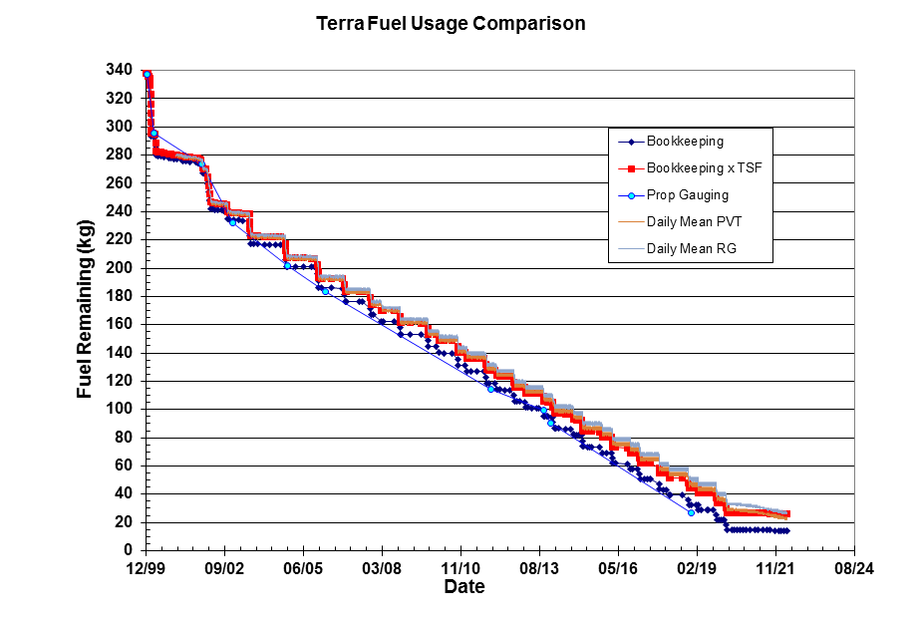
Lifetime Estimates
Fuel Remaining
Fuel Reserve = 12kgs
12 kg
Fuel estimates have been reviewed by ETD, S/C Manufacturer and FOT
  Bookingkeeping x TSF & PVT methods believed to be most accurate
  Most conservative Bookkeeping used as trigger for constellation exit

Slide 8
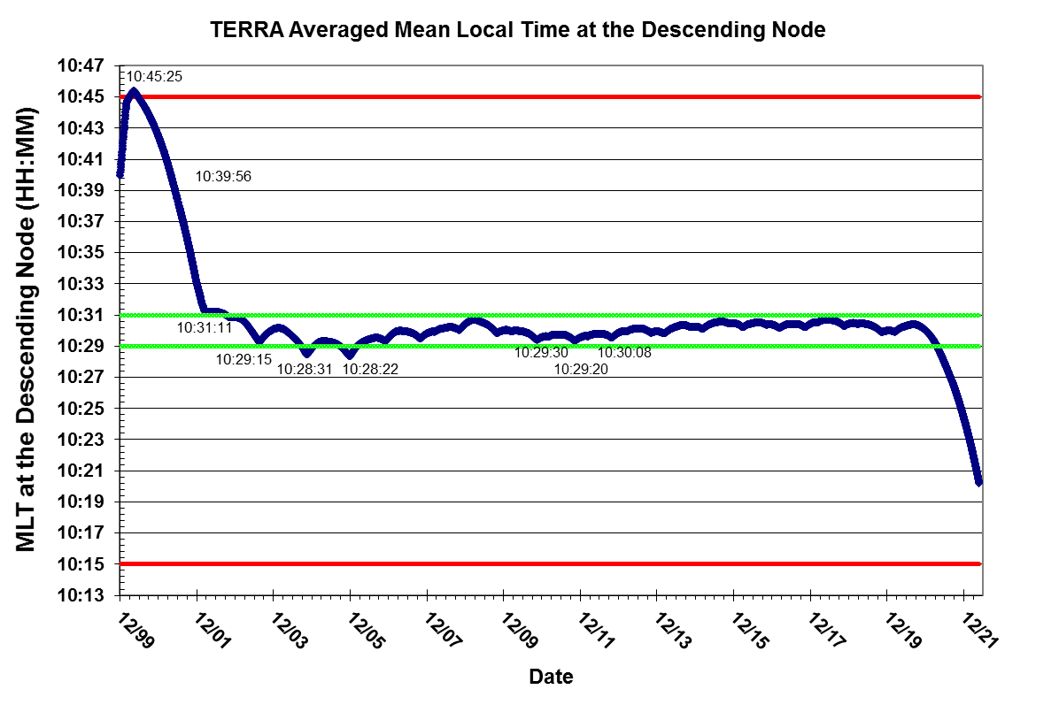
Current Mean Local Time

Slide 9
Recent Activities
  Propulsive Maneuvers
  Drag Make-up Maneuver (DMU) #132 executed on 12/16/21
  Drag Make-up Maneuver (DMU) #133 executed on 01/13/22
  Drag Make-up Maneuver (DMU) #134 executed on 02/23/22
  Drag Make-up Maneuver (DMU) #135 executed on 03/31/22
  Drag Make-up Maneuver (DMU) #136 / RMM #21 executed on 04/07/22
  Drag Make-up Maneuver (DMU) #137 executed for 06/02/22
  Drag Make-up Maneuver (DMU) #138 executed for 07/28/22
  Constellation Exit Maneuver (CEM) #1 executed for 10/12/22
  Constellation Exit Maneuver (CEM) #2 executed for 10/19/22
  Calibration Maneuvers
  MODIS Roll #223 executed on 11/24/21
  MODIS performed Lunar Calibrations without rolling
    12/24/21
    01/22/22
  MODIS Roll #224 executed on 02/20/22
  MODIS Roll #225 executed for 06/18/22
  MODIS Roll #226 executed for 07/17/22
  MODIS Roll #227 executed for 08/16/22
  MODIS Roll #228 executed for 09/15/22
  No Oct. 2022 MODIS Roll due to CEM maneuvers
  MODIS Roll #229 planned for 11/13/22
  MODIS Roll #230 planned for 12/13/22
  11/17/21: Expanded TMON Telemetry Patch
  12/15/21: Terra PBAT Temperature TMON uplink
  12/15/21: BBAT BPC Channel Failure TMON Uplink
  01/17/22: Terra Sequential Shunt Unit (SSU) #10 Failure
  03/15/22: MODIS Command Processor Reset Anomaly
  03/22/22: Terra Sequential Shunt Unit (SSU) #7 Failure
  06/06/22 – 06/17/22: MOPITT Decontamination and Hot Cal
  08/10/22 – 08/12/22: IRU-B Health Check Activity
  09/09/22 @ 11:16:49z : ASTER SWIR Shutdown
  09/13/22: ASTER SWIR CPHTS Shutdown
  10/03/22 - 10/10/22: MOPITT Hot Cal and Safe Transition (CEM Prep)
  10/10/22: MODIS Door Closed (CEM Prep)
  10/11/22: ASTER Contamination Safe (CEM Prep)
  10/20/22: ASTER Resumption of observations (CEM Recovery)
  10/20/22 – 10/21/22: MODIS CEM Recovery
  10/20/22 – 10/26/22: MOPITT CEM Recovery
  10/25/22: Terra Lunar Induced Solar Eclipse #52
  10/27/22 – 10/28/22: MOPITT Hot Calibration

Slide 10
Inclination Adjust Maneuvers
(no change)
Inclination Adjust Maneuvers used to maintain nominal spacecraft mean local time (descending node) of 10:30 AM
  02/20/2020 IAM #57 (320 sec burn) executed successfully
  02/27/2020 IAM #58 (320 sec burn) executed successfully
Predictions indicate need to perform 3-4 maneuvers per year
  2017: (2 in Spring, 2 in Fall) -- COMPLETE
  2018: (1 in Spring, 2 in Fall) – COMPLETE
  2019: (1 in Spring, 2 in Fall) – COMPLETE
  2020: (2 in Spring, 0 in Fall) -- COMPLETE; last inclinations for Terra mission
Terra is no longer performing inclination maneuvers
DMUs were performed until Constellation Exit in October 2022
  Last DMU was DMU#138 on July 28th, 2022
RMMs will continue to be performed as needed until the end of the mission

Slide 11
Terra High Interest Events
Year | Jan | Feb | Mar | Apr | May | Jun | Jul | Aug | Sep | Oct | Nov | Dec | Total
2021 (T1-T4) | 0 | 0 | 1 | 0 | 0 | 2 | 1 | 1 | 0 | 1 | 2 | 1 | 9
Tier 3 | 0 | 0 | 1 | 0 | 0 | 0 | 0 | 0 | 0 | 0 | 0 | 0 | 1
Tier 4 | 0 | 0 | 0 | 0 | 0 | 0 | 0 | 0 | 0 | 0 | 0 | 0 | 0
2022 (T1-T4) | 2 | 2 | 0 | 4 | 1 | 1 | 2 | 2 | 3 |  |  |  | 17
Tier 3 | 0 | 1 | 0 | 1 | 0 | 0 | 1 | 0 | 0 |  |  |  | 3
Tier 4 | 0 | 0 | 0 | 1 | 0 | 0 | 1 | 0 | 0 |  |  |  | 2
Tier Definitions: T1 – Notify (email/phone), T2 – Conduct Briefing, T3 – Plan Maneuver, T4 – Execute Maneuver
2010: 5 HIEs – 1 DAM performed on 01/22/2010: Terra vs. 34700 CA on 1/23 @ 20:46z
2011: 20 HIEs – 2 DAM planned and waived off
2012: 19 HIEs – 1 maneuver waived off due to CA
2013: 17 HIEs – 7 that required significant action
2014: 24 HIEs – 6 that required DAM execution or nominal maneuver waive-off and replanning
2015: 33 HIEs – 8 that required DAM execution or nominal maneuver waive-off and replanning
2016: 11 HIEs – 0 that required DAM execution or nominal maneuver waive-off and replanning
2017: 8 HIEs – 1 that required DAM execution or nominal maneuver waive-off and replanning
2018: 6 HIEs – 2 that required DAM execution or nominal maneuver waive-off and replanning
2019: 9 HIEs - 5 that required DAM execution or maneuver waive-off and replanning
2020: 6 HIEs - 3 that required DAM execution or maneuver waive-off and replanning
2021: 1 HIE that required DAM execution or maneuver waive-off and replanning
2022: 3 HIEs that required DAM execution or maneuver waive-off and replanning
  Terra vs. CZ-4 debris (Object# 26132) with TCA @ 02/24 10:03z -- nominal DMU replanned 1 day early (HIE self mitigated; DMU still performed since needed for orbit maintenance)
  Terra vs. Cosmos 2506 debris (Object# 47212) with TCA @ 04/07 00:45z – DAM/RMM #21 successfully executed at 00:16z
  Terra vs. Unknow (Object# 85095) with TCA @ 07/29 06:23z -- nominal DMU replanned (time shifted) to avoid close approach

Slide 12
ESMO RMM Planning Automation
ESMO has updated its Close Approach (CA) Process to an Automated approach
  Prepares for future increased object catalog w/ Space Fence
  Reduces workload for each event
  Keeps solution “at the ready” for short notice events
ESMO Flight Dynamics team developed an autonomous ephem generation tool
Ephems built off optimal and constrained cases solved for by the Collision Risk Management System (CRMS)
Ephems posted directly to SpaceTrack and sent to CARA for screening
  Delivery to CARA is now automatic based on logic built into the FDS ephem tool to whittle ephems down from maximum of eight generated to a maximum of five delivered
  Any other options needed can be sent manually
Screening results automatically compiled and outputted via an email report from CRMS
Auto Ephem Generation implemented in February 2017
Auto Ephem Delivery implemented in February 2018
ESMO has completed CARA Devolution Parallel Operations (Sept 2019) and now in an “interim” devolved state
  CRMS Release 9 delivered and went operational on August 5th, 2021
  CRMS Release 9.1 delivered and went operational on December 10, 2021
  MOCA CONOPS signed and in ESMO CM -- June 2022
  CRMS Release 10 delivered and went operational on June 22, 2022

Slide 13
Devolution Metrics
Satellite Name | # of Events | # of HIEs | # of Ephems Screened | # of RMMs
Aqua | 12244 | 83 | 663 | 0
Aura | 12553 | 61 | 544 | 6
Terra | 11612 | 56 | 712 | 4
Total | 36409 | 200 | 1919 | 10
Stats from 10/1/2019 through 10/15/2022
ESMO has handled numerous events successfully in its quasi-devolved state

Slide 14
Retrograde Maneuver Preparation
FOT development of retrograde capability
  Short Duration Retro : Complete
    Only executed to prevent GTE violation
    Performed in S/C night
    Design Completion: May 2019
  Long Duration Retro: Complete
    Constellation Exit and Deorbit Burns
    Executed in S/C Day and Night
    ASTER to be in Safe Mode
    Design Completion: December 2019
Terra Retrograde Capability - COMPLETE
All instrument configurations understood
Constellation Exit Maneuver Working Group stood up in March 2022
  Ensured team proficiency and readiness to execute CEMs
  Many simulations performed
Constellation Exit Maneuvers performed successfully
  CEM#1 performed successfully on 10/12/22
  CEM#2 performed successfully on 10/19/22

Slide 15
Upcoming Activities
Upcoming Activities
Terra Lunar Induced Solar Eclipse #52 (69% max predicted eclipse) | 10/25/22
MISR Bi-Monthly Calibration (October 2022) | 10/25/22
FSSE CCB Meeting | 10/26/22 @ 1 pm
ASTER Science Team Meeting @ Tokyo, Japan | 11/07/22 – 11/09/22
ASTER-NASA Interface Meeting (Virtual) | 11/10/22
Constellation MOWG (Fall 2022) | 11/16/22 – 11/18/22
Terra 23-year Launch Anniversary | 12/18/22
MISR Bi-Monthly Calibration (December 2022) | 12/20/22
Terra Lunar Induced Solar Eclipse #53 (Total Eclipse) | 04/20/23
Terra Lunar Induced Solar Eclipse #54 (Annular Eclipse) | 10/14/23
Decommission Preparation | Ongoing

Slide 16
Future Maneuver Plans

Slide 17
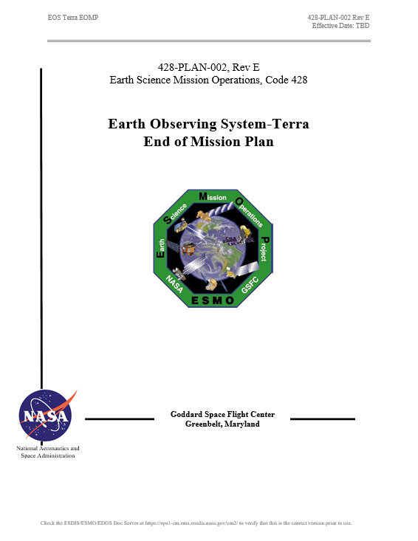
Terra End-of-Mission Plan
  Document Status
  Rev D - End-of-Mission Plan Document has been revised and under review cycle
  APPROVED - NASA HQ Signed in October 2018
  Rev E – Generated and working its way through signatures
    Minor updates to numbers based on 3 years since Rev D
  Content
  Terra will continue normal operations through October 2020
  Once all non-reserved fuel has been used, MLT will be drifted to 10:15 AM
  October 2022, Terra exits constellation
  Remaining fuel used to lower perigee prior to spacecraft passivation
  Exit plan is consistent with the current Constellation Operations Coordination Plan

Slide 18
Terra Lifetime Maneuvers
Spring 2022 Update
Remaining Orbit Maintenance Maneuvers
Mission Year | Inclination Maneuvers | DMU Maneuvers | Fuel Used (kg) | Fuel Remaining (kg)
2018 | 1 Spring, 2 Fall | 4 | 10.783 | 44.998
2019 | 1 Spring, 2 Fall | 5 | 10.752 | 34.245
2020 | 2 Spring, 0 Fall | 3 | 6.890 | 27.066
2021 | 0 Spring, 0 Fall | 6 | 0.344 | 26.503
2022 | 0 Spring, 0 Fall | 5 | 0.381 | 24.594
COMPLETE
Constellation Exit and Deorbit Maneuvers
Mission Date | Maneuver Type | Fuel Used (kg) | Fuel Remaining (kg)
10/12/2022 | CEM #1 | 3.365 | 21.229
10/19/2022 | CEM #2 | 3.347 | 17.883
2/25/2026 | PLM #1 | 3.328 | 14.554
3/04/2026 | PLM #2 | 3.310 | 11.244
3/11/2026 | PLM #3 | 3.293 | 7.951
3/18/2026 | PLM #4 | 3.276 | 4.675
3/25/2026 | PLM #5 (59.5%) | 1.974 | 2.701
COMPLETE

Slide 19
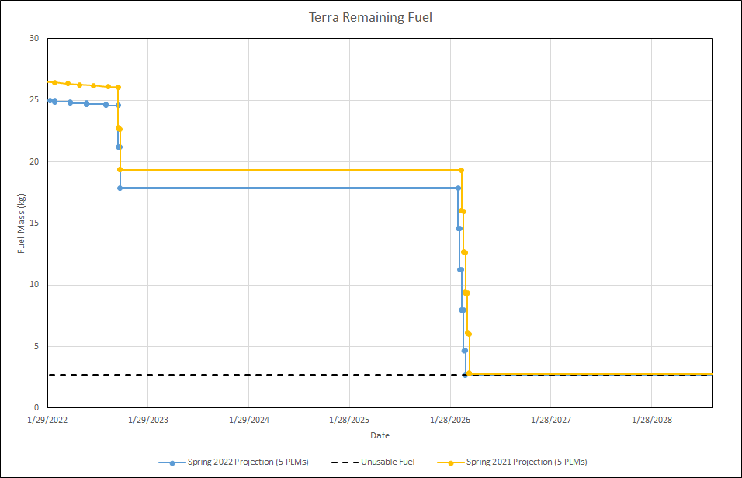
Terra Fuel Usage
Constellation Exit, October 2022
Perigee Lowering, February 2026
Unusable Fuel Buffer (2.7 kg)
Partial 5th PLM
Updated based on Spring 2022 Lifetime Analysis

Slide 20
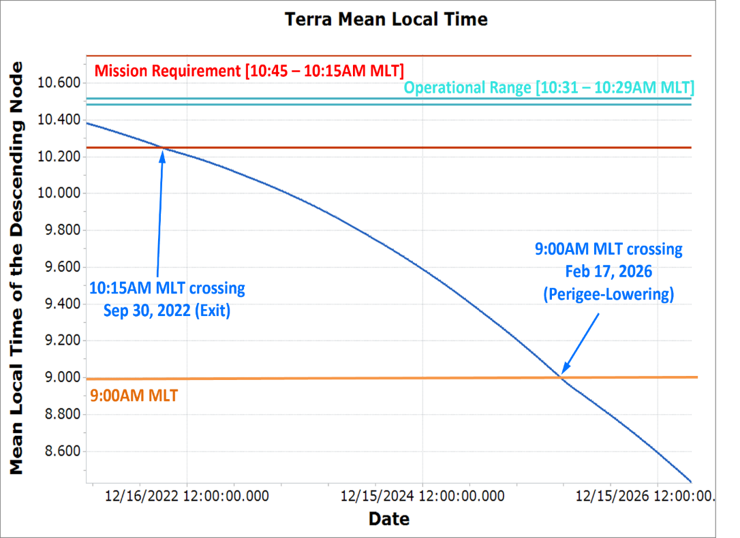
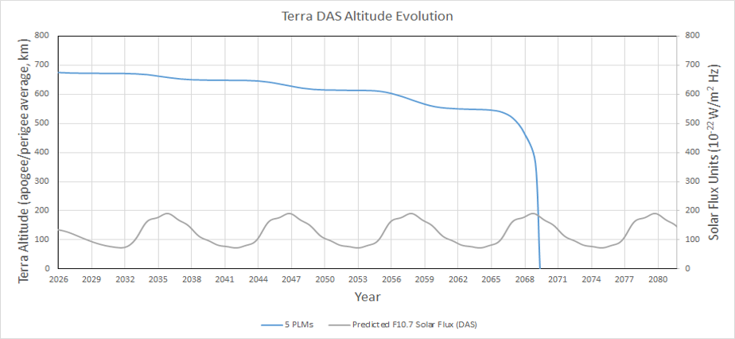
Terra Lifetime Maneuvers
MLT and Altitude Predictions
Decommissioning Plan | Exit Year | Deorbit Year | De-orbit Burns (#) | Apogee at Depletion (km) | Perigee at Depletion (km) | End of Mission (EOM) | EOM to Reentry (years) | Reentry Date
Baseline (4 x 320-sec burns + 1 x 191-sec burn) | 2022 | 2026 | 5 | 694.97 | 655.75 | 2026 | 43.25* | 2069.5
Updated based on Spring 2022 Lifetime Analysis
*Note: Terra launched prior to the 25-year re-entry requirement

Slide 21
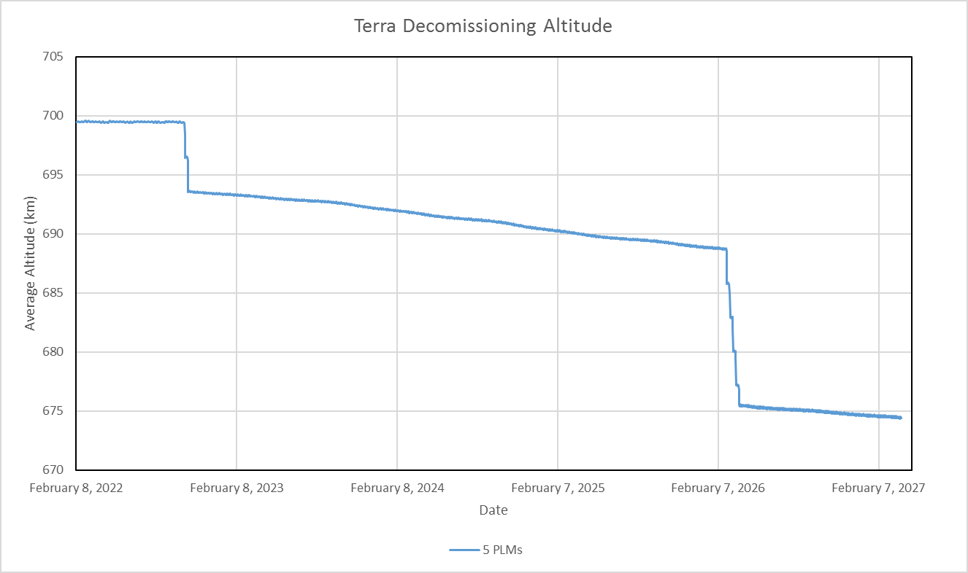
Final Average Height
(semi-major axis minus Earth radius)
Perform DMUs until
October 2022 (699.4 km)
Drift to 688.7 km
February 2026
Exit to 693.6 km
October 2022
Lower orbit to 675.5 km
March 2026
Updated based on Spring 2022 Lifetime Analysis

Slide 22
Summary
  Terra remains very healthy 22+ years into the mission
  Data Capture percentages continue at ~100%
  Collision Avoidance events continue to be part of routine ops
    CRMS and Devolved operations is working very well
  EOMP (Rev D) officially approved/signed – October 2018
    Rev E should be getting close to having all signatures
  Terra has exited the constellation and will only perform RMMs until end mission in March 2026(?)
    4 to 5 Perigee Lowering Maneuvers will be performed to exhaust all fuel prior to spacecraft passivation
    Terra Project Scientist has requested we plan operations through April 2027; still need to update lifetime charts accordingly

Slide 23
Questions

Slide 24
Additional Slides
  Orbit / Inclination / MLT Maintenance
  WRS Ground Track Error
  OSMA Waiver Email

Slide 25
Orbit/Inclination/MLT Maintenance
Requirement: Mean Local Time (MLT) maintained between 10:15 and 10:45 measured at the Descending Node.
Goal: Maintain Terra mean local time of the descending node (MLTDN) below 10:31.
Constraint: OCO-2 has requested Terra maintain a MLT less than 10:31 for the duration of its lifetime to maintain a safe separation at the poles.
Requirement: Maintain WRS-2 ground track error, 0 +/-20 km.
Requirement: Maintain Frozen orbit with Argument of Perigee at 90 degrees +/-20 and Eccentricity of 0.0012 +/- 0.0004.
Constraint: Maximum burn duration limited to 320 seconds by spacecraft manufacturer. Complete yaw slews and inclination maneuvers during spacecraft orbital night. Maneuver close to spring and fall equinox to maximize efficiency.

Slide 26
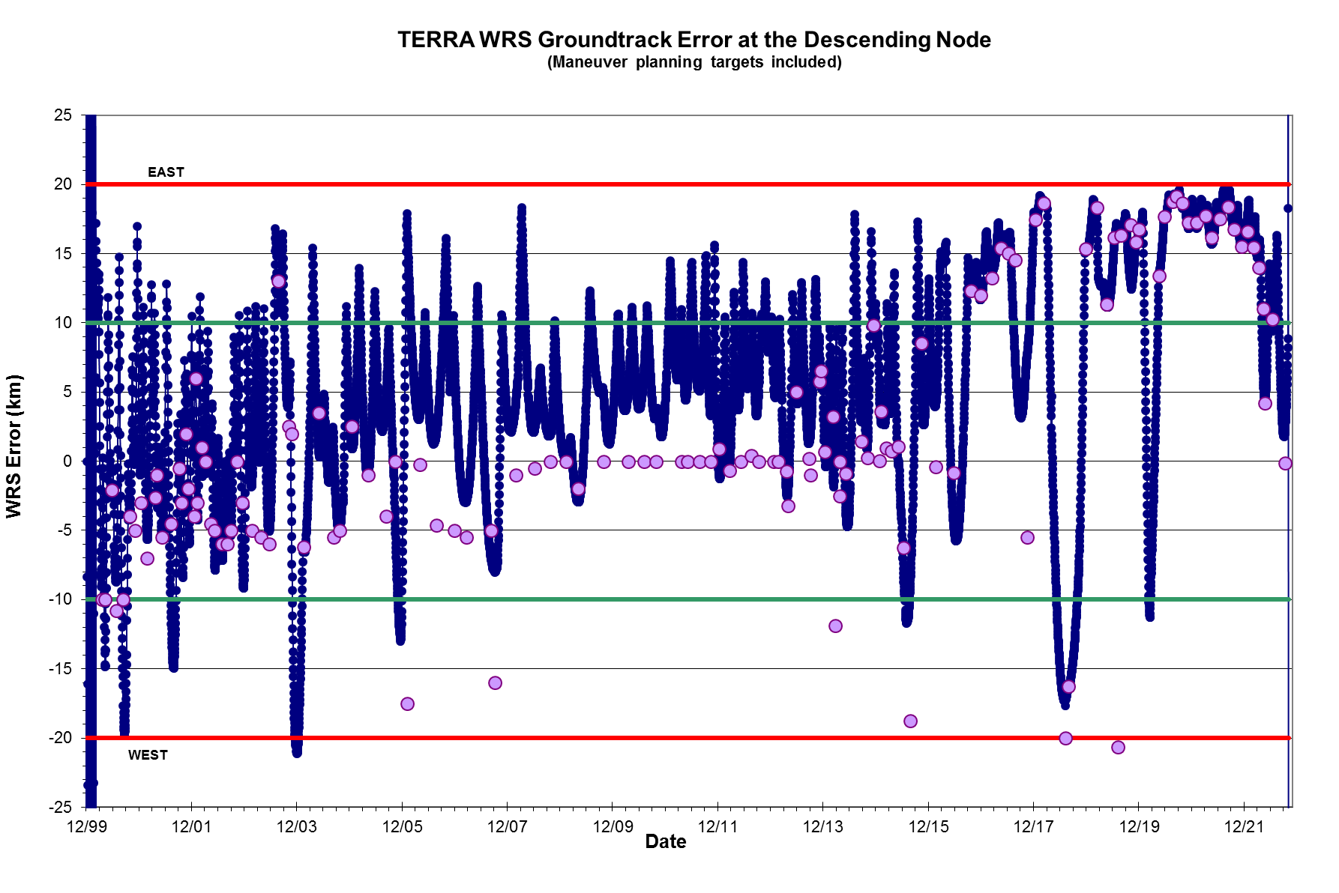
WRS Ground Track Error (GTE)

Slide 27
OSMA Official Direction
From: Aleman, Suzanne M. (HQ-GD000)
Sent: Wednesday, November 02, 2016 11:37 AM
To: Yuhas, Cheryl L. (HQ-DK000) <cheryl.l.yuhas@nasa.gov>
Cc: Liou, Jer-chyi (JSC-XI411) <jer-chyi.liou-1@nasa.gov>; Hull, Scott M. (GSFC-5920) <scott.m.hull@nasa.gov>
Subject: FW: Terra need for Orbital Debris waivers
Hi Cheryl,
I received you voice mail regarding the question on whether a waiver is needed for the 25 year rule for TERRA.
I consulted with J. C Liou on this question we have concluded that a waiver is not needed. Please see the e-mails below.
Please let me know if you have any questions.
Best regards,
Sue Aleman
NASA HQ OSMA
MMOD Program Executive

