Slide 1
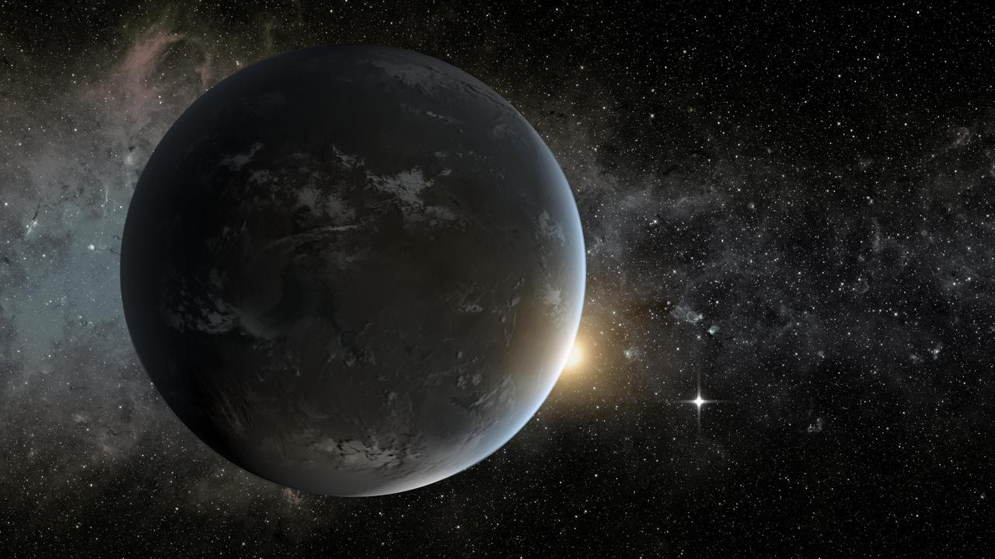

Pairing a GCM and Bayesian Framework to Predict Habitable Zone Evolution
Austin Ware, Patrick Young, Nancy Kiang
Image Credit: NASA

Slide 2
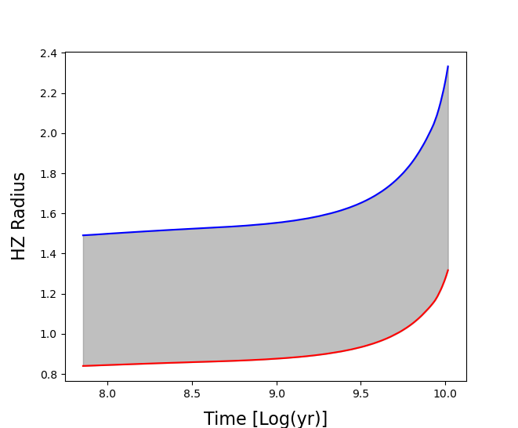
Continuous Habitable Zones
1 M⊙, 1 Z⊙
Continuous Habitable Zone (CHZ): Orbital area remaining continuously within HZ
How long in the HZ is long enough?

Slide 3
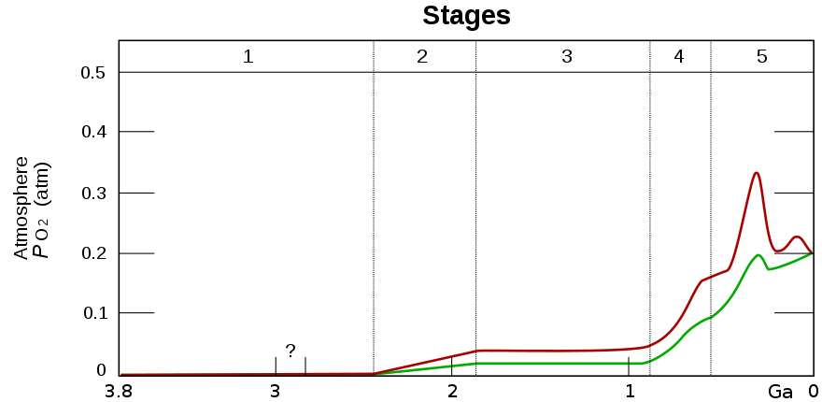
Continuous Habitable Zones
How long is long enough?
  Great Oxidation Event (GOE) ~ 2 Gy
2 Gy Continuous Habitable Zone (CHZ2): Orbital area remaining continuously within HZ for 2 Gy or longer
GOE
Holland, Heinrich D. 2006, PTRS, 361, 903

Slide 4
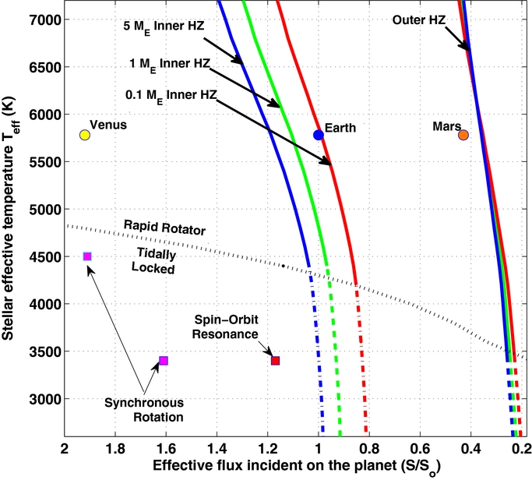
Kopparapu et al. 2013/14 1D, cloud-free climate model
  Optimistic HZ
    Inner HZ: Recent Venus (RV) ~ 1 Ga
    Outer HZ: Early Mars (EM) ~ 3.8 Ga
Kopparapu et al. 2014

Slide 5
Bayesian Model
Prior probability that orbital radius is within the CHZ2
Tycho stellar evolution models
+
HZ models
Posterior likelihood
Probability of orbital radius being within 2 Gy CHZ
(CHZ2)
Likelihood of models given…
Measured stellar mass, metallicity, age

Slide 6
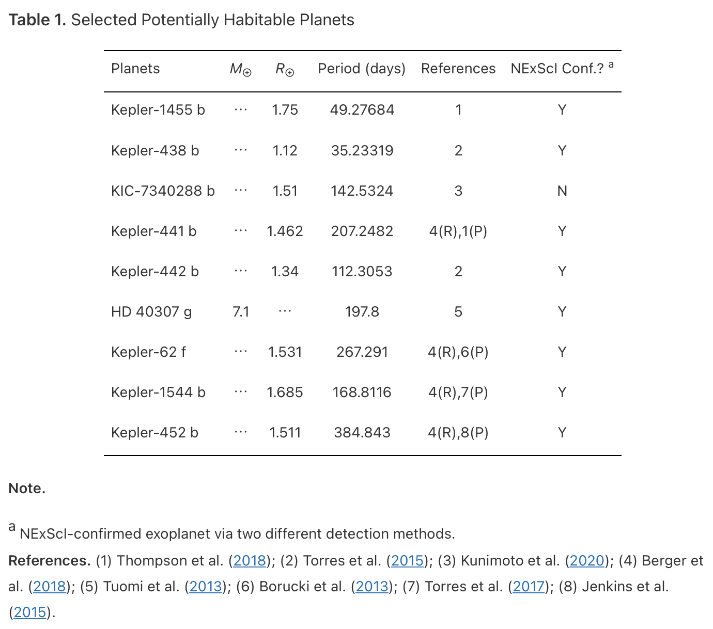
Sample Selection
Earth-like Rocky Planets: ⁽¹⁾ R < 1.8 R⊕
⁽²⁾ M < 10 M⊕
Instellation within Kopparapu et al. 2013 optimistic (Recent Venus/Early Mars) HZ limits
Host stars between 0.5-1.1 M⊙ (previous Tycho catalog lower limit)
9 potentially habitable planets + Venus, Earth, and Mars
¹Thompson et al. 2018, ²Zeng et al. 2019
Ware et al. 2022

Slide 7
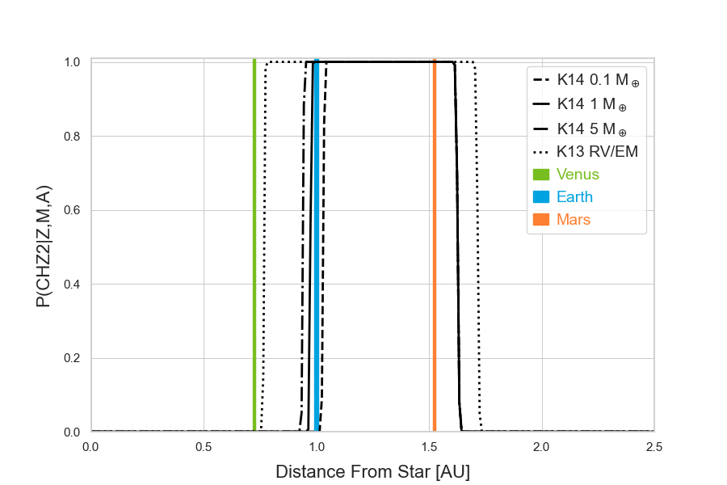
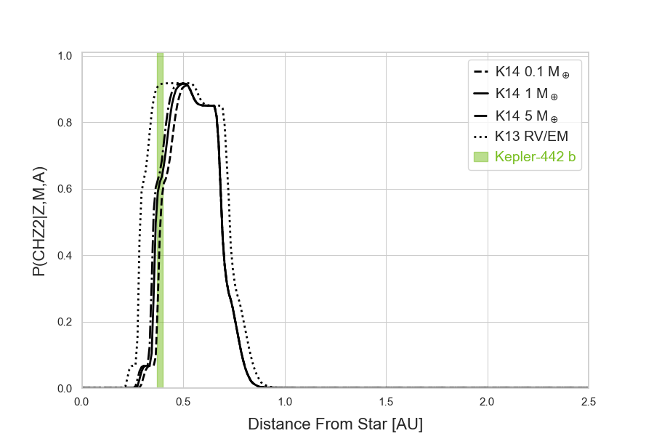
Sun, G2V, Teff = 5772 K
Kepler-442, K5V, Teff = 4402 K
Ware et al. 2022

Slide 8
ROCKE-3D Land Planets Perturbed Parameter Ensemble: Latin Hypercube Design
Uniform land surface
Flat topography
No vegetation,
no ocean
Dynamic lakes
Earth size only
Eccentricity=0
9 continuous variables
+ 1 categorical
(dependent variables
in parentheses)
110 experiments for
d=10 variables x 10
(Loeppky et al. 2009)
Final ensemble of 84
members after crashes
and mistakes
Parameter Type | Variable | Range
Stellar | 1. Stellar effective temperature | 8 stars, Teff = 2515 K - 5772 K
 | 2. Instellation, S0X | TRAPPIST1e to early Venus, S0X = 0.62 - 1.471
Orbital
 | 3. Solar day , d | LHS: d = 2⁻⁴ – 2⁶ (0.0625 – 128) Earth days, log2 uniform Tidally locked 3:2 Spin-orbit: d = 14.81481 to 841.92269 Earth days
 | 4. Obliquity | 0 - 90 degrees
 |  | (0.0087 – 1.4132 Earth years)
 |  | (0.2847495 to 496.2158218 Earth days) (Tidally Locked: 3.378264 to 496.215822 Earth days) (3:2 Spin-orbit: 4.938272 to 280.640895 Earth days)
 | (Eccentricity) | None, 0
 | (Planet radius) | Earth radius
Atmosphere | 5. Surface pressure, P | M: (P = N2 + CO2 = 0.5 - 10 bar) | N: 0.5 to 10 bar
 | (5). N2 | M: 0.5 - 2.0 bar | N: (N2 = P – CO2 0.0 to 10 bar)
 | 6. CO2 | 10⁻⁶ - 10 bar, log10 uniform, then rounded CO2 fraction ≥0.0001
 |  | M: 25% 0.0, 57.2x10⁻⁶ to 10 bar | N: 31% 0.0, 95.3x10⁻⁶ to 10 bar
Land surface | 7. Surface albedo | 0.11 (Abe) - 0.3 (Earth)
 | 8. Roughness | 0.005 (GCM min) - 0.7 (GCM bare avg)
 | 9. Soil texture | Two categories: sand (least water holding capacity), silt loam (best for temperate life)
Initial conditions | 10. Initial soil H2O | m: Available H2O between field capacities of sand, 0.2 m, and silt loam 0.7 m. Sand planets capped at 0.2 m | n: Available H2O between field capacities of sand, 0.2 m, and silt loam 0.7 m. Sand planets not capped at 0.2 m.

Slide 9
Defining Habitable Zone Boundaries
Outer Edge
Defined by maximum mean surface temperature (C)
Simple Linear regression on observables: Teff (K) and S0 (relative irradiance)
Adjusted R-squared: 0.4502
Threshold: Surface temperature > 0 degrees C
Inner Edge
Defined by water lifetime (yr)
Simple Linear regression on observables: Teff (K) and S0 (relative irradiance)
Adjusted R-squared: 0.465
Threshold: Water lifetime > 2 Gyr
Coefficients:
    Estimate Std. Error t value Pr(>|t|)
(Intercept) 17.407010 2.159571 8.060 5.71e-12
Teff.K 0.002794 0.000371 7.525 6.43e-11
S0X -7.008545 1.571173 -4.461 2.61e-05
Coefficients:
    Estimate Std. Error t value Pr(>|t|)
(Intercept) 99.949889 37.293487 2.680 0.00891
Teff.K -0.041986 0.006496 -6.464 7.16e-09
S0X 158.735033 26.743560 5.935 6.96e-08
$$H_{2}Olifetime(yr)=a_{1}T_{eff}+a_{2}S0+a_{3}$$
$$SurfaceTemperature(C)=a_{1}T_{eff}+a_{2}S0+a_{3}$$

Slide 10
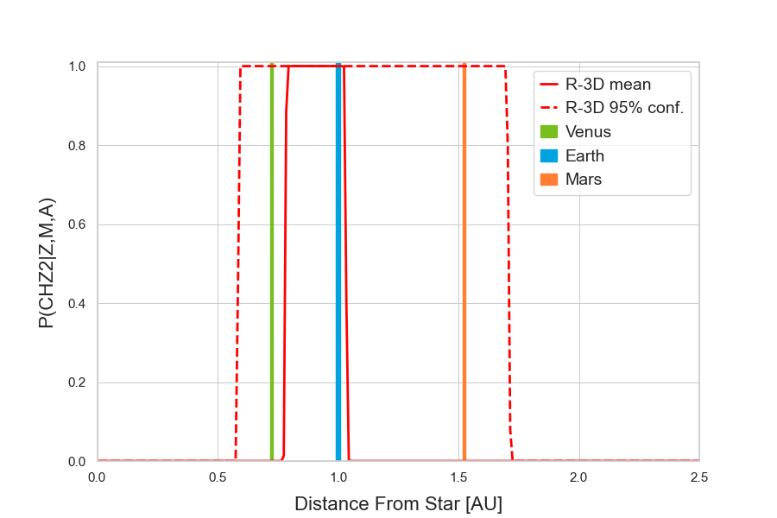
Sun, G2V, Teff = 5772 K

Slide 11
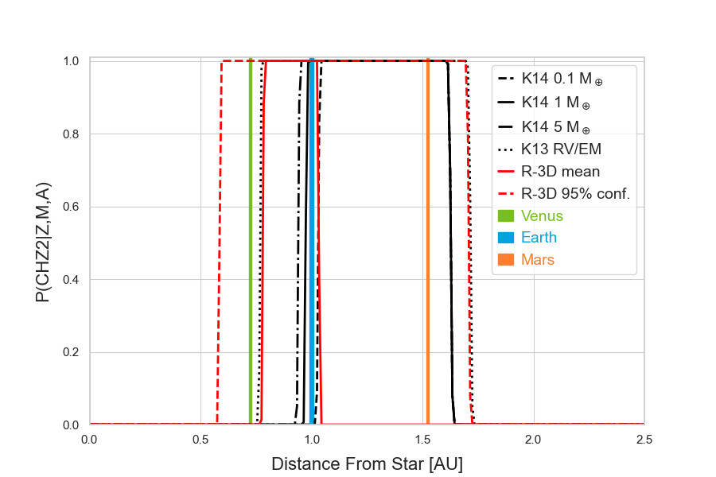
Sun, G2V, Teff = 5772 K

Slide 12
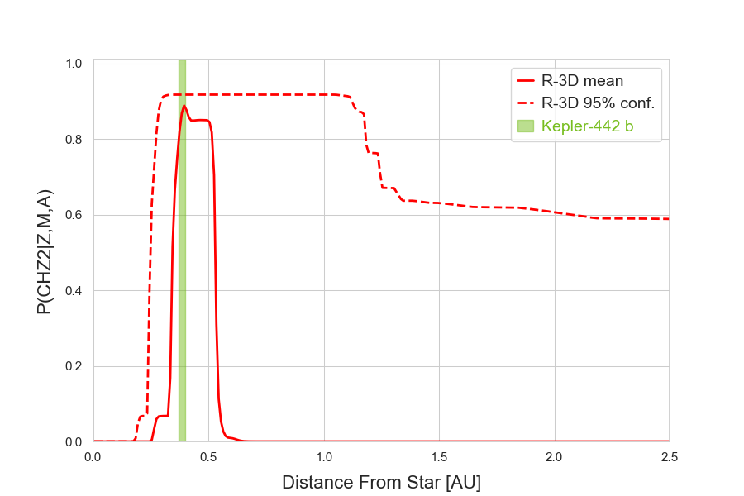
Kepler-442, K5V, Teff = 4402 K

Slide 13
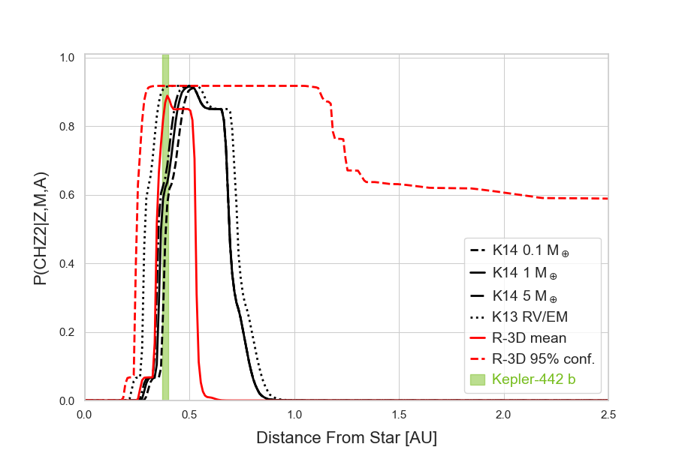
Kepler-442, K5V, Teff = 4402 K

Slide 14
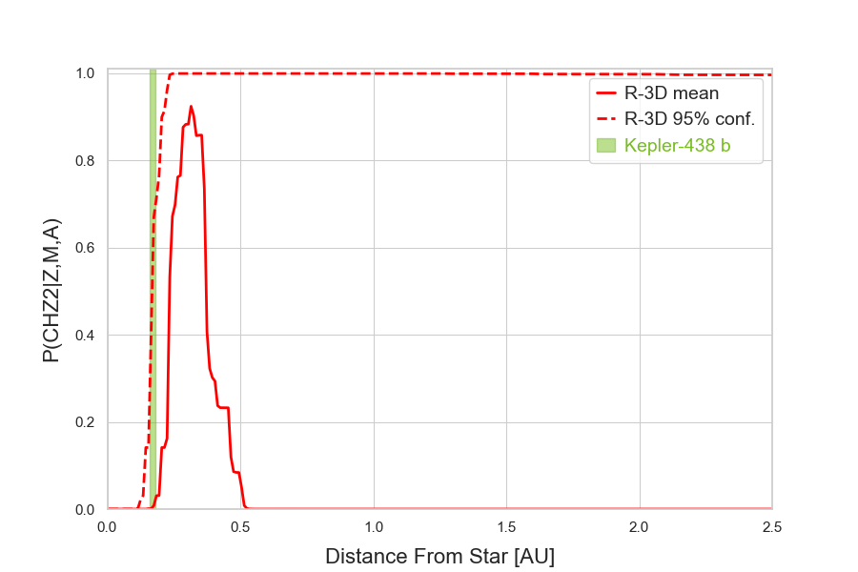
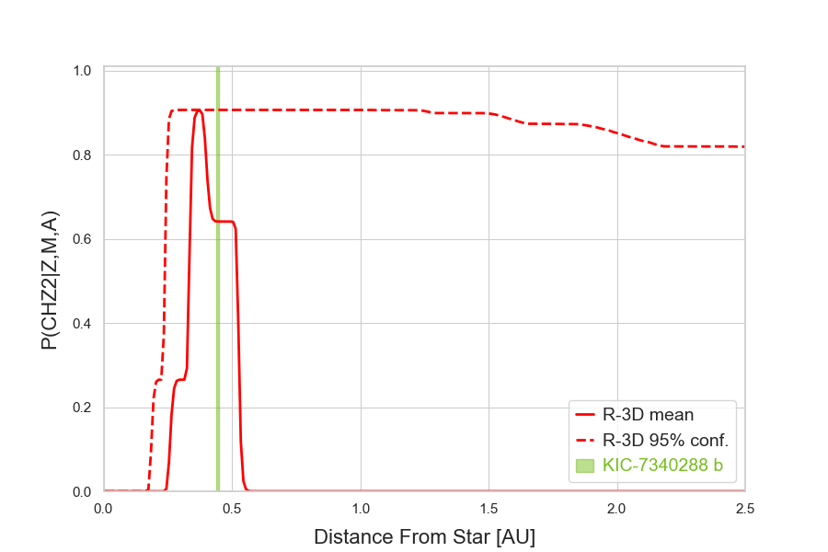
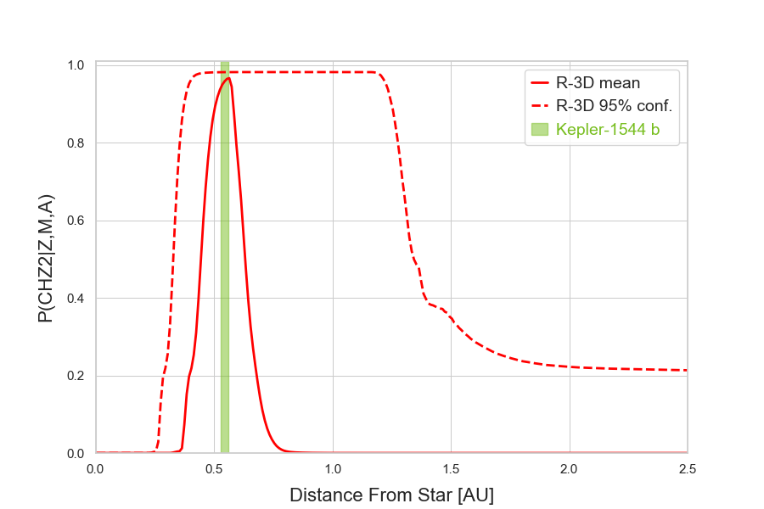
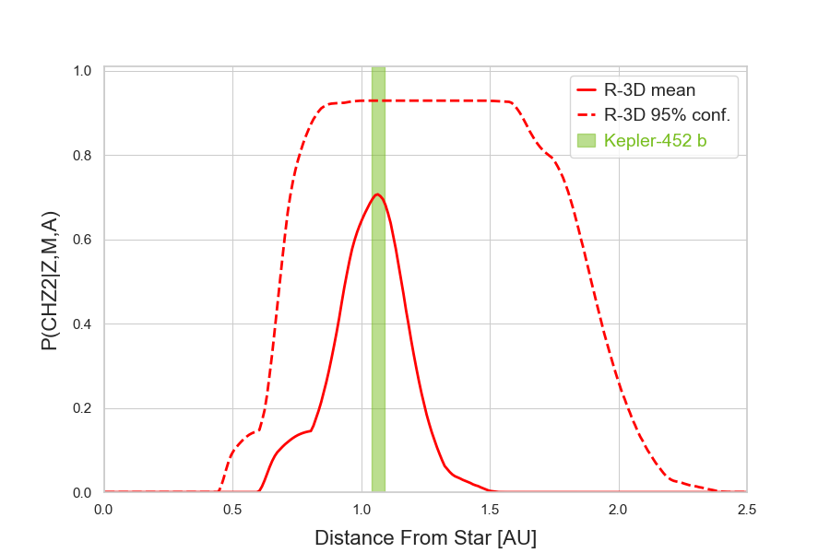
Kepler-438, M1V, Teff = 3748 K
KIC-7340288, M0V, Teff = 3959 K
Kepler-1544, K3V, Teff = 4852 K
Kepler-452, G5IV, Teff = 5772 K

Slide 15
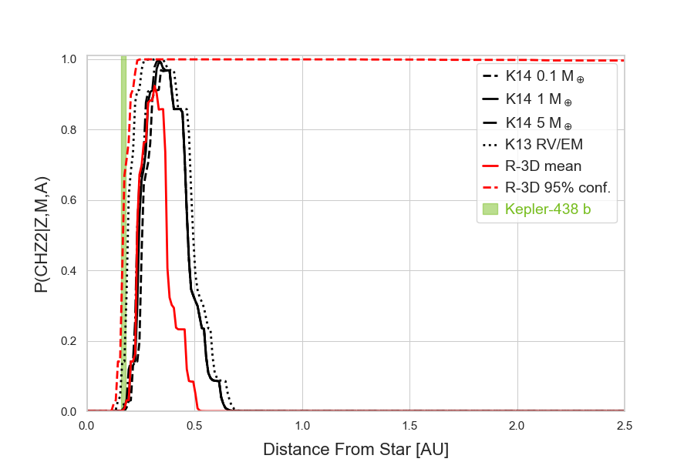
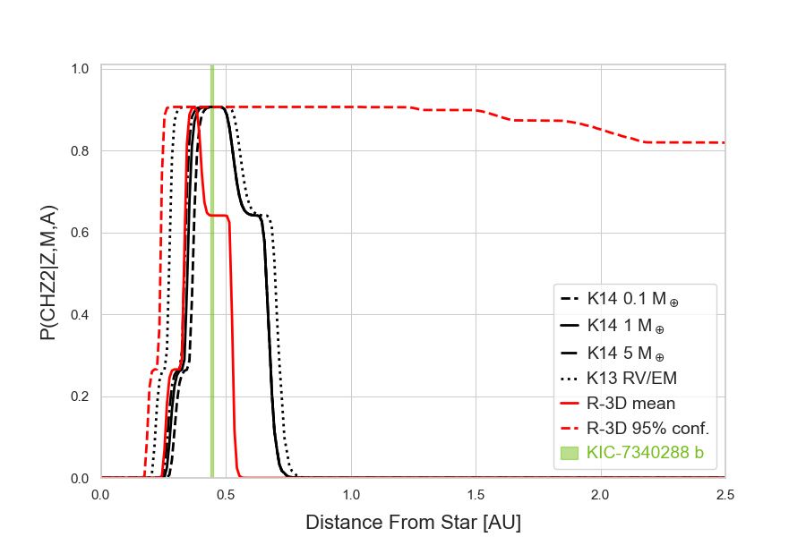
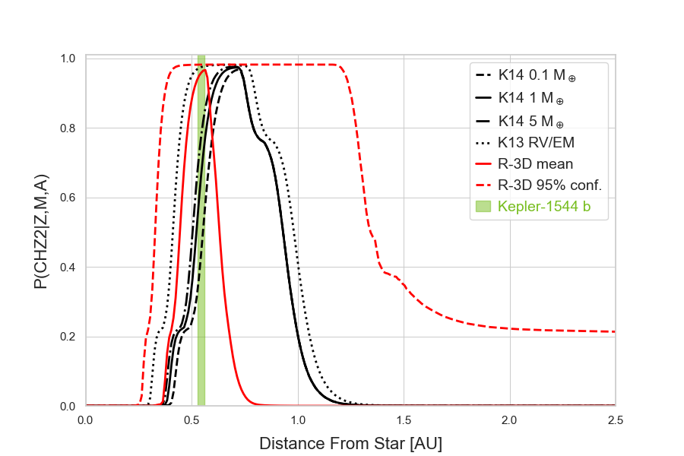
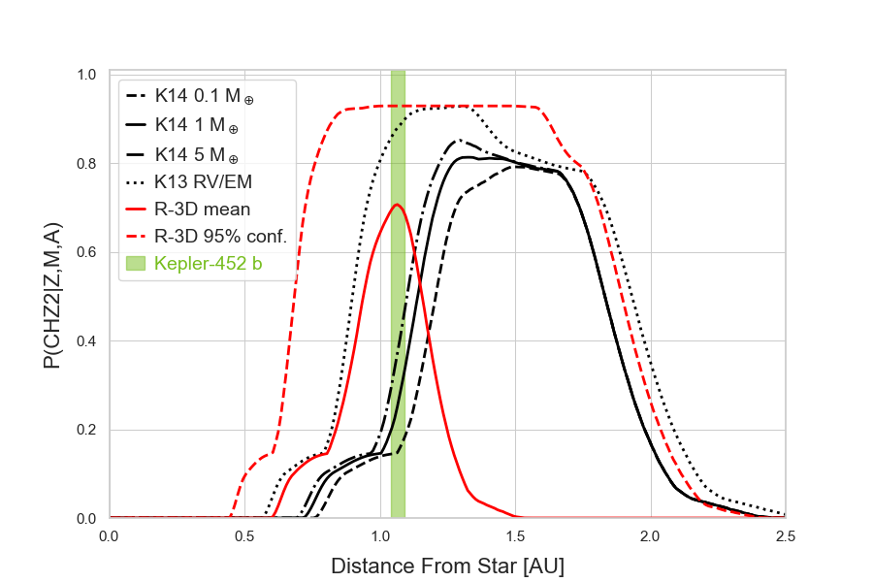
Kepler-438, M1V, Teff = 3748 K
KIC-7340288, M0V, Teff = 3959 K
Kepler-1544, K3V, Teff = 4852 K
Kepler-452, G5IV, Teff = 5772 K

Slide 16
Conclusions
Future ensembles should include a wider range of instellation values
Land planets ensemble HZ boundaries are generally more optimistic than 1D model
Quantifying the uncertainty in the HZ boundaries allows us to establish confidence intervals
Next step: Expand sample to include all currently known potentially habitable planets (~30)

Slide 17
Acknowledgements
We thank Sonny Harman for calculations of water lifetimes for the land planets ensemble
Nexus for Exoplanet System Science (NExSS), NASA Astrobiology Program, Mary Voytek
Sellers Exoplanet Environments Collaboration (SEEC), NASA Goddard Space Flight Center
Planetary Science Division (PSD), NASA Headquarters, Stephen Reinhard
Modeling, Analysis, and Prediction (MAP), Earth Science Division (ESD), David Considine
Exoplanet Exploration Program (ExEP), Jet Propulsion Laboratory (JPL)/CalTech, NASA Headquarters, Karl Stapelfeldt and Eric Mamajek
Please see Nancy Kiang’s talk on Friday “A ROCKE-3D Perturbed Parameter Ensemble: Habitability Metrics for Land Planets”
atware@asu.edu

Slide 18
Backup slides

Slide 19
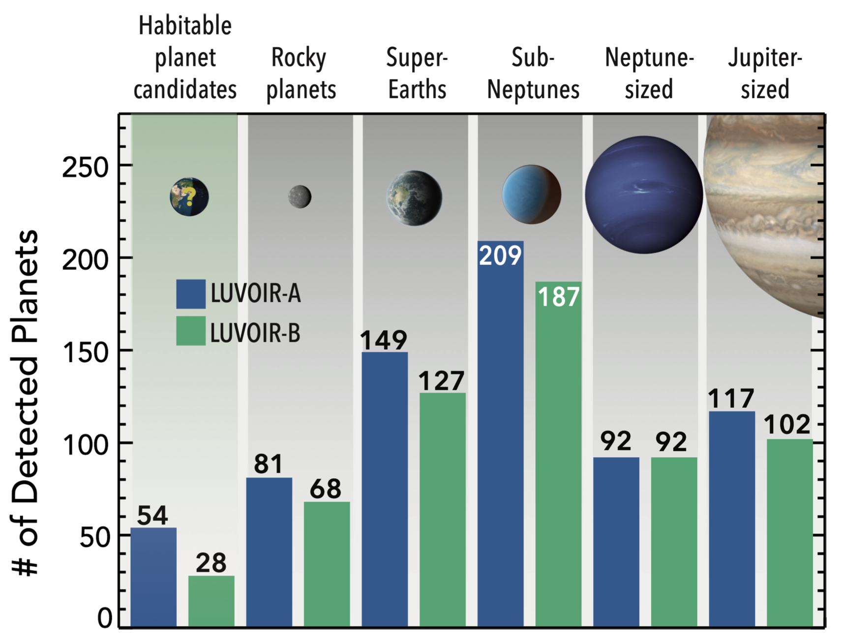
Potentially Habitable Planets
Habitable Zone (HZ): Orbital area around a star where a planetary surface could support liquid water
Earth-like Rocky Planets: ⁽¹⁾ R < 1.8 R⊕
⁽²⁾ M < 10 M⊕
# of Potentially Habitable Planets: ~30 (assuming optimistic HZ limits from Kopparapu et al. 2013)
Large number of targets => prioritize characterization by potential to support life
LUVOIR Final Report
¹Thompson et al. 2018, ²Zeng et al. 2019

Slide 20
GCM vs. 1D Models
1D models focus on vertical radiation and heat transport
  Relatively simple with fast equilibration times
  Unable to self-consistently account for clouds and other multi-dimensional processes
Global Climate Models (GCMs) can account for clouds, orbit, rotation, and atmospheric + oceanic circulation
  Require accounting for a large set of boundary conditions
  Provide a more realistic view of the climate

Slide 21
ROCKE-3D (Resolving Orbital and Climate Keys for Earth and Extraterrestrial Environments with Dynamics, Way et. al. 2017)
NASA GISS GCM ModelE Earth System Model (Schmidt et al. 2006, 2014)
http://www.giss.nasa.gov/tools
4°x5°, 40-layer atmosphere with top 0.1 hPa
SOCRATES radiation (Edwards 1996; Edwards & Slingo 1996)
Land surface hydrology to allow circulating water to pool and dry up:
  6 soil layers to 3.5 m depth
  Aerodynamic soil evaporation from layer 1
  Dynamic lake formation from soil run-off and evaporation
  Spillage to adjacent grid cells for arbitrary topography

Slide 22
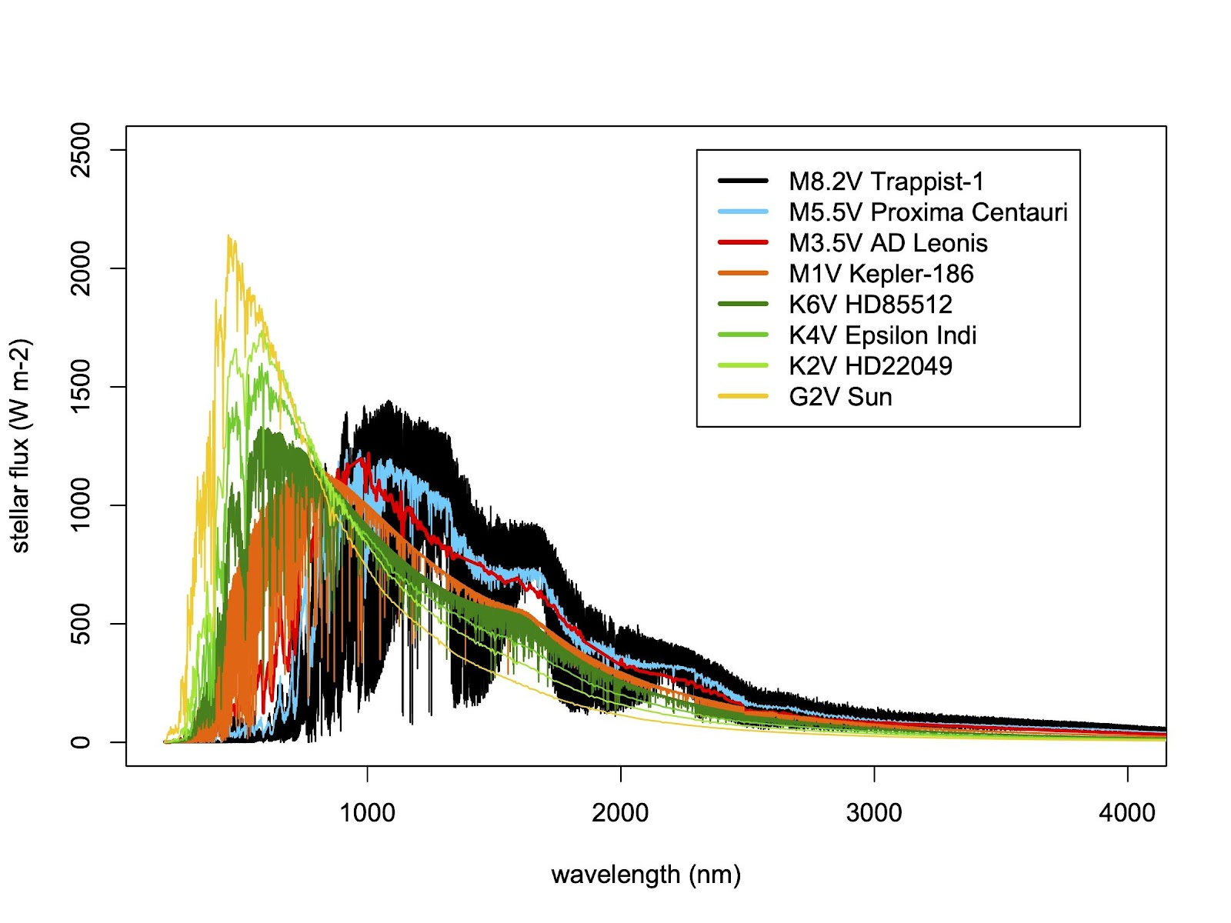
8 Stellar Spectra for the Land Planets PPE

Slide 23
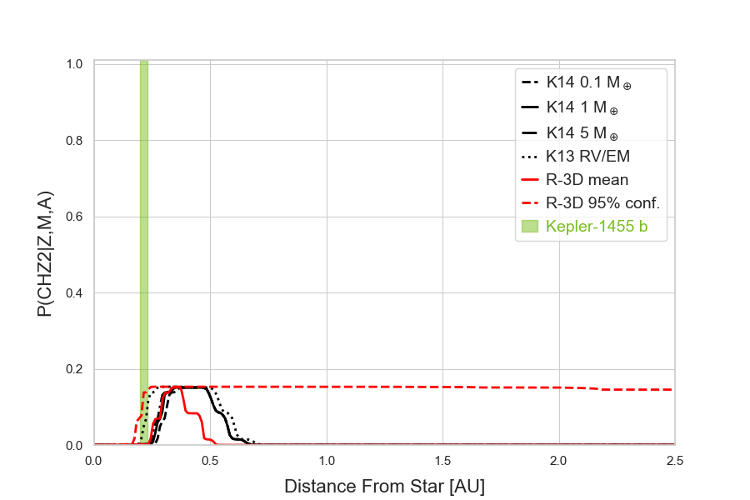
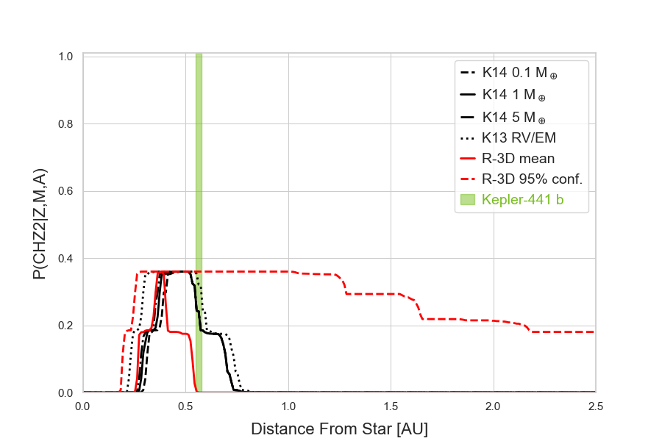
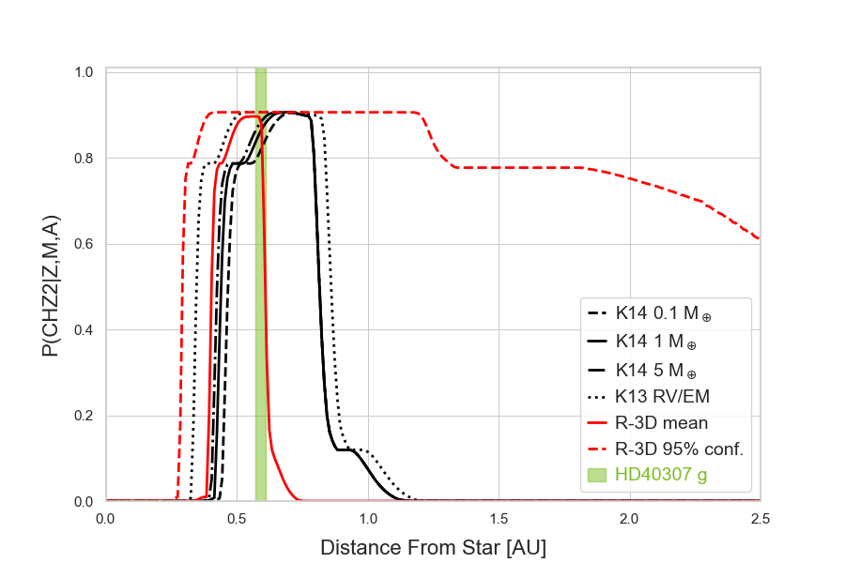
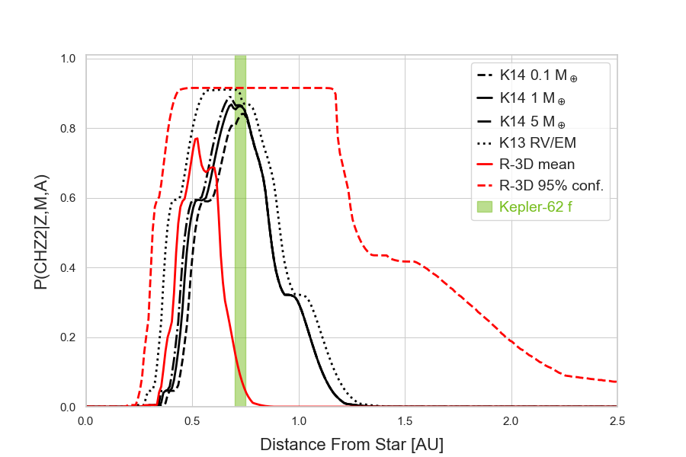
Kepler-1455, M0V, Teff = 3899 K
Kepler-441 K8V, Teff = 4340 K
HD40307, K2.5V, Teff = 4827 K
Kepler-62, K2V, Teff = 4859 K

