Slide 1
MOWG Aqua “Free Exit”
Passing Analysis
Nov 16 – Nov 18, 2022
Kinsey Alexander, Omitron, Inc.
EOS FDS, gsfc-eos-fds@eoc.ecs.nasa.gov

Slide 2
Agenda
Background
Methodology
Aqua. vs A-Train
Aqua vs. Morning Constellation
Aqua vs. C-Train
Conclusions
Backup

Slide 3
Background
This analysis uses the Spring 2022 Aqua Lifetime run which follows the “Free Exit” plan
  Ephemeris propagates from the definitive state beginning Jun 14, 2022
  No inclination adjust maneuvers (IAMs) following the Spring 2021 IAM Series
  No drag make-up (DMU) maneuvers starting Jan 2022
  No risk mitigation maneuvers (RMMs) modeled with RMM fuel held in reserve
  Passivation in September 2026
This package covers an updated passing analysis for Aqua’s free exit, spanning through January 01, 2024
  Compares Aqua’s orbit to the orbit of the A-Train, C-Train, and Morning Constellation missions

Slide 4
Background – A-Train Missions
Aqua Lifetime and Decommissioning Ephemeris
  Aqua_Lifetime_Decom_Code500.ephem
    Generated Jun 15, 2022
    Includes Perigee Lowering Maneuvers (PLMs) planned for Jul 2026
Aura Lifetime and Decommissioning Ephemeris
  Aura_Lifetime_Decom_Code500.ephem
    Generated Jun 21, 2022
    Models DMUs until constellation exit (Aug 2024) to maintain Ground Track Error
    Includes Constellation Exit Maneuvers (CEMs) and PLMs planned for Aug and Sep 2024
GCOM-W1 Ephemeris
  SOEMP-MAN-LONG.GCOMW1.F20220101.000000.T20240101.FFephem
    Delivered to CCS on Feb 28, 2022
    Post-spring 2022 IAM series
    Models DMUs
OCO-2 Ephemeris
  OC2_EXTENDED_LONGPRED_EPHEM_2022_08_23_01.e
    Delivered to CCS on Sep 01, 2022
    Models DMUs

Slide 5
Background – Morning Constellation
Landsat-7 Ephemeris
  L72022235LONGTERM.e
    Delivered to CCS on Aug 23, 2022
Landsat-8 Ephemeris
  L08_OBS_FDS_LongPredEphem_2022252120000_2024001000000_2022257031619.ffephem
    Delivered to CCS on Sep 16, 2022
Landsat-9 Ephemeris
  L09_OBS_FDS_LongPredEphem_2022252120000_204001000000_2022259123456.ffephem
    Delivered to CCS on Sep 16, 2022
Terra Lifetime and Decommissioning Ephemeris
  Lifetime_and_Decommissioning_PLMsMerged_Mar2027_code500.ephem
    Generated on May 25, 2022
    Models DMUs to maintain Ground Track Error until Terra performs its first CEM
      Terra will then drift until PLMs are initiated Mar 2027
    CEMs are modeled within the span of this analysis
      Two 320 second CEM burns in Oct 2022

Slide 6
Background – C-Train Mission
CALIPSO Ephemeris
  CAL_PREDICTED_EPHEMERIS_LONG_2021_12_02_10_30_23.FFephem
    Delivered to CCS on Dec 12, 2021
  CALIPSO was used as a representation of the whole C-Train

Slide 7
Aqua vs. A-Train

Slide 8
Aqua is predicted to pass Aura, then GCOM-W1, then OCO-2
  The cadence between passings is predicted to shorten as Aqua drifts down
The A-Train passings were analyzed in terms of total miss distance and radial/in-track/cross-track (RIC) separation components
  Close approaches were identified as local minima in spacecraft range and reported based on miss distance
  RIC components follow the CARA convention with the RIC frame centered on Aqua – GCOM-W1, OCO-2, and Aura treated as secondaries
    Negative radial separation → Aqua above
    Negative along-arc track separation → Aqua ahead
    Negative cross-track separation → Aqua left
Passings with A-Train members were analyzed from the following start dates through Jan 01, 2024, based on the length of available ephemerides:
  Aura: Jun 17, 2022
  GCOM-W1: Jun 14, 2022
  OCO-2: Aug 23, 2022

Slide 9
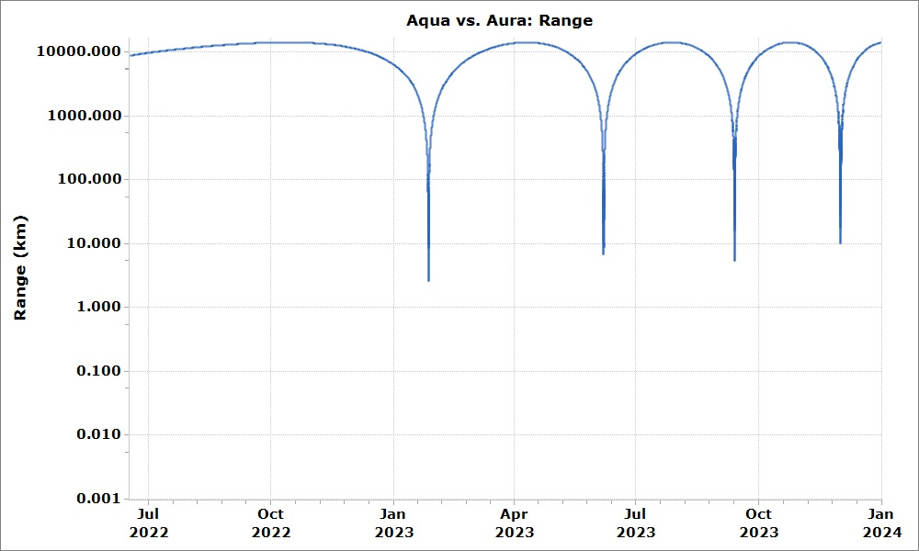
Aqua vs. Aura
Aura has 4 predicted passings with Aqua before Jan 01, 2024
The minimum range is predicted to occur on the first passing at 2.59 km on Jan 26, 2023
TCA Date | Total Miss | Radial | Along-Arc | Cross Track
(--) | (km) | (km) | (km) | (km)
Jan 26, 2023 | 2.59 | 2.48 | -0.74 | 0.08
Jun 06, 2023 | 6.61 | 3.47 | 5.60 | 0.58
Sep 12, 2023 | 5.22 | 4.08 | 3.25 | 0.17
Dec 01, 2023 | 9.81 | 5.19 | -8.31 | 0.44

Slide 10
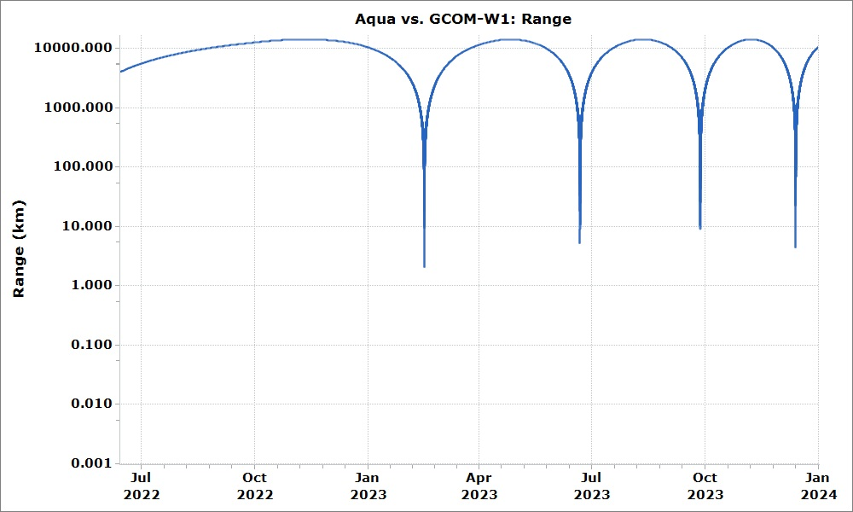
Aqua vs. GCOM-W1
GCOM-W1 has 4 predicted passings with Aqua before Jan 01, 2024
The minimum range is predicted to be 2.05 km on Feb 15, 2023
TCA Date | Total Miss | Radial | Along-Arc | Cross Track
(--) | (km) | (km) | (km) | (km)
Feb 15, 2023 | 2.05 | 1.60 | -1.28 | 0.03
Jun 21, 2023 | 5.07 | 3.26 | 3.88 | 0.16
Sep 27, 2023 | 9.12 | 3.65 | -8.34 | 0.48
Dec 13, 2023 | 4.42 | 4.42 | 0.03 | 0.03

Slide 11
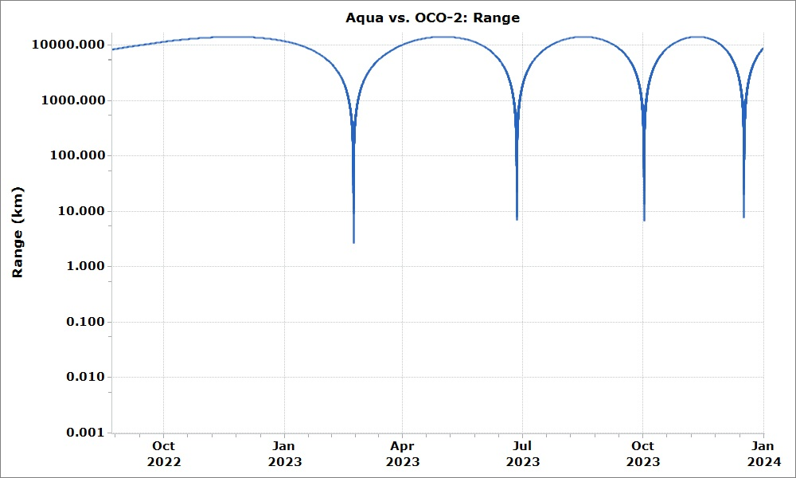
Aqua vs. OCO-2
OCO-2 has 4 predicted passings with Aqua before Jan 01, 2024
The minimum range is predicted to be 2.65 km on Feb 22, 2023
TCA Date | Total Miss | Radial | Along-Arc | Cross Track
(--) | (km) | (km) | (km) | (km)
Feb 22, 2023 | 2.65 | 1.87 | 1.88 | -0.06
Jun 26, 2023 | 6.85 | 2.97 | -6.17 | 0.23
Oct 01, 2023 | 6.63 | 3.62 | 5.55 | -0.28
Dec 17, 2023 | 7.51 | 4.69 | 5.85 | 0.37

Slide 12
Aqua vs. A-Train: Conclusions
Analysis indicates that all passings with A-Train constellation members are safe, but actual environmental conditions could change the miss distances and/or passing geometries
  Miss distances remain above 2 km
  Aqua will be below each secondary in all predicted passings
The analysis presented here uses long-term predicted ephemerides generated using the latest available data – Various factors will influence the geometry of these passings as they get nearer:
  Differences between predicted and observed drag and performance of station keeping or risk mitigative maneuvers can significantly impact the radial separations
    For example, this has resulted in Aqua drifting faster than anticipated
Though these analyses will be helpful for identifying possible passings of concern, FDS will rely on routine conjunction assessment screenings to inform the missions of any risk

Slide 13
Aqua vs. Morning Constellation

Slide 14
The passings with Morning Constellation members were analyzed in terms of the radial & time buffers at the orbit intersection points
  Radial buffer follows the CARA convention with the RIC frame centered on Aqua - Terra, Landsat-7, Landsat-8, Landsat-9 are treated as secondaries
    Negative radial separation → Aqua above
  Time buffer is the difference in crossing time at the orbit intersection points
    Positive time buffer → Aqua ahead
    Time buffer of zero → Passing event
  Use the radial buffers during passings to gauge safety
Passings with Morning Constellation members were analyzed for the following start dates through Jan 01, 2024
  Terra: Jun 14, 2022
  Landsat-7: Aug 23, 2022
  Landsat-8, Landsat-9: Sep 09, 2022

Slide 15
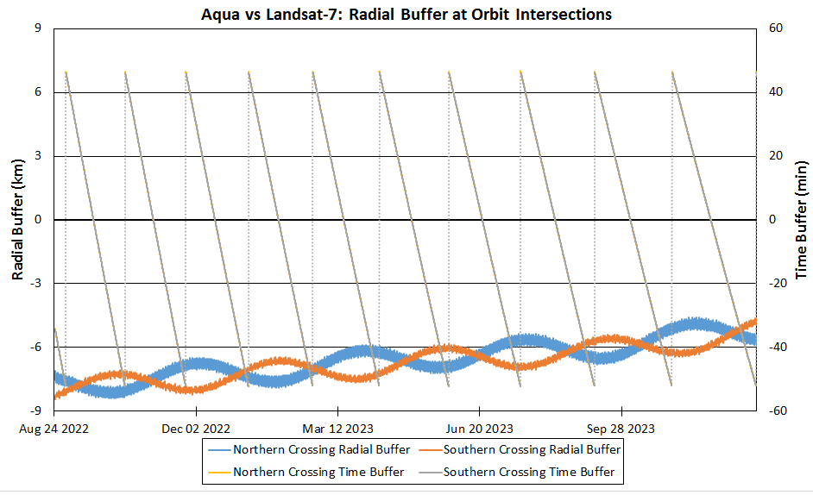
Aqua vs. Landsat-7
Date | Radial Buffer (km)
(--) | Northern | Southern
Sep 20, 2022 | -7.99 | -7.60
Nov 02, 2022 | -7.60 | -7.71
Dec 15, 2022 | -6.99 | -7.86
Jan 29, 2023 | -7.66 | -6.48
Mar 16, 2023 | -6.39 | -7.26
May 03, 2023 | -6.68 | -6.40
Jun 21, 2023 | -6.48 | -6.51
Aug 12, 2023 | -5.94 | -6.49
Oct 04, 2023 | -6.22 | -5.67
Nov 29, 2023 | -4.97 | -5.93
Radial buffer stays above 4 km for all passings.

Slide 16
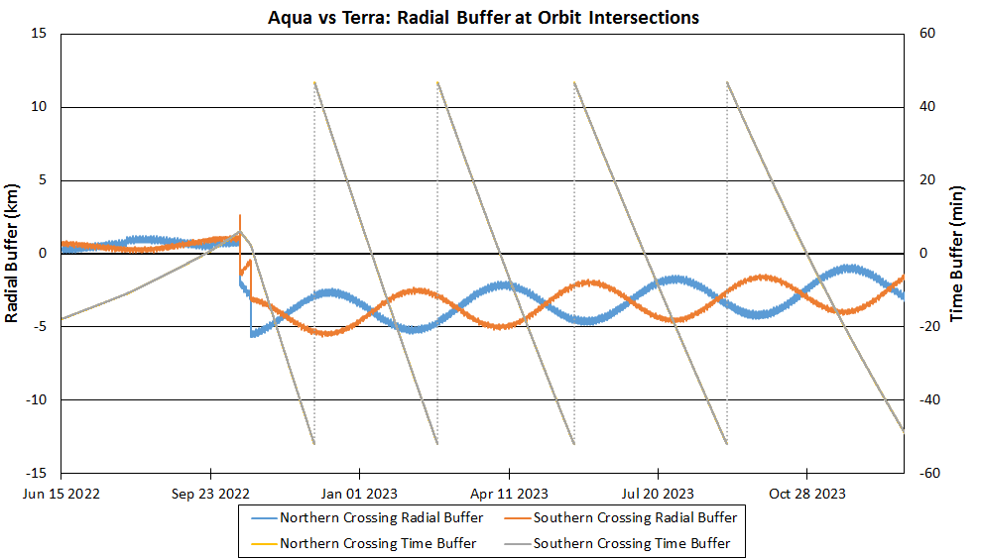
Aqua vs. Terra
Date | Radial Buffer (km)
(--) | Northern | Southern
Sep 19, 2022 | 0.58 | 0.93
Oct 21, 2022 | -5.36 | -3.23
Jan 08, 2023 | -3.99 | -4.02
Apr 04-05, 2023 | -2.26 | -4.90
Jul 10, 2023 | -2.57 | -3.99
Oct 27, 2023 | -2.23 | -2.96
Radial buffer stays above 2 km for all passings after Terra’s CEMs.
Terra CEMs
Oct 2022

Slide 17
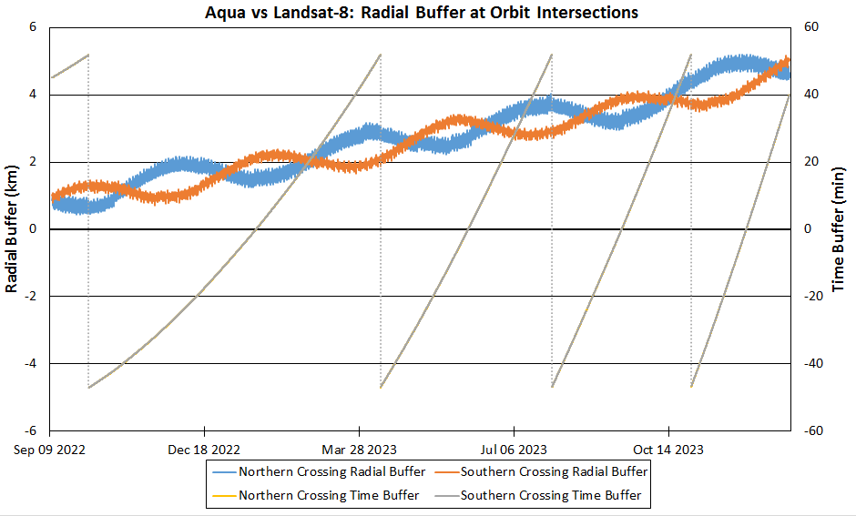
Aqua vs. Landsat-8
Radial buffer stays above 1 km for all passings.
Date | Radial Buffer (km)
(--) | Northern | Southern
Jan 20, 2023 | 1.39 | 2.29
Jun 06, 2023 | 2.68 | 3.32
Sep 13, 2023 | 3.32 | 3.92
Dec 03, 2023 | 4.99 | 4.27

Slide 18
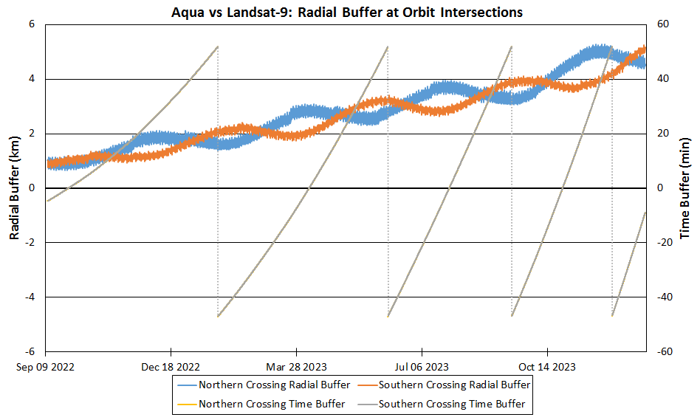
Aqua vs. Landsat-9
Radial buffer stays above 2 km for all future passings.
Date | Radial Buffer (km)
(--) | Northern | Southern
Sep 27, 2022 | 0.93 | 1.18
Apr 07, 2023 | 2.84 | 2.18
Jul 27, 2023 | 3.65 | 2.76
Oct 26, 2023 | 4.34 | 3.80

Slide 19
Aqua vs. Morning Constellation: Conclusions
Analysis indicates that all passings with all Morning Constellation members are safe, but actual environmental conditions could change the miss distances and/or passing geometries
Geometry of these passings will be influenced by the same factors listed earlier
  Differences between predicted and observed drag and performance of station keeping or risk mitigative maneuvers can significantly impact the radial separations
Though these analyses will be helpful for identifying possible passings of concern, FDS will rely on routine conjunction assessment screenings to inform the missions of any risk

Slide 20
Aqua vs. C-Train

Slide 21
Methodology used to analyze crossings with the C-Train was the same as that used for Morning Constellation crossings
Crossings with CALIPSO were analyzed for the period Jun 14, 2022 – Jan 01, 2024

Slide 22
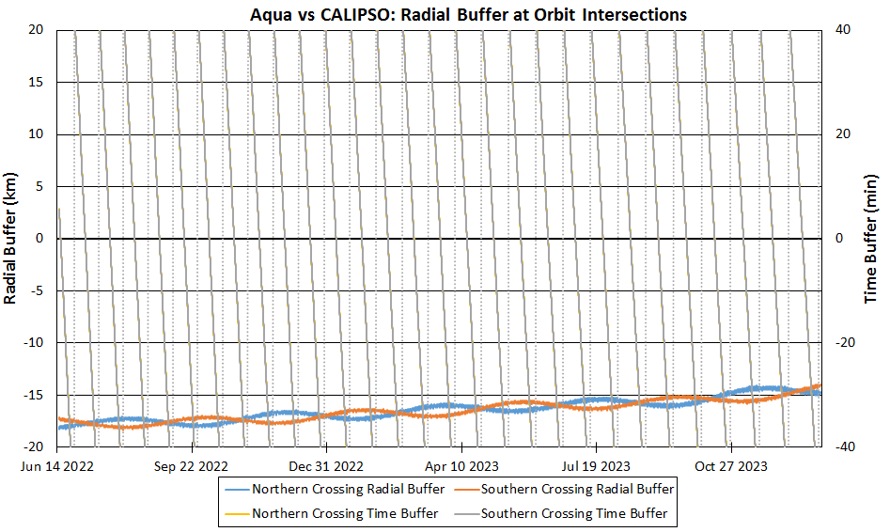
Aqua vs. CALIPSO
Date | Radial Buffer (km)
(--) | Northern | Southern
Jun 16, 2022 | -18.04 | -18.04
Jul 04, 2022 | -17.70 | -17.70
Jul 23, 2022 | -17.38 | -17.38
Aug 10, 2022 | -17.21 | -17.21
Aug 28, 2022 | -17.50 | -17.50
… | … | …
Sep 23, 2023 | -15.99 | -15.15
Oct 14, 2023 | -15.34 | -15.40
Nov 05, 2023 | -14.50 | -15.47
Nov 26, 2023 | -14.47 | -15.14
Dec 18, 2023 | -14.60 | -14.56
Radial buffer stays above 14 km for all passings. Table does not show all passings – see backup for full table.

Slide 23
Aqua vs. C-Train: Conclusions
Analysis indicates that all passings with CALIPSO are safe, but actual environmental conditions could change the miss distances and/or passing geometries
Geometry of these passings will be influenced by the same factors listed earlier
  Differences between predicted and observed drag and performance of station keeping or risk mitigative maneuvers can significantly impact the radial separations
Though these analyses will be helpful for identifying possible crossings of concern, FDS will rely on routine conjunction assessment screenings to inform us of any risk

Slide 24
backup

Slide 25
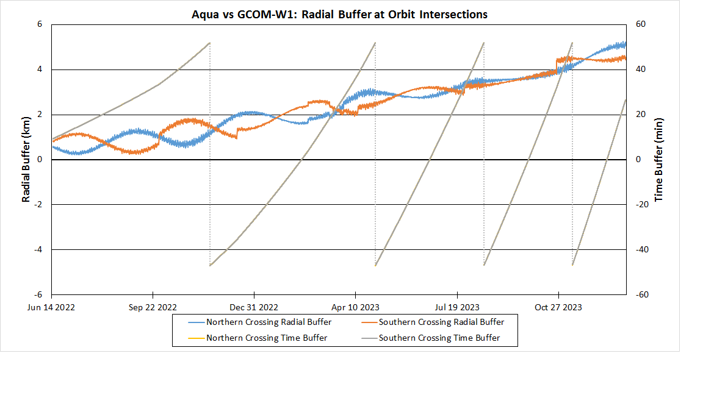
Aqua vs. GCOM-W1
Date | Radial Buffer (km)
(--) | Northern | Southern
Feb 15, 2023 | 1.60 | 2.36
Jun 21, 2023 | 2.78 | 3.26
Sep 27, 2023 | 3.65 | 3.66
Dec 13, 2023 | 4.93 | 4.42

Slide 26
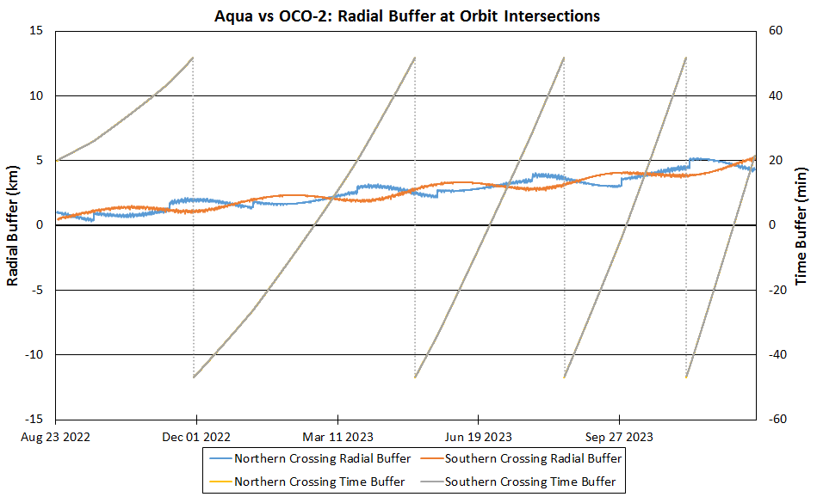
Aqua vs. OCO-2
Date | Radial Buffer (km)
(--) | Northern | Southern
Feb 22, 2023 | 1.87 | 2.25
Jun 26, 2023 | 2.97 | 3.14
Oct 01, 2023 | 3.62 | 4.03
Dec 17, 2023 | 4.66 | 4.69

Slide 27
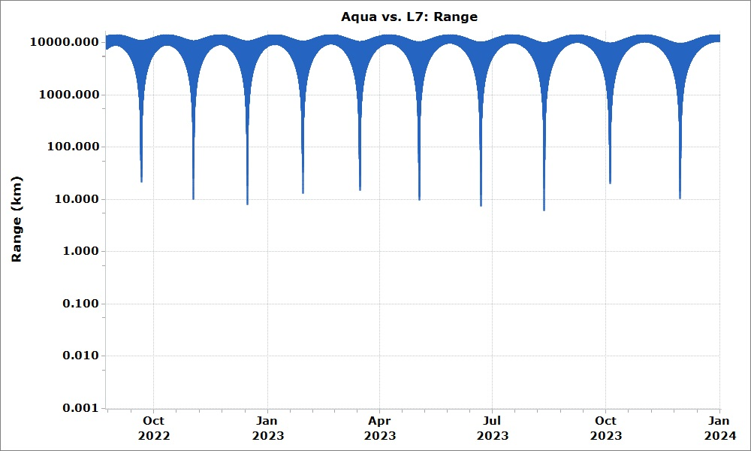
Aqua vs. Landsat-7
TCA Date | Total Miss | Radial | Along-Arc | Cross Track
(--) | (km) | (km) | (km) | (km)
Sep 20, 2022 | 21.49 | -8.12 | 12.50 | 15.47
Nov 01, 2022 | 9.87 | -7.60 | 4.20 | 4.69
Dec 15, 2022 | 7.88 | -7.86 | 0.56 | 0.05
Jan 29, 2023 | 9.66 | -6.68 | -4.65 | -5.20
Mar 16, 2023 | 14.97 | -6.39 | 9.01 | 10.10
May 03, 2023 | 9.66 | -6.68 | -4.65 | -5.20
Jun 21, 2023 | 7.29 | -6.48 | -2.58 | -2.14
Aug 12, 2023 | 5.97 | -5.94 | -0.21 | 0.47
Oct 04, 2023 | 20.06 | -5.67 | -13.80 | 13.42.
Nov 29, 2023 | 10.43 | -4.97 | 6.41 | 6.55

Slide 28
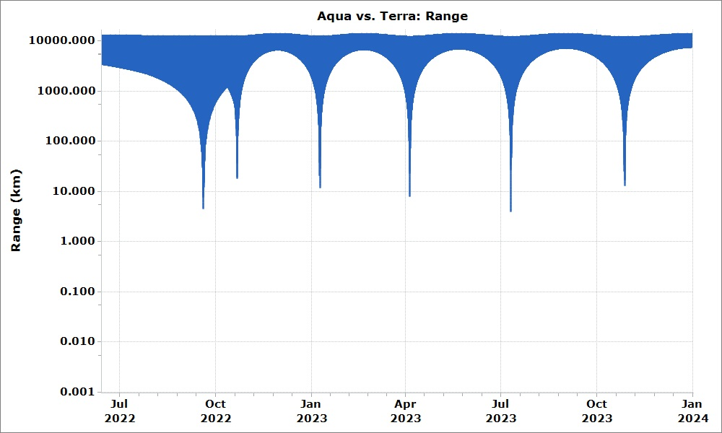
Aqua vs. Terra
TCA Date | Total Miss | Radial | Along-Arc | Cross Track
(--) | (km) | (km) | (km) | (km)
Sep 19, 2022 | 4.49 | 0.46 | 1.95 | 4.02
Oct 21, 2022 | 18.25 | -5.47 | 8.05 | 15.44
Jan 08, 2023 | 11.83 | -4.03 | 5.43 | 9.70
Apr 04-05, 2023 | 7.76 | -4.90 | -3.07 | 5.18
Jul 10, 2023 | 4.49 | 0.46 | 1.95 | 4.02
Oct 27, 2023 | 12.92 | -2.95 | -6.58 | 10.71

Slide 29
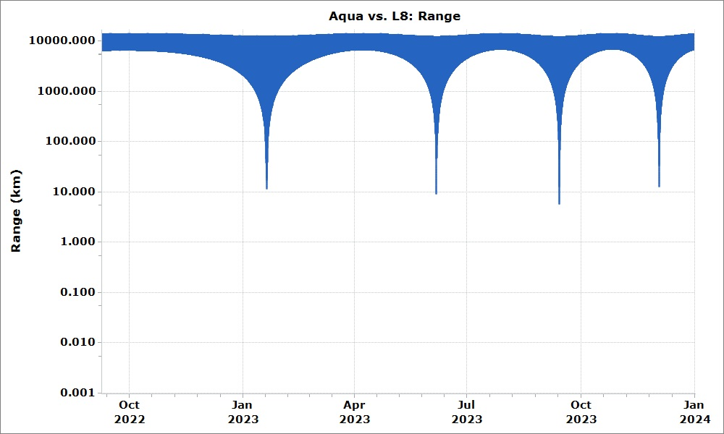
Aqua vs. Landsat-8
TCA Date | Total Miss | Radial | Along-Arc | Cross Track
(--) | (km) | (km) | (km) | (km)
Jan 20, 2023 | 11.31 | 2.18 | -5.54 | 9.61
Jun 06, 2023 | 8.95 | 2.57 | 4.47 | 7.32
Sep 13, 2023 | 5.71 | 3.32 | -2.60 | -3.85
Dec 03, 2023 | 12.44 | 4.90 | -5.96 | -9.75

Slide 30
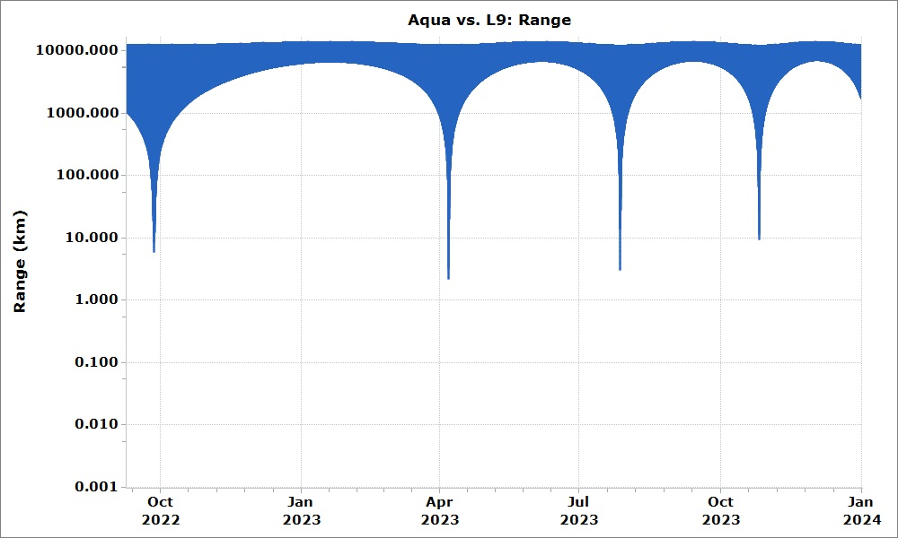
Aqua vs. Landsat-9
TCA Date | Total Miss | Radial | Along-Arc | Cross Track
(--) | (km) | (km) | (km) | (km)
Sep 27, 2022 | 5.89 | 1.15 | -2.10 | 5.38
Apr 07, 2023 | 2.19 | 2.18 | -1.24e-3 | 0.20
Jul 27, 2023 | 3.07 | 2.87 | -0.16 | -1.08
Oct 26, 2023 | 9.31 | 4.34 | -3.58 | -7.43

Slide 31
Aqua vs. CALIPSO: All Passings
Date | Radial Buffer (km)
(--) | Northern | Southern
Jun 16, 2022 | -18.04 | -18.04
Jul 04, 2022 | -17.70 | -17.70
Jul 23, 2022 | -17.38 | -17.38
Aug 10, 2022 | -17.21 | -17.21
Aug 28, 2022 | -17.50 | -17.50
Sep 16, 2022 | -17.91 | -17.30
Oct 04, 2022 | -17.89 | -17.20
Oct 23, 2022 | -17.55 | -17.22
Nov 11, 2022 | -16.90 | -17.54
Nov 29, 2022 | -16.59 | -17.75
Dec 18, 2022 | -16.72 | -17.30
Jan 06, 2023 | -17.08 | -16.76
Jan 26, 2023 | -17.25 | -16.33
Feb 14, 2023 | -16.99 | -16.53
Mar 05, 2023 | -16.46 | -16.92
Mar 25, 2023 | -16.03 | -16.97
Apr 13, 2023 | -16.01 | -16.55
May 03, 2023 | -16.32 | -16.10
May 23, 2023 | -16.41 | -15.74
Jun 13, 2023 | -16.10 | -15.84
Date | Radial Buffer (km)
(--) | Northern | Southern
Jul 03, 2023 | -15.43 | -16.22
Jul 23, 2023 | -15.32 | -16.32
Aug 13, 2023 | -15.70 | -15.75
Sep 02, 2023 | -15.91 | -15.24
Sep 23, 2023 | -15.99 | -15.15
Oct 14, 2023 | -15.34 | -15.40
Nov 05, 2023 | -14.50 | -15.47
Nov 26, 2023 | -14.47 | -15.14
Dec 18, 2023 | -14.60 | -14.56

