Slide 1
Aqua/Aura Lifetime Drag Coefficient Analysis
Ben Leser
EOS FDS
MOWG, November 16-18, 2022
Notes:
4

Slide 2
Contents
Introduction
Methodology
Literature Review
Trending Review
CD Estimation Method
Results
Conclusions
References

Slide 3
Introduction
The choice of drag coefficient (CD) used in lifetime propagation can have a significant impact on end-of-life (EOL) predictions
  Aqua: Lower CD → Lifetime models less drag → Orbit decays more slowly → Higher orbit at passivation → Longer orbit dwell time
  Aura: Higher CD → Lifetime models more drag → Drag make-up (DMU) maneuvers use more fuel → Less fuel available for orbit-lowering → Longer orbit dwell time
Previous FDS lifetimes used CDs that seemed low compared to recent CD trends – meaning drag would be undermodeled if used now
  This observation motivated a search for more appropriate CDs – recent lifetimes used new CDs, but there wasn’t a well-defined selection method
The goal of this analysis was to find a method for estimating more appropriate CD values for Aqua and Aura lifetime propagation
  Three methods were considered – this package focuses on the selected method, backup includes all three methods and comparison

Slide 4
Methodology
Assumptions and preliminary decisions
  A single CD value will be used for the entire span of lifetime propagation
  The CD value used in lifetime propagation will be based on FDF-generated data
  Solar activity, as measured by F10.7, is the main driver of changes to the drag environment
  The effect of solar flux on atmospheric density lags one day behind the observed F10.7 values
  Daily observed solar flux values from trending are adjusted based on the Earth-Sun distance to calibrate them all to 1 AU, as used in the Jacchia-Roberts density model ^{[1]}
Reviewed relevant literature
Took an initial look at FDS CD and solar flux trends (full review in backup)
  FDS trends CDs used in product generation – all plots show the daily FDF CD value
  FDS trends solar flux data using NOAA data that is updated daily
Evaluated various methods of filtering CD data based on solar flux level, in terms of average CD

Slide 5
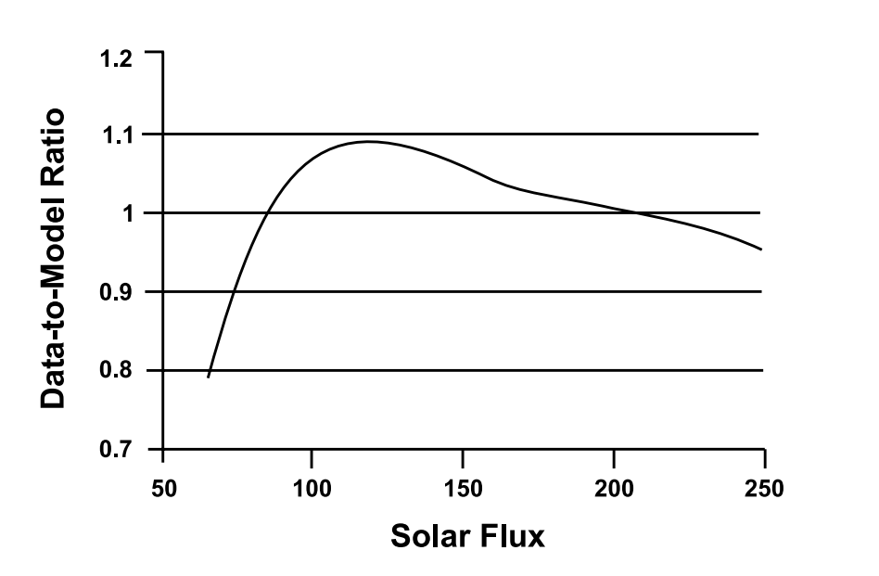

Literature Review
Many sources suggest a constant CD of 2.2 in propagation in LEO ^{[1]}
  We trend Aqua/Aura’s solved-for CD values, so we want to rely on that data
Literature review revealed that the accuracy of the Jacchia atmospheric density model varies with the F10.7 solar flux index ^{[2,3]}
  Plot shows density model errors as a function of 81-day avg. solar flux level
  The CD is a solved-for parameter in FDF’s OD process, so density modeling errors will be absorbed by the CD
$$a_{D}=−\frac{1}{2}\frac{C_{D}A}{m}ρv^{2}$$
Least squares fit of measured-modeled density ratios vs. solar flux, based on data from five satellites at 400 km altitude from 1970-2000 ^{[2]}
Realistic drag prediction requires a CD value that appropriately compensates for errors in the density model

Slide 6
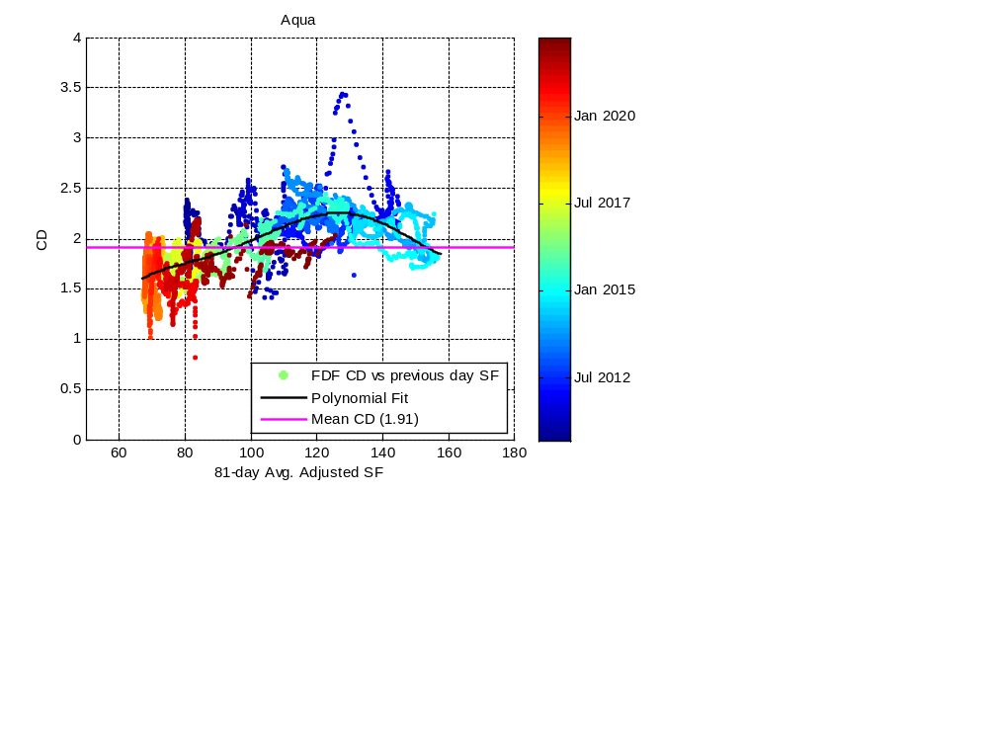
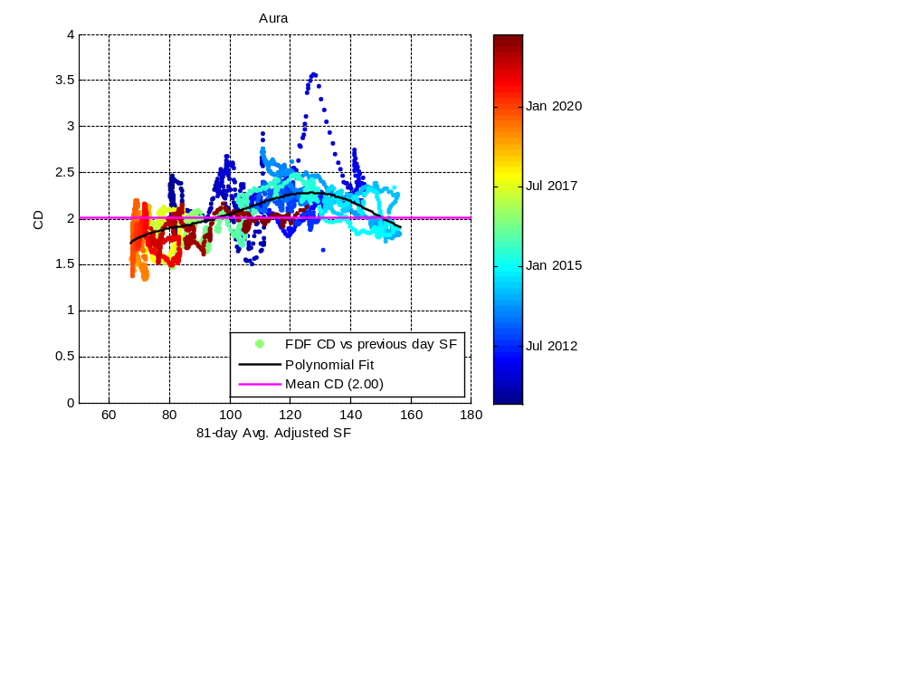
Trending Review
Elected to use only CD data as far back as Sep 2010, when FDF began using ODTK for Aqua & Aura daily product generation (see backup)
Trending CD against the 81-day avg. SF reveals a trend that appears similar to the measured-modeled density ratio vs. solar flux trend found in the literature
  Trends in ODTK solved-for CD values appear to coincide with trends in density modeling errors

Slide 7
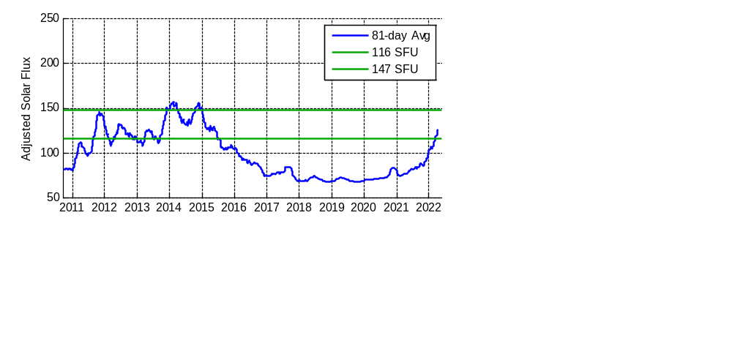
CD Estimation Method
Realistic drag prediction requires a CD value that appropriately compensates for errors in the density model
  Simple approach: Average across historical CD trending data to compute a CD for use in lifetime propagation — density model errors vary with solar flux, so we can use solar flux to select what CD data to include in averaging
Use solar flux value to select CD data representative of the predicted drag environment during lifetime analysis span – chose “direct filtering” method
  Set upper/lower bounds for solar flux based on range encountered during lifetime
  Schatten predictions contain monthly mean smoothed estimates of solar flux values – comparable to the 81-day avg. solar flux values from trending
Use only CD data within SF limits

Slide 8
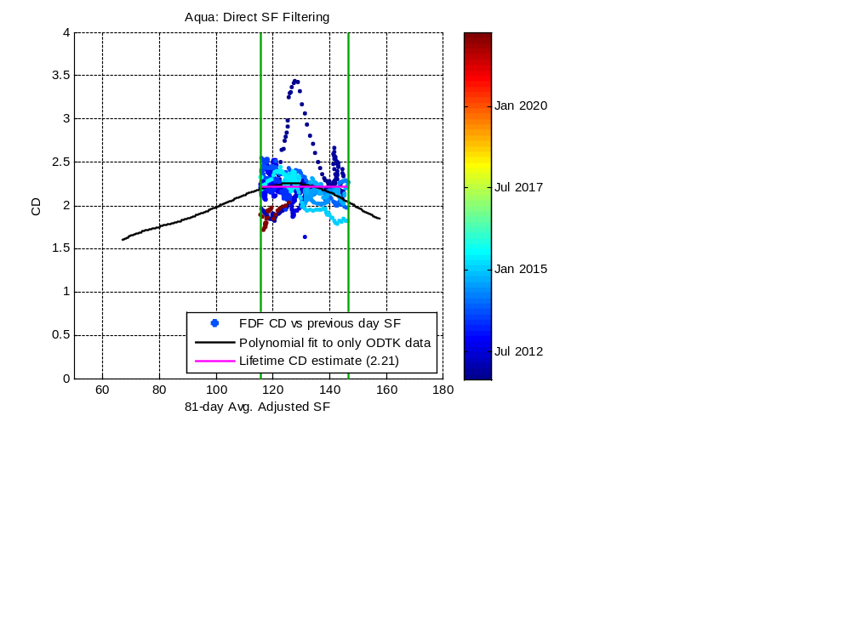

Results
Estimating lifetime CD as a simple average yields a value comparable to the polynomial within the expected solar flux range
  Latest trending data used in this analysis is dated May 20 2022
  Propagation spans set using passivation dates from latest lifetimes (at the time of this analysis)
  Based on May 2022 Schatten predicts, expected range of solar flux was 116-147 SFU
  Polynomial fit for each mission is based on all ODTK data (same curves as on Slide 6)

Slide 9
Conclusions
An analysis was performed to determine a method for estimating a CD value for use in Aqua & Aura lifetime propagation
  Literature and trending reviews were performed to determine direction and scope of possible methods – three methods were examined
Realistic drag prediction requires a CD value that appropriately compensates for errors in the density model
  Estimated by averaging over CD data that represents the predicted drag environment as determined based on solar flux
FDS recommended using a method of directly filtering CD trending data based on the 81-day avg. solar flux to compute lifetime CDs
  Stakeholders approved use of this method and the presented values for the Spring 2022 lifetime analyses
  The FDS lifetime analysis process will be updated to use this method to compute a new CD value for each future lifetime analysis update

Slide 10
References
^{[1]} Vallado, D. A., and Finkleman, D., "A Critical Assessment of Satellite Drag and Atmospheric Density Modeling," AIAA 2008-6442. AIAA/AAS Astrodynamics Specialist Conference and Exhibit. August 2008.
^{[2]} Marcos, F. A., Wise, J. O., Kendra, M. J., Grossbard, N. J., and Bowman, B. R., "Detection of a Long-Term Decrease in Thermospheric Neutral Density," Geophy. Res. Lett., Vol. 32, No. 4, 2005.
^{[3]} Marcos, F. A., Bowman, B. R., and Sheehan, R. E., "Accuracy of Earth's Thermospheric Neutral Density Models," AIAA 2006-6167. AIAA/AAS Astrodynamics Specialist Conference and Exhibit. August 2006.

Slide 11
QUESTIONS?

Slide 12
BACKUP

Slide 13
Trending Review (1/3)
FDF OD System
Upon review of FDS CD trends, it was observed that recent CD values are much higher than during early mission – this is believed to be due to an FDF software change
  On Sep 15 2010, FDF switched from RTOD to ODTK for the OD software package used in Aqua & Aura daily product generation
  According to an FDS analysis from that time, RTOD-based and ODTK-based CD values can differ significantly despite satisfying all product requirements
Since FDF still uses ODTK, FDS elected to exclude all RTOD-based CD data from our analysis and proposed lifetime CD estimation methods
OD System | Aqua | Aura
Both | 1.76 | 1.84
RTOD | 1.56 | 1.52
ODTK | 1.91 | 2.00

Slide 14
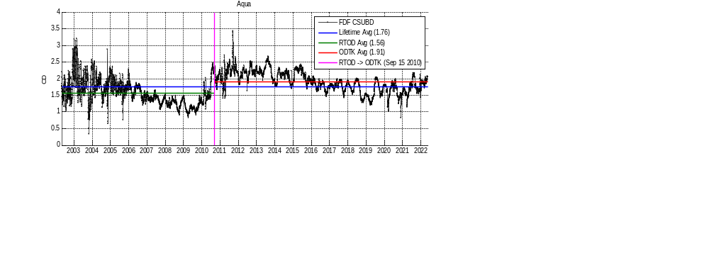
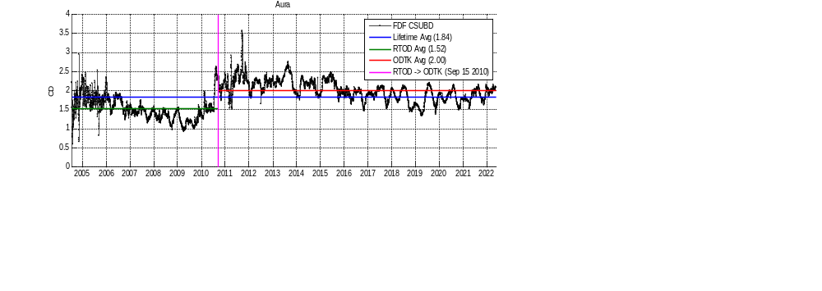
Trending Review (2/3)
Drag Coefficient History, Mission Start – May 20 2022
RTOD
Mission Start – Sep 14 2010
ODTK
Sep 15 2010 – May 20 2022
RTOD
Mission Start – Sep 14 2010
ODTK
Sep 15 2010 – May 20 2022

Slide 15
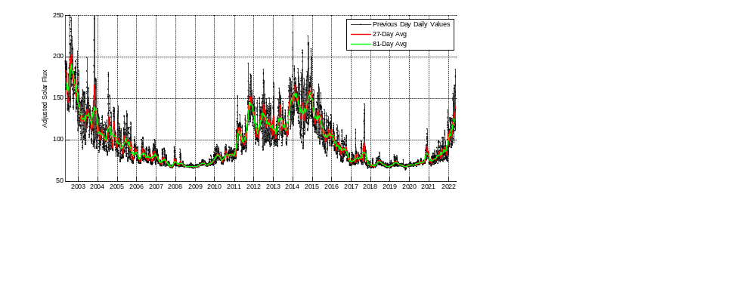
Trending Review (3/3)
Solar Flux History, Aqua Mission Start – May 20 2022
Daily observed solar flux values are adjusted based on the Earth-Sun distance to calibrate them all to 1 AU and remove related oscillations in solar flux level
  Adjusted values are used in the Jacchia-Roberts density model ^{[1]}
Solar rotation period is ~27 days – 27-day and 81-day averages are commonly used when reviewing solar flux trends

Slide 16
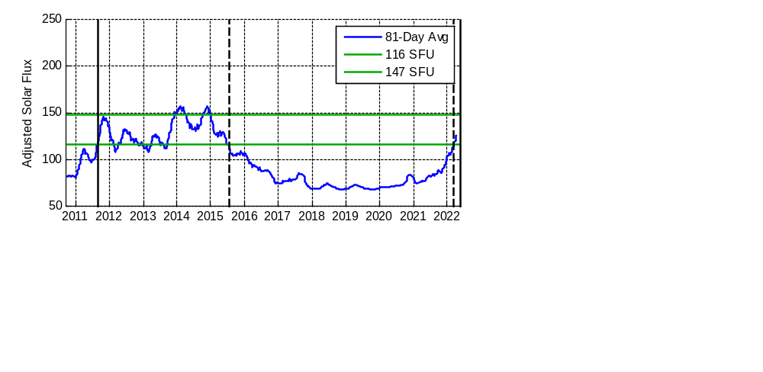
Filtering Methods (1/2)
Solar Flux Filtering Methods
Want to select data representative of the predicted drag environment during lifetime so that the average CD will result in reasonable drag predictions
  Lifetime uses mean nominal Schatten solar flux predictions – set upper and lower bounds for solar flux based on range encountered during lifetime propagation span
  Schatten predictions contain monthly mean smoothed estimates of solar flux values – compare Schatten values to the 81-day avg. solar flux values from trending
Two ways to filter by solar flux value – selected data shaded green below:
  Direct: Include all days on which the solar flux value is within set limits
  Indirect: Include data ranges selected based on a proxy – we examined selecting periods during which the solar flux tended to be within set limits
Direct
Indirect

Slide 17
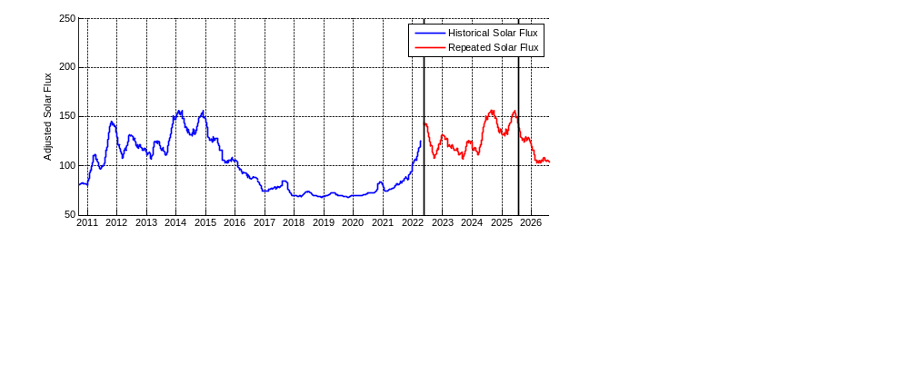
Filtering Methods (2/2)
Solar Cycle Repeat Method
This approach was used by SpaceNav to compute the CD used in the Aqua lifetime presented at the Nov 2021 Delta-CER (2.1)
Assume that future solar flux and CD values will follow the previous solar cycle and average over the predicted lifetime span
  Match up recent trends with older data based on solar flux value, then append the historical data to the end of existing data
  Example plot below shows selected data for Aura’s predicted lifespan
81-day avg. is centered on the day of interest and can’t be computed for last 40 days of data, resulting in a gap between historical & repeated flux curves.

Slide 18
Results (1/4)
Summary
All three methods were tested for both Aqua and Aura considering the next lifetime analyses, which were performed in Spring 2022
  Latest trending data used in this analysis is dated May 20 2022
  Passivation dates from the latest lifetimes (at the time of this analysis) were used to define lifetime propagation spans
    Aqua: May 2022 – Aug 2026
    Aura: May 2022 – Aug 2025
  Used May 2022 Schatten predicts – expected range of solar flux for both missions’ lifetimes was 116-147 SFU
For each mission, all methods resulted in similar CD values
  Comparison of the methods was needed to make a recommendation
Method | Aqua | Aura
Direct SF Filtering | 2.21 | 2.24
Indirect SF Filtering | 2.17 | 2.21
Solar Cycle Repeat | 2.15 | 2.18

Slide 19
Results (2/4)
Comparison of Methods
Indirect solar flux filtering and solar cycle repeat methods are quite similar – main difference is that the former will include more recent data as it’s collected
Direct solar flux filtering has the most advantages and is the simplest method to apply while yielding similar results to other methods
Method | Advantages | Disadvantages
Direct SF Filtering | Only need the latest Schatten predicts to determine the CD Includes recent trending data
Indirect SF Filtering | Includes recent trending data | Requires manual effort Choice of dates to include is somewhat arbitrary
Solar Cycle Repeat | Already used in Aqua lifetime presented at Delta-CER in Nov 2021 | Requires manual effort Choosing data to include in repeat cycle can be arbitrary Excludes recent trending data

Slide 20
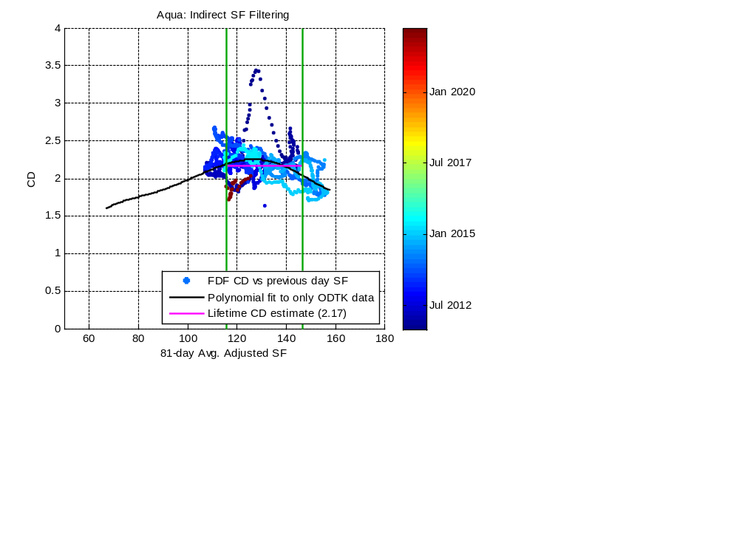
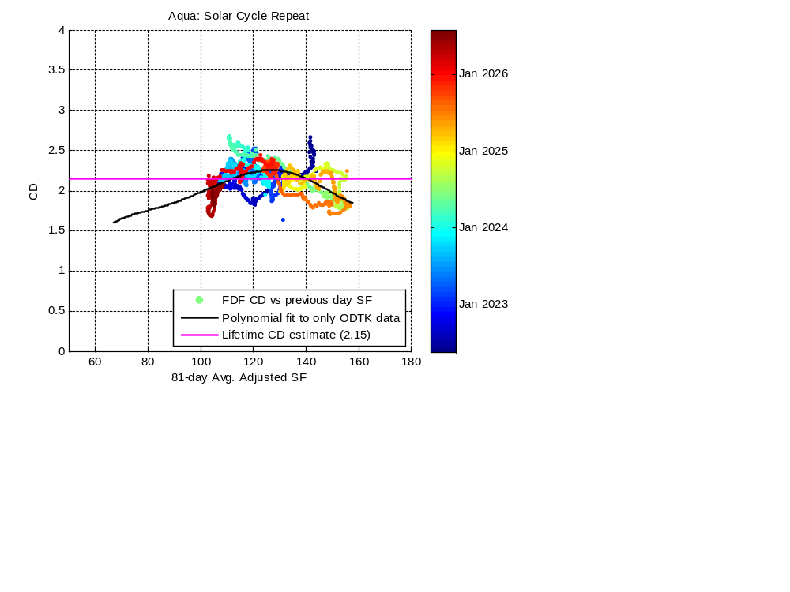
Results (3/4)
Comparison of Methods, Aqua CD-SF Plots

Slide 21

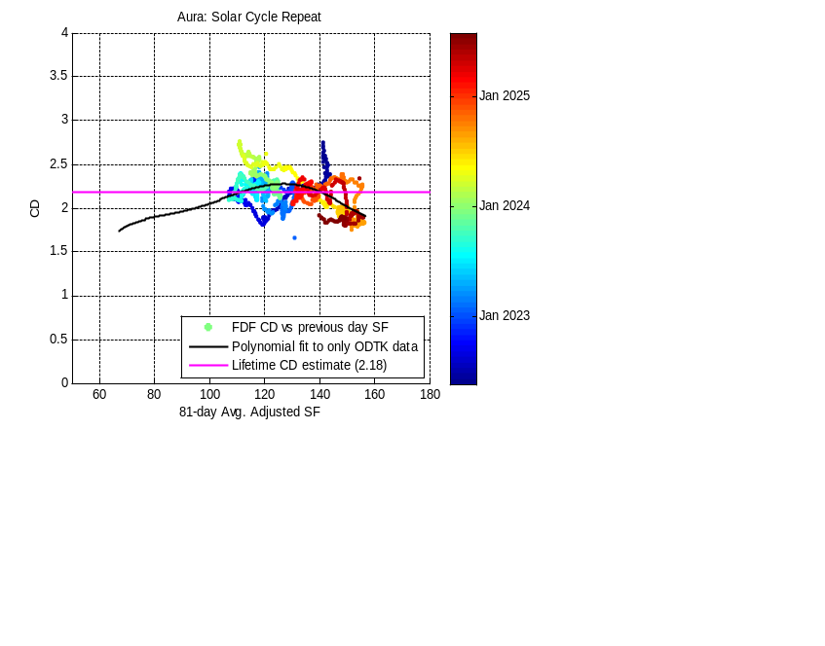
Results (4/4)
Comparison of Methods, Aura CD-SF Plots

Slide 22
RTOD vs. ODTK Comparison
An FDS analysis was performed in 2010 to compare FDF products generated using ODTK to those generated using RTOD and verify requirements would still be satisfied. This analysis included a comparison of the daily CSUBD product, which found that the daily CD value can differ significantly between the two OD systems despite the products satisfying all requirements.

Slide 23
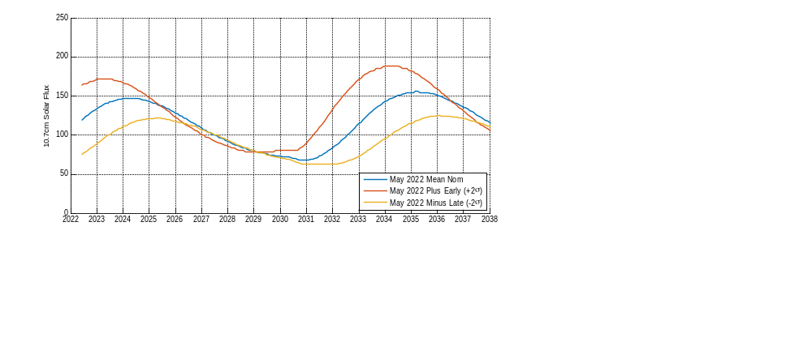
May 2022 Schatten Solar Flux Predictions
The May 2022 Schatten solar flux predictions were the latest at the time of this analysis
The May 2022 value is 116 SFU
Based on the passivation dates from past lifetimes, the predicted range of solar flux values for the Spring 2022 lifetimes was 116-147 SFU

