Slide 1
Supersonic Transport Scheduling and Fleet Analysis Model
Ty Marien and Toni Trani (Presenters)
Ty Marien, Jonathan Seidel, Karl Geiselhart, Wu Li, and Sam Dollyhigh
NASA Team
Z. Wang, N. Hinze, E. Freire, and A.A. Trani
Virginia Tech Team
NASA Annual Systems Analysis Symposium
November 2, 2022

Slide 2
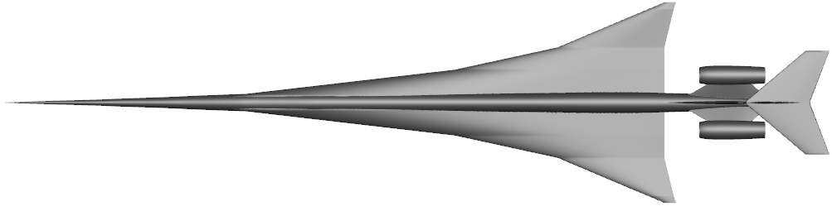
ISAT Supersonic Studies Background
For past few years, the PAMO/ISAT has sponsored a series of studies with the Virginia Tech Air Transportation Systems Laboratory to look at supersonic transport market demand through the contract with the National Institute of Aerospace (NIA).
Study Objectives:
  Determine the target size/range/speed of a low-boom “objective vehicle”
  Explore the market feasibility of supersonic transports
  Understand how low-boom designs compare to conventional designs in terms of vehicle economics.

Slide 3
FY22 Supersonic Transport Scheduling and Fleet Analysis Study
In this previous work, Virginia Tech developed a market demand methodology called the Low-Boom Systems Analysis Model (LBSAM). LBSAM is an integrated model that allows us to forecast global passenger demand for our low-boom transport concepts by estimating aircraft life cycle costs, minimum required airfares, feasible origin-destination pairs, and flight times. The model considers historical airfare distributions in the different markets to estimate the number of passengers willing to switch to supersonic service.
FY22 Primary Tasks:
  Add a network model with tail tracking and feasible flight schedules to help verify our aircraft network utilization assumptions.
  Add a passenger preference model to LBSAM to better predict the passenger switch rate from subsonic to supersonic service.
  Run sensitivity studies of the integrated demand model to validate its operation.

Slide 4
Acknowledgements
Virginia Tech would like to acknowledge the technical and financial support of the following individuals and organizations:
Ty Marien (NASA Langley Research Center)
Jonathan Seidel (NASA Glenn Research Center)
Wu Li (NASA Langley Research Center)
Karl Geiselhart (NASA Langley Research Center)
Sam Dollyhigh (Contractor to NASA Langley)
National Institute of Aerospace (NIA)

Slide 5
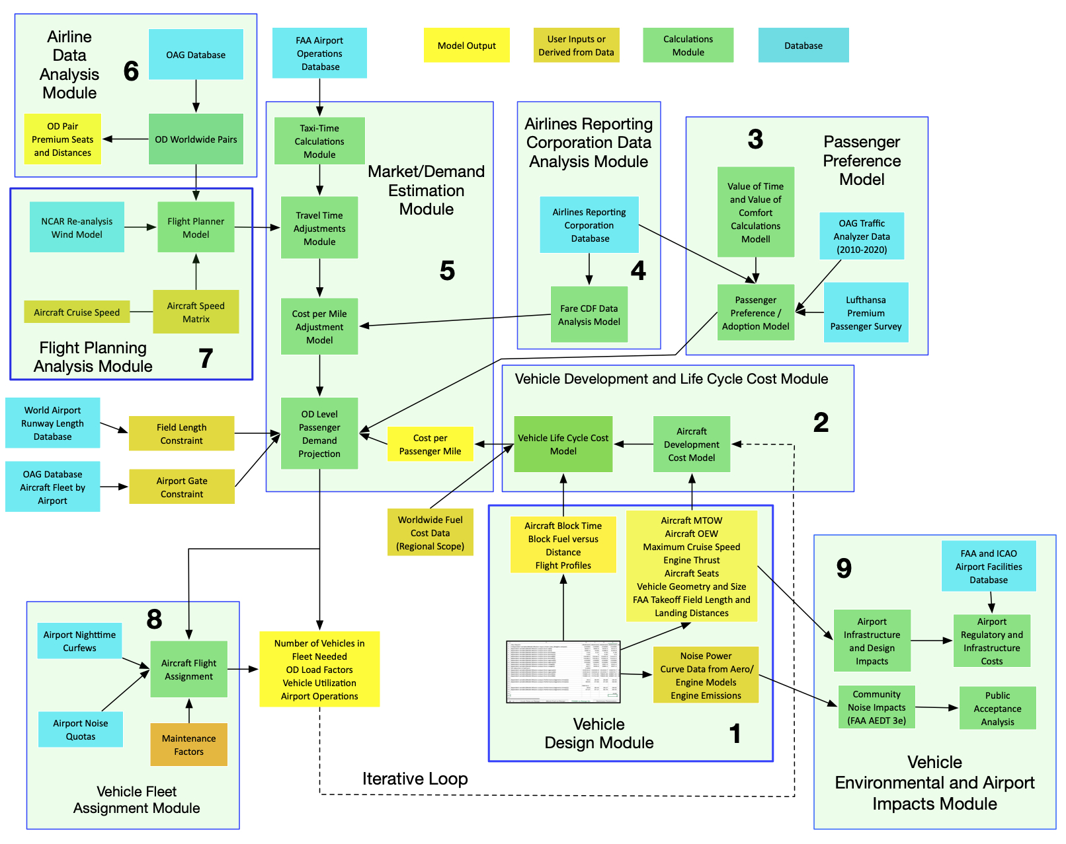
Low-Boom Systems Analysis Model (LBSAM)

Slide 6
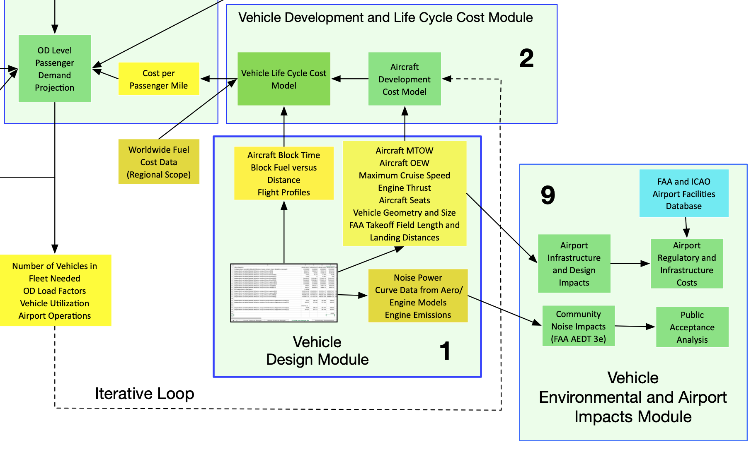
Vehicle Development and Life Cycle Cost Module

Slide 7
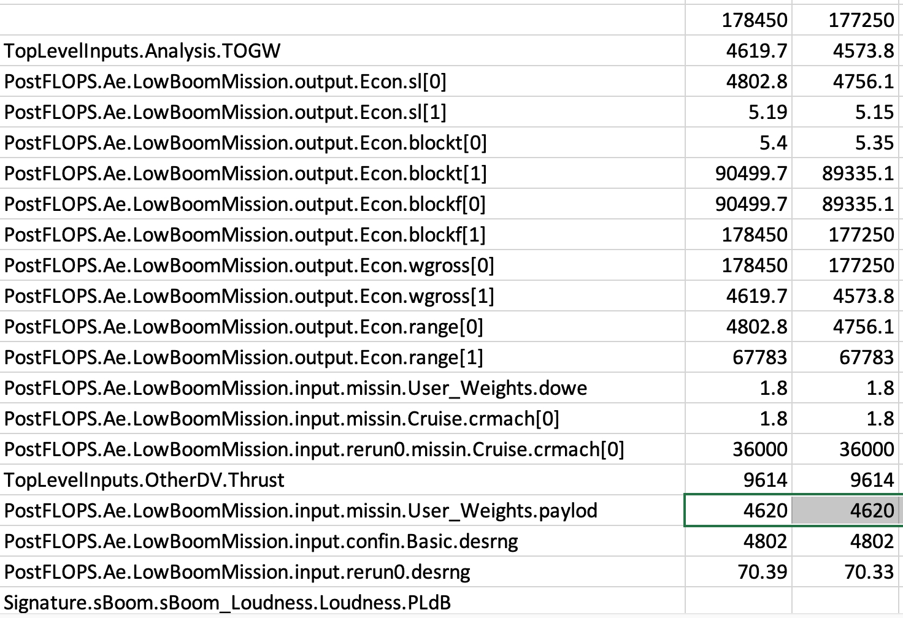
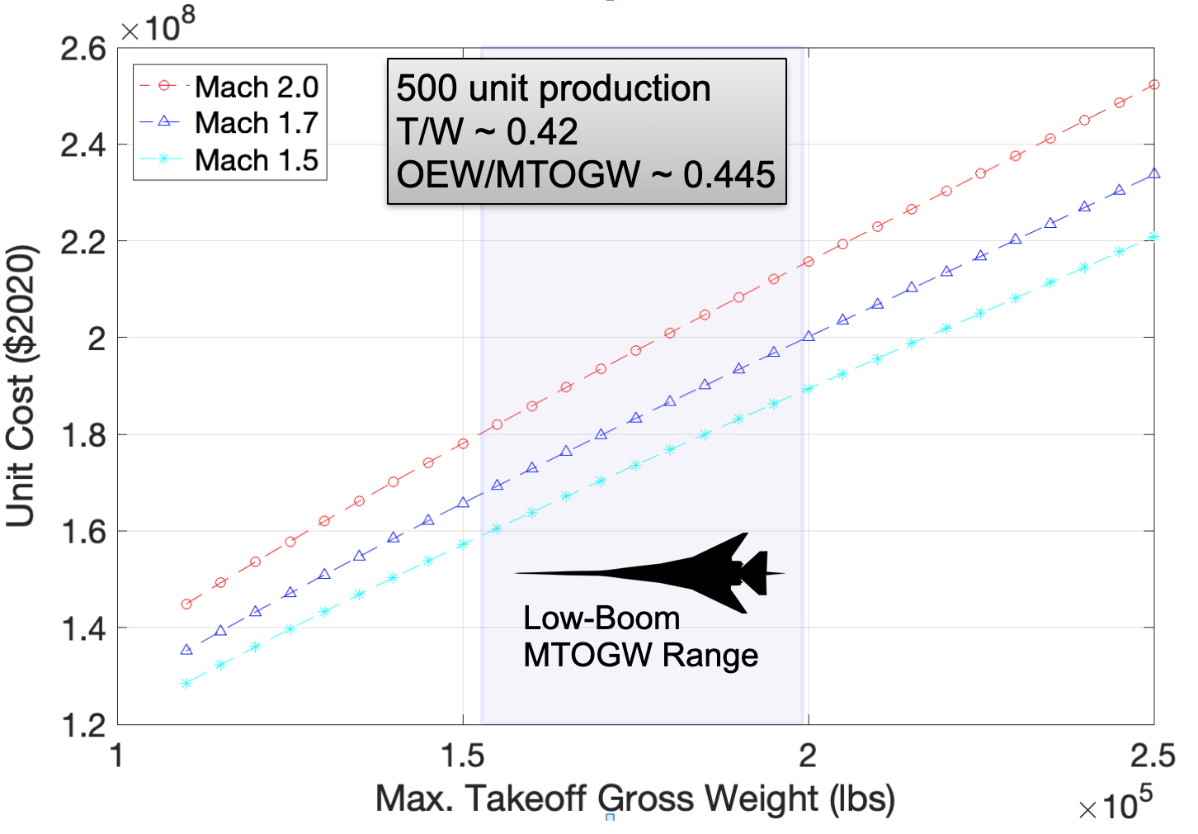
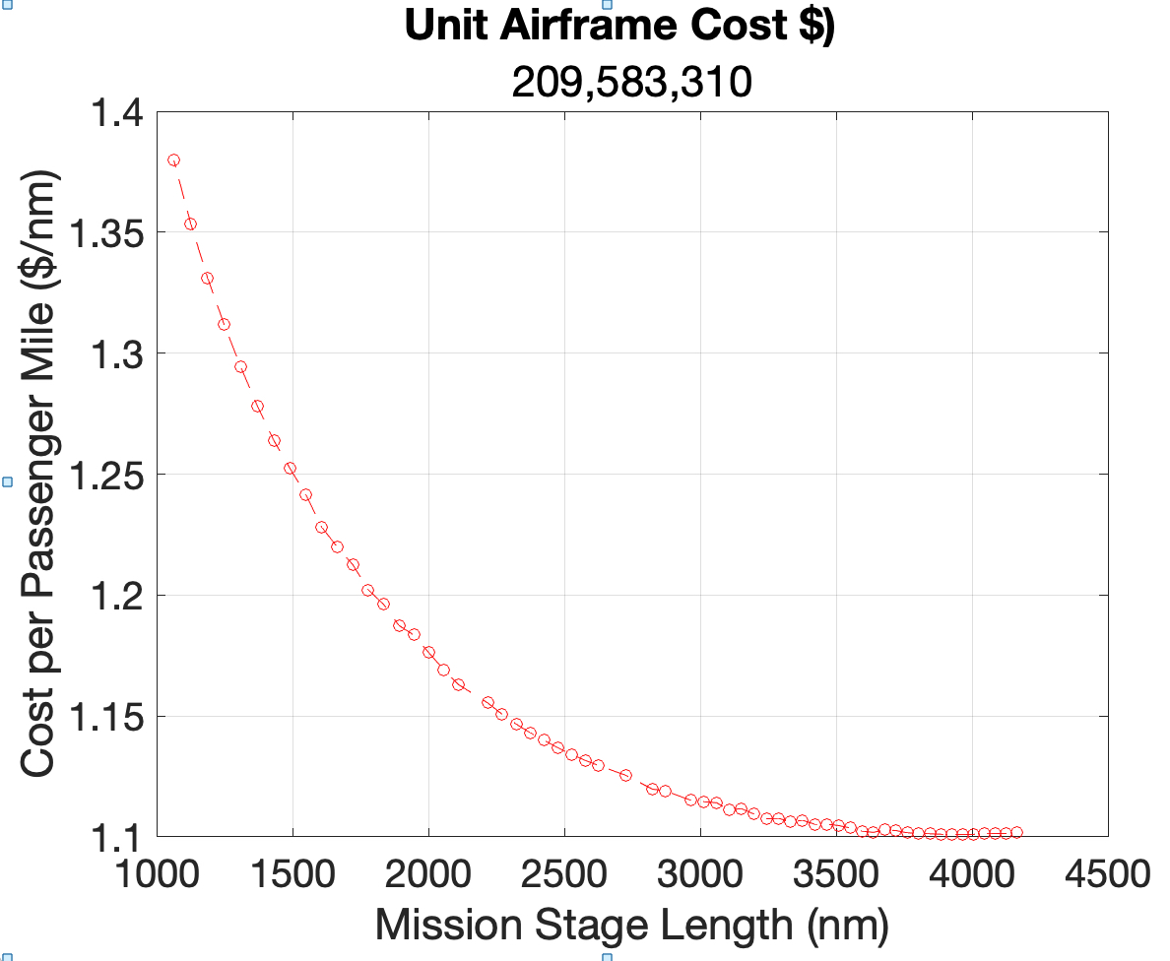
Aircraft Development and Life Cycle Cost Module
FLOPS Model Output
Output of
Aircraft Development
Cost Model
Aircraft speed, quantity produced, takeoff and empty weights, and other technical parameters produced by FLOPS are used to estimate the vehicle development costs using non-linear regression equations adapted from a RAND cost model
An operational aircraft life cycle cost model is used to estimate the Cost per Passenger Mile (CPM) based on the initial vehicle cost estimate
The CPM cost is used by the Passenger Choice and Market Demand modules
Output of
Aircraft Operations
Life Cycle Cost Model

Slide 8
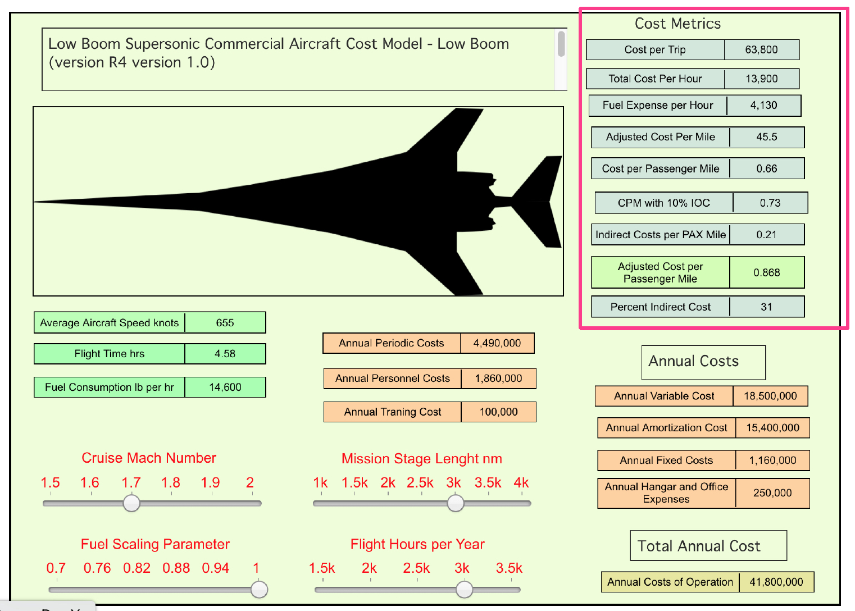
Aircraft Operations Life Cycle Cost Module
Supersonic aircraft operations life-cycle cost model include the following:
Vehicle unit cost
Number of annual operations
Maintenance hours per flight hour
Engine overhaul costs
Time between overhauls
Landing fee per landing
Percent of repositioning flights
Stage length flown
Fuel consumption and fuel cost
Hangar cost
Crew and maintenance personnel
Avionics and interior refurbishing costs
Load factor per flight
Depreciation
Life-cycle time
Landing fees and ground handling costs
Airport emission fees
Navigation fees
Insurance costs (liability and hull)
Taxes airline passenger facility fees
Output of
Aircraft Operations
Life Cycle Cost Model

Slide 9
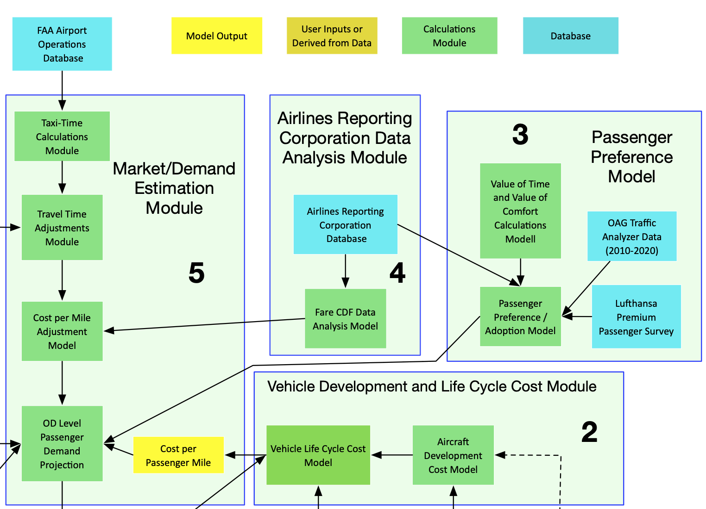
Passenger Preference Module

Slide 10
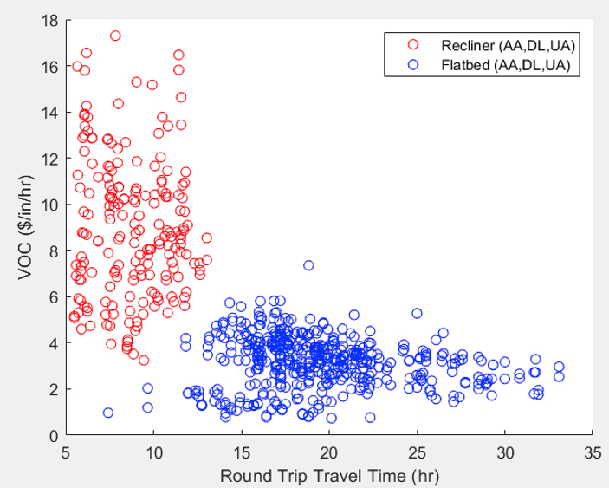

Passenger Preference Module
Estimates the fraction of passengers willing to switch from subsonic to high-speed commercial services using Value of Time (VOT) and Value of Comfort (VOC)
Estimates the tradeoffs between the travel time advantages of high-speed travel and the potential disadvantages of traveling in a more confined seat typically found in supersonic vehicles
Estimated Values of Time for premium
seats range from $120-$240/hr
using a Lufthansa passenger survey and
OAG Traffic Analyzer airfare analysis
Analysis using
OAG Traffic Analyzer
and SeatGuru

Slide 11
Market Demand Estimation Module

Slide 12
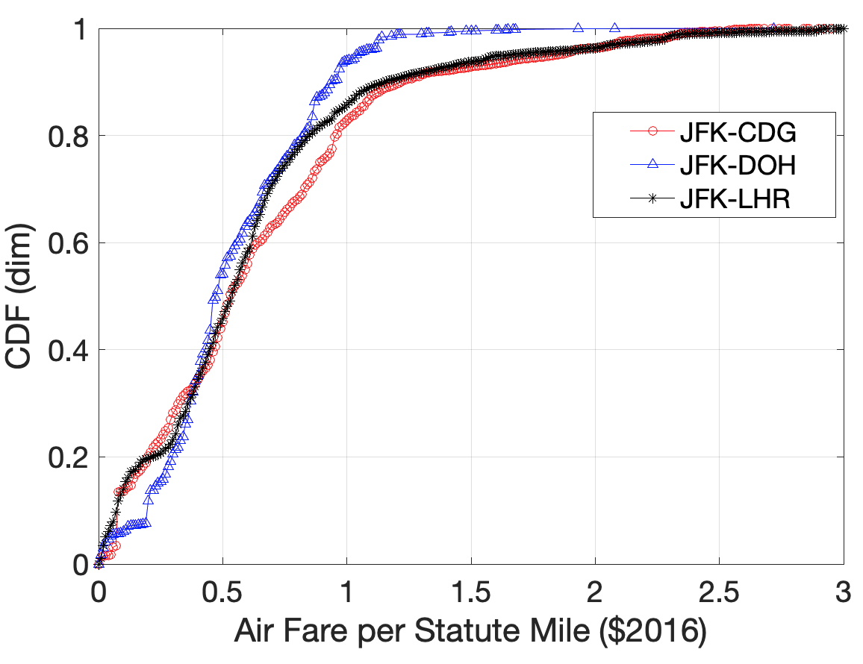
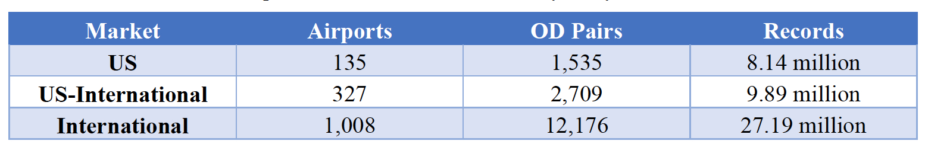
Market Demand Estimation Module
Estimates the number of passengers traveling in the high-speed vehicle at the route level.
Employs the Airline Reporting Corporation (ARC) database with 46 million premium class airline tickets (first and business class) to estimate the number of passengers switching to high-speed commercial service
Low-Boom CPM
Cost + VOT/VOC
Threshold
Example: Considering Value of Time and Value of Comfort
20% of the premium passengers in the JFK-LHR route may be willing to switch to supersonic aircraft
if the supersonic air fare is $0.8/mile
Airline Reporting Corporation (ARC) datasets

Slide 13
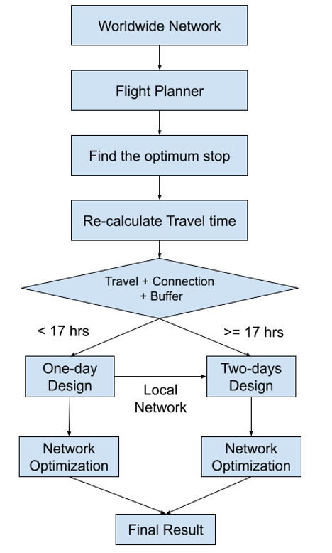
Vehicle Fleet and Network Assignment Module
Estimates the number of airframes needed to cover all the OD-level routes identified in the Market Demand Module
Mix-integer programming technique creates daily schedules worldwide
Predicts vehicle utilization, load factors at the OD airport and network levels, revenue, passenger spill-over, and repositioning flights
The outputs are sent (via an iterative loop procedure) to the Vehicle Development and Life Cycle Cost Module until demand and supply are in equilibrium

Slide 14
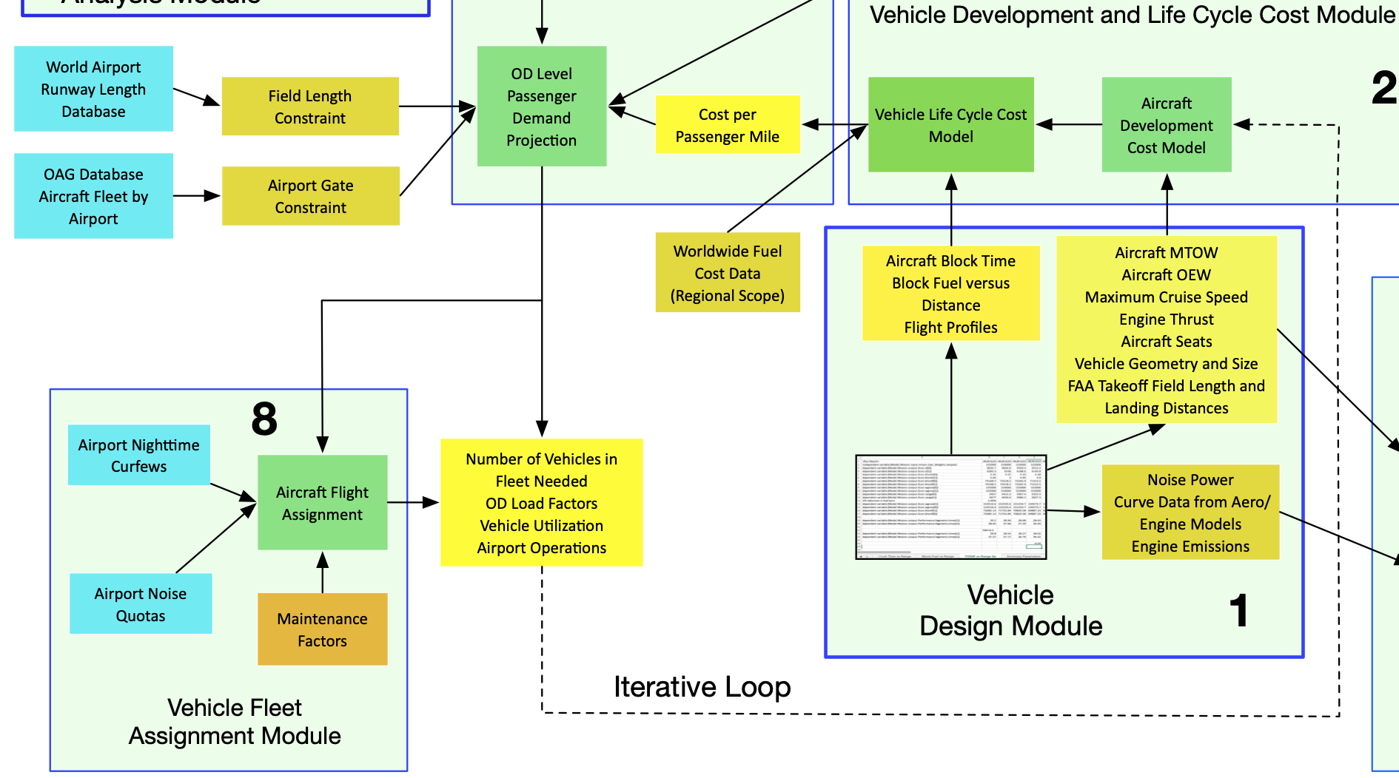
Vehicle Fleet Assignment Module

Slide 15
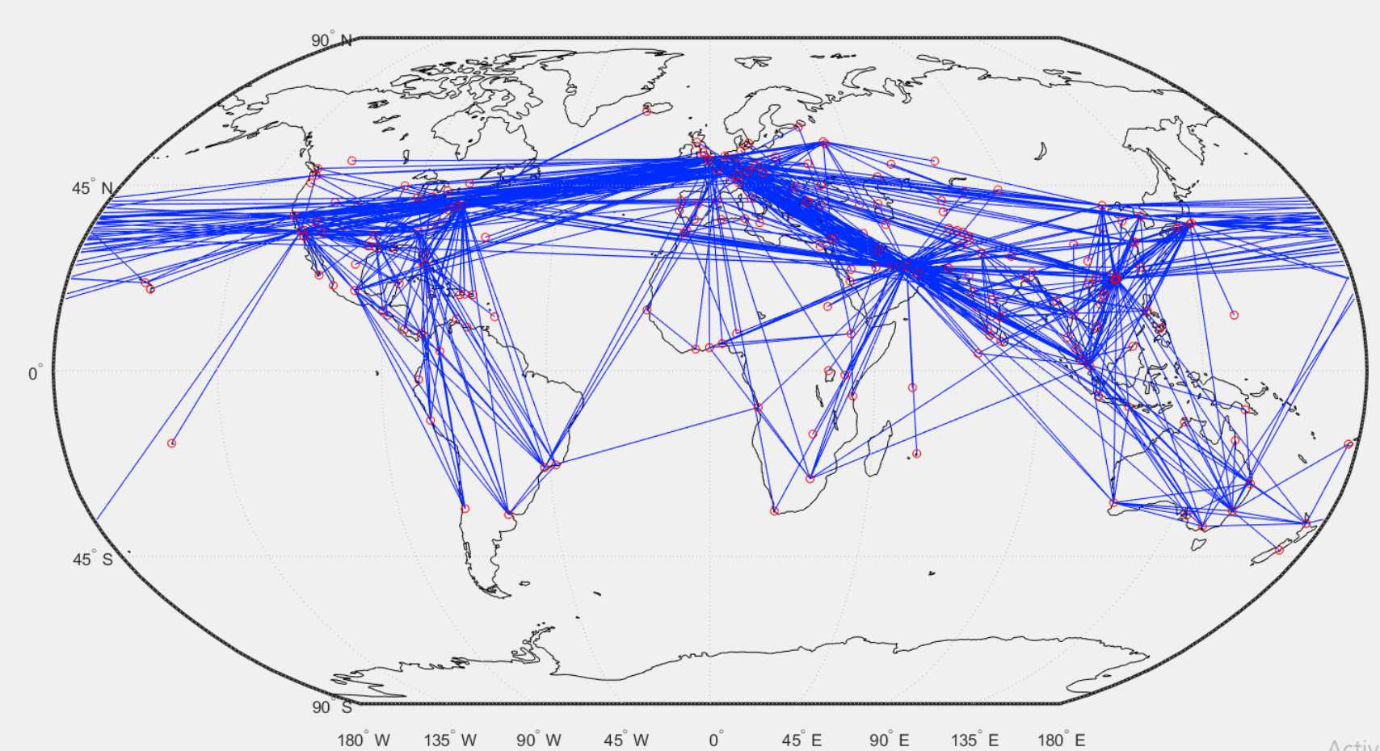
Sample Low-Boom World Network
Fleet assignment module assigns individual aircraft to the worldwide network
Network design considers nighttime curfew constraints

Slide 16
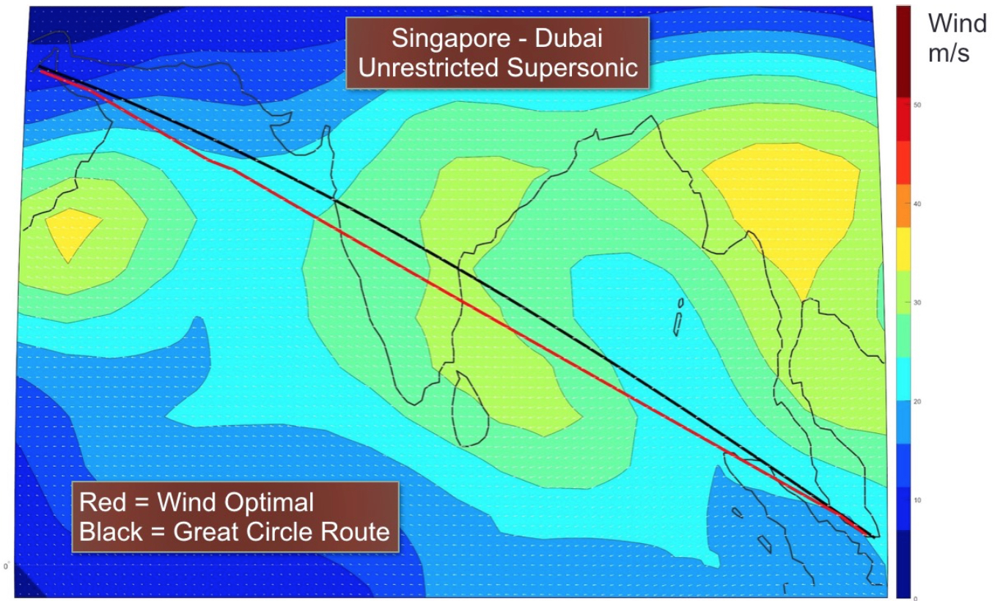
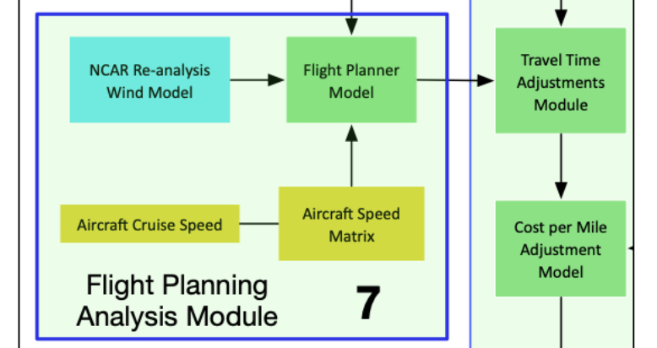
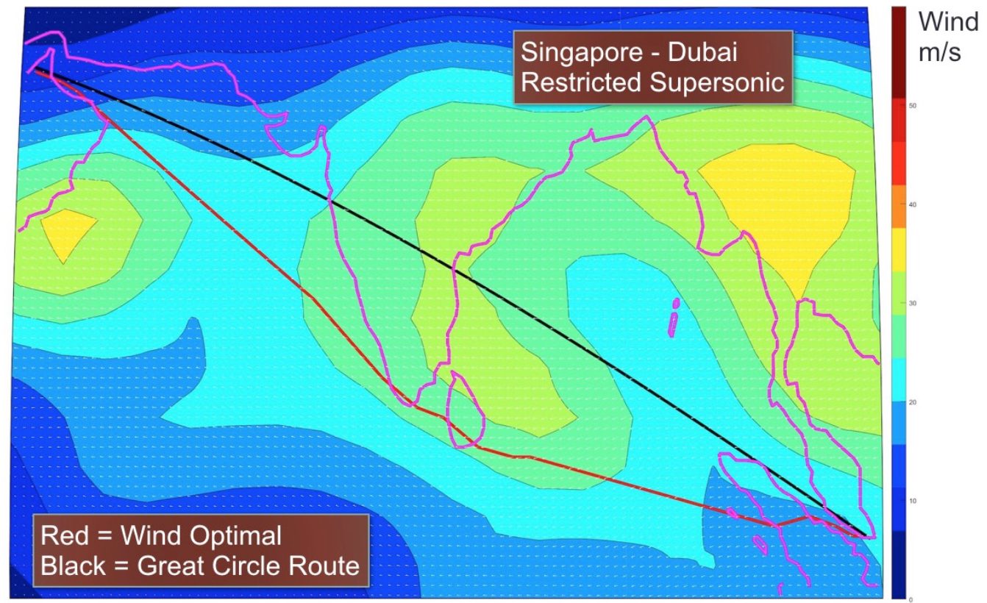
Overland/Overwater Flight Restrictions
Estimates flight trajectories for supersonic aircraft considering supersonic overland restrictions (if applicable)
Flight planner uses NOAA Re-analysis wind data sets
Runway length and airport gate compatibility analysis are considered in the selection of candidate OD airport pairs

Slide 17
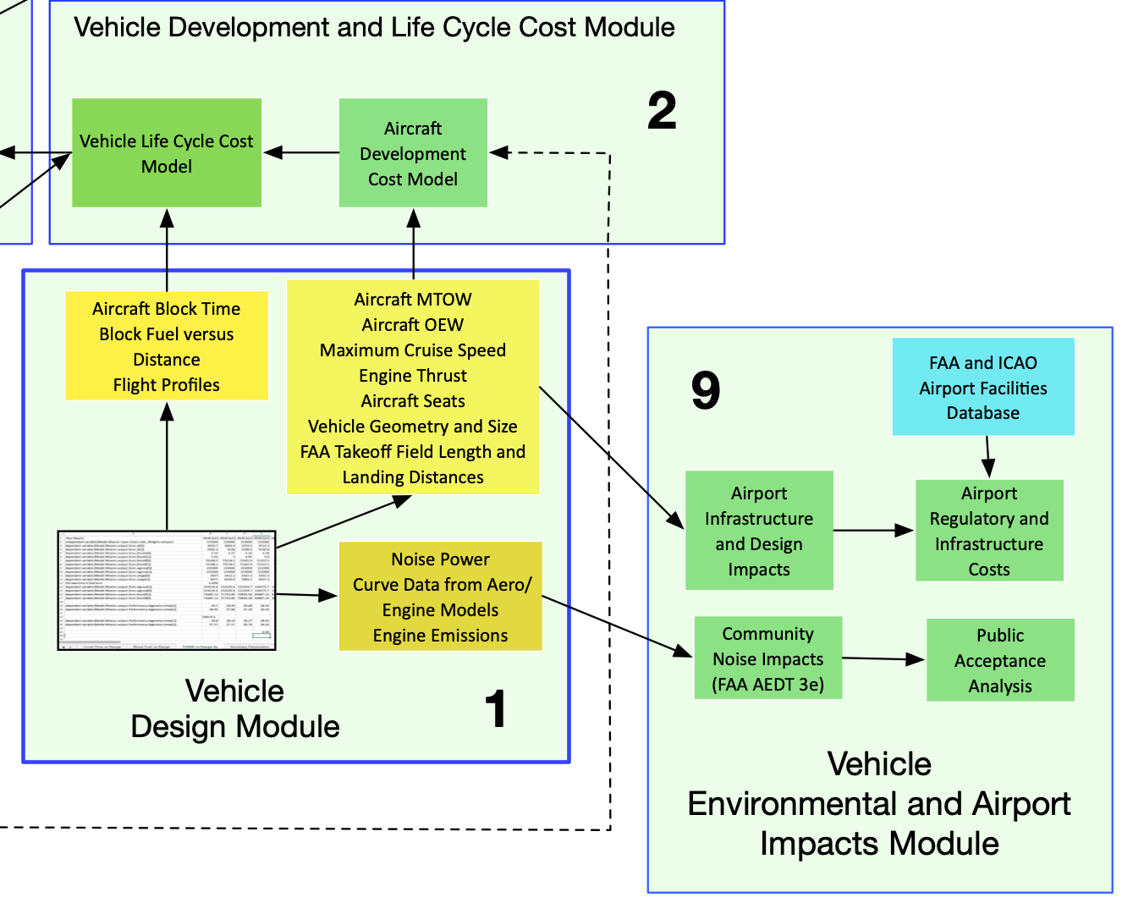
Vehicle Environmental and Airport Impacts Module

Slide 18
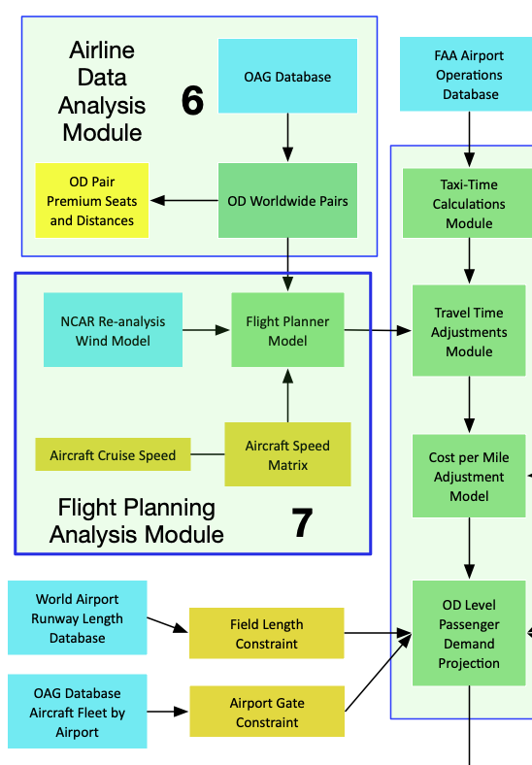
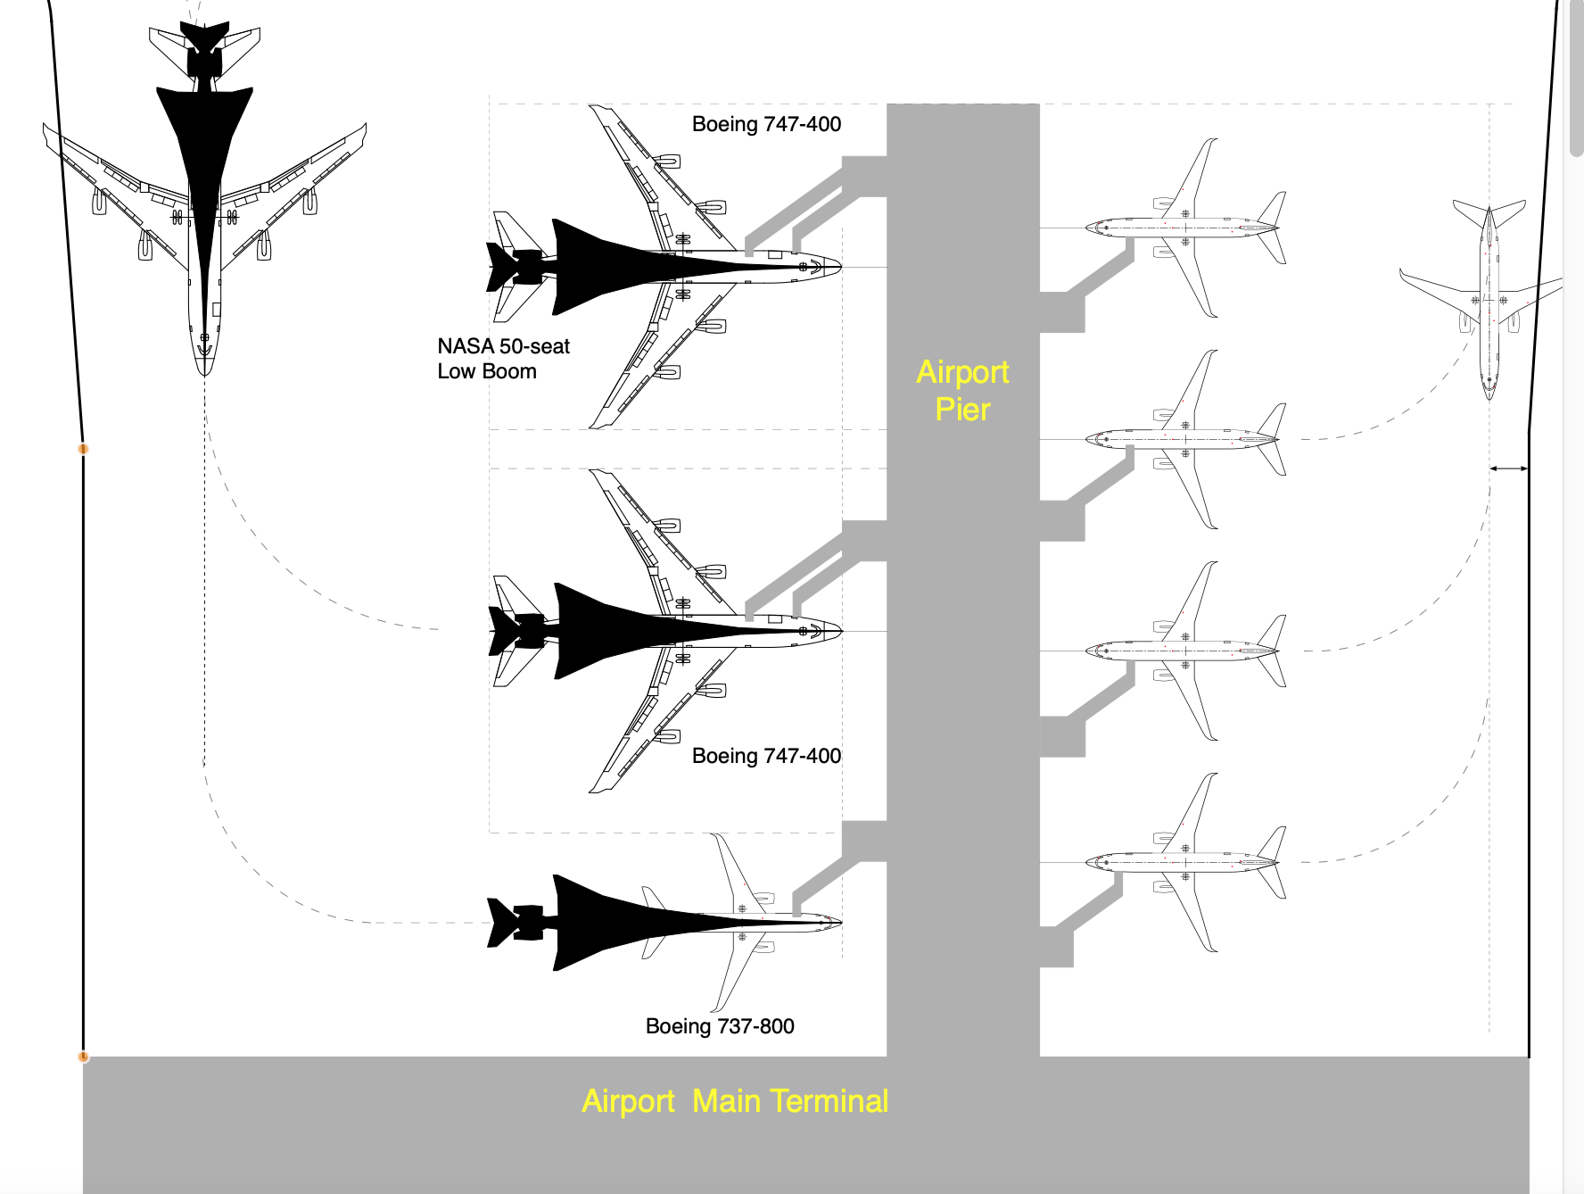
Airport Compatibility Impacts
LBSAM OD airport pair candidates includes checks for runway length and gate size compatibility

Slide 19
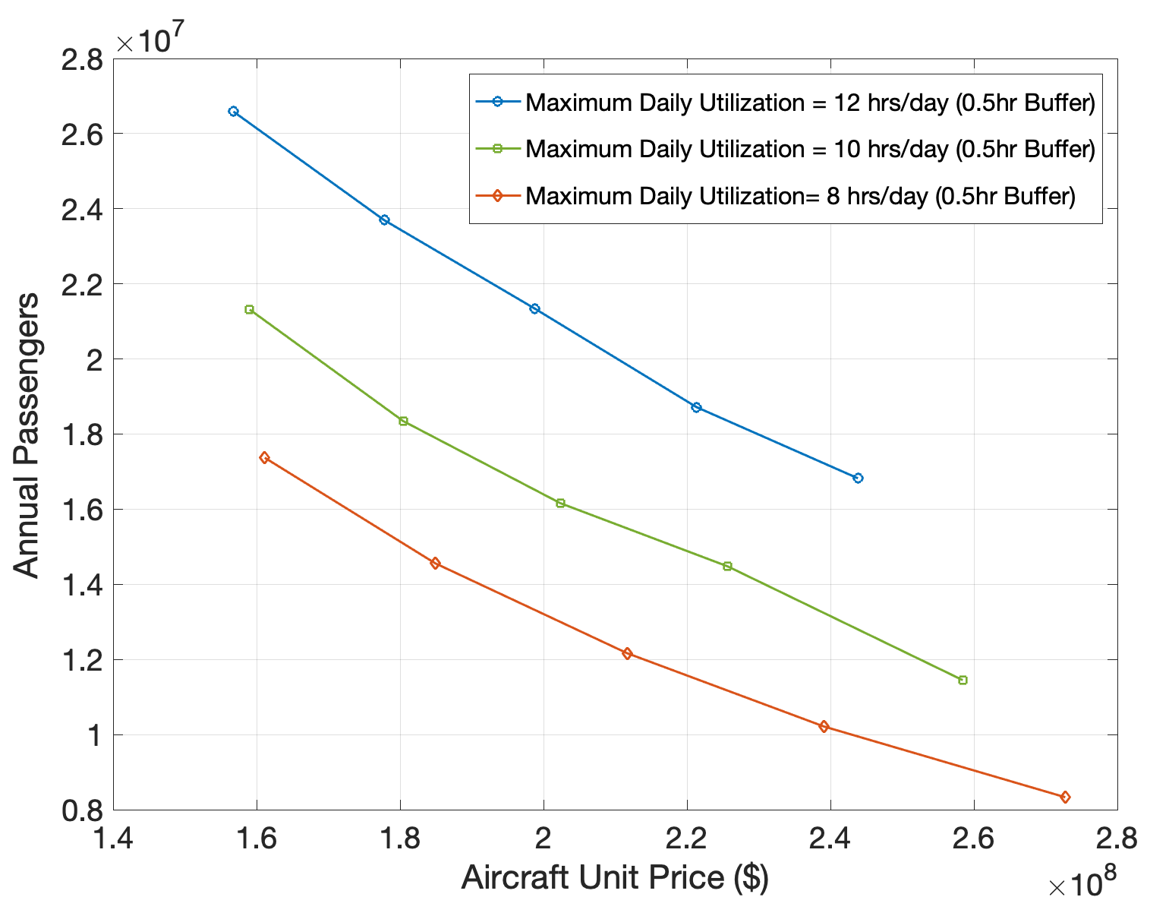
A 10% increase in Aircraft Unit Price Decreases Worldwide Passenger Demand by 7.5%
Aircraft development cost is critical to a feasible supersonic aircraft program
The elasticity of annual passenger demand with aircraft units cost is -0.75
A 10% increase in aircraft unit price decreases worldwide demand by 7.5%
Value of Time = $200/hr
Value of Comfort = $1.4/inch/hr
Fuel cost = $3.50 per gallon

Slide 20
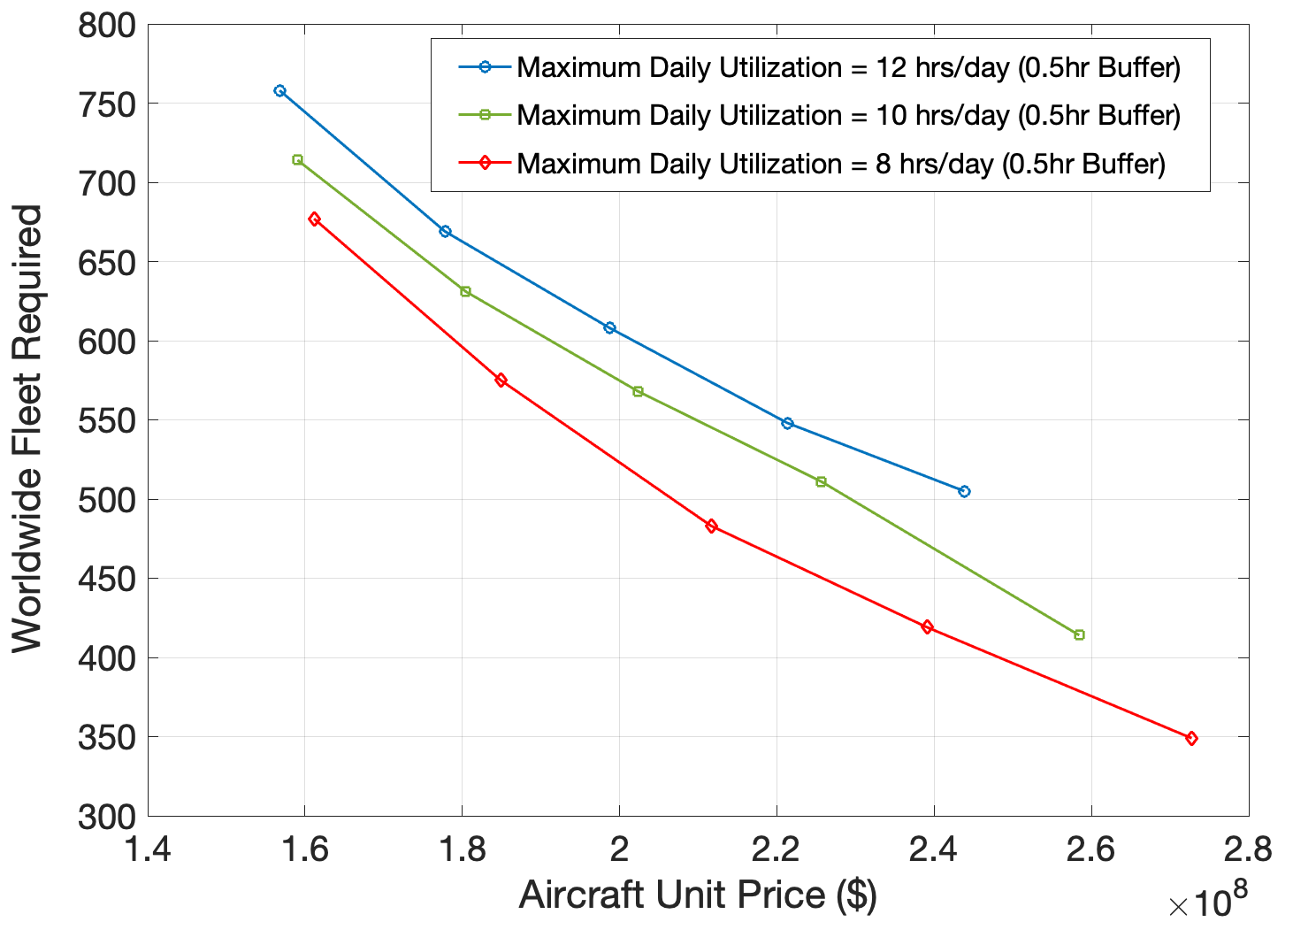
A 10% increase in Aircraft Unit Price Decreases the Number of Aircraft Needed by 11%
Aircraft development cost is critical to attracting supersonic demand
The elasticity of aircraft fleet size with aircraft unit cost is -1.1
A 10% increase in aircraft unit price decreases the number of aircraft demand by 11%
Value of Time = $200/hr
Value of Comfort = $1.4/inch/hr
Fuel cost = $3.50 per gallon

Slide 21
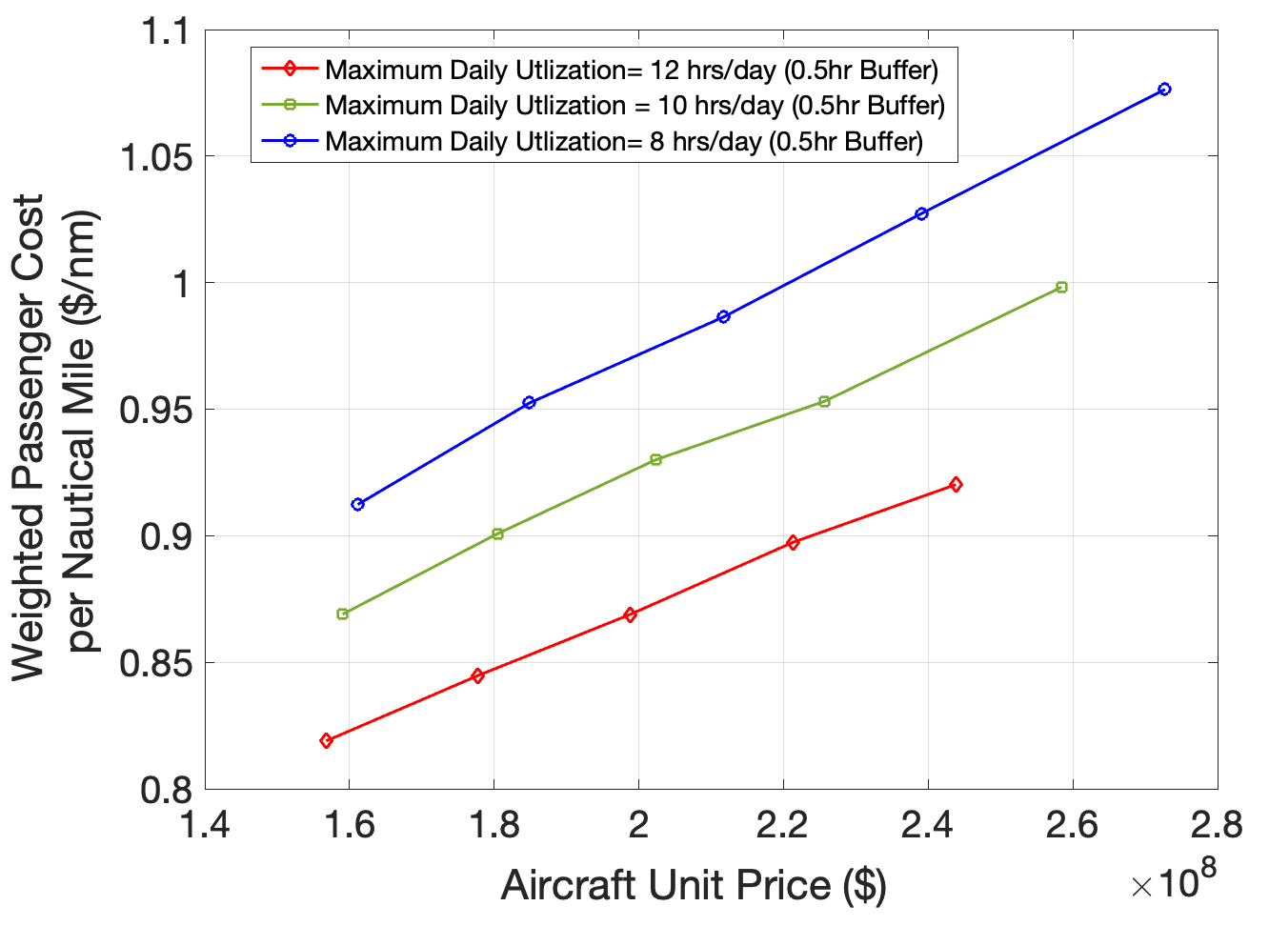
Relationship Between Aircraft Unit Price and Weighted Cost per Passenger Mile
Supersonic passenger demand if very sensitive to price
The percent of passengers paying premium fares is nonlinear with air fare
Value of Time = $200/hr
Value of Comfort = $1.4/inch/hr
Fuel cost = $3.50 per gallon

Slide 22
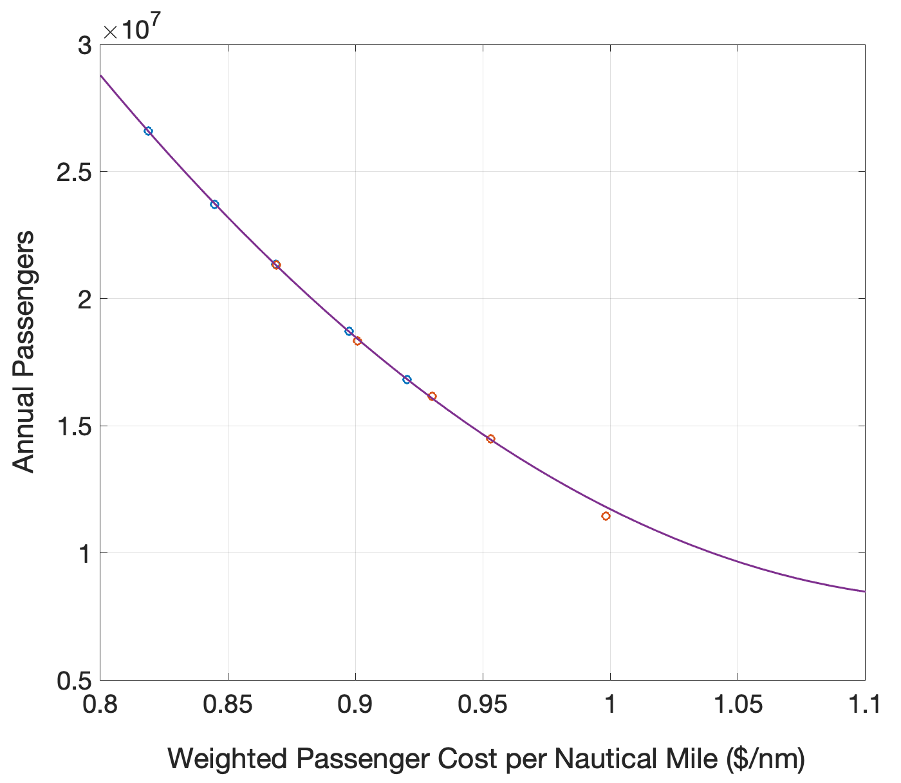
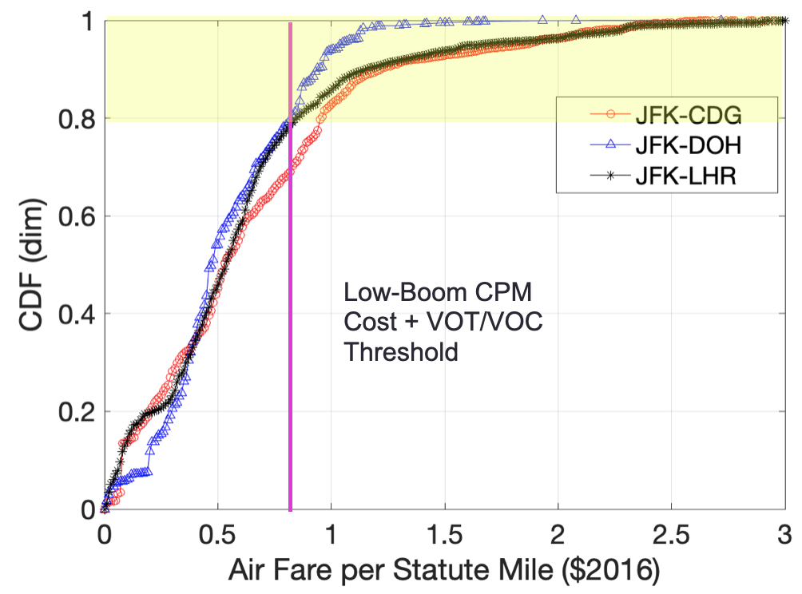
A 10% increase in Cost per Passenger Mile Decreases the Worldwide Demand by 31%
Supersonic aircraft passenger demand if very sensitive to price (Cost per passenger Mile)
The percent of passengers paying premium fares decreases very rapidly at high air fares
Value of Time = $200/hr
Value of Comfort = $1.4/inch/hr
Fuel cost = $3.50 per gallon

Slide 23
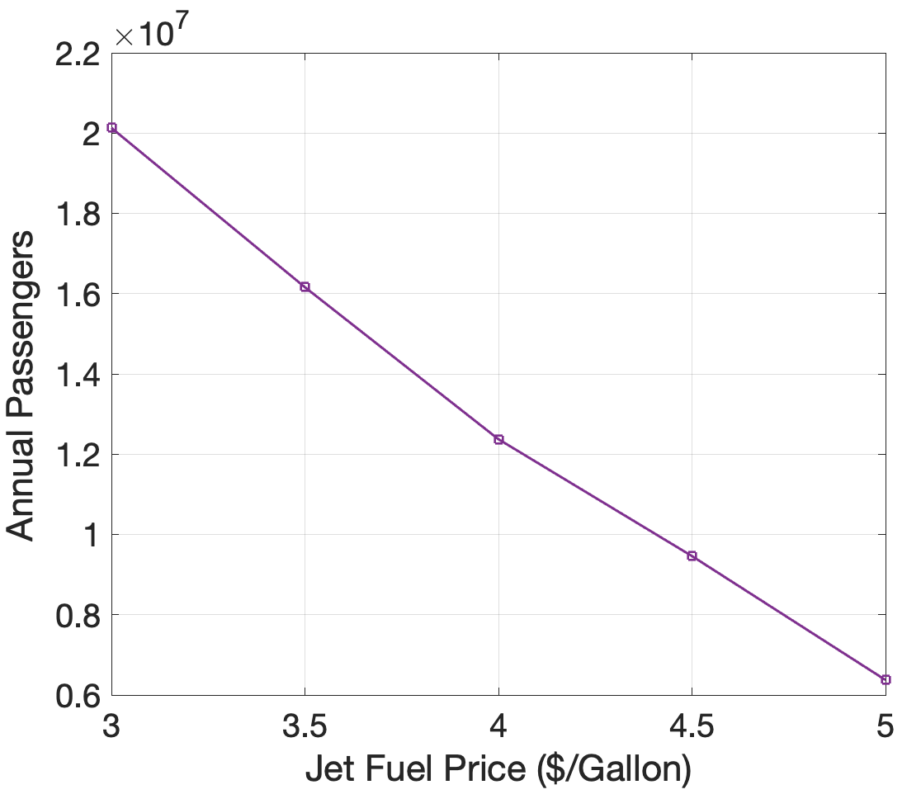
A 10% Increase in Jet-A Fuel Price Decreases the Worldwide Passenger Demand by 10.3%
Fuel price is a very important parameter in the model to produce an economically feasible low-boom program
The elasticity of aircraft fleet size with jet fuel cost is -1.03
A 10% increase in jet-A fuel price decreases the number of aircraft demand by 10.3%
Value of Time = $200/hr
Value of Comfort = $1.4/inch/hr
Maximum Daily Utilization = 10 hrs
with 1/2 hour buffer

Slide 24
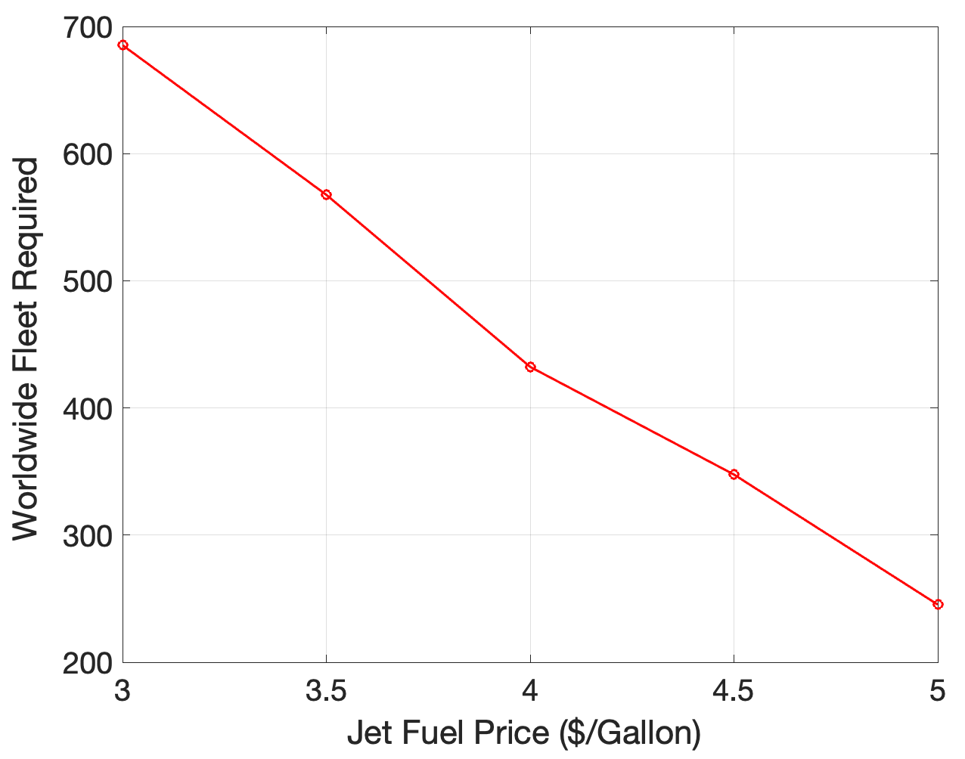
A 10% Increase in Jet-A Fuel Price Decreases the Number of Aircraft Needed by 10.6%
Fuel price is a very important parameter in the model to produce an economically feasible low-boom program
The elasticity of aircraft fleet size with jet fuel cost is -1.06
A 10% increase in jet-A fuel price decreases the number of aircraft demand by 10.6%
Value of Time = $200/hr
Value of Comfort = $1.4/inch/hr
Maximum Daily Utilization = 10 hrs
with 1/2 hour buffer

Slide 25
Conclusions
The enhanced LBSAM models offers an integrated approach to study worldwide demand for supersonic aircraft concepts
  Model includes network effects and captures the dynamics between fleet size, aircraft unit cost, aircraft economics, and passenger preference
Model runs converge (demand-supply) in 5-12 iterations (2-4 hours of CPU time)
Using optimistic parameters in the model development and aircraft operational cost, we estimate between 400-600 supersonic airframes may be needed in the year 2040
Under optimistic model assumptions (i.e., high daily utilization and moderate fuel prices), low-boom supersonic aircraft could transport between 16-22 million annual passengers in 2040
Faster supersonic aircraft concepts require re-examination of aircraft development cost equations and changes to the aircraft operations life cycle cost models

Slide 26
Backup Slides

Slide 27
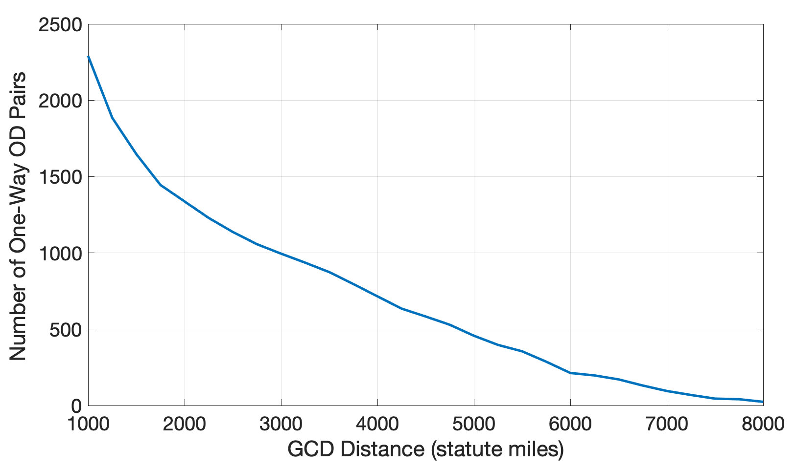
Distribution of Worldwide OD Pairs versus Distance
Questionable routes
for Low-Boom application
1000-1500 statute miles
Forecast of Premium Seats
Year 2040
Routes with > 20,000 premium seats
OAG 2016 Base Year
ICAO 2022 CAGR Values
1647 one-way routes

Slide 28
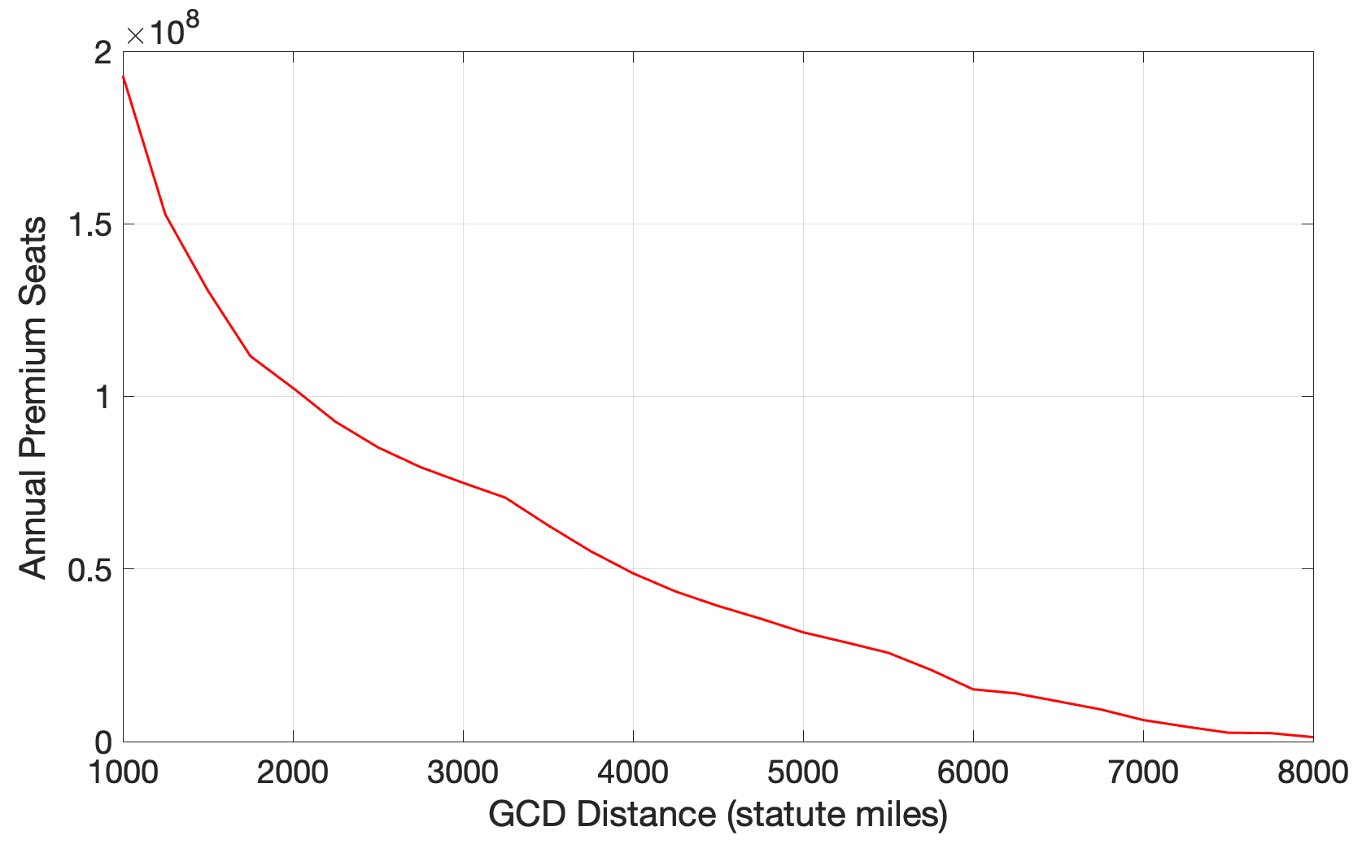
Distribution of Premium Seats versus Distance
Forecast of Premium Seats
Year 2040
Routes with > 20,000 premium seats
OAG 2016 Base Year
ICAO 2022 CAGR Values
Questionable routes
for Low-Boom application
1000-1500 statute miles
135 million
premium seats

Slide 29
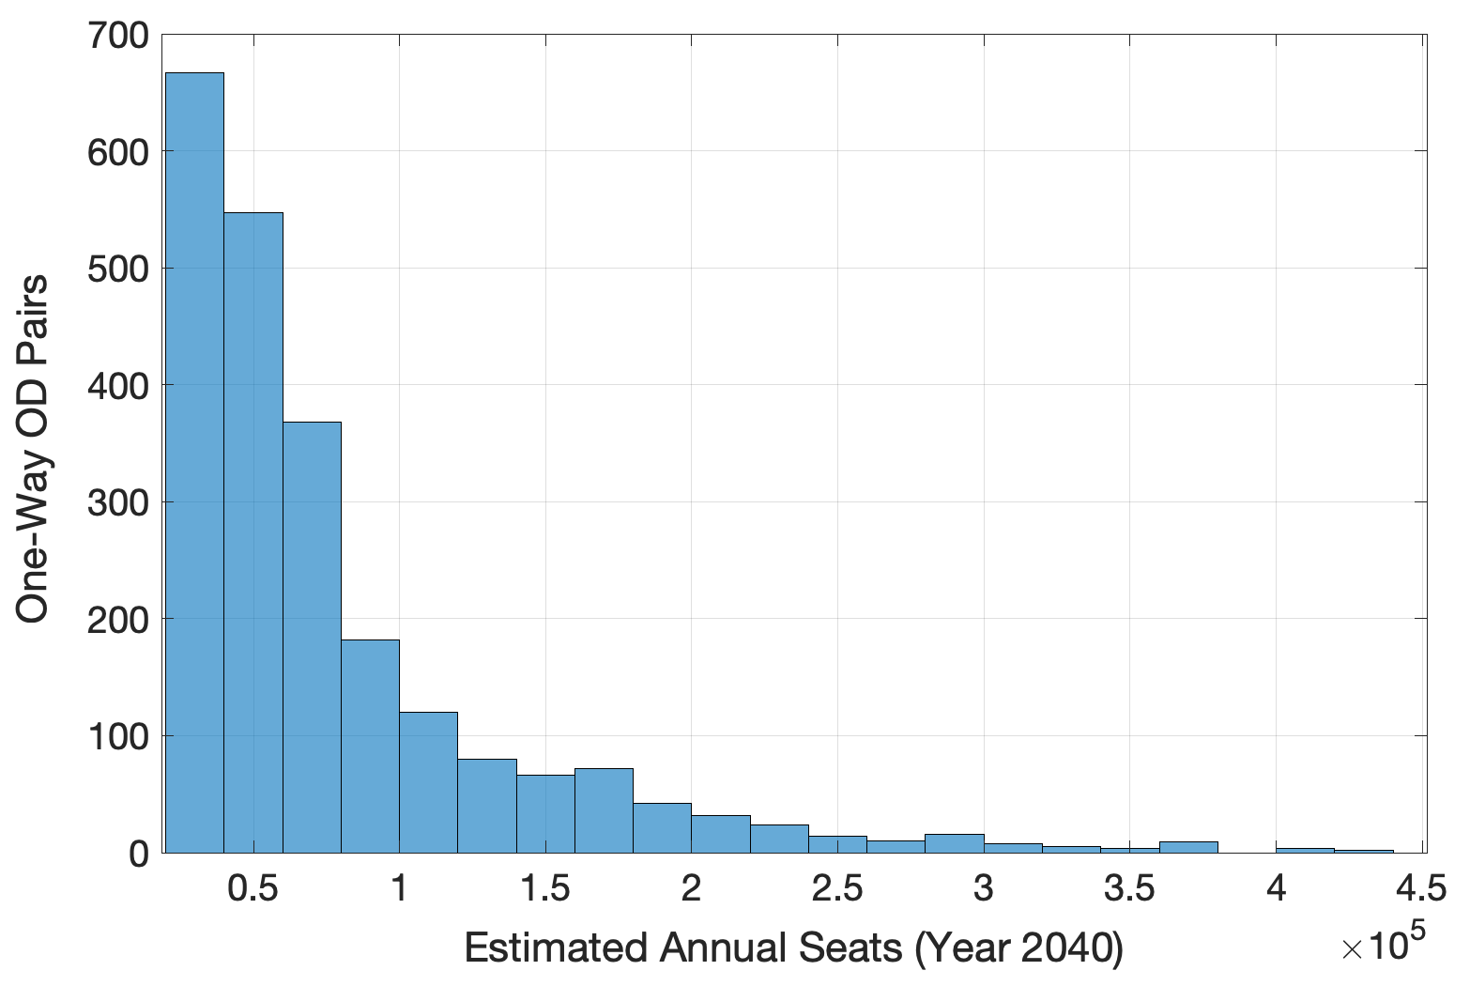
Distribution of OD Airport Pairs versus Distance
Forecast of Premium Seats
Year 2040
Routes with > 20,000 premium seats
OAG 2016 Base Year
ICAO 2022 CAGR Values

