Slide 1

SOTERIA Data Testbed Overview
Human Contributions to Safety
NASA’s System-Wide Safety Project
Presented by Jon Holbrook, PhD

Slide 2
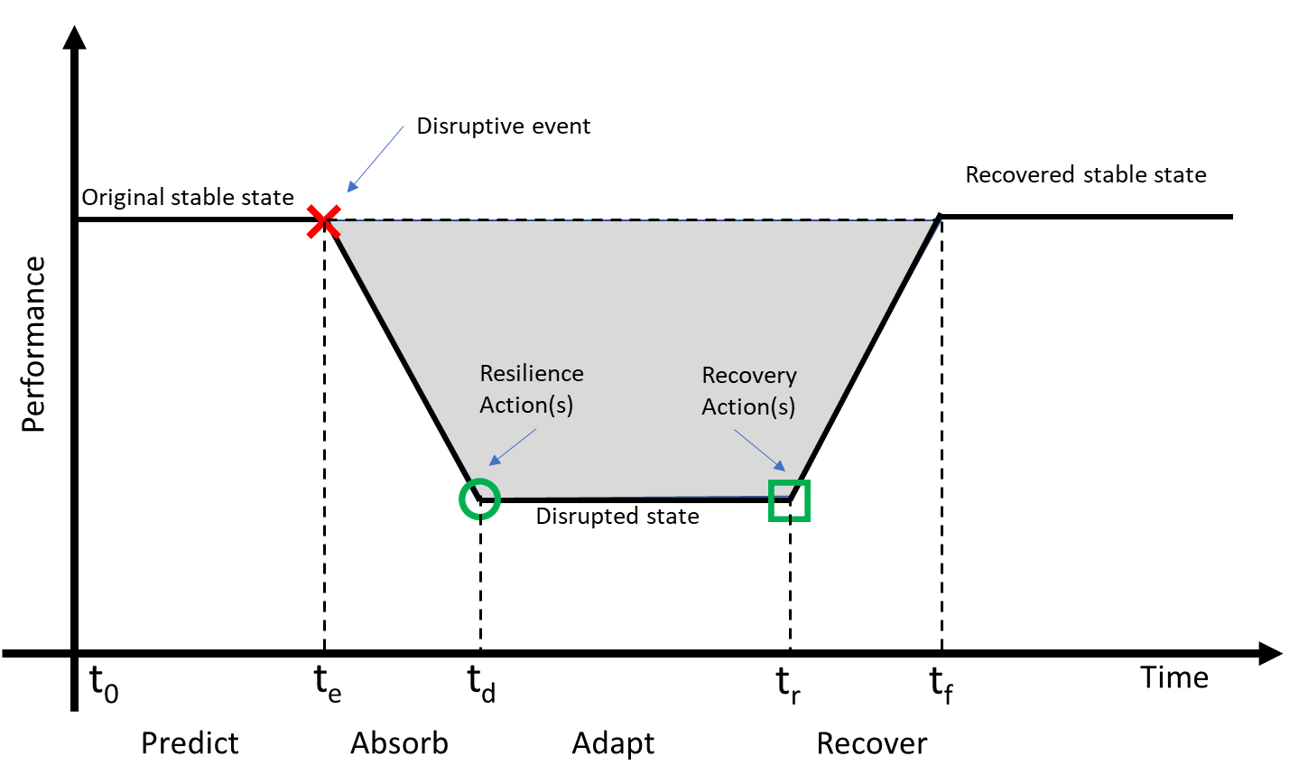
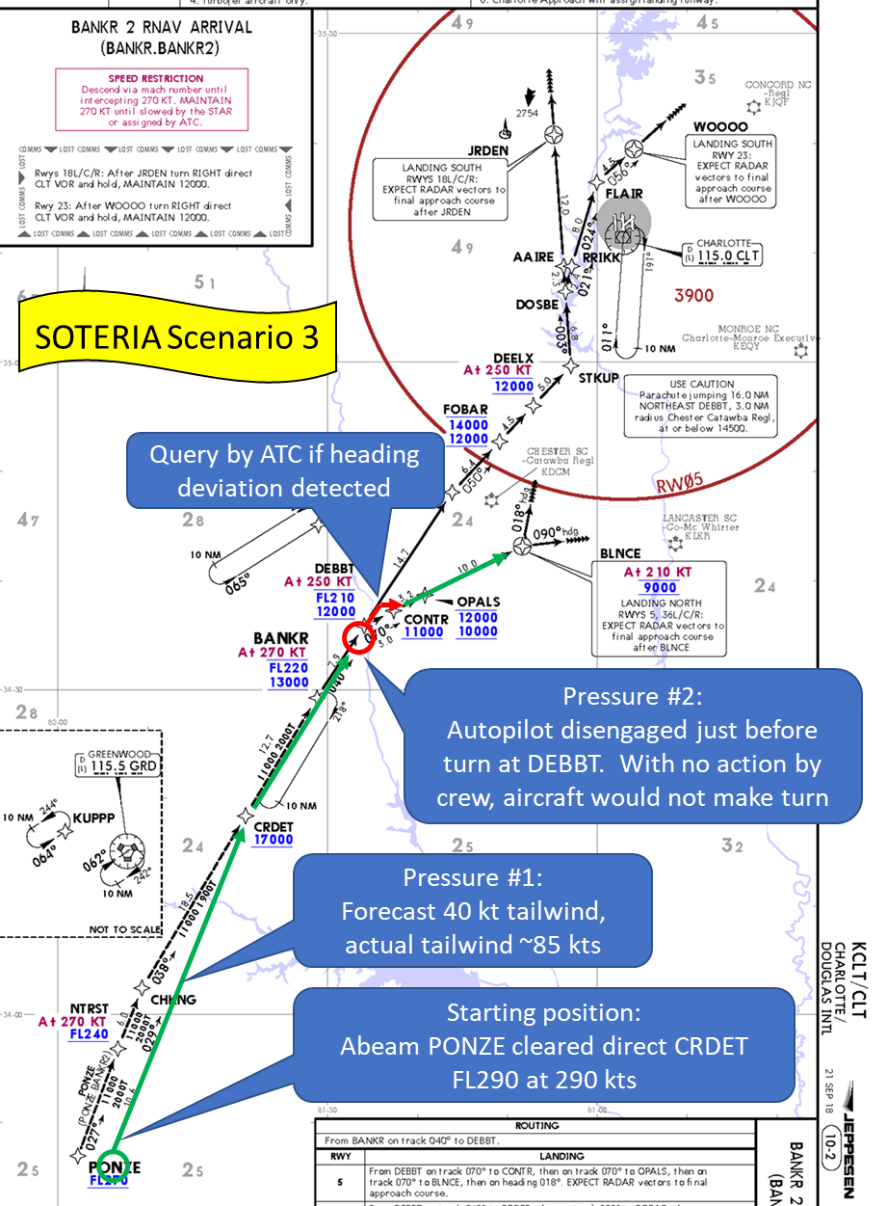
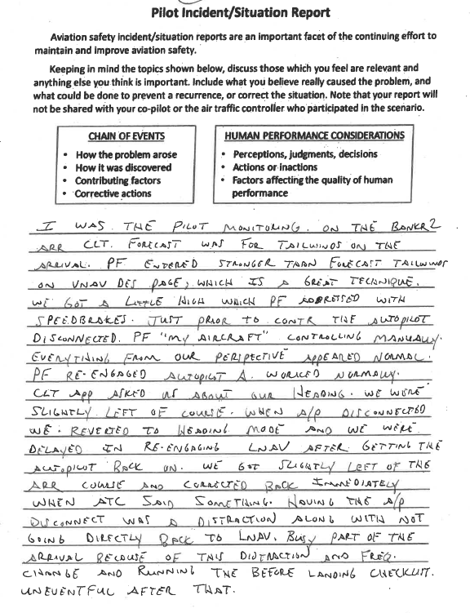
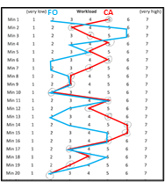
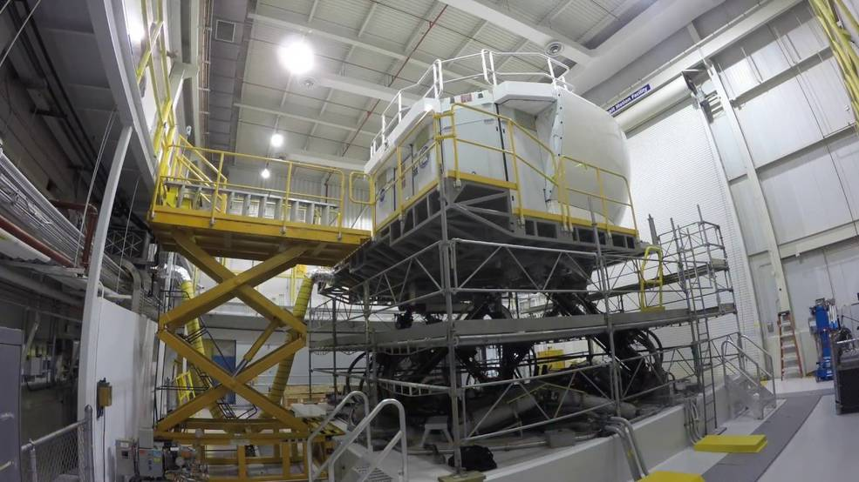
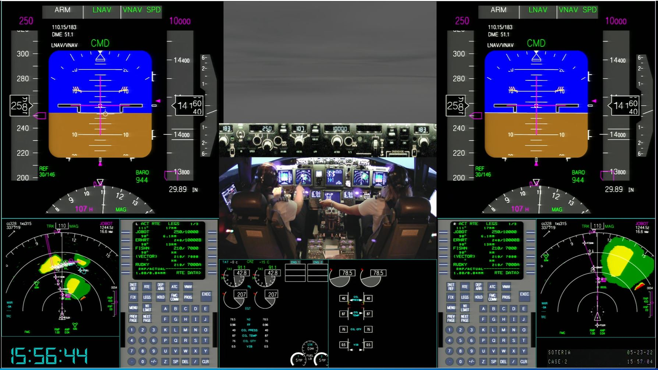
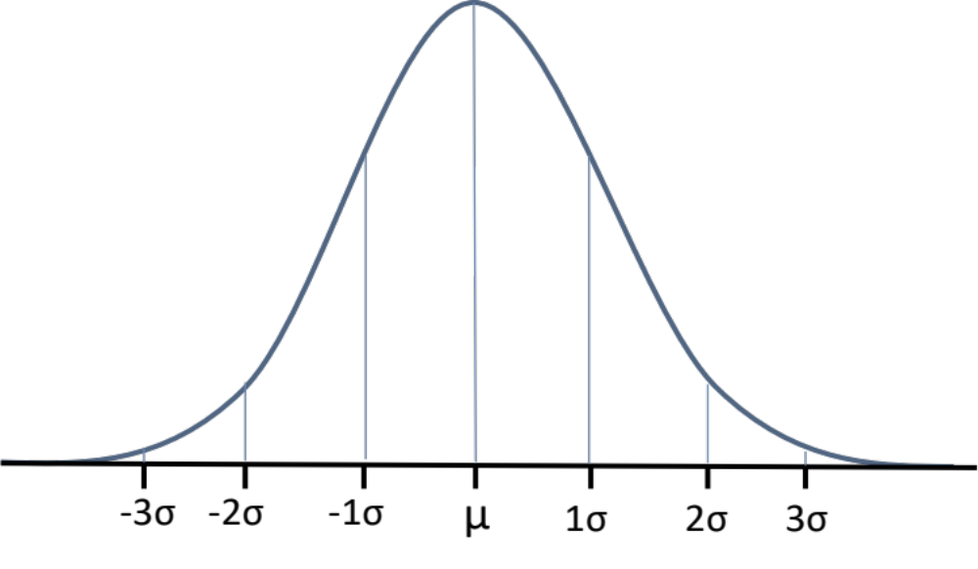
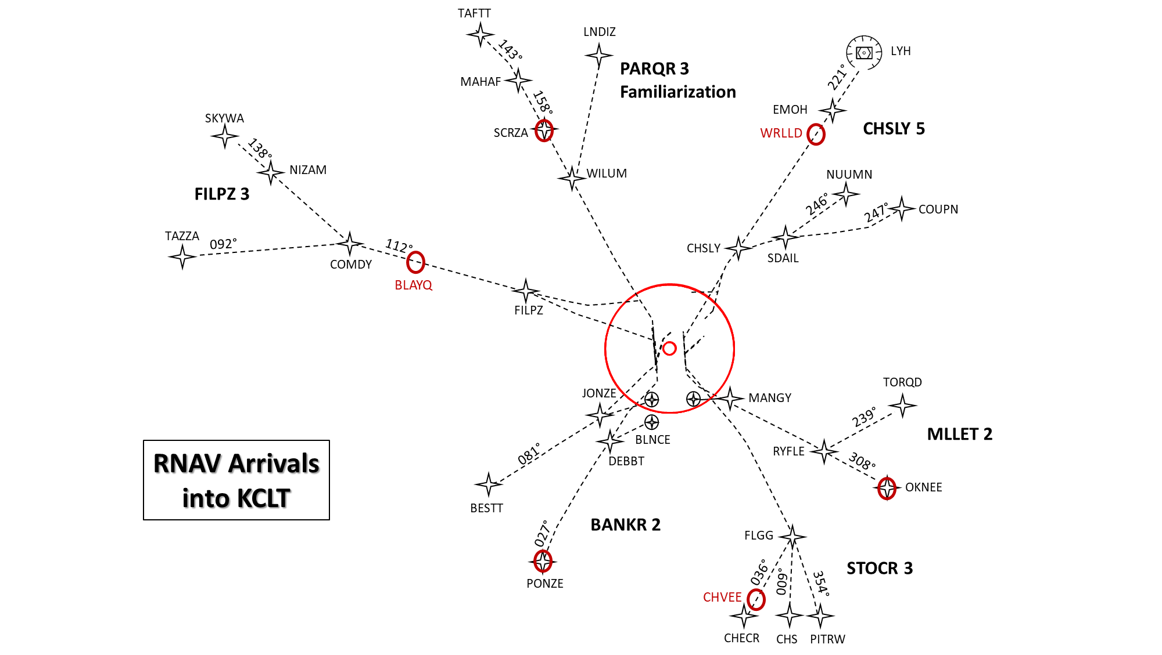
Measuring Human Contributions to
Safe and Successful Performance
Motivation and Objectives
Progress and Highlights
Address often-unrecognized gap in data collected about operator performance
  The majority of currently collected data focuses on rare safety failures, rather than frequent safety successes
  Can lead to “data driven” policy & design risks due to sampling bias; rare failures are not representative of human performance
Explored using commercial aviation flight deck due to maturity of simulation capabilities and proliferation of safety data collected in this operational domain
  Principles & metrics for assessment could be generalized to any safety-critical domain, including emerging operations
Created a data testbed for identifying approaches for measuring the actions and strategies that operators use to successfully anticipate, monitor for, respond to, and learn from events in their environment
Approach
Impact
13 B737 flight crews took part in a 1.5-day study at Langley’s Integration Flight Deck (IFD), using a high-fidelity B737 motion-base simulator
Participating flight crews flew a series of eight 20-minute scenarios based on arrivals into Charlotte Airport. Each scenario was designed to contain at least 2 manageable “threats” for crews to experience
Enable assessment of methods for learning from what happens, not just from what fails
Potential to massively expand the pool of safety-relevant data, which will enhance the ability to be “in time” and reduce risk of sampling bias
Focus of traditional safety learning
For more information, contact:
Jon Holbrook, PhD
NASA Langley Res Ctr
jon.holbrook@nasa.gov
757-864-9275
Untapped Potential

Slide 3
How to “change the narrative…”
… that humans are the safety problem
COMMUNICATION
What we convey with words
What we convey with policy and system design decisions
In today’s aerospace industry, data talks
To change the narrative, we need new data and new ways to examine data
IMPACT
System design, organizational awareness, operational learning/training
Most importantly: System safety that is robust to future changes

Slide 4
What is SOTERIA?
In Greek mythology, Soteria was the goddess of safety and salvation, deliverance, and preservation from harm
SOTERIA: System-wide Safety Operations and Technologies for Enabling Resilient In-Time Assurance
A simulation activity recently undertaken by NASA’s HC2S team under the System-Wide Safety (SWS) Project
SWS Project focus: Transformational changes in aviation to make flight more efficient and accessible will require new technologies, policies, and procedures. Enabling these changes to be done safely at every step is the goal of the SWS project.
HC2S Team focus: People represent the primary source of safety in aviation, through their capability to anticipate, monitor for, respond to, and learn from expected and unexpected change. Understanding and measuring this capability so that it can be integrated into the design of technologies, policies, and procedures is the goal of the HC2S team.

Slide 5
Introductions
NASA’s Human Contributions to Safety (HC2S) team
  Ms. Kathryn Ballard
  Mr. Barth Baron
  Dr. Immanuel Barshi
  Dr. Dorrit Billman
  Ms. Jolene Feldman
  Dr. Alan Hobbs
  Dr. Jon Holbrook
  Capt. Dan Kiggins
  Dr. Joel Lachter
  Mr. Bryan Matthews
  Dr. Randy Mumaw
  Dr. Lance Prinzel
  Mr. Chad Stephens
  Mr. Michael Stewart

Slide 6
Briefing on the NASA SOTERIA data testbed

Slide 7
Goal of SOTERIA
How can we measure human contributions to safe/successful performance?
Create a data testbed to enable exploration of methods and metrics for pilot contributions to safety and mission success.
Why needed?
Untapped Potential
  “Exceptional” events are non-representative
  Infrequent events → infrequent learning
  Access to operational data for research purposes is challenging
  Limited access to “ground truth”
  Limited access to multiple data types for the same events
Focus of traditional safety learning

Slide 8
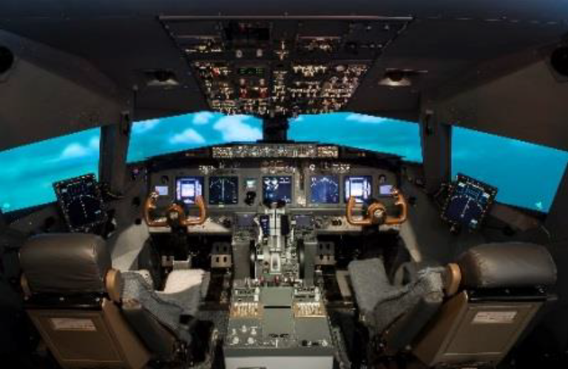
SOTERIA Operational Concept
How do pilots respond to expected and unexpected disturbances during RNAV arrivals?
Using NASA Langley’s Integrated Flight Deck (IFD) simulator, 12 crews (12 CAs paired with 12 FOs) of Boeing 737NG rated pilots from American Airlines performed multiple RNAV STAR arrivals into Charlotte Douglas International Airport (KCLT)
Scenarios were designed to include a range of challenging but manageable disturbances
  Identified / inspired by pilot interviews and reviews of ASRS reports
Goal was to create an environment realistic enough to leverage expertise and flexible enough to enable a range of possible behaviors

Slide 9
SOTERIA Scenarios
PARQR3 (Familiarization)
CHSLY5 (Energy mgmt, traffic congestion)
FILPZ3 (Convective weather)
BANKR2 (Unanticipated tailwind, autoflight failure)
MLLET2 (Wake encounter, TR Unit failure)
STOCR3 (High workload event, rwy change)

Slide 10

TAFTT
LNDIZ
143°
LYH
PARQR 3
Familiarization
221°
MAHAF
158°
EMOH
SKYWA
CHSLY 5
SCRZA
WRLLD
138°
NIZAM
WILUM
NUUMN
FILPZ 3
246°
247°
COUPN
TAZZA
092°
112°
CHSLY
COMDY
SDAIL
BLAYQ
FILPZ
JONZE
TORQD
MANGY
239°
BLNCE
MLLET 2
RNAV Arrivals
into KCLT
081°
DEBBT
RYFLE
308°
OKNEE
BESTT
BANKR 2
027°
FLGG
036°
STOCR 3
PONZE
009°
354°
CHVEE
CHECR
CHS
PITRW

Slide 11
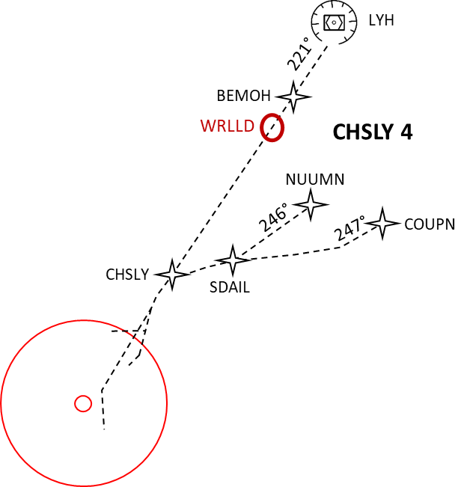
CHSLY5 (Energy Mgmt, Traffic Congestion)
Start:
WRLLD FL320 at 280 KT
With ATL CTR, a few minutes prior to top of descent
Landing SOUTH, expecting RWY 23
Primary Challenges:
ATC gives significant profile changes: “Given lots of changes from profile: maintain speed, speed up, slow down; heading from fix, then modified again; given climb for traffic, etc. (1444706)”
CHSLY 5

Slide 12
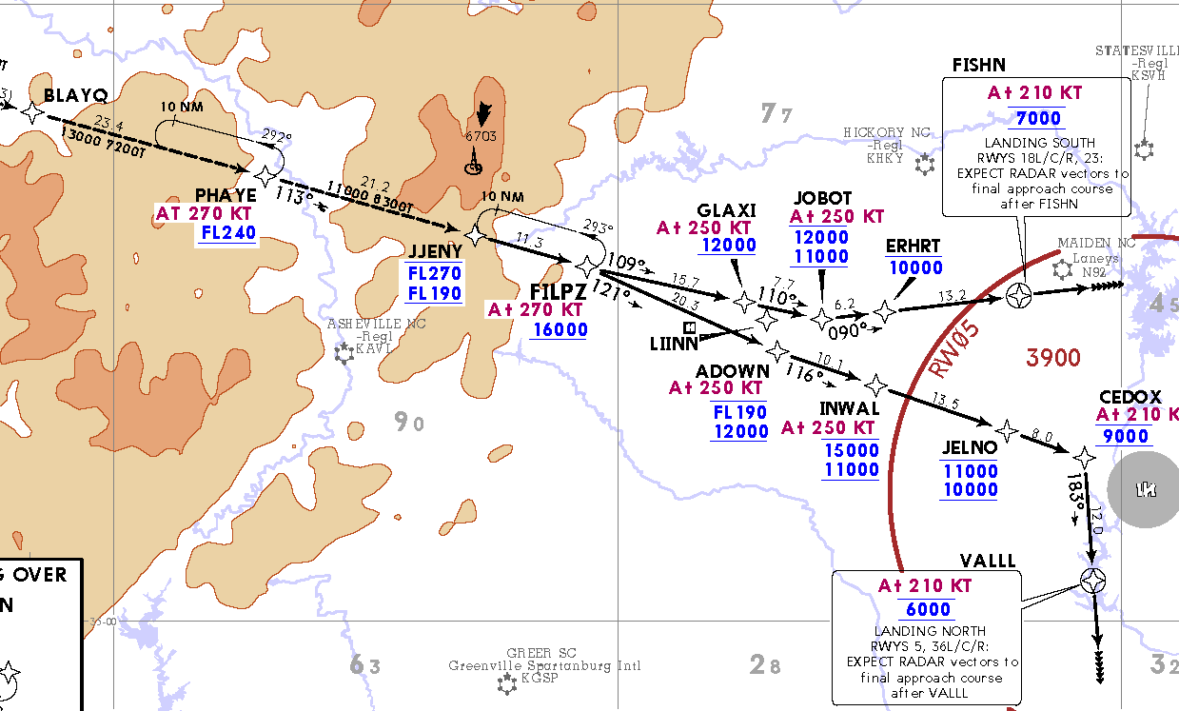
FILPZ3 (Convective weather)*
Start:
BLAYQ FL330 at 270 KT
With ATL CTR, a few minutes prior to top of descent
Landing SOUTH, expecting RWY 18R
NOTAM: Convective activity near or along your route of flight
Primary Challenges:
Dynamically evolving weather
Hear other aircraft deviating L/R of course
Cell over final approach fix
Microburst alert at the field
FA reports passenger barricaded themselves in aft lavatory
Hearing other aircraft deviating L/R of course for WX
ATC reports microburst alert at KCLT
* This scenario used for retrospective think-aloud

Slide 13
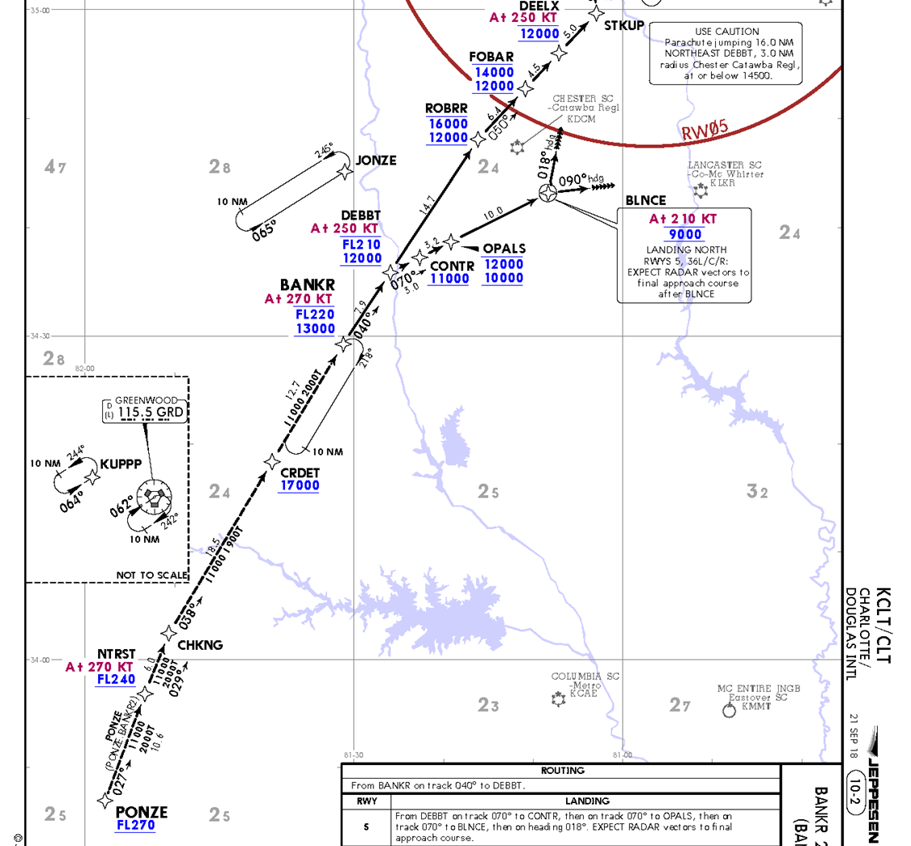
BANKR2 – Unanticipated tailwind, autoflight failure*
Start:
Abeam PONZE cleared direct CRDET
FL290 at 290 KT
With ATL CTR, a few minutes prior to top of descent
Landing NORTH, expecting RWY 36L
NOTAM: Quartering tailwind at 40 KT
Primary Challenges:
Tailwind significantly stronger than forecast
Autopilot disengaged just before turn at DEBBT
Query by ATC if heading deviation detected
Pressure #2:
Autopilot disengaged just before turn at DEBBT. With no action by crew, aircraft would not make turn
Pressure #1:
Forecast 40 kt tailwind,
actual tailwind ~85 kts
Starting position:
Abeam PONZE cleared direct CRDET
FL290 at 290 kts
* This scenario used for event report narratives

Slide 14
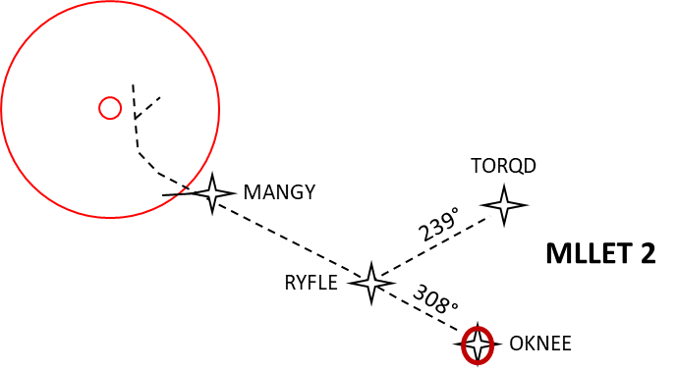
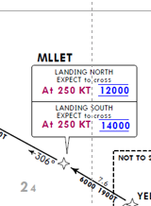
MLLET2 – Wake encounter, TR Unit failure
Start:
OKNEE FL220 at 320 KT
With JAX CTR, a few minutes prior to top of descent
Landing SOUTH, expecting RWY 18R
Primary Challenges:
Behind a heavy, given some mild wake periodically, followed by significant wake encounter that kicks of A/P
TR Unit light illuminates; crew needs to run the checklist and think through implications
ATC issues incorrect clearance (down to 12000 rather than 14000)

Slide 15
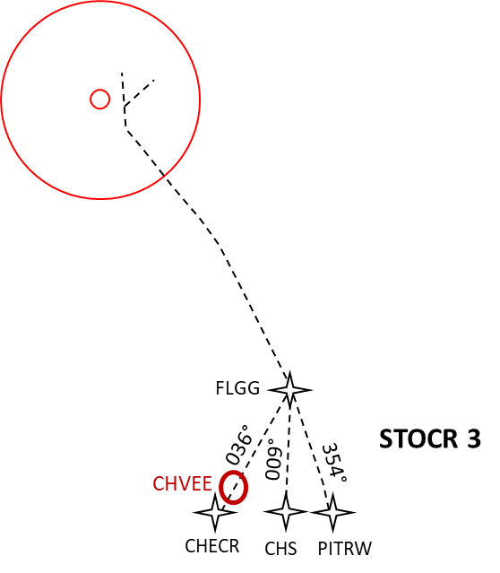
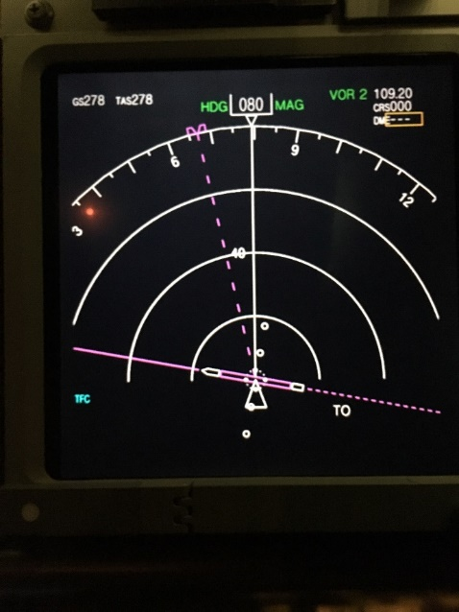
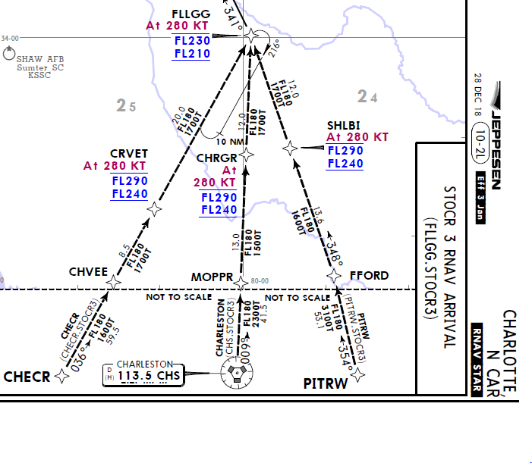
STOCR3 – High workload event, airport flip
Start:
CHVEE FL260 at 280 KT
With JAX CTR, a few minutes prior to top of descent
Landing SOUTH, expecting RWY 18L
Primary Challenges:
ATC requests intercept and fly outbound radial off CHS VOR
Airport flip, so now arriving RWY 36L, crew must re-brief approach with compressed time

Slide 16
What is in the SOTERIA Data Testbed?
System-based data
  (Simulated) flight data (“FOQA”)
  Psychophysiological measures
    Eye/gaze tracking
    Electroencephalography (EEG)
    Electrocardiography (ECG)
    Heart rate variability
Observer-based data
  “Over the shoulder” video recordings to enable post-hoc expert observation (“LOSA” / “LIT”)
Self-report data
  Demographics survey
  System resilience potential assessment
  Subjective workload
  Subjective situation awareness
  Resilient performance self-assessment
    Galvanic skin response
    Skin temperature
    Accelerometry
  Resilient performance surveys
  Event narratives (“ASAP”)
  Cued retrospective think-aloud

Slide 17
Procedure
Day 1
Day 2
Later
SOTERIA
BOEING
Cued ASRS report
Cued retrospective think-aloud
Cued minute-by-minute workload rating
LOSA/LIT
Compute Resilient Performance Profile
S0
S1
S2
S3
S4
S5
B1/B2
Pre-Study
During-Run
Post-Run
Post-Study
Demographics
System Resilience Potential scale
Resilient Performance Survey 1
Sim data
Eye-tracking
EEG
Heart rate
OTS video
TLX
SART
Resilient Performance Self Assessment
Resilient Performance Survey 2

Slide 18
Pre-Study Data Collection
Demographics
System Resilient Potential Scale
Resilient Performance Survey #1*
* Will discuss later, with Resilient Performance Survey #2

Slide 19
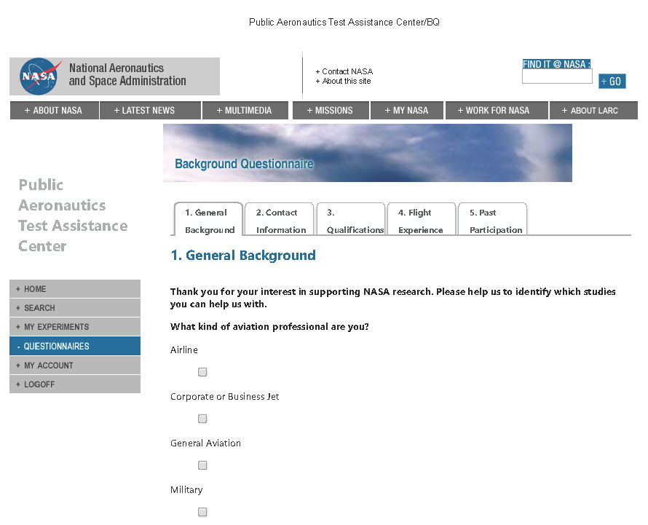
Demographics
General Background
Contact Information
Qualifications
Flight Experience
Past Participation
https://flight-research.larc.nasa.gov

Slide 20
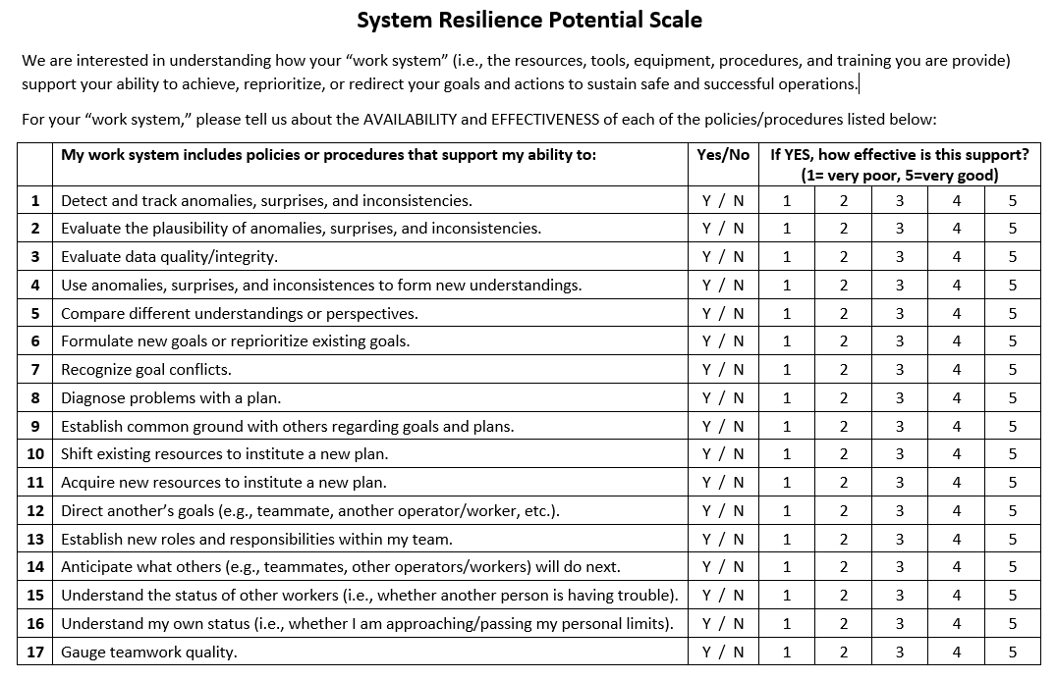
System Resilience Potential scale
Derived from Hoffman & Hancock (2017)

Slide 21
During-Run Data Collection
Simulated Flight Data
Psychophysiological Data
Over-the-Shoulder Video
Notes:
TLX
SART
RPSA

Slide 22
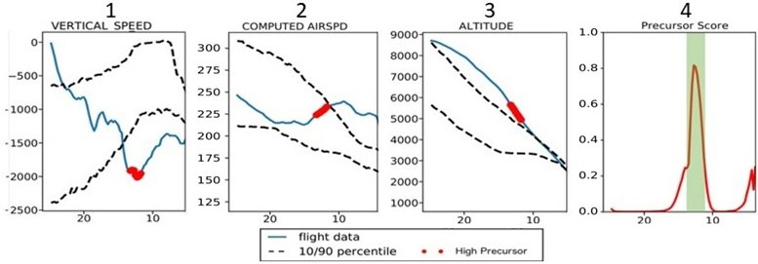
Simulated flight data (“FOQA” Parameters)
Roll Angle
Latitude
Longitude
Altitude
Corrected AOA
Pitch Angle
APPR SPD TARGET
COMPUTED AIRSPD
N1 ACTUAL (LOW ROTOR SPD)
N2 ACTUAL (HGH ROTOR SPD)
PFD SELECTD SPEED
DRIFT ANGLE
YAW
WIND SPD
A/P HEADING MODE
A/P NAV MODE
A/P RUNWAY MODE
A/P LOC MODE
A/P TRACK
A/P APROACH
A/P ALT MODE
A/P VERT SPD MODE
A/P GS MODE
A/P CLIMB
A/P DECEND
AP1 ENGAGD
AP2 ENGAGD
FD1 ENGAGD
FD2 ENGAGD
ATS ENGAGD
ATS ACTIVE
GEAR LEVER SELECTD DWN
FLAPS
SPD BRAKES

Slide 23

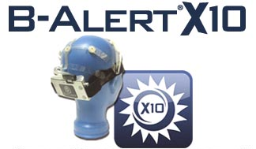
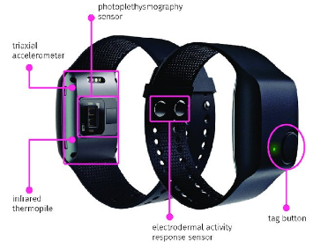
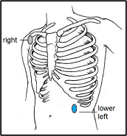
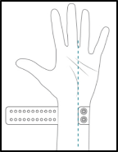
Psychophysiological data
Electroencephalography (EEG)
Electrocardiography (ECG)
https://www.advancedbrainmonitoring.com/products/b-alert-x10
Photoplethysmogram (PPG)
Galvanic Skin Response (GSR)
Peripheral Skin Temperature
3-axis Accelerometry for actigraphy measures
https://www.empatica.com/research/e4/
Head and Eye Tracking with a 5-camera SmartEye Pro system
https://smarteye.se/smart-eye-pro/
All psychophysiological data were synchronized and saved with the flight data from the 737-800 simulator, flight simulator cockpit voice recording, a scene camera video recording, and 6 simulated avionics displays with eyesDx MAPPS software (https://www.eyesdx.com/products/mapps/)

Slide 24
Over-the-shoulder video
Use videos to learn about/compare methods/frameworks for observation
  How do different frameworks impact insights? (e.g., TEM, LIT)
  Can we use videos to identify methods/strategies of identifying “important” observables (particularly a priori)?
  Identify changes (from expected); ways to classify unexpected; ways to classify how unexpected events are managed
Other things we can do with the videos…
  Conduct cued think-aloud with participants (did this)
  Conduct cued think-aloud with non-participant SMEs
  Can non-participant SME accurately identify what crews (reported they) were thinking?

Slide 25
Post-Run Data Collection
Workload (TLX)
Situational Awareness (SART)
Resilient Performance Self Assessment
Notes:
TLX
SART
RPSA

Slide 26
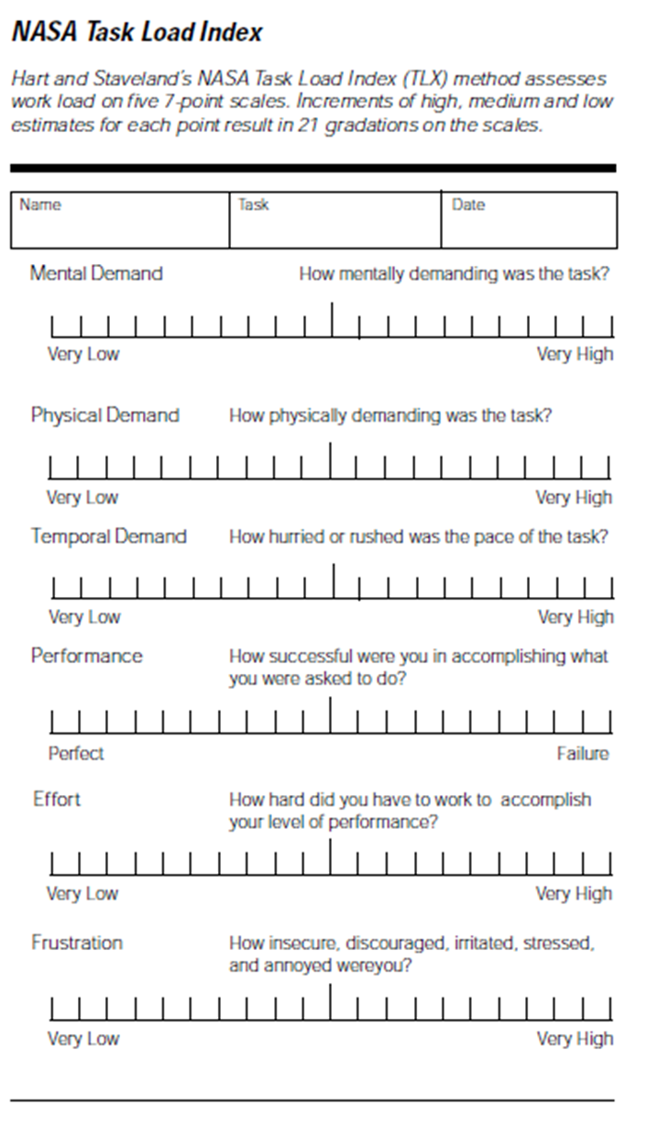
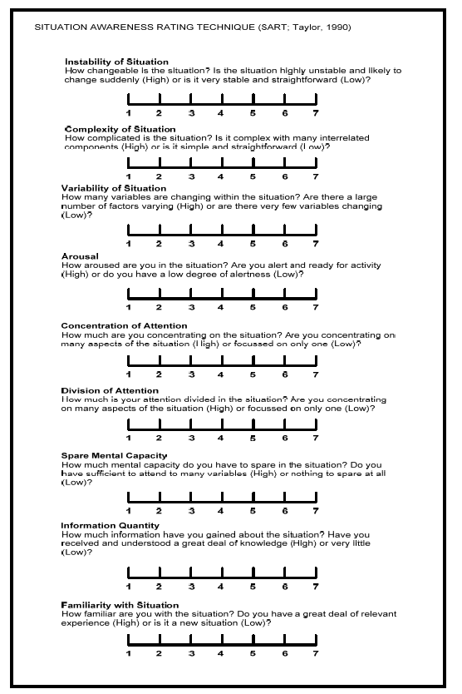
Perceived Workload
Perceived Situational Awareness

Slide 27
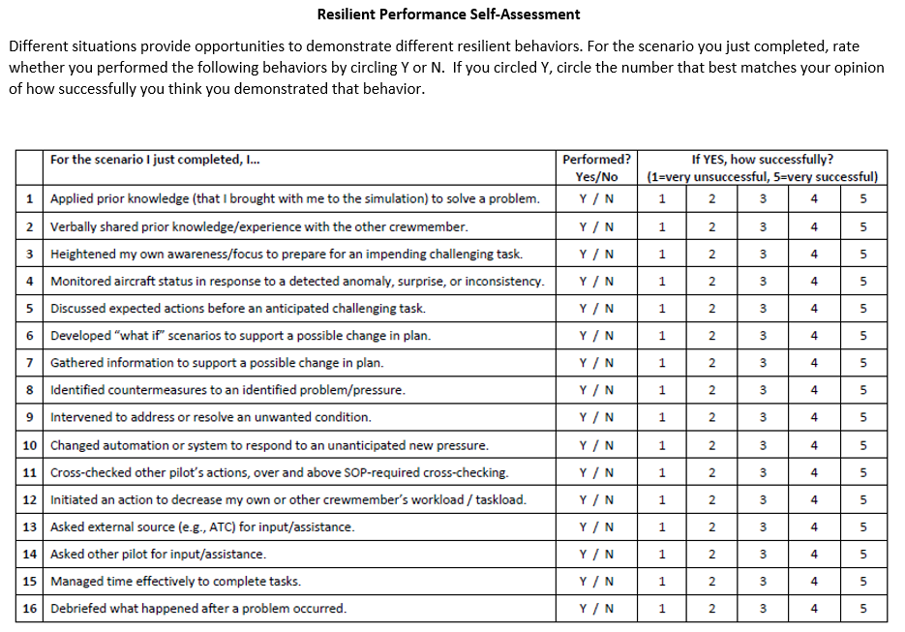
Resilient Performance Self-Assessment
Derived from AA LIT (2021)

Slide 28
Post-Study Data Collection
Event Report Narratives
Cued Retrospective Think-Aloud
Resilient Performance Survey #2

Slide 29
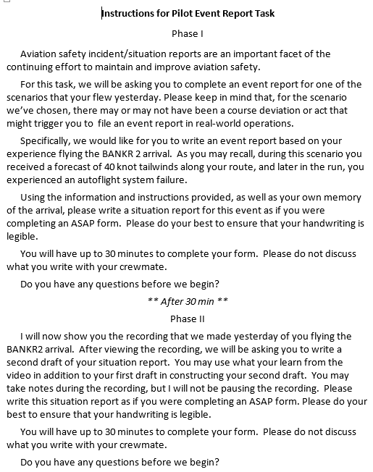
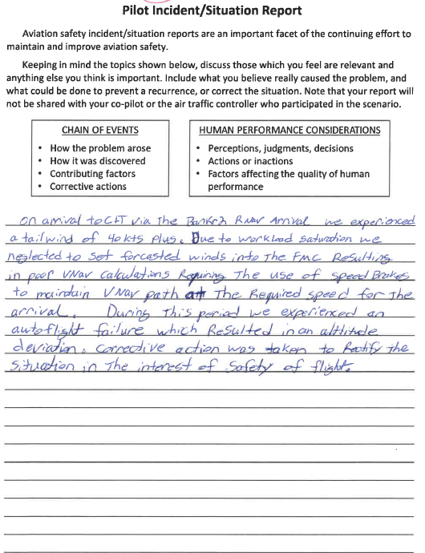
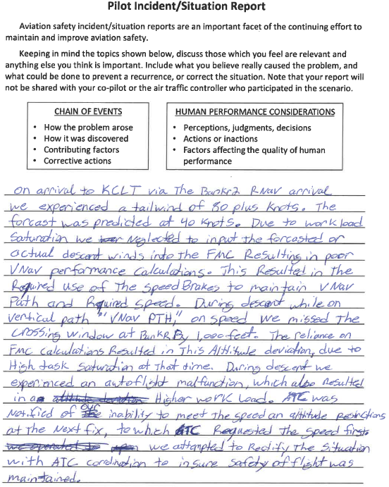
Event Report Narratives
Instructions
Draft 1
Draft 2

Slide 30
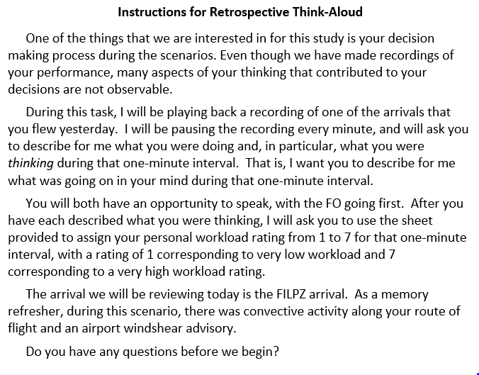
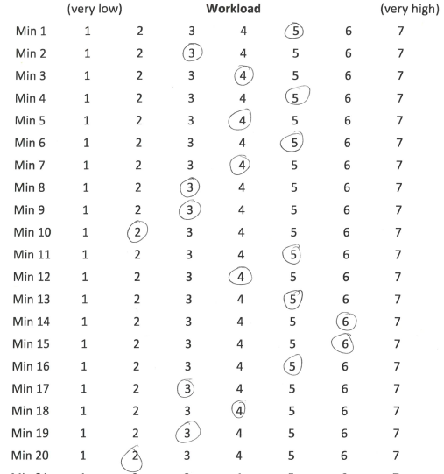
Cued Retrospective Think-Aloud
& Min x Min Workload Assessment
CA/PM (red) | FO/PF (blue)

Slide 31
Resilient Performance Survey
Organization
Flight Information, including challenge (5Q)
Preflight through Cruise (3 Q)
Descent Briefing and Arrival Phases (19 Q)
Approach and Landing (9 Q)
Overall Info-Seeking, Learning, and Assessments of Flight (8 Q)
Rating- Agreement and % time: CRM, monitoring, limits of autopilot (10 Q)
Career tip to share on monitoring (1Q)
Demographics (5 Q)
How does behavior of pilots contribute to resilience performance? Safety?
How can surveys help us understand this?
How to design a “useful” survey?
Resilient
Performance
SOTERIA
Survey
Methods

