Slide 1





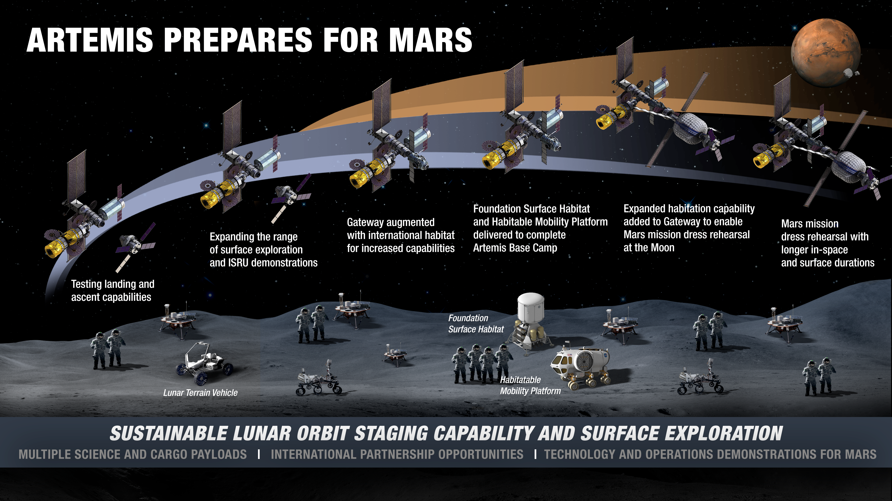
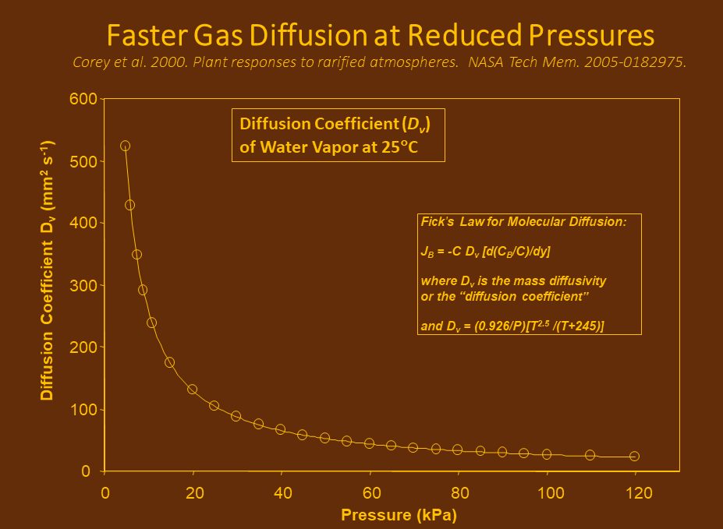
Reduced atmospheric pressures with altered compositions are new variables for deep space missions
Bruce M Link¹, Ralph Fritsche², Gioia D Massa², Raymond M Wheeler² , Charles D Quincy²
¹Southeastern Universities Research Association.; ²NASA, UB, Kennedy Space Center, FL
Abstract
Deep space missions to the Moon and Mars face challenging environments and require different testing and ground control facilities. Two novel factors are the increased radiation environment, and the reduced pressure/ altered atmospheres needed to facilitate extra-vehicular activity (EVA). Some vehicles under development have atmospheres in the range of 51 to 70 kPa with up to 40% oxygen, while the Mars Transit Vehicle will have earthlike compositions and pressures. In parallel to high altitude changes on Earth, reduced pressures impact biology by decreasing oxygen availability, increasing evaporation and leaf transpiration rates, and cause cooling effects on wet surfaces. In animals, studies show a relationship between altered gut microbiomes and pathologies at high altitudes. Plant microbiomes also vary by altitude, though the origins of the differences are difficult to determine. Early plant studies suffered from inadequate gas exchange in microgravity, and rooting systems continue to show signs of hypoxia. Elevated oxygen percentage may help or may be insufficient due to reduced pressures and requires further study.
On Earth, altitude is a potential proxy for the lower pressures (but not the increased oxygen levels) proposed for future space craft and habitats. A pressure of 70 kPa is equivalent to about 3050 m of altitude, similar to Leadville, Colorado. Soil microbiomes are highly affected by altitude, but the effects are difficult to separate from changes in soil type, pH, precipitation, and colder overall temperatures, nonetheless, altitude is a primary predictor of soil microbiome variations [4].
Deep space crop production requires an understanding of how the altered atmospheric pressure and compositions will impact crop growth, and these conditions are not found on Earth. Furthermore, it may be possible to optimize the atmospheric mixture for the crops separately from the crew compartment since they are usually grown in specialized hardware. For example, it would be relatively easy to control the pCO2 (concentration) at a higher or lower level. For safety and ease of operations the pressures of the growth chambers are typically kept the same as the crew compartment. Determining optimal conditions will require facilities for growing crops under high fidelity simulated conditions.
https://www.nasa.gov/sites/default/files/thumbnails/image/moon_2028_20200403.png
Key Variables for Ground Control Facilities
Figure 1. Representation of Artemis mission plans. Pressures in the circles: Foundation Surface Habitat (FSH) and the Habitable Mobility Platform (HMP) as well as the Human Landing System (HLS, not shown) are likely to be at reduced pressures with altered oxygen content to facilitate space walks. This is to reduce pre-breathing times before donning suits that operate at lower pressures of pure oxygen.
Conclusions
Reduced Pressure
Gas mixtures (especially oxygen)
Altered Gravity
Radiation
Oxygen availability is known to impact the microbiome communities, but studies need to be conducted at relevant pressures and atmospheric compositions.
Reduced pressures (hypobaria) can result in at least two stresses in plants: greater water loss (higher transpiration) and changes in gas exchange [1]. The increase in the diffusion coefficients combined with the reduced pressure leads water evaporation from the leaf surface to increase unless humidity is kept high to reduce this effect. Reduced pressures have long been used to increase storage times for fruits due to the increased diffusion of ethylene out of the plant tissue delaying fruit ripening. [2] The overall lower pressure can also reduce the concentrations of CO₂ and O₂ in the plant tissues. This has the potential to increase hypoxia, particularly in the root zone and especially in microgravity. Plant response to reduced pressures is complex. Zhou et. al (2017) [3] show that, at the transcriptional level, the response is not fully compensated under normal oxygen concentrations and high humidity.
Few facilities can replicate reduced pressure and elevated oxygen. Furthermore, these conditions need to be studied in combination with radiation and altered gravity effects. The use of existing test facilities like the Microgravity Simulation and Support Facility (MSSF) at the Kennedy Space Center, and the NASA Space Radiation Laboratory at Brookhaven National Laboratory, in combination with the development of new capabilities, is needed to better simulate and establish standards for critical deep space stresses. This will allow the development of fully integrated biological models. The ability to accurately simulate space radiation and altered atmospheres is essential to development of reliable crop systems and to provide data for designing bioregenerative life support systems (BLSS).
References
[1] K. A. Corey, P. A. Fowler and R. M. Wheeler, "Plant Responses To Rarified Atmospheres," in Mars Greenhouses: Concepts and Challenges. Proceedings from a 1999 Workshop, Kennedy Space Center, 2000.
[2] S. P. Burg and E. A. Burg, "Fruit Storage at Subatmospheric Pressures," Science, vol. 153, no. 3733, pp. 314-315, 15 July 1966.
[3] M. Zhou, J. B. Callaham, M. Reyes, M. Stasiak, A. Riva, A. K. Zupanska, M. A. Dixon, A.-L. Paul and R. J. Ferl, "Dissecting Low Atmospheric Pressure Stress: Transcriptome Responses to the Components of Hypobaria in Arabidopsis," Frontiers in Plant Science, vol. 8, p. 528, 2017.
[4] M. Tang, L. Li, X. Wang, J. You, J. Li and X. Chen, "Elevational is the main factor controlling the soil microbial community structure in alpine tundra of the Changbai Mountain," Scientific Reports, vol. 10, no. 1, p. 12442, 24 July 2020.
Figure 2. Reduced pressures increase diffusion rates resulting in higher rates of water loss, as well as changes in other gas exchange rates. In plants this can lead to drought stress or cooling of the leaves unless humidity is elevated.

