Slide 1
Dynamic Finite Element Model Correlation
James P. Winkel
Structural Dynamics Engineer
NASA Langley Research Center
November 15th, 2022

Slide 2
Discussion Goals
Explain what model correlation is and why it is necessary
Clarify why preparing for and carrying out a good modal test is critical to the correlation success
Present the standard correlation tools and methodologies
Convey the common issues experienced when trying to correlate the models
Make evident the items to consider when trying to correlate common aerospace joints
Discuss ways to deal with hardware non-linearities when using a linear models

Slide 3

Contents
What is model correlation?
Typical tools utilized
Test Preparation and Execution
  Basic Model Checkouts
  Importance of Hardware/CAD vs FEM Comparison
  Mass/CG Matching
  Pretest Planning
  Boundary Conditions
  Test Completion
Common Finite Element Issues
Joint Modeling
Other Correlation Tools
Dealing with non-linear joints
Conclusions
Warning: Choosing to skip any one of these or wait to do it until after the test can lead to expensive consequences ranging from having to redo correlation work to having to repeat the test.

Slide 4
Model Correlation
Correlation: Attempting to validate all the assumptions and load paths of a finite element model (FEM) and providing sufficient evidence that the model accurately predicts the expected loads and environments for all flight configurations under all expected loading conditions.
Important: Not all correlated models are created equal.
  Example: A lot of models that are termed “correlated” simply equate to the model conservatively predicting results, not actually matching the behavior.
 | Dynamic (Discussion Focus) | Static
Goal of Correlation: | Load Paths accurately identified, mass and stiffness appropriately modeled, realistic damping if needed | Stresses and strains are conservatively covered
Typical Test: | Modal Testing/Resonance Search | Static Testing
Typical Equipment | Accelerometers, load cells | Strain Gauges, Force Sensors
Typical Metrics | Cross Orthogonality, Natural Frequencies, Mode Shapes | Applied force vs Strain Plots

Slide 5
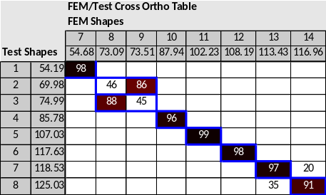
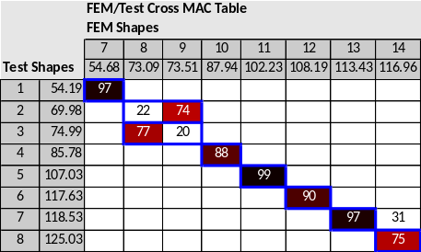

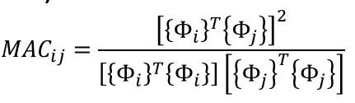
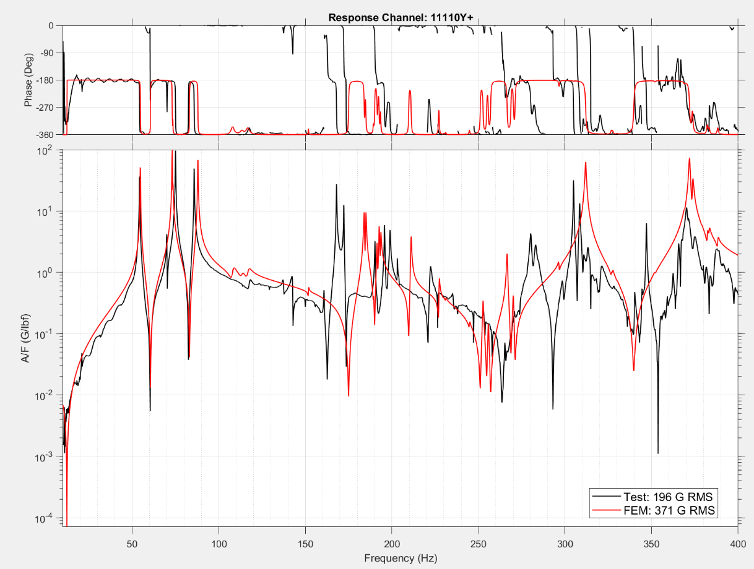

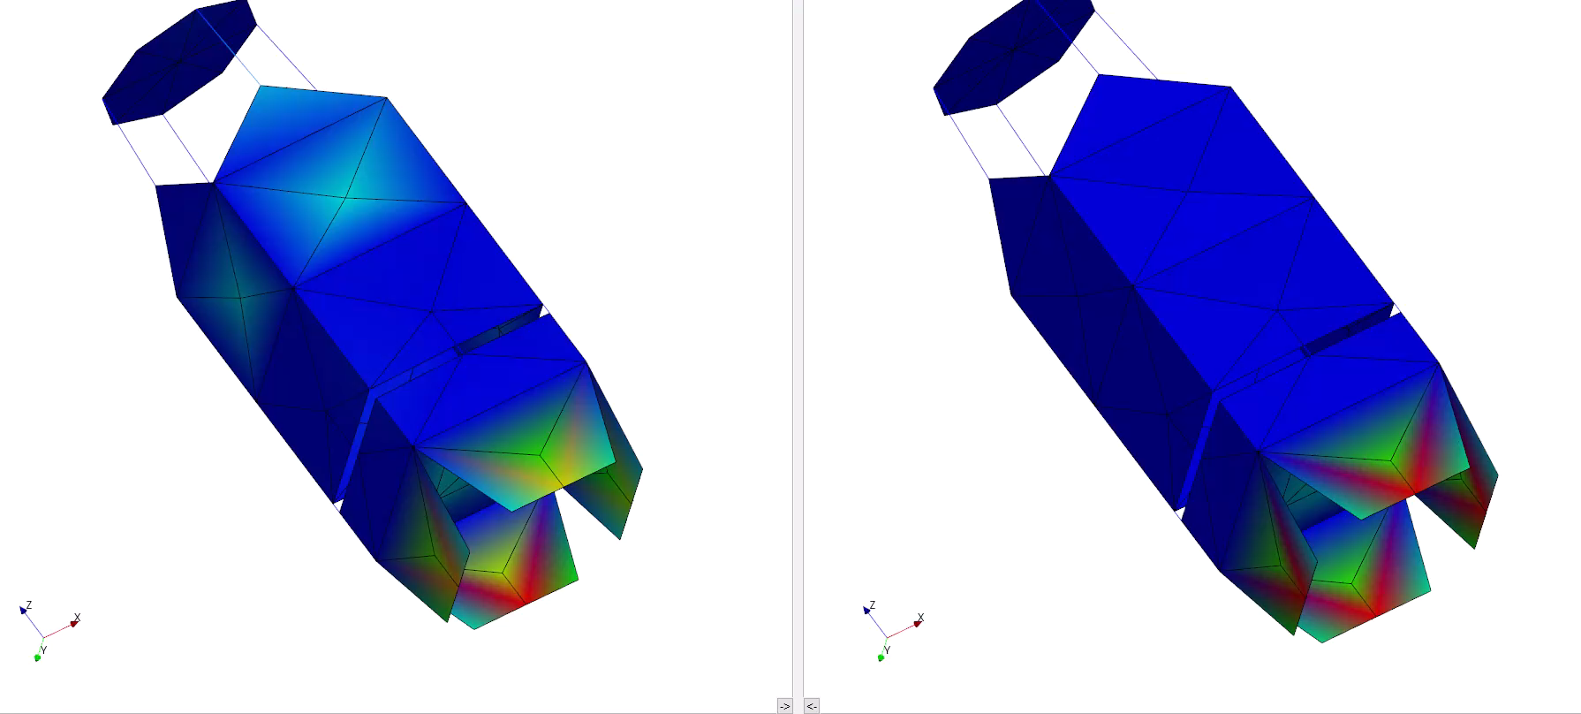
Typical Correlation Metrics
Cross-Orthogonality (X-Ortho)
  Should be >90% on diagonals, <10% on off-diagonals.
Modal Assurance Criteria (MAC)
Direct Acceleration Comparisons
  Frequency Response Functions (FRFs)
    Example: Nastran SOL 111
  Power Spectral Density Functions (PSDs)
  Time Histories
    Example: Nastran SOL 112
Mode Shape Visual Comparisons
Frequency Comparisons
Correlation goals depend on size and complexity
= [I]
Test
FEM
Test
FEM
Test Shape – 85.78 Hz
Analysis Shape – 87.94 Hz

Slide 6
Test Preparation and Execution
Basic Model Checkouts
Website Link: https://femci.gsfc.nasa.gov/validitychecks/index.html
Perform element shape, coincident node/element, and other model checks that are generally available in the pre/post processing software GUI (e.g., Femap, Hypermesh, etc.)
Default Nastran Checks that should always be on:
  Groundcheck
  Weightcheck
  Note: Not all model checkouts are automatic
Review all NASTRAN error messages and resolve them no matter how insignificant they may seem.
Commonly mis-utilized Nastran Parameters:
  BAILOUT
  AUTOSPC
  COUPMASS
  K6ROT
  Note: If the parameter is in the deck, you must know what its there for!

Slide 7
Test Preparation and Execution
Hardware/CAD-FEM Comparison
This should always be performed as a first step, preferably before testing occurs.
  It seems obvious but is often overlooked
  A model that looks like the CAD (auto meshed) can be a poor representation of load path; the model must accurately represent the load path/transfer!
  In some cases, poor modeling has made model correlation extremely difficult
Check for the following (starting with primary load path structure):
  Geometry Placement
  Mass representation and distribution, especially Non-Structural Mass (NSM)
  Visual Inspection of the assembly
  Element thicknesses
  Composite layup orientation/ply counts
  Assumptions
IMPORTANT: Successful finite element model correlation is only feasible if the FEM adequately represents the mass, stiffness and load path of the structure – that includes the geometry of the hardware!

Slide 8
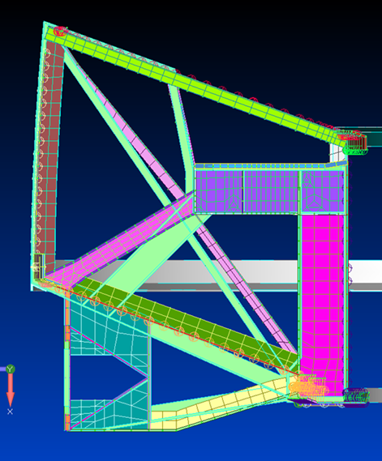
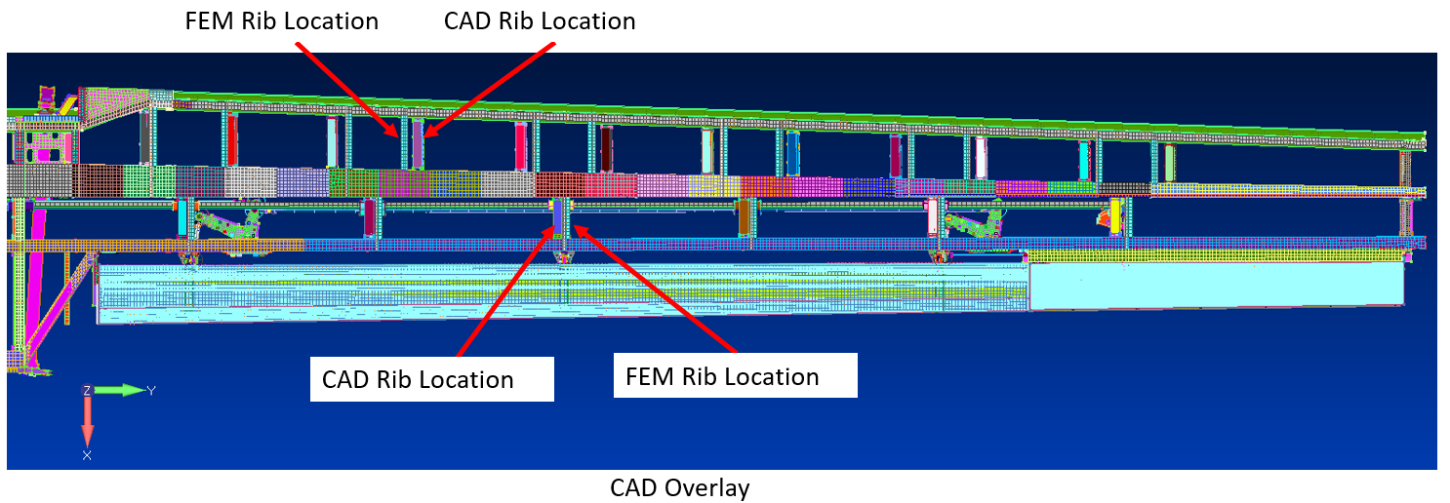
Test Preparation and Execution
Geometry Placement
CAD is often easier to change than the FEM and required for design changes to be approved, but this is not always the case for the FEM, which generally lags behind the actual design.
Hardware changes that are deemed minor are sometimes left out of the FEM; however, the cumulative effect of multiple small changes can add up to make a substantial difference
Tip: Overlay CAD on top of the FEM, do all the major subassemblies appear to be properly located?

Slide 9
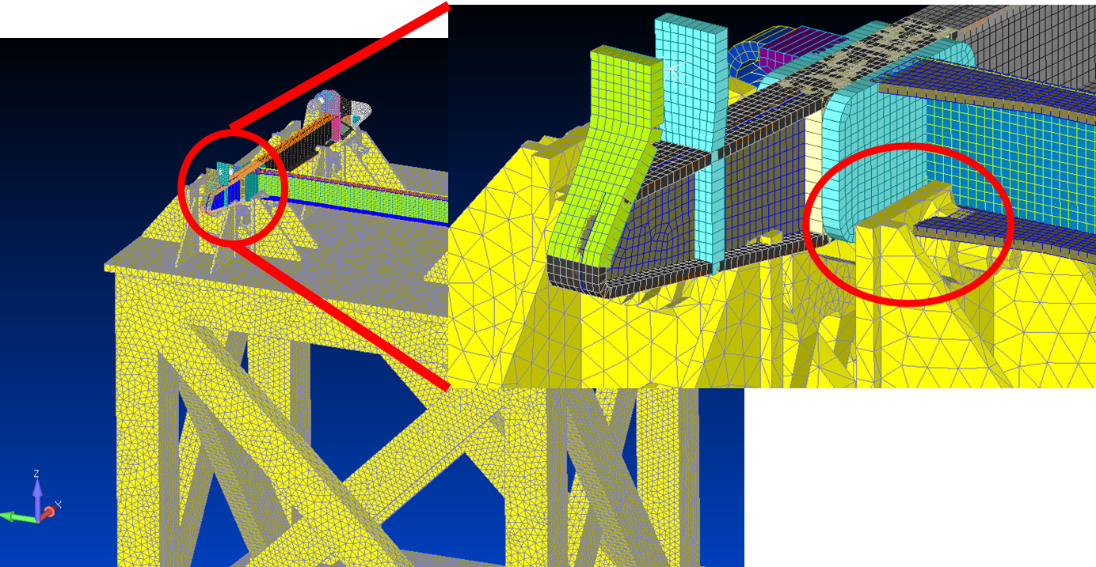
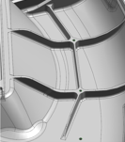
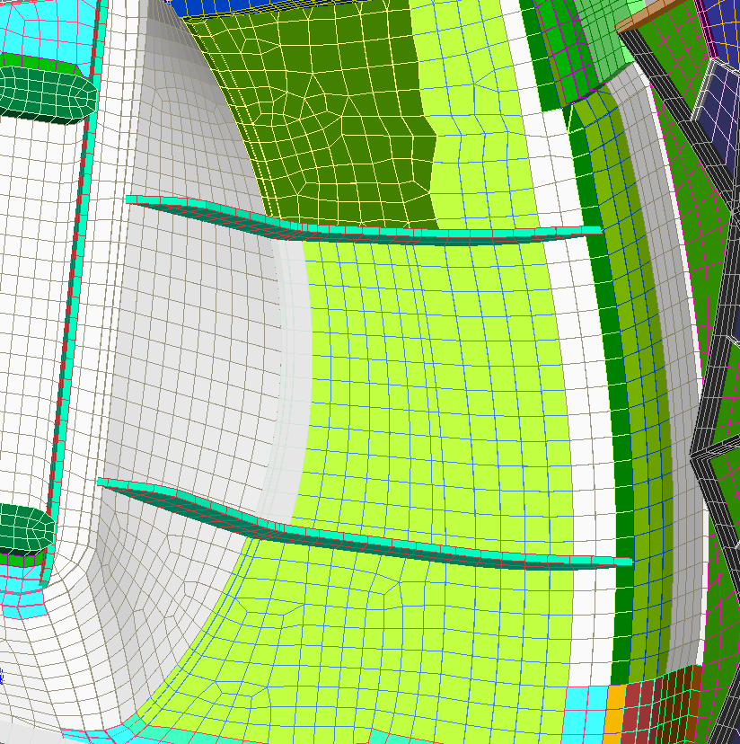
Test Preparation and Execution
Visual Inspection
Visually check the FEM and understand how it was assembled.
  Do parts overlap that should not? Are structural elements missing or mislocated?
  Are the interfaces in the correct locations? Are there missing fastener connections?
  Follow the primary load path through the FEM
Important: Don’t ever treat a FEM like a black box! It is your responsibility to understand all a FEM’s limitations and assumptions.

Slide 10
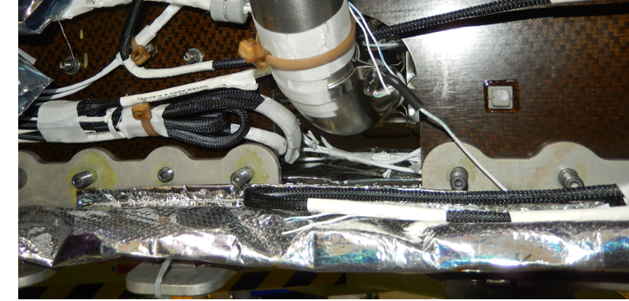
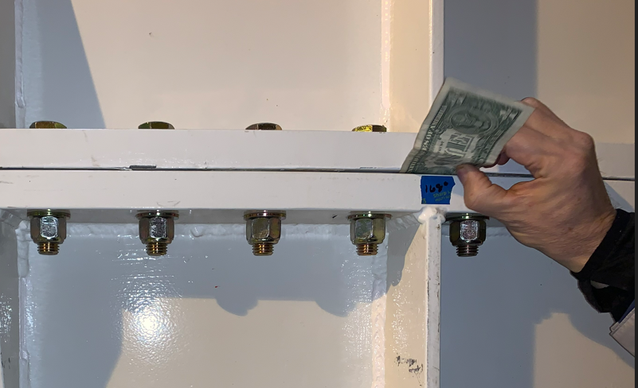
Test Preparation and Execution
Checking Assumptions
Whenever possible, it is best for the engineer(s) who performed the pretest analysis and responsible for the model correlation to be present at the test site.
This presence will allow for review of test article and test configuration:
  Firsthand understanding of the hardware and instrumentation locations
  Identify missing/alternate components and differences from the expected test configuration
  Confirm critical measurements; including hardware thicknesses and dimensions and as-installed accel locations
  Check interface modeling assumptions against the hardware configuration
  Inspect the fixturing and boundary configuration, including boundary instrumentation
  Observe the test, including the test issues or anomalies that almost always occur.
Takeaway: Model correlation becomes much easier when visual inspection and test participation is possible. Being there in-person is worth a thousand second-hand accounts!

Slide 11
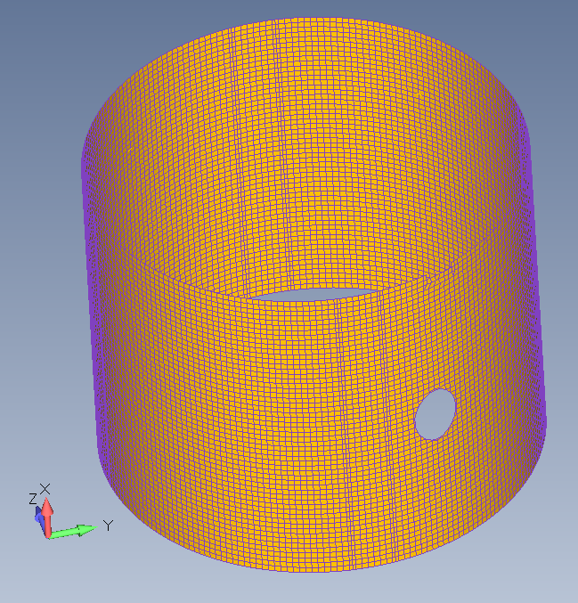
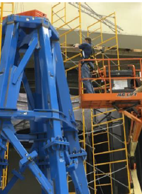
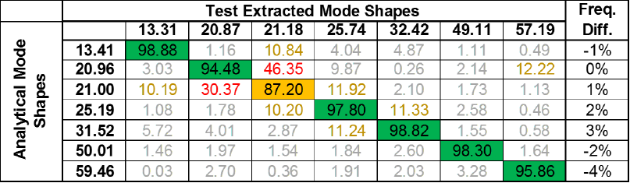
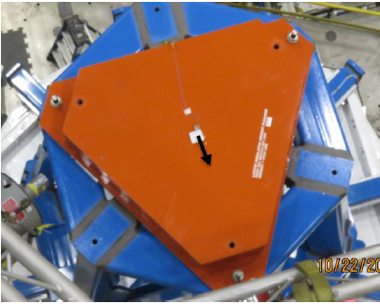
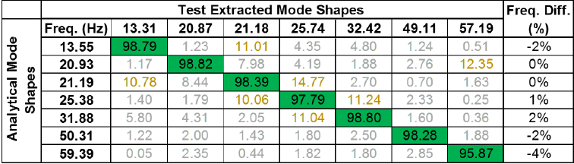
Test Preparation and Execution
Test Article Mass Properties
All parts of the Test Article should be weighed – at the Assembly, Subassembly or Component level - to verify the mass and cg.
If the mass/CG isn’t correct, there will be embedded error in the model and correlation activities will be unnecessarily difficult.
Items that are frequently missed/misplaced:
  Fluid Mass such as propellants or referee fluids in tanks
  Non-Structural Mass “smeared” over wrong areas
  CONM2 elements without any MMOI information
  Attaching masses to weak structure such that extra modes are created
  Utilizing too many massless elements, or representing structures as NSM
Spreading the NSM over the entire cylinder when the hardware it represents only attaches here.
The location of the mass in the FEM was aligned with the axis of the tower.
The hardware has an ~1” offset in the actual build.

Slide 12

Test Preparation and Execution
Pretest Planning
Important: Choosing where to place instrumentation based on visually capturing the mode shapes in not enough!
Two very common mistakes are made:
  Not checking to make sure the reduced mass matrix is adequate
  Not instrumenting both sides of critical joints and interfaces
Utilizing the pseudo-orthogonality to ensure a sufficient test analysis model (TAM) has been developed.
  Should be >95% on diagonals, <5% on off-diagonals.
Remember: Everything is being based on what a “flawed” model is predicting. Think about what might be wrong and add instrumentation accordingly.
Tip: Go into the model and vary stiffnesses of the joints and change assumptions to ensure the planned instrumentation can still capture all potential mode shapes.
= [I]

Slide 13

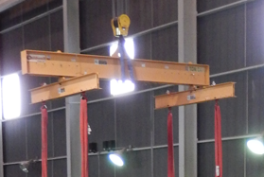
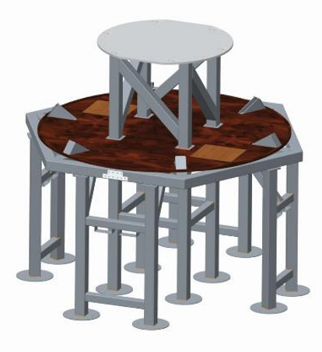
Test Preparation and Execution
Boundary Conditions
This is the #1 reason modal tests need to be redone and correlations cannot be successful! They are not ever as trivial as they are made out to be.
The goal should be to drive the boundary as close to free or as close to fixed as possible. Test article modes need to be well separated from boundary modes.
  Ideally and order of magnitude separation would exist, but at a minimum should maintain at least the “Octave Rule”
Avoid the following boundaries due to high likelihood of coupling with test article:
  Complex bungee block setups
  Non-linear lifting fixtures (ex. Pinned beams or telescoping tubes)
  Flexible ground support structures
Perform the pretest analysis with the boundary modeled sufficiently. Only take it out of the model once the test data confirms it is not necessary to have.
  Floors flex! – Modeling them as rigid connections is rarely correct
  Nothing is free-free, Not even bungee cords!
If you must test on a complicated boundary condition, carry out a modal test of the boundary separately to doing the test of the entire system. Avoid trying to correlate the entire system together.
No matter what the boundary is, ALWAYS instrument it in the test to verify the assumptions.

Slide 14
Test Preparation and Execution
Test Completion
Before taking instrumentation off a test article and calling the test completed, has the following been done:
  The test-to-test self-orthogonality checks need to show <10% on the off diagonal or very close to that for the primary target modes.
  All response channel auto-spectra shall have good separation over the ambient noise level of the test facility.
  Drive point FRFs using the shaker force and drive point accelerometers shall show clean phase agreement throughout the test excitation frequency range (phase should not cross between the 0-180 or 180-360 range).
  Drive point reciprocity relationships need to overlay in the test frequency range.
  The coherence of the response channels needs to maintain values in the test frequency range.
  Are all the primary target modes identified in at least one of the tests?
  Initial comparisons of side-by-side animations of the test vs FEM shapes have been made and no further local impacts or shaker locations have been deemed necessary to understand any differences.
  Non-linearity on primary modes is well established through testing at different excitation levels and any source of non-linearity has been identified?
  Are there extra modes in the test that the FEM does not have? Are more impact tests/instrumentation required to fully understand the unexpected mode shapes?
Important: If you're in doubt on any one of these, figure it out before you leave the test site, it is unlikely it will be able to be resolved or overcome in the correlation!

Slide 15
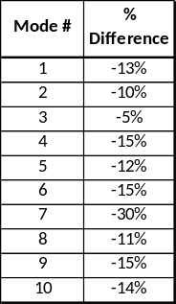
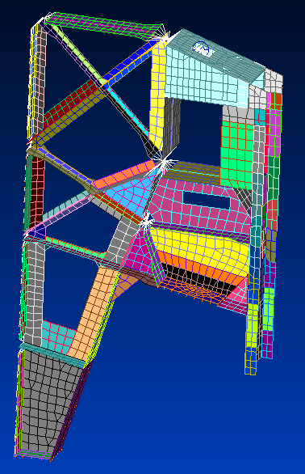
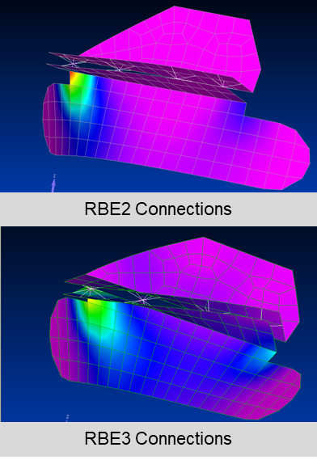
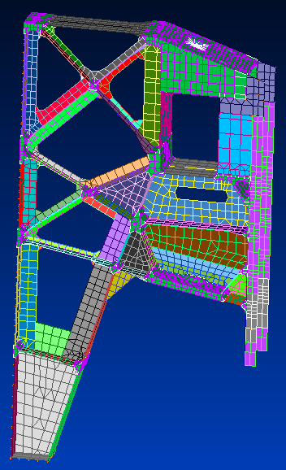
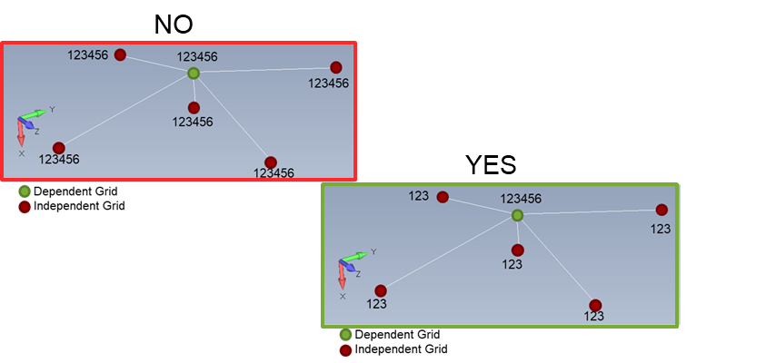
Element Compatibility
RBE2 vs. RBE3
One of the biggest mistakes commonly found in model correlation is the incorrect utilization of rigid elements (misnomer – they’re not elements).
Utilizing an RBE2 will :
  Over-stiffen the structure and can cause unrealistic deflections if not done properly
  Redistribute mass by truncating the dependent DOF in the mass matrix – not always as intended!
  Often neglect the mass of the component being represented
Avoid large scale rigid elements whenever possible
Be intentional when using RBE2 elements to model fastened joints.
Keeping track of the independent/dependent DOF relationships is critical.
Tip: Even a simple and rough representation of a component is better than a rigid representation.
RBE3 Common Mistake

Slide 16
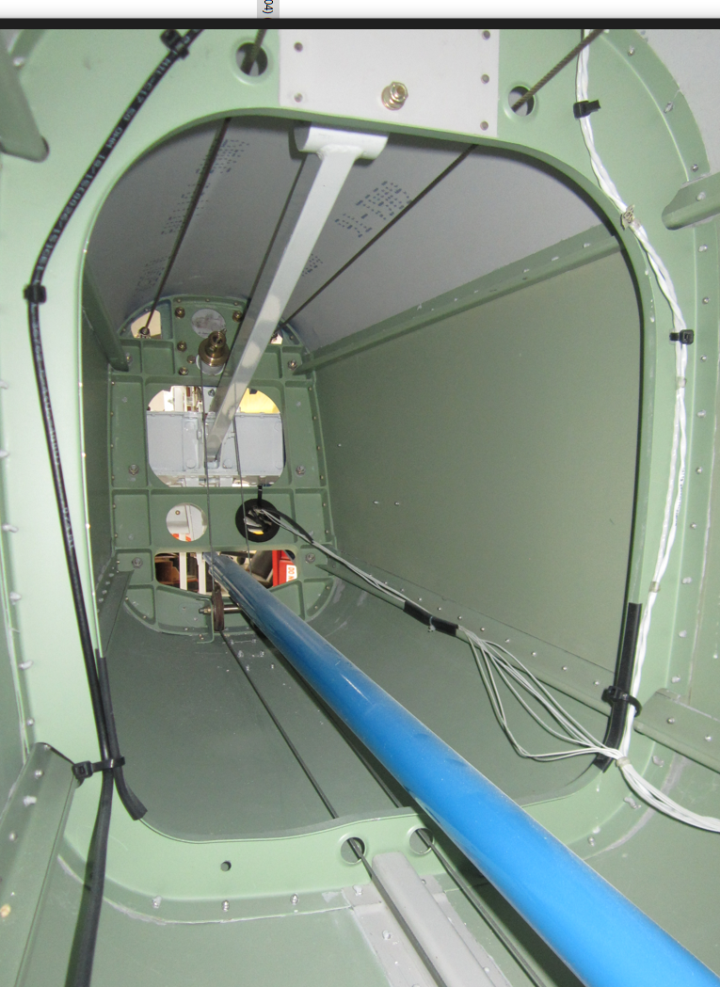
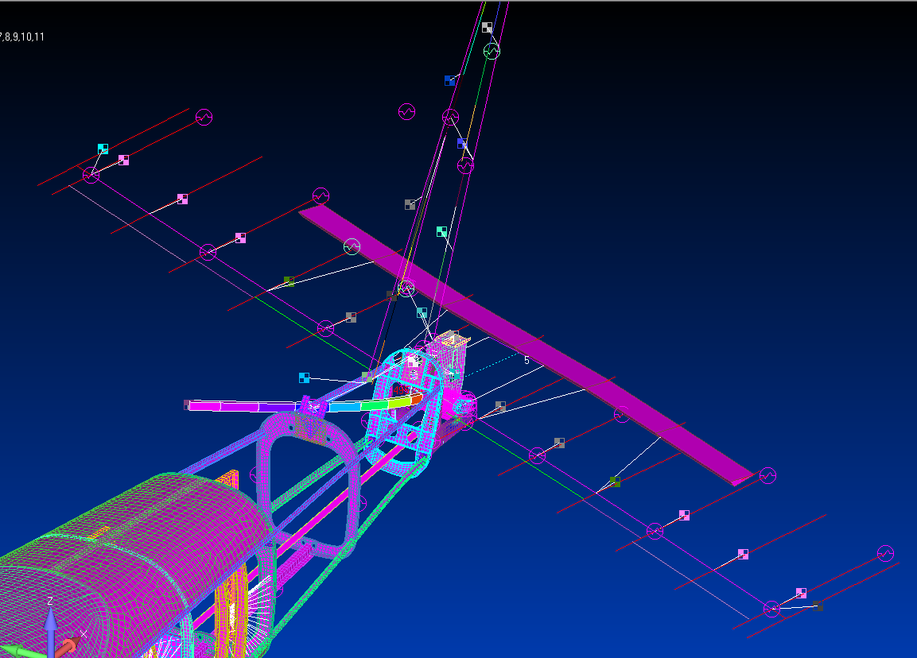
Rigid Element Example
The white beam in the picture on the right was originally modeled as an RBE2 with a lumped mass at the end to represent the counterbalance mass.
The modal test had three modes all within a very tight frequency span of each other, all which appeared to be horizontal stabilizer modes.
When modeled with flexible beam elements, the model clearly showed the counterbalance bending coupling with the horizontal stabilizer as indicated in the test.
Key Takeaways:
  Modeling assumptions don’t always transfer (Static to Dynamic models)
  Avoid using rigid elements to model structure
  Visual inspection of this structure during the test should have raised concerns over why no instrumentation was present on it.
  This example is an obvious oversimplification the load transfer behavior; most are not as simple to identify.

Slide 17
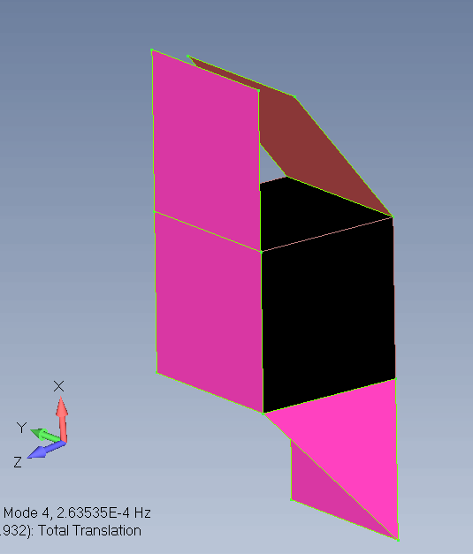
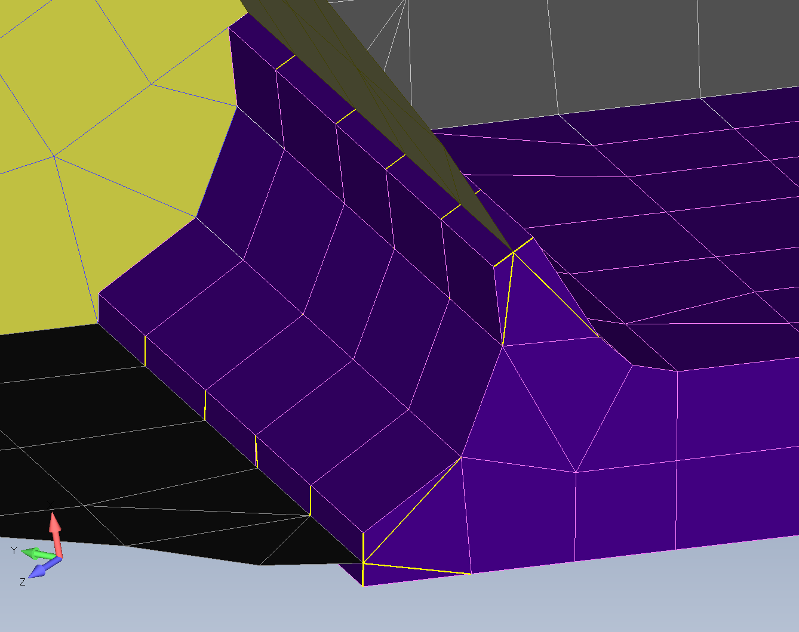
Element Compatibility
Connecting Different Element Types
Connecting 3D-to-2D elements can be done correctly, but care must be taken in doing so.
  Solid elements cannot carry, transfer rotational loads
Approaches commonly utilized:
  ‘Skin the solid element’ - Coincident attach a shell to the appropriate side(s) of the solid element faces
  Spline - Utilize RBE3 to connect to at least three non-coincident locations on solid element to transfer rotations.
Connecting 2D-to-1D elements is done using a similar approach.
  Transitioning from an 2D shell to a beam requires consideration of the loads being transferred.
Add ‘stringers’ when connecting 2D elements around corners (at 90 degrees with each other)
  Shell elements do not have physics based out-of-plane stiffness
Tip: Run simple test case of the modeling approach being used to ensure issues are not being created by the transfer between element types.

Slide 18
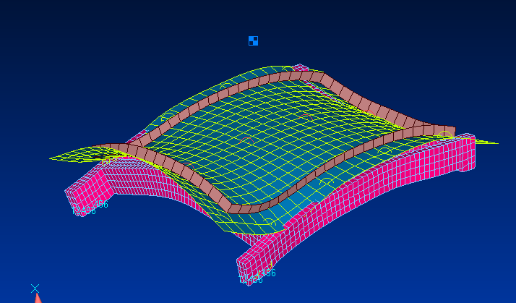
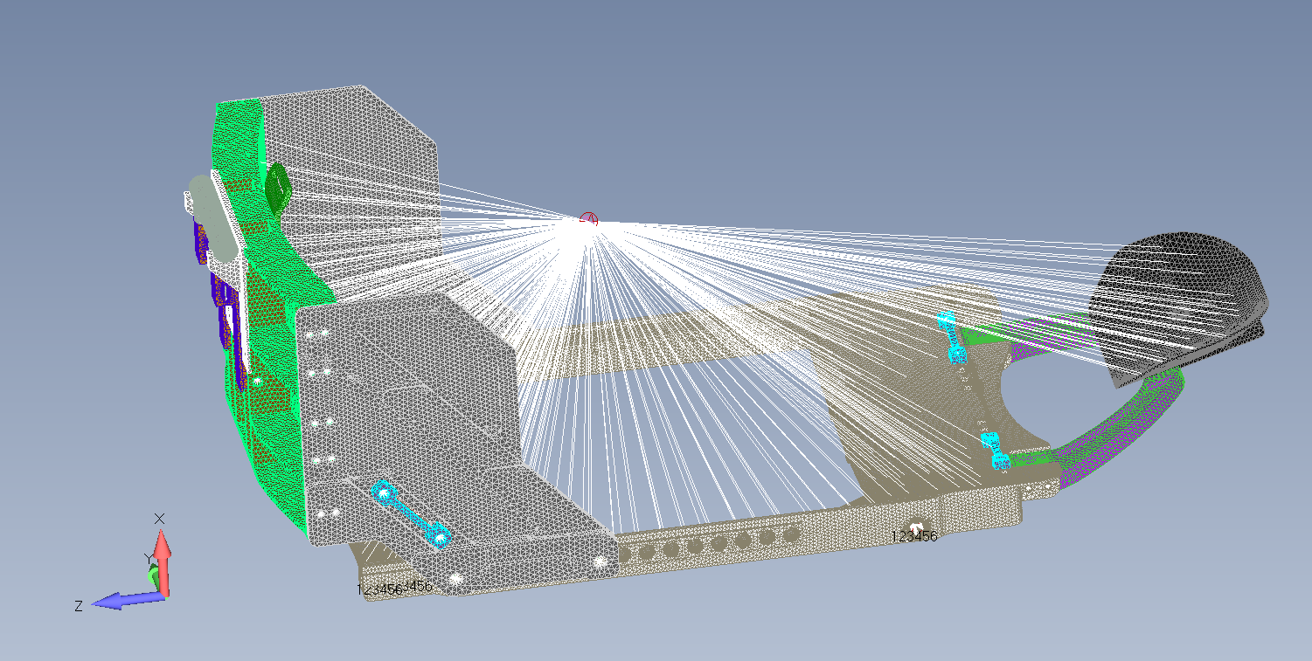
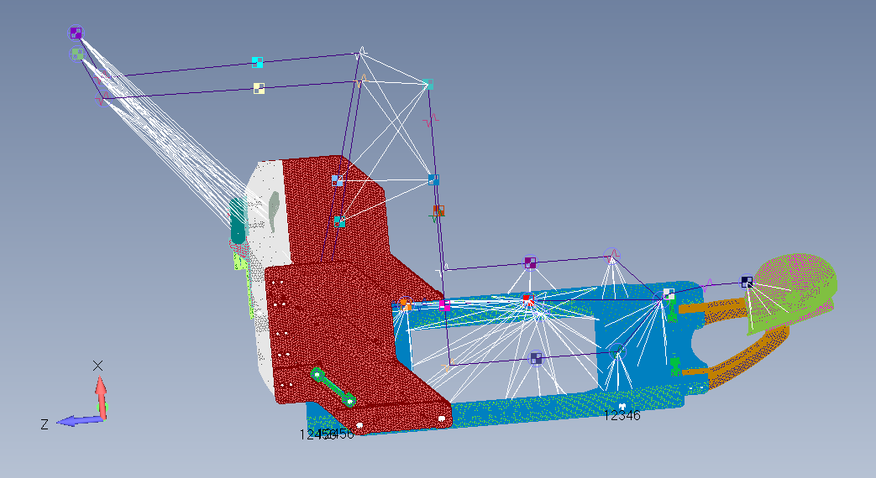
Element Compatibility
Lumped Masses
Lumped mass representations are often:
  Oversimplified (bypasses physics-based mass loading)
  Incomplete – No mass moment of inertia information
  Un-realistically connected to the structure (e.g., overly stiffens supporting structure)
Avoid modeling complex structures, important components which you need accurate representation, or significant size masses with lumped masses.
Other options to consider utilizing:
  Superelement and/or DMIG representations
  Multiple masses connected with flexible connections
  Attach multiple masses to compliant intermediary structure (e.g., mounting plate or bracket)
If the structure you are modeling with a lumped mass has dynamics within 2x frequency range of interest, don’t use this modeling approach.
Tip: Verify that physics-based behavior is properly represented by first modeling the item in detail and then swapping out to the lumped mass.
With MMOI – 74.99 Hz
Without MMOI – 97.32 Hz

Slide 19
Joint Modeling
Joint modeling is the most common source of modeling error, and therefore a major focus in model correlation.
Goal is to realistically represent the mass and stiffness distribution through the joint.
Questions to ask about a joint model:
  How much of the mechanism is supposed to be included in any simplified modeling?
  What is the reasonable stiffness range per interface?
  For joints with translational or rotational releases, remember few joints are completely fixed or free, so include physical interface elements so that the stiffness and DOF’s can be adjusted/modified.
    Note: If a CBUSH requires extremely large stiffness values to correlate an interface, perhaps more fidelity is required.
  Is there component level testing to back up stiffness values?
    Note: Be careful to understand how the test was done though because simplified local loading doesn’t always accurately reflect joint behavior seen in the large-scale assembly.
  Avoid zero stiffness values in most cases.
Avoid single connections that “supposedly” represent fasteners and avoid over constraining single fasteners by not allowing load to be reacted across the bolt pattern.
  One-to-one RBE or CBUSH connections are generally NOT sufficient for representing local load behavior.
Important: Remember that for fastened joints, the model needs to accurately represent the stiffness of the entire preloaded joint, not just the stiffness of the fastener; including the compliance of the connected elements is essential.

Slide 20
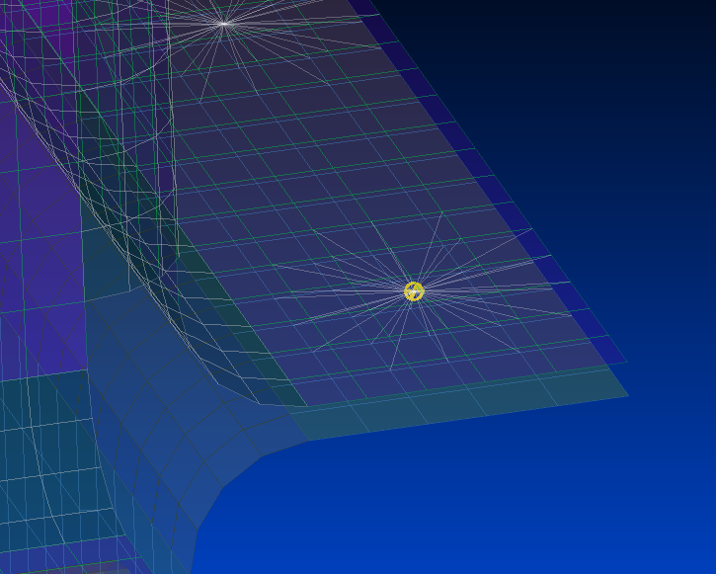
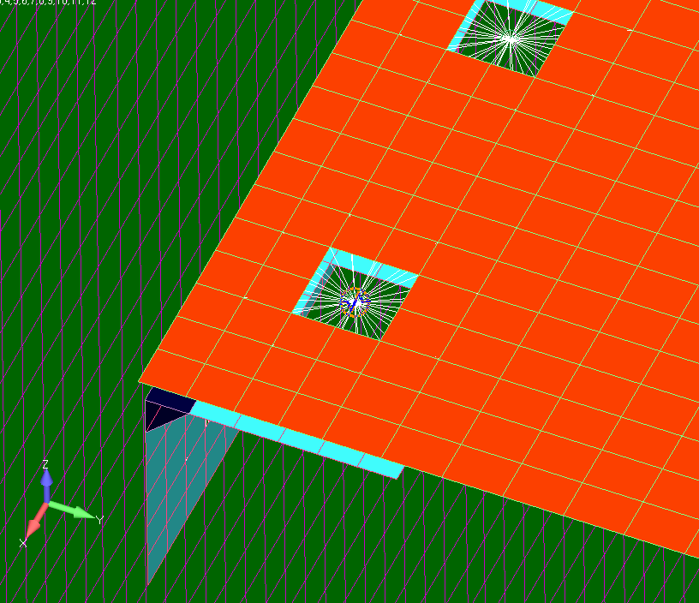
Suggested Fastened Joint
Modeling Approach
Utilize a RBE3 on either side of the interface that is sized approximately equal to the expected compression cone generated by the fastener.
  If it’s a large mesh size, go to closest surrounding elements.
Use coincident (zero-length) CBUSH elements connected both sides of the joint.
  Orient the stiffness of the CBUSH with either a coordinate system or user defined vector.
  CBUSH offers the most flexibility for tunning of the joint stiffness.
  The bending rotational stiffness of the connection can then be used to drive how much of the flange contact bearing stiffness should be accounted for, also serves as a great “tunning knob” in finite element correlation.
Reasonable starting stiffness estimates for the CBUSH:
  Axial Stiffness: Calculate AE/L for the fastener diameter
  Shear Stiffness: Take ~1/2 the axial stiffness
  Torsion Stiffness: Set to very small, but not zero (~100 lbs/in)
  Bending Stiffness: Set to an order of magnitude higher than the axial stiffness
The key benefit to this approach is that the loads at the fastener locations can still be easily extracted from the model.
The downside to this approach is that for large flanges, the rotational stiffness values can quickly converge on needing to be infinitely rigid and still not get the required stiffness in the joint
For large flanges or bolt patterns, the goal is proper load distribution through the joint, rather than accurate stresses within the joint. Leverage couples across the large interfaces to force the load reaction to be distributed.
Tip: Visualize a mode shape that exercises the joint in different directions, does the joint appear to behave realistically or is there unconstrained motion.

Slide 21
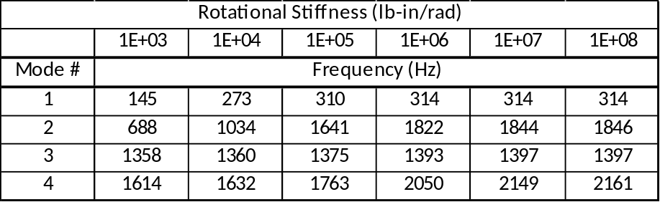
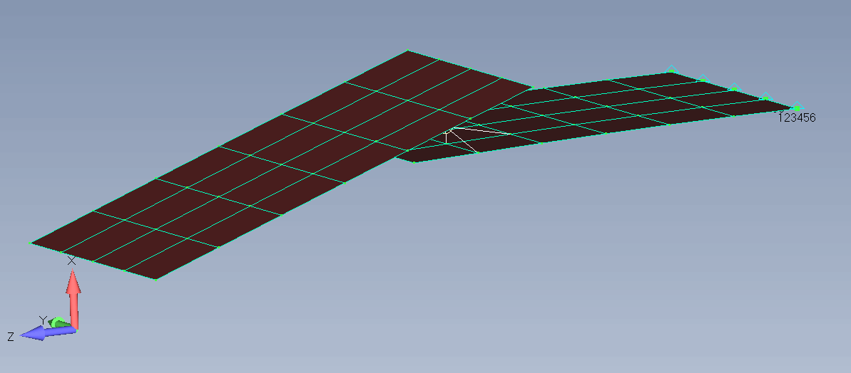
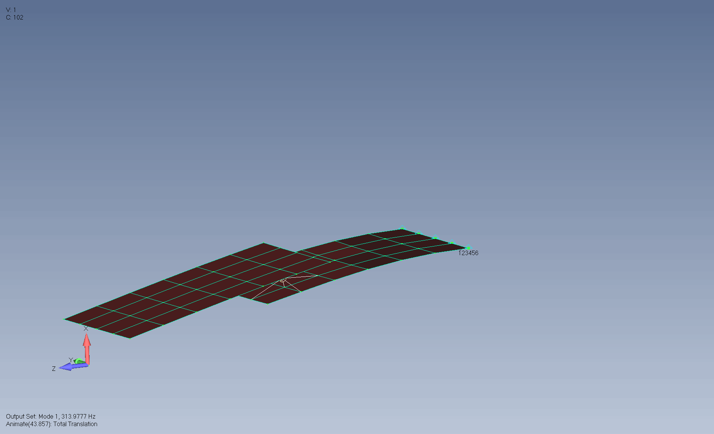
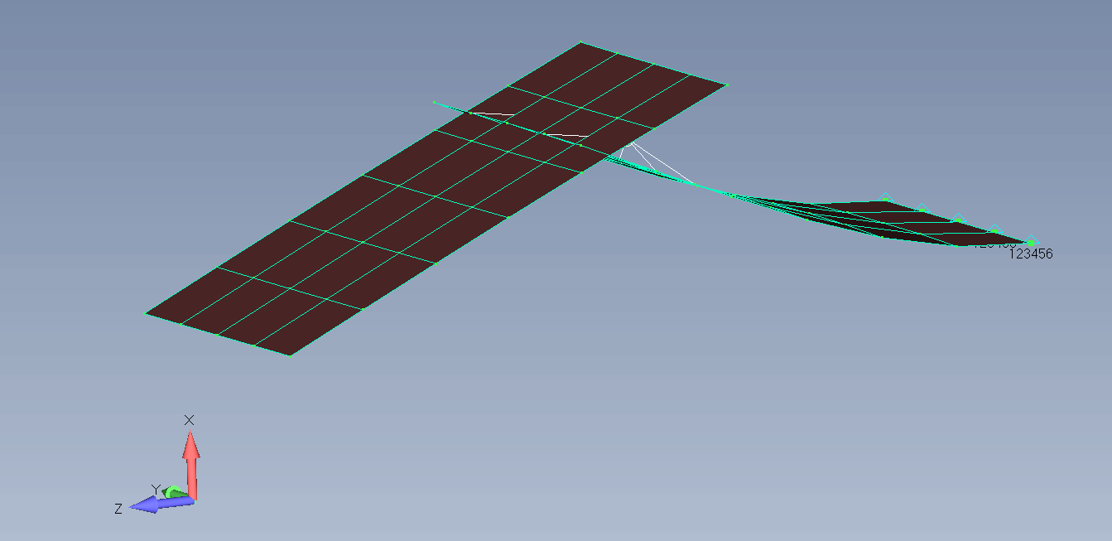
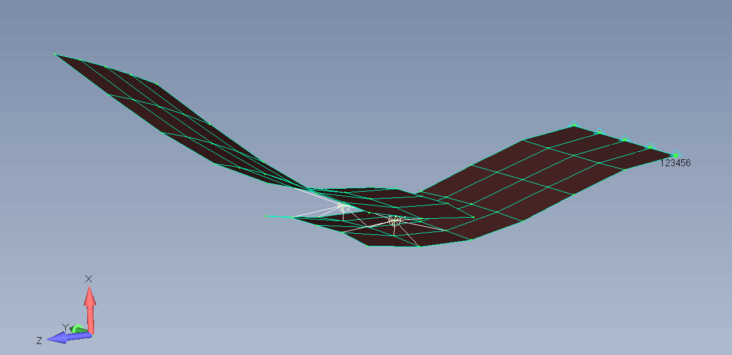
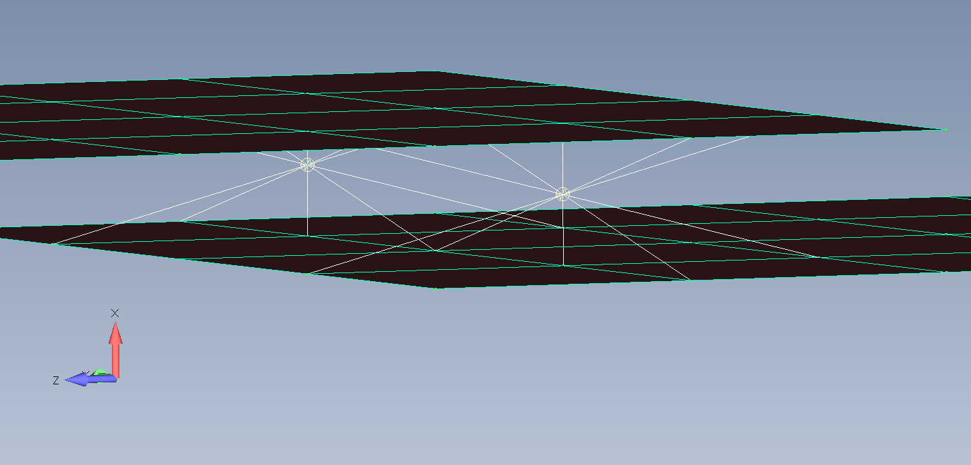
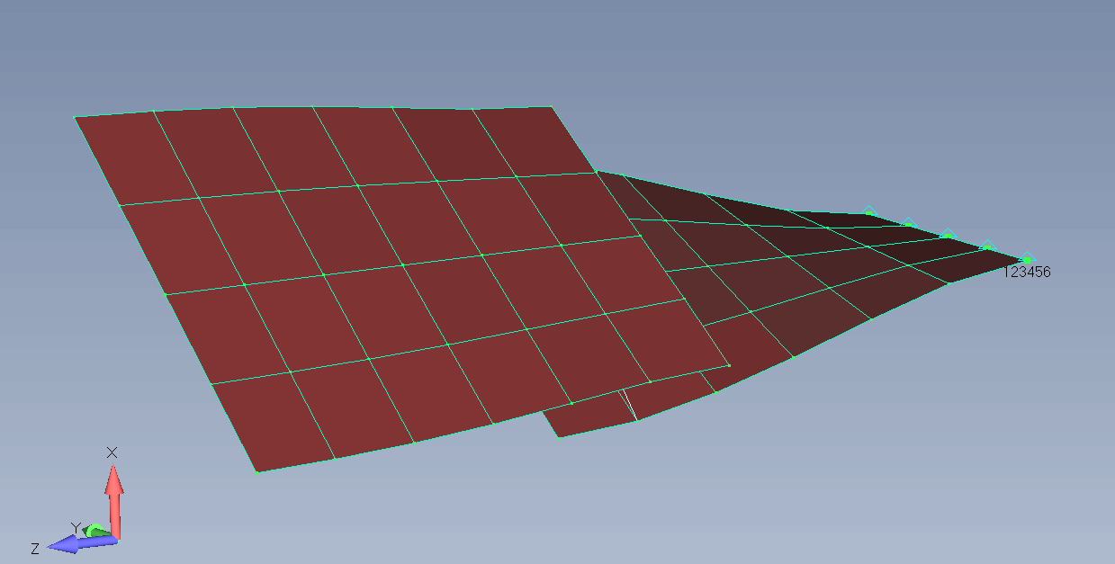
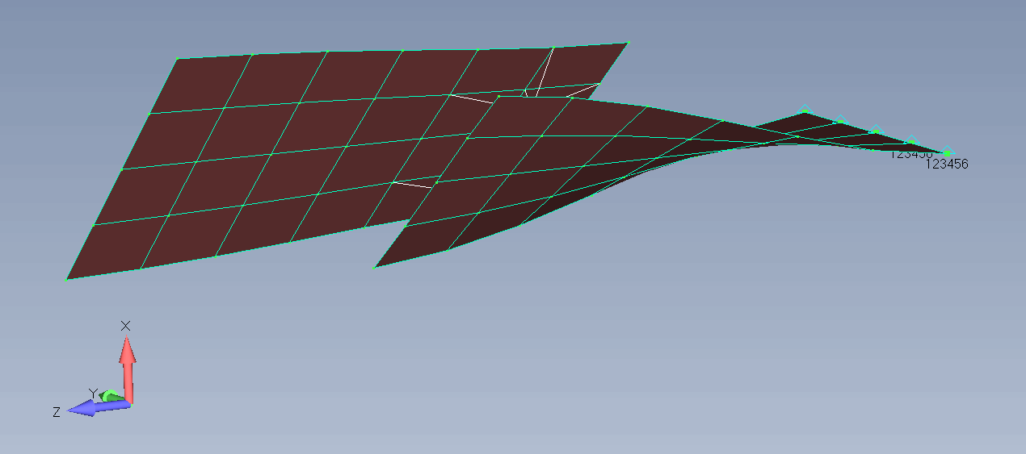
Simple Fastener Joint Model Trade Study
Modeling two plates being attached by a pair of fasteners.
This simple trade study makes it easy to see what value of rotational stiffness is necessary to create an accurate representation of the joint behavior.
Note: The RBE3 should only transmit the 3 translational DOF from each independent grid to all 6 DOF on the dependent grid.
RBE3
CBUSH
RBE3

Slide 22
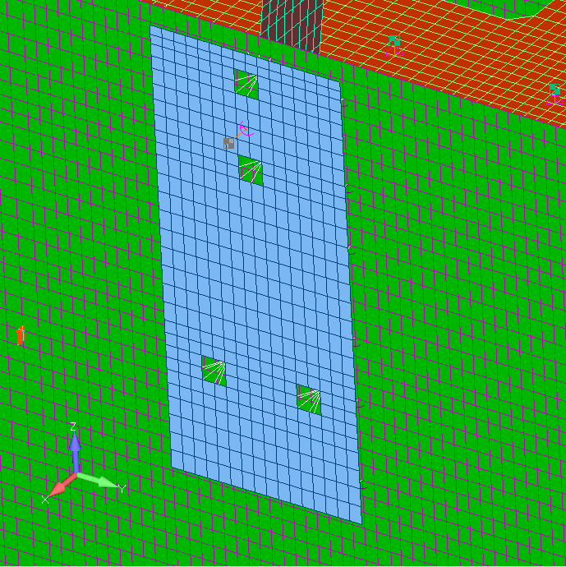
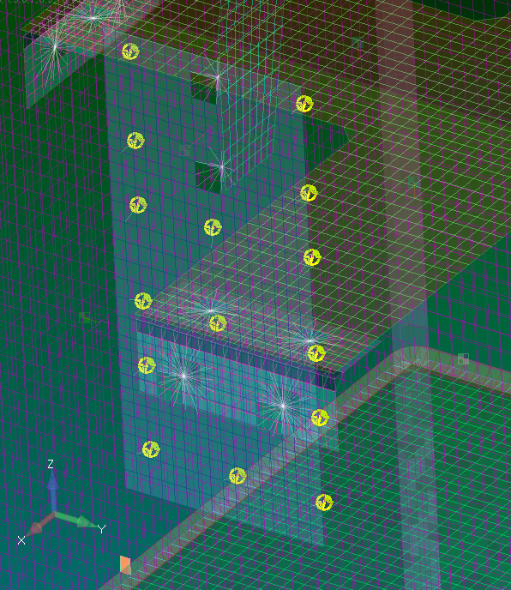
Extra Contact Stiffness
In the case where a very large surface area part is bolted to another with a small bolt pattern, it often becomes necessary to capture that contact stiffness.
Minimize the use of contact elements or regions for things like this because it takes away the ability to dial in the stiffness during the correlation.
For asymmetric contact (bearing in one direction but not the reverse), modal behavior is often closer to neglecting contact.
In general, these should be several orders of magnitude softer than the primary stiffness holding the joint together.
  Note: Only axial stiffness is necessary here.
Remember: In reality, this is a non-linear design that you are doing your best to approximate with a linear model.

Slide 23
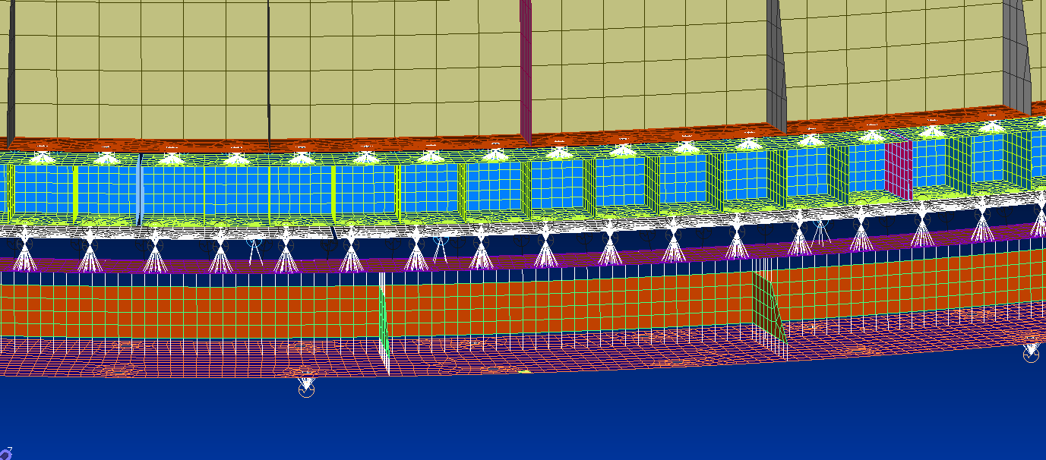
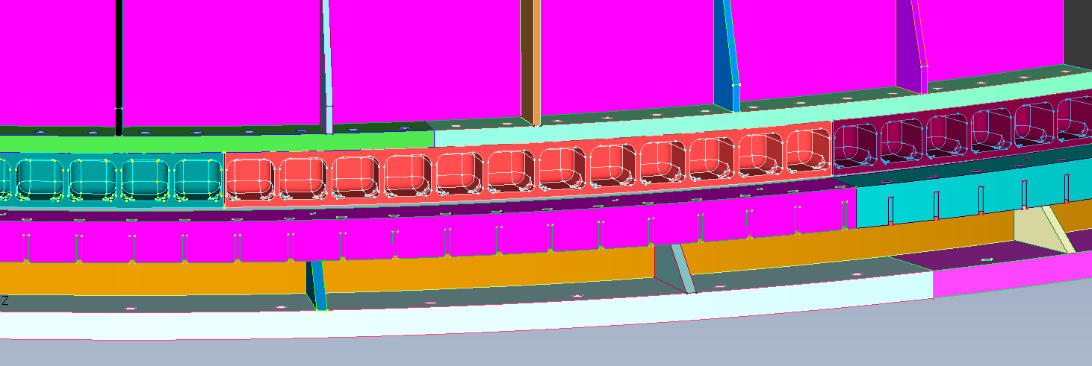
Thick Plate Joints
When modeling large thickness plates (relative to mesh size), three primary concerns exist:
  Shell-to-shell connections will not predict the true joint stiffness
  The mass over prediction of the joint can be significant
  The plate element shape factors are violated (shape functions are based on thin shell theory)
There are several approaches to avoid these pitfalls when connecting two plates together:
  Use a single RBE2 elements as shown in example below.
  Use rigid offsets with coincident connection nodes and a connection element (e.g., CBUSH)
Reminder: Look at the joint flexibility and behavior for modes that exercise it locally, does it deform realistically or not? Is the entire joint participating in the load transfer?

Slide 24
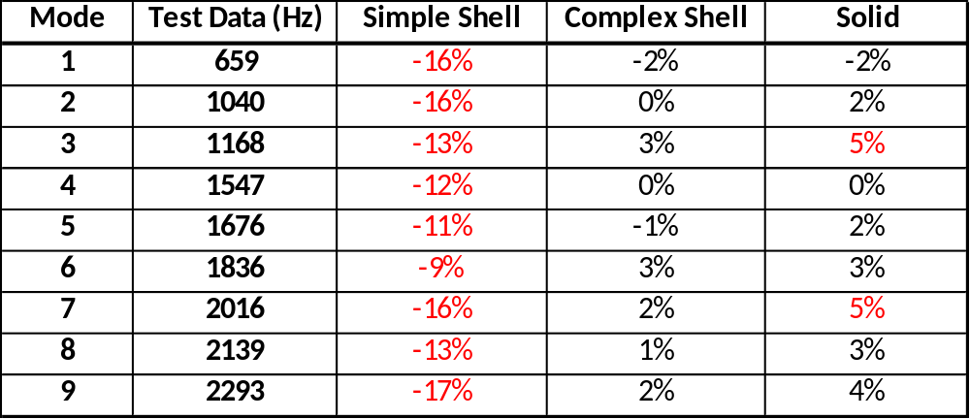
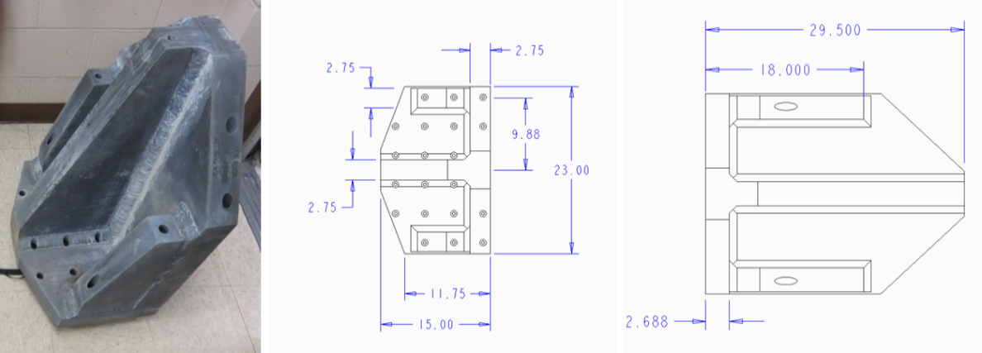
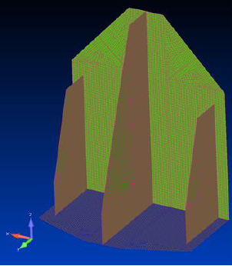
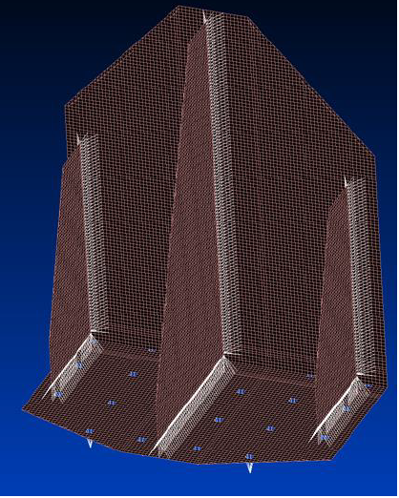
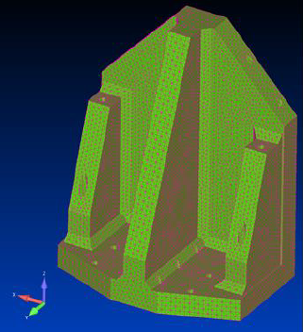
Thick Plate Example

Slide 25


Utilizing Other Metrics
Simulate the test runs with your model and see how it compares
  Do certain peaks only show up in the model predictions?
  Do specific locations look worst than others?
  Ignore the amplitudes in the comparison, unless you use measured damping values (analytical damping values are chosen to be conservative)
When dealing with a test article with multiple load paths:
  Should not rely purely on cross-orthogonality or MAC alone to prove correlation.
  Really need a separate way to confirm the load path.
  Ensure both load paths are fully instrumented with strain gages, load cells, etc…
  Load share can be different during dynamic loading and static loading, so it’s best to have data for both
If the hardware is going to be operating in multiple configurations, be sure to collect data on as many as possible because it will help locate any issues with the model and anchor the correlation.
FEM
TEST
FEM
TEST

Slide 26




Modal Element Strain Energy
This is a correlation engineer’s “best friend”
Generally, where the strain energy in the mode is the highest, that is where the stiffness in the model is most critical to that mode shape.
  If it doesn’t make sense, it’s generally a good indication something is modeled wrong or over-constrained.
Great tool for sorting out minor differences in closely spaced modes.
  Example: Two modes ~2Hz apart and both look visually the same, however, the strain energy clearly shows one is due to the frame stiffness and the other is due to a connecting line stiffness.
In addition, can be helpful to group the strain energy by components and determine a percentage of the total strain energy that exists in each component for each mode shape. (example shown below).
ESE(PLOT, THRESH=0.0)=ALL
Element Strain Energy Plots

Slide 27
Consider Nonlinearity
It is very common for aerospace structures to exhibit nonlinear behavior in one way or another.
Remember: Models are typically correlated to low-level excitations (ie. modal), which will likely lead to some flight modeling assumptions to be invalid during testing.
  Any joint that is designed to be released during flight loading still has friction that may not be overcome during low-level testing.
  Always include a linearity check with 3 levels for one of the test runs. Each level should be at least doubled.
  It may be helpful to implement modeling features that are easily modified to capture the non-linear behavior at various excitation levels (CBUSH elements).
Tip #1: Complicated joints that act non-linear will most likely need to be modeled in much more detail than a simplified single element representation.
Tip #2: The engineer performing the correlation really should be at the test site during testing to visually examine the hardware, manipulate it, observe its behavior during testing, and compare it to any assumptions that were made in the pretest modeling.

Slide 28




Linearity Studies
One common way for non-linear joints to be identified is by running dynamic testing at different force levels.
An overlay of the frequency domain data will clearly show which resonant frequencies are non-linear (e.g., frequency shifts, peak shape changes).
Example #1: Most modes are showing up very linear, but the two near 35 Hz are clearly exhibiting non-linear behavior
Example #2: All modes of this hardware are exhibiting large amounts of non-linear behavior
Important: The engineer performing the correlation must understand where the hardware maintains linearity and where it does not in order to be successful in correlating the FEM.
Example #1
Example #2

Slide 29




Bolted Joint Non-Linearity Example
Test was done on very thin sheet metal bolted joint. Accels on both side of the joint.
  This is an extreme example due to the weakness of the joint.
X and Y directions stay very linear up to 200 Hz.
  Looking for phase lock through the entire test frequency range.
Z direction separates and goes out of phase after 150 Hz
  Clear indication that the measurement locations on the joint are no longer acting as a tightly constrained bolted joint.
Above Flange
Below Flange
Above Flange
Below Flange
Y
Above Flange
Below Flange
Z
X

Slide 30

Multiple Configuration Example
The testing took place on an aircraft that was suspended from its landing gear.
Observed a difference between the stowed flap and slightly deployed flap test configurations.
Conclusion was that there had to be contact occurring somewhere on the flap in the stowed condition.
Flap Stowed Test
Flap Slightly Deployed Test

Slide 31

Multiple Configuration Example
There must be contact between the cove and the flap when the flap is in its stowed configuration in order to create such a substantial shift in the FRF between stowed and slightly deployed flaps.
Flexible CBUSH elements were placed between the cove and the flap top surface.
Tip: Attempting to bound and correlate non-linear behavior is one area where optimization tools really start to be worthwhile and helpful.

Slide 32


Multiple Configuration Example
The X-Ortho clearly shows the impact of inputting the springs for the stowed flap configuration.
Takeaway: If only one configuration had been tested, this would have likely been missed or made the correlation much more challenging.
  Understand this doesn’t resolve everything, it’s still a linear model.
  If a model will be used in analysis of multiple configurations, make sure you validate or understand the behavior of all the configurations.
Important: Results like this often drive the need to run analysis with both configurations or at least determine which configuration produces less-conservative results.
Original Correlation
After Contact Springs Added

Slide 33
Conclusions
If you have a good analytical and test foundation and don’t ignore the basics, FEM correlation can often be a very straightforward process.
Be sure to understand the types of elements being utilized and their limitations.
Always utilize breakout model studies when in doubt on how to accurately model a joint.
Don’t forget to take advantage of all the tools you have available to you when reviewing the overall accuracy of a FEM.
Non-linearities can create significant challenges to a correlation but can still be managed and bounded.
Correlate to the Test Article configuration first, and then make appropriate adjustments to the flight model.

Slide 34
Acknowledgements
Special thanks to the following people for providing further insight, review, and guidance on this topic.
  Teresa Kinney – NASA
  Lance Proctor – NASA

