Slide 1
Demonstrating the Promise and Problems for Open Science in Heliophysics
Rebecca Ringuette^{1,2}, Shawn Polson³, Lutz Rastaetter², Eric Grimes⁴, Jonathan Niehof⁵, Nicholas A. Murphy⁶, Yihua Zheng².
¹ADNET Systems Inc, Bethesda, MD, United States.
²Community Coordinated Modeling Center (CCMC), NASA Goddard Space Flight Center, Greenbelt, MD, United States.
³Laboratory for Atmospheric and Space Physics (LASP), University of Colorado, Boulder, CO, United States.
⁴Institute of Geophysics and Planetary Physics, University of California, Los Angeles, CA, United States.
⁵Space Science Center, University of New Hampshire, Durham, NH, United States.
⁶Center for Astrophysics | Harvard & Smithsonian, Cambridge, MA, United States.

Slide 2


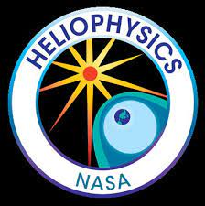
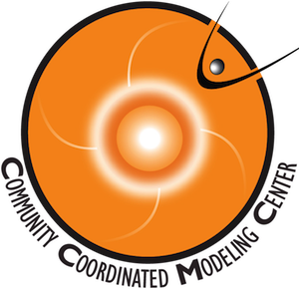
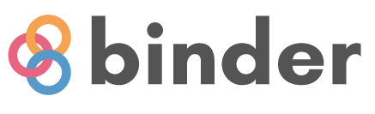
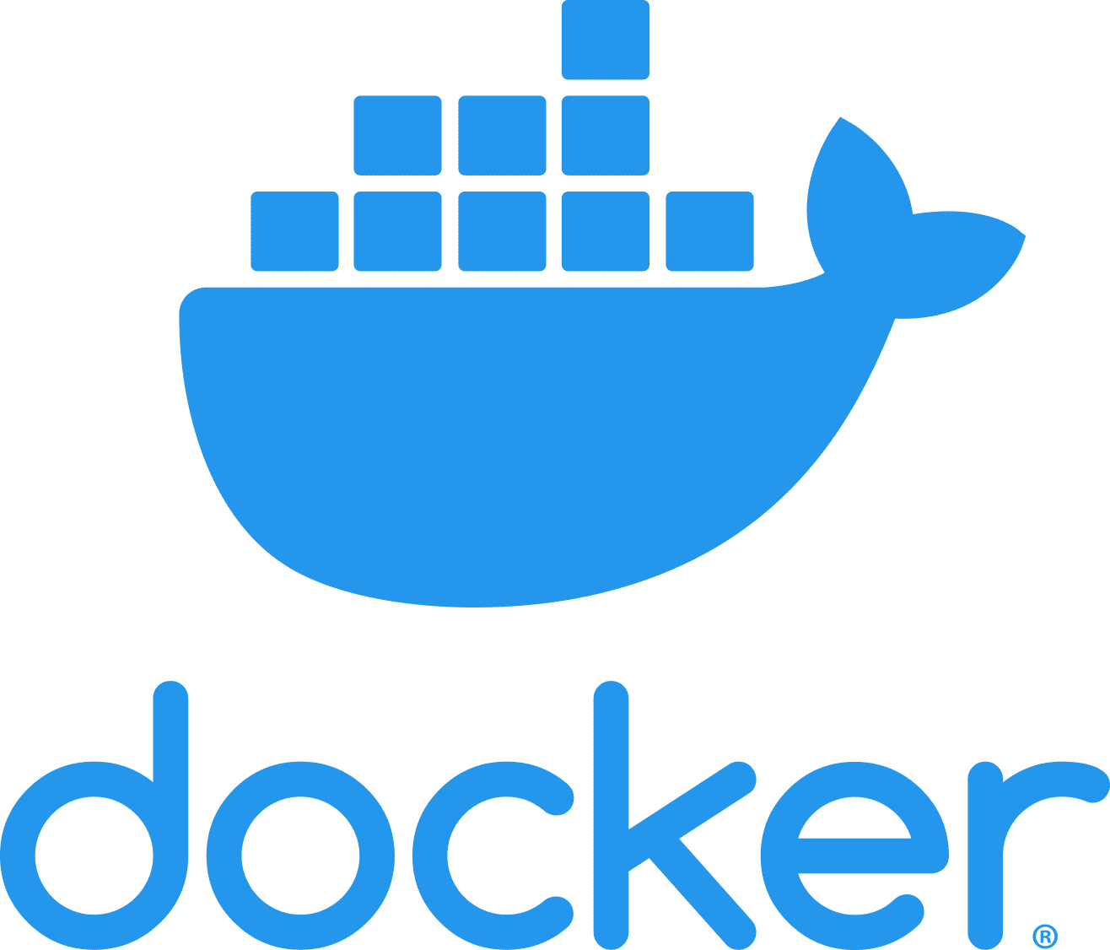


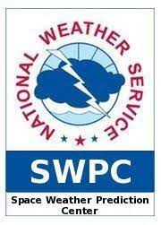

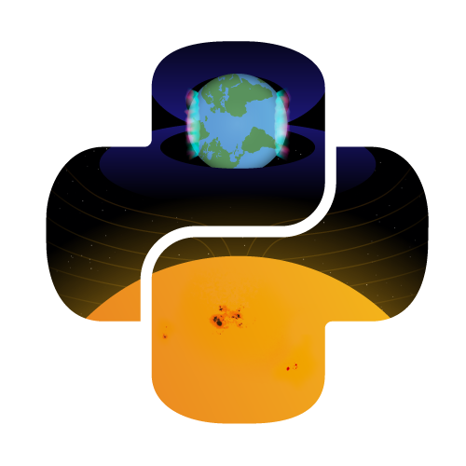
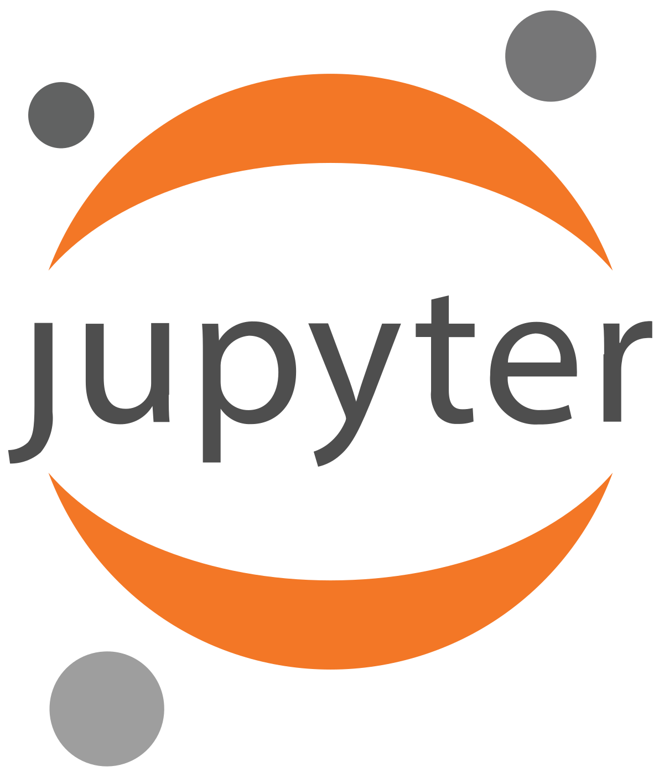
Now is the time…
2023 is designated as the
Year of Open Science.
The initial push for open science is expected to be sustained until 2027 with permanent changes.
The call for white papers for the 2024 Heliophysics Decadal Survey is coming.
Technology is ready and the demand is increasing.
PyHC

Slide 3
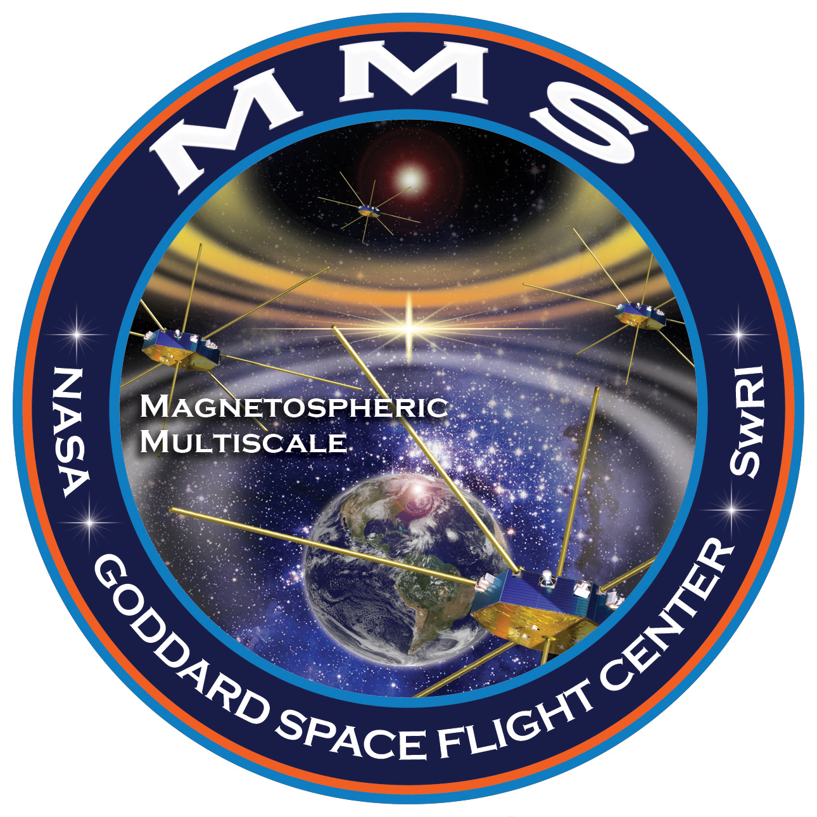
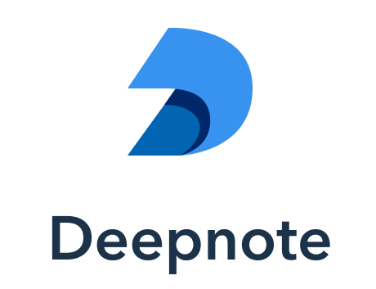
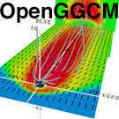
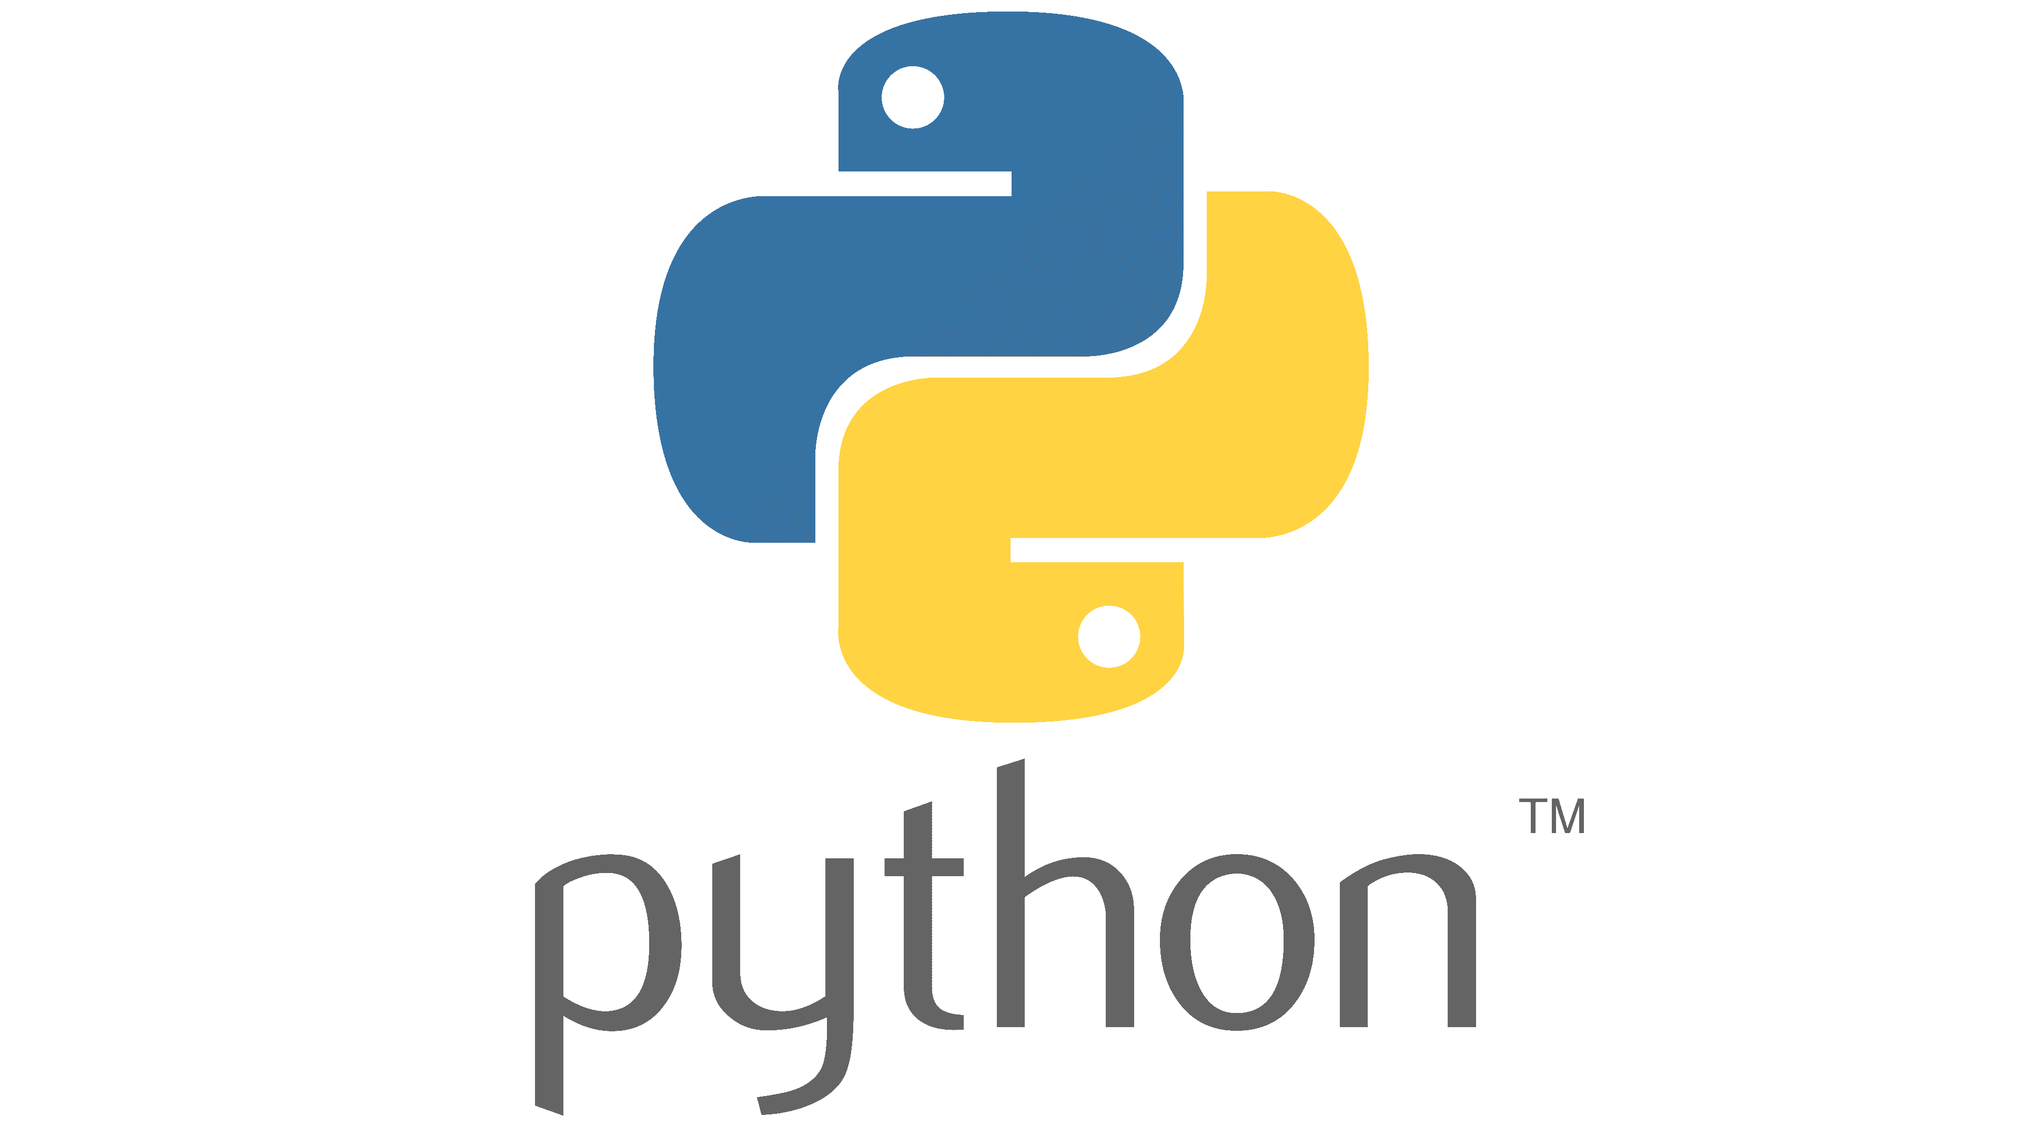
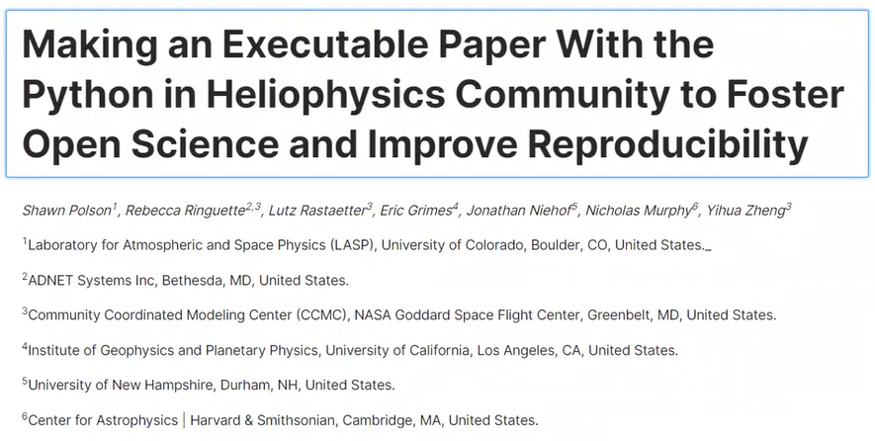


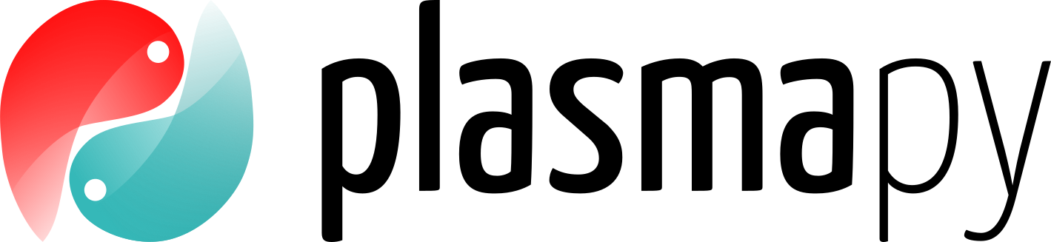

What can we do already?
Collaboration between software and science!
Install multiple packages in one online container.
Share and collaborate on programming notebooks.
Analyze small datasets on the cloud.
Extend to larger science.

Slide 4
Time for a White Paper
Limited to small datasets (< 5 GB), so problematic for most imagery and model data analysis and comparisons.
  Network speeds impede analysis of data not stored in the same container. Can this be faster?
  Downloading not possible for low-resource projects. Can the dataset be reduced beforehand?
New approach to science with software developers, software engineers, and scientists on equal footing. Delegation of tasks according to skill = smoother science process!
Questions to address in the white paper:
  What infrastructure and capabilities do we depend on to develop models and use models and model outputs? What would happen if those were no longer funded?
  What additional support and capabilities do we need to advocate for to be able to adhere to open science standards in our work? Free resources aren’t free. Our time is not free either.
  What organizations should provide those capabilities and support? How?

