Slide 1





Kamodo: A Model-Agnostic Tool for Model-Model and Model-Data Comparisons
Rebecca Ringuette^{1, 2}, Lutz Rastaetter², Darren De Zeeuw^{2,3}, Asher Pembroke⁴, Katherine Garcia-Sage², Oliver Gerland⁴, Michael Contreras⁴, Robert Robinson^{3, 2}.
¹ADNET Systems, Inc., ²NASA Goddard Space Flight Center,
³Catholic University of America, ⁴Ensemble Consultancy.
Kamodo-Core
CCMC-Kamodo
CEDAR 2022 Invited Talk – Snakes on a Spaceship

Slide 2

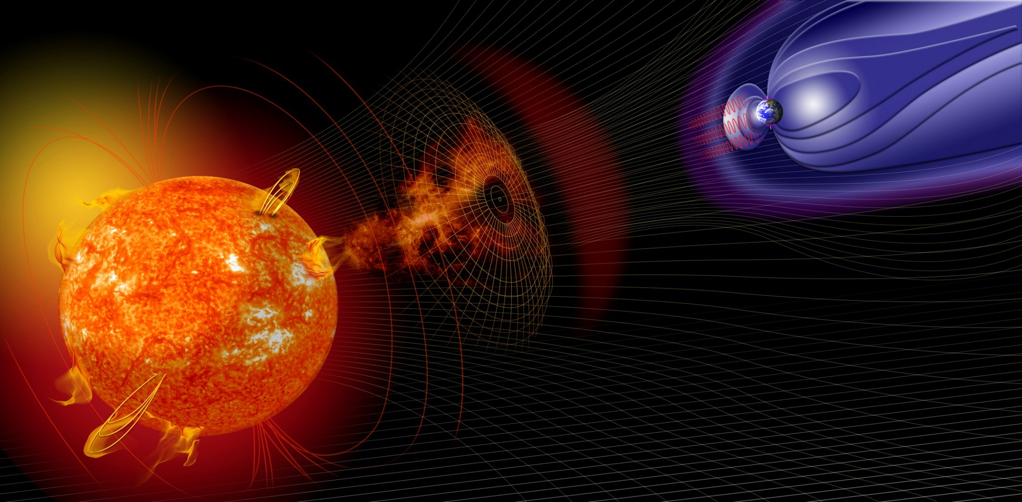
Models at CCMC
Models, Model chains, &
Frameworks for model coupling
LFM-TING
GUMICS
TIE-GCM
SAMI-3
WSA-ENLIL
LFM-MIX
GIC
GMAT
SAM
SWMF.SC+EEGGL+CME
WSA-ENLIL+Cone
OpenGGCM+CTIM
CTIPe
IDA4D
AWSoM
EEGGL
SRPM
WSA-ENLIL+EPREM
SWMF+RCM+deltaB
PFSS.Petrie
ANMHD
USU-GAIM
WSA-ENLIL+SEPMOD
SWMF+RCM
PFSS.Macneice
SWMF+RCM+RBE
RCM
SWACI-TEC
REleASE
ABBYNormal
PFSS.Luhmann
SWMF+RCM+CRCM
Fok.CIMI
PREDICCS
LFM-MIX-TIEGCM
NRLMSISE
EMMREM
Fok.RBE
MAG4
UMASEP
Houston, we have a problem…
iPATH
WINDMI
LANLstar
UPOS RB
GITM
ASAP
ASSA
AMOS
IGRF
Tsyganenko
AE-8/AP-8
PBMOD
EXO Solar Wind
WSA
NLFFF
CORHEL
PS VP
Weigel-deltaB
AE-9/AP-9
TRIPL-DA
AACGM
Apex
VERB
Weimer IE
MAGIC
SNB3GEO
Heltomo SMEI
Weimer-deltaB
AMPS
Heltomo IPS
IRI
JB2008
GCR
BON
NOVICE
BRYNTRN
IMPACT
DTM
NAIRAS
CARI-7
COSGROVE-PF
DBM
Ovation Prime
SWMF.SH
VPIC
PAMHD
DIPS
PIC-Hesse
Corona
Heliosphere
Magnetosphere
Local Physics
Inner
Magnetosphere
Ionosphere/
Thermosphere
Notes:
Old bullets = talking points. CCMC now official recipient of space weather models, including Rick’s (corona/heliosphere). Need a way to easily compare model data to observations (e.g. Rick’s model data to Parker Solar Probe data), and plug in data from one model to another for coupling.

Slide 3
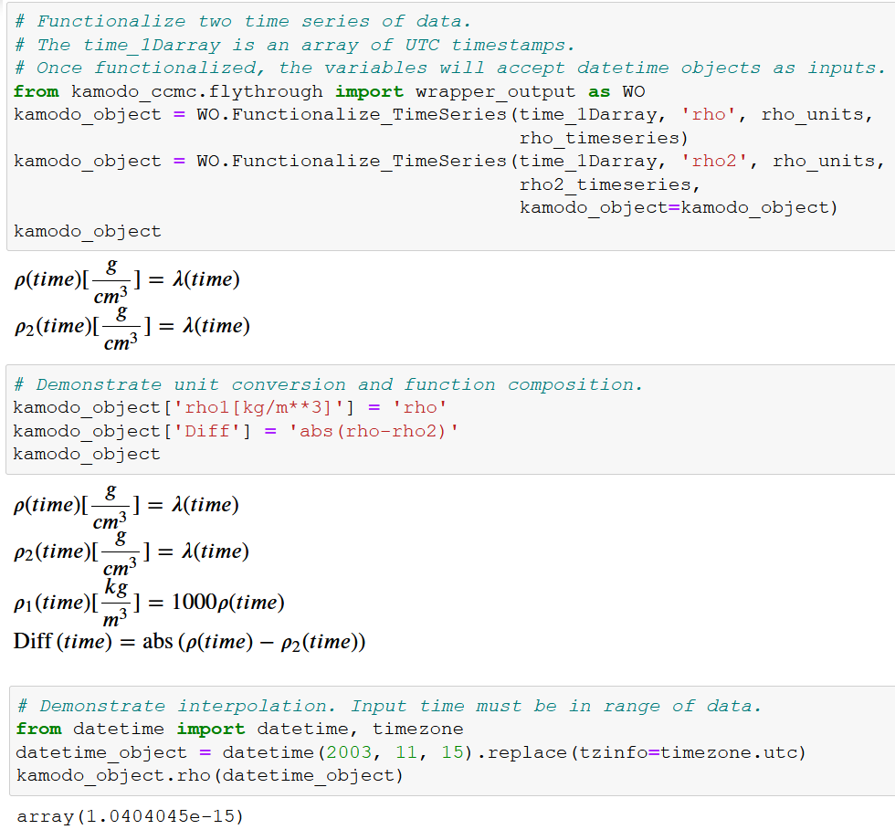
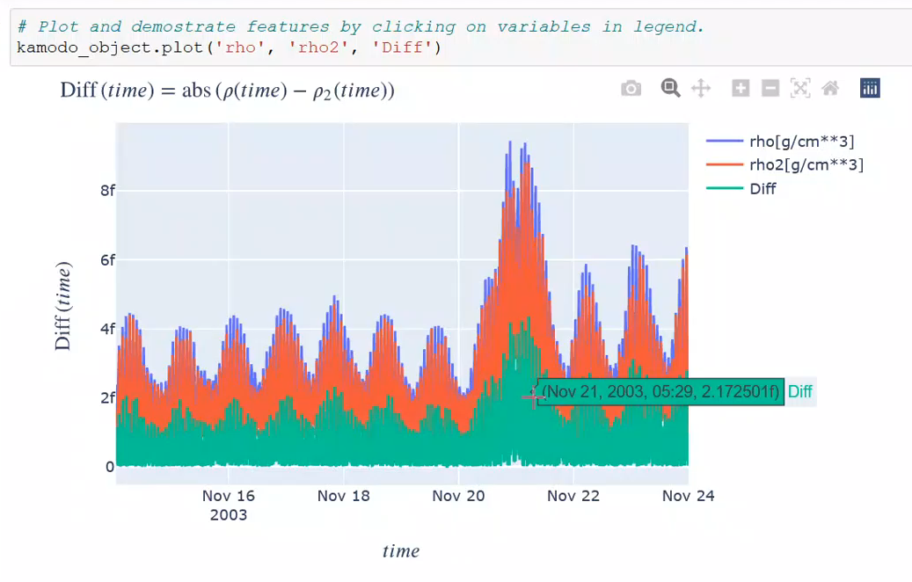
What is Kamodo?
Capabilities are built upon functions and interpolators, easily enabling
  Unit conversions
  Function composition
  Interpolation
  Interactive plotting
  Model-data comparisons
Currently available on github as open source
https://github.com/EnsembleGovServices/kamodo-core
https://github.com/nasa/Kamodo

Slide 4
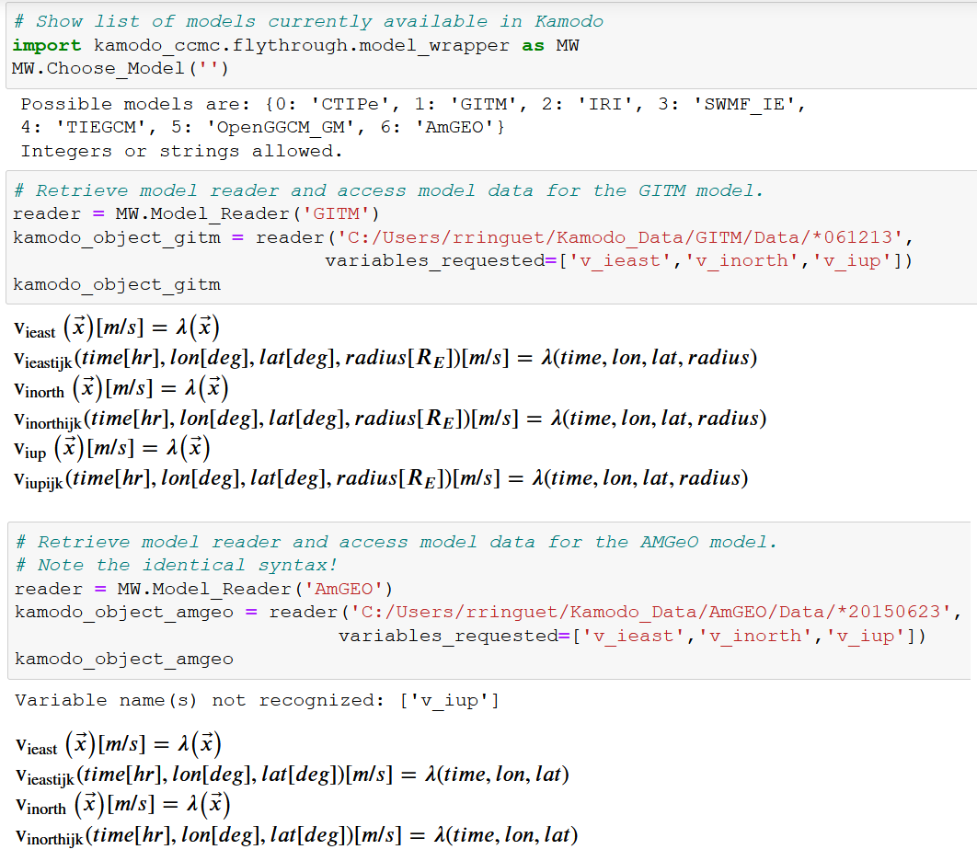
Model Readers:
Functionalized Model Data
Provide a fast, model-agnostic method to easily functionalize model data.
Handle custom data formats, grids, and interpolators ‘behind the scenes’.
Returned Kamodo objects offer the same capabilities as before (e.g. plotting and function composition).
‘v_iup’ not in AMGeO output, but code didn’t break.

Slide 5
Model Readers:
Comparing Model Data
Use Kamodo’s Model Readers to retrieve functionalized data from multiple models with the same variables
Interpolate the data onto the same grid
Functionalize the new variables of reduced dimensions
Use function composition to perform comparative analyses
‘v_iup’ not in AMGeO output, but code didn’t break.

Slide 6
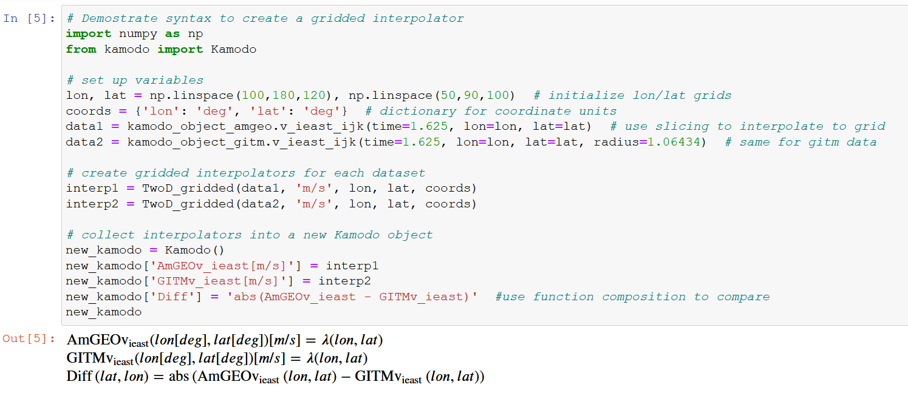
Model Reader Demo:
Comparing Model Data Across Multiple Models
See the back-up slide for this function.

Slide 7
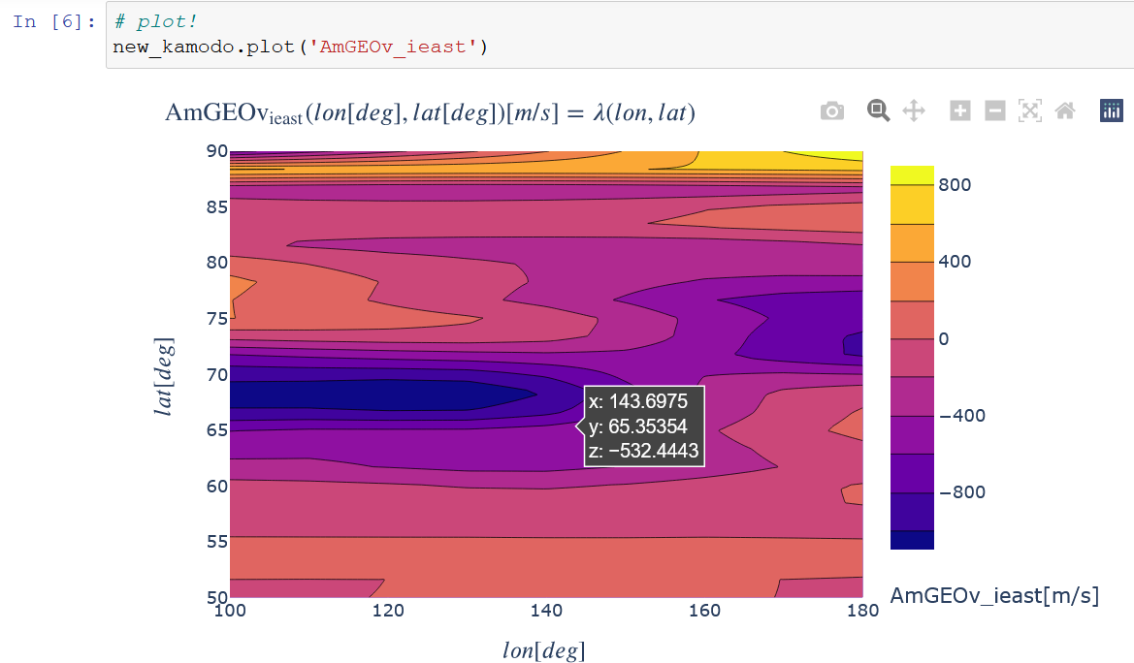
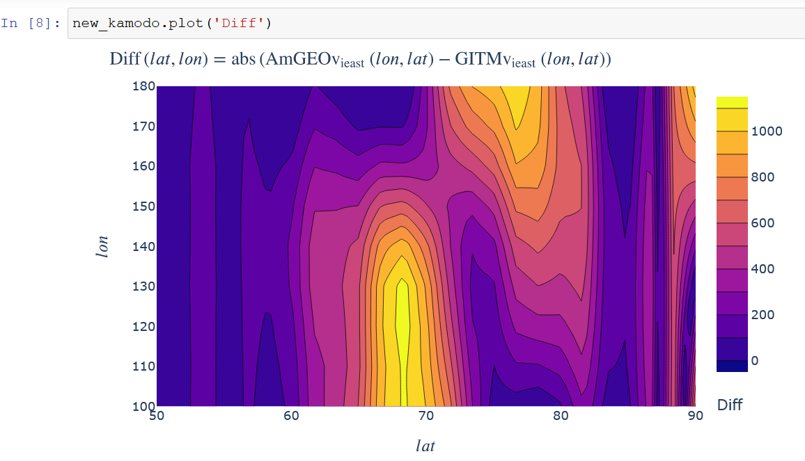
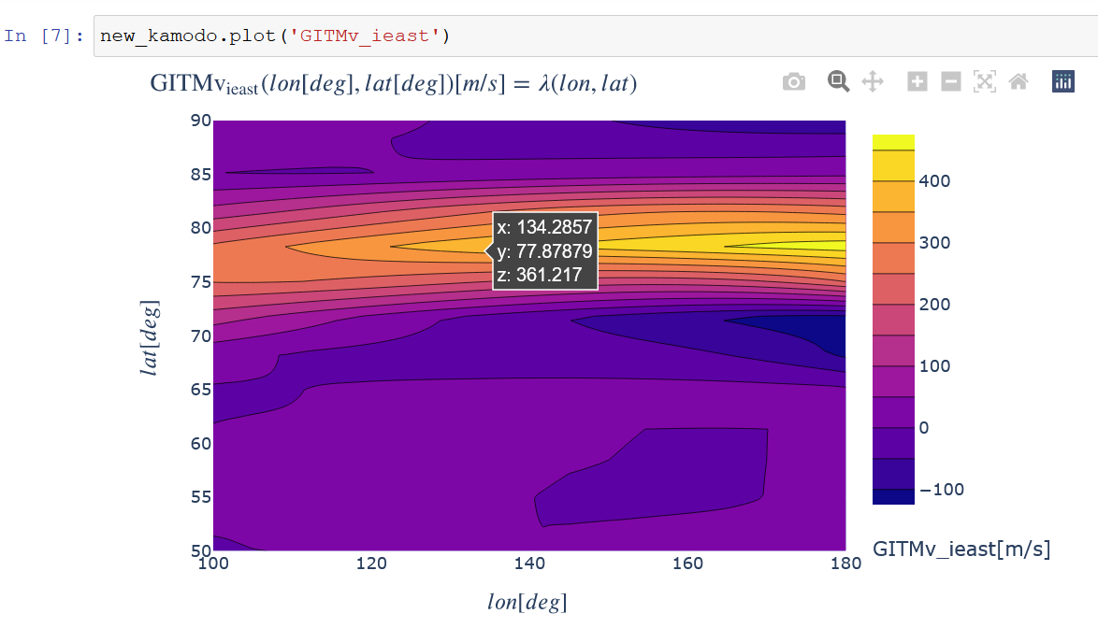
Model Reader Demo:
Comparing Model Data Across Multiple Models

Slide 8
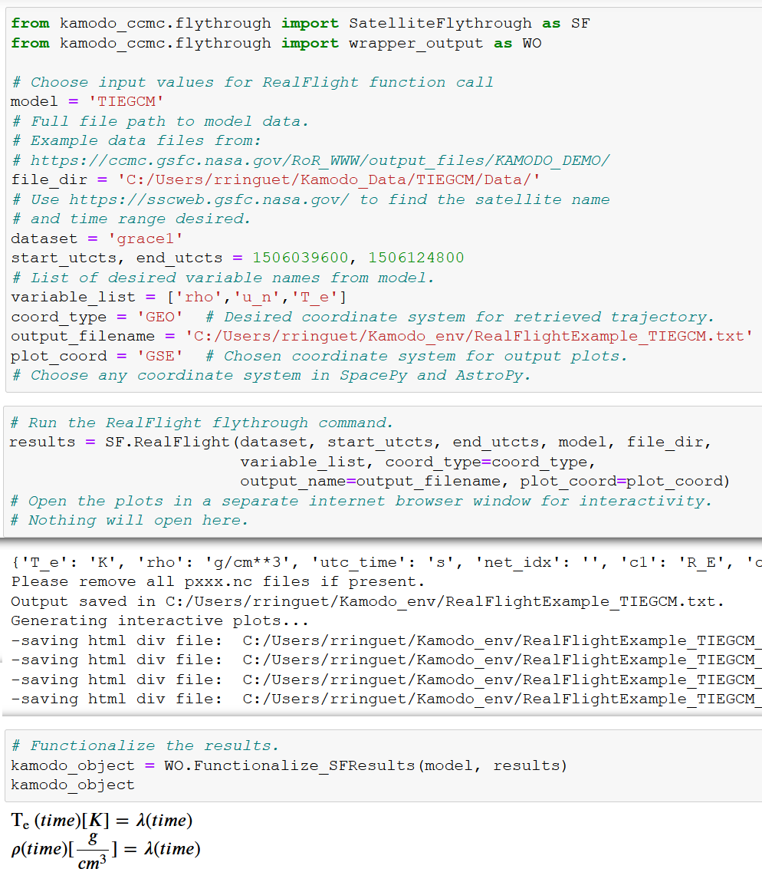
Satellite Flythrough:
Interpolate Values for any
Trajectory
Model-agnostic flythrough capability built upon a network of model readers.
Automatically handles coordinate conversions between trajectory and model coordinates via SpacePy-Astropy coordinate library.
Simple command syntax for easy model-data comparisons.
Also accessible from the command-line.
Notes:
Ran about one day of trajectory data from the Grace1 satellite, retrieved from SSCWeb.

Slide 9
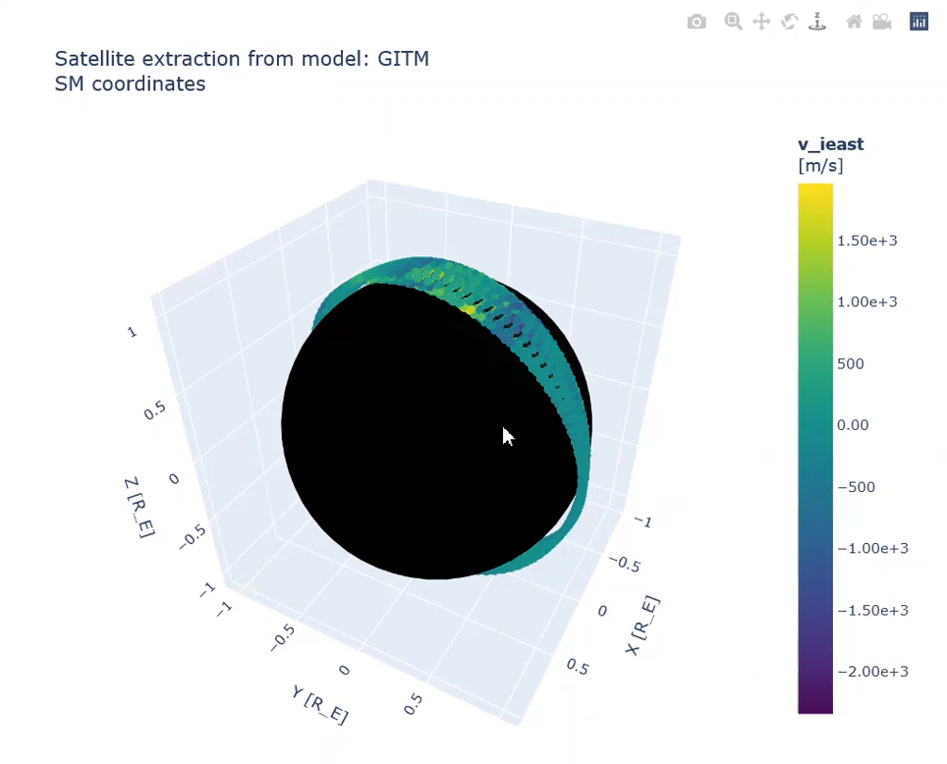
Satellite Flythrough
Trajectory Options
Options currently available for trajectories:
RealFlight to retrieve real satellite trajectories from the Satellite Situation Center Website (SSCWeb).
ModelFlythrough and MyFlight provide your own satellite trajectory by direct input or through a file.
Fakeflight generate an adjustable sample trajectory.
More options coming soon!

Slide 10

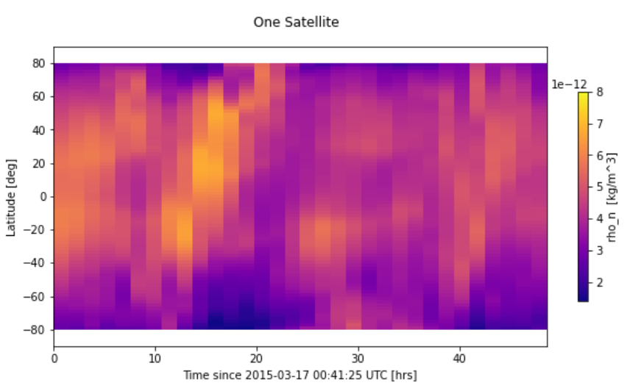
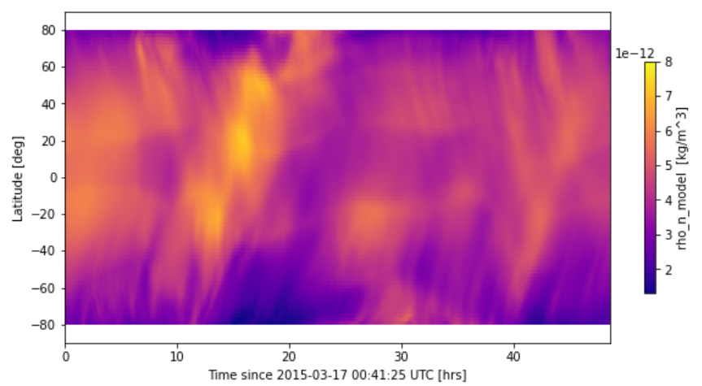
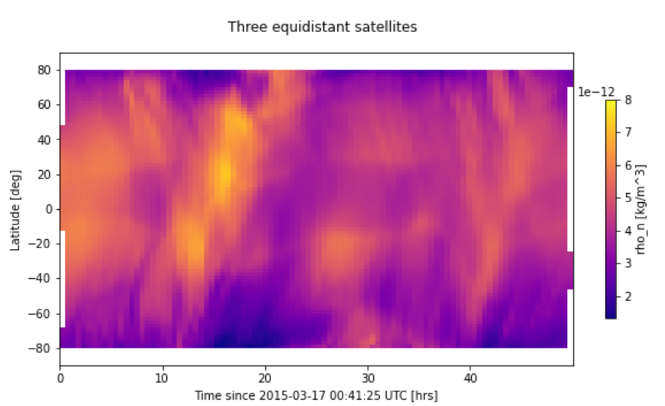
Kamodo: Support of GDC
New satellite constellation tool reconstructs in
any pair of dimensions what a given constellation configuration would see.
Currently available for any Kamodofied model with model-agnostic syntax (e.g. several ITM models).
Satellite
constellation
reconstructions
Model data
Multiple slicing and analysis methods available.

Slide 11
Collaborate with us to make your model data interactive!
Currently supported model outputs:
  CTIPe
  AMGeO
  IRI 2016
  SWMF (IE)
  TIE-GCM
  GITM
  OpenGGCM (GM)
Model outputs coming soon:
  SWMF (GM)
  GUMICS
  SuperDARN
  RAM-SCB
  GAMERA
  VERB
  WACCM-X
  ENLIL
  SAMI3
  Weimer
  ADELPHI
  WAM-IPE

Slide 12
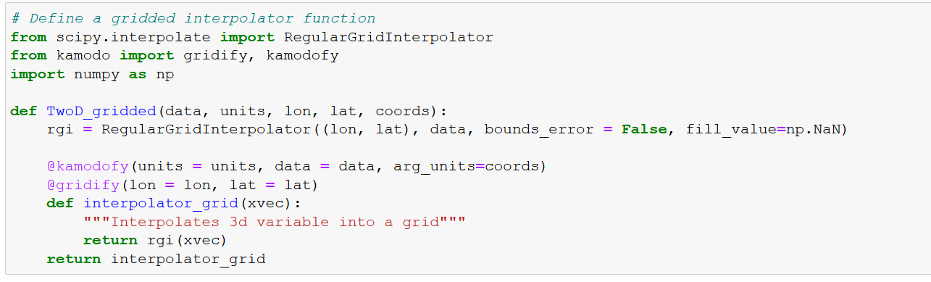
Model Reader Demo:
Comparing Model Data Across Multiple Models

