Slide 1
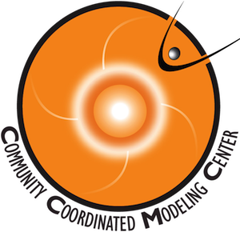

New Software Capabilities using Kamodo at CCMC
Rebecca Ringuette^{1, 2}, Asher Pembroke³, Lutz Rastaetter², Darren DeZeeuw²
¹ADNET Systems, Inc., ²Community Coordinated Modeling Center (CCMC) at Goddard Space Flight Center (GSFC), ³Predictive Science, Inc.

Slide 2
Motivation
Provide capabilities for CCMC users to extract data from hosted models.
Design a user-friendly interface accessible in multiple languages.
Enable users to retrieve real satellite trajectories, provide their own, or use a sample adjustable trajectory to ‘fly through’ the model data.
Begin with Ionosphere/Thermosphere models, progress to Magnetosphere models and beyond.
Build a reconstruction tool on top of the satellite flythrough software (more features to come, e.g. a line-of-sight tool).

Slide 3
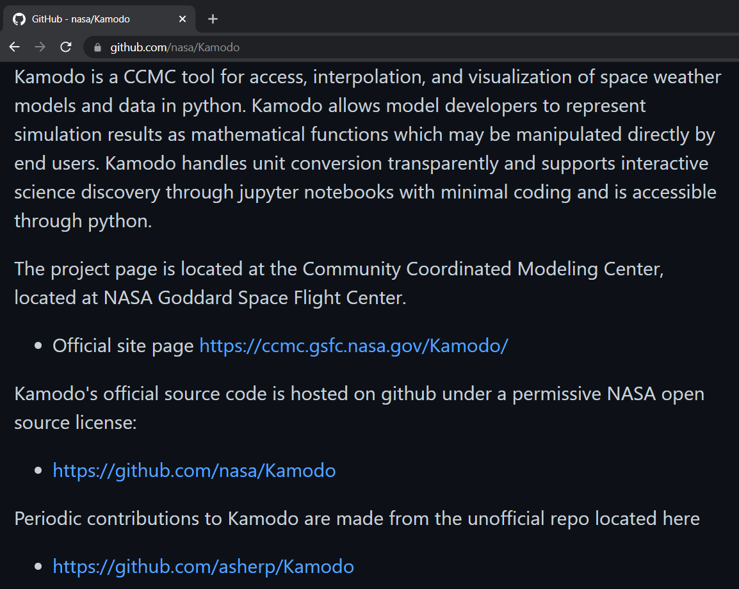
What is Kamodo?
Official description from Github .
Please see Github page for more details and examples.
The software described in this presentation are based on the ‘asherp’ repository.

Slide 4
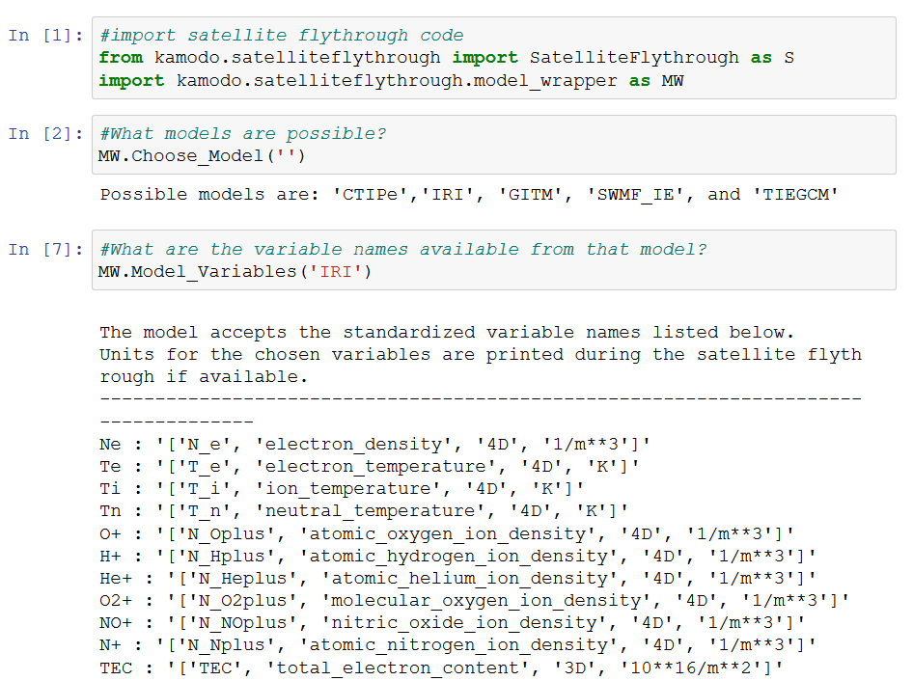
Satellite Flythrough
Fly trajectory through model data: Choices
  Choose a model* from the available list (more to come).
  Choose variable(s) from model’s list.
  Choose function call based on satellite trajectory choice.
*Requires a model-specific reader with time and space interpolation that subclasses Kamodo. Instructions for collaboration and more detailed documentation coming soon.
Variable names
Variable units

Slide 5
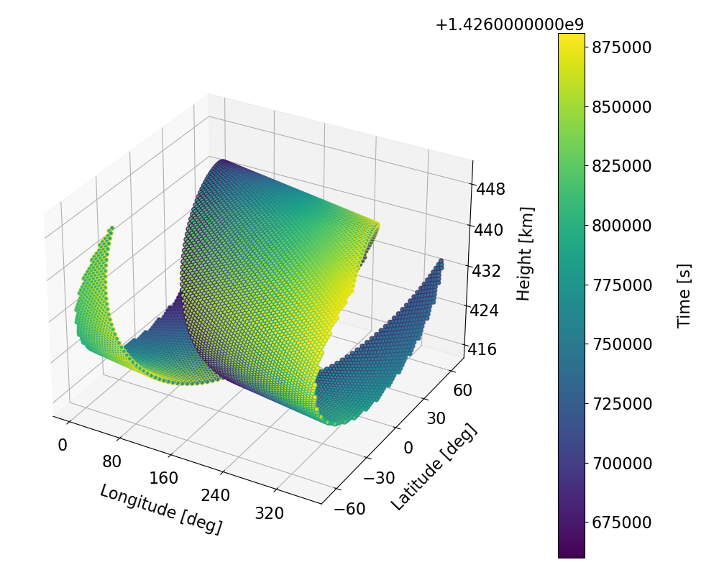
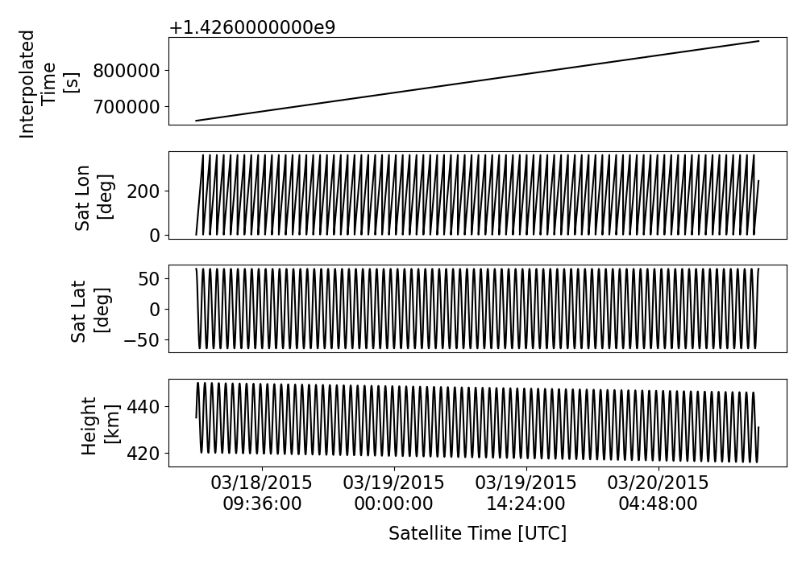
Satellite Flythrough
Sample trajectory output
Trajectory options
  Retrieve real satellite trajectories from the Satellite Situation Center Web (SSCWeb). Function uses SpacePy to convert to geographical coordinates. (Call ‘RealFlight’ function.)
  Provide your own satellite trajectory (time, altitude, geographical latitude, and geographical longitude) by direct input. (Call ‘ModelFlythrough’ function directly.)
  Generate an adjustable sample trajectory using ‘SampleTrajectory’ function (pictured at right). (Call ‘FakeFlight’ function.)
Note: Users can also easily retrieve other satellite data from the Coordinated Data Analysis Web (CDAWeb) using the ‘hapi.py’ reader for model-data comparisons.

Slide 6
Satellite Flythrough
Model Flythrough Logic
  Splits trajectory into chunks aligning with the time ranges found in (automatically) prepared model data files. Shifts given times between model files to nearest file.
  Automatically detects if a chosen variable is dependent upon pressure level in the model data, then converts all satellite altitudes to pressure levels if needed by inverting the height data provided by the model (takes additional time). Users can choose the height accuracy of the conversion (in meters).
  Flies trajectory chunks through model data using interpolators in the Kamodo object generated.
  Assembles the results and trajectory chunks and returns data to user.
Typical execution times are a few seconds or less for a few days of data, and on the order of a few minutes or less if conversions to pressure altitude are required.

Slide 7
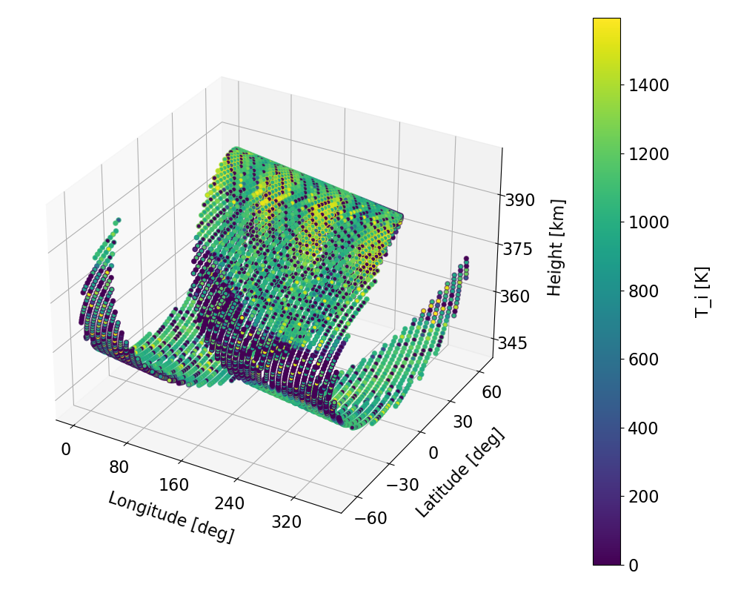
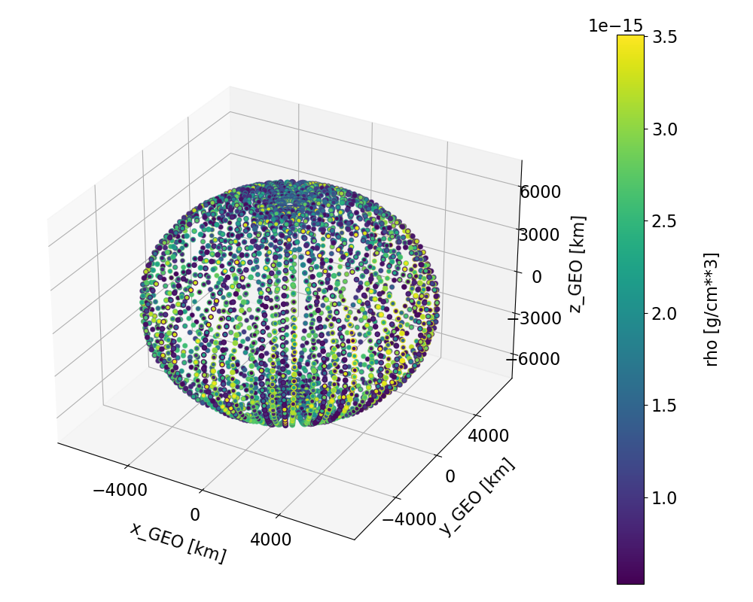
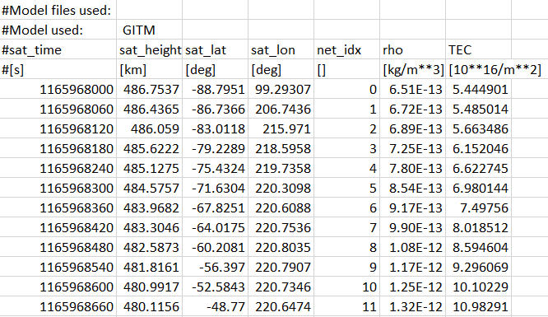
Sample
Results
FakeFlight
RealFlight
CTIPe model flythrough using a sample trajectory, plotted in satellite coordinates.
TIEGCM model flythrough using a satellite trajectory, plotted in cartesian coordinates.
Not shown:
All satellite flythrough functions can be called directly from C++ via pybind11. (C and Fortran interfaces coming soon.)
A simplified module is provided for single point flythrough requests, with results also written to csv format.
Sample csv output

Slide 8
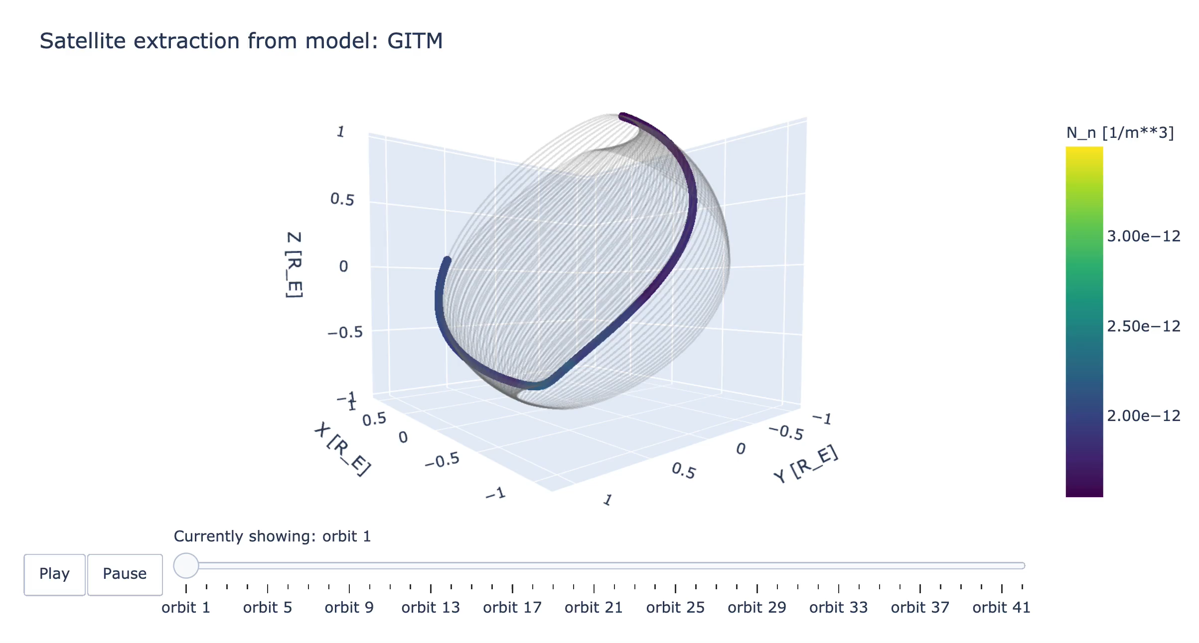
New type of visualization coming!

Slide 9
Reconstruction
Motivation and Desired Capabilities:
Provide a software capability for satellite constellations to determine how many satellites are needed in a constellation to resolve certain features in the model data.
User provides a satellite trajectory, dimensional offsets between constellation members, model name, and desired options.
Offer reconstruction in any six possible pairs of dimensions (time and spatial) and later in 3D (spatial only).
Offer several analysis options (currently four).

Slide 10
Reconstruction
Software Logic: 2D
Generates shifted copies of the satellite trajectory
Corrects for longitude wrapping
Flies all trajectories through the chosen model data
  unchanged OR averaged in two secondary dimensions as requested
Grids results into the pair of dimensions requested with resolution chosen
Retrieves model data using analysis method chosen
  slice at averaged two secondary dimensions OR averaged over range of two secondary dimensions as requested
Compares result to model data
Notes:
Don’t get into details of options, just give a taste of what’s coming

Slide 11
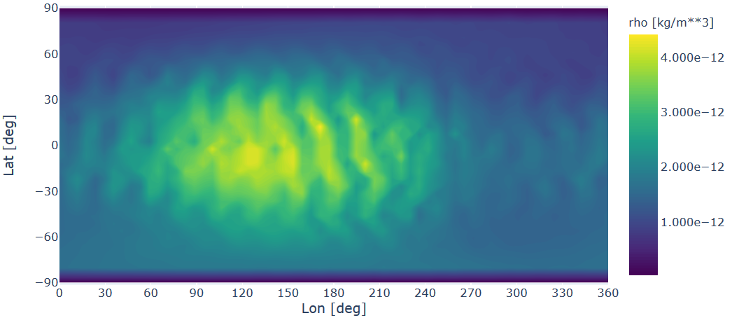
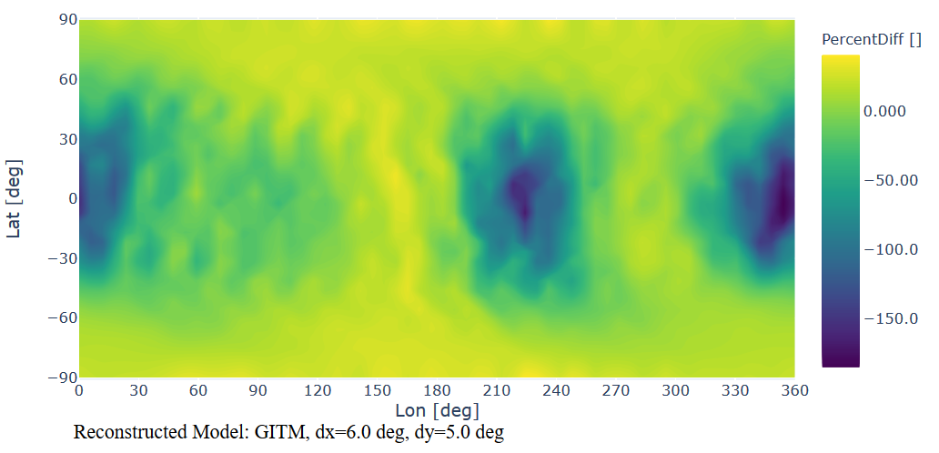
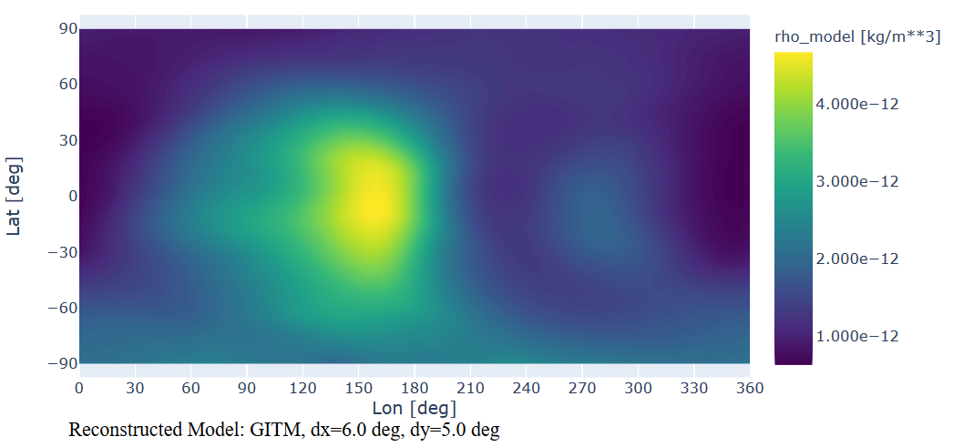
Model - Reconstruction
Model
X 100 = Percent Difference
Reconstructed satellite flythrough of density through the GITM model for longitude offsets of 0°, 30°, 60°, and 90°, plotting in latitude and longitude coordinates. No other modification of the satellite trajectory was performed.
Percent difference of reconstructed and modeled density data, plotted in the same coordinates.
Plots shown are for one of four analysis options and one of six dimensional pairs to be offered by the 2D version.
Slice of GITM model data at average time and height of the satellite trajectories, plotted in the same coordinates.

Slide 12
Summary
Demonstrated a sample of upcoming model data interaction capabilities to be implemented for user access at the Community Coordinated Modeling Center (CCMC)
  The satellite flythrough software is a fast, model-agnostic method to ‘fly’ a satellite trajectory through the model data. Additional models are being added often.
  The reconstruction software builds upon the satellite flythrough software to offer constellation missions a way to determine the best configuration for their science question.
By design, any additional layers will work with all models compatible with the satellite flythrough software, including a line-of-sight tool.

