Slide 1

The Reliability Function
HSV RAM XIV
Paul Thomas Britton
paul.t.britton@nasa.gov
11/1/2022

Slide 2

Table of Contents
Probability Theory
Random Variables
Fatigue Life Example
Probability Distributions
The Reliability Function
Backup
Probability Space
Definitions
Examples
Problem Statement
Solution
Glossary
Notes:
The main topic is the application of the Reliability Function to modeling Fatigue Life.
Learning objectives:
Exercise Calculus muscles
Gain better fluency with Probability Theory Terminology
Gain confidence with understanding the math behind reliability
Understand the basics of the Reliability Function
Be able to apply Weibull Analysis to Fatigue Life Data

Slide 3
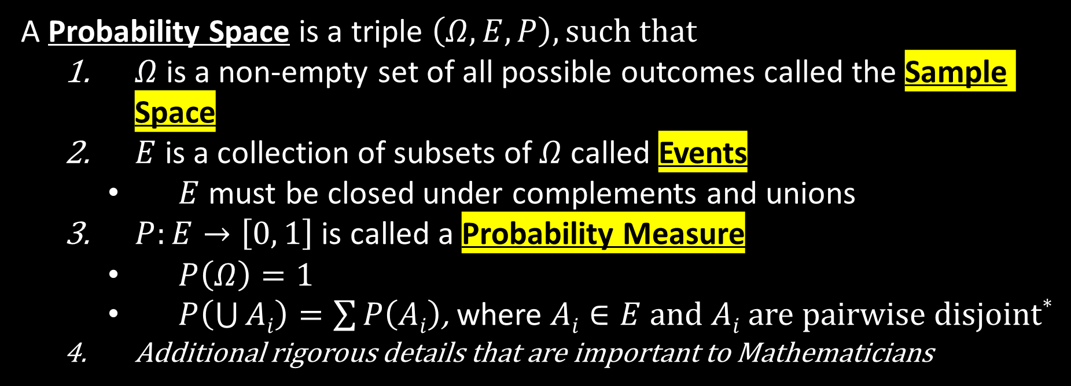
Probability Theory
A Probability Space is a triple $\left(Ω, Ε,Ρ\right), such that$
  $Ω$ is a non-empty set of all possible outcomes called the Sample Space
  $E$ is a collection of subsets of $Ω$ called Events
    $E$ must be closed under complements and unions
  $P:E→\left[0, 1\right]$ is called a Probability Measure
    $P\left(Ω\right)=1$
    $P\left(\bigcup{Ai}\right)=\sum{P\left(Ai\right)}$, where $Ai∈E$ and $Ai$ are pairwise disjoint*
  Additional rigorous details that are important to Mathematicians
*Pair of dice example: $P\left(rolling a 4\right)=P\left(\left[1, 3\right]\right)+P\left(\left[3, 1\right]\right)+P(\left[2, 2\right])$
Notes:
To quantify uncertainty, we must turn to the branch of mathematics concerned with probability.
Theorizing about the unknown is a challenge even to mathematicians. Applying the theory is an even greater challenge.

Slide 4


Random Variables
A Random Variable is a function $X$ that maps outcomes of an experiment to numerical quantities.
Therefore, we can express mathematically, the probability that the outcome to an experiment is mapped by $X$ to a quantity within an interval
$$\text{P}\left(a≤X≤b\right)≝P\left(\left[a, b\right]\right)$$

Slide 5
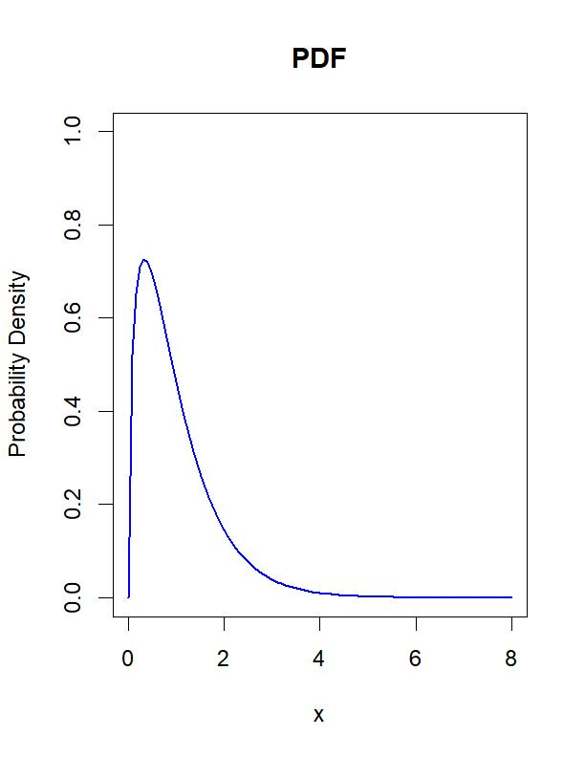


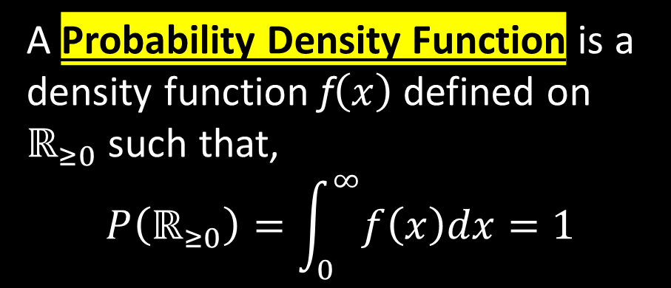
Probability Distributions (${Ω=ℝ}_{≥0}$ case)
A Probability Distribution is a mathematical model used to construct probability measures. Probability Density Functions are one such characterization for continuous random variables. They are analogous to Histograms, and they have useful geometric interpretations.
A Probability Density Function is a density function f$\left(x\right)$ defined on $ℝ_{≥0}$ such that,
$$P\left(ℝ_{≥0}\right)=\int_{0}^{∞}{f\left(x\right)dx=1}$$
And,
$$P\left(\left[a, b\right]\right)=\int_{a}^{b}{f\left(x\right)dx}$$
Notes:
PDF is key to the geometric interpretation of probability.
P() and E must be shown to satisfy the three axioms of a probability space.
PDF is analogous to a Histogram.

Slide 6



The Reliability Function (Definitions)
The Cumulative Distribution Function F$\left(x\right)$ is defined as
$$\text{F}\left(x\right)≝\int_{0}^{x}{f\left(z\right)dz}=P\left(X≤x\right)$$
The Inverse Cumulative Distribution Function $F^{−1}(p)$ is defined at $p$ to be the value $x$ such that$\text{F}\left(x\right)=p$
The Reliability Function or Survival Function is defined as the complement of the Cumulative Distribution Function:
$$S\left(x\right)≝1−F\left(x\right)=P\left(X>x\right)$$
Notes:
The Reliability Function should not be confused with the inverse cumulative distribution function.

Slide 7
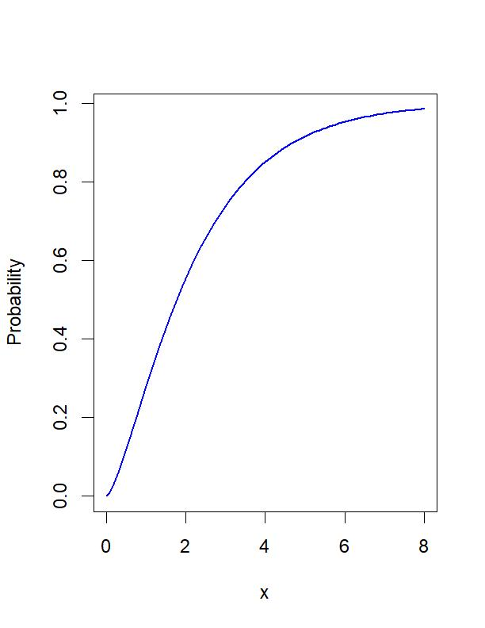
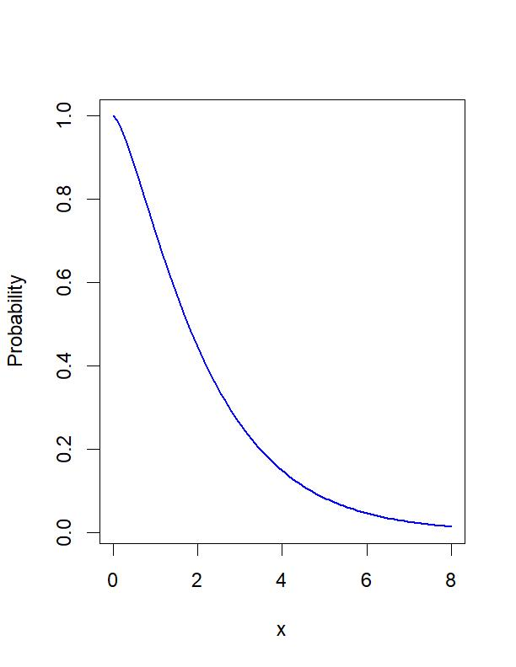


The Reliability Function (Quiz 1)
$$\text{F}\left(x\right)=P\left(X≤x\right)$$
$$S\left(x\right)=P\left(X>x\right)$$
Notes:
The Reliability Function should not be confused with the cumulative distribution function or the inverse cumulative distribution function.
Highlight properties.
Quiz: which is the Reliability Function?

Slide 8








Example Distributions (Quiz 2)
The Exponential Distribution $(λ)$
The Weibull Distribution $(β, η)$
$$f\left(x\right)= \frac{β}{η}{\left(\frac{x}{η}\right)}^{β−1}e^{−{\left(x/η\right)}^{β}}$$
$$f\left(x\right)= λe^{−λx}$$
$$F\left(x\right)=1−e^{−λx}$$
$$F\left(x\right)=1−e^{−{\left(x/η\right)}^{β}}$$
$$S\left(x\right)=e^{−λx}$$
$$S\left(x\right)=e^{−{\left(x/η\right)}^{β}}$$
Notes:
Two Parameters are more powerful than one. And doubles the opportunity for mistakes.
Quiz: Which formulae are which? PDF, CDF, Reliability Function

Slide 9
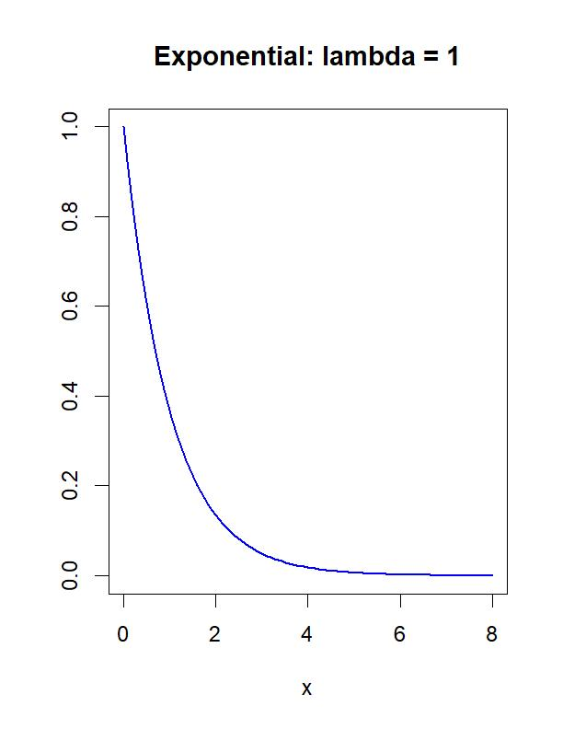
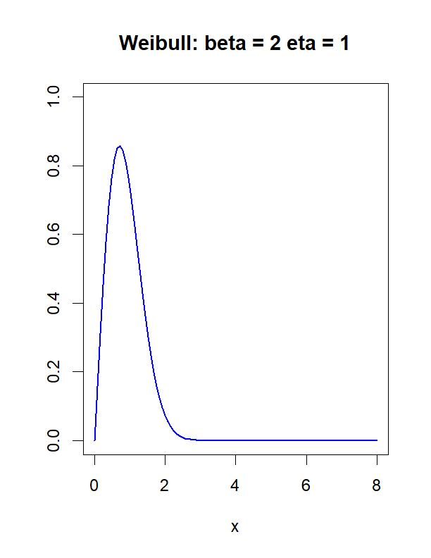


Example Distributions (Quiz 3)
The Exponential Distribution $(λ)$
The Weibull Distribution $(β, η)$
Notes:
Quiz: What functions are shown? PDF, CDF or Reliability Function?

Slide 10
Fatigue Life Example (Purpose)
Material Fatigue can be thought of as cumulative yet difficult to detect damage to material through cyclical loading. A reasonable and potentially useful application of the reliability function would be to model the fatigue life of rivets.
Recall an earlier problem*:
  A small boat manufacturer wants to know the probability that a rivet fails, creating a hole that could sink their boats.
  Each boat uses 600 rivets, and the manufacturer has already built 6 boats with no occurrences of this failure.
Probability that Boat Sinks due to Rivet Failure?
*Expectation vs. Reality: The Sunrise Problem Applied to Probabilistic Risk Assessment, Joseph Osowski

Slide 11
Fatigue Life Example (Definitions)
  Rivet failure is defined to be crack growth through to complete fracture
  Define the end of fatigue life to be detectible crack initiation.
  Boat rivet fatigue life can be decomposed into units called sea years. One sea year is defined to be the amount of fatigue damage incurred by a rivet from exposure to cyclical loading equivalent to that of a single year at sea.
Given a set of fatigue life spectral data from rivet testing and boat trip loads data, it is possible to fit a probability distribution that can be used to model the reliability of rivets against crack initiation.

Slide 12
Fatigue Life Example (Problem Statement)
100 rivets were repeatedly tested under a cyclical loading profile until all rivets experienced crack initiation. After each set of 100 test runs, the rivets were inspected for cracks. Analysis has also determined that a single test load profile is equivalent to 1/3 of a sea year.
Boat level requirements state that each rivet must have a reliability greater than 0.99995 throughout qualified service life
Notional Test Data:
15 rivets cracked between 600 and 700 test runs
80 rivets cracked between 700 and 800 test runs
5 rivets cracked between 900 and 1000 test runs
Requirements can be verified by fitting this data to a Weibull distribution and deriving a service life specification
Fatigue Life Begins
Crack Initiation
Rivet Failure
Boat Sinks
Notes:
It is possible to work with left censored and interval data as well as exact and right censored data.

Slide 13
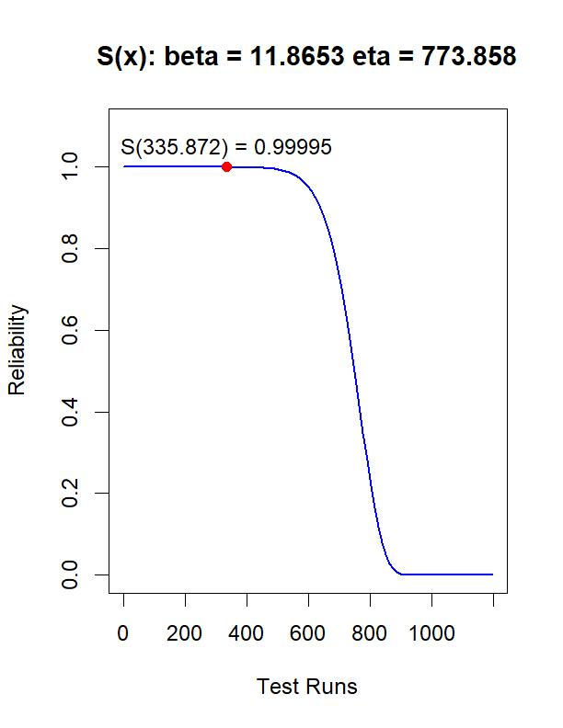
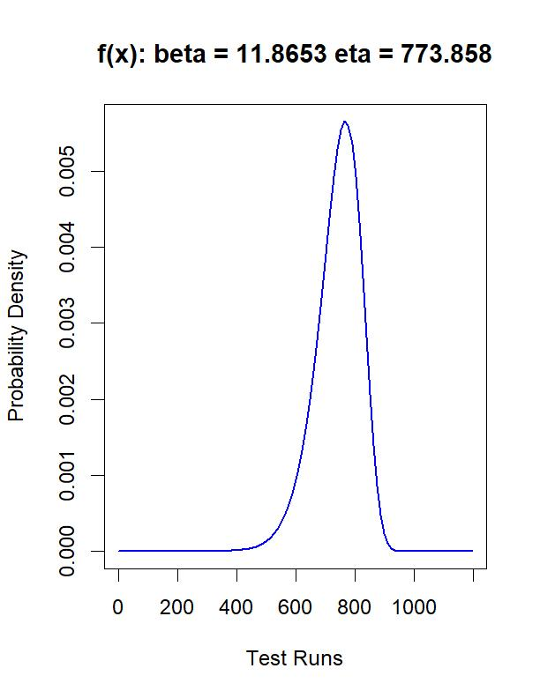



Fatigue Life Example (Weibull MLE Solution)
Maximize $L$ for $β$ and $η$:
$$L\left(β,η\right)={\left[S\left(600\right)−S\left(700\right)\right]}^{15}∙{\left[S\left(700\right)−S\left(800\right)\right]}^{80}∙{\left[S\left(900\right)−S\left(1000\right)\right]}^{5}$$
Solution:
  $$β=\text{11}\text{.}\text{8653}$$
  $η=773.8583$
Rivet reliability requirement verification remains valid for a service life of 110 years at sea
$S\left(210\right)=0.9999998$
1 in 10,000 chance of crack initiation during a 70-year service life at sea
Notes:
Usually, the log of L is maximized for computational convivence.
Identify the Mode, Mean and Median

Slide 14
Questions?
Notes:
It is possible to work with left censored and interval data as well as exact and right censored data.

Slide 15
Backup

Slide 16
Glossary
Cumulative Distribution Function (CDF) | The CDF of a real-valued random variable X, evaluated at x, is the probability that X will take a value less than or equal to x.
Event | An event is a set of outcomes of an experiment or a subset of the sample space.
Experiment | An experiment is any procedure that can be infinitely repeated and has a well-defined set of possible outcomes.
Fatigue | Cyclic load induced flaws and damage to material that can ultimately lead to crack initiation.
Histogram | A histogram is an approximate representation of the distribution of numerical data.
Likelihood Function | The likelihood function describes the joint probability of the observed data as a function of the parameters of a given statistical model.
Maximum Likelihood Estimate (MLE) | MLE is a method of estimating the parameters of an assumed probability distribution, given observed data.
Numerical Method | A numerical method is a mathematical tool designed to solve numerical problems.
Probability Density Function (PDF) | The PDF of a continuous random variable is used to specify the probability of the random variable falling within a particular range of values.
Probability Distribution | A Probability Distribution is a mathematical model used to construct probability measures.
Probability Measure | In mathematics, the concept of a measure is a generalization and formalization of geometrical measures (distance/length, area, volume) and other common notions, such as mass and probability of events. Probability measures must satisfy all the general measure properties as well as the property that a probability measure must assign value 1 to the entire probability space.
Probability Space | A probability space is a mathematical formalism of a random process or experiment.
ℝ_(≥0) | The non-negative real numbers.
Random Variable | A Random Variable is a function 𝑋 that maps outcomes of an experiment to numerical quantities.
Reliability | The probability that a product, system, or service will perform its intended function adequately for a specified duration or will operate in a defined environment without failure.
Reliability/Survival Function | The reliability function is theoretically defined as the function of t that returns the probability of success at time t.
Sample Space | The sample space of an experiment or random trial is the set of all possible outcomes or results of that experiment.

