Slide 1
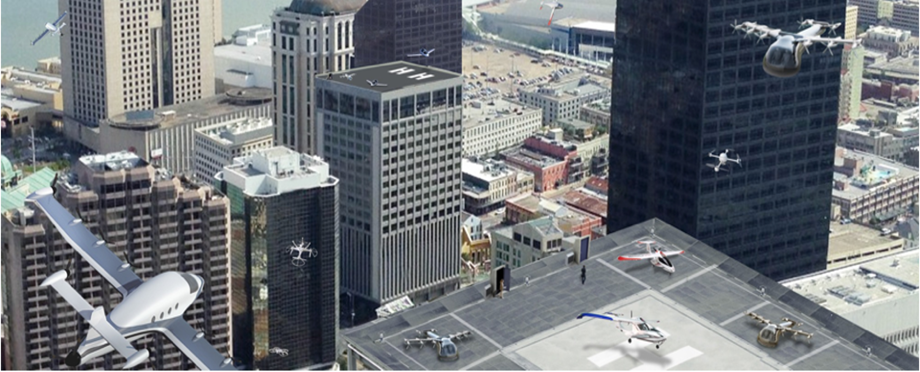

ATM-X's Urban Air Mobility (UAM) Subproject
Secured Airspace for UAM Workshop
Notes:
https://nari.arc.nasa.gov/sites/default/files/attachments/SecuredAirspaceforUAMWorkshop_Nov.%201_Agenda_DRAFT.pdf

Slide 2
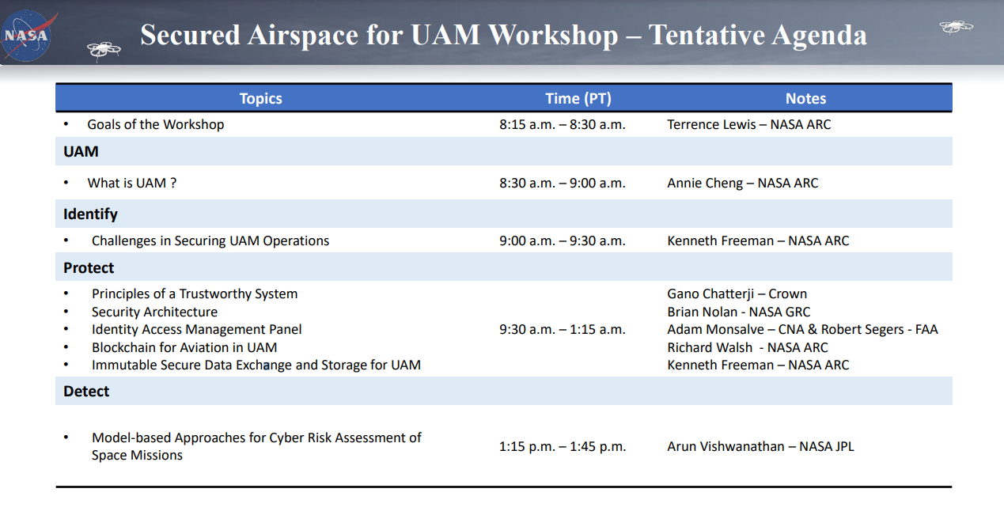
Topics

Slide 3
What is UAM

Slide 4
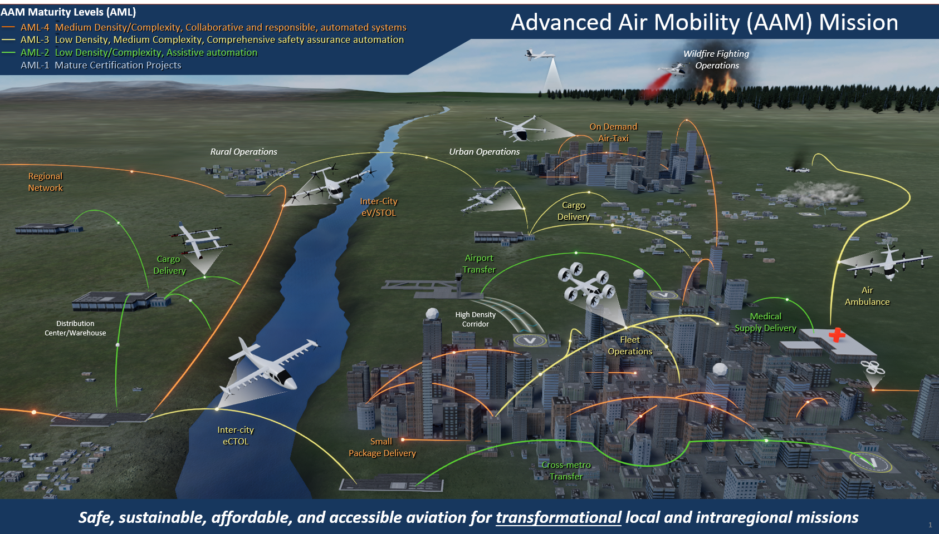
Urban Air Mobility (UAM)
UAM is a subset of the Advanced Air Mobility (AAM) concept under development by NASA, FAA, and industry
UAM focuses on passenger or cargo-carrying air transportation services in and around urban areas
Allows moving people and cargo between places previously not served or underserved by aviation
NASA’s role: help emerging aviation markets develop a safe air transportation systems
  Advanced technologies (e.g., electric aircraft, automated air traffic management)
  Leverage existing and develop new operational procedures
Credit: National Aeronautics and Space Administration (NASA) Advanced Air Mobility Mission Integration Office (AMIO)

Slide 5
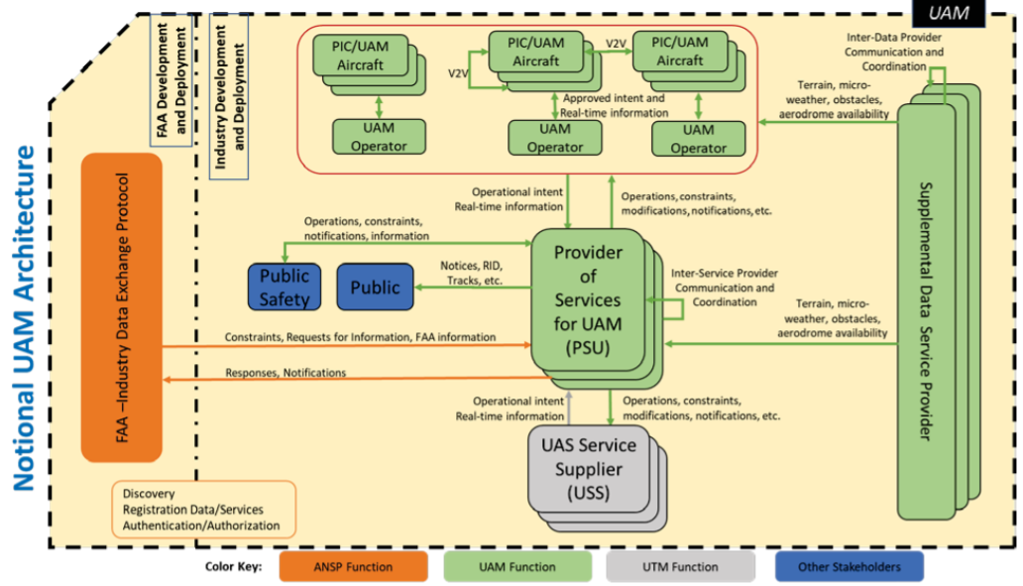
Notional Architecture for UAM
FAA ConOps v1 notional architecture describes the primary actors, functions, and data flows that support UAM operations in the envisioned future
UAM airspace system will include aspects of a federated architecture
Operators will rely on an array of technologies that are either self-provided or from a third-party
  e.g., Provider of Services to UAM (PSU), Supplemental Data Service Provider (SDSP)
Governance is divided between a central authority (e.g., FAA/ANSP) and constituent units (e.g., operators)
  Actors will operate collaboratively while adhered to a set of Community-Based Rules (CBRs)
Credit: The Federal Aviation Administration (FAA), Office of NextGen. Urban Air Mobility (UAM) Concept of Operations (ConOps) Version 1.0. June 2020.

Slide 6
ATM-X UAM Subproject – Recently Completed Demonstration Activity
National Campaign (NC)-1 Strategic Conflict Mgmt (X4) Simulation: July 2021 to June 2022
Overview
Conducted by NASA with seven industry airspace partners
Two primary objectives
  Research and develop airspace technologies, including PSUs, to enable strategic conflict management
  Prepare airspace partners for NC-1 flight test
Associated UMLs are UML-2 and UML-3
First time testing and evaluating UTM concepts and technologies for UAM while also identifying, developing and testing new services needed for UAM
  FAA UAM ConOps v1 architecture served as an initial starting point to integrate and test third-party services
  Third-party services include DSS and PSU, and other new services such as Demand-Capacity Balancing (DCB) to facilitate strategic conflict management
No human participants
Accomplishments
Potential new airspace constructs and technologies for UML-3 operations
NASA and seven airspace partners demonstrated initial technologies for strategic conflict management in a collaborative environment
Developed initial APIs to support these implementations, made available to public
Developed candidate CBRs with industry
Collaborative test and evaluate approach
Data collection to inform future research
Identified gaps in concepts and technologies (e.g., DSS) from UTM and captured lessons learned
Input to industry working groups (ASTM)

Slide 7
ATM-X UAM Subproject – Upcoming Demonstration Activities
ATM Interoperability Simulation (AIS): Summer 2022
  Human-in-the-loop simulation to examine potential new requirements for ATC
  Partnership with Joby
Tactical Conflict Management (X5) Simulation: FY23-FY24
  Strategic Conflict Management (SCM) automation capabilities
  Tactical Conflict Management (TCM) automation capabilities
  Interoperability tested through internal simulation and analysis
UML-3 Operational Integration Assessment (OIA): FY24-FY25
  Integrate cooperative conflict management automation from X5 into a high-TRL operational environment (FAA’s WJHTC)
  System actors represented: Fleet Manager, UAM and non-UAM PIC, Vertiport Manager, ATC
As we develop and test the federated architecture,
there is an increasing need to think about security

