Slide 1

Paternal imprinting of dosage-effect defective1 (ded1) contributes to seed weight xenia in maize
Dawei Dai, Janaki S. Mudunkothge, Mary Galli, Si Nian Char, Ruth Davenport, Xiaojin Zhou, Jeffery L. Gustin, Gertraud Spielbauer, Junya Zhang, W Brad Barbazuk, Bing Yang, Andrea Gallavotti, and A. Mark Settles
Adapted from Nat Commun 13, 5366 (2022). https://doi.org/10.1038/s41467-022-33055-9
under http://creativecommons.org/licenses/by/4.0/
A. Mark Settles
Life Support Studies AST
Bioengineering Branch
Image Credit: NASA

Slide 2
Flowering plant seeds result from double fertilization of the haploid generation
♀
♂
♀
♂
In animals, meiosis produces gametes directly.
Fertilization results in a zygote → embryo → fetus
Adult (2n)
In plants, meiosis produces haploid spores.
Spores grow mitotically to develop gametophytes
  Microspore → 3-cell pollen
  Megaspore → 7(+)-cell megagametophyte
Sporophyte (2n)
Gametes
(1n)
Spores (1n)
Double fertilization
  2n zygote → embryo
  3n endosperm
Endosperm has some analogy to a placenta.
  Transfers nutrients from mother to embryo.
Gametophytes (1n)
Endosperm
(3n)
Embryo
(2n)
Fetus (2n)

Slide 3
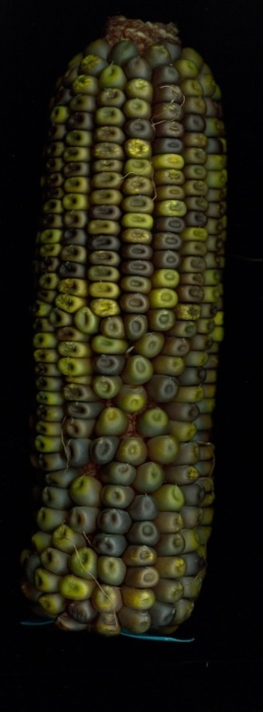
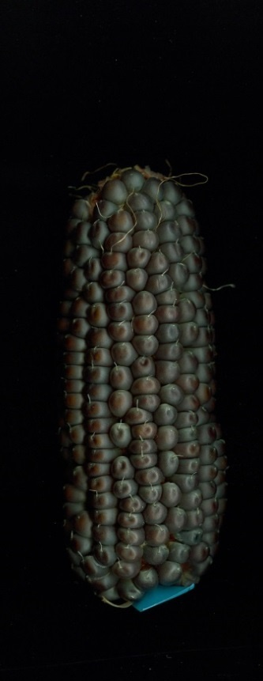
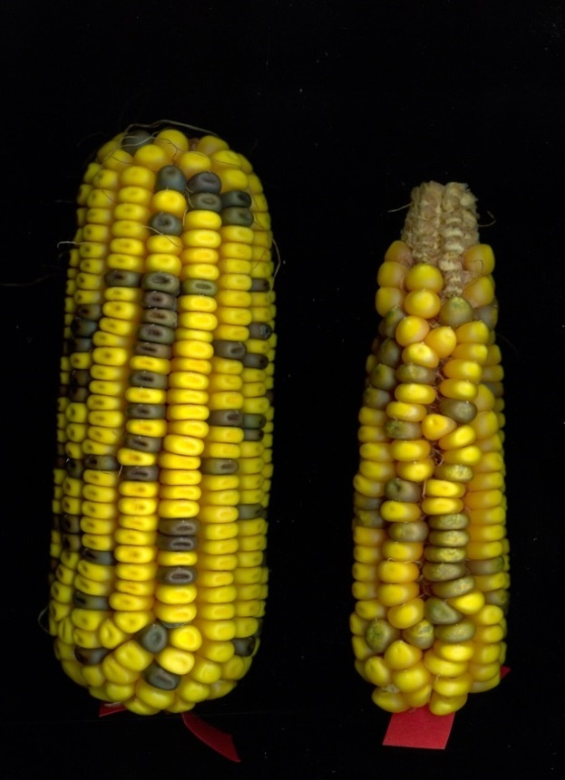
Maize seed phenotypes show significant parent-of-origin effects
BC1 ears from Mo17xW22 hybrid
In 1881, Wilhelm Focke proposed that the paternal influence on seed phenotype had similarity to the ancient Greek concept of xenia.
Hybrid/W22
W22/Hybrid
Hybrid/Mo17
Mo17/Hybrid
Same kernel genotypes
25% Mo17, 75% W22
Same kernel genotypes
75% Mo17, 25% W22

Slide 4
Xenia refers to the sacred responsibilities in the guest-host relationship
In ancient Greece, hosts had a religious obligation to provide hospitality.
One of the obligations of the guest is to give a gift after receiving hospitality.
Focke’s idea was that pollen gives some form of genetic gift to the seed:
  good xenia to produces a healthy seed
  bad xenia causes poor seed development
Today, plant xenia is often a catch-all term for any type of paternal-effect on seed development.
  e.g. complementation of a recessive allele in the maternal plant

Slide 5
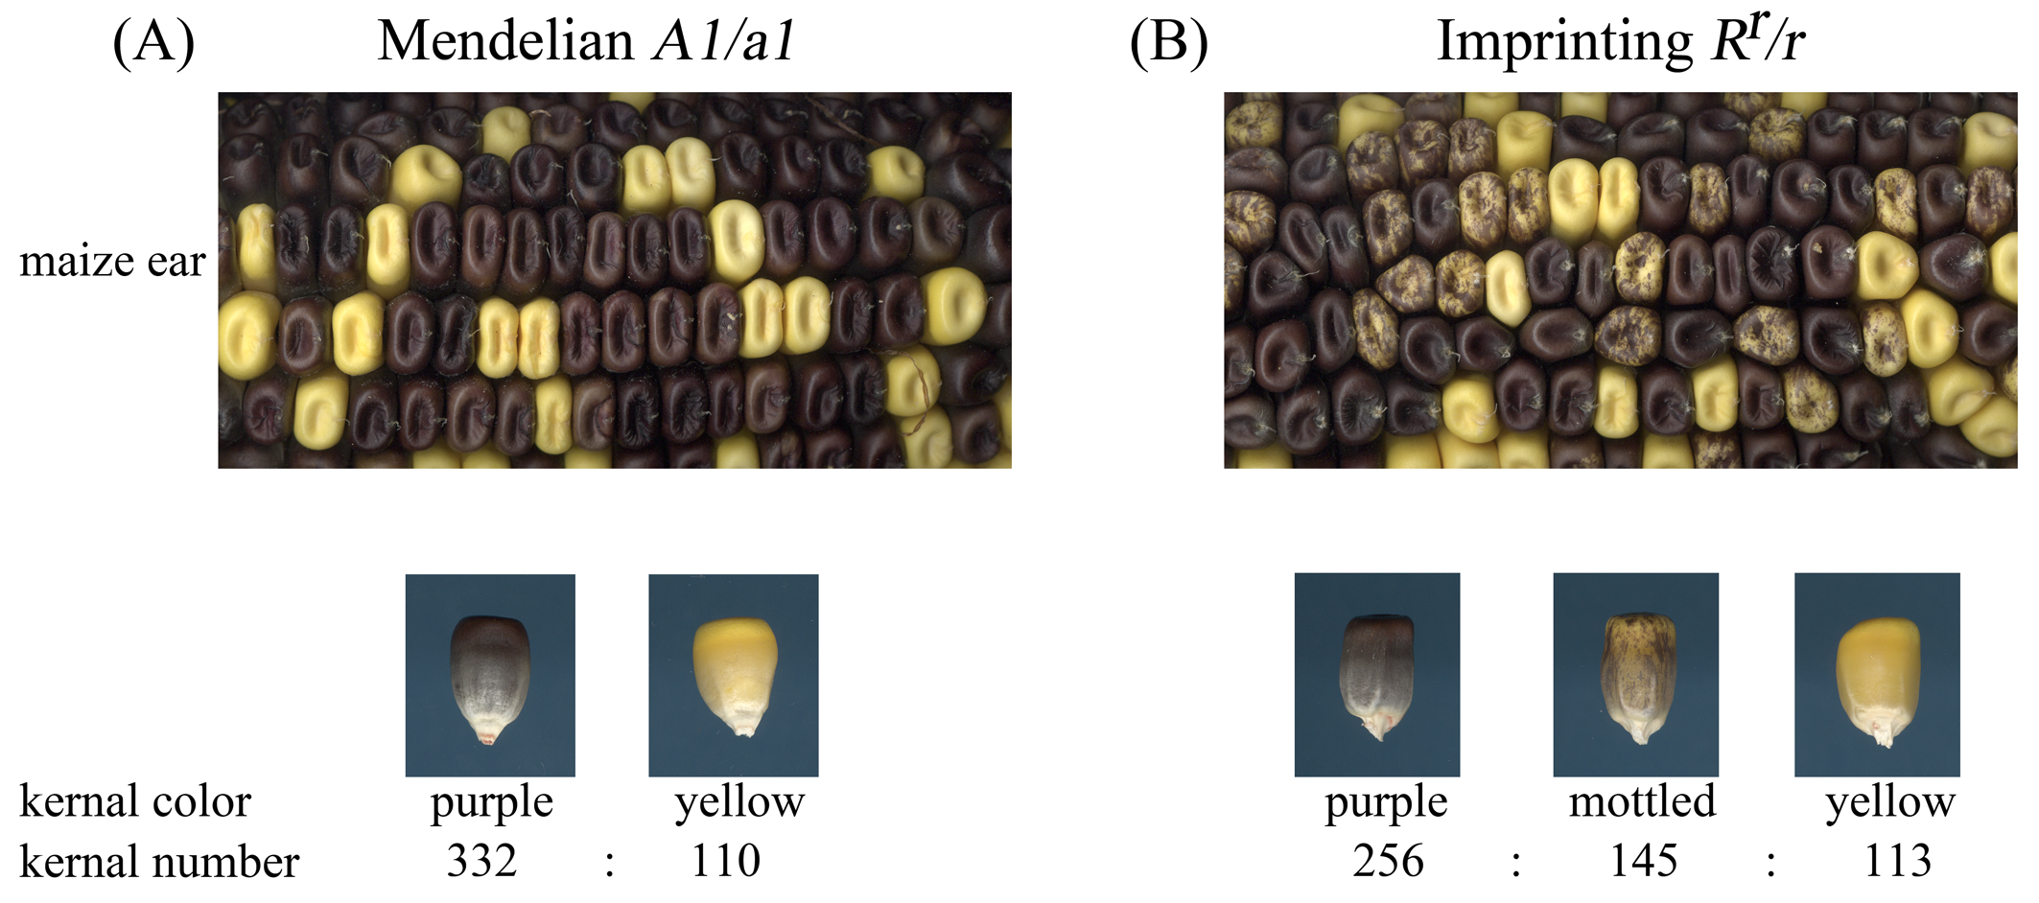
Imprinting: Different chromatin states allows parent-of-origin specific expression
Gregor Mendel discovered dominant-recessive alleles in the 1860’s.
When R^{r} is inherited from the male, expression is suppressed leading to mottled phenotype.
Jerry Kermicle discovered imprinting in the 1960’s.
Bai & Settles (2015) Front. Plant Sci. 5:780. doi: 10.3389/fpls.2014.00780. PMCID: PMC4307191

Slide 6
Parental-conflict or Kinship Theory for the origin of imprinting
Diploid angiosperms develop seeds with a 3n endosperm and a 2n embryo.
Haig and Westoby (1989) developed a hypothesis to explain this imbalance in the context of imprinting:
  Maternal genes have selective advantage by optimizing resources to all progeny
  Paternal genes have selective advantage if they increase resources to their specific progeny
Their prediction for this Parent Specific Gene Expression hypothesis was that there are paternal “guest-gift” genes:
  There should be genes where the paternally-derived alleles are more strongly expressed than maternally-derived alleles
  The genes should encode proteins responsible for acquiring resources from the mother.
  The genes should be expressed in the offspring tissue that acquires resources.
AL
SE
EAS
embryo
BETL
ESR
Haig & Westoby (1989) American Naturalist 134: 147-155.

Slide 7
Identifying a guest-gift gene: dosage-effect defective1 (ded1)
Can we identify mutants where paternally-derived dek alleles have a quantitative difference?
mut/mut
mut
mut/mut
+
+/+
mut
+/+_
+
mut
mut
mut
+
+
mut
+
+
Visible dek
Normal weight
Light weight
Normal weight

Slide 8
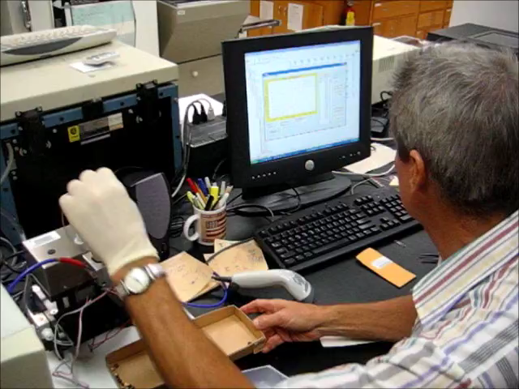
Quantitative phenotypes: High-throughput single-kernel grain analyzer
Screened normal kernels from 1,068 independent dek mutants for quantitative differences in weight or composition

Slide 9
Seed weight dosage effect screen of 1,068 independent seed mutants found ded1
Enriched for +/+ genotype
Normal kernels segregate 1:1:1
+/+
dek/+
+/dek
Collect Seed Weights
Ave. W22 = 206.5 mg
Ave. Normal = 206.1 mg
ded-1/+ ⊗
Increased variance and a step increase in kernel weight from 197-199 mg
Dai et al. (2022) Nat Commun. 13(1):5366. doi: 10.1038/s41467-022-33055-9. PMCID: PMC9470594.

Slide 10
ded1 encodes an R2R3 Myb transcription factor
ded1-ref
100 bp
Zm00001d033265
Map-based cloning identified a retrotransposon insertion in exon 3 of the gene.
Stop
GGACTATTGGAGTATATCTTCTTGTAACTGTAGCTGACCGA
Dai et al. (2022) Nat Commun. 13(1):5366. doi: 10.1038/s41467-022-33055-9. PMCID: PMC9470594.

Slide 11
ded1 encodes an R2R3 Myb transcription factor
ded1-ref
100 bp
Zm00001d033265
Map-based cloning identified a retrotransposon insertion in exon 3 of the gene.
Stop
GGACTATTGGAGTATATCTTCTTGTAACTGTAGCTGACCGA
NLS
ded1-ref
50 aa
R2 R3 Acidic
CRISPR/Cas9 gene editing generated multiple alleles truncating the open reading frame to delete the acidic activation domain of the protein.
R2
R3
Acidic
sgRNA
ded1-1 KRSLKAKVAG
ded1-2 KRSLKATGGVHPQPVP
ded1-3 KRSLKATPAEEEEQRAAGAGRAVVRPGGVHPQPVP
ded1-4 KRSLKAKRRLKKKSNAQQVPAGQWSVLGGVHPQPVP
Dai et al. (2022) Nat Commun. 13(1):5366. doi: 10.1038/s41467-022-33055-9. PMCID: PMC9470594.

Slide 12
ded1 encodes an R2R3 Myb transcription factor
ded1-ref
100 bp
Zm00001d033265
Normal
Stop
GGACTATTGGAGTATATCTTCTTGTAACTGTAGCTGACCGA
ded1-ref/ded1-ref
NLS
ded1-ref
ded1-4/ded1-4
50 aa
R2 R3 Acidic
R2
R3
Acidic
sgRNA
ded1-4/ded1-ref
ded1-1 KRSLKAKVAG
ded1-2 KRSLKATGGVHPQPVP
ded1-3 KRSLKATPAEEEEQRAAGAGRAVVRPGGVHPQPVP
ded1-4 KRSLKAKRRLKKKSNAQQVPAGQWSVLGGVHPQPVP
ded1-ref/ded1-4
CRISPR alleles have a more severe mutant kernel phenotype.
Complementation tests yield intermediate mutant kernel weights.
Dai et al. (2022) Nat Commun. 13(1):5366. doi: 10.1038/s41467-022-33055-9. PMCID: PMC9470594.

Slide 13
ded1 has a paternal specific effect on seed weight
W22 (♀) X (♂) ded1/+
ded1/+ (♀) X (♂) W22
Reduces kernel weight with pollen transmission.
Normal weight with ear transmission.
Paternal weight effect observed in multiple alleles and inbred genetic backgrounds.
♀\♂ | D | d
DD | DDD | DDd
DD | DDD | DDd
♀\♂ | D | D
DD | DDD | DDD
dd | ddD | ddD
Dai et al. (2022) Nat Commun. 13(1):5366. doi: 10.1038/s41467-022-33055-9. PMCID: PMC9470594.

Slide 14


ded1 expression is a Paternally Expressed Gene (PEG)
⅔W22:⅓Mo17
⅔Mo17:⅓W22
qRT-PCR Ded1
W22 ♀
Mo17♂
Mo17 ♀
W22 ♂
a
Mo17
W22
Multiple RNA-seq studies identified ded1 as a PEG:
10 DAP: 70-75% paternal mRNA
14 DAP: 53-69% paternal mRNA
Zhang et al (2011) PNAS 108:20042-20047.
Waters et al (2011) Plant Cell 23:4221-4233.
Zhang et al (2014) Genome Res. 24: 167-176.
Ded1
b
Mo17
Ded1
+
AluI
W22
c
n.d.
1
2
3
4
5
6
7
8
9
10
RT-PCR CAPS assay for relative expression of Ded1.
⅔ of Ded1 transcript comes from the single paternal allele.
DDD = ♀ WT X ♂ WT
ddD = ♀ ded1 X ♂ WT
DDd = ♀ WT X ♂ ded1
ddd = ♀ ded1 X ♂ ded1
Dai et al. (2022) Nat Commun. 13(1):5366. doi: 10.1038/s41467-022-33055-9. PMCID: PMC9470594.

Slide 15
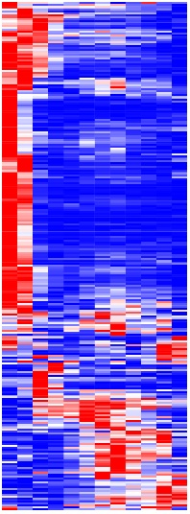
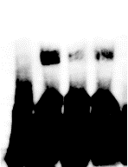
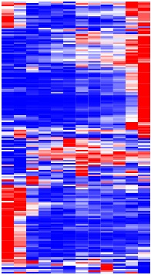
ded1 is responsible for acquiring resources from the mother
ded1
down
1022
Bound
promoters
2762
ded1
up
1050
Endosperm (DAP)
Bound
promoters
6
8
10
12
14
16
18
20
22
24
26
28
DED1-activated target genes
Enriched for genes with peak expression <14 DAP
Includes: transcription factors, auxin synthesis, sugar transporters
2324
764
258
180
870
DED1-GST
Nor Competitor
Mut Competitor
-
-
-
+
-
-
+
+
-
+
-
+
1 kbp
DED1-repressed target genes
Enriched for genes with peak expression >8 DAP
Includes: starch and anthocyanin accumulation
Shift
fl3
Free
DAP-seq identified 5,860 genes with DED1 bound to the promoter region
Overlay with normal vs. ded1 DEGs found 438 direct targets.
row
min
row
max
Dai et al. (2022) Nat Commun. 13(1):5366. doi: 10.1038/s41467-022-33055-9. PMCID: PMC9470594.

Slide 16
ded1 is expressed in offspring tissues that acquire resources
8 DAP
13 DAP
Max
END
AL
SE
EAS
Min
CZE
Ded1 is expressed only in endosperm with maximal expression ≤6 DAP.
ESR
BETL
Ded1 is expressed in all endosperm cell types, peak in BETL
Ded1 is expressed in EAS
Source data:
Zhan et al (2015) Plant Cell. 27: 513-531.
Source data:
Doll et al (2020) Plant Cell. 32: 833-852.
Dai et al. (2022) Nat Commun. 13(1):5366. doi: 10.1038/s41467-022-33055-9. PMCID: PMC9470594.

Slide 17
Conclusion: ded1 is a “guest-gift” xenia effect that exemplifies predictions of kinship theory
Haig and Westoby (1989) prediction | ded1 Observation
Evolutionary selection on imprinting should result in PEGs with paternal bias of expression. | Paternal ded1 allele is 50-75% of the transcript. ~5-fold greater expression from paternal allele.
PEGs should encode proteins responsible for acquiring resources from the mother. | DED1 activates genes involved in early endosperm uptake of nutrients. DED1 represses genes involved in latter stages of nutrient storage.
PEGs should be expressed in the offspring tissue that acquires resources. | Ded1 is expressed exclusively in endosperm. Ded1 expression shifts to the EAS tissue that directs nutrients to the developing embryo.

Slide 18



Acknowledgements
Settles Lab, UF
Dawei Dai
Janaki Mudunkothge
Jeff Gustin
Gertraud Spielbauer
Junya Zhang
Technical Support
Fang Bai
John Baier
Gina Babb
Chi-Wah Tseung
Collaborators & Co-authors
Paul Armstrong, USDA-ARS
Brad Barbazuk, U. of Florida
  Ruth Davenport
Andrea Gallavotti, Waksman Institute
  Mary Galli
Bing Yang, Donald Danforth Center
  Si Nian Char
Xiaojin Zhou, Chinese Acad. of Ag. Sciences
Funding
NSF-PGRP
NIFA
China Scholarship Council
UF: PMCB, Genetics Institute
Vasil-Monsanto Endowment

