Slide 1
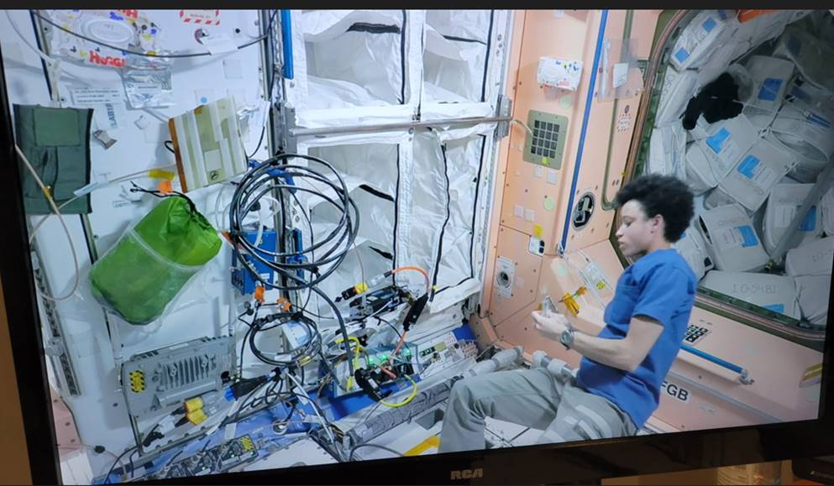
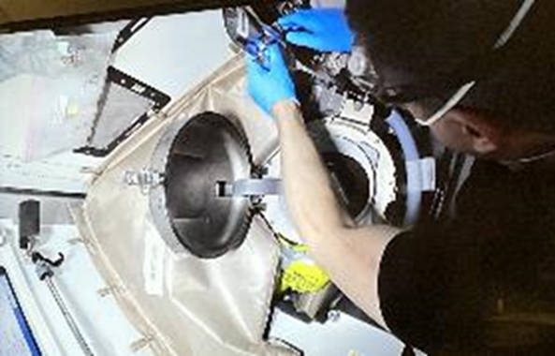
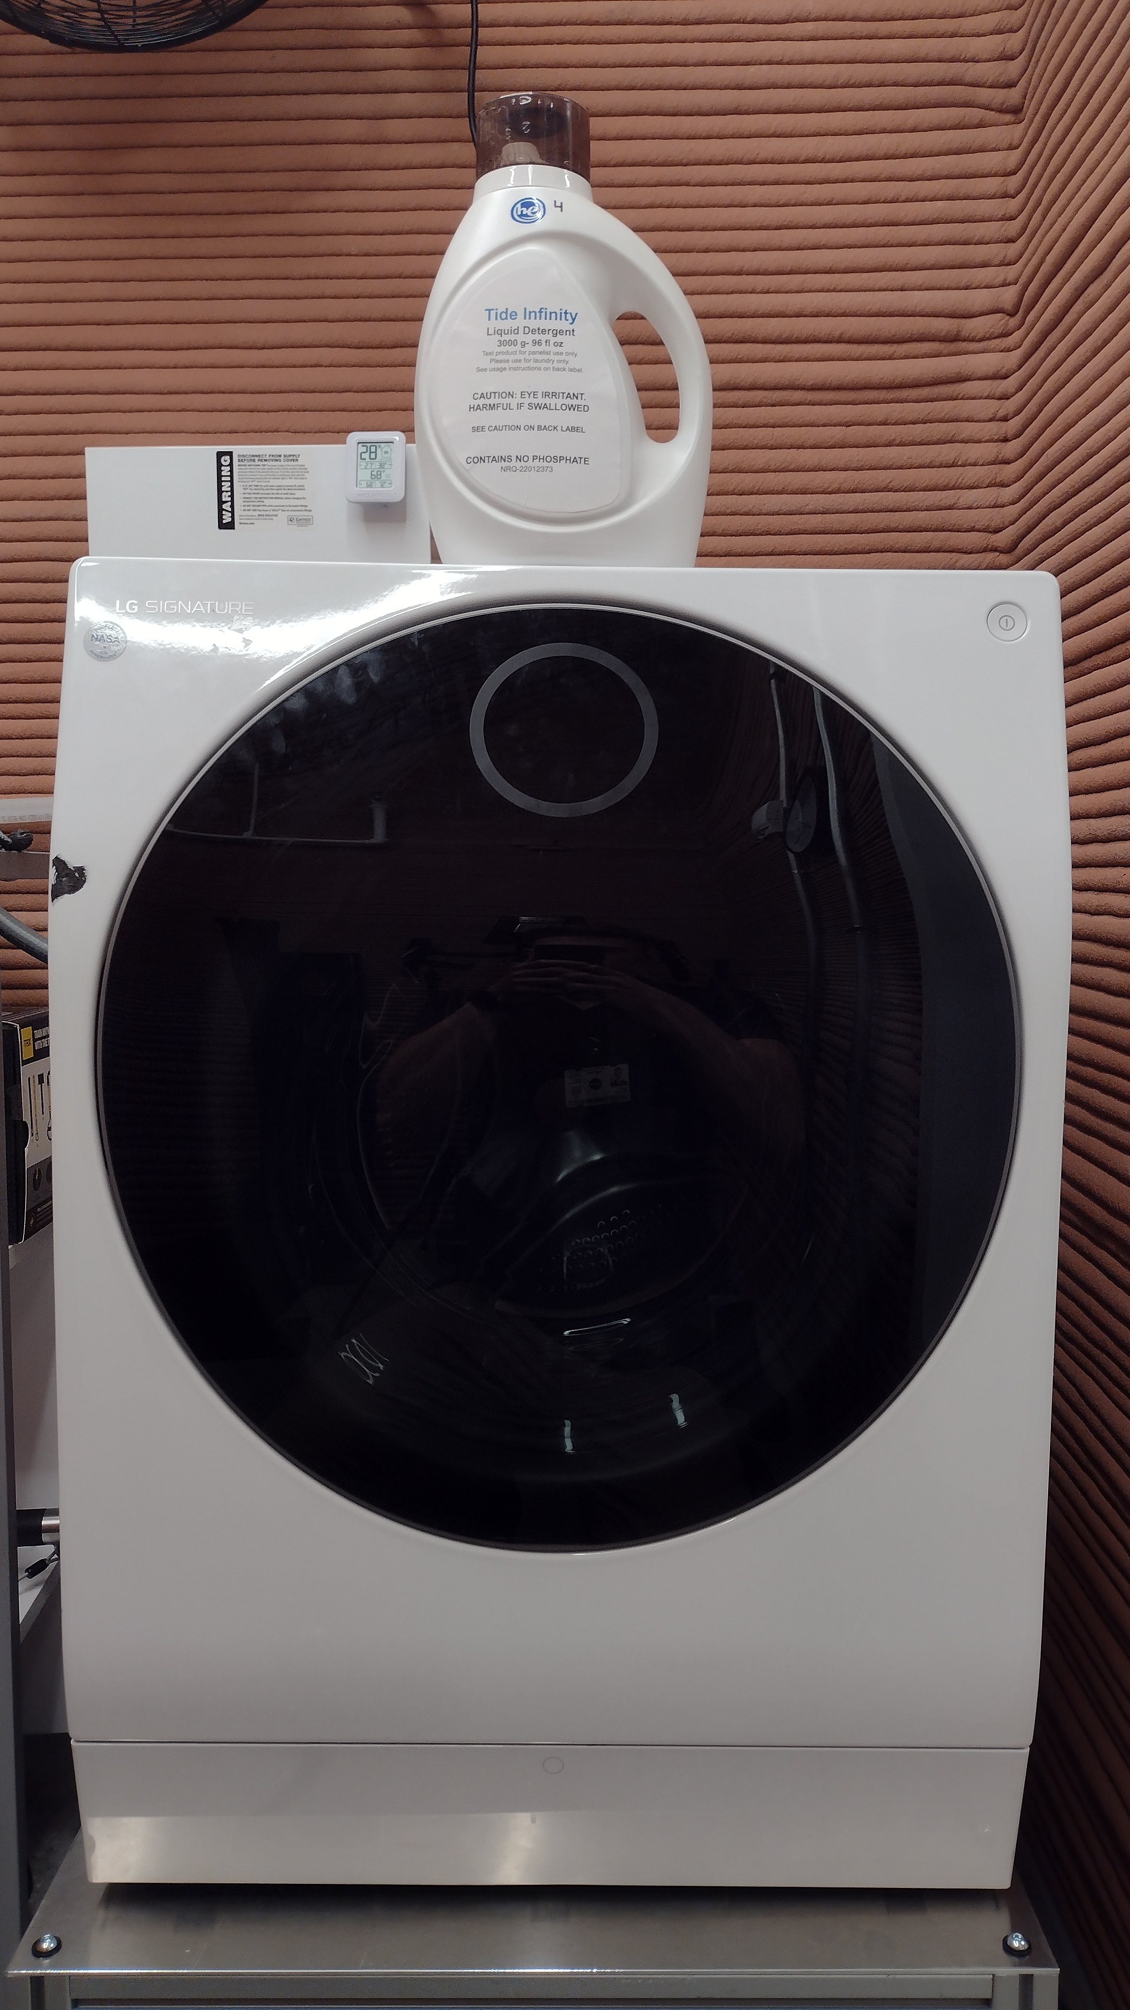
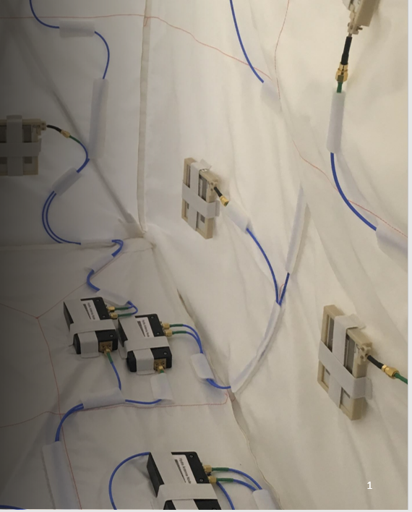
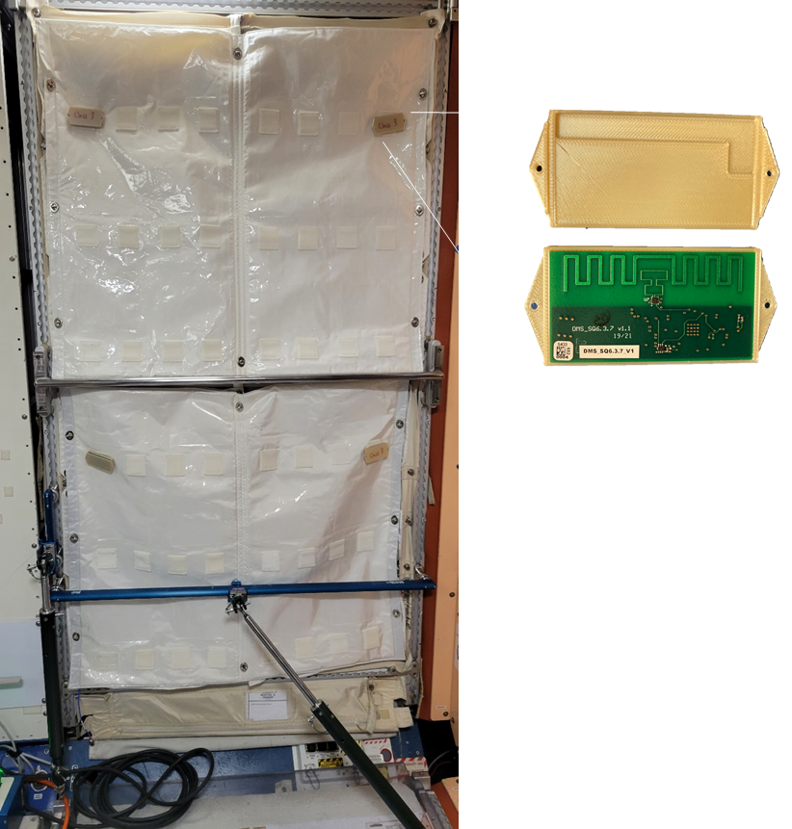
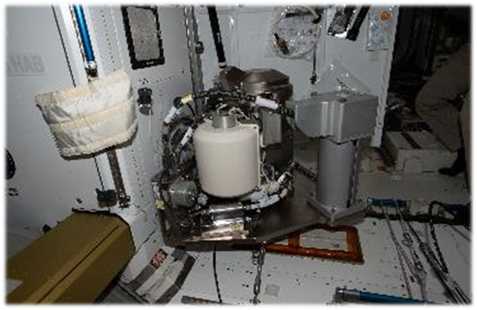
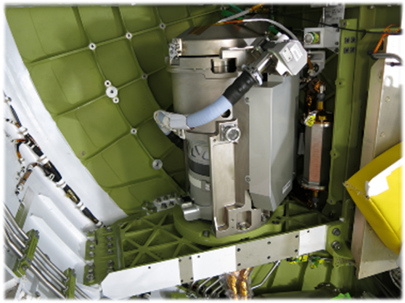
Exploration Capabilities Logistics Reduction
EXCAP-LR
Principal Investigator(s): REALM – Patrick Fink, UWMS – Melissa McKinley, ACS - Mike Ewert
Technology Taxonomy Area (TX): 06-52 Autonomous Inventory Tracking, 08-28 Wireless Sensor Networks, 06-56 Fecal Resource Recovery, 06-31 Common Compact Commode, 06.1.3 Waste Management, 06.1.4 Habitation Systems
TRL: 4-7
FY22 PROJECT Overview
Outcome
REALM: Delivered REALM-3 Hardware for demonstration on ISS – shown being installed on ISS by crewmember Jessica Watkins
UWMS: Performed Limited Checkout of UWMS on ISS and additional testing with crew feedback.
ACS: Completed annex 1 of a Space Act Agreement (SAA), which developed an environmentally-friendly laundry detergent for cleaning clothes in space. “Tide Infinity” detergent is now in testing in a NASA bioreactor water purification system and will be used in the CHAPEA Mars analog test in 2023.
All human space missions require substantial logistical mass and volume. As our exploration missions increase in distance and duration, reduction of these logistics requirements becomes more important. The movement and tracking of logistics between vehicle elements are increasingly recognized as critical to crew efficiency and on-orbit mission assurance. This project targets the best opportunities to demonstrate logistics reduction, repurposing, and efficient tracking and management of logistics. These technologies and innovations will make future exploration missions more affordable.
REALM-3 (RFID (Radio Frequency Identification) Enabled Autonomous Logistics Management) – Hydra (HYper-Distributed RFID Antenna) Smart Stow: receives RFID signal from readers, use very small % of signal to self-power on-board microcontroller and RF switch, multiplex RFID signal to other nodes in a chain or to a multitude of antennas. ISS HYDRA Smart Stow is over-instrumented to allow evaluation of a branched network HYDRA chain.
UWMS (Universal Waste Management System) – provides a compact, lower mass/volume toilet for exploration missions
ACS (Advanced Clothing Systems) – investigates ways to reduce clothing mass and volume directly or through efficiently cleaning them for reuse.
INNOVATION
REALM: Two methods to improve RFID audits and localization accuracy:
HYDRA Smart Stow
RFID signal is introduced directly into stowage volumes
HYDRA – HYper-Distributed RFID Antenna
Self-multiplexing antenna system harvests small % of RFID signal to power internal controller and auto-switches signal to multiple antennas
Allows for vastly increased dissemination of RFID signal in spacecraft
.
Infusion Space / Earth
REALM infusion is in progress for ISS, Exploration modules, commercial LEO development, and application for terrestrial commercial applications
UWMS provides demonstration of the first US designed toilet since shuttle and the insight from this work directly informs exploration vehicles and missions for Mars and Lunar initiatives.
ACS is working to make traditional laundry more resource efficient and adaptable to space.
(2) Drawer Monitor System (DMS)
DMS tags = RFID sensor tags that report time-stamped motion events over the RFID channel
DMS tags are attached to rack doors
Motion events reported back to machine learning (ML) algorithms provide additional context so that the ML can estimate item locations with greater accuracy.
PARTNERSHIPS / collaborations
This project depends upon collaboration and partnerships to make progress in all areas of Logistics Reduction.
REALM partnered with Auburn University and multiple contractors including METECS and Jacobs Engineering
UWMS and waste management work includes multiple contractors and subcontractors and collaborations including Collins Aerospace, KBR, Jacobs Engineering and work at multiple NASA centers
ACS project benefitted from a non-reimbursable Space Act Agreement with Procter & Gamble for “Cleaning in Space”.
UWMS delivered two toilets for Exploration missions.
The ISS unit is on ISS in Node 3 and is 65% smaller and 40% lighter than the current ISS Toilet in use by US crewmember.
The Orion unit currently installed in the Artemis-II vehicle is 61% smaller than the Shuttle Toilet.
Future Work
REALM: Continue infusion with Artemis programs and commercial partners. Continue technology evolution and demonstration on ISS.
UWMS: Complete technology demonstration on ISS
ACS: Continue working with P&G through Annex 2 of the SAA.
ACS is currently collaborating with the JSC CHAPEA project for low impact laundry, which allows demonstration of the work done in a Space Act Agreement with Procter and Gamble on a formulation of detergent for use in Exploration.
2022 JSC Technology Showcase MSC# _MSC-27477-1_______
DAA# _TBD________

