Slide 1
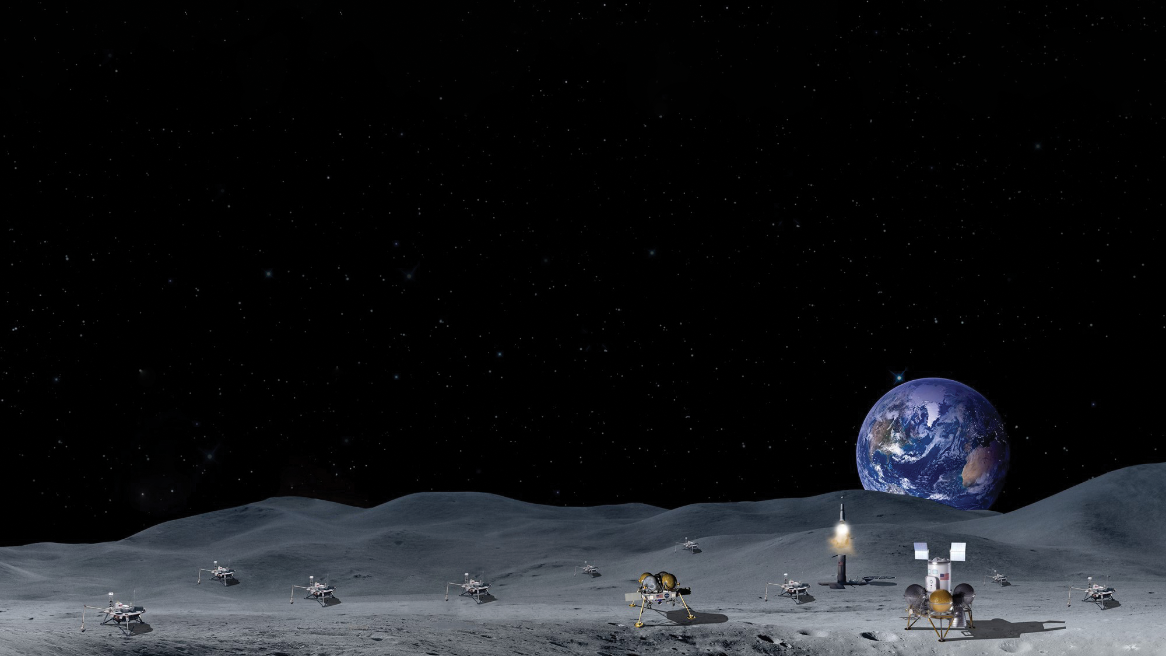

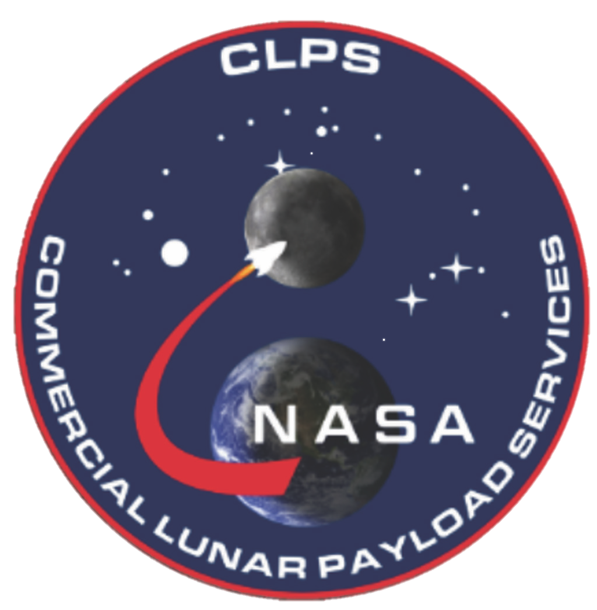
National Aeronautics and
Space Administration
Commercial Lunar Payloads Services (CLPS)
Center Capabilities: Ames Research Center
Center Points of Contact:
Sally Cahill
Spaceflight Chief
sally.a.cahill@nasa.gov
650-604-5671
David Mauro
Spaceflight Deputy Chief
david.mauro@nasa.gov
650-604-4775

Slide 2

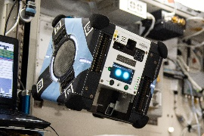
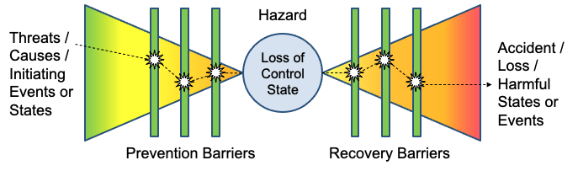
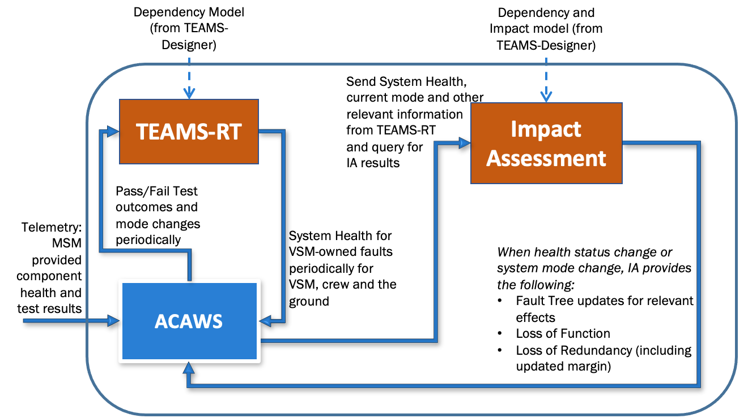
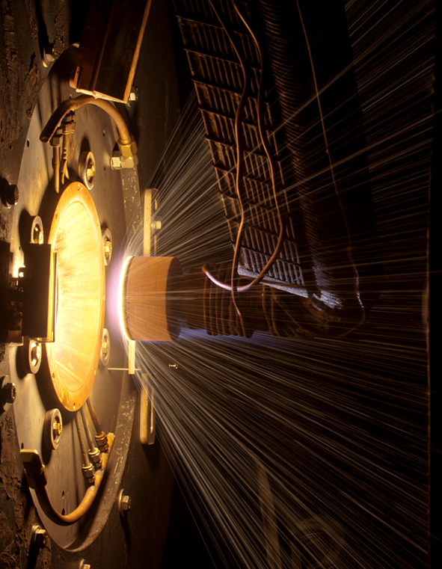
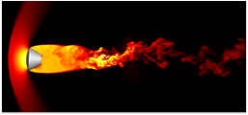
Ames Research Center CLPS Capabilities
Intelligent Systems (https://ti.arc.nasa.gov/)
Automation and Autonomy:
  Autonomous operations to reduce flight controller and crew workload during crewed missions,
  and to reduce flight controller workload during dormant periods
  Advanced Planning & Scheduling technologies
  ISS flight-proven technologies (Autonomous Mission Operations, Playbook, etc.)
  In-Vehicle Robotics (IVR) for crew assist and uninhabited operations
Software Verification and Validation Tools:
  Statistical testing to identify safe region of operations for autonomous systems
  Adaptive stress testing, turning AI on AI to find corner cases in testing
  V&V results integrated into comprehensive semi-automated assurance cases for certification
Systems Health Management:
  Real-time monitoring with diagnostics & prognostics
  Caution and warning and fault response during crewed missions
  Situational awareness and responsive during dormant periods
  Resilience and physics-based modeling
Human Systems Integration for Robotic Missions (https://human-factors.arc.nasa.gov/techareas/tech_areas.php)
  Integrated Data Systems, low-cost, highly adaptable/expandable integrated information systems
  architecture for managing engineering and safety data across the mission life-cycle.
  Virtual and augmented reality for telepresence and robotic teleoperation.
  Activity Planning and Scheduling Systems for Lunar Payloads.
TPS Material Development & Testing for CLPS Sample/Payload Return
  The Ames Entry Systems & Technology Division is a leader in aerothermodynamics, thermal protection systems (TPS)
  materials, high-enthalpy ground test facilities, and entry systems engineering.
  (https://go.usa.gov/xtA3r)

Slide 3
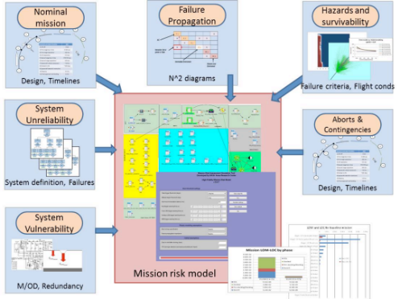
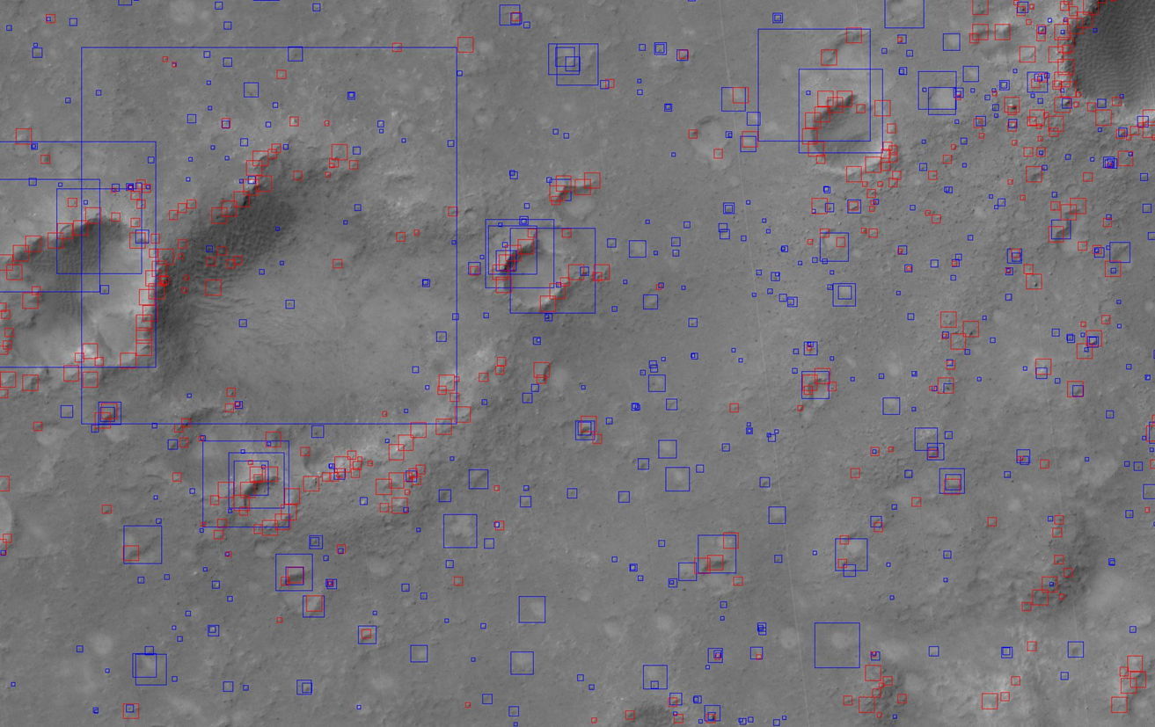
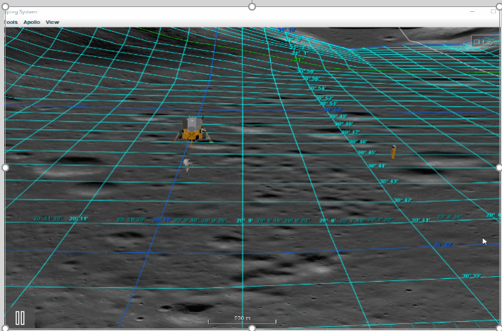
Ames Research Center CLPS Capabilities
Engineering Risk Assessment (ERA) (https://www.nas.nasa.gov/projects/era.html)
ERA extends traditional probabilistic risk assessment techniques through the explicit
inclusion of physics-of-failure and dynamic system modeling. The result is a set
of rapid turn around tools/models which provide quantitative, risk metrics for
uses such as:
  Ensuring crew safety though awareness of risk implications of
  Risk-informed decision making for investment choices
  Design decisions throughout the project lifecycle
  Risk-informed decision making for investment choices
  Requirement scoping, validation, and verification
Tools for Visualizing and Analyzing Lunar Data
The Celestial Mapping System (CMS) generates user-interactive virtual 3D data for celestial bodies including the moon. It offers flexibility to update to the latest imagery and terrain datasets as they are being acquired. (https://celestial.arc.nasa.gov/)
The Moon Trek portal provides analysis tools measuring distance, elevation profiles, solar angle, slope, crater and boulder hazards, lighting, electrostatic surface potential, and more, in addition to serving visualization of mapped data products and creating products such as 3D printing files. (https://trek.nasa.gov/moon/)
The Ames Stereo Pipeline (https://github.com/NeoGeographyToolkit/StereoPipeline) is a suite of expert image analysis software tools for building terrain models from orbital imaging data.
ERA Tools are
currently used
throughout the
life cycle of NASA
spaceflight projects.
Crater and Boulder Hazard Analysis
Lunar surface visualization in CMS with terrain conforming graticules, 3D terrain exaggeration and 3D COLLADA models

Slide 4
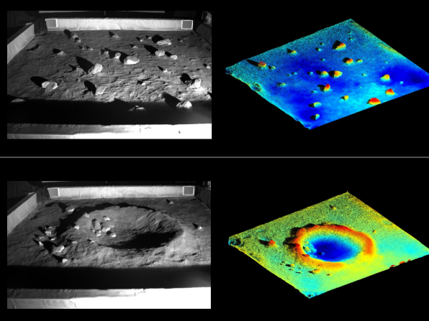
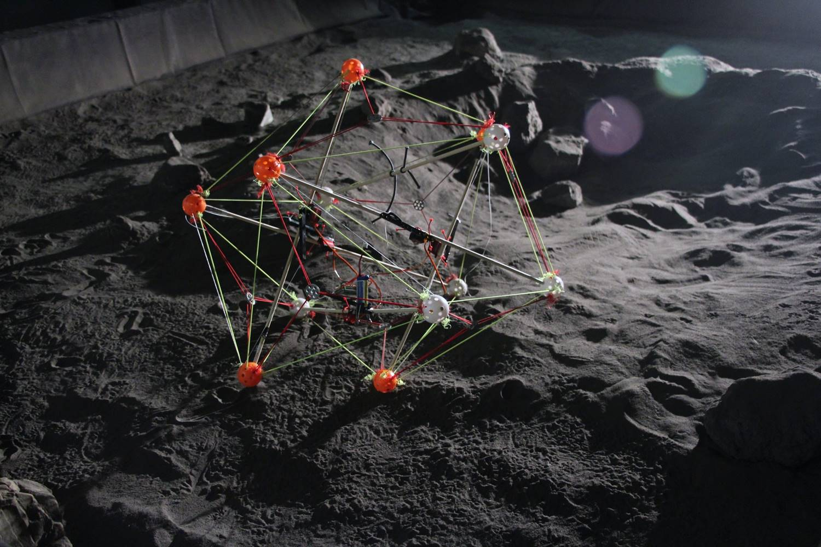
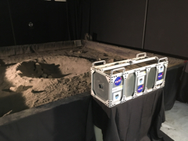
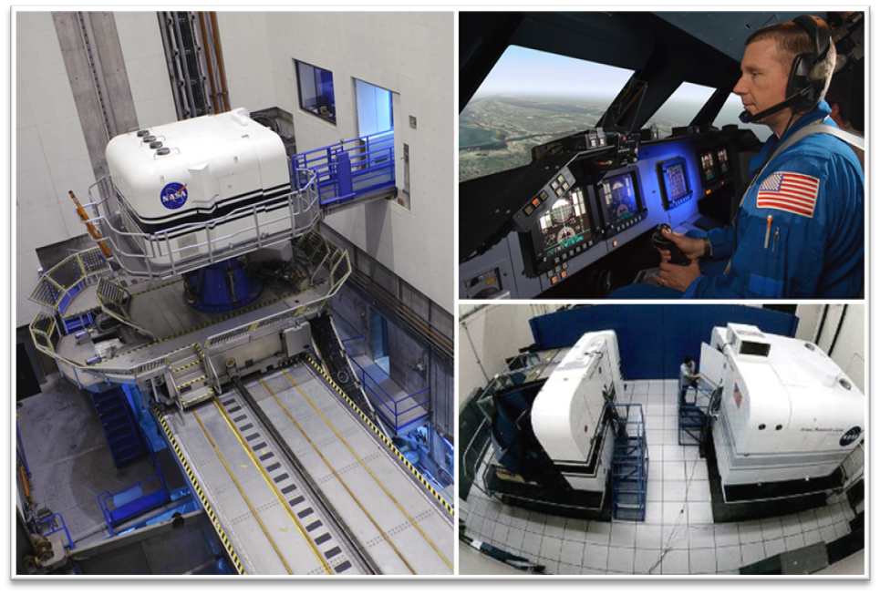
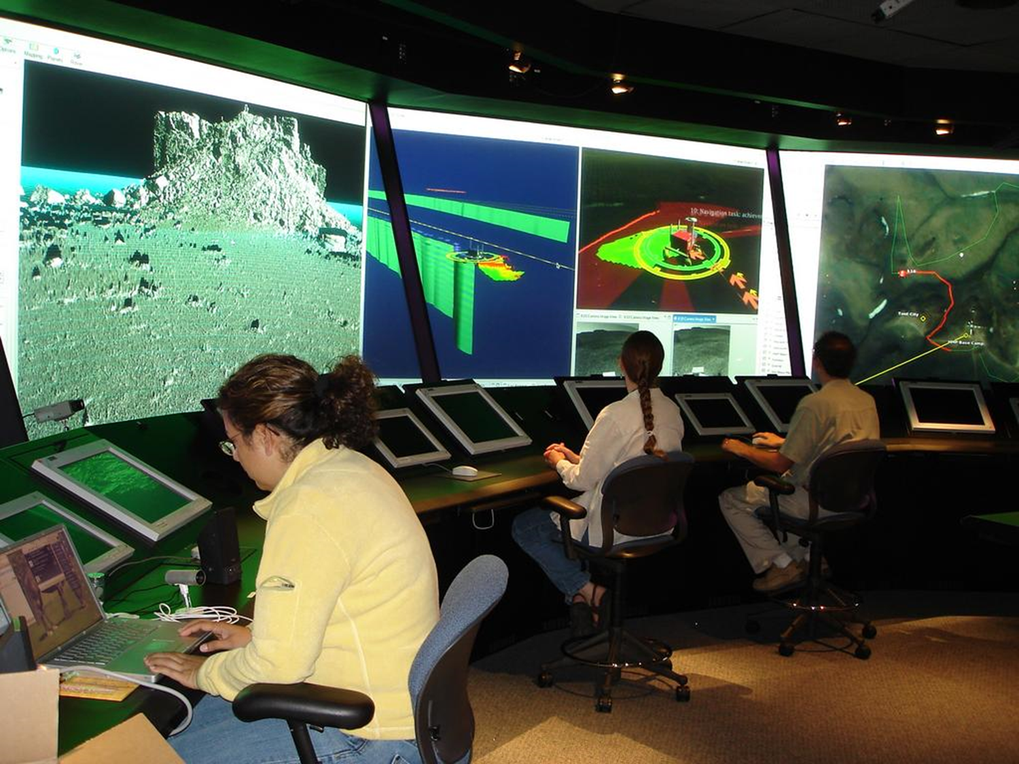
Ames Research Center CLPS Capabilities
Regolith Testbed for Development and Testing (https://sservi.nasa.gov)
  The SSERVI-managed Regolith Testbed is available to the planetary science and human exploration communities, including CLPS and commercial developers.
  Thus far, the testbed has been used to conduct studies on optical sensing, drill testing, ISRU ID and extraction techniques, and remote robotic outreach activities.
  The testbed can accelerate innovation from idea generation thru iterative testing and can quickly drive design improvements for science and technology projects.
  The testbed can help understand the basic effects of continued long-term exposure to dust in a simulated analog test environment.
  The current facility contains two testbeds which cover the two largest types of lunar terrain:
    the first has the largest collection in the world (approximately 8 tons) of JSC-1A lunar lowlands regolith simulant in a testbed that measures 4m x 4m
    the second is approximately 19m x 4m and has nearly 20 tons of LHS-1 lunar highlands/lunar poles simulant (powdered anorthosite and crushed basaltic glass)
  The facility can be configured to suit the needs of the desired testing and is equipped for dust mitigation and safety oversight.
Vertical Motion Simulator (https://www.nasa.gov/ames/vms)
  The VMS is the largest six-degree-of-freedom ground-based motion flight simulator in the world with 60 feet of vertical travel and 40 feet of lateral travel which was designed to accurately simulate vertical takeoff and landing (VTOL) vehicles.
  The VMS has been used to simulation the Human Landing Systems project under the Artemis Program and has been used in the development and testing of the next generation of electric vertical takeoff and landing (eVTOL) vehicles.
Future Flight Central (https://www.nasa.gov/centers/ames/business/future_flight_central_facilities.html)
  Future Flight Central (FFC) is a high fidelity, 360- degree field of view, full scale human-in-the-loop simulation facility originally designed to support air traffic control tower simulation.
  The immersive visualization capabilities of FFC have also been used for flight test visualizations and ground control operations for testing of unpiloted missions.

