Slide 1


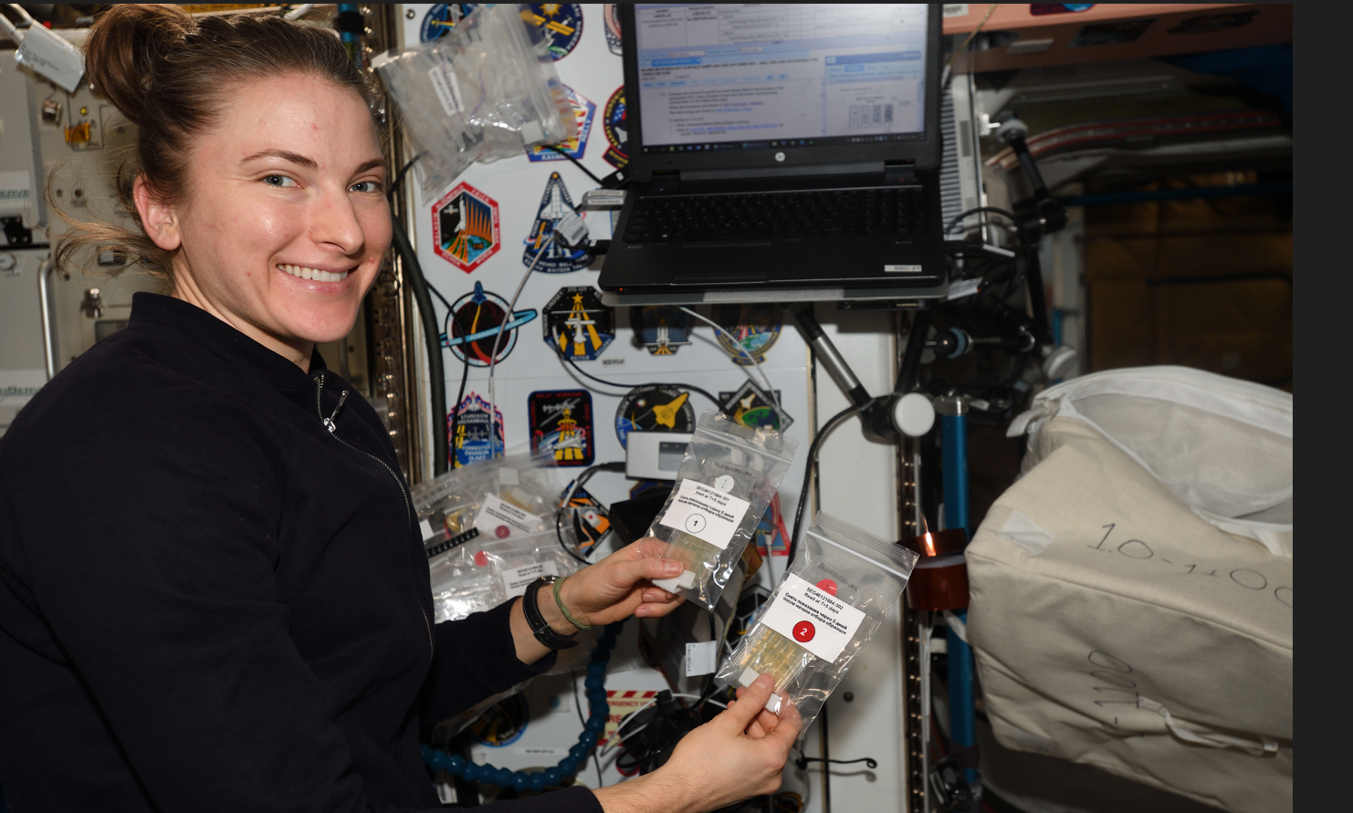
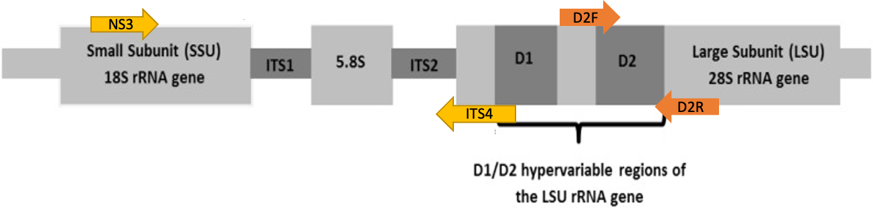
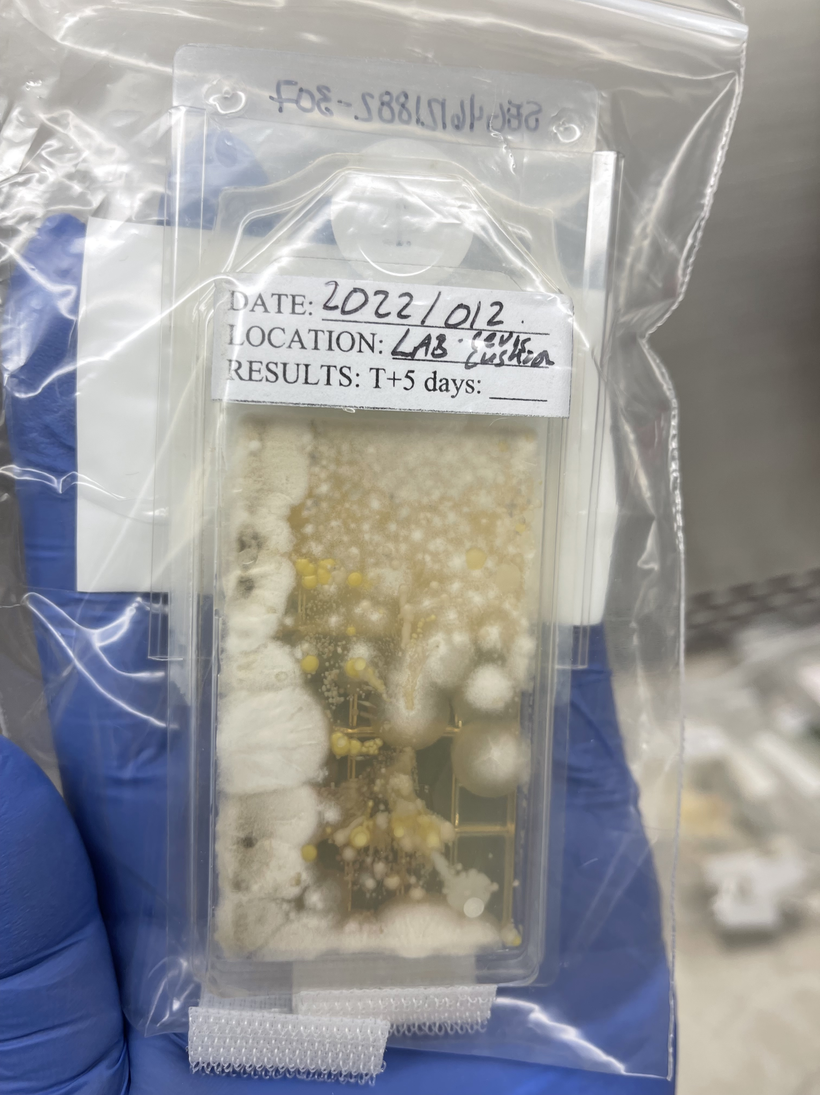
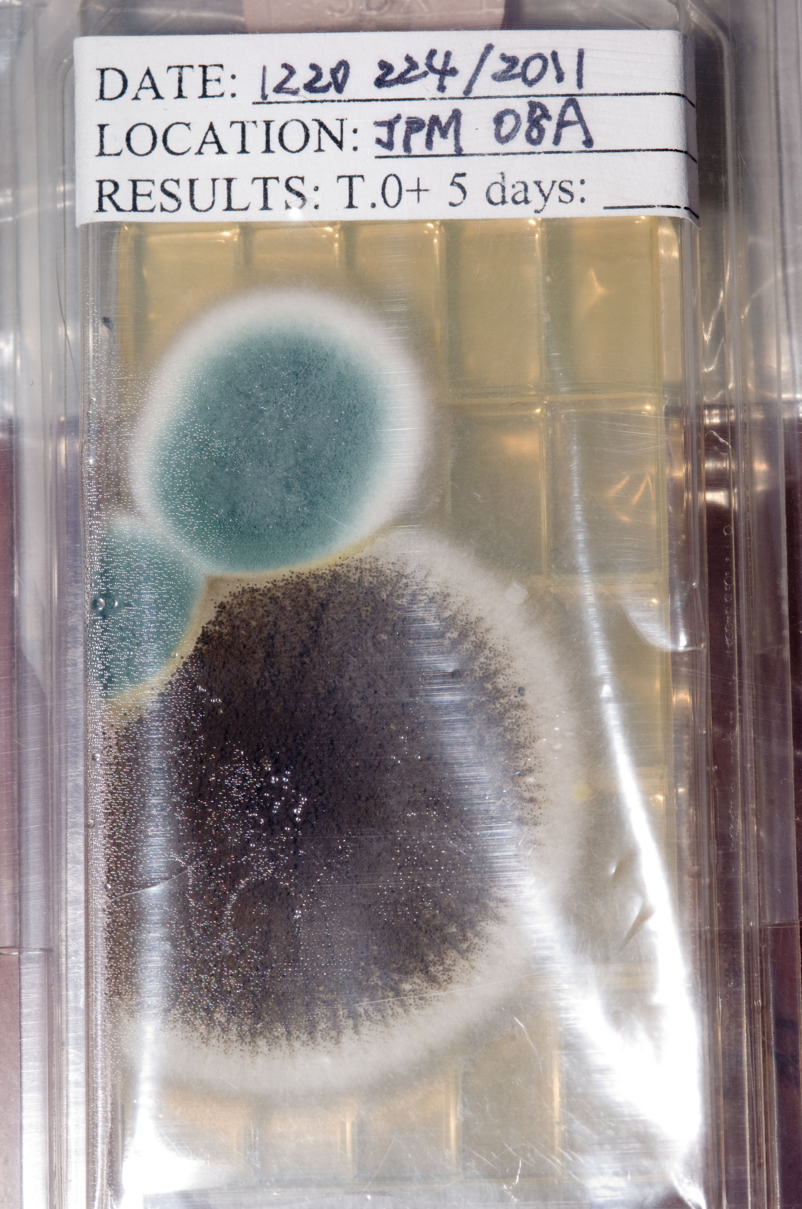
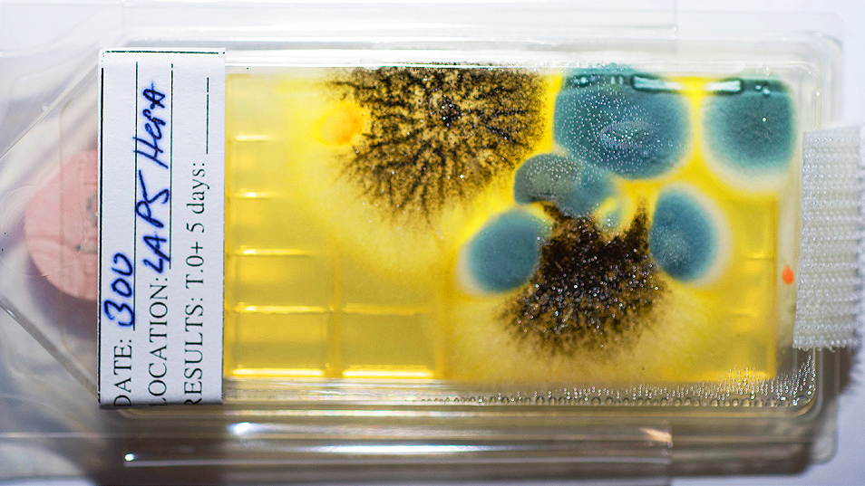
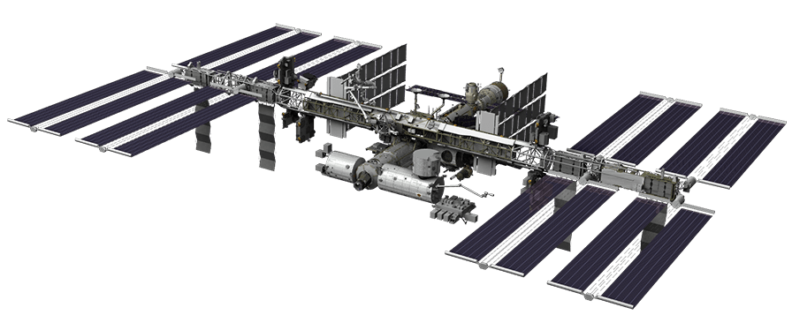
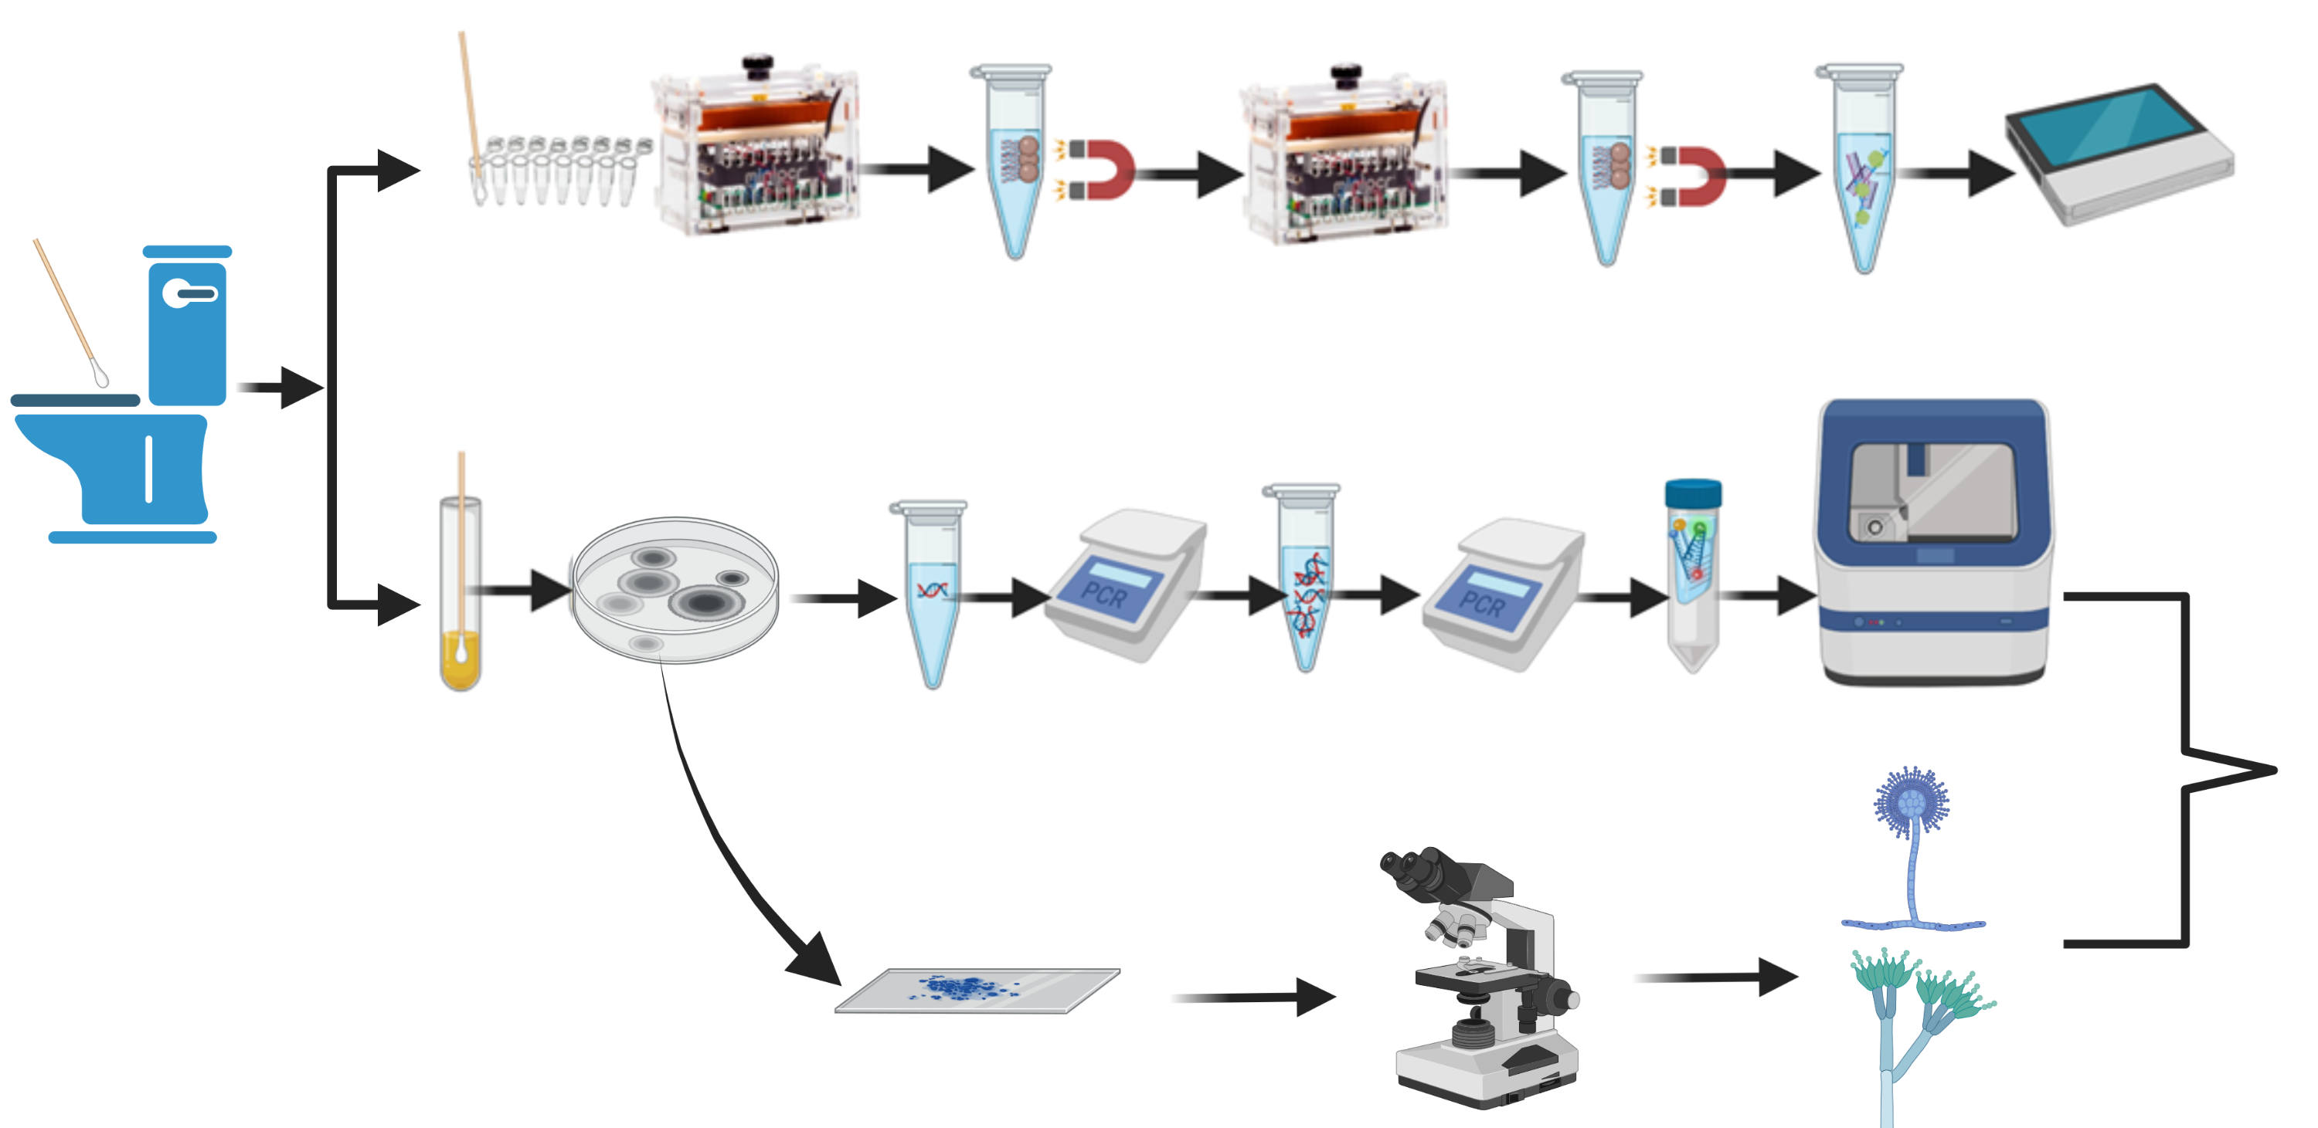
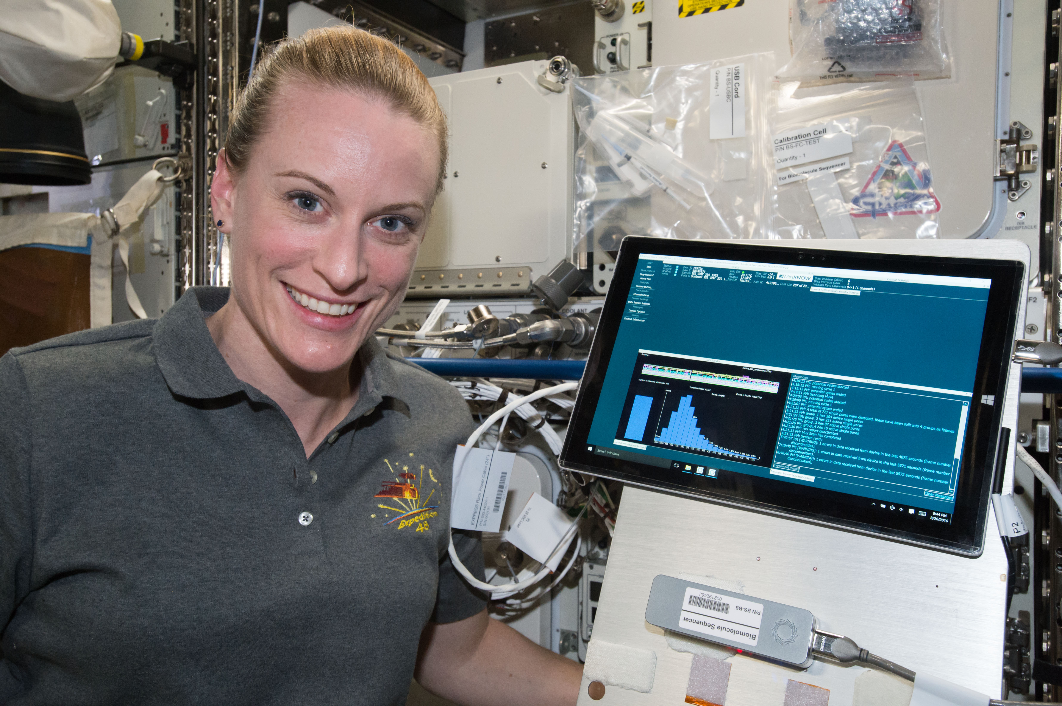
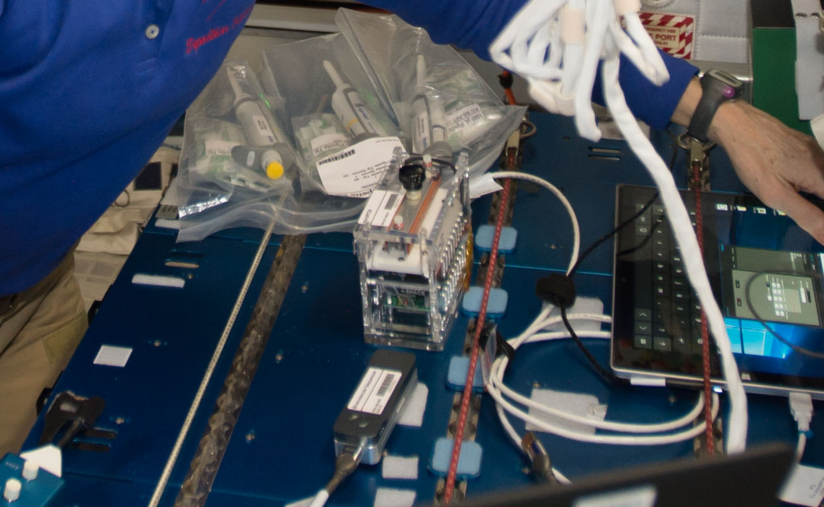
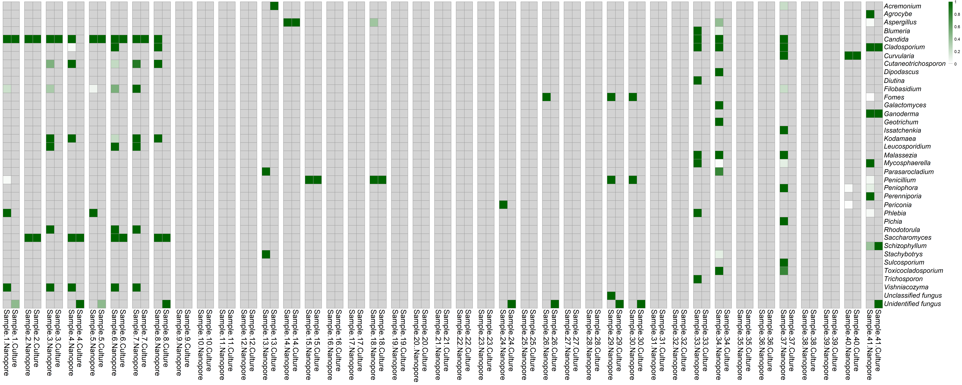
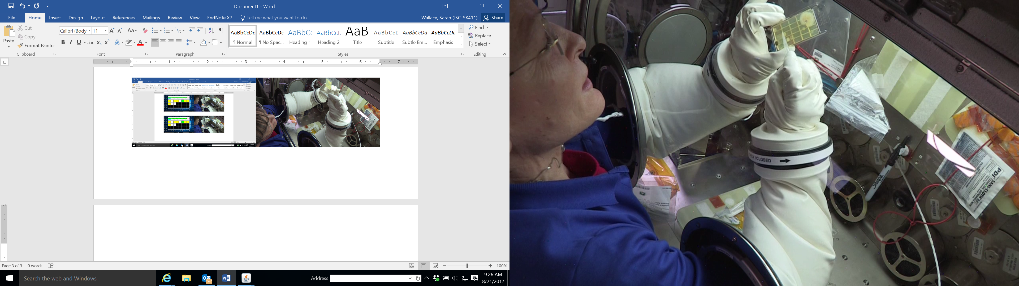
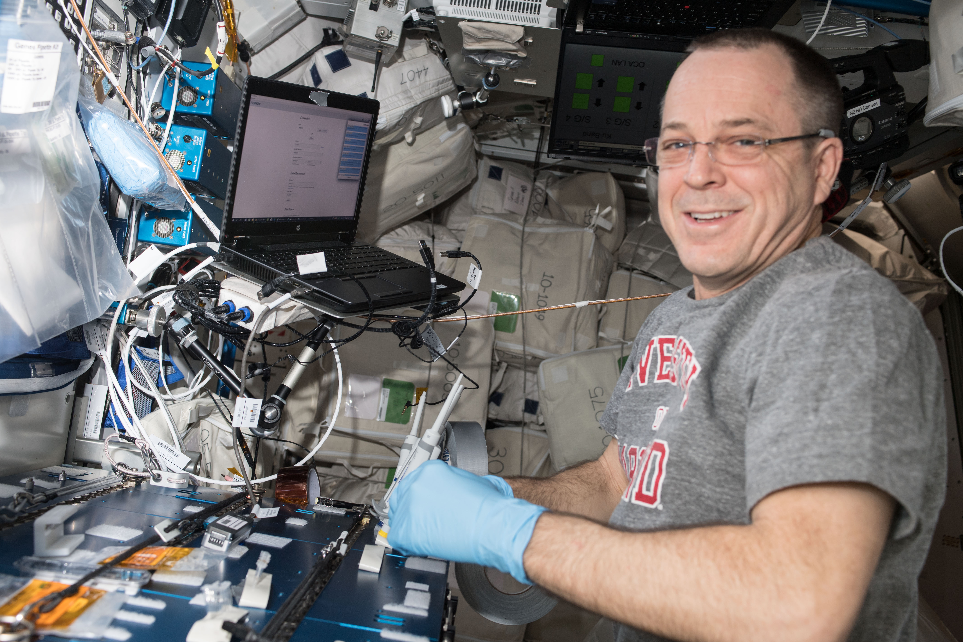
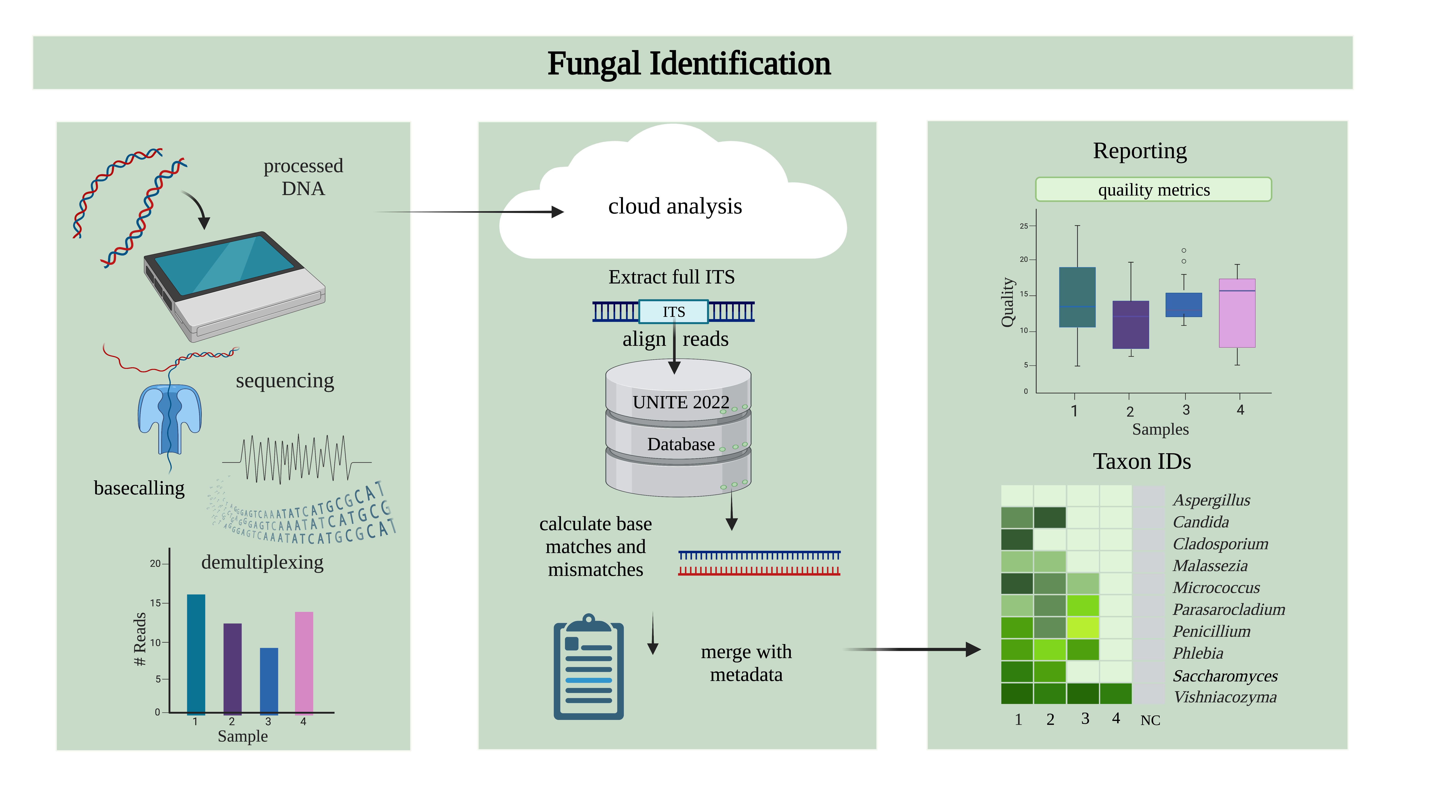
Culture-Independent Fungal Profiling for the International Space Station
using Nanopore Sequencing: Method Development
Hang N. Nguyen¹, Sarah Stahl-Rommel¹, G. Marie Sharp², Christian L. Castro¹, and Sarah L. Castro-Wallace³
¹JES Tech, Houston, TX, USA, ²KBR, Houston, TX, USA, ³Biomedical Research and Environmental Sciences Division, NASA Johnson Space Center, Houston, TX, USA
Background
Fungal Optimization
Culture Isolate Validation
Microbial monitoring of the International Space Station (ISS) environment is a crew health requirement that includes both bacterial and fungal identification. To achieve this currently, culture-based methods are used for sample collection, and these samples must be returned to the laboratory for analysis.
Primer selection
  Various primer pairs tested
  All pairs resulted in an amplicon between ~1500 bp to ~2000 bp⁴
  Validated through testing with the 18 most common yeast and molds returned from ISS
  Selected primers: NS3F-ITS4R
  Validate the optimized nanopore sequencing-based fungal workflow with known fungal isolates from the laboratory’s archive
Microbiology Lab ID | Nanopore ID
Aspergillus niger (slide) | Aspergillus niger
Aspergillus species | Aspergillus clavatus
Aspergillus species (slide) | Aspergillus sp.
Aureobasidium species (slide) | Aureobasidium pullulans
Eurotium species | Aspergillus montevidensis
Fusarium oxysporum (slide) | Fusarium oxysporum
Fusarium species (slide) | Fusarium oxysporum
Penicillium species (slide) | Penicillium commune
Pleurostomaphora richardsiae | Pleurostoma richardsiae
Pseudocercospora species (slide) | Pseudocercospora jagerae
Rhodotorula species (slide) | Rhodotorula mucilaginosa
Tritirachium oryzae (slide) | Tritirachium oryzae
Onboard Microbial Monitoring
Returned Fungal Slides
Region sequenced for nanopore-based ID
Region sequenced for Sanger-based ID
Developed Workflow
ISS collection and culture followed by identification on Earth.
Modified Swab-to-Sequencer Protocol
All isolates were identified to the correct genus, and the majority could be correctly identified to the species level with the nanopore-based method
Validated the workflow from extraction through sequencing with the known isolates
This process results in:
A bias toward culturable microorganisms.
A significant delay between sample collection and delivery of final data (weeks to months).
DNA extraction from swab
Bead-based
purification
ITS amplification
Purification and sample pooling
Library
preparation
Nanopore Sequencing
Environmental Swab Validation
Advancements in molecular technology have aided a broad range of applications, including medical, industrial, and basic sciences. Additionally, increases in portability and ease-of-use of molecular platforms have provided point-of-use capabilities demonstrated by the miniPCR™ thermal cycler (miniPCR bio) and the MinION™ sequencer (Oxford Nanopore Technologies). Together, these devices have been applied to, and validated for, the identification of bacteria onboard the ISS¹⁻³.
Two swabs collected in tandem
41 sample sets (82 swabs) were collected, as well as 5 negative control swabs:
All negative control swabs were negative for both culture and nanopore
Fungi were not identified from 19 samples (matching culture and nanopore data)
Parallel fungal profiles were obtained between the two methods
Higher diversity was noted from the nanopore data
There were no instances in which the nanopore method missed a culture isolate identification
Swab inserted into media
Plating onto media
DNA extraction
PCR
Enzymatic purification
Fluorescent nucleotide adaption
Spin column purification
Sanger Sequencing
Culture
ID confirmed
A
B
Fungal culture slide
Microscopic Analysis
NASA JSC Microbiology’s Standard Procedure for Fungal Identification
Created with Biorender.com
Optimization to overcome:
  Low biomass
  Difficult-to-lyse spores
  Debate regarding the region for taxonomic assignment
  Lack of bioinformatic pipelines and reference databases
Fungal Analysis Pipeline Optimization
Length filtered Nanofilt version 2.8.0.
Conclusions
Hidden Markov Model from ITSx version 1.1.3
The ISS-validated, bacterial swab-to-sequencer method was modified for fungal identification
Optimization included: fungal primer evaluation and selection, extraction and amplification condition modifications, and data analysis pipeline improvements
The developed method was validated with both known fungal culture isolates, as well as environmental swabs (culture-independent assessment)
Forward work: Testing and validation onboard the ISS.
The implementation of this method onboard ISS will enhance our understanding of its unique fungal microbiome.
C
D
A) Astronaut Kate Rubins sequences DNA in space for the first time in August 2016. B) A “lab bench” setup onboard the ISS showing miniPCR, the MinION, and pipettes. C) Astronaut Peggy Whiston performs the first identification of unknown bacteria collected and cultured from the ISS in August 2017. D) Astronaut Ricky Arnold performs the first culture-independent, swab-to-sequencer bacterial profiling of ISS surfaces in July 2018.
Alignment identity using marginStat
MinKNOW software versions 21.11.6-22.08.6
Mapped using minimap2-2.24 to the UNITE database
Created with Biorender.com
Alignment identity to the UNITE reference sequences
Building on this previous work, a spaceflight-compatible fungal workflow has been developed.
The current spaceflight library preparation was substantially optimized, a bioinformatic pipeline was created, and refinements to the UNITE database were implemented.
Acknowledgements
(1) Castro-Wallace et al. Nanopore DNA Sequencing and Genome Assembly on the International Space Station. Sci Rep 7, 18022 (2017). (2) Burton et al. Off Earth Identification of Bacterial Populations Using 16S rDNA Nanopore Sequencing. Genes 11, 76 (2020). (3) Stahl-Rommel et al., Real-Time Culture-Independent Microbial Profiling Onboard the International Space Station Using Nanopore Sequencing. Genes 12, 106 (2021).
(4) Arbefeville, S. Comparison of sequencing the D2 region of the large subunit ribosomal RNA gene (MicroSEQ®) versus the internal transcribed spacer (ITS) regions using two public databases for identification of common and uncommon clinically relevant fungal species. Journal of Microbiological Methods 140, 40-46, (2017).
This work was funded by Exploration Capabilities (formerly Advanced Exploration Systems) Life Support Systems. We thank W. Schneider, I. Stambaugh, and C. Meyer.

