Slide 1
Using Digital Image Correlation for Material Testing at Cryogenic Temperatures
Joseph Cochran, University of Utah
Matlock Mennu, Analytical Services & Materials, Inc.
iDICs 2022

Slide 2
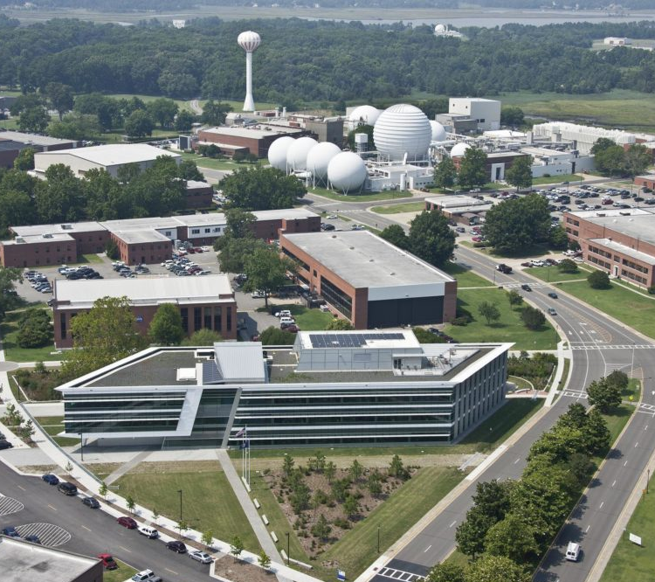
Overview
NASA Langley Research
Center (LaRC) Fatigue and Fracture Lab
Metal Alloy Characterization Based on Temperature
Digital Image Correlation (DIC) and Environmental Chamber Setup
Test
Results
Issues During Testing
Observation and Mitigation
https://images.nasa.gov/details-LRC-2013-B701_P-00137

Slide 3
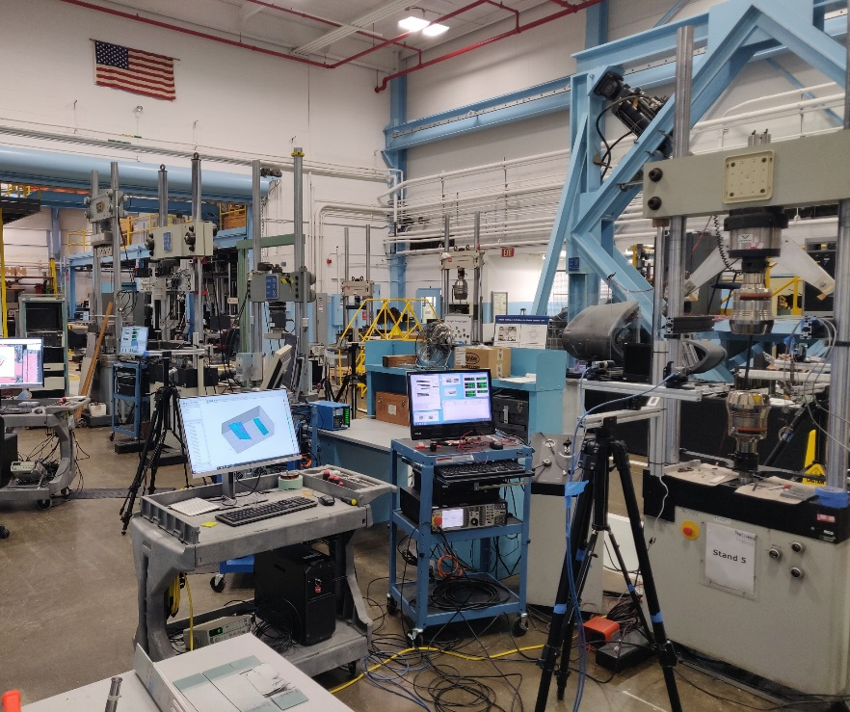
NASA LaRC Fatigue and Fracture Lab
Several hydraulic and servomechanical load frames available for material and sub-component level testing
Load Frames: 5,000 lbs. to 400,000 lbs.
Cyclic and static loading
Tests are generally non-standard to characterize behavior and/or provide data for test/analysis correlation
DIC is routinely used for nearly every test
Environmental chambers are available for testing at temperatures ranging from -320°F to 600°F

Slide 4
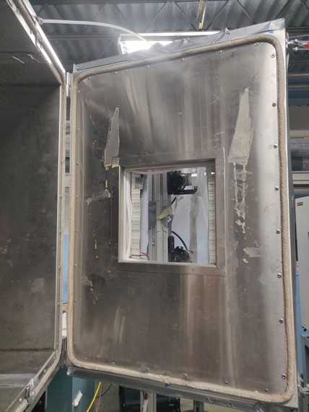
Environmental Chamber Setup
Environmental chamber mounted to Instron hydraulic test frame for characterizing material properties
Port holes for fitting to temperature control unit and access to instrumentation inside
Hinged doors on both front and back, with retrofitted quartz glass for observing test coupons
How to mount DIC cameras for the tests

Slide 5
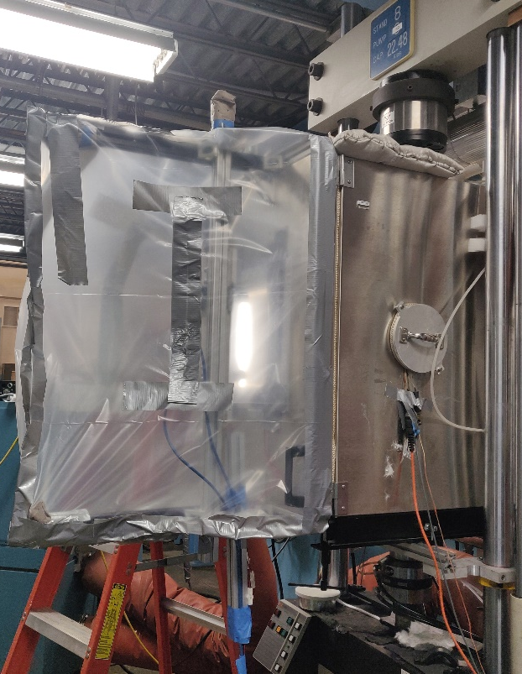
Initial DIC Setup
Camera setup on aluminum structural framing mounted on the hinged door
  Allows access to the chamber
  Maintain offset from test coupon for multiple samples
  No movement/adjustment of cameras
Plastic tent was used to cover the aluminum framing and DIC cameras to prevent condensation on the windows
Dry air hose was routed through this plastic tent directed at the glass window
Setup was duplicated on both front and back side
Lighting: Light-emitting diode (LED) strips were mounted on left and right side of the glass window
Cam 1
Cam 2

Slide 6
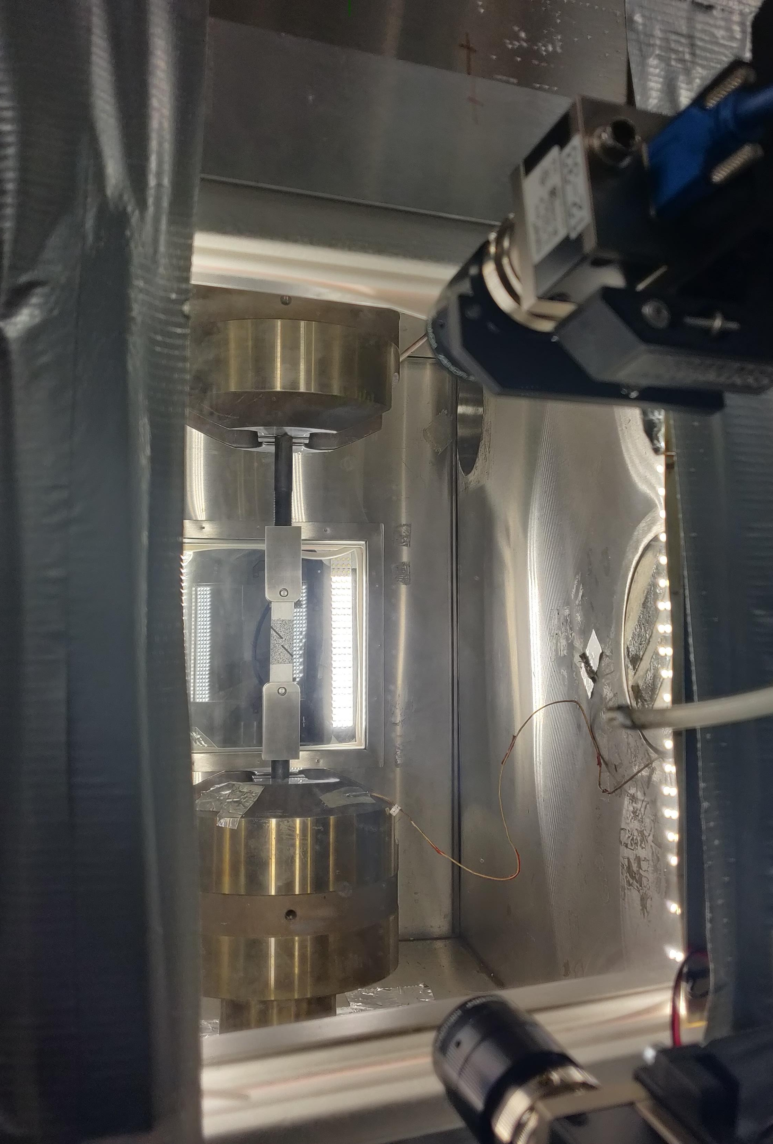
DIC Camera Setup
Cameras: Basler Ace 12 MP*
Image Resolution: 4096 X 3000 pixels²
Lens: 50-mm lens
Aperture: f/5.6
Field of View: 5 in
Image Scale: 750 pixels/in
Stereo-Angle: 22.28°
Stand-Off Distance: 20 in
Image Acquisition Rate: 1 Hz
Cam 1
Cam 2
* Specific vendor and manufacturer names are explicitly mentioned only to accurately describe the test hardware. The use of vendor and manufacturer names does not imply an endorsement by the U.S. Government nor does it imply that the specified equipment is the best available.

Slide 7
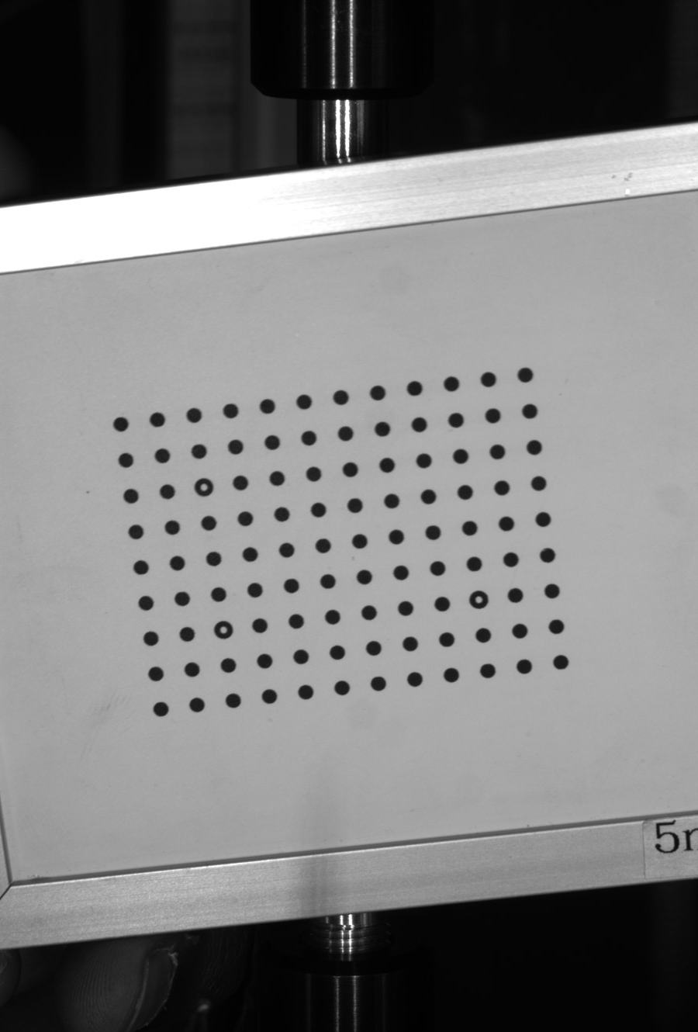
Calibration
Calibration was performed one side at a time
  The side most frequented for removing and replacing test coupons was calibrated last
  Calibration grid used: 5 mm
  Software used: VIC-3D
Calibration was done at room temperature before starting the temperature cycle and testing

Slide 8
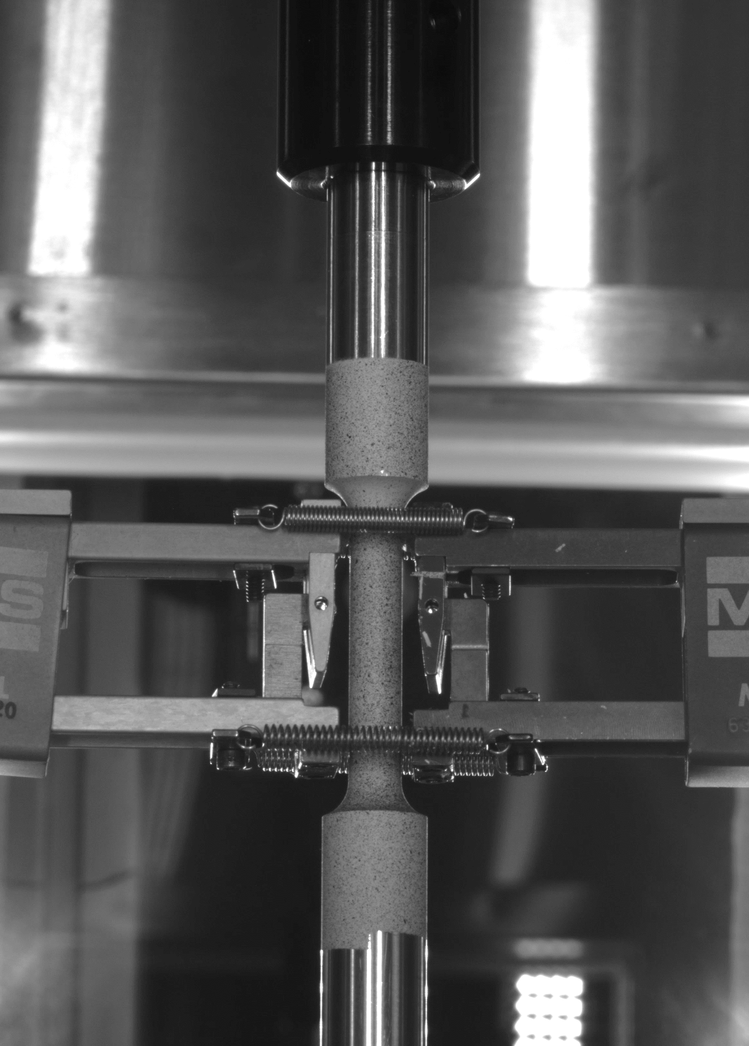
Testing Round Notch Coupons
Quasi-static loading (0.02 in/min) until failure
Extensometers were used as a fail-safe if DIC results could not be obtained (mainly during cryogenic) temperatures
  Two extensometers mounted on the coupon with springs
DIC data recorded with load and temperature data from the load frame using Bayonet Neill–Concelman (BNC) cables

Slide 9
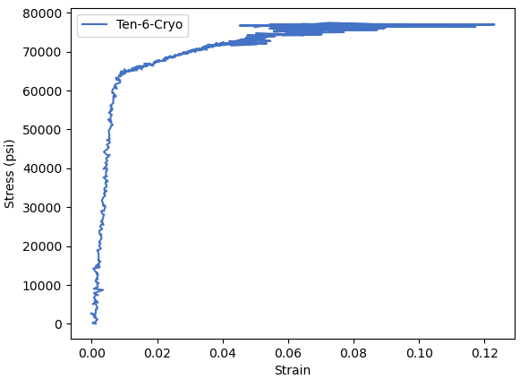
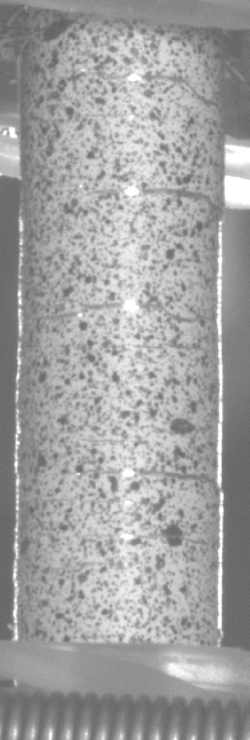
Initial Results
Stress-strain curve
Cracks in paint at 5%
Observed data noise levels
  Larger than expected projection errors (>0.1 pixels)
  Suspected camera vibration due to liquid nitrogen (LN2) inflow
Strain errors
  Observed at cold temperatures and strains greater than 5%
  Errors caused by paint cracking
Projection Error
1.4
1.2
Back
Front
1
0.8
Error (px.)
0.6
0.4
Back Avg: 0.313 pixel
0.2
0
Front Avg: 0.178 pixel
0
200
400
600
800
Time(s)

Slide 10
Coefficient of Thermal Expansion (CTE) Test
CTE experiments
  Measure strain as a function of temperature
  Three temperature holds
    0°F, -75°F, -150°F
Projection error increased with decreased temperature curve
Projection Error and Temperature
3.5
3
2.5
2
Error (px.)
1.5
1
0.5
0
150
0
5000
10000
15000
20000
25000
30000
35000
40000
45000
50000
55000
60000
65000
70000
75000
80000
100
SET POINT
F)
50
°
0
Temp. (
-50
-100
-150
0
5000
10000
15000
20000
25000
30000
35000
40000
45000
50000
55000
60000
65000
70000
75000
80000
Time (s)

Slide 11
Return to Room Temperature
Isolate temperature effects from camera setup
Projection error decreases with increased temperature

Slide 12
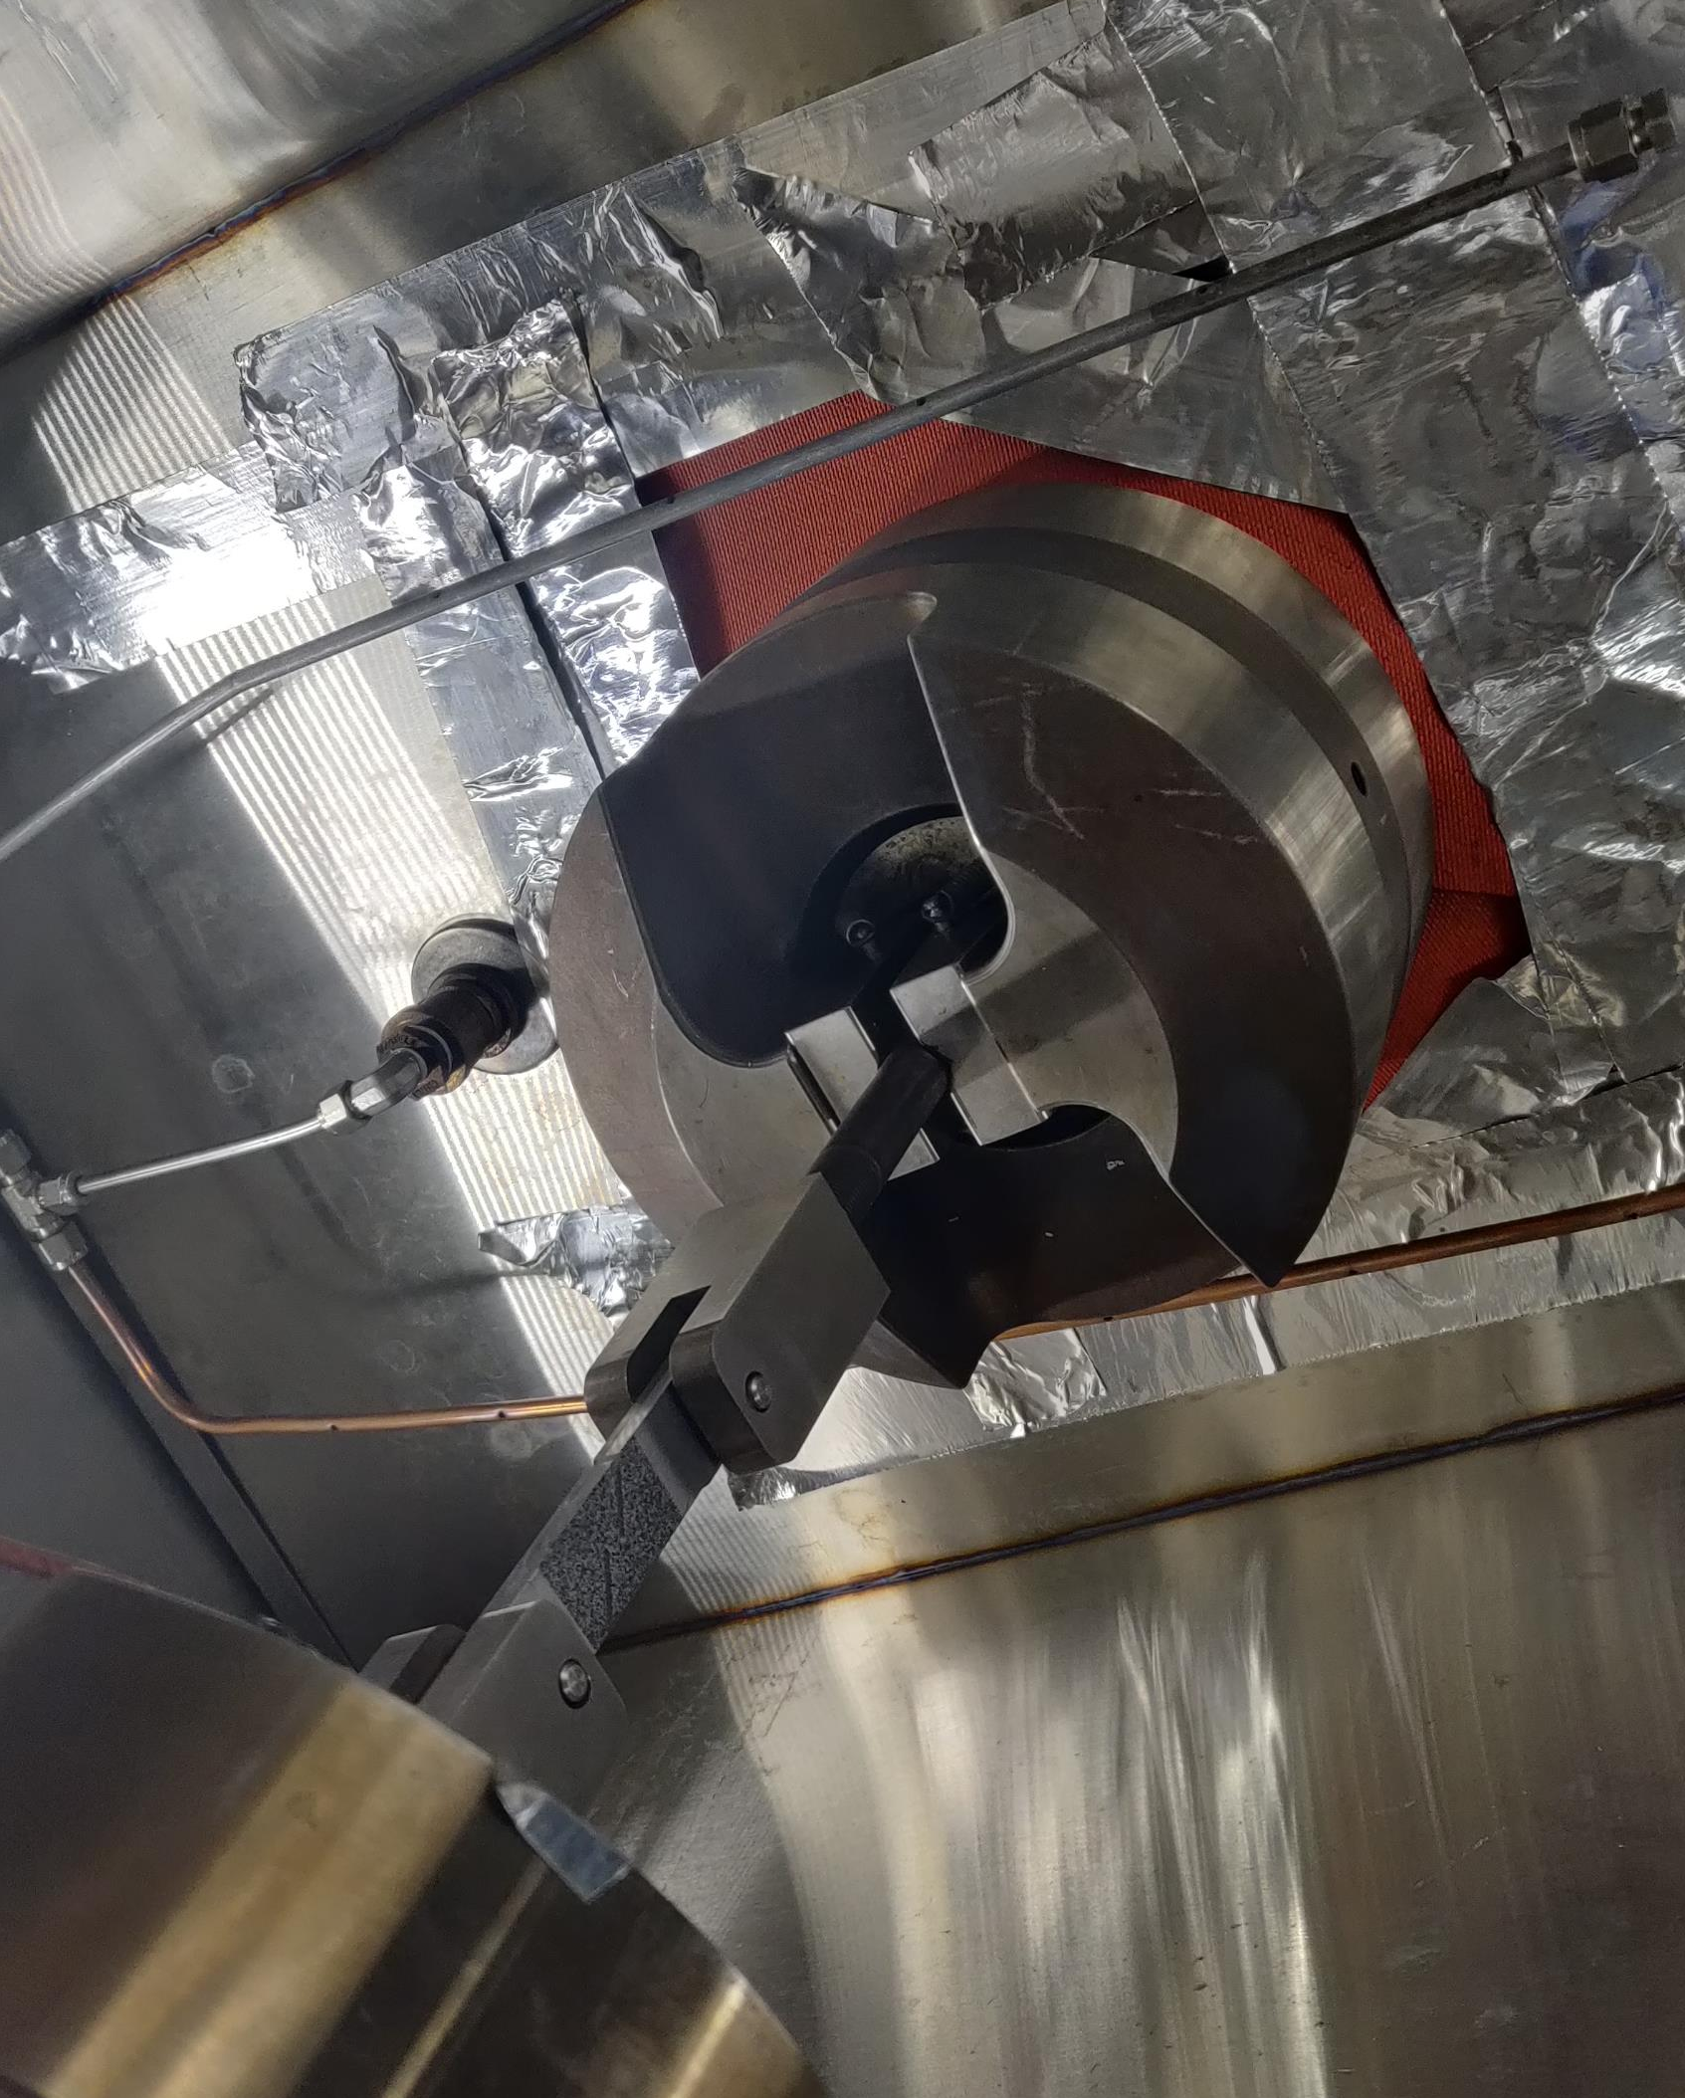
Error Sources
Vibration
  Temperature control unit connected to chamber
  External fan used to disperse nitrogen escaping the chamber
Temperature
  Liquid nitrogen introduced in the chamber with copper tubing attached to the top of the chamber
    Temperature gradient (mirage effect)
  Frost build up when testing multiple coupons

Slide 13
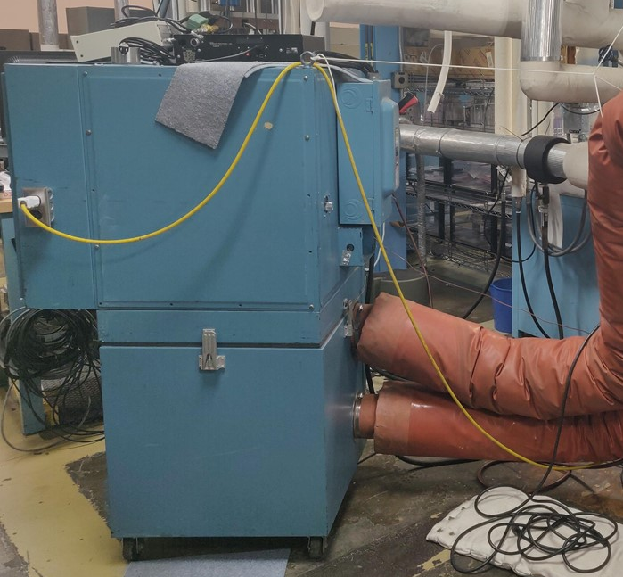
Temperature Control Unit
Produces vibration
  Due to blower used for air conditioning
  Solenoid used for regulating LN2 inlet
External fan
  No perfect seals
  Sometimes used to disperse excess LN2 surrounding test frame

Slide 14
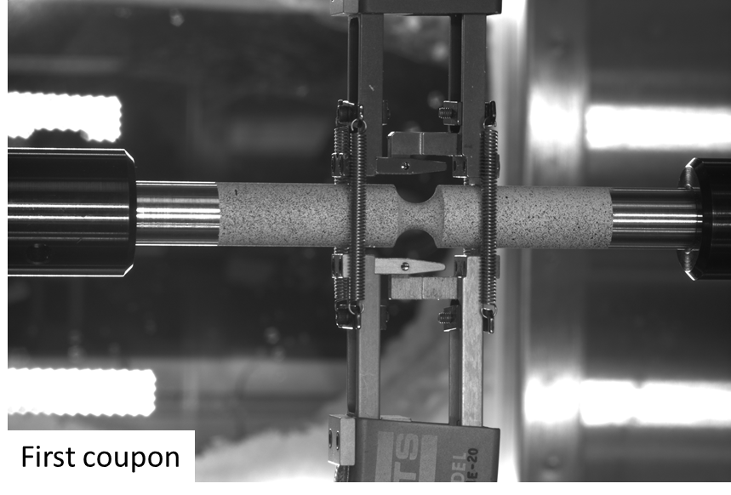
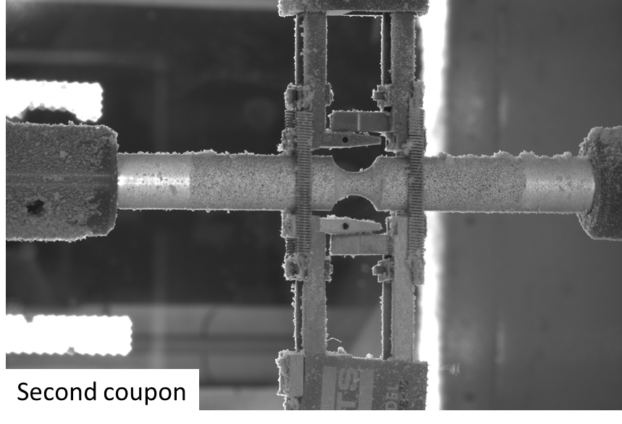
Frost During Testing
Frost build up on coupon during consecutive tests

Slide 15
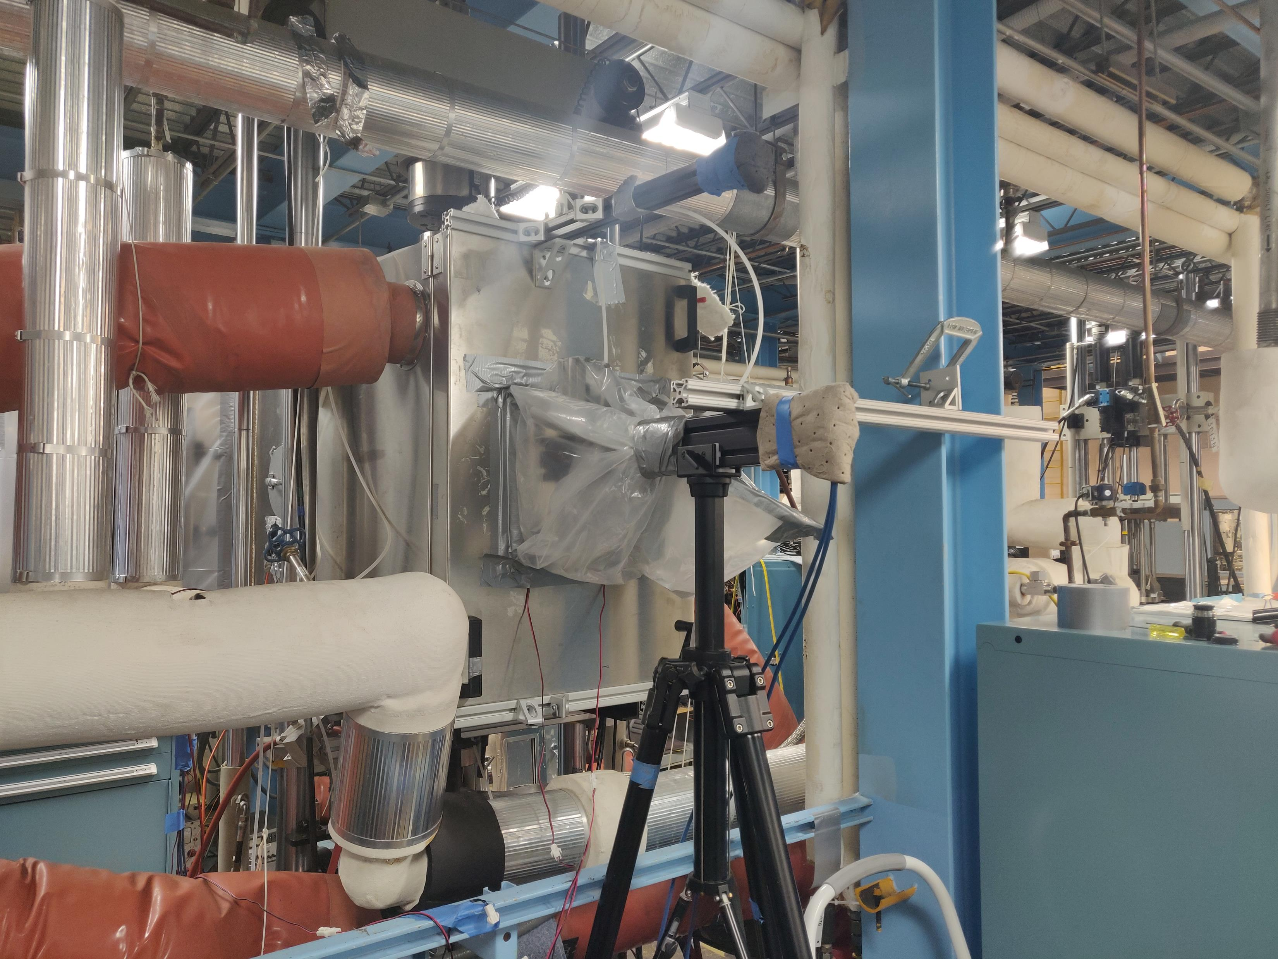
New Setup
Use tripod for mounting cameras
  Clamped to the rigid beam structure
Plastic tent only on the glass window
  Minimize the area for dry air distribution
Additional air hose for each camera
Monitor real time on each side with separate computer systems
Clamp
Tripod

Slide 16
Results
Projection error reduced with new setup
  Measurement error independent from temperature effects
Limitation to the setup
  The cameras needs to be isolated from all vibration and temperature effects while allowing ease of access to inside of chamber
Clamp
Tripod

Slide 17
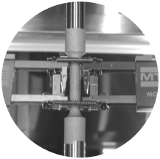
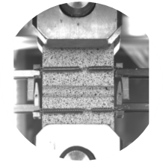
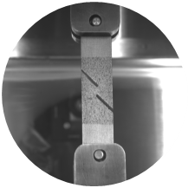
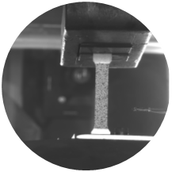
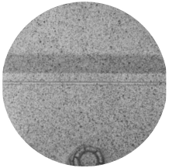
Summary of Tests Completed
Stress-strain and CTE data
Development of a material model for a critical flight hardware
Round, notched tensile tests (extracted from hardware component 1)
  3 different notches for different levels of triaxiality
  3 different temperatures
Flat, notched tensile tests (extracted from hardware component 1)
  4 different notches for different level of triaxiality
  3 different temperatures
Shear at 3 different temperatures (extracted from hardware component 1)
Sub-sized tensile tests at 3 different temperatures (extracted from hardware component 2)
CTE tests on material (extracted from hardware component 1 and 3)

Slide 18
Thank you
Questions?

