Slide 1


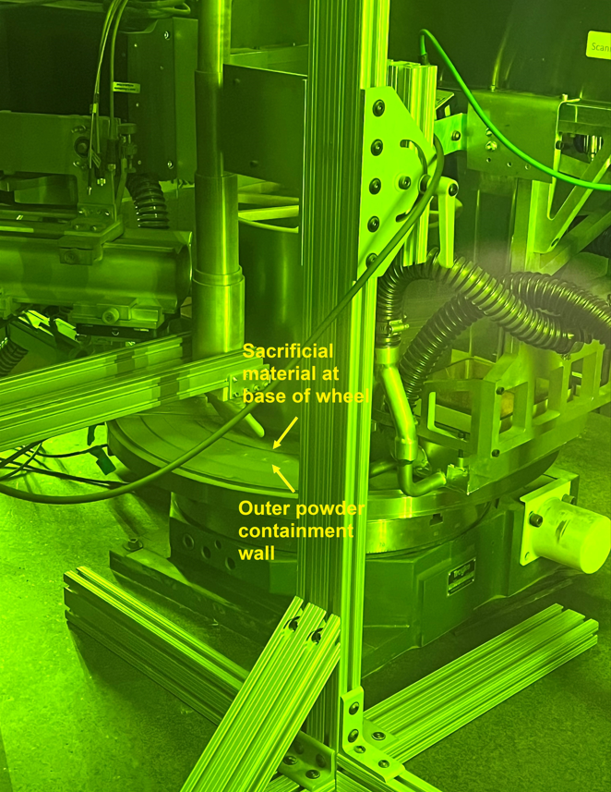
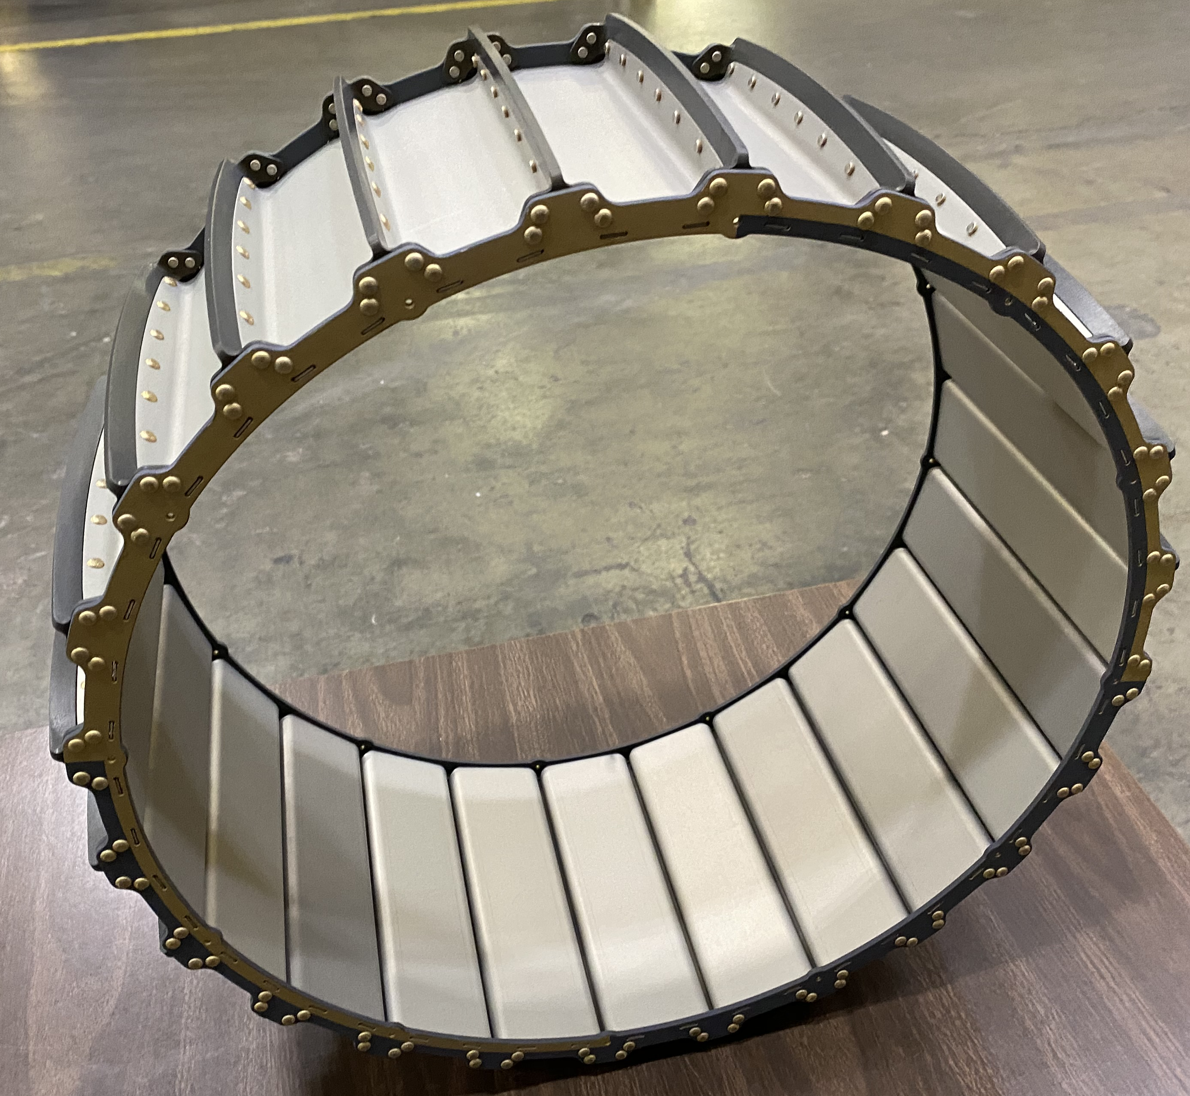
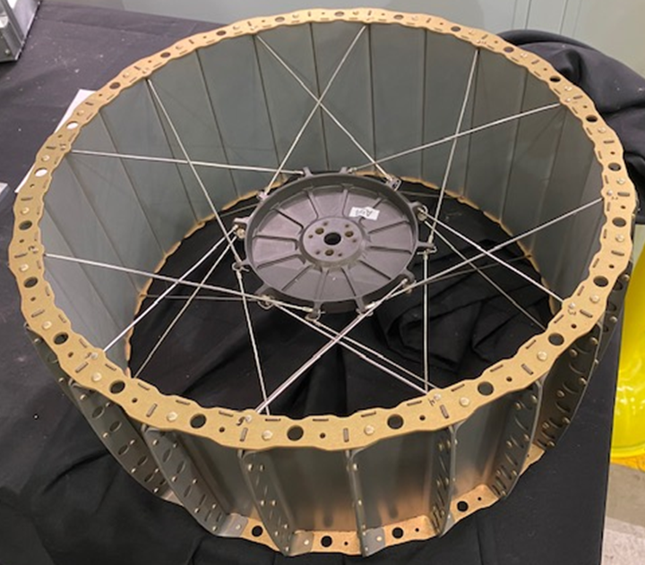
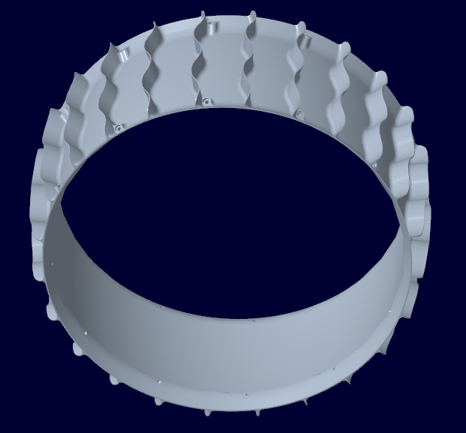
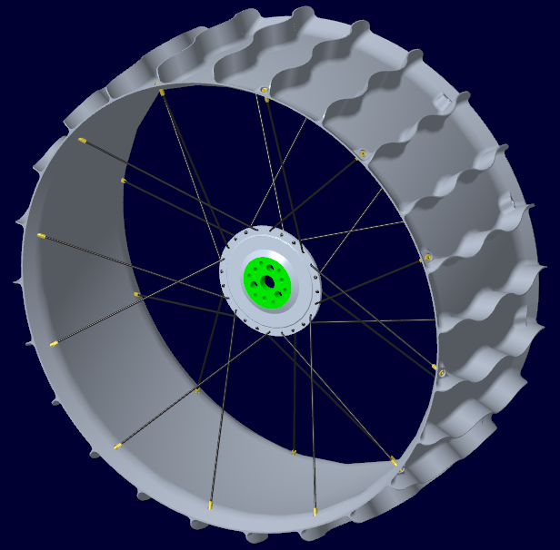
Additively Manufactured VIPER Wheel Study
FY22 JSC / WSTF ICA # _4_
National Aeronautics and Space Administration
Johnson Space Center (JSC) / White Sands Test Facility (WSTF) 2022 JSC Technology Showcase: FY22 CIF IRAD, ECI & JSC/WSTF ICA
Principal Investigator(s): Richard Hagen, Alex Sobey, Brian Gibson Ph.D (ORNL)
Technology Taxonomy Area (TX): 12.1, 12.2, &12.3
TRL: Start 2 / Current 4
Overview
The current wheel design for VIPER (Volatiles Investigating Polar Exploration Rover) is an excellent design that is both light weight and strong. However, with recent advances in additive manufacturing there is the possibility of producing a wheel that is stronger, lighter, and more structurally efficient in a shorter amount of time. This proposal is seeking to investigate design methodologies, suitable AM material, and printability of a new wheel design. Oak Ridge National Lab will be providing design guidance (includes feedback on the structural shape and material selection) and production of a printed rim for a prototype wheel. The goal of the project is to produce a wheel design methodology for future rover wheels that is faster, cheaper, and stronger than the current manufacturing process.
INNOVATION
By using the latest manufacturing technology, a more efficient structural design is easily produced in days. The potential to be able to design and manufacture a new wheel in days instead of 12 to 16 weeks allows for quick iterations at a reduced cost. Additionally, the new wheel design reverses the installation of the spokes to reduce the manufacturing cost of the hub and to simplify assembly for an overall reduction in the fabrication cost of a complete wheel assembly.
Current VIPER Wheel Rim:
50 fabricated metal parts
360 rivets
Outcome
At this point the project has only been able to produce one wheel due to delays in getting the NASA/ORNL Inter Agency Agreement signed, funds transferred, and ORNL getting the metal additive printer up to speed.
  ORNL printed the first wheel rim design using Inconel 718 since that is currently the only material available for the additive machine used. There are very few metal additive machines that can handle a 20” diameter part and they have limited material options.
  Current printed wheel concept is estimated to weigh around 10 pounds when printed with Inconel 718.
  Once the additive wheel rim arrives at JSC the wheel will be assembled with the new hub and spoke design for evaluation.
Wheel Rim being printed at ORNL
Infusion Space / Earth
This design concept is too late to be adopted by the VIPER rover. However, by developing a design that can utilize existing the VIPER test bed one can easily evaluate the suitability of this manufacturing process for future rover wheels. The plan is to take the fully assembled wheel design and evaluate its’ performance. If the concept proves worthy, additional funds will be sought for further development in support of projects such as the Lunar Electric Rover.
PARTNERSHIPS / collaborations
The lead designers of the wheel rim are Alex Sobey and Richard Hagen. Brian Gibson is the primary contact at ORNL responsible for printing the wheel rim. Additional personnel at ORNL who assisted with this project are Jay Reynolds, Gordon Robertson, Peter Wang, Greg Larsen, Charles Wade, Michael Borish, Benjamin Stump, and Paritosh Mhatre. This project uses a new Inter Agency Agreement (IAA) with ORNL signed this summer. Since we are the first project to utilize this new agreement there were some delays in getting the funding to ORNL, which delayed production of the wheel rim in time for evaluation on the VIPER Testbed.
Future Work
FY’23 Test the wheel assembly in the Viper wheel test bed as a direct comparison to the existing VIPER Wheel.
FY’23 With additionally funding new light weight design elements can be added to the wheel rim and hub designs. Additionally, ORNL is seeking funding to develop of lighter weight metal alloys for use on the large-scale multi-laser powder bed fusion system used to produce the wheel rim.
DAA# 20220016311

