Slide 1

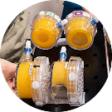
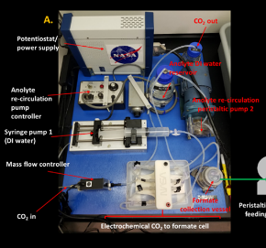
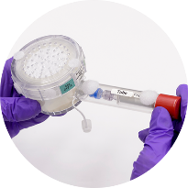
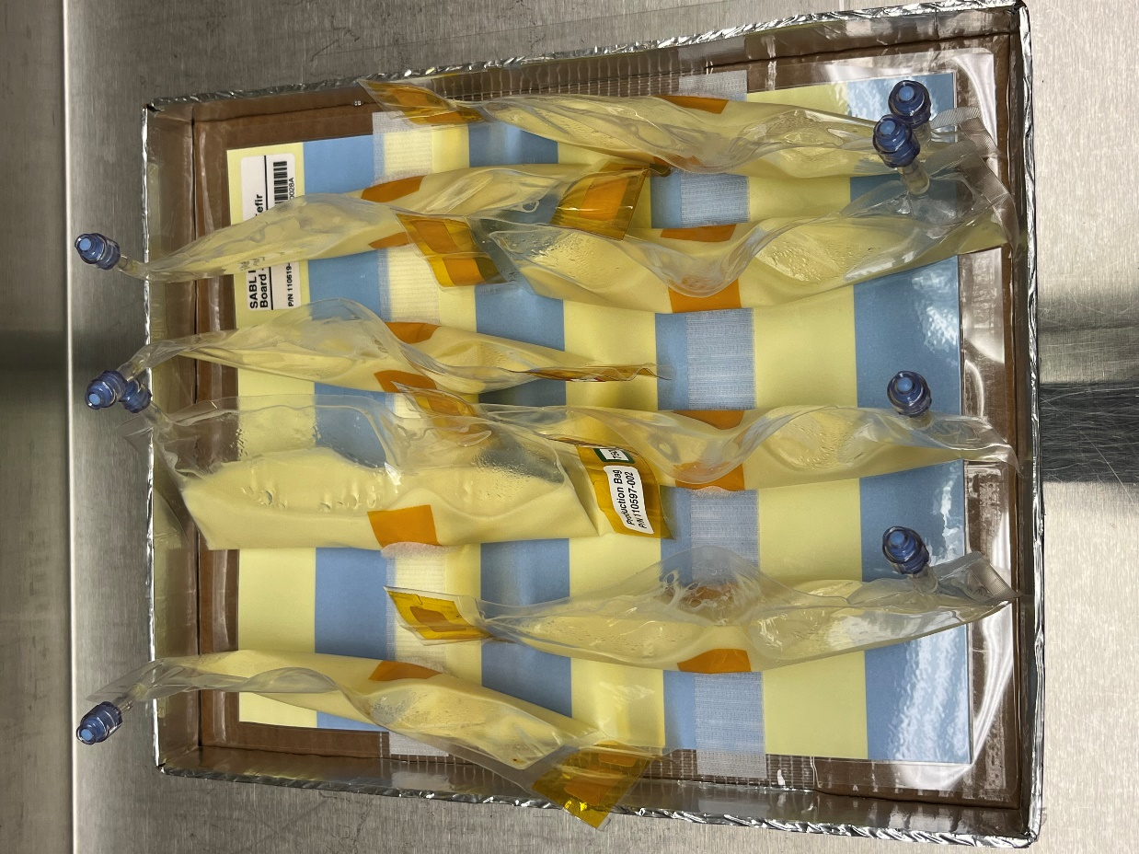
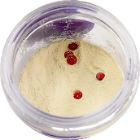
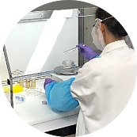
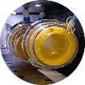
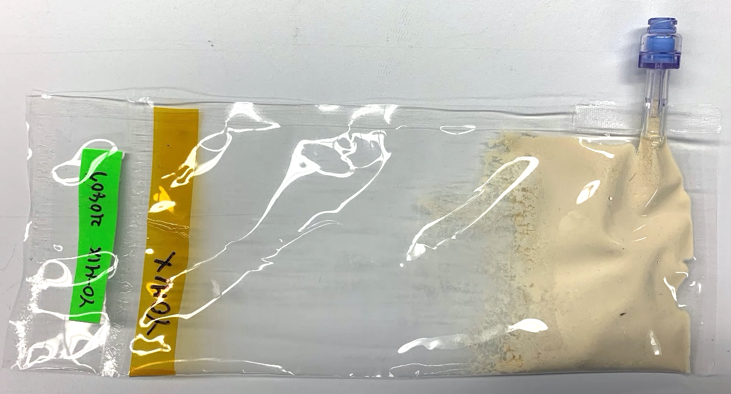
Space Technology Mission Directorate
Game Changing Development Program
Frances Donovan| Synthetic Biology Project Manager, Investigator| CNRS November 2, 2022
Frances.M.Donovan@NASA.gov

Slide 2
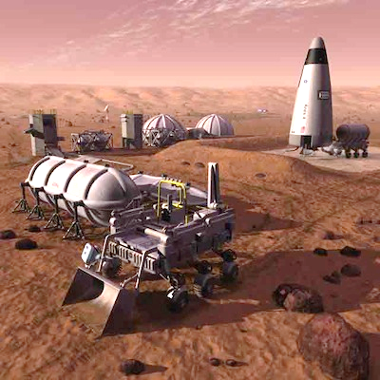
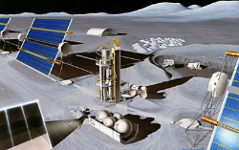
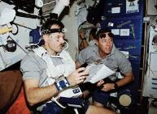
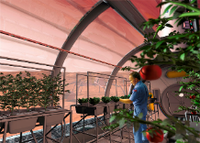
Sustainable Exploration and BioManufacturing
Future missions require new methods to provide sustainability:
In situ Resource Utilization (ISRU) generates supplies from local resources.
In situ Manufacturing (ISM) provides capability to make needed chemicals, fuels, building materials, pharmaceuticals, etc. on-site and on-demand.
Closed-loop life support systems treat and recover valuable resources via regenerative air, wastewater, and solid waste processing systems.
Space medicine systems requires the ability to monitor and maintain crew health under very adverse conditions.
Food production systems are needed to supply certain nutritional needs not met by current food provisioning systems.
These systems require increased reliability and self-sustainability, and decreased mass, power, volume, and consumable use.
Credits: NASA

Slide 3
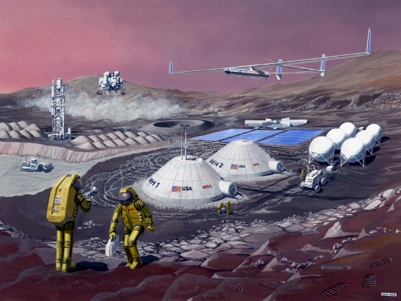
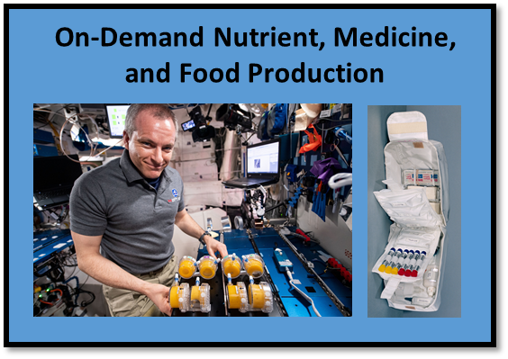
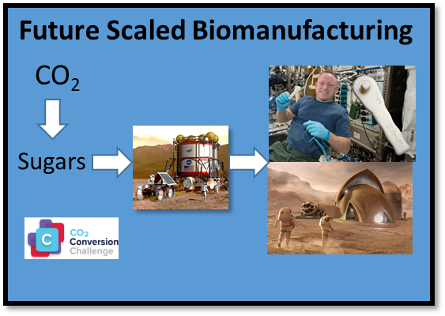
Advantages of BioManufacturing
Biological systems are:
Scalable
Programmable
Precise (pure isomers)
The only route of production in some cases (protein therapeutics)
Low Tº and pressure
Regenerable

Slide 4
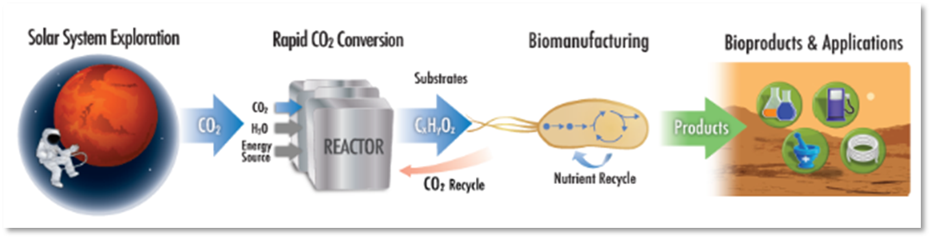
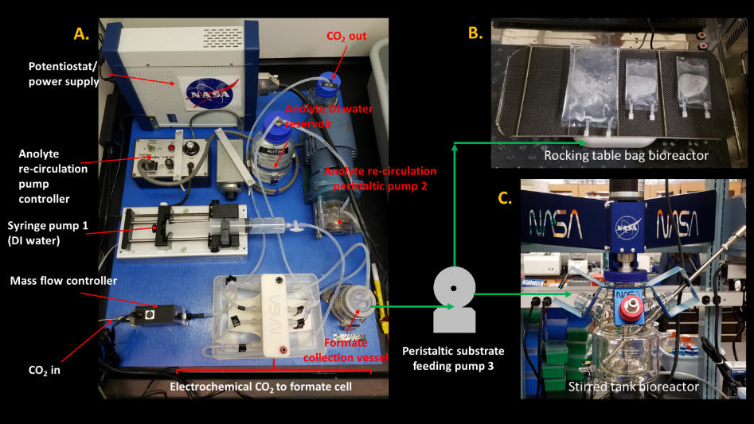
CO₂-based BioManufacturing Prototype
Objective: Use rapid physico-chemical methods to convert CO₂ to an organic media for microbes to produce mission-relevant products in space.
Initial test of prototype platform: Integration of CO₂-to-formic acid reactor with bioreactors. A. NASA-ARC CO₂-to-formic acid reactor system with electrochemical cell from Dioxide Materials, B. NASA-ARC Rocking table with FEP bag bioreactors, and C. NASA-ARC Stirred tank bioreactor. Preliminary integration will consist of a peristaltic feeding pump to provide formic acid to either the rocking table or stirred tank bioreactor.

Slide 5
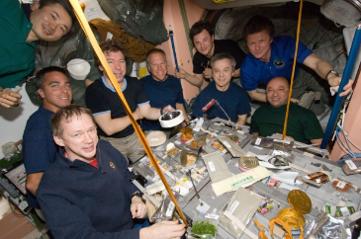
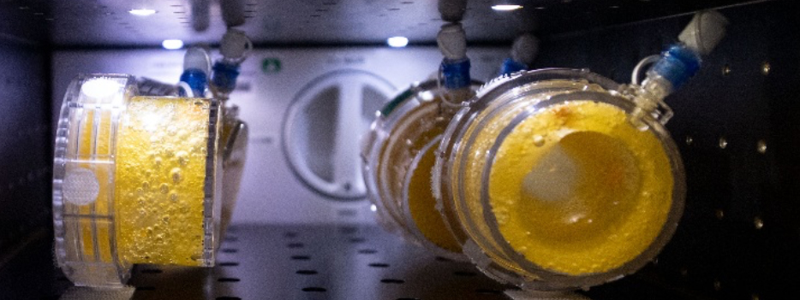
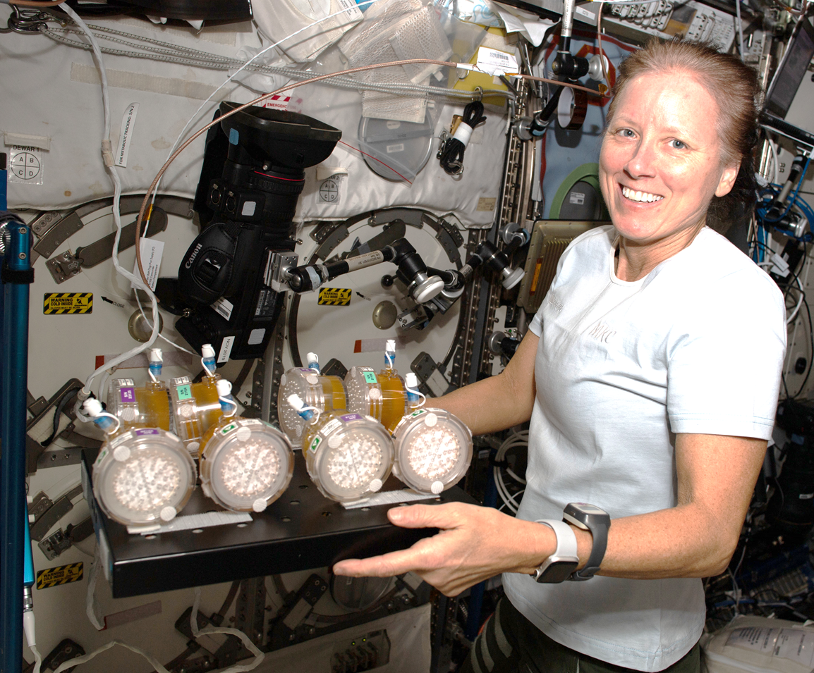
Nutrition in Space
Nutrients degrade with time in food and supplements
  Enhanced nutritional needs in space travel
  Radiation and microgravity countermeasures
  Disease-specific concerns
Psychology of food/isolation
Need to produce some foods in situ
Adapted from Zwart et al (2009) Food Science 74(7):H209-H217.
https://doi.org/10.1111/j.1750-3841.2009.01265.x
Credits: NASA

Slide 6
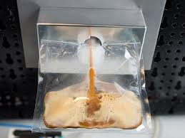
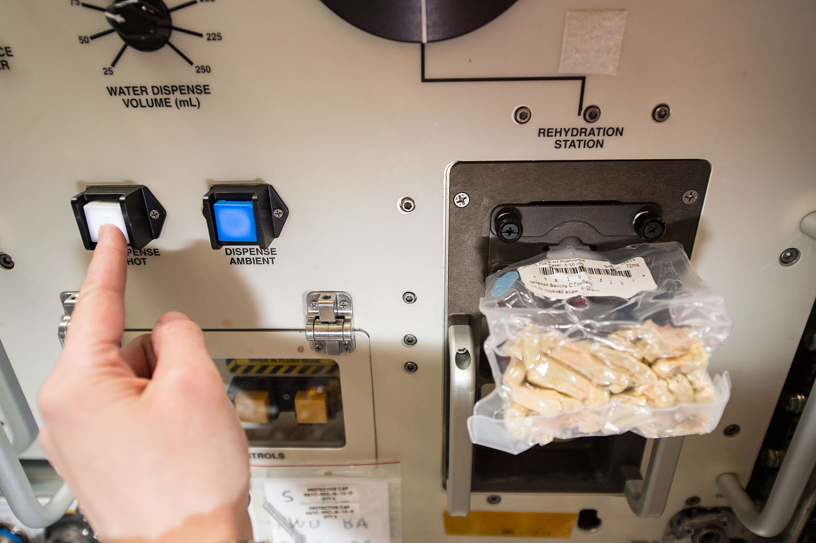
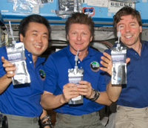
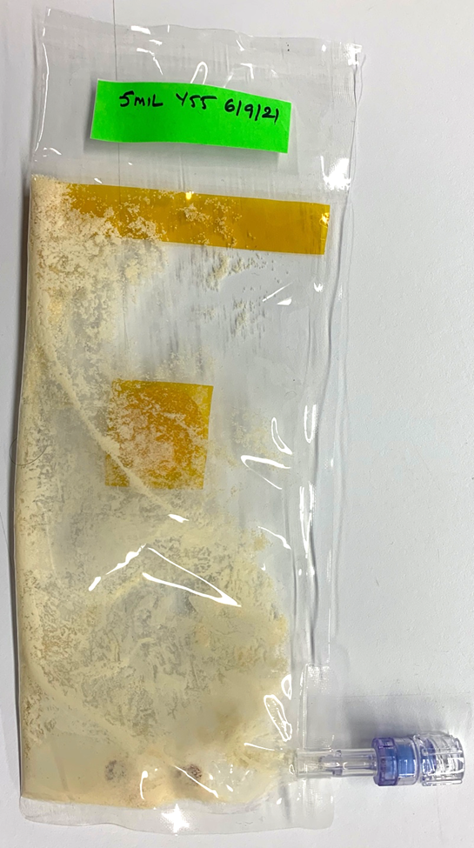
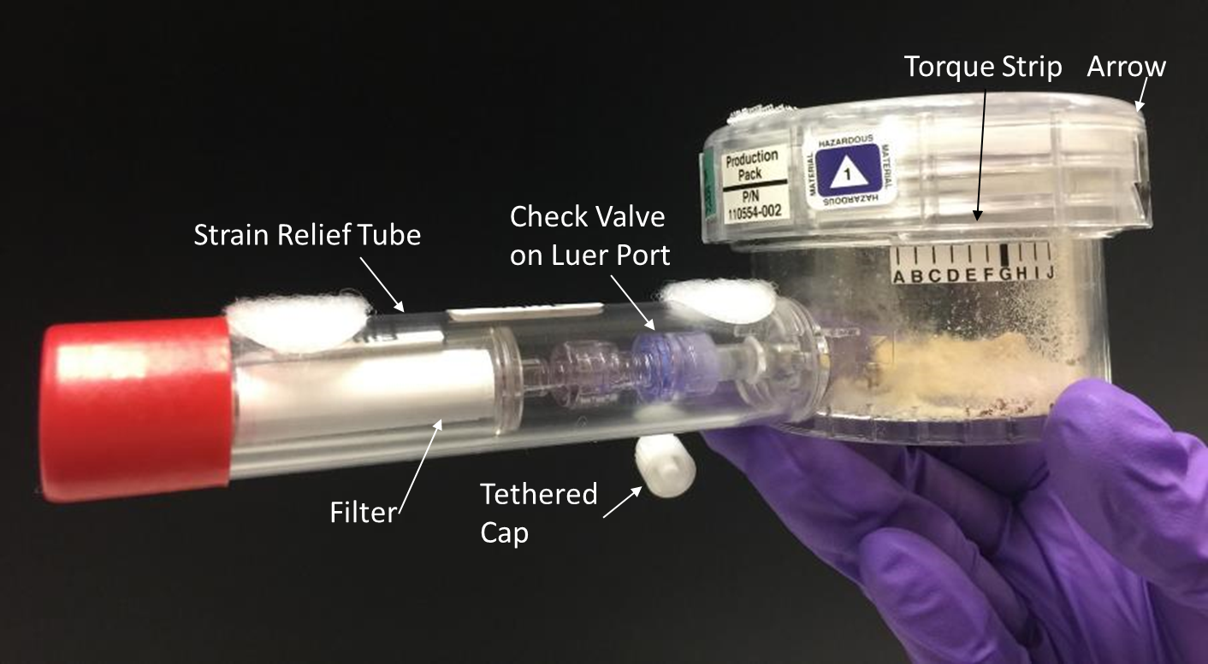
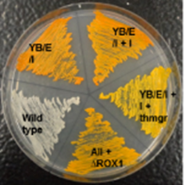
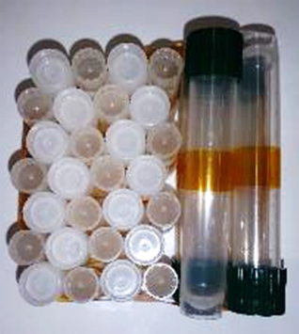
BioNutrients
Develop and Demonstrate an on- demand nutrient production system for long duration missions to support nutrient degradation in stored foods.
Deliverables:
Flight-tested microbial production platform evolvable for future surface missions – capable of producing many compounds (e.g., nutrients, medicines)
Space-adapted microbial hosts for future generic use and genetic engineering.
On-orbit safety and operational systems for future implementation.
5-Year ISS Storage-Reactivation Demonstration – NG-11 (04/17/19)
Future Mission Implementation Concept
Incubation
Safety
Test
BioNutrients-1 Flight Production Pack Development for on-orbit testing
Engineering microbes to produce nutrients and medicines on-demand
Developing microbes adapted for use
in space

Slide 7

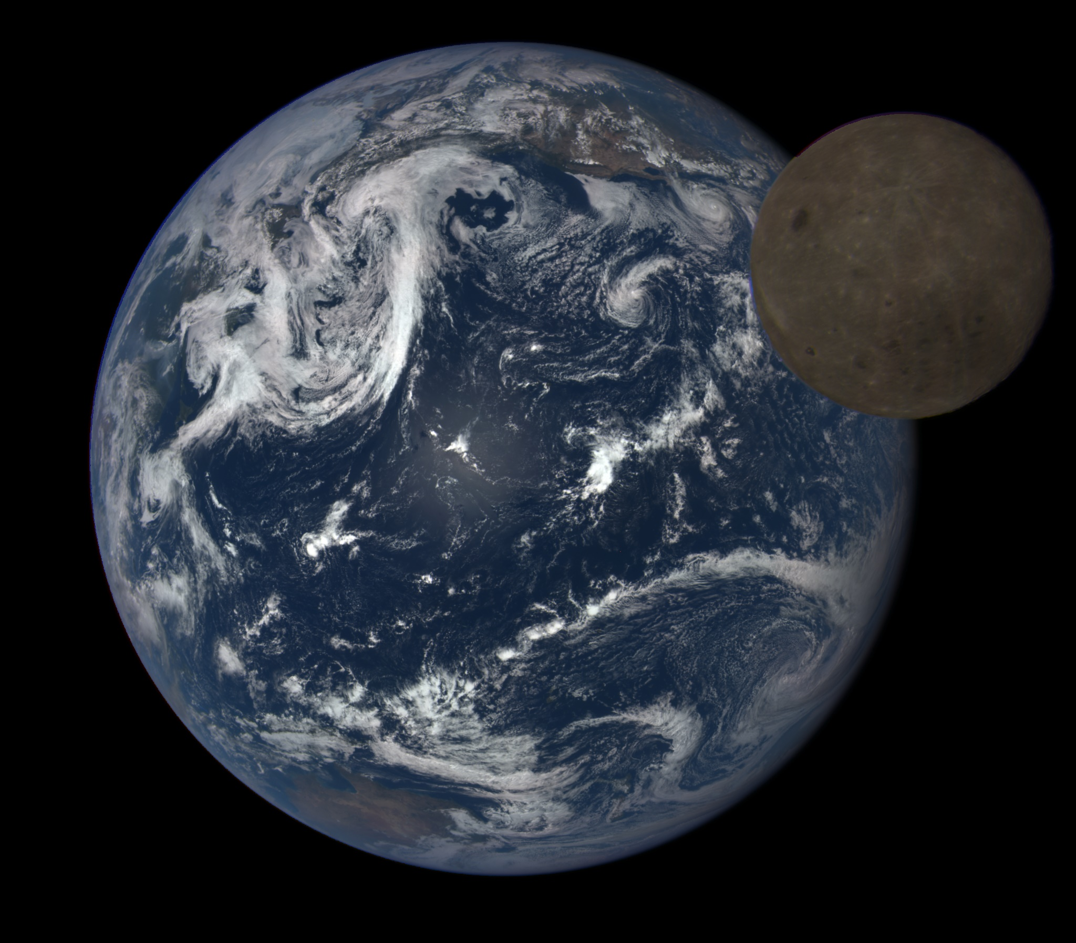
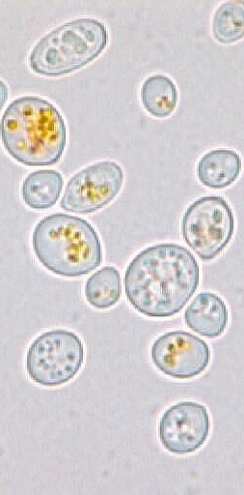
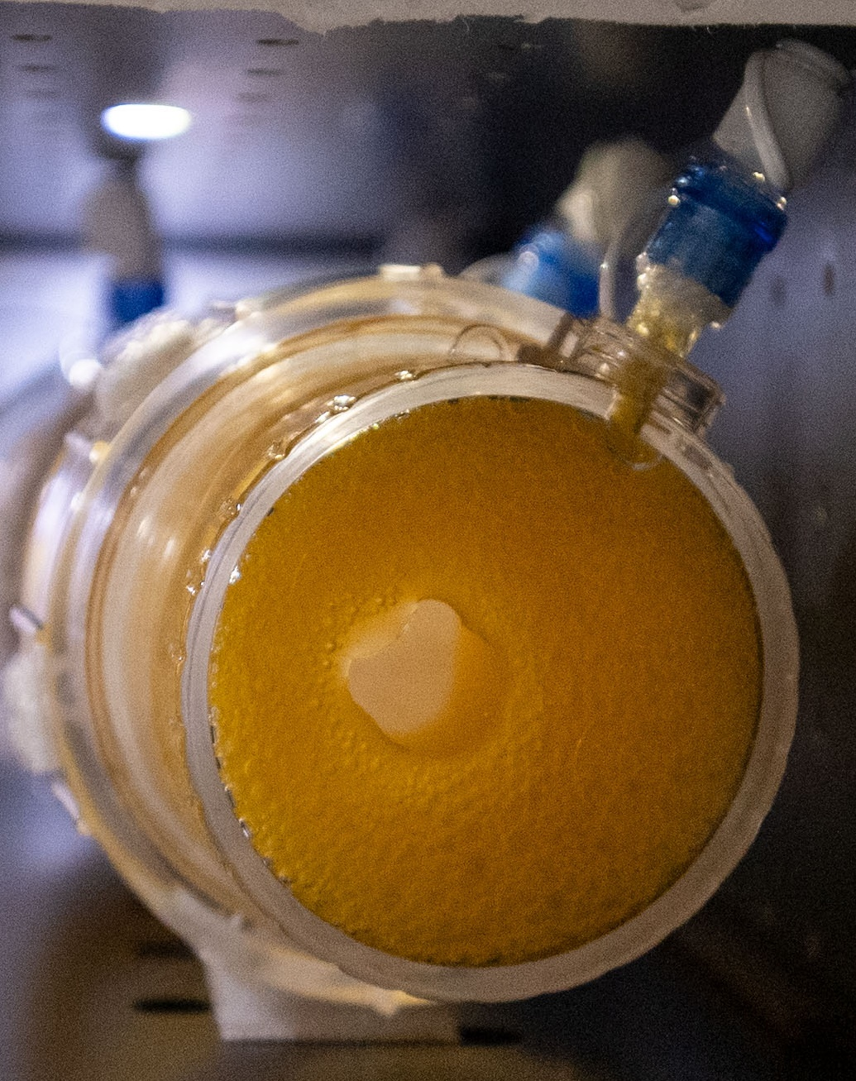
Biomanufacturing on the Lunar Surface
Protein & Ion Leaks
Cell cycle arrest
Lipid Peroxidation
Low ATP
DNA Damage
Repressed translation
Lunar surface radiation is expected to increase DNA and ROS damage to cells.
Cells shift energy from growth and production to repairing damage.
Will antioxidant production in yeast be reduced?
Image credit: NASA

Slide 8


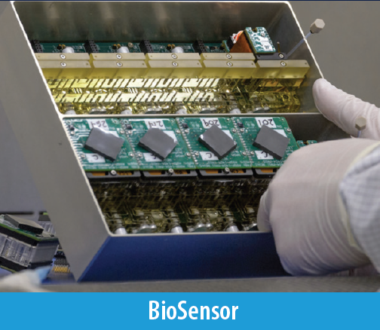
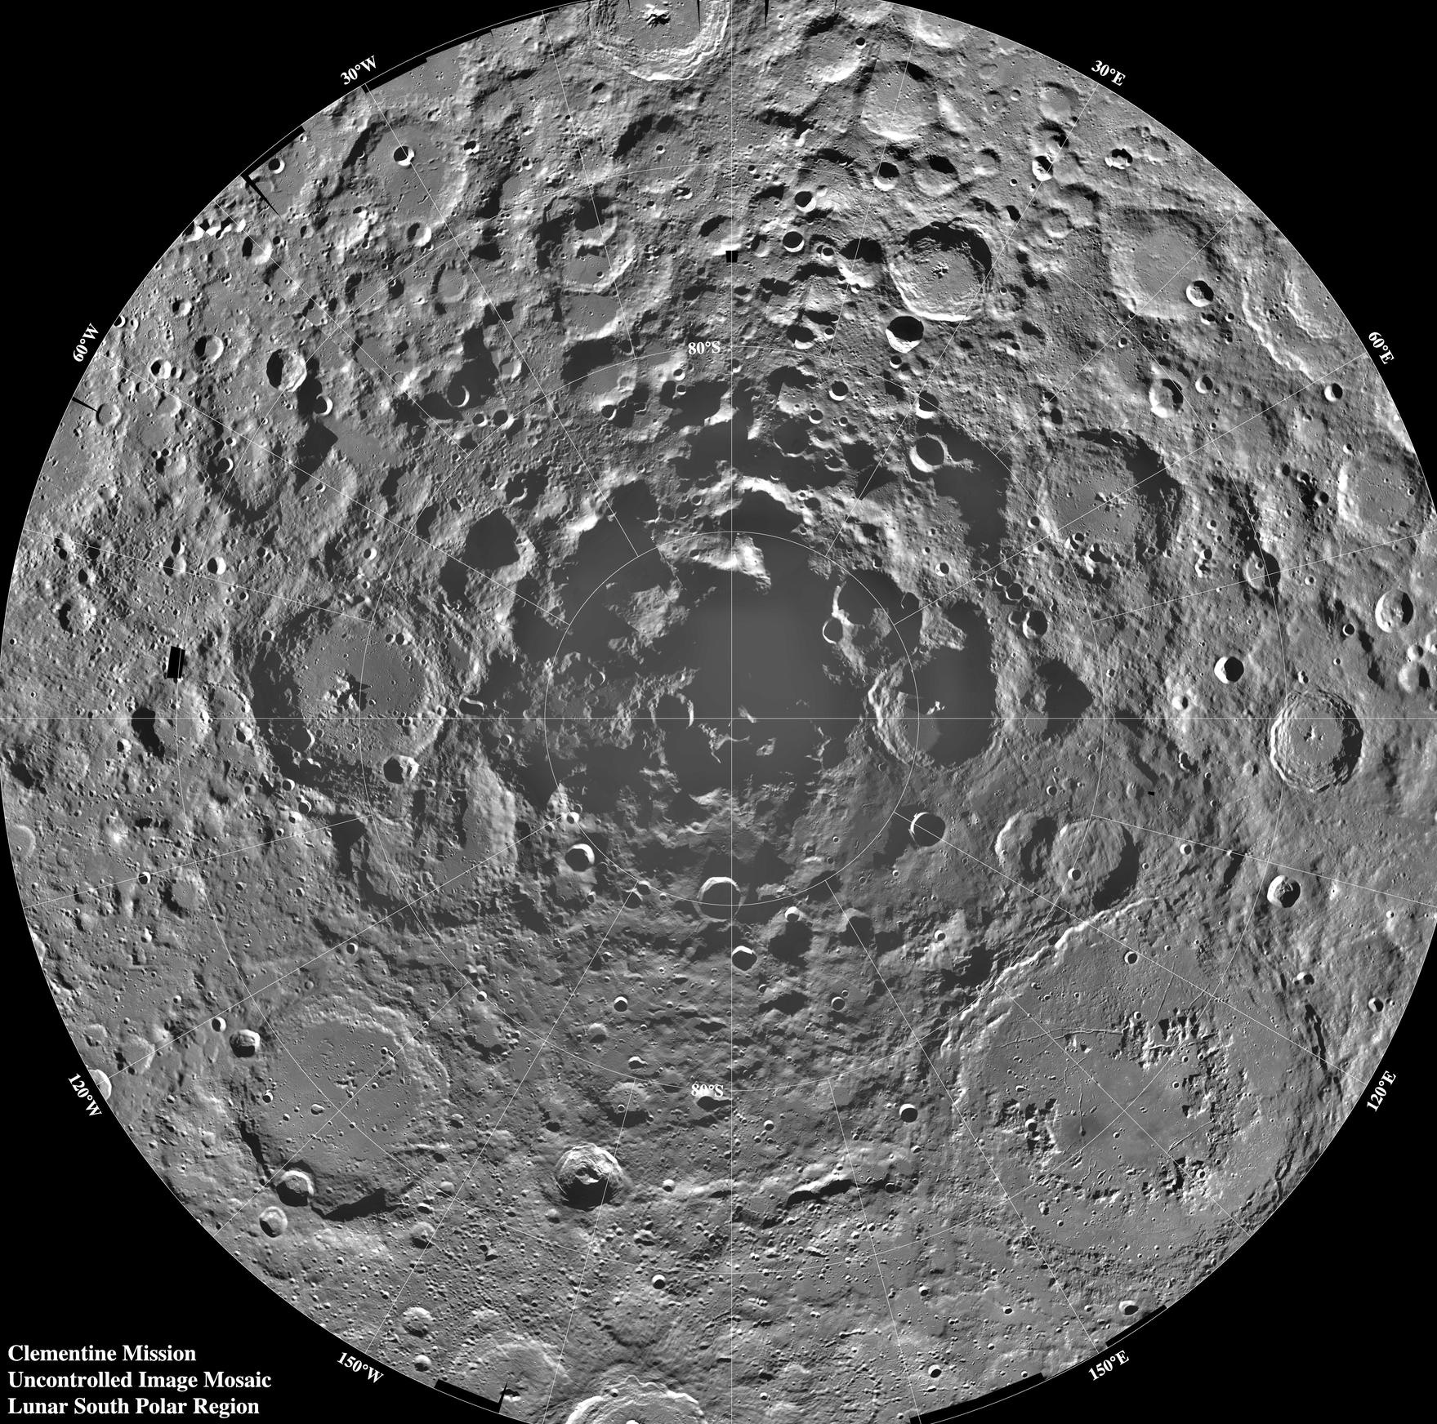
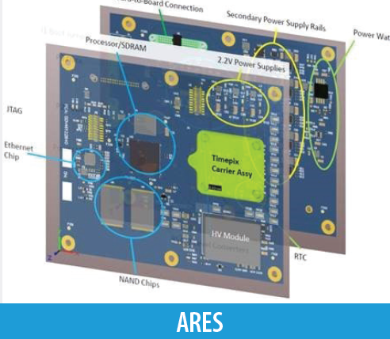
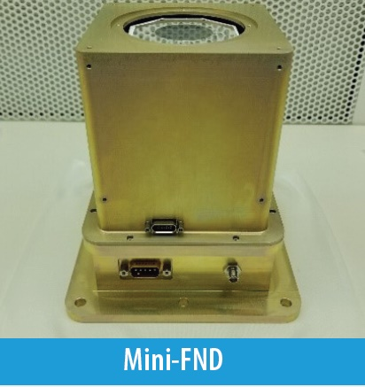
Lunar Explorer Instrument for space biology Applications:
a South Pole Lunar surface investigation
Motivation.
What are the radiation health risks for crewed exploration of the lunar surface?
Will proposed mitigations for crew health using in-space biomanufacturing be effective beyond low Earth orbit?
Approach.
Engineer yeast strains to test growth and metabolism for sensitivity to radiation.
Measure biologically relevant radiation in transit and on the lunar surface.
Expected Outcomes and Impact.
Determine cellular sensitivity to the lunar environment.
Evaluate feasibility of bioproduction on the Moon.
Test genetic strategies to enhance cellular tolerance to the lunar environment.
Determine ground truth radiation risks for crew.
LEIA Instruments
Team: Dr. A. Mark Settles (PI), Dr. Sergio Santa Maria (Deputy PI), Dr. Donald M. Hassler (Co-I, SwRI), David Pletcher (PM), Leandro James (SE)
For more information: https://www.nasa.gov/press-release/nasa-selects-new-instruments-for-priority-artemis-science-on-moon
Image credits: NASA

