Slide 1
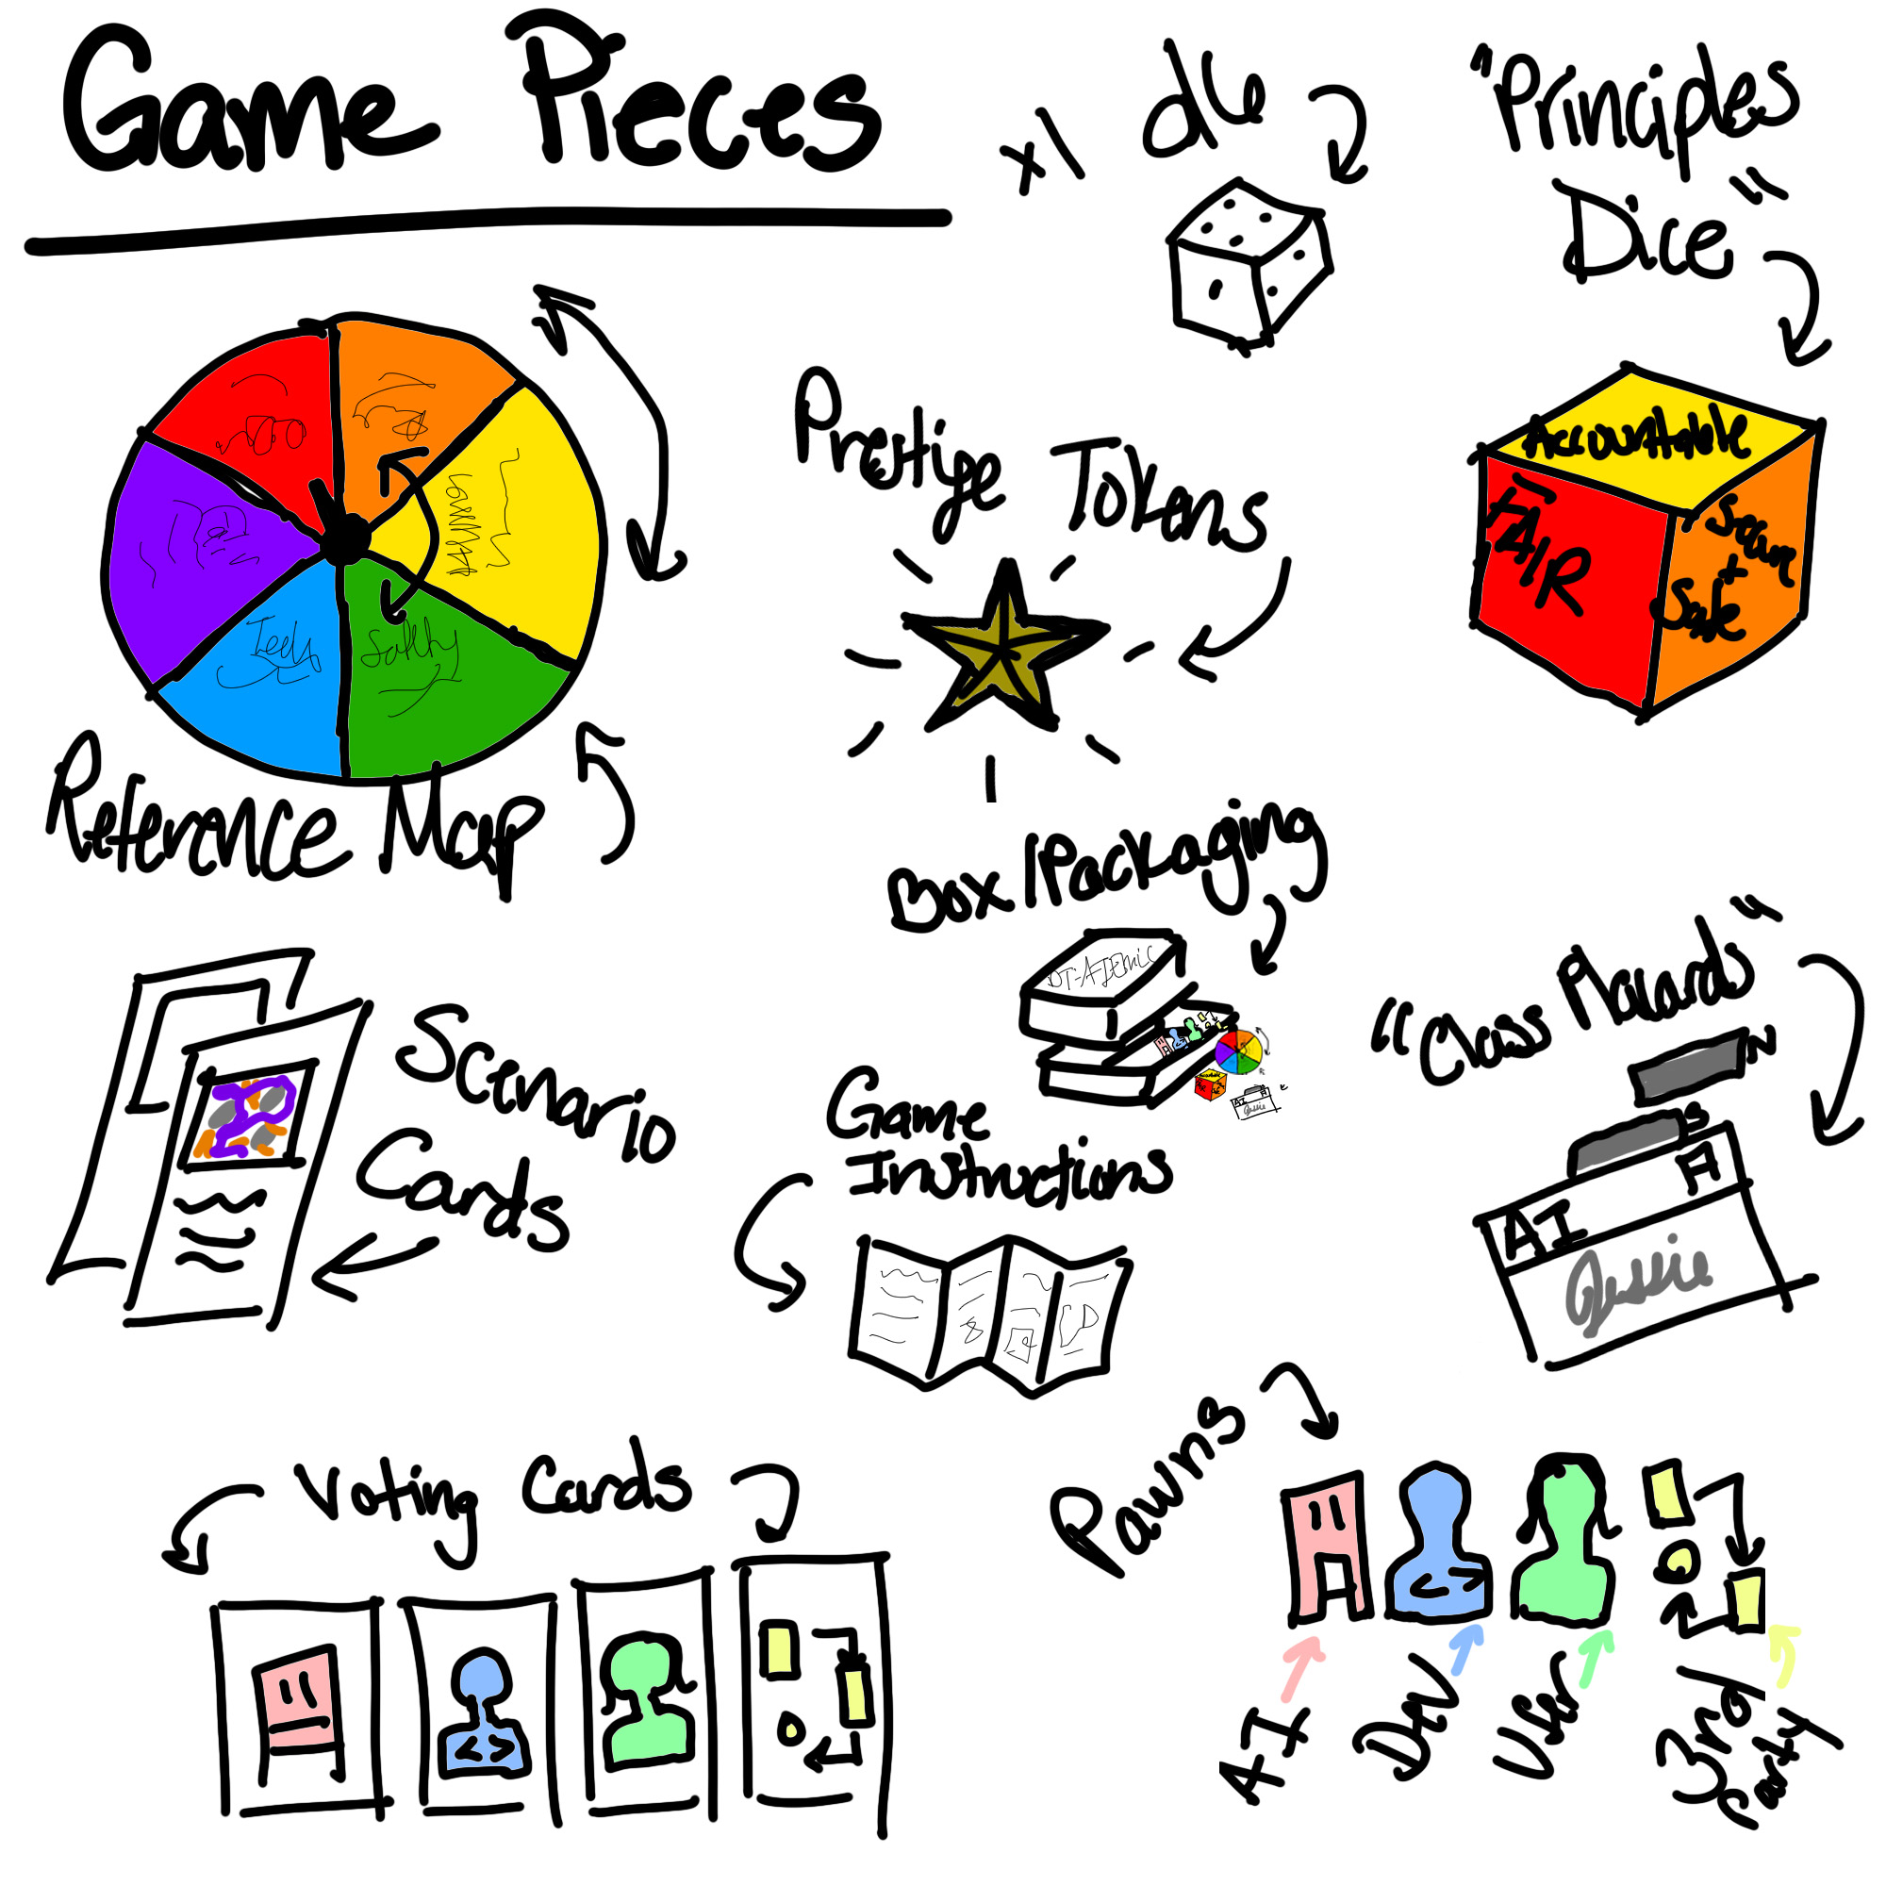
AI Ethics Board Game
(Appendix for AI Ethics)
Jessica Robinson & Cristina Morales
NASA Langley Data Science Summit
November 2022
Notes:
Introduce selves, our work, and this project

Slide 2
Background and Motivation
Goal:
To create an immersive experience for deliberation of uncertain ethical AI scenarios.
Using: NASA Framework for the Ethical Use of AI^{[2]}
Fair
Explainable & Transparent
Accountable
Secure & Safe
Human-Centric & Societally Beneficial
Scientifically & Technically Robust
Method: Design Fiction^{[1]}
Something that creates a story world
With something being prototyped in that story world
Does so in order create a discursive space
Notes:
Uncertain AI ethics scenarios:
Not "cliché," not trolley problem, stuff that is more grounded
When there is no one "right" decision
Immersivity:
suspension of disbelief
Design Fiction
(1) uncertain AI ethics
(2) policy and user/dev responsibility
(3) space is created among dev/users

Slide 3
Research Questions
Questions for AI ethics:
Q1.1: What are common use cases of AI and how is ethics involved?
Q1.2: Who are the primary stakeholders in the development of ethically-sound AI?
Q1.3: What influences ethics-based decisions?
Questions for immersivity:
Q2.1: Where/What is a story world that supports our questions about uncertain AI Ethics?
Q2.2: How can we develop meaningful interaction regarding uncertain AI Ethics?
Notes:
Questions for AI ethics:
Q1.1: brainstorming sessions, technical reports
Q1.2: AI, Dev, User, 3rd Party
Q1.3: time, money power, self
Questions for immersivity:
Q2.1: near future digitally transformed world
Q2.2: game mechanics jesse schell

Slide 4
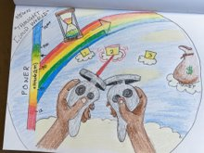
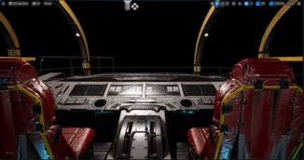
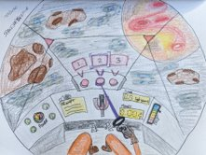
Virtual Reality
Windows Mixed Reality
Unreal 5
Figure 2: Concept sketch of "Cloud" story word
Figure 1: VR prototype space in Unreal Engine 5
Figure 3: Concept sketch of "Space" story world
Notes:
Q2.1: DT'd near future, space as a vehicle
Q2.2: How can we develop meaningful interaction regarding uncertain AI Ethics?
- mechanics
Q.1.3 - time, money, power, self
Different mechanics take different priorities with different interfaces
In many ways the question migrated from "How can we develop meaningful interaction" to "What game mechanics support meaningful interaction?"

Slide 5

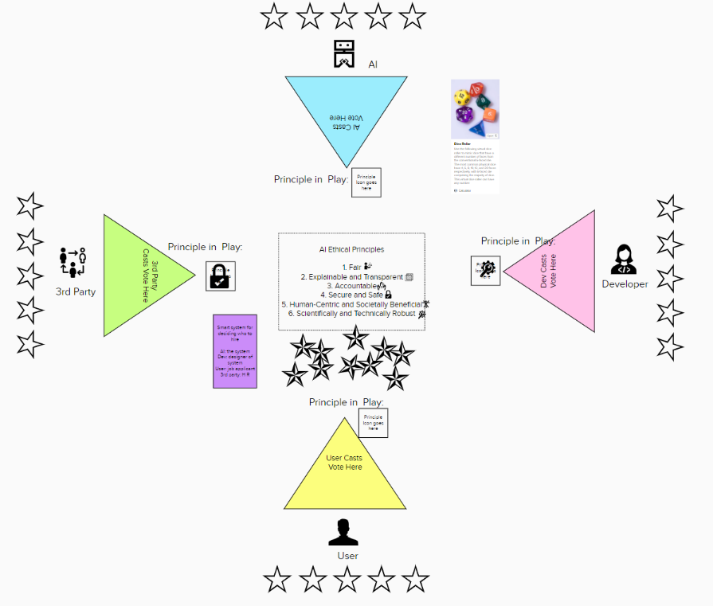
Board Game Mechanics
Migrated into a Board Game
  Mural for playtesting
  Creation of Physical Game Assets
  Digital Version
Game Mechanics^{[1]}
Space
Objects, Attributes, and States
Actions
Rules
Skill
Chance
Figure 4: Online playtest environment in Mural
Notes:
Accessible, less tech limitations, collaborative (versus VR)
Explain the game – what is NOT shown is the previous iterations
Game Mechanics[1]
Space:
DT'd future
On table/in person
Objects, Attributes, and States
Prestige points: goal is to be first player with 5
Four different player types
Actions
Scenario card is drawn
Roll for chance to win
Spin for chance to debate
Rules
Skill
Debate
Chance
Dice rolls
Random pairings of scenario : stakeholder : principle

Slide 6
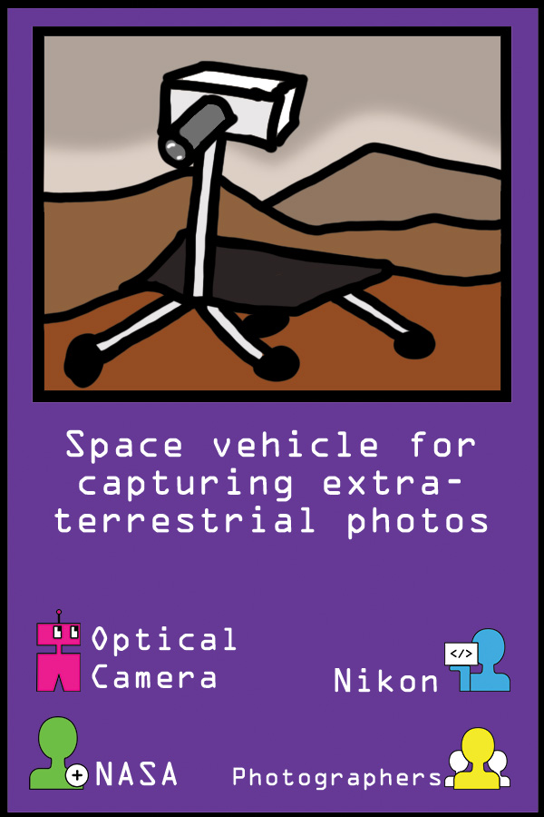
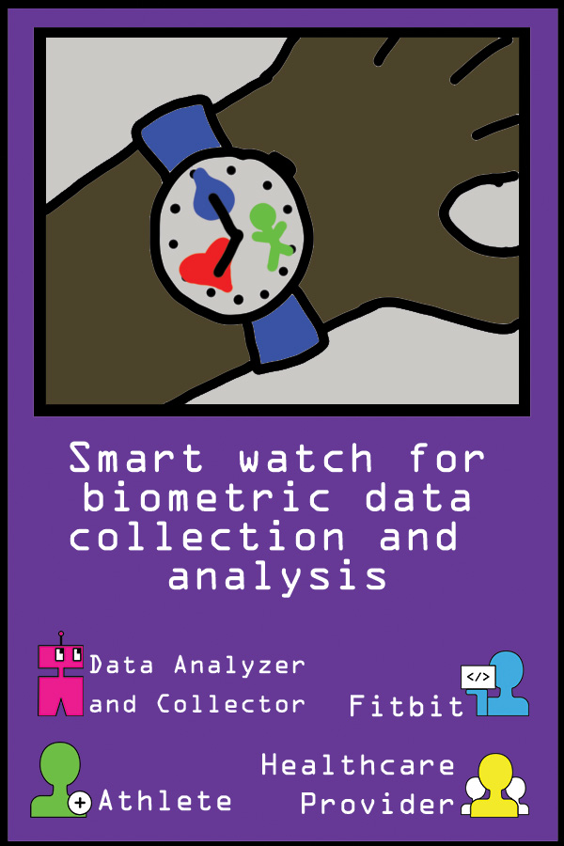
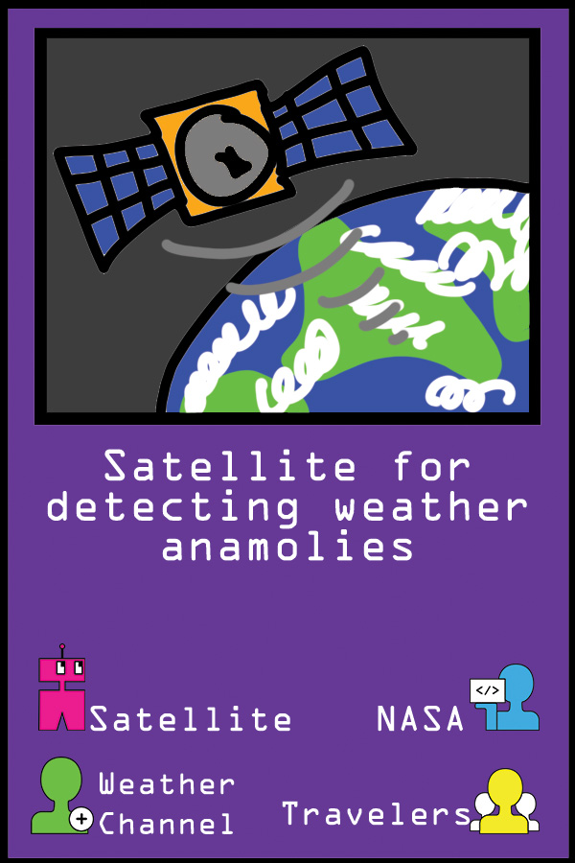
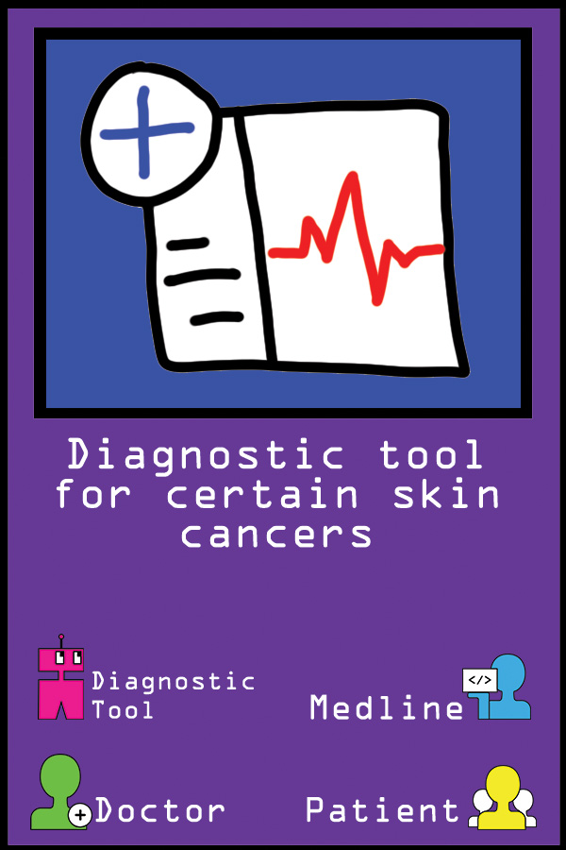

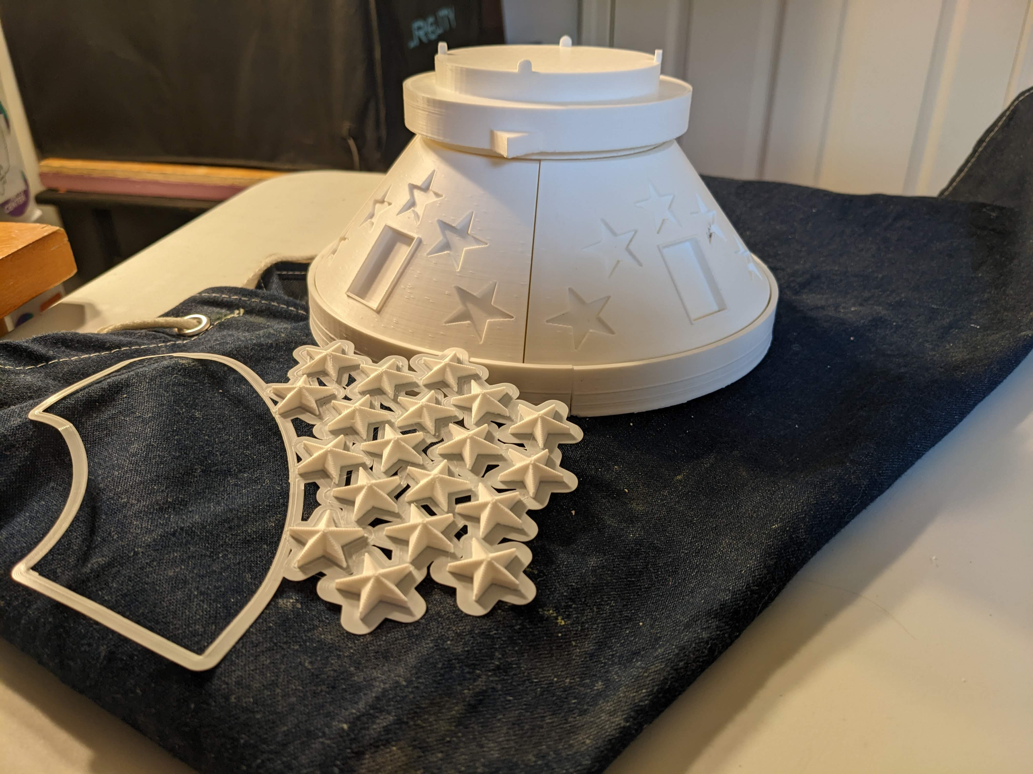
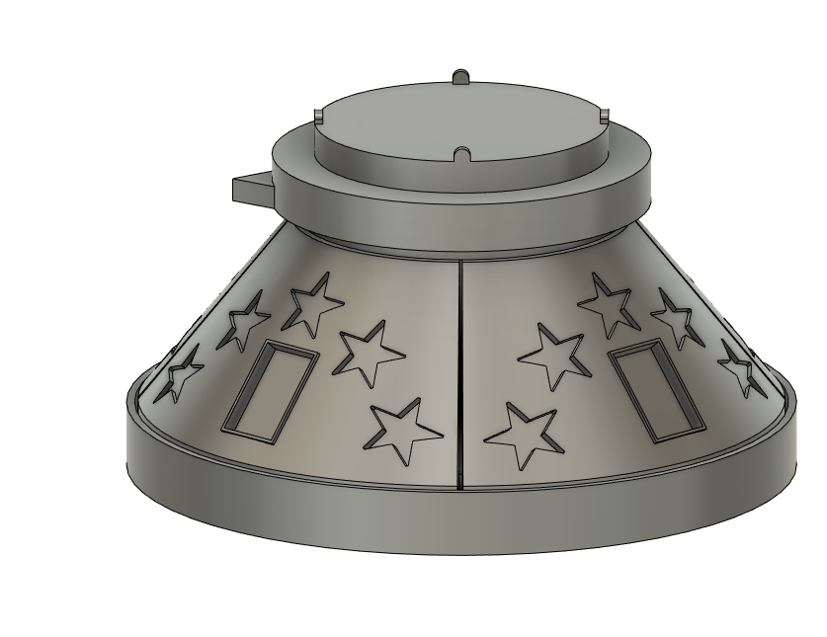
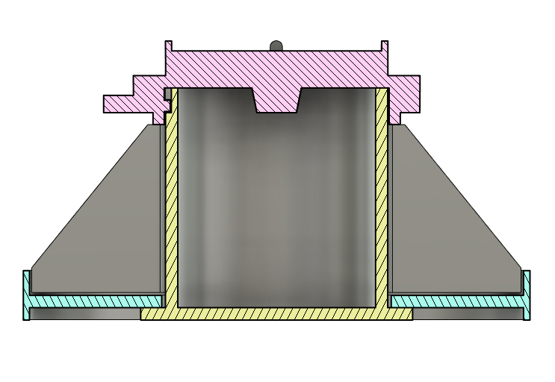
Delivery
Figure 5: Example "Scenario" and "Augment" cards
Figure 6: 3D printed game assets
Figure 7: Game packaging in assets model in Fusion360
Notes:
"novice vs expert"
Depending on interests:
Artwork
Package design
Scenarios
Rules
Packaging double as pieces
Kept in mind: how will people gain access to it
Not just something you buy at the store
Craft your own version

Slide 7
Future Work
"Open Source Board Game"
  Online Repository or Access
    Library to physical assets for in-person play
    Instructions for creating your own physical copy
    Library to scenarios and digital content

Slide 8
Demonstration

Slide 9
References
  [1] Lindley, J., & Coulton, P. (2015). Back to the future: 10 years of design fiction. Proceedings of the 2015 British HCI Conference, 210–211. https://doi.org/10.1145/2783446.2783592
  [2] Mclarney, E., Gawdiak, Y., Oza, N., Mattmann, C., Garcia, M., Maskey, M., Tashakkor, S., Meza, D., Sprague, J., Hestnes, P., Wolfe, P., Illingworth, J., Shyam, V., Rydeen, P., Prokop, L., Powell, L., Brown, T., Miller, W., & Little, C. (2021). NASA Framework for the Ethical Use of Artificial Intelligence (AI). https://ntrs.nasa.gov/citations/20210012886
  [3] Schell, J. (2008). The art of game design: A book of lenses. Elsevier/Morgan Kaufmann.

Slide 10
Contact
Jessica (Jessie) Robinson
jr010014@ohio.edu
Cristina Morales Mojica
cristina.m.moralesmojica@nasa.gov

