Slide 1
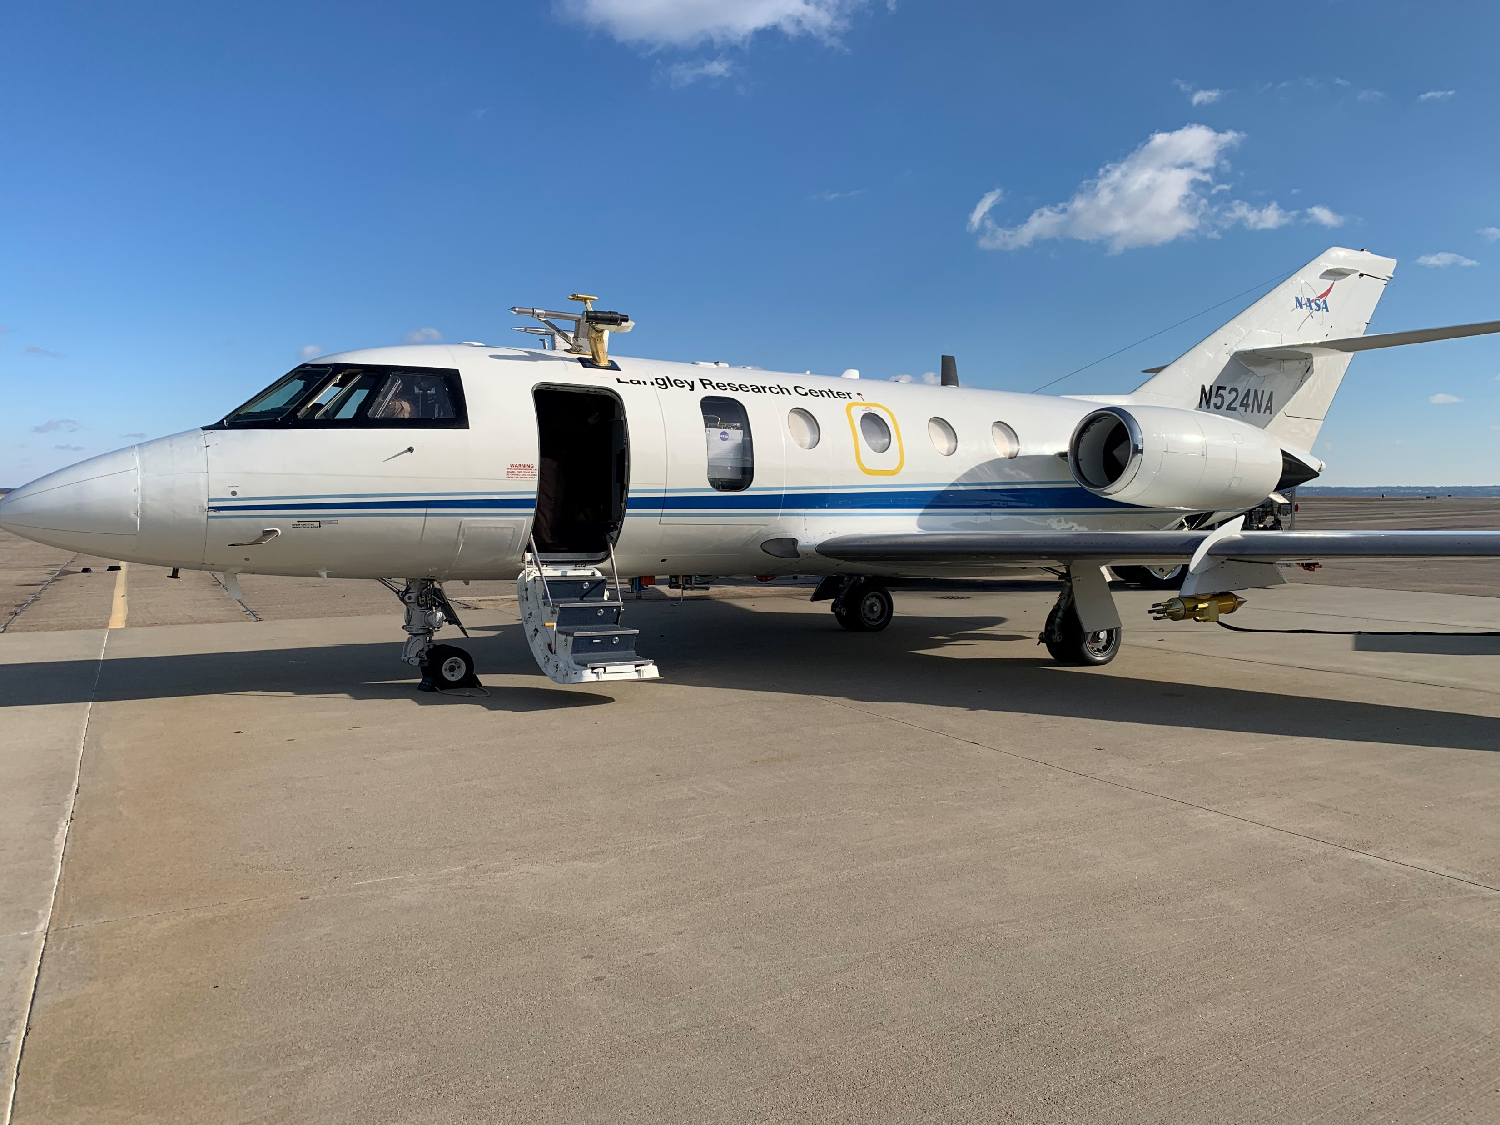

TAMMS Data Status Post Mission
Lee Thornhill – Instrument PI
John Barrick – the real brains
NASA Langley / SSAI
Contact Info:
Kenneth.l.Thornhill@nasa.gov
757 869-2109

Slide 2
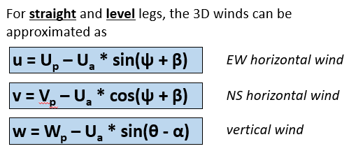
How do you compute the 3-D winds????
The ambient wind speed components are computed as the difference between two vectors:
Velocity of the aircraft with respect to the Earth (inertial)
Velocity of the air with respect to the aircraft (differential pressures & static P&T)
Important Notes:
These tend to be an order of magnitude higher than the resulting air speed (either horizontal or vertical)
True Airspeed (U_{a}) is a function of the Mach Number and the total air temperature
Mach Number is a function of static and impact pressure and is subject to how well the static pressure is calibrated
So at its most basic level its just geometry …

Slide 3
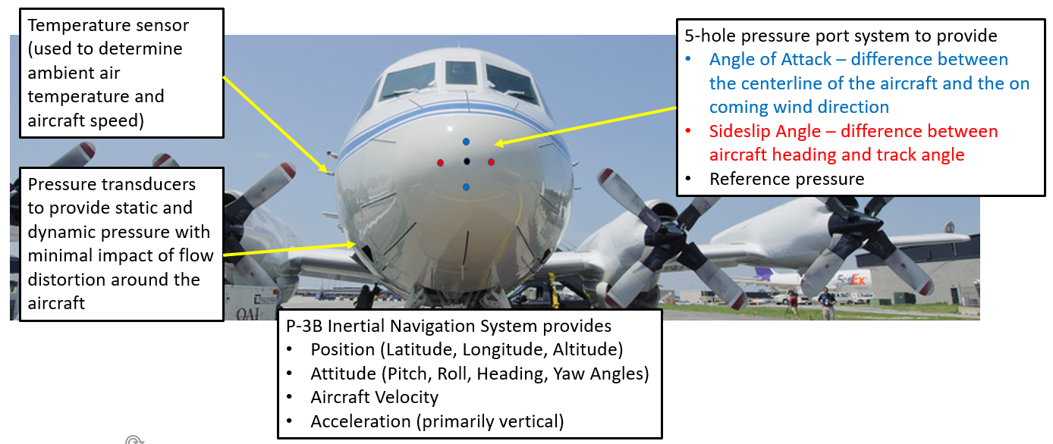
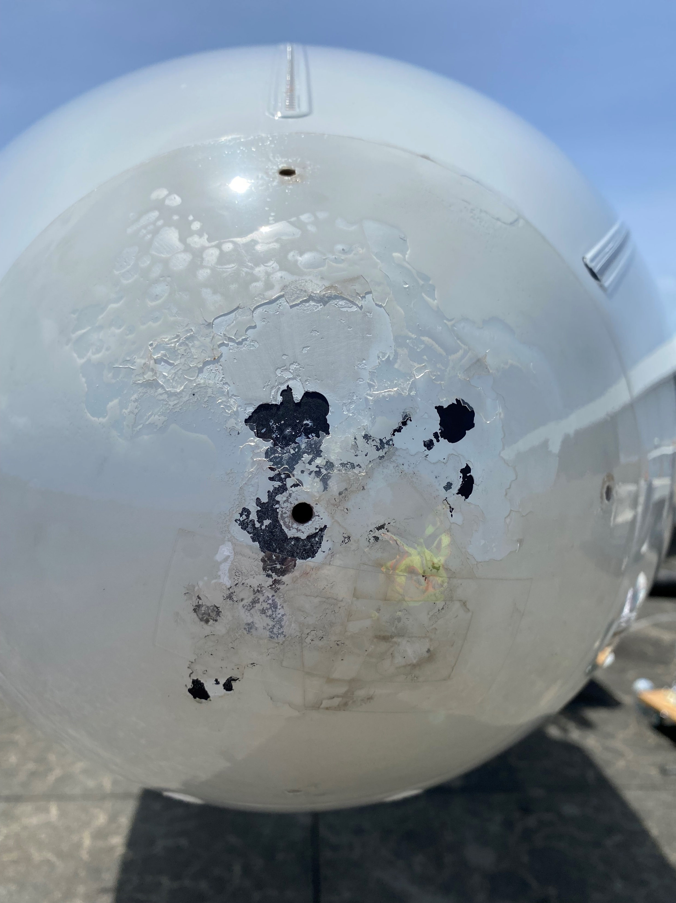
Measurements Overview
INTERNAL COMPONENTS:
A real-time data system from UEI is used
An Applanix 610 is used for the Inertial data (better accuracy and precision especially for Vertical Platform velocities)
The data is collected and an IWG1 data string is broadcast to the other computers in the aircraft and to the ground.
A time server provides a common time base
Data is downlinked to the ground to check instrument health during flight.

Slide 4
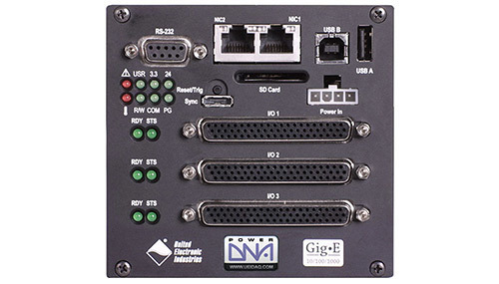
Real time Data System
New Data System
Manufactured by UEI (ueidaq.com)
Linux Based
Real-time
Rugged 50g shock, 3 g vibration
Small (4” x 4” x 4”)
Runs at powerup
24-bit 16 channel analog card (with separate timers on each channel)
8 channel ARINC-429 card (all receive) with independent timestamps for each incoming sample
More than 60 data streams are individually sampled at > 100 Hz
Entire setup takes up about ½ of a single bay rack
Other components include:
  Analog / ARINC-429 breakout box
  5 channel Ethernet switch
  Applanix 610
  UPS
Data is broadcast over Ethernet to be monitored remotely

Slide 5
Full vertical winds Equation (from Lenschow, 1986)
w = Wp – Ua/D *(t1c – tan(beta) * t2c – tan(alpha)*t3c) + L*t4c
Measurements Needed (and source) *** Data Recorded at at least 100 Hz ***
Wp = Aircraft vertical velocity (from Applanix)
Ua = True Airspeed (fn Pressure and Temperature)
Alpha & Beta (AOA and sideslip differential pressures)
D = sqrt(1 + tan²(alpha) + tan²(beta)) (differential pressures)
T1c = sin(Pitch) (from Applanix)
T2c = cos(Pitch) * sin(Roll) (from Applanix)
T3c = cos(Pitch) * cos(Roll) (from Applanix)
T4c = dPitch * sin(Pitch) (from Applanix)
L = separation distance (m) (pressure port to transducer)

Slide 6
Current Data Summary and Archive Status
Summary of Measurements
First year data collected with a PC-based LabWindows system
Post year-1 we switched the real time data system
System was responsible for our data collection as well as the KT-19 (surface IR temp) and for collecting and broadcasting an IWG1 file to the other computers on the Falcon and on the ground
Minimal data loss due to acquisition issues (part of flight early with the RT system there was a hiccup)
Primary issues leading to data loss was icing messing with the TAT or dP ports
Where are we as of today…
Data for all 3 campaigns are in the archive and are final
I have gone back and made the files consistent from year to year for simplicity
Two data files are in the archive
  1-s Summary Files: Aircraft position and attitude, Pressure, Temperature,, and horizontal winds
  20-hz Winds Files: Aircraft position and attitude, 3-D winds, pressure, temperature and surface temp
Note: for moisture data, use DLH not dew point (hence why its not in my archive files)
Data is in ICARTT format, so text
Winds are filtered to remove non-SL data. Undoubtably some made it but most are out. There are artifacts introduced for non-SL wind data and caution needs to be used. If you want to use it email me and we can discuss ….

Slide 7
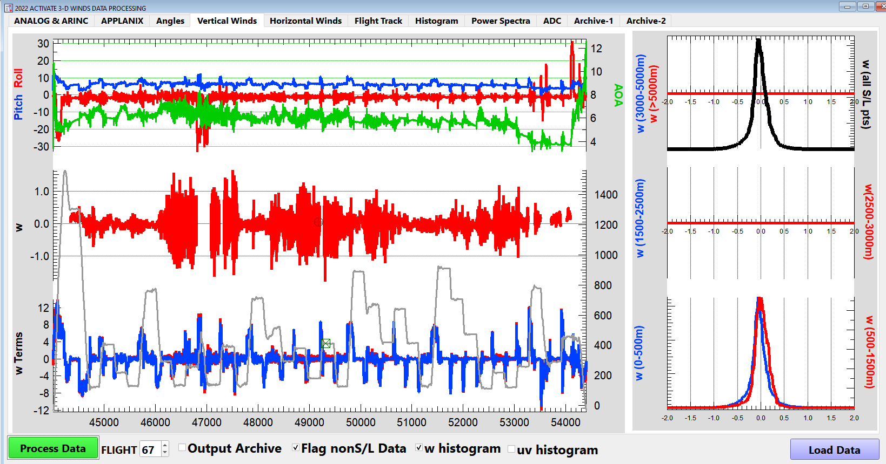

Slide 8
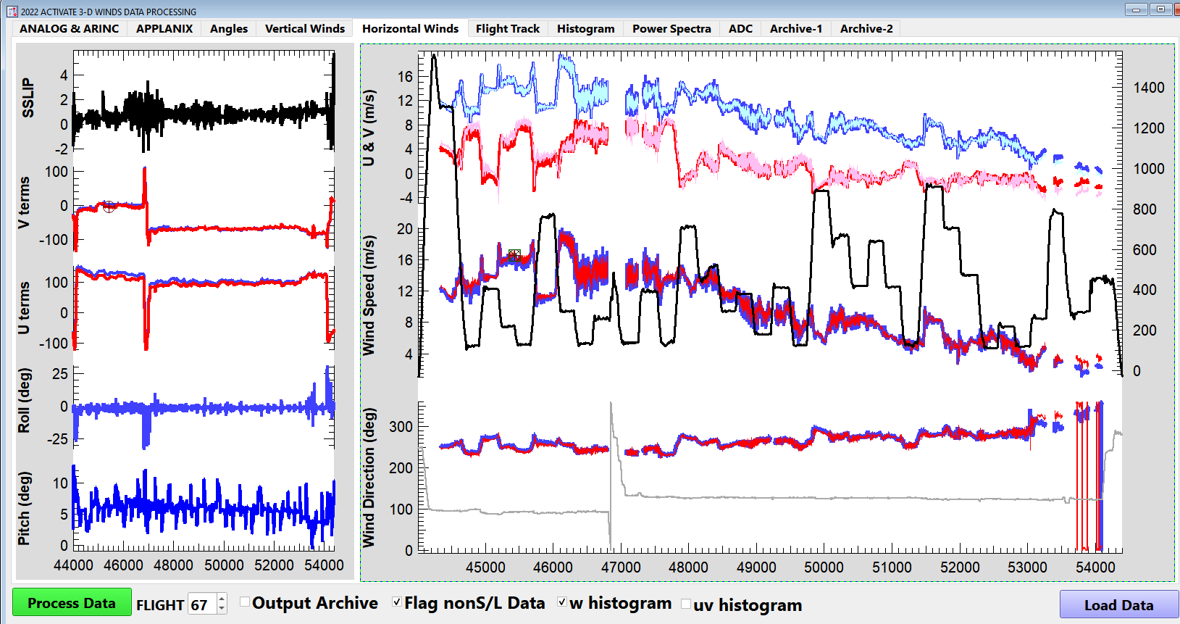

Slide 9

Current Uses of the Data
Papers
And Posters …

