Slide 1
Overshoot in Modelled Pathways
Kate Calvin

Slide 2
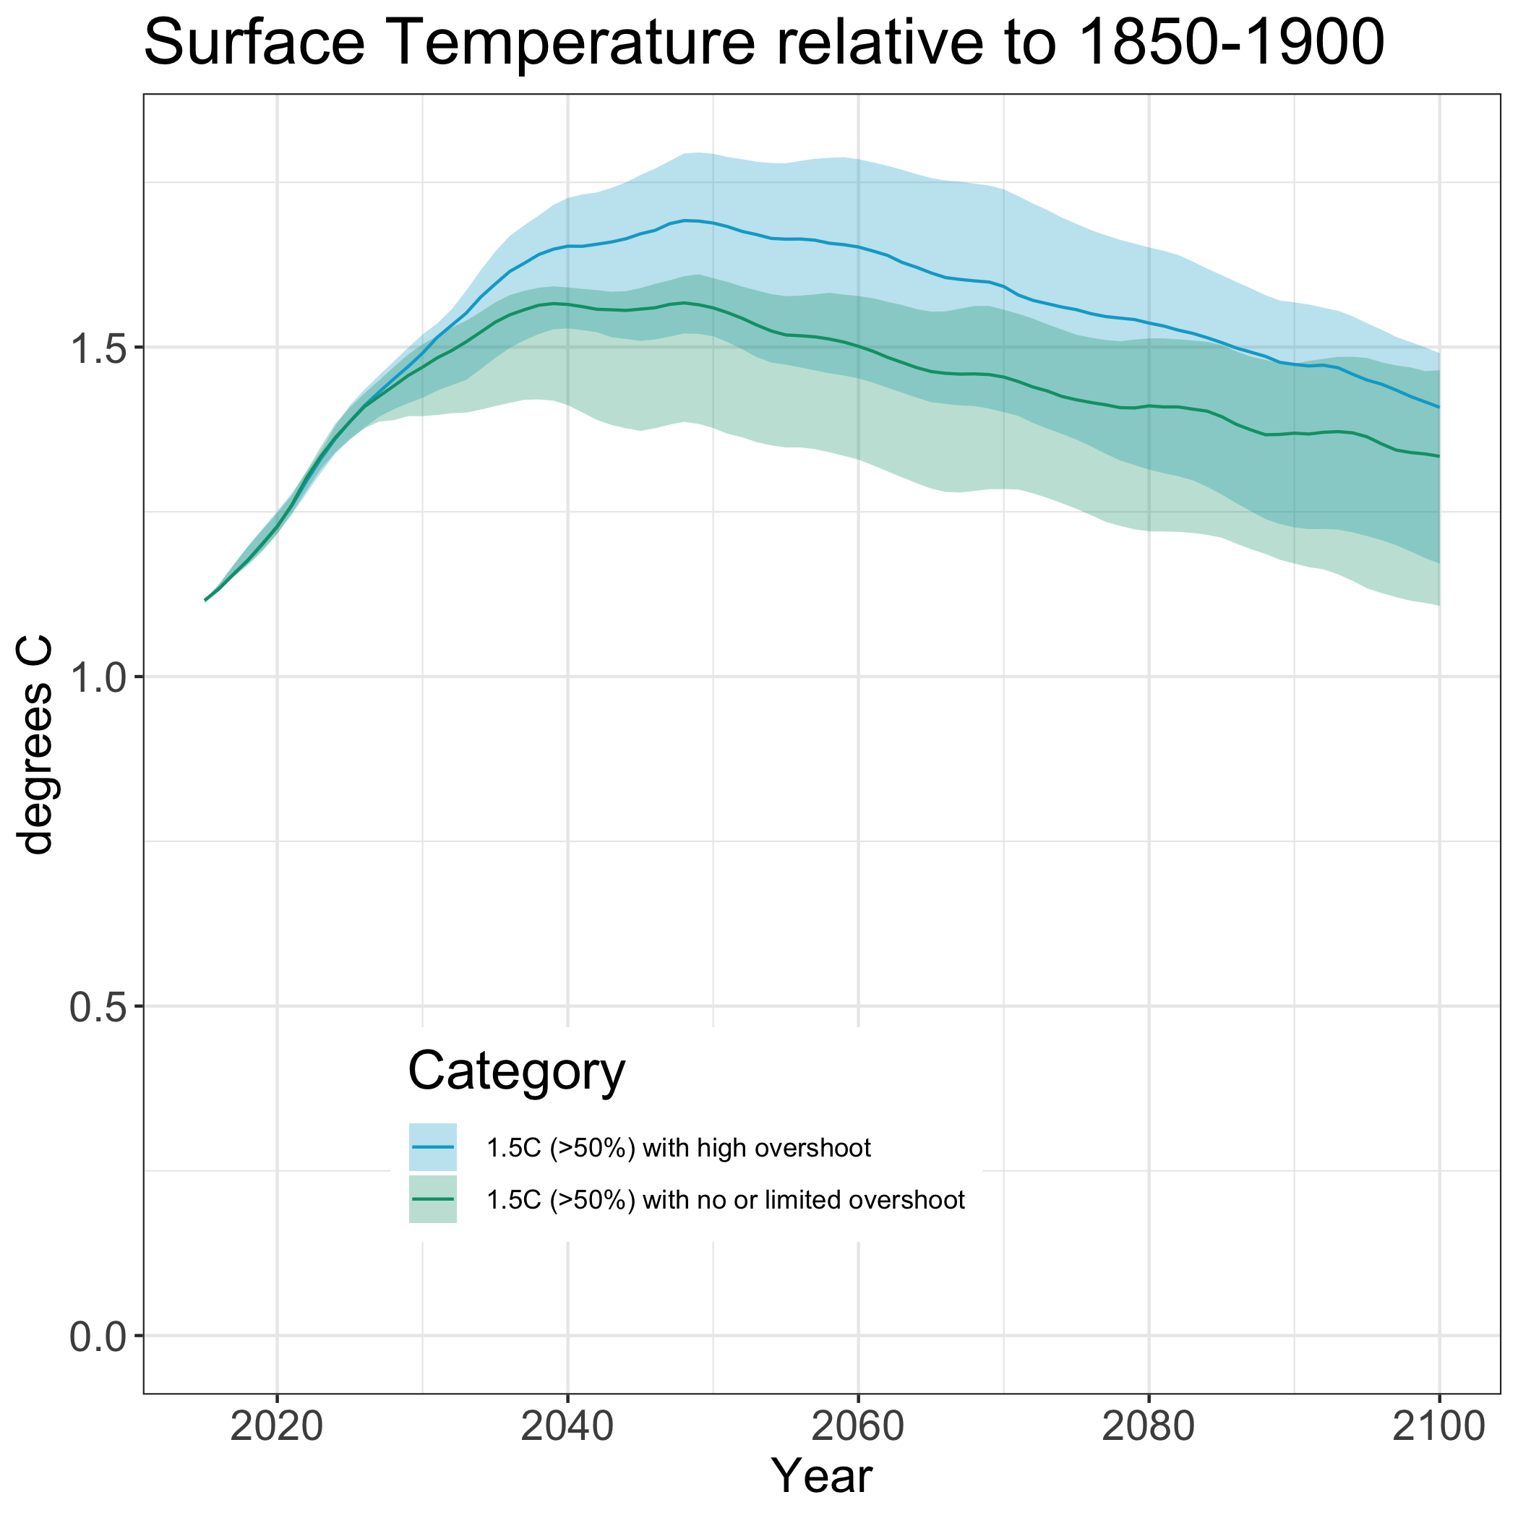
Overshoot pathways: Temperature Change
WGIII categorized pathways depending on their likelihood of exceeding global warming levels (at peak and in 2100).
  Limited overshoot: exceeding 1.5°C by up to about 0.1°C and for up to several decades
  High overshoot: temporarily exceeding 1.5°C by 0.1°C-0.3°C for up to several decades
WGI also assesses a pathway with higher overshoot.
Data from IPCC WGIII Box SPM.1 Figure 1

Slide 3
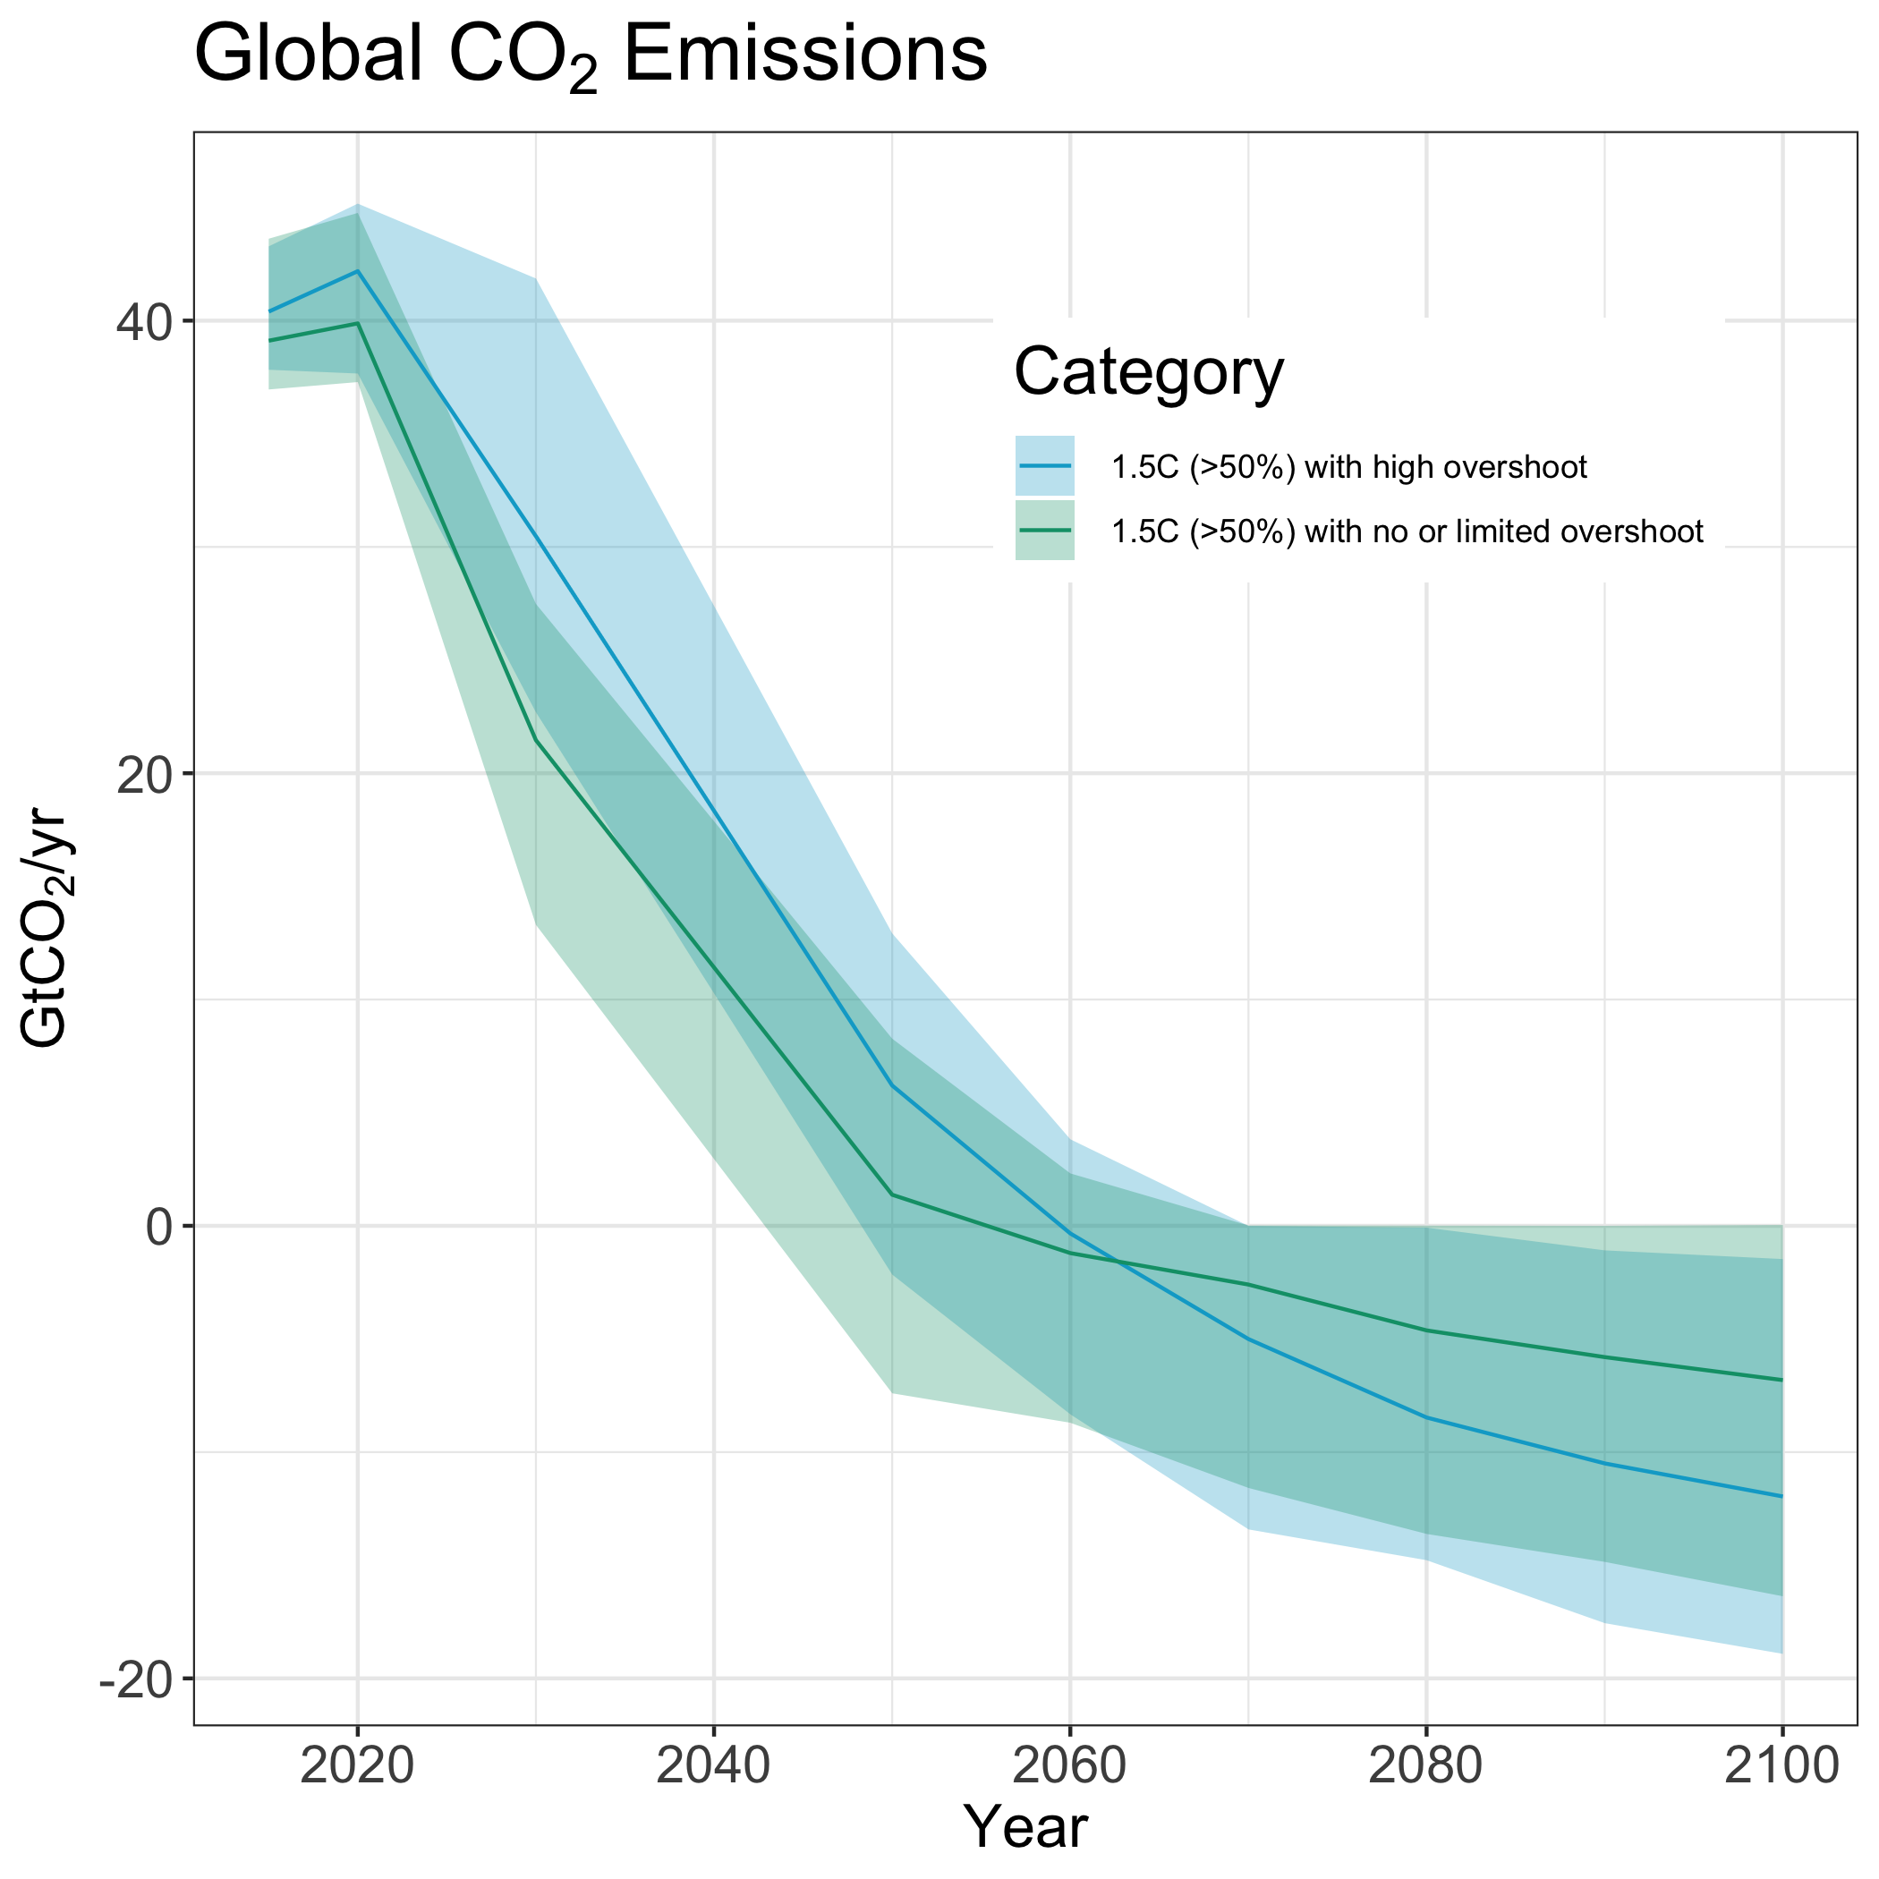
Overshoot pathways: Implications for Emissions
Data from IPCC WGIII Box SPM.1 Figure 1
Data from IPCC WGIII Figure 3.10

Slide 4
Overshoot pathways: Implications for Emissions
Pathways with lower overshoot include more rapid near-term emissions reductions.
Data from IPCC WGIII Box SPM.1 Figure 1
Data from IPCC WGIII Figure 3.10

Slide 5
Overshoot pathways: Implications for Emissions
Pathways with higher overshoot include more more net negative emissions in the long-term.
Data from IPCC WGIII Box SPM.1 Figure 1
Data from IPCC WGIII Figure 3.10

Slide 6
Overshoot pathways: Carbon Dioxide Removal
The aggregate amount of carbon dioxide removal used in a mitigation pathway is larger than the total net negative CO₂ emissions.
  Cumulative net negative CO₂ emissions are larger in pathways with high overshoot (median 360 GtCO₂) than in pathways with no or limited overshoot (median 220 GtCO₂).
  Methods and levels of CDR deployment in modelled pathways vary depending on assumptions about costs, availability, and constraints.
  The impacts, risks, and co-benefits of CDR vary depending on the method, context, and scale.
Data from IPCC WGIII Figure 3.10

