Slide 1

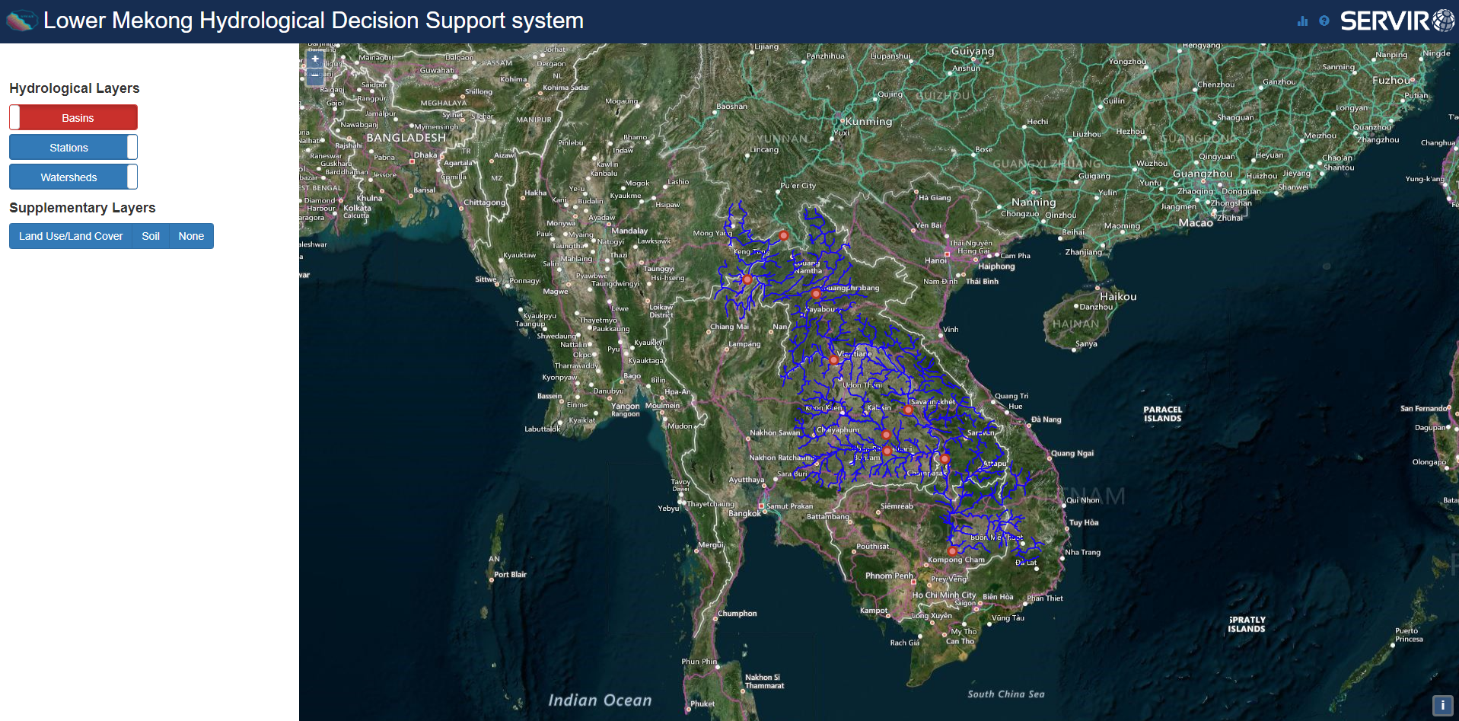
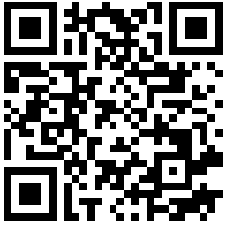
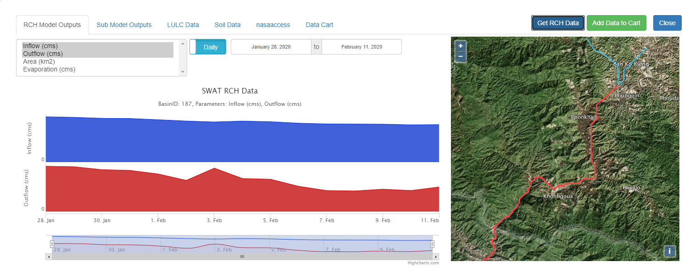
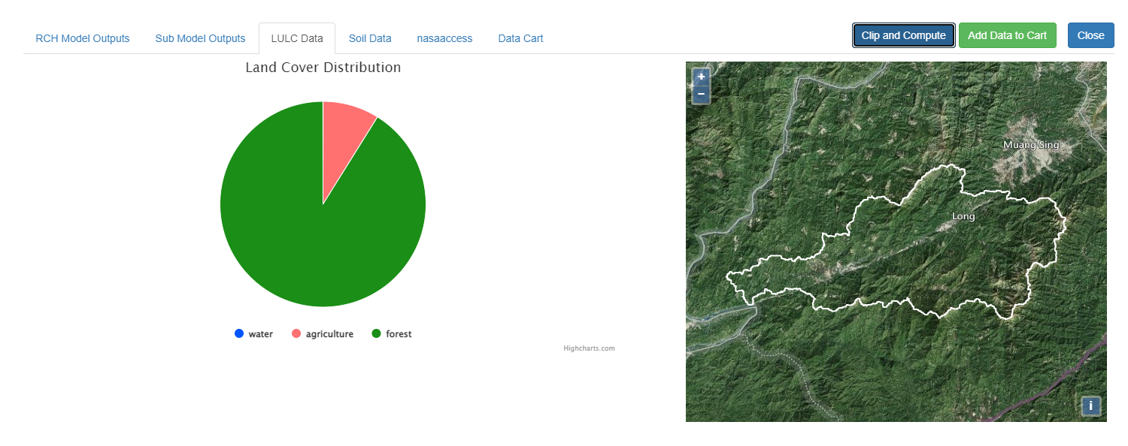
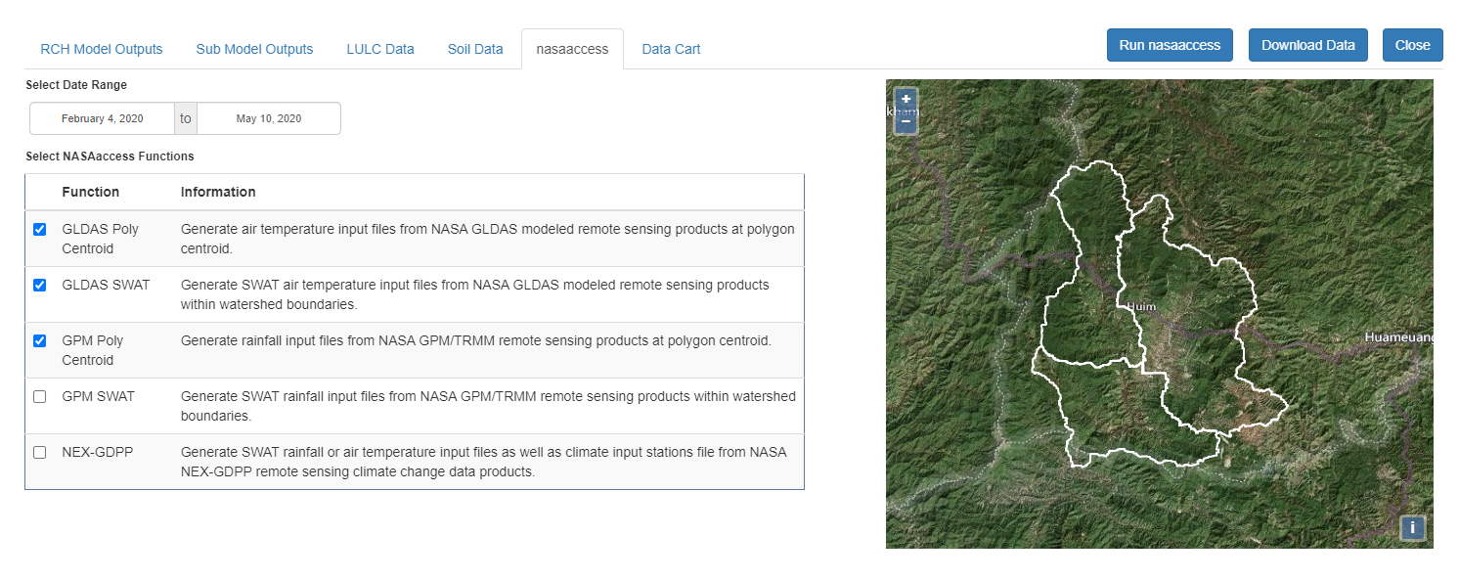
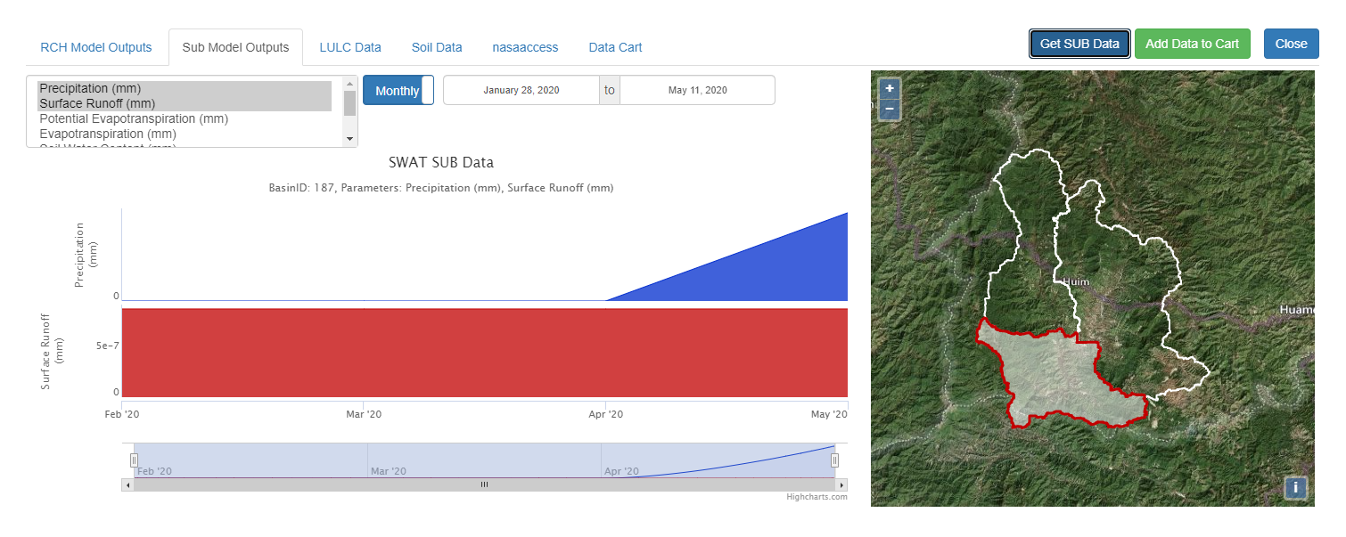
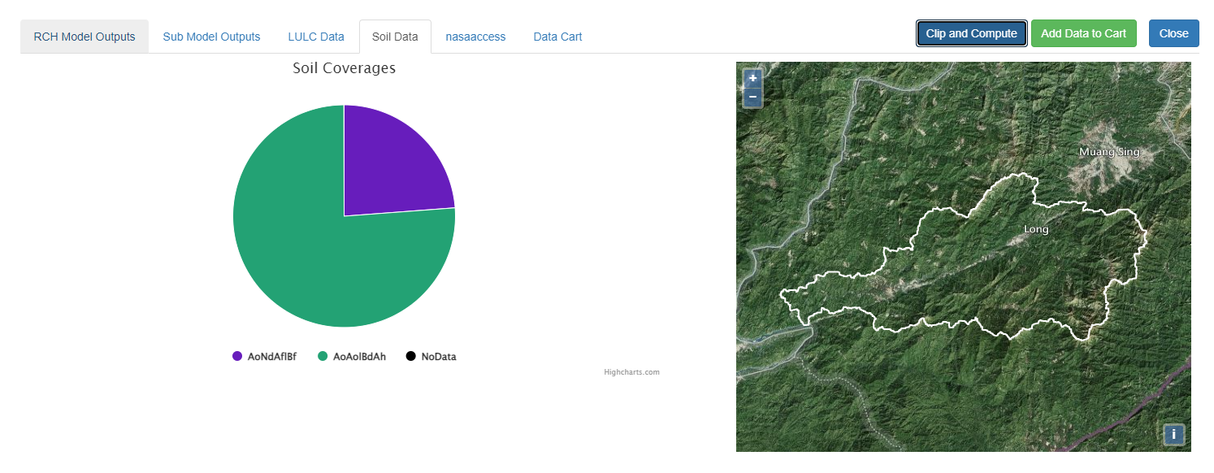
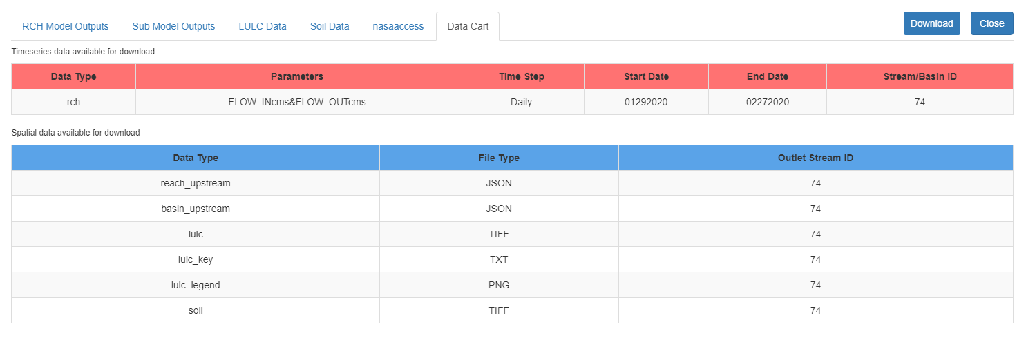




H42J-1415
Lower Mekong Hydrological Decision Support system
Githika Tondapu¹, Ibrahim Nourein Mohammed², John D Bolten², Jim Nelson³, Ashutosh S Limaye⁴, Biplov Bhandari⁵, Francisco Jose Delgado⁶ and Aparna Phalke⁵
(1)NASA SERVIR - USRA, Huntsville, United States, (2) NASA GSFC, Greenbelt, MD, United States, (3)Brigham Young University, Civil and Environmental Engineering, Provo, UT, United States, (4)NASA Marshall Space Flight Center, SERVIR Science Coordination Office, Huntsville, AL, United States, (5)University of Alabama in Huntsville, Earth System Science Center, Huntsville, AL, United States, (6)USRA, NASA-SERVIR, Huntsville, United States
I. Introduction
The Lower Mekong Hydrological Decision Support system (LMHDSs - https://mekong-swat.servirglobal.net/) is an environmental data analysis tool developed at the NASA Goddard Space Flight Center with funding from the SERVIR Applied Sciences Team and technical support from SERVIR Science Coordination Office (SCO). The web application allows stakeholders and decision-makers to view and download the inputs and outputs of the Soil and Water Assessment Tool (SWAT, https://swat.tamu.edu/) model temporally and spatially. The front end is developed using JavaScript libraries like OpenLayers and Stock charts and the backend uses Django, a Python-based web framework. The web app provides several features, including visualizing map products, time-series plots, land-use/land-cover and associated soil information, and a data cart for downloading data. In addition, LMHDSs incorporates the NASAaccess software package, which provides seamless access to various climate and weather data products from NASA’s Earth observations portfolio.
II. The Django web app: LMHDSs
This app is based on the SWATOnline visualization tool. The Lower Mekong Hydrological Decision Support system (LMHDSs) web app has several functionalities. In the left navigation panel of the home page (Fig.1), there are toggle buttons to switch between the layers of basins, watersheds, stations and visualize the Land Use/Land Cover and Soil layers. The user can select a stream or station on the map to view details and explore the various SWAT model inputs and outputs. In the RCH/SUB tab (Fig.2, Fig.3), user can select a variable (or multiple), date range and there is a toggle button to switch between Daily and Monthly data. By clicking the "Get {RCH or SUB} Data" button, one can query the model outputs for the selected parameters. The resultant time series data can be added to a .csv file by clicking the "Add Data to Cart" button. In order to view land use and soil coverage information, user should click the "Clip and Compute" button In LULC/Soil tabs(Fig.4, Fig.5) to see a pie chart depicting the coverage distribution of different land cover and soil classes. To access GPM (precipitation) and GLDAS (air temperature) data products from NASA, user can navigate to NASAaccess tab (Fig.6), then select a date range and select at least one of the NASAaccess functions. By clicking the "Run nasaaccess" button, user will get an email to the email address provided when the data is ready. The last tab is the “Data Cart” (Fig.7), where all the time-series data, upstream subbasin and stream layers and supporting files are available for download.
IV. Conclusions
We are working on improving the visualization tool to further streamline the GUI and to more effectively and concisely deliver the outputs of the SWAT model to end users. Following are links to additional resources:
SWATOnline GITHUB PAGE: https://github.com/SERVIR/SWAT2.0
LMHDSs GITHUB PAGE: https://github.com/SERVIR/mekong-swat-django
NASAaccess GITHUB PAGE: https://github.com/nasa/nasaaccess
SWATOnline JOURNAL PUBLICATION: Spencer McDonald, Ibrahim Nourein Mohammed, John D. Bolten, Sarva Pulla, Chinaporn Meechaiya, Amanda Markert, E. James Nelson, Raghavan Srinivasan, Venkat Lakshmi, Web-based decision support system tools: The Soil and Water Assessment Tool Online visualization and analyses (SWATOnline) and NASA earth observation data downloading and reformatting tool (NASAaccess), Environmental Modelling & Software, Volume 120, 2019, 104499, ISSN 1364-8152, https://doi.org/10.1016/j.envsoft.2019.104499 .
App URL: https://mekong-swat.servirglobal.net/
SCAN TO ACCESS THE APP
FIGURE 1: LMHDSs home page
FIGURE 2: Time series from the Reach tab
FIGURE 4: Pie chart from LULC tab
FIGURE 6: NASAaccess functions tab
ADDITIONAL SERVIR APPLICATIONS OF INTEREST:
https://tethys.servirglobal.net/apps/swat2/
https://aqatmekong-servir.adpc.net/en/map/
https://rheasviewer.servirglobal.net/
FIGURE 3: Time series from the Subbasin tab
FIGURE 5: Pie chart from the Soil tab
FIGURE 7: Data cart tab

