Slide 1
Sampling Functions from Gaussian Processes and Structured Covariance Gaussian Networks
Tenavi Nakamura-Zimmerer¹ and J.B. Scoggins²
¹Flight Dynamics Branch ²Aerothermodynamics Branch
NASA Langley Research Center
NASA Data Science Summit
15 November 2022

Slide 2
Outline
Aerodynamic modeling and UQ
  Motivating stochastic process models
Gaussian process regression
  Efficiently sampling consistent functions
Structured covariance Gaussian NNs
  Converting conditional distributions to stochastic processes
Conclusions

Slide 3
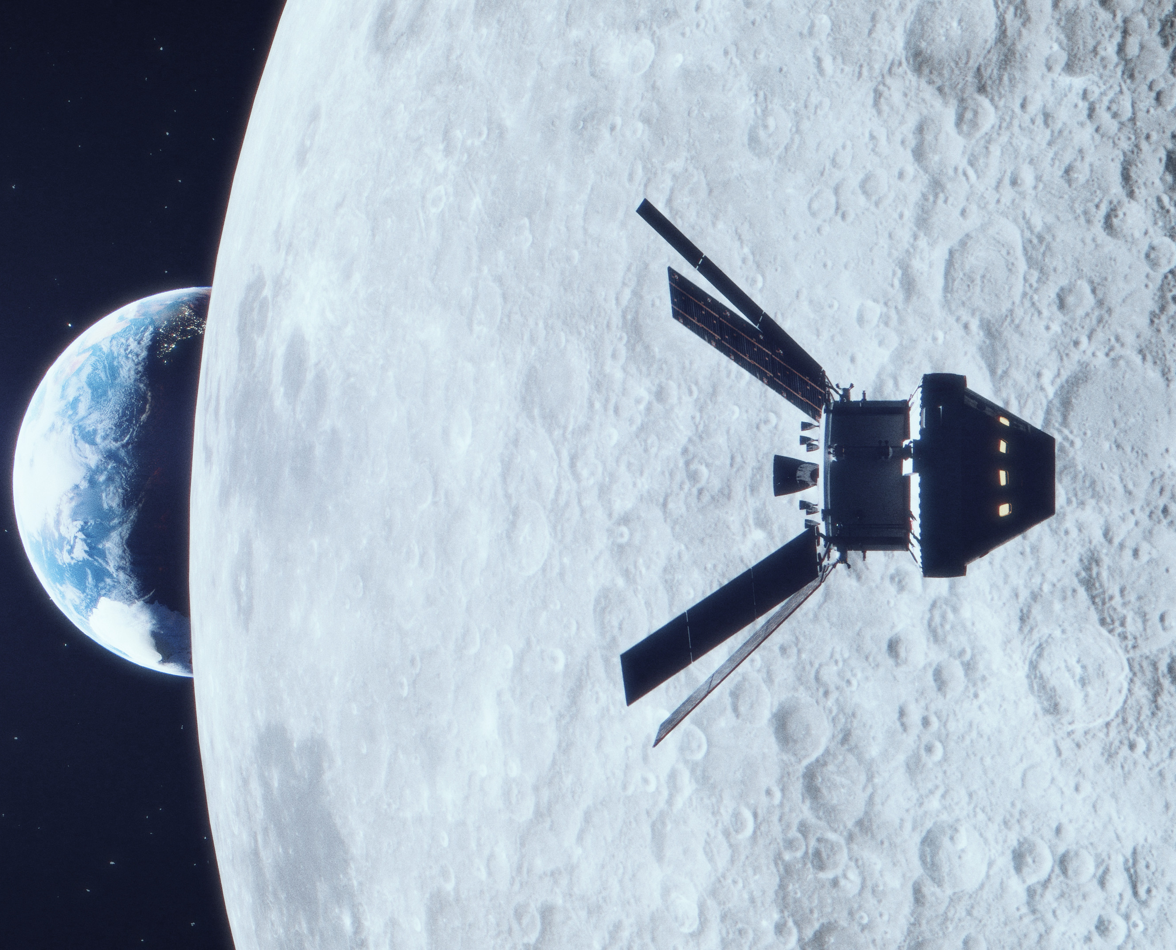
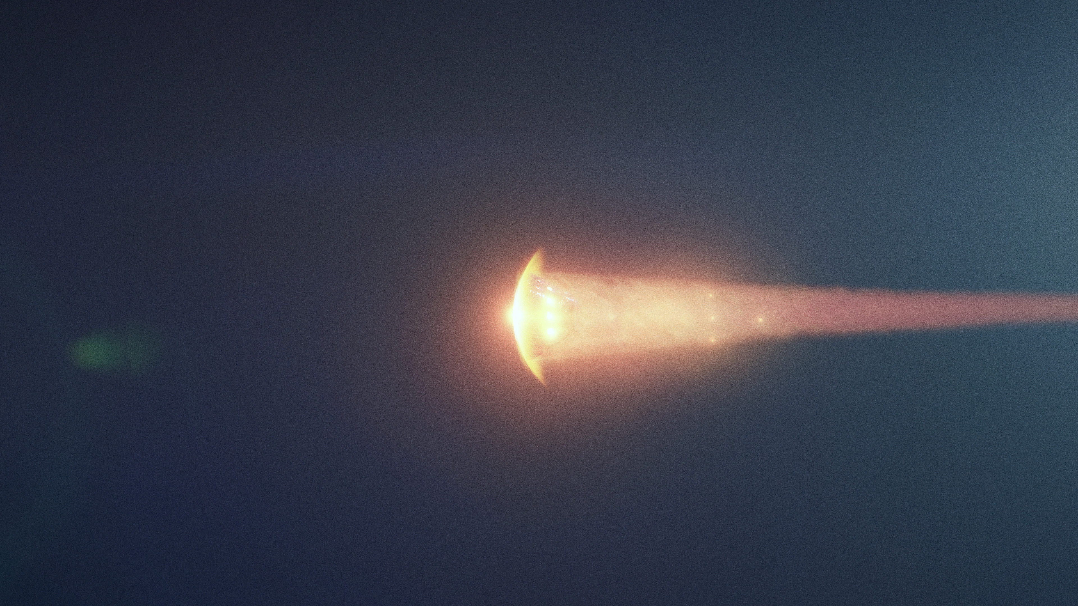
Orion crew module
Image credits: Liam Yanulis, NASA

Slide 4

Orion crew module aerodynamics
(static, longitudinal aero only)
Drag Force
Lift force
Velocity
$$α$$
Airflow
Angle of attack
Center of mass
Pitching moment

Slide 5
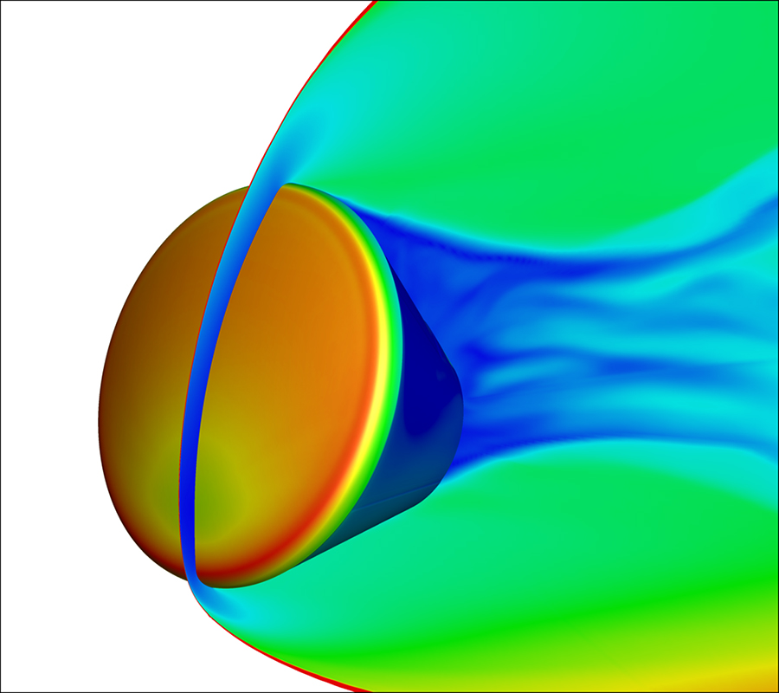
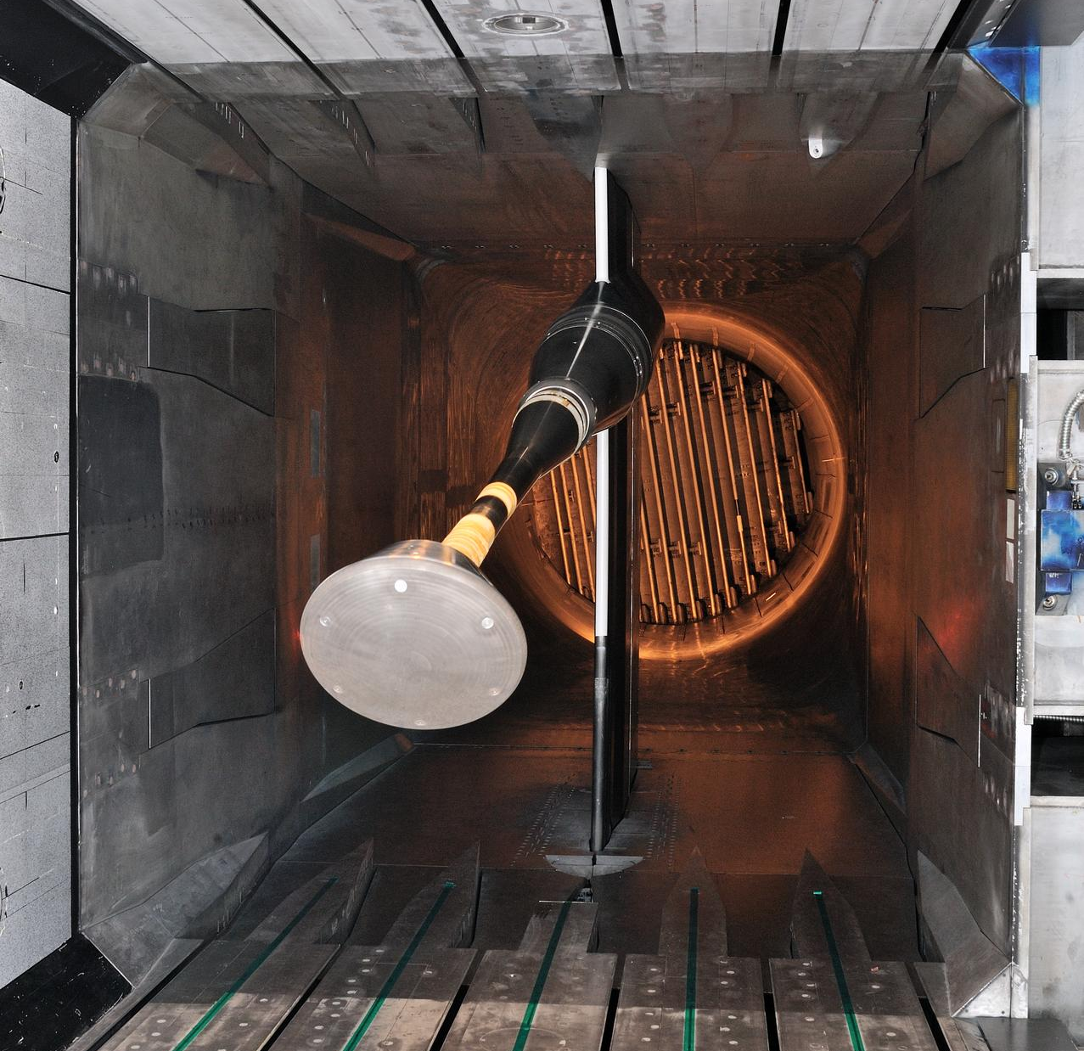
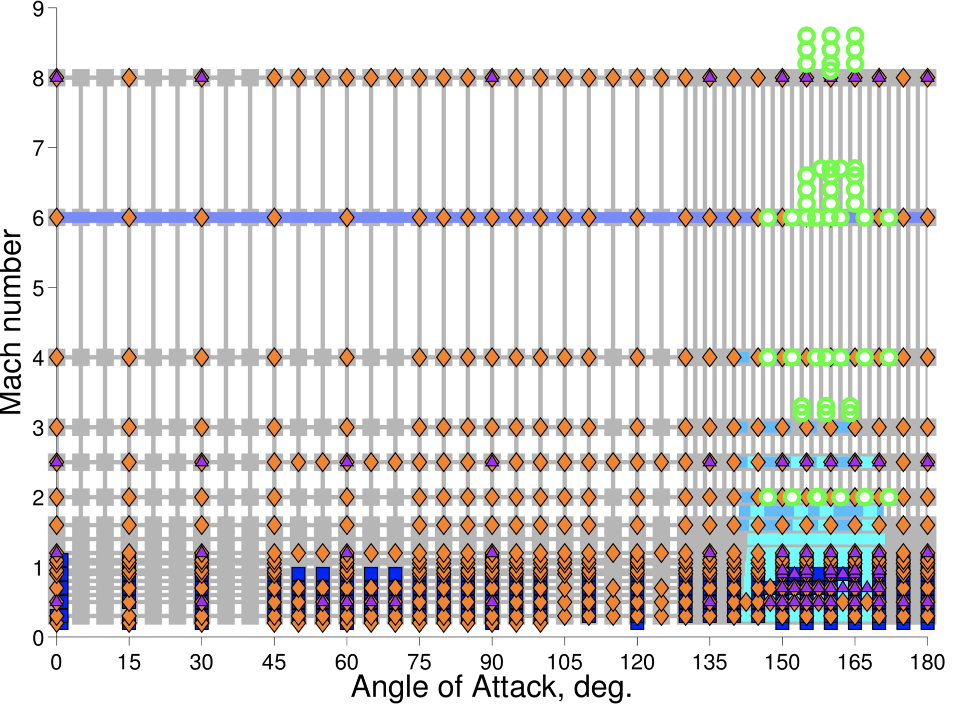
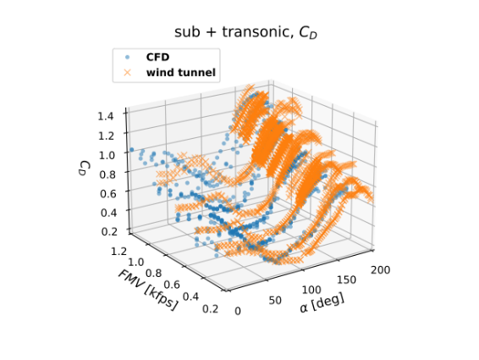
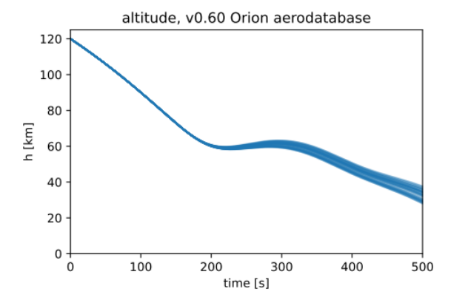
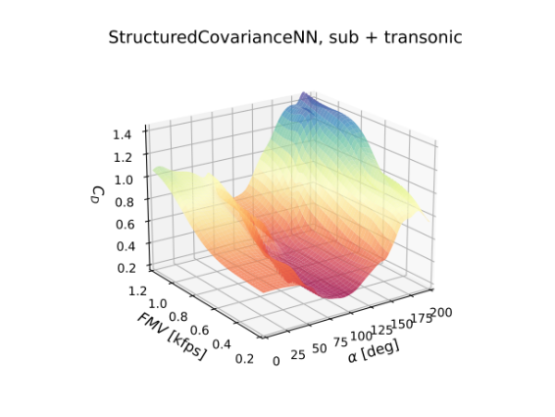
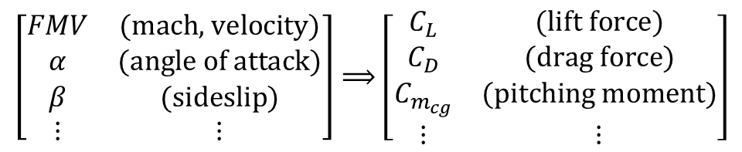
Aerodynamic modeling
DATA
ENGINEERING & MISSION DESIGN
1
2
3
AERO-DATABASE
$$\left[\begin{matrix}FMV & \text{(}\text{mach}\text{, }\text{velocity}\text{)} \\ α & \text{(}\text{angle} \text{of} \text{attack}\text{)} \\ β & \text{(}\text{sideslip}\text{)} \\ ⋮ & ⋮\end{matrix}\right]⟹\left[\begin{matrix}C_{L} & \text{(}\text{lift} \text{force}\text{)} \\ C_{D} & \text{(}\text{drag} \text{force}\text{)} \\ C_{m_{cg}} & \text{(}\text{pitching} \text{moment}\text{)} \\ ⋮ & ⋮\end{matrix}\right]$$
Image credits. 1: Chun Tang, NASA. 2: Sandra Gibbs, NASA. 3: Karen Bibb, NASA.

Slide 6
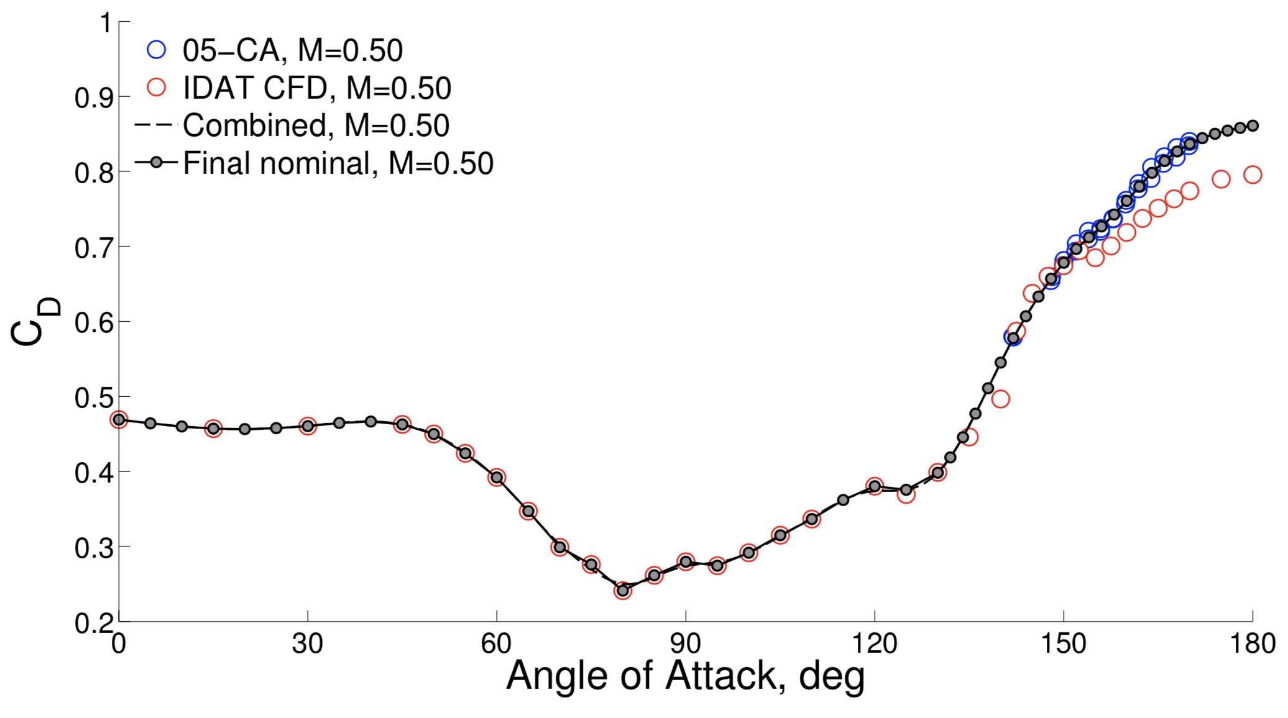
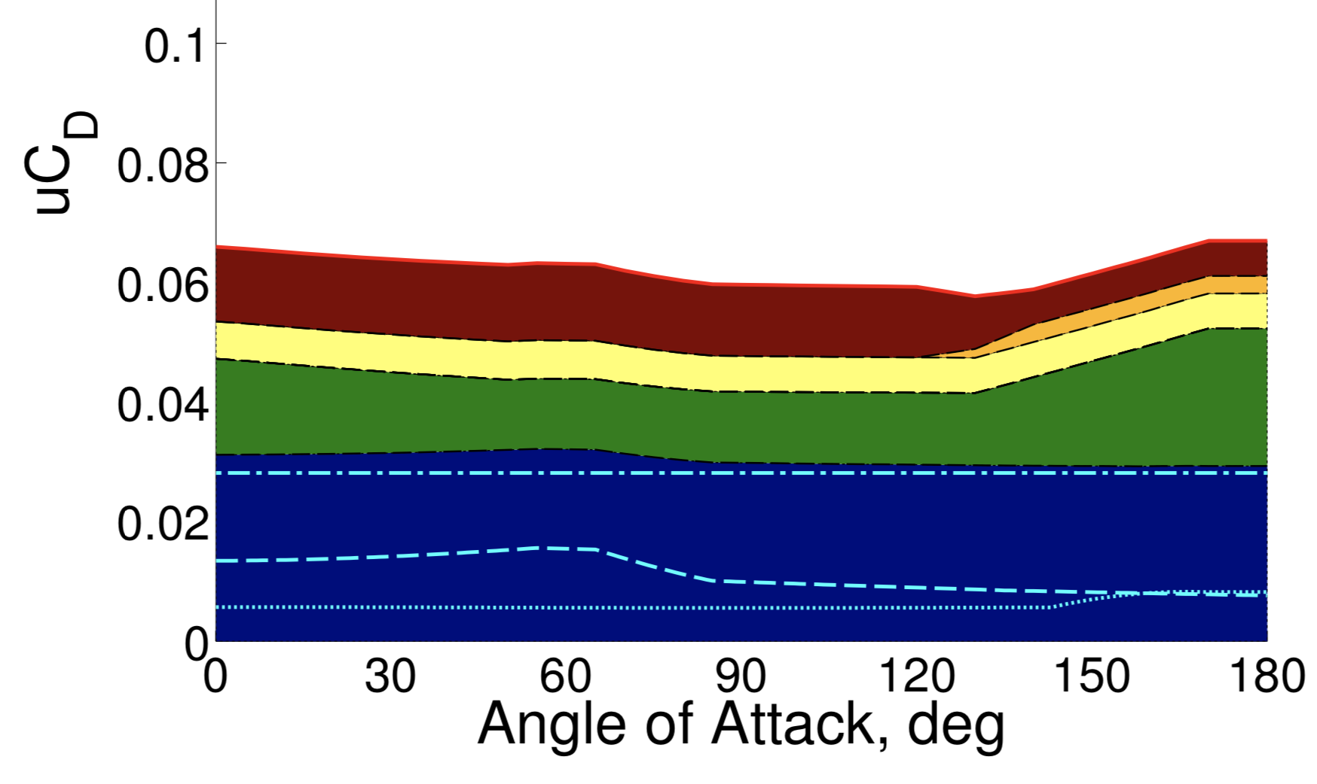
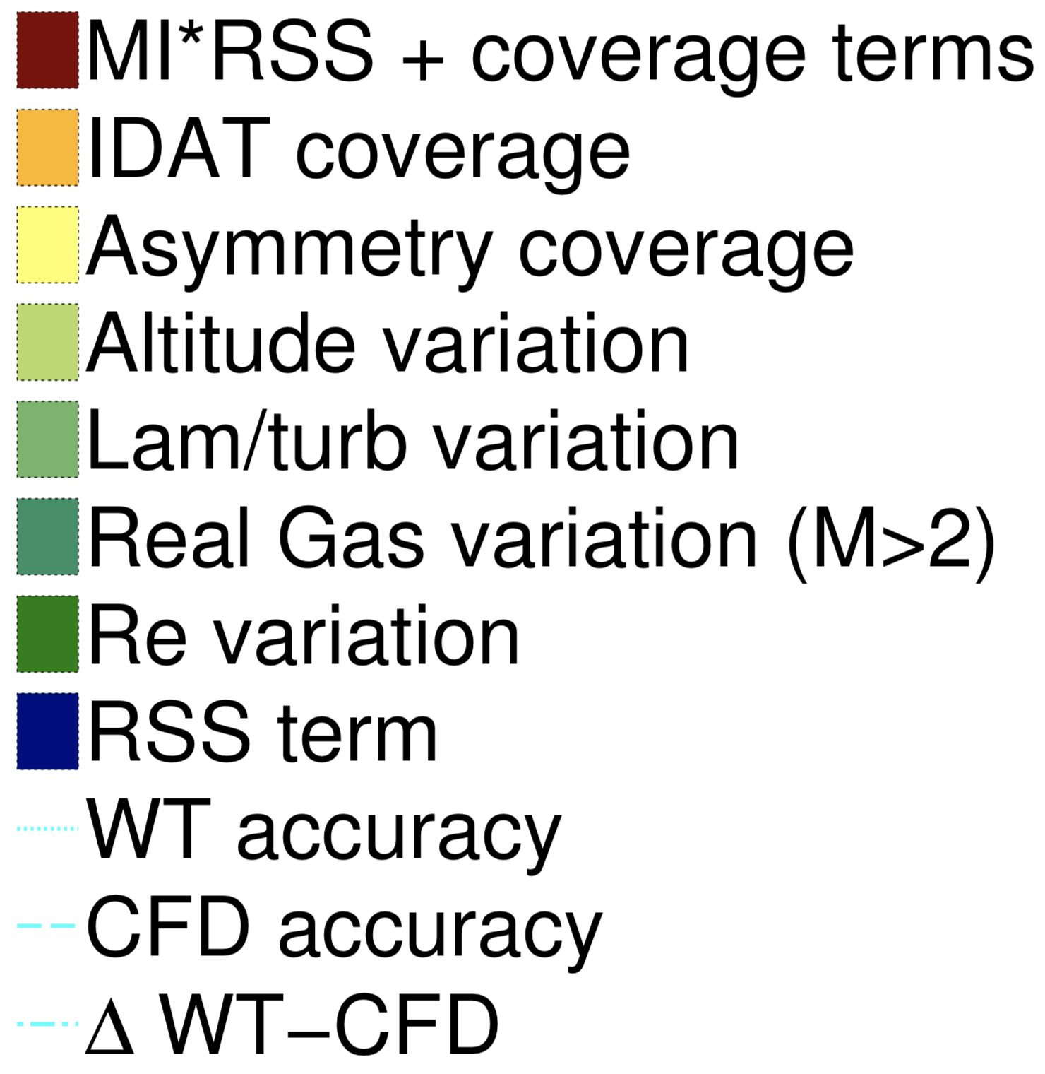
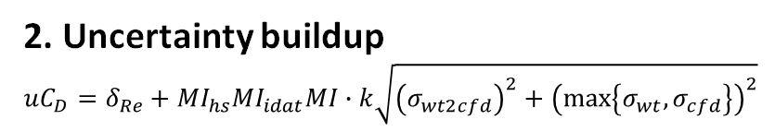
Aerodynamic uncertainty quantification
Data is noisy, can deviate from true physics, can reflect different stages of vehicle design process – need UQ!
State of the practice: “UQ by inspection”
Development of the Orion crew module static aerodynamic database, part I: Hypersonic & part II: Subsonic/supersonic (Bibb et al., AIAA SciTech Forum, 2011a,b)
1. Nominal aero
2. Uncertainty buildup
$${uC}_{D}=δ_{Re}+{MI}_{hs}{MI}_{idat}MI∙k\sqrt{{\left(σ_{wt2cfd}\right)}^{2}+{\left(\max\left\{σ_{wt},σ_{cfd}\right\}\right)}^{2}}$$

Slide 7
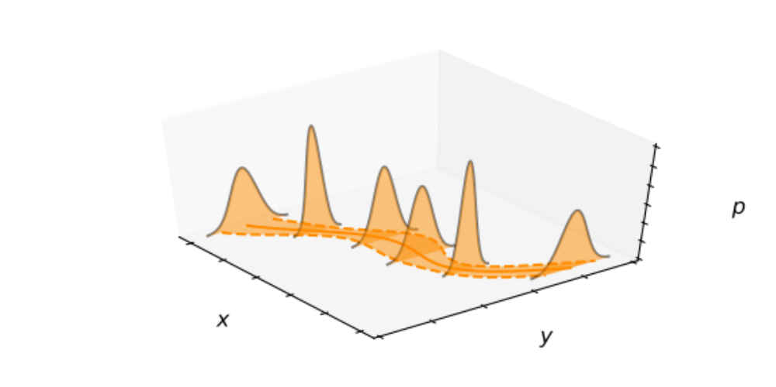

Machine learning for aerodynamic UQ
AeroFusion Early Career Initiative:
Tailor and apply modern ML for streamlined & repeatable aerodynamic UQ
From data, learn a surrogate conditional probability distribution
Many possible methods…
Gaussian process regression
Structured covariance Gaussian NNs
Bayesian NNs
Dropout NNs
Sliced normal regression
Random predictor models
Polynomial regression
Conditional generative NNs
$$y\sim p\left(y | x\right)$$

Slide 8


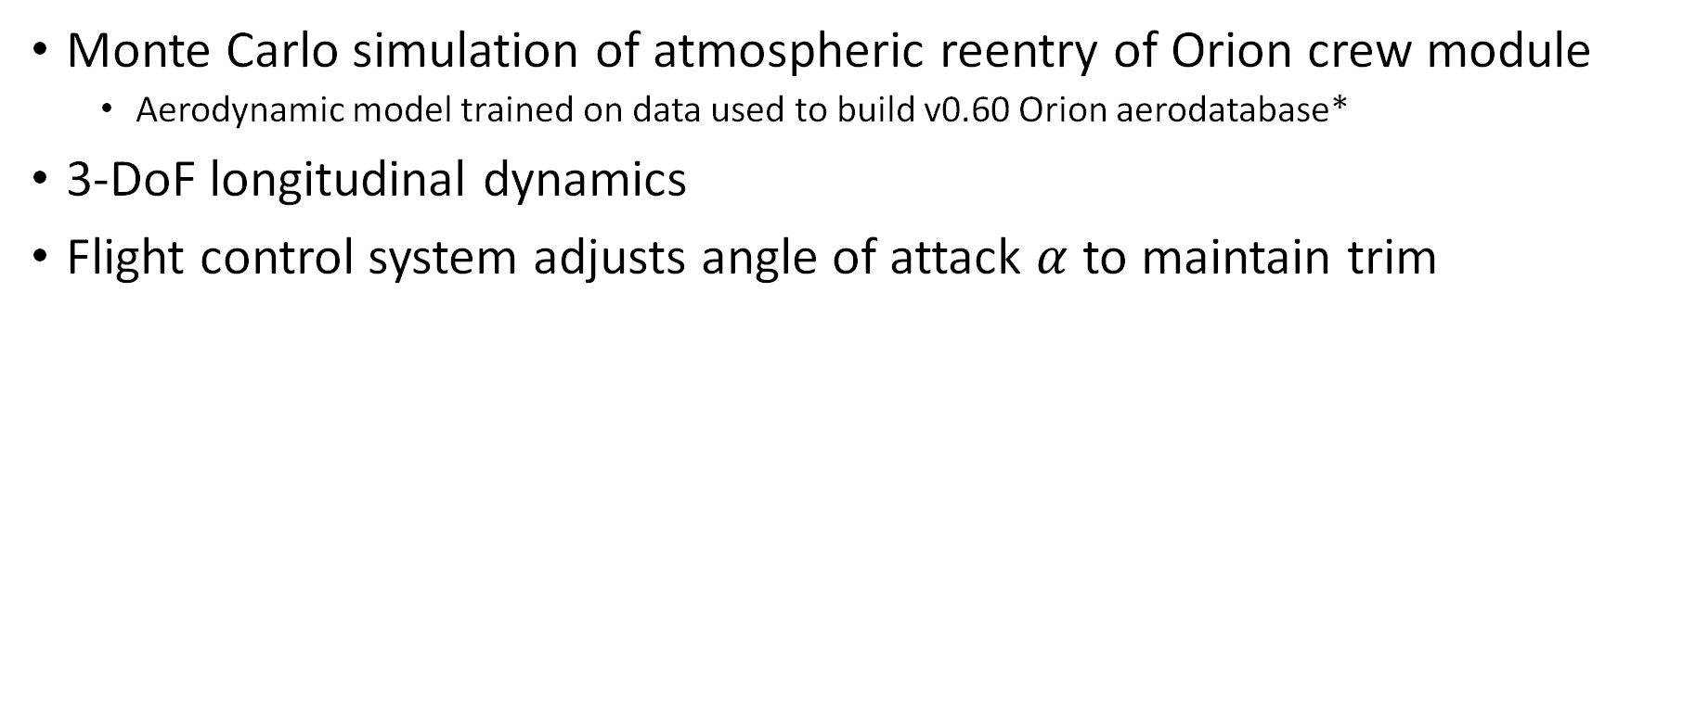
Atmospheric reentry simulation
Monte Carlo simulation of atmospheric reentry of Orion crew module
  Aerodynamic model trained on data used to build v0.60 Orion aerodatabase*
3-DoF longitudinal dynamics
Flight control system adjusts angle of attack $α$ to maintain trim
altitude
velocity
flight path angle
angle of attack
$$\left\{\begin{aligned}\dot{h}=V\sin{γ} \\ \dot{V}=−g\sin{γ}−\frac{\overline{q}S}{m}C_{D}\left(α,FMV\right) \\ \dot{γ}=\left(\frac{V}{r_{0}+h}−\frac{g}{V}\right)\cos{γ}+\frac{\overline{q}S}{mV}C_{L}\left(α,FMV\right) \\ \dot{α}=−KC_{m_{cg}}\left(α,FMV\right)\frac{∂C_{m_{cg}}}{∂α}\left(α,FMV\right)\end{aligned}\right.$$
Image credit: Liam Yanulis, NASA. *Bibb et al. SciTech 2011a,b

Slide 9
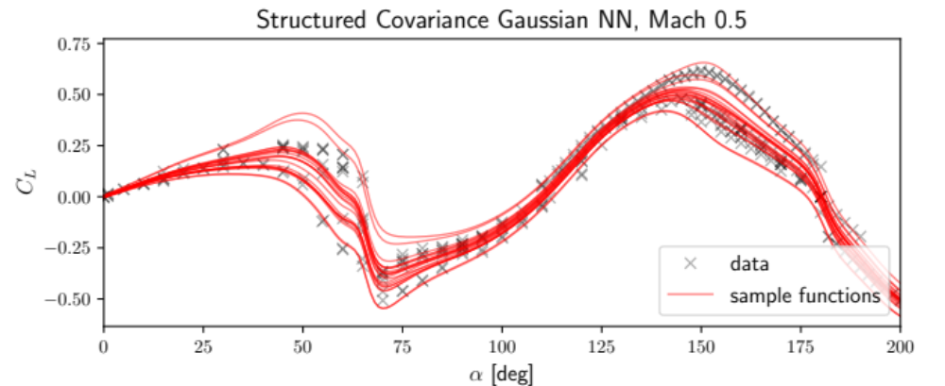
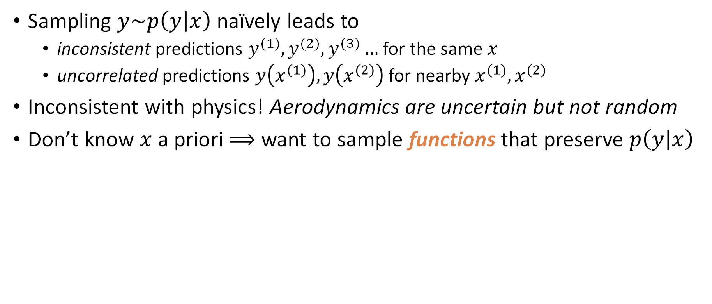
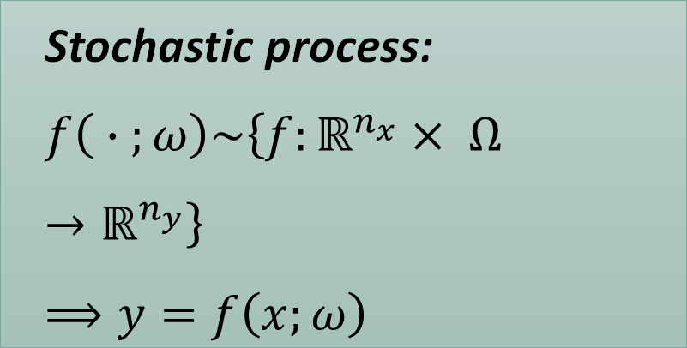
Stochastic process models
Sampling $y\sim p\left(y | x\right)$ naïvely leads to
  inconsistent predictions $y^{(1)},y^{(2)},y^{(3)}…$ for the same $x$
  uncorrelated predictions $y\left(x^{(1)}\right),y\left(x^{(2)}\right)$ for nearby $x^{(1)},x^{(2)}$
Inconsistent with physics! Aerodynamics are uncertain but not random
Don’t know $x$ a priori $⟹$ want to sample functions that preserve $p\left(y | x\right)$
Stochastic process:
$$f\left( ∙ ;ω\right)\sim \left\{f:ℝ^{n_{x}}× Ω→ℝ^{n_{y}}\right\}$$
$$⟹y=f\left(x;ω\right)$$

Slide 10
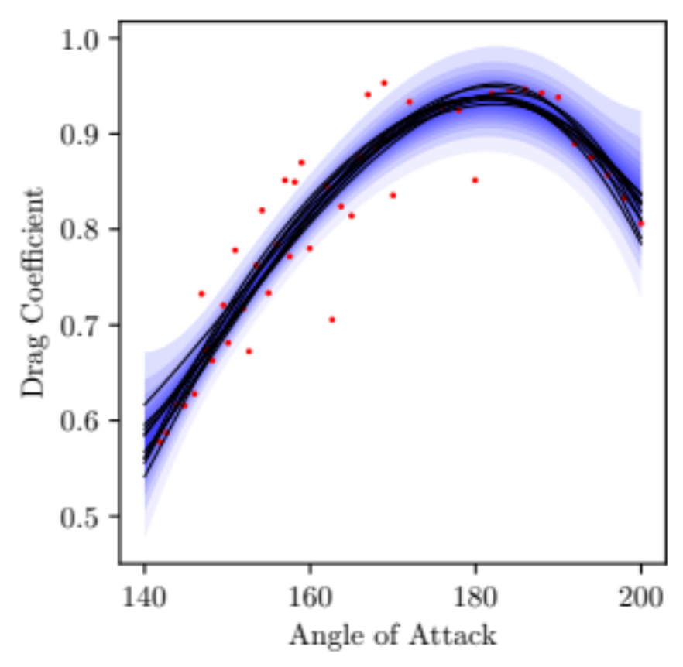

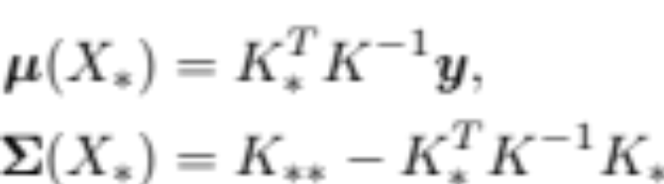
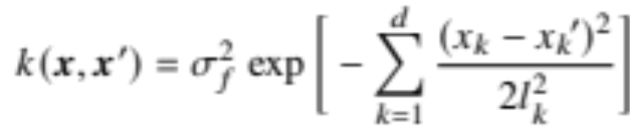
Gaussian process regression (GPR)
Generalization of Gaussian distribution to functions using kernel function to model covariance (Rasmussen & Williams, 2006)
Function values at input points are jointly Gaussian with predictive mean and variance obtained by conditioning on training data
Kernel hyperparameters learned by maximizing the log marginal likelihood of seeing data given model

Slide 11
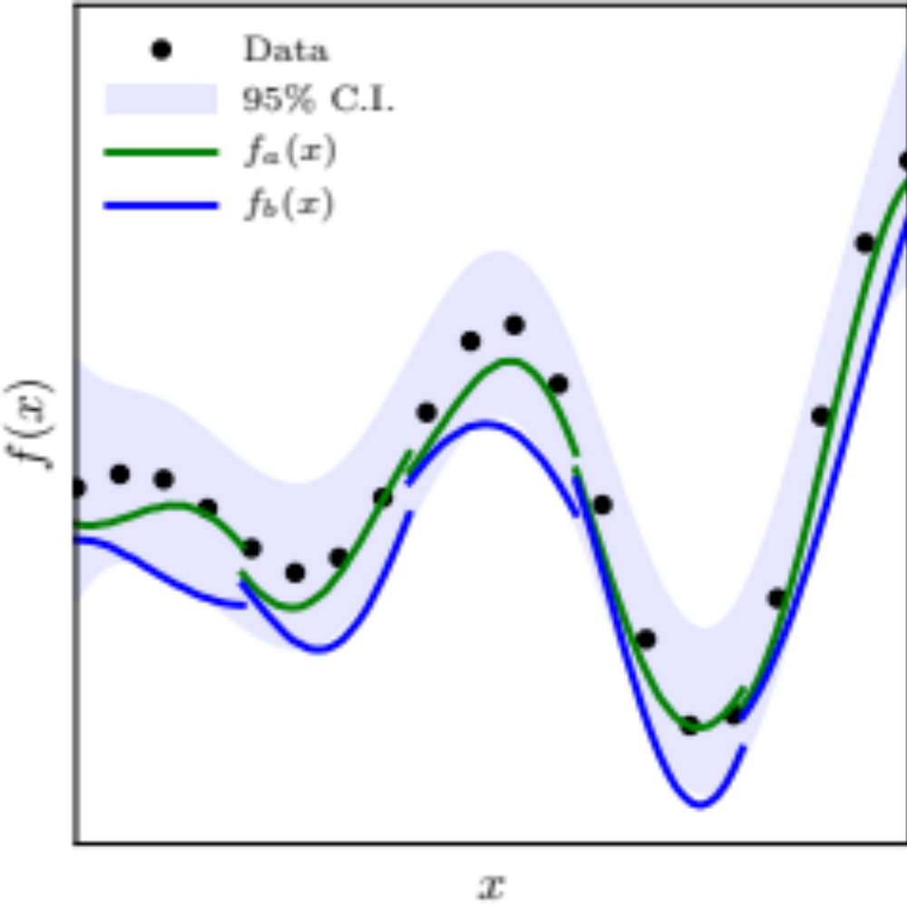




Inconsistent GPR function sampling
Cholesky factorization used to sample from joint Gaussian distribution with order
Repeat samples generate inconsistent functions
  Each new sample forgets history (correlation) with previously sampled points
For trajectory sims, function inputs unknown a priori
Possible solution: sample lookup tables
  Interpolation errors
  Costly for input dimensions > 2

Slide 12
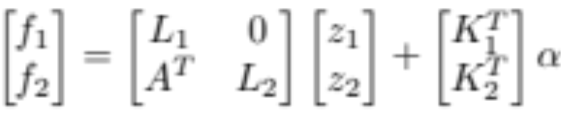
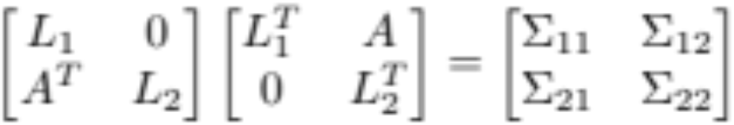

Consistent GPR function sampling
Adding new points (2) to previously sampled points (1)
Solving for block Cholesky components leads to reduced system, that can be updated by performing Cholesky decomposition only on new points
For single point updates, computational complexity reduced to
Additional book-keeping to maintain list of unique input points and intermediate results
updated Cholesky obtained from block covariance matrix
previous samples
new samples
updated Cholesky
updated normal samples
updated mean

Slide 13
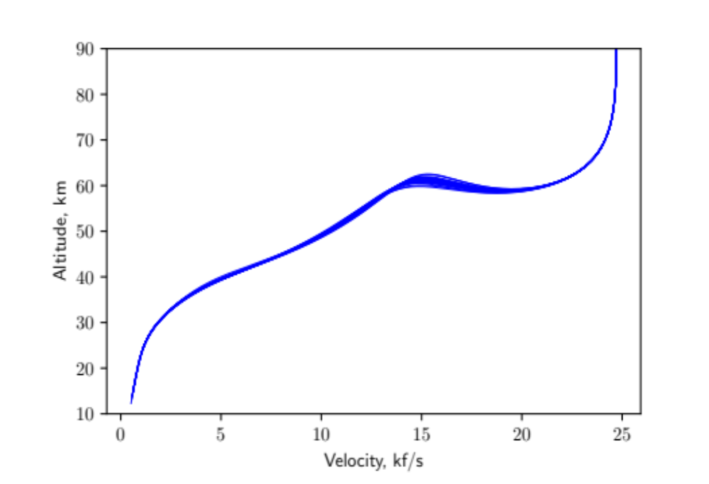
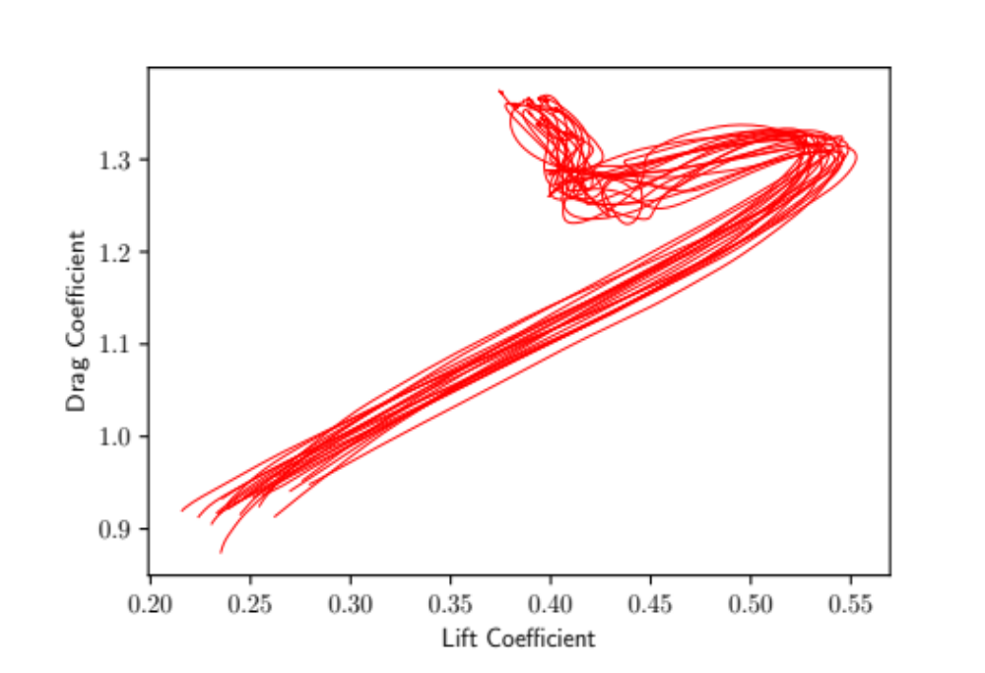
GPR function sampling for trajectory simulation
Integrated trajectories account for uncertainties in aero coefficient database
time
time
Continuous aero coefficient function sampled along trajectory that is not known a priori

Slide 14

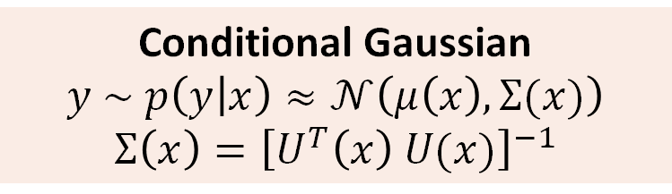

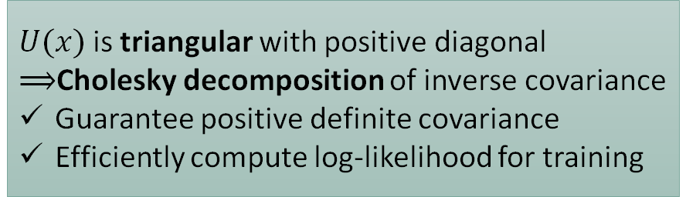

Structured Covariance Gaussian Networks (SCGN)*
* Dorta et al., IEEE/CVF Conference on Computer Vision and Pattern Recognition, 2018.
Nakamura-Zimmerer et al. AIAA SciTech Forum, 2023 (to appear).
Mean network
Conditional Gaussian
$$y \sim p\left(y | x\right)≈𝒩\left(μ\left(x\right),Σ(x)\right)$$
$$Σ\left(x\right)={\left[U^{T}\left(x\right) U(x)\right]}^{−1}$$
$$μ(x)$$
$$x$$
Covariance network
$$U(x)$$
$U(x)$is triangular with positive diagonal
$⟹$Cholesky decomposition of inverse covariance
Guarantee positive definite covariance
Efficiently compute log-likelihood for training

Slide 15
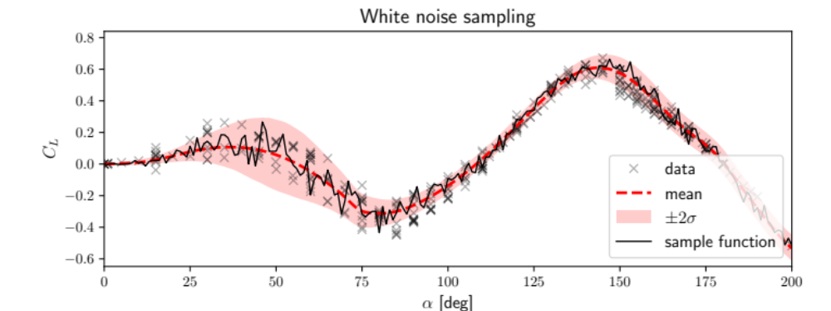
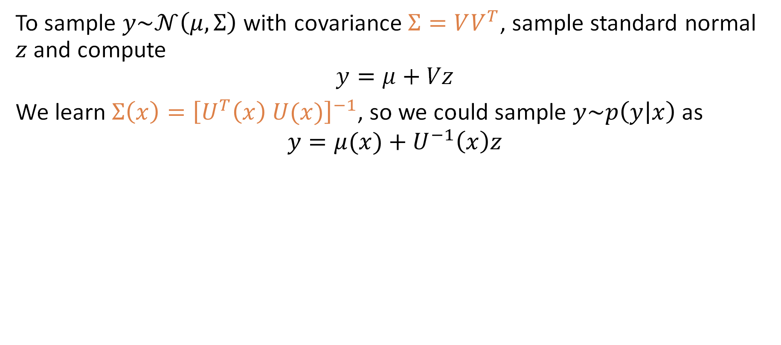
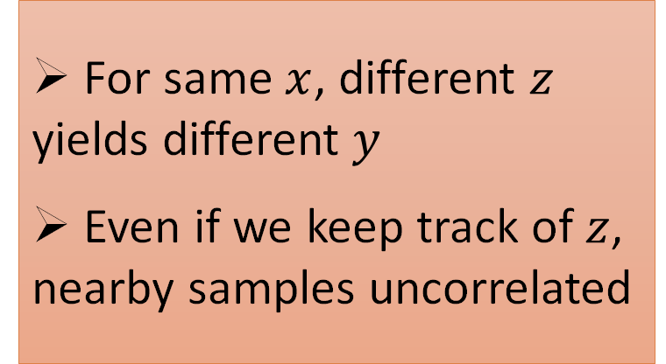
Sampling the conditional distribution
To sample $y\sim 𝒩\left(μ,Σ\right)$ with covariance $Σ=VV^{T}$, sample standard normal $z$ and compute
$$y=μ+Vz$$
We learn $Σ\left(x\right)={\left[U^{T}\left(x\right) U(x)\right]}^{−1}$, so we could sample $y\sim p\left(y | x\right)$ as
$$y=μ(x)+U^{−1}\left(x\right)z$$
For same $x$, different $z$ yields different $y$
Even if we keep track of $z$, nearby samples uncorrelated

Slide 16
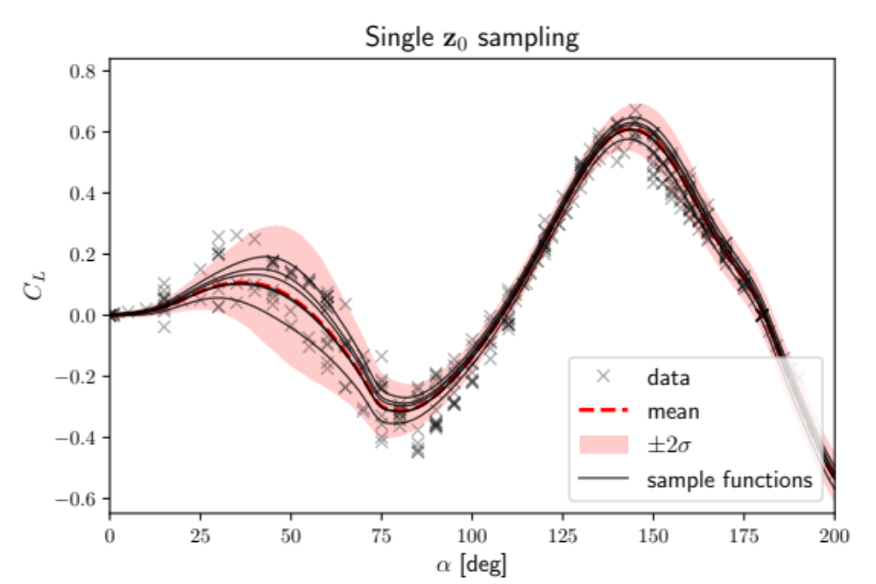
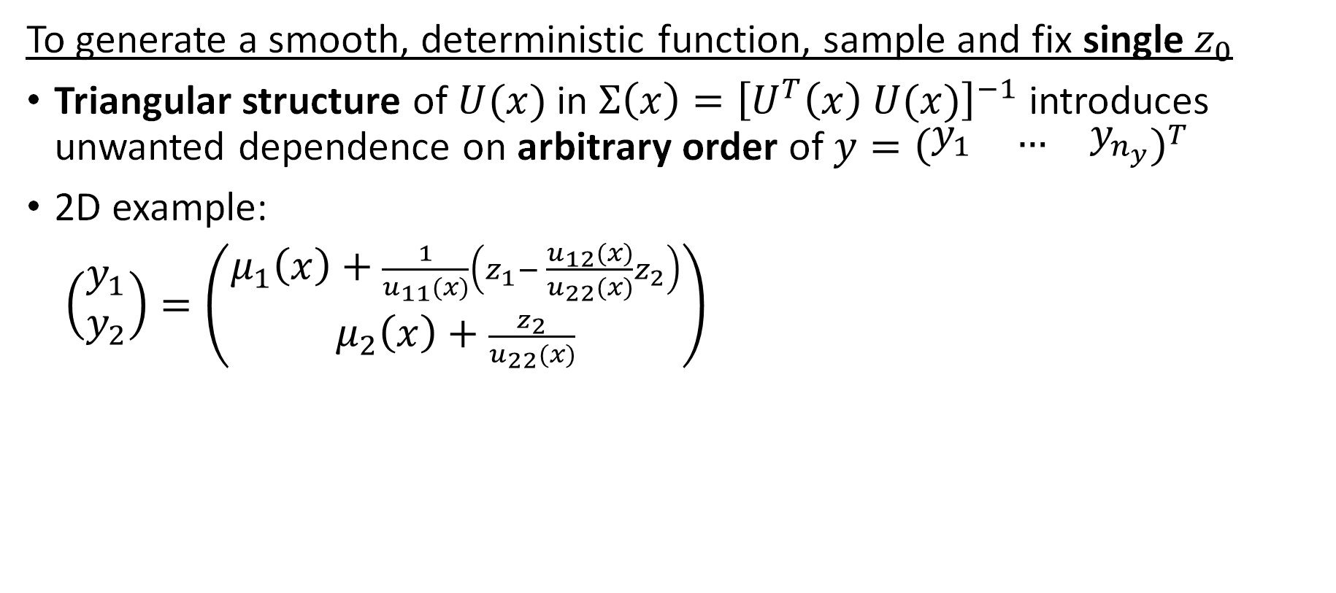
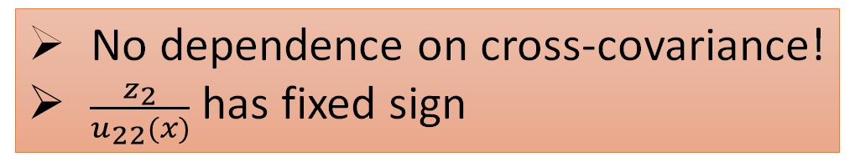
Towards smooth function samples
To generate a smooth, deterministic function, sample and fix single $z_{0}$
Triangular structure of $U(x)$ in $Σ\left(x\right)={\left[U^{T}\left(x\right) U(x)\right]}^{−1}$ introduces unwanted dependence on arbitrary order of $y={\left(\begin{matrix}y_{1} & … & y_{n_{y}}\end{matrix}\right)}^{T}$
2D example:
$\left(\begin{matrix}y_{1} \\ y_{2}\end{matrix}\right)=\left(\begin{matrix}μ_{1}\left(x\right)+\frac{1}{u_{11}(x)}\left(z_{1}− \frac{u_{12}(x)}{u_{22}(x)}z_{2}\right) \\ μ_{2}\left(x\right)+\frac{z_{2}}{u_{22}(x)}\end{matrix}\right)$
No dependence on cross-covariance!
$\frac{z_{2}}{u_{22}(x)}$ has fixed sign

Slide 17
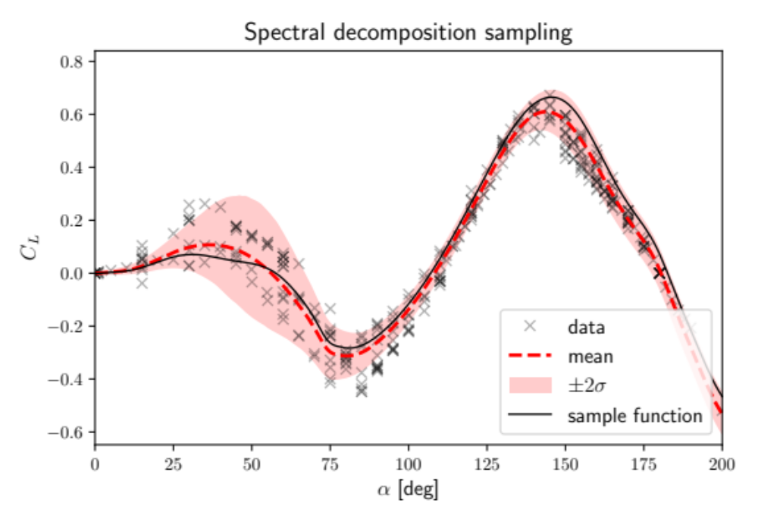
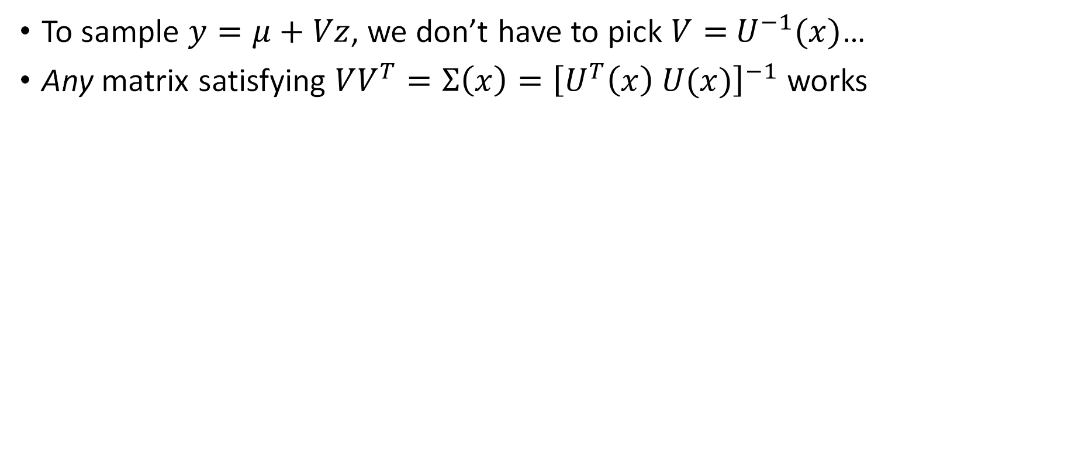
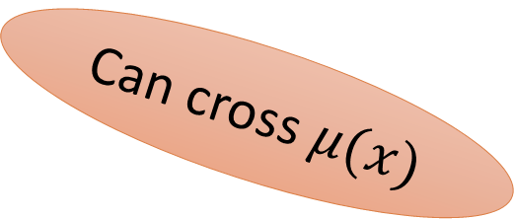
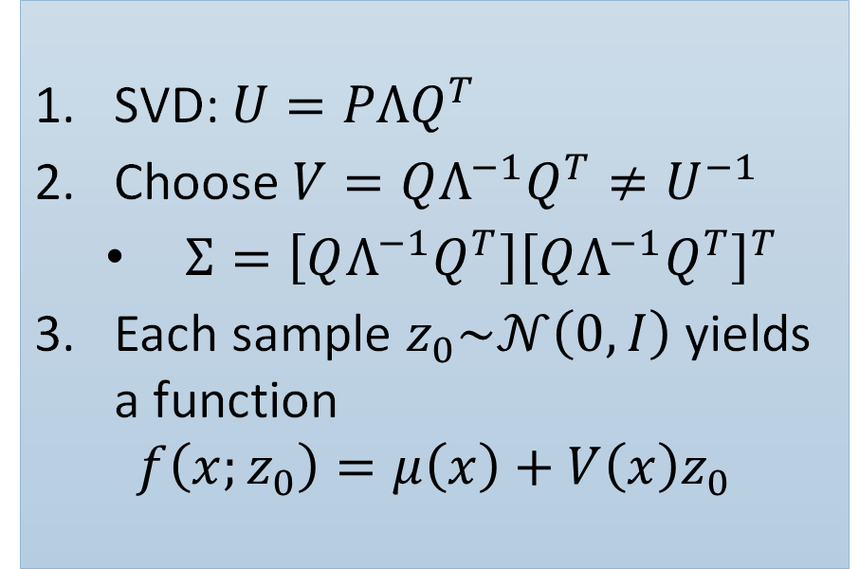
Spectral decomposition sampling
To sample $y=μ+Vz$, we don’t have to pick $V=$ $U^{−1}(x)$…
Any matrix satisfying $VV^{T}=Σ\left(x\right)={\left[U^{T}\left(x\right) U(x)\right]}^{−1}$ works
SVD: $U=PΛQ^{T}$
Choose $V=QΛ^{−1}Q^{T}≠U^{−1}$
  $Σ=\left[QΛ^{−1}Q^{T}\right]{\left[QΛ^{−1}Q^{T}\right]}^{T}$
Each sample $z_{0}\sim 𝒩\left(0,I\right)$ yields a function
$$f\left(x;z_{0}\right)=μ\left(x\right)+V\left(x\right)z_{0}$$
Can cross $μ(x)$

Slide 18
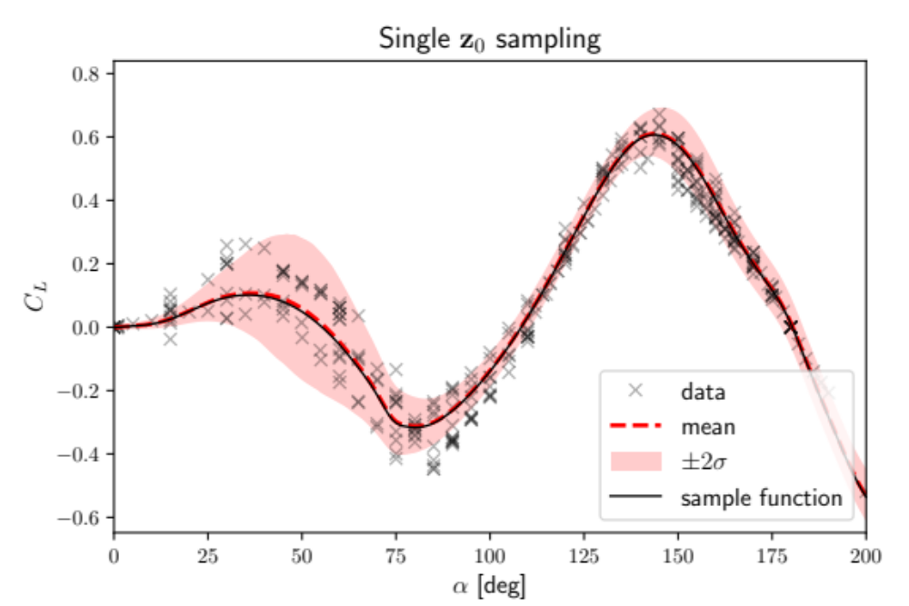
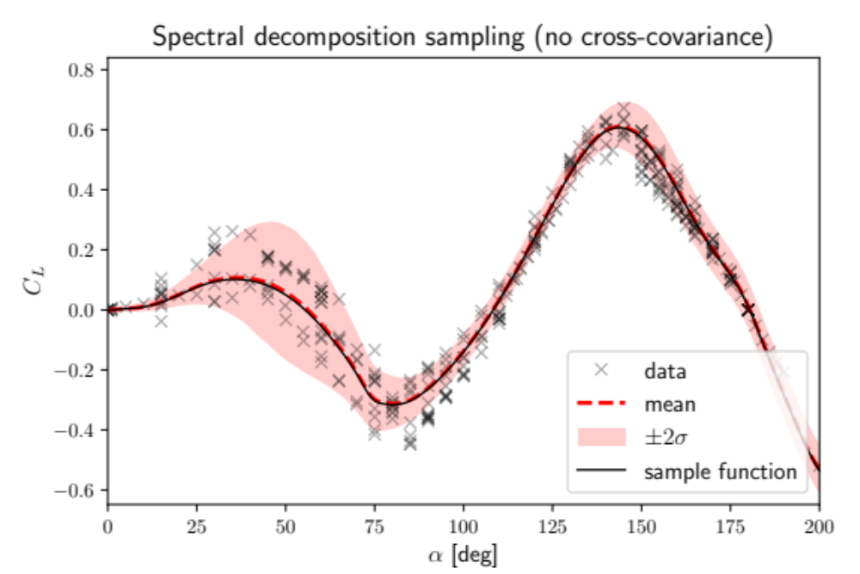
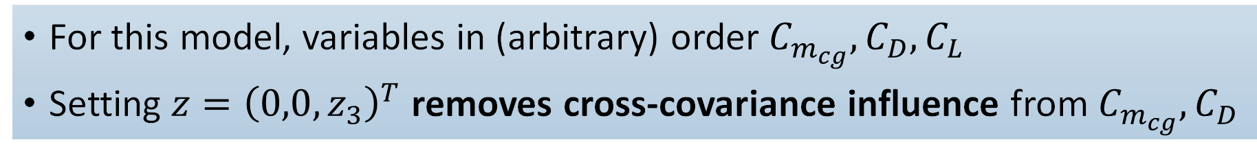
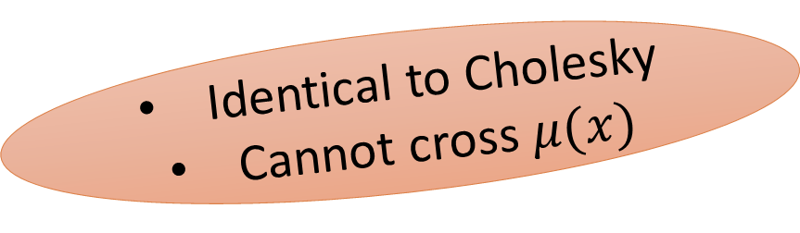
Why spectral decomposition?
For this model, variables in (arbitrary) order $C_{m_{cg}},C_{D},C_{L}$
Setting $z={\left(0,0,z_{3}\right)}^{T}$ removes cross-covariance influence from $C_{m_{cg}},C_{D}$
Identical to Cholesky
Cannot cross $μ(x)$

Slide 19
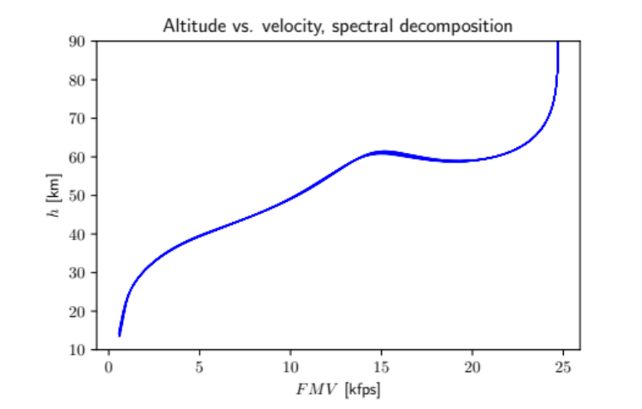
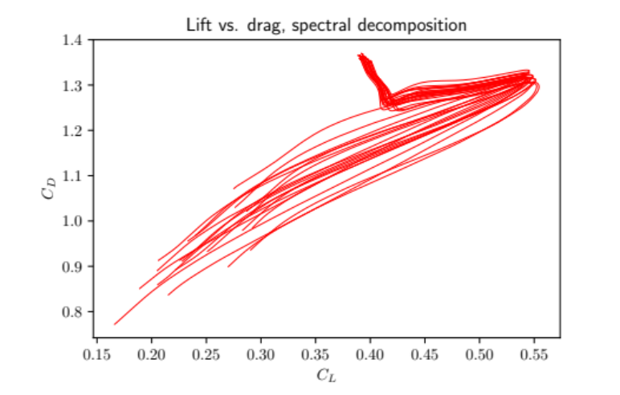
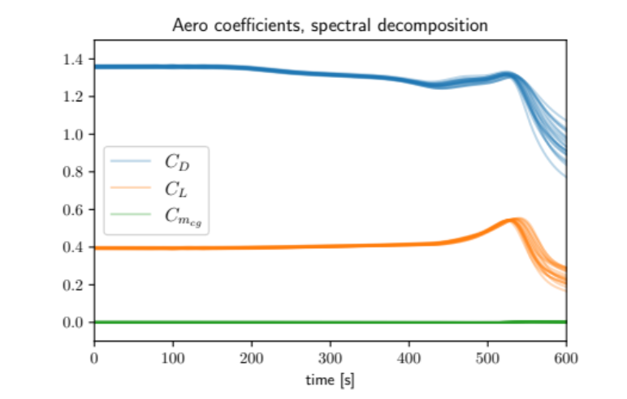
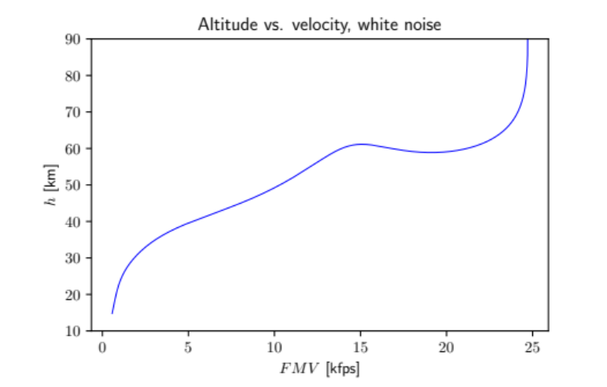
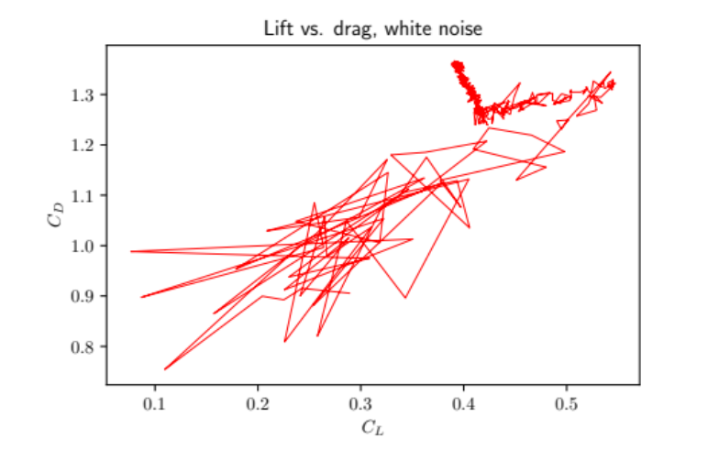
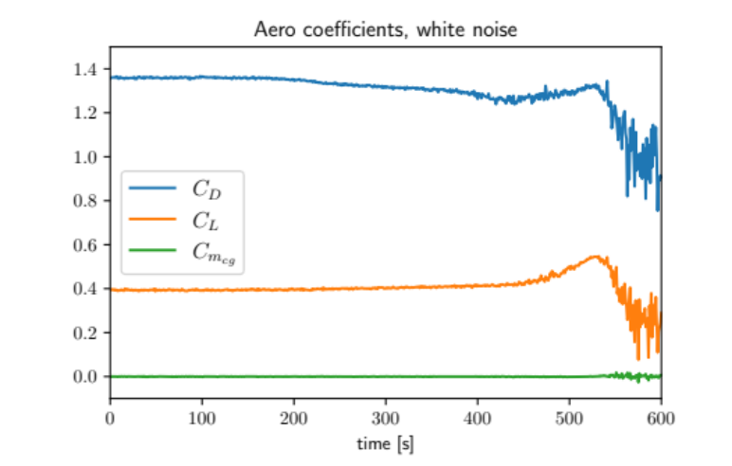
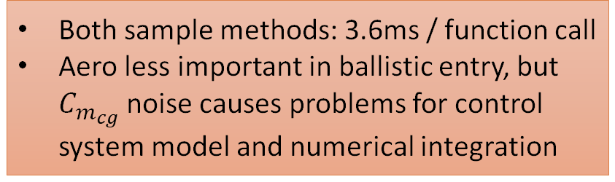
Effect on reentry trajectory simulations
time
Both sample methods: 3.6ms / function call
Aero less important in ballistic entry, but $C_{m_{cg}}$ noise causes problems for control system model and numerical integration
time
For clarity, only 1 white noise trajectory shown
Notes:
White noise: 3.9e-03
Spectral: 4.0e-03

Slide 20
Concluding remarks
Deterministic function samples required for variety of ML/UQ tasks
GPR and SCGN present unique challenges for function sampling
  GPR: consistent function sampling algorithm based on block updates of the Cholesky decomposition of the covariance matrix
  SCGN: spectral decomposition sampling strategy removes variable order dependencies
Trajectory simulations provide an important testbed / motivation for function sampling algorithms
GPR and SCGN function sampling demonstrated on 3-DoF trajectory simulation for models trained on Orion aerodynamic coefficient data

Slide 21
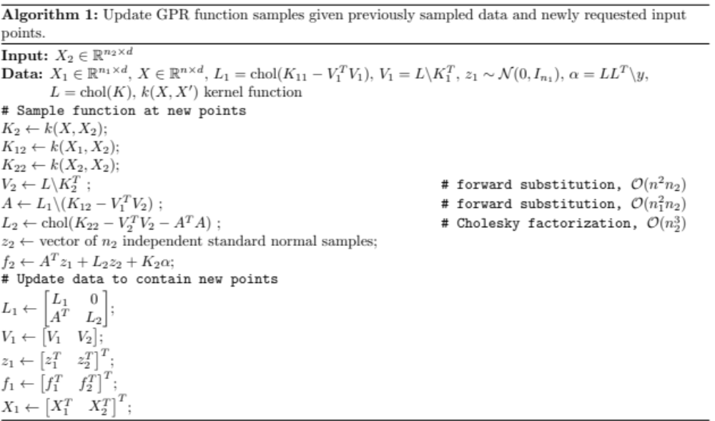
Appendix: GPR function sample updates

