Slide 1
Commercial Smallsat Data Acquisition (CSDA) Program
Very High-resolution Radar & Optical Data Assessment (VH-RODA) 2022 Workshop
Alfreda Hall
Science Mission Directorate
Earth Science Division
07 November 2022

Slide 2


















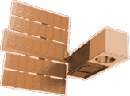


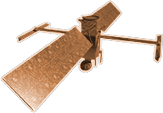








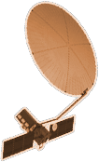

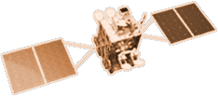



CYGNSS (8)
NISTAR, EPIC
2015
GRACE-FO (2)
SMAP
ICESAT-2
OCO-2
2020
LIS
SAGE III
GPM
SENTINEL-6
MICHAEL FREILICH
TSIS-1
EARTH FLEET
LANDSAT 8
ECOSTRESS
LANDSAT-9
SUOMI NPP
INVEST/CUBESATS
GEDI
CIRIS 2023
NACHOS 2022
CTIM 2022
NACHOS-2 2022
SNOOPI* 2022
MURI-FO* 2022
HYTI* 2023
OCO-3
1995
2010
TROPICS (4)
EMIT
LANDSAT 7
CALIPSO
SWOT
TERRA
CLARREO-PF
AQUA
CLOUDSAT
AURA
JPSS INSTRUMENTS
TEMPO
2000
OMPS-LIMB 2022
LIBERA 2027
OMPS-LIMB 2027
OMPS-LIMB 2032
PREFIRE (2)
2005
NISAR
MAIA*
ISS INSTRUMENTS
KEY
PACE
INTERNATIONAL PARTNERS
U.S. PARTNER
ISS INSTRUMENT
JPSS INSTRUMENT
CUBESAT
LAUNCH DATE TBD
TSIS-2*
(PRE) FORMULATION
IMPLEMENTATION
OPERATING
EXTENDED
GEOCARB*
SENTINEL-6B
GLIMR*
INCUS*
LANDSAT NEXT*
ESO-1, 2, 3, 4*
MISSIONS
10.11.22
2025

Slide 3
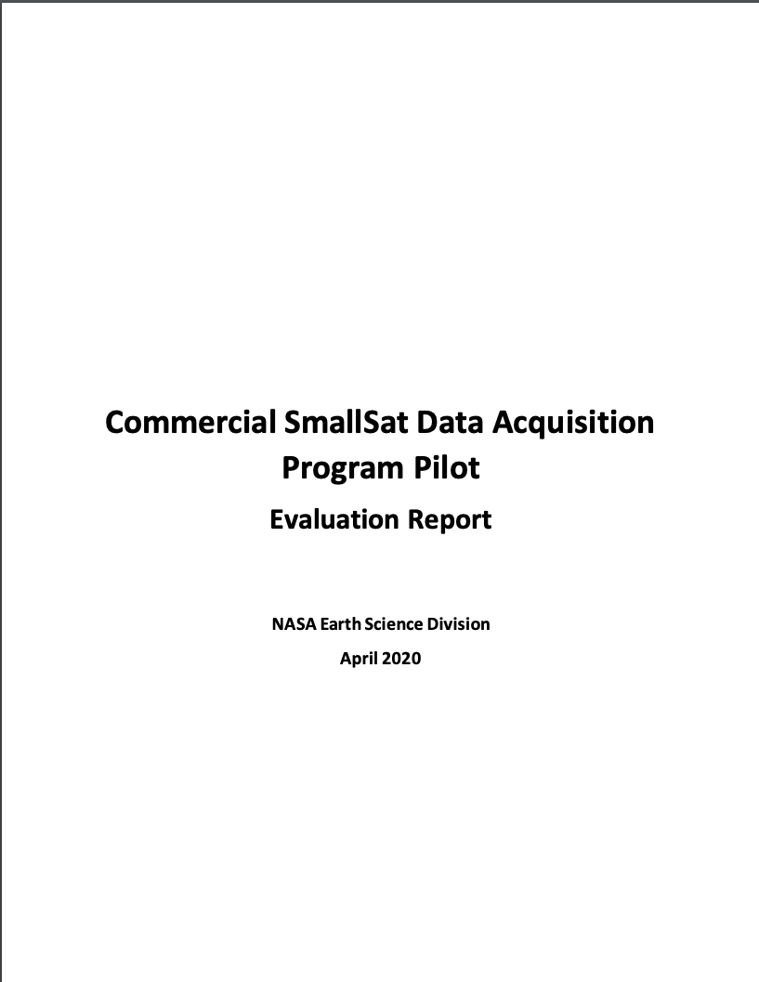

Commercial Smallsat Data Acquisition (CSDA) Program
Pilot initiated in November 2017 to evaluate data from operating commercial small-satellite constellations for research and applied science activities
  Augment and/or complement NASA Earth observations
  Cost effective means to advance/extend research and applications
Blanket Purchase Agreements (BPAs) were awarded in September 2018 to Maxar (DigitalGlobe) Inc., Planet Labs Inc., and Spire Global.
Pilot successfully ended early 2020 → sustained program - CSDA Program
  Restrictive nature of the End User License Agreements (EULAs) made standard scientific collaboration difficult and must be addressed in future data purchases.
Notes:
Pilot Results
Majority of evaluations demonstrated the usefulness of commercial data and imagery for advancing scientific research and applications.
Investigators encountered limitations:
Calibration and geolocation
Increased the amount of work needed to access, preprocess, and analyze data (e.g., download services, documentation, and metadata).
Restrictive nature of the EULAs made standard scientific collaboration difficult and must be addressed in future data purchases.
Overall, the utility of the evaluated data outweighed the difficulties encountered.

Slide 4
Commercial Smallsat Data Acquisition (CSDA) Program
Program Objectives:
Establish a continuous and repeatable process to onramp new commercial data vendors.
Enable sustained use of purchased data for broader use and dissemination by Earth scientific community.
Ensure long-term data preservation, access and distribution of purchased data and long-term access for scientific reproducibility.
Coordinate with other US Government agencies and international partners on the evaluation and scientific use of commercial data.
https://earthdata.nasa.gov/csdap

Slide 5

End User License Agreements (EULAs) Tiered Approach
Scientific Non-Commercial Use License
Tiered EULA approach is modeled after National Reconnaissance Office’s (NRO’s) family of EULAs.

Slide 6
CSDA Program License Uplifts
In 2021, CSDA licensing agreements expanded to broaden the applicability for scientific applications across the US Government
    Spire Global, Inc.: Available to Federal/State/Local/Tribal Governments & funded research
        Full GNSS Science Data Catalog
    Planet Labs: Available to Federal Civilian Agencies, NSF, & their funded research
        Full PlanetScope and RapidEye archive
      Other licensing details remain similar:
        30-day latency; scientific use only
Onramp 2 and beyond vendors– utilize the broaden licenses: USG, USG Plus, and Public Release
These licensing uplifts will make the data more readily-available across the government and improve both value and interagency collaboration.
Notes:
Went from NASA only End Users License Agreements (EULAs) to tiered EULAs (USG, USG Plus, Public Release)
Collaborations with NRO –
Tiered EULA approach is modeled after NRO’s family of EULAs.
Utilize the tiered EULA approach to satisfy other agency commercial data request via SNWG Assessment Process.
More information on CSDA’s holdings, including how to access the data, is available at the CSDA website:

Slide 7
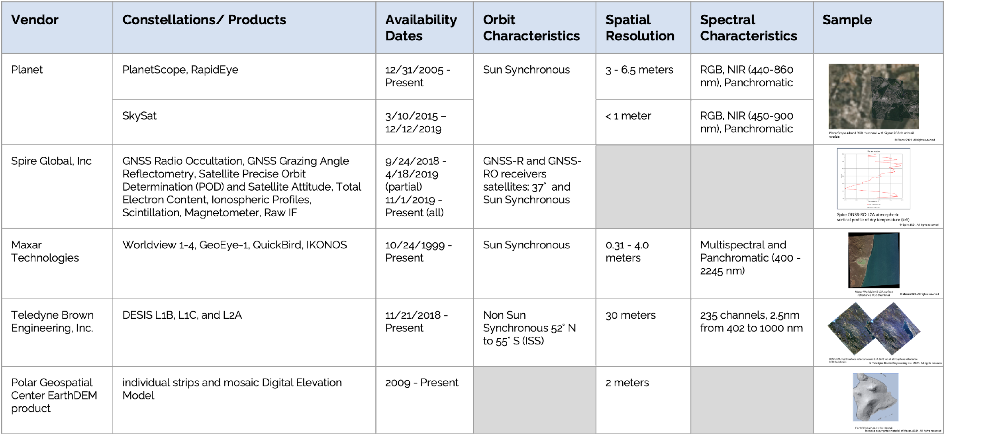
CSDA Data Holdings
https://earthdata.nasa.gov/esds/csdap/commercial-datasets
Notes:
Dataset details, access method, and licenses are found at https://earthdata.nasa.gov/esds/csdap/commercial-datasets

Slide 8
FY23 Activities & Beyond: On-ramp and Evaluation
On-Ramp #2: On-Ramp of qualified vendors from second Request for Information (RFI) (October 2019). Data quality criteria will use the draft joint ESA-NASA Evaluation Framework Guidelines for SAR and Optical:
  Airbus DS GEO (US) Inc BPA awarded July 2021; Selected principal investigators (PIs) initiated one-year evaluation of the SAR data products January 2022. Final PI Reports due: ~Jan 2023.
  BlackSky Geospatial Solutions, Inc BPA awarded Sept. 2021; Selected principal investigators (PIs) initiated one-year evaluation of the SAR data products July 2022. Final PI Reports due: ~July 2023.
On-Ramp #3: On-Ramp of qualified vendors from third RFI (December 2020) is underway. Sole source synopsis posted for Capella Space, ICEYE US, Inc, GeoOptics, Inc, and GHGSat, Inc.
  Selection of PIs for evaluation via ROSES 2022 (A. 43); Proposals received: July 21; Review panels being assembled
  GHGSat, Inc. BPA awarded September 28, 2022, to provide methane data products to be evaluated under the CSDA program.
2nd Commercial SmallSat Data Analysis solicitation will be released (ROSES 2023 A.44) to promote scientific use of purchased data by the scientific and applied science communities.

Slide 9
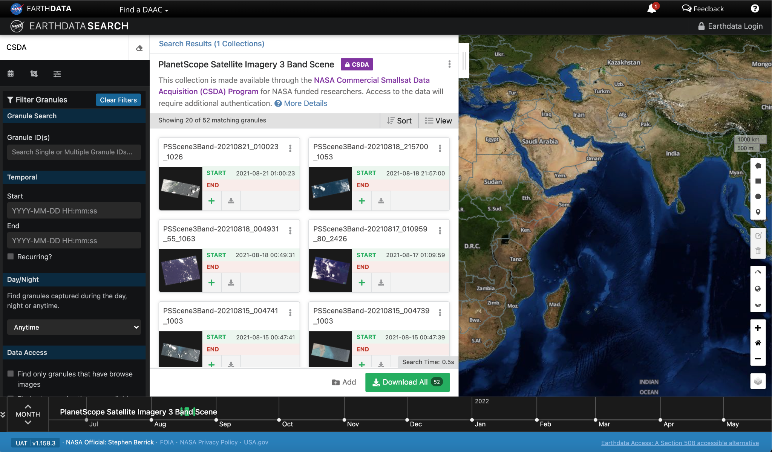
Data Search via EOSDIS
Coming Soon
Coming soon: Data discoverable and downloadable through NASA’s CMR, Earthdata Search Client

Slide 10
ESA-NASA International Collaboration
ESA/NASA Joint Program Planning Group Sub-Group 3: Ground Segments and Data: Coordinated evaluation of commercial Third-Party mission data
  Elaborated common data assessment guidelines to be used to support future NASA and ESA evaluation of commercial missions
    Drafted Joint ESA-NASA Earth Observation Mission Quality Framework Guidelines for Optical and Synthetic Aperture Radar (SAR)
  Performed cross-assessment of some commercial missions, in particular Planet constellations (PlanetScope and SkySat constellations), exchanging information on the evaluation before publication
  Coordinated participation in data quality workshops related to Very High Resolution EO (VH-RODA, JACIE)
  Collaborate on drafting the joint evaluation data usability framework guidelines.
  Initiate discussions on coordination data licenses for data purchased and related issues for facilitating data use, where permissible

Slide 11
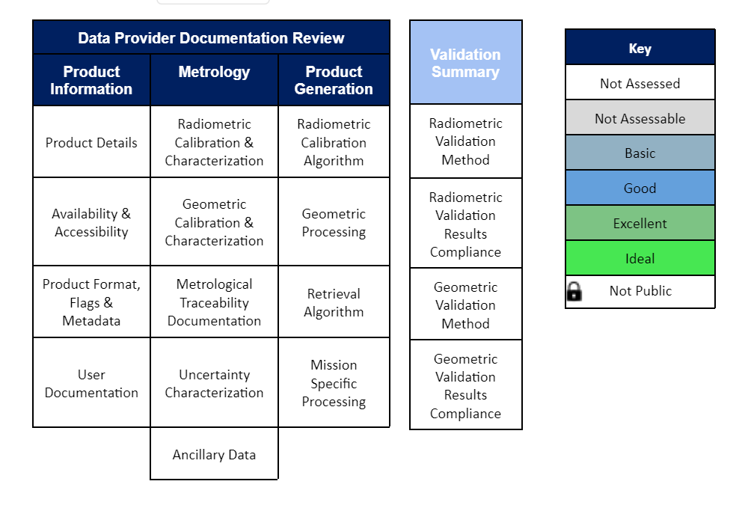
ESA-NASA International Collaboration (cont’d)
Joint Data Quality Guidelines Summary Cal/Val Maturity Matrix - To be filled in to report the result of assessment.

Slide 12
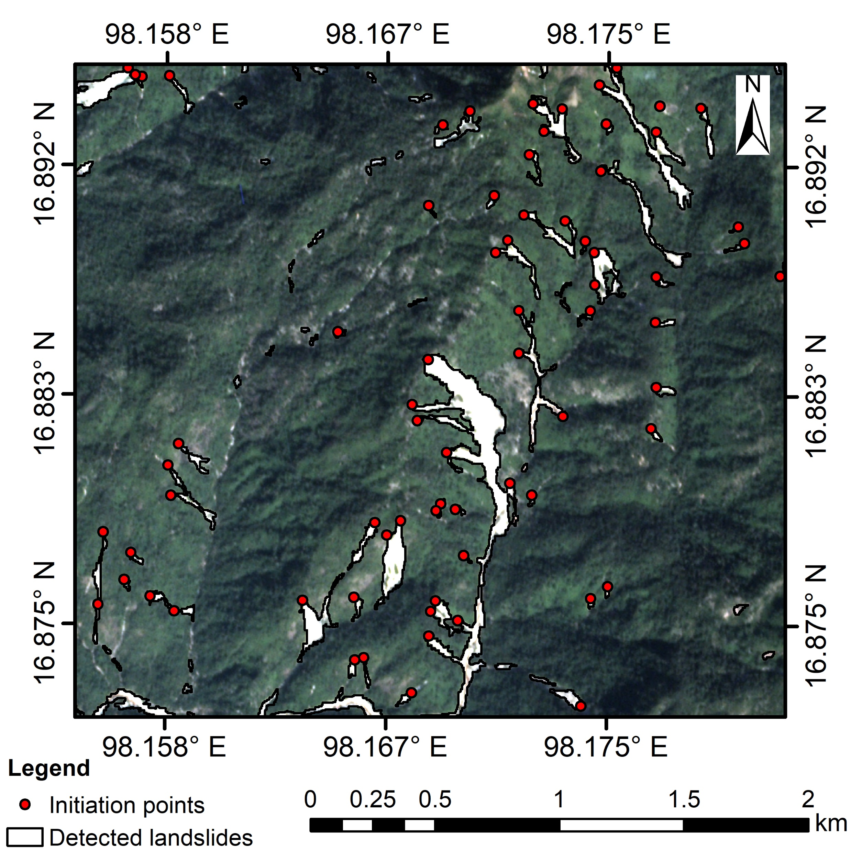
Landslide Detection using Commercially-Purchased Imagery
CSDA Science Results
A recent study has utilized the Planet constellation to detect and map landslides in the Lower Mekong region
  The white regions (right) show where landslides were detected by high-resolution optical imagery acquired from Planet
  The landslide initiation points (red dots) can be determined by cross-referencing the detected landslides with a digital elevation model
These results leverage the high spatial resolution and temporal revisit available from the Planet imagery in conjunction with the high-fidelity NASADEM data
Imagery (background), detected landslides (white), and landside initiation points (red dots) over Hpa-An, Kayin state, Myanmar on 5 Dec 2018
© Planet Labs, Inc. (2018). All rights reserved.
Amatya et al. (2022)

Slide 13
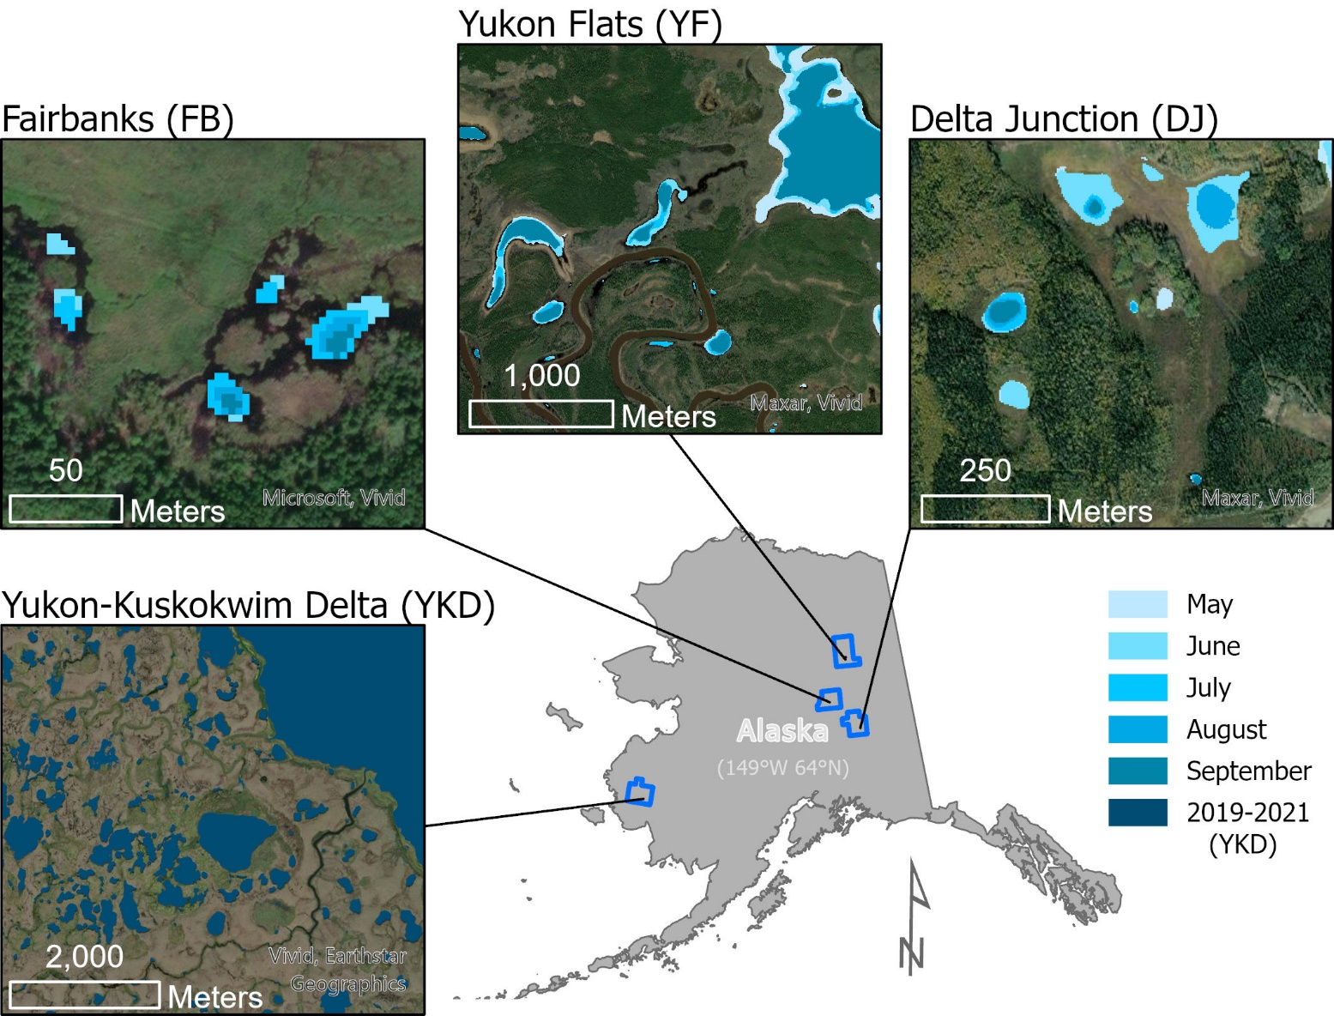
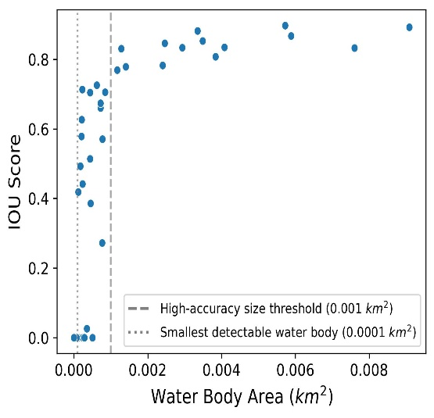
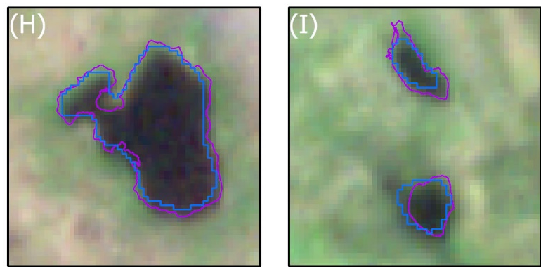
Mapping Lakes and Ponds in Alaska at Very High Spatiotemporal Resolutions
A. Mullen¹, J. D. Watts¹*, B. M. Rogers¹, M. L. Carroll², C.D. Elder³, J. Noomah¹, Z. Williams², A. Bredder⁴, E. Rickenbaugh^{1,5}, J. A. Caraballo-Vega², E. Levenson⁶, S.W. Cooley⁶, S. Potter¹, Y. Yang¹, G. Fiske¹, C.E. Miller³, S.M. Natali¹
¹Woodwell Climate Research Center, Falmouth, MA, USA. ²NASA Goddard Space Flight Center, Greenbelt, MD, USA. ³NASA Jet Propulsion Laboratory, Pasadena, CA, USA. ⁴University of Maryland, College Park, MD, USA. ⁵Montana State University, Bozeman, MT.⁶University of Oregon, Eugene, OR, USA.
Overview
Small water bodies and their seasonality are not accounted for within existing surface water products, despite their global importance.
Project used a dense time series of 3-m PlanetScope imagery to explore the ability of very high resolution imagery to detect and monitor seasonal changes in surface water.
IOU: 0.39
IOU: 0.84
*based on 47 GPS tracks
Methods
U-Net Model Validation Scores
Precision | 0.95
Recall | 0.94
F1 | 0.95
IOU | 0.91
*based on 500 hand delineated water bodies
Case study spanned four regions in Alaska: Yukon-Kuskokwim Delta tundra, and three boreal wetland complexes (i.e., Fairbanks; Yukon Flats; Delta Junction).
Utilized a convolutional neural network (U-Net) trained on 11,000 manually delineated water bodies within Maxar WorldView-2 imagery.
Validated the U-Net model water body detections against independent hand-delineated and GPS-surveyed water bodies.
Results
The automated U-Net & PlanetScope approach detected very small water bodies > 0.001 km² with high accuracy (precision = 0.95) and identified water bodies as small as 0.0001 km².
These results set a new “gold standard” in water mapping and can be readily extended to elsewhere on Earth.
Pickering et al. (2021) doi:10.3390/rs13112191
© Planet Labs, Inc. (2019-2021). All rights reserved.

Slide 14
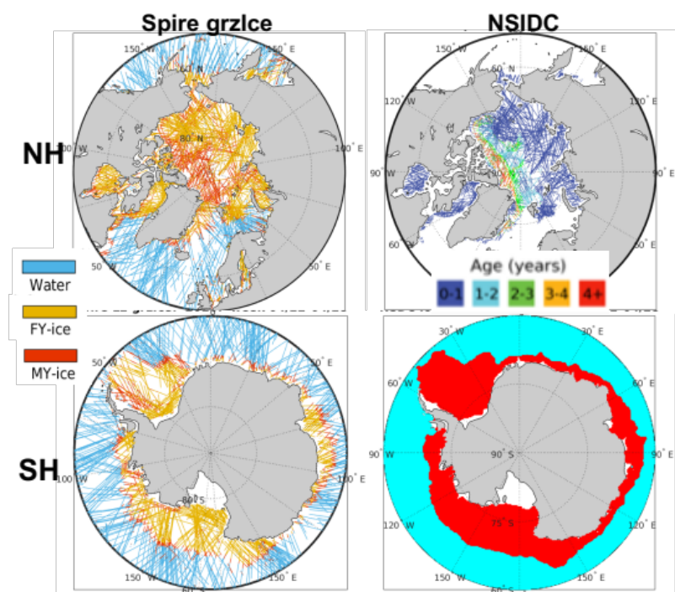
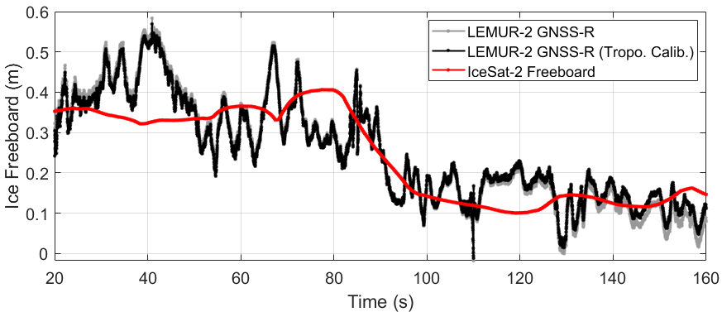
CSDA Science Results (cont’d)
Two Spire-produced Level 2 products derived from GNSS Grazing Angle reflectometry have recently been evaluated and added to the routine data deliveries:
  Sea ice product has skill in discriminating first year and multi-year ice (top-right)
    Ice age correlated to surface roughness, which relates to the coherency of the reflected signal
  Altimetry product shown to characterize sea ice height variations (bottom-right)
    The Spire data follows the same trend as that of the IceSat-2 but shows larger variability
    Though noisy, the reflections have potential in providing temporal information on ice height beyond the 90-day IceSat-2 repeat cycle
Sea ice age estimated from grazing angle specular reflection tracks (right) compared to NSIDC ice age product during the week of 22-28 April 2020
Pickering et al. (2021) doi:10.3390/rs13112191
Spire sea ice surface height retrieval compared to with IceSat-2 freeboard data.
© Spire Global, Inc. (2020). All rights reserved.
Jade Morton (U. of Colorado-Boulder)

Slide 15
Summary
Commercial Smallsat Data Acquisition Program is a sustained program.
All data purchased by NASA as well as DESIS are available to funded researchers in accordance with the vendor’s scientific use license.
Onramp procurements for the new vendors are underway.
CSDA data holdings will be coming available via Earthdata Cloud Search CY2022.
Accessing and Requesting Commercial Smallsat Data FAQ:
https://earthdata.nasa.gov/esds/small-satellite-data-buy-program/faq-commercial-data
Notes:
Earthdata search – dataset will be phased in – starting with Planet.

Slide 16
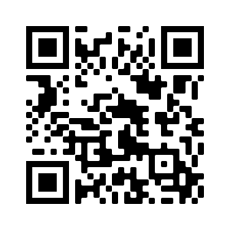
Commercial Smallsat Data Acquisition (CSDA) Program
https://earthdata.nasa.gov/csdap
Notes:
Earthdata search – dataset will be phased in – starting with Planet.

