Slide 1
Machine Learning for EMU glove inspections Overview, Testing and Results
Office Code: EVA & Human Surface Mobility Program
Name of Forum: 2022 NASA Data Science Summit
Date: 15-17 NOV 2022
This publication does not contain information which falls under the purview of the U.S. Munitions List (USML), as defined in the International Traffic in Arms Regulations (ITAR), 22 CFR 120-130, and is not export controlled. This publication does not contain information within the purview of the Export Administration Regulation (EAR), 15 CFR 730-774, and is not export controlled. This publication is not intended for distribution outside of the NASA and International Partner communities. Release to the public requires approval through the appropriate NASA Release Process (e.g., FOIA, NASA STI, etc.).
Jordan Lindsey/John Swatkowski
EHP / Engineering (EC1)
Notes:
Funding provided by NASA Digital Transformation
ISS NL approves the use of SBC-2 for this project
HPE is in favor of continued use for this project
ER6 has been coding the scripts needed to execute the model and return results for us

Slide 2
Overview
What is the problem?
Project Overview
Ground-based results
Results from ISS SBC-2 test
Forward work
Summary

Slide 3
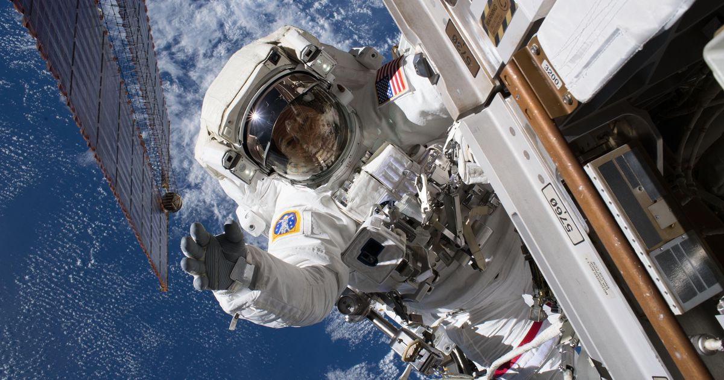
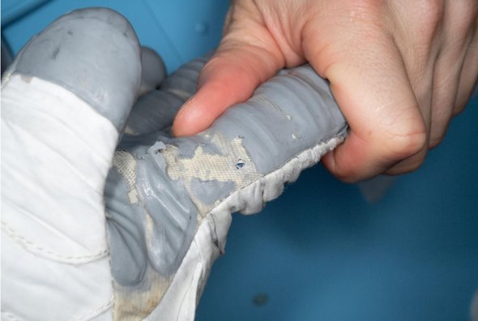
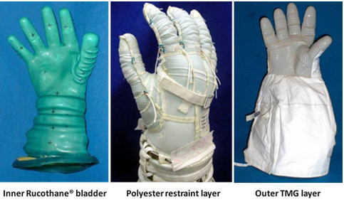
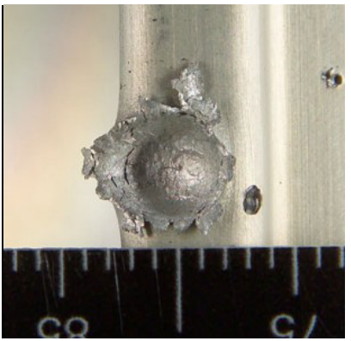
Problem
The EVA environment and glove tasks result in wear and tear to the outer glove layer
A fundamental problem with EMU gloves is that damage to the outer glove layer may introduce a hole into the pressure suit.
Exposure of the pressure suit would present a danger to the crew during a spacewalk and limits that crew’s ability to preform subsequent EVA’s.
Exploration on the lunar surface and at Mars will increase the frequency for EVA’s over the ISS maintenance, an upgrade tempo of ~10 per year.

Slide 4
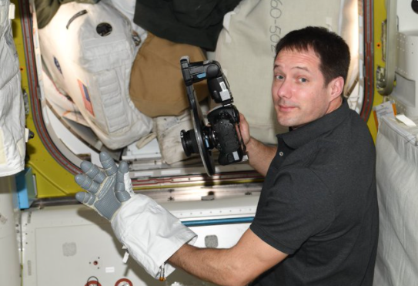
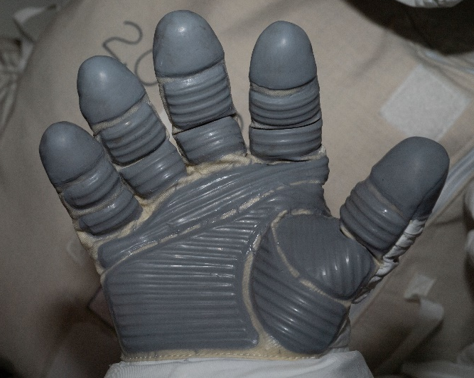
Current Process
2 types of glove inspections that are performed on-orbit:
Live Glove checks during the EVA
After major translations, every 90 minutes, or after the crew completes a hand intensive task (electrical connections), the crew perform a glove inspection.
Post-EVA Glove Inspection
Another inspection is performed post EVA. After the crew have repressed, are safe inside the airlock, an internal crew member (IVA) will use a DSLR camera with a specific lens to capture a specific sequence of photos.
After photos for both crew are complete, the images are downloaded to a laptop, allowing the ground team to downlink and share them with the EMU Glove subject matter experts for review.
The ground based reviewed process can take several days to complete, at which time the subject matter experts will gather and review the photos to identify any areas of concern, or reasons preventing the use of these gloves on a subsequent EVA.
Process

Slide 5
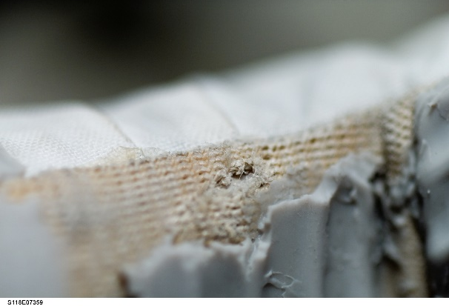
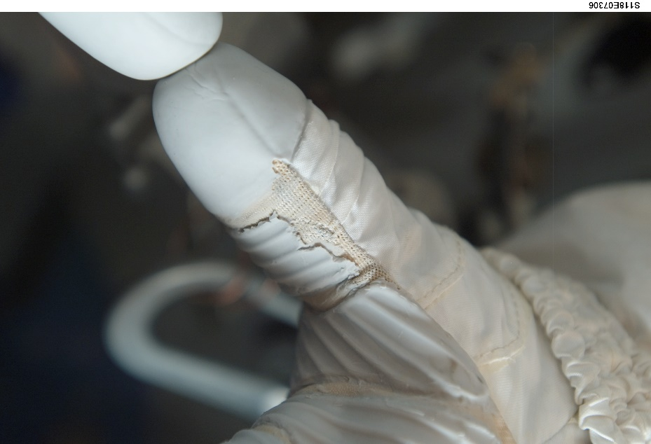
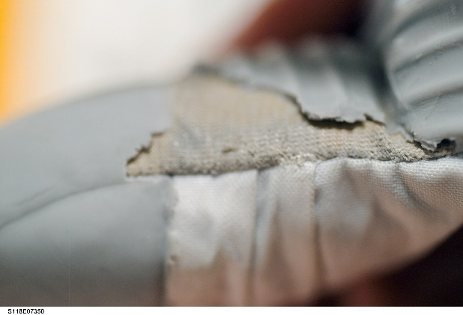
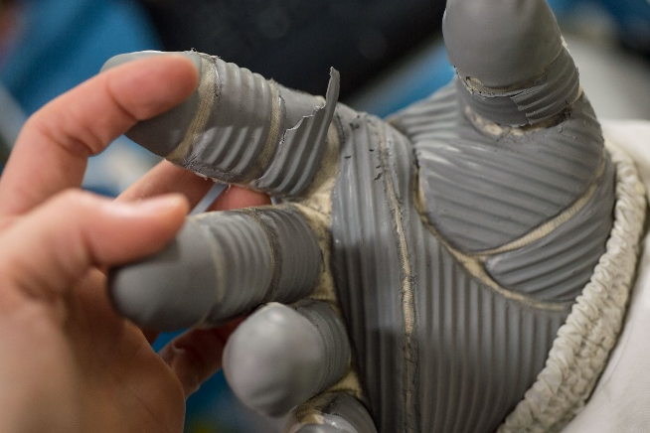
Need for EMU glove inspections
Damage Modalities (labels for Obj Det)
Vectran damage – cut resistant layer,
RTV wear – first layer of defense
RTV Trim – crew removal required
Thumb and index finger are high use area

Slide 6
Project Overview
Motivation: Reduce the time required to complete Post EVA Glove inspections for Lunar and Mars missions. Having the capability to automate inspections and approve the gloves for the next EVA at an exploration destination would reduce the dependency on the ground based Glove SMEs. ISS is being used as an R&D testbed.
Phase 1: Addressing Post-EVA Glove Analysis Process
Gathered approximately 3000 existing glove photos from Imagery Online (IO) , developed a training set and test set of photos.
Continuing to optimize models for identifying cases where the EMU gloves would be deemed NO-GO.
Positioned to test the model in a parallel case with an EVA.
EVAs scheduled March/April 2022
The recommendation proposed by the algorithm would be presented to the expert panel for comment and review.
Phase 2: Addressing Real Time
Phase 2 would expand the ML Model by adapting it to use HD video to perform an inspection of the EVA gloves real-time and not with just still images.
Currently working with FOD to determine ways of improve real-time inspections in front of the new HECA camera, to ensure we get good video to analyze.
Notes:
Make it clear this is an R&D project; not in the safety critical path for operations
Working with MSFT Azure and HPE/SBC-2
HPE/SBC-2 have presented us with a chance to test on ISS, showing the first step in completing this analysis at the “edge”
Plan to meet with the expert panel AFTER they have reviewed the post EVA glove photos, come to a recommendation and that recommendation has been shared with the FOD team and crew
We DO NOT want to stand in the way or slow down this safety critical process
After the recommendation has been shared, we would like to meet with the panel to discuss our findings and ask for their feedback
HECA video is relatively new to ISS, so the data set of available video is small.
For EMU Glove inspection, this is practically non-existent
We are working with FOD EVA on ways to build up that data set and will discuss that later in the presentation
This process is moving along rapidly, and we are making progress toward this capability soon

Slide 7
ML Approach
Digital Transformation initiative at NASA seeks to accelerate technical/engineering innovation, increase efficiency, increase safe mission systems and more while embracing the areas pursued in the IT world such as AI/ML and cloud computing.
During NASA’s 2021 “Digital Transformation” solicitation of projects from across the agency to test, utilize and compare 3 different commercial platforms (AWS, Google and Azure), this project was selected to use MS Azure.
Azure platform has both AutoML (drag and drop) as well as the ability to build your own model. AutoML was tested and utilized for this project

Slide 8
Classification
Utilized the Classification capability of Azure as a starting point. The main purpose was to investigate a low overhead approach for potentially identifying issues with the gloves.
Images could quickly be loaded in the training area and tags applied to the image, not to specific locations; reducing the time spent supplying the model.
LIME (local interpretable model explanation) was used to better understand what areas the model had identified as consistent and important. Did this line up with areas human experts used to make determinations?
Due to lower fidelity modeling (Azure compact) this effort proved to be inconsistent, and the project moved to object detection.

Slide 9
Ground based results
Ground based analysis of US EVA 76 post EVA glove photo using our classification model
For this specific image, the model is recommending a 97% probability of “GO”
Notes:
US EVA 76 ground based inspection
Various tags are used to represent the different damage modalities
Tags can easily be updated, for instance Paint was used to identify “grease” or “smudges”
This case there is a 97% probability of GO for use, based on this image
Team is exploring ways to combine predications of a give glove, to recommend an overall probability (sum probabilities over the set of images)
Also exploring ways to combine results from various models to give a higher confidence for given prediction (ensemble learning)
Run the same images through multiple models that have shown higher confidence in detecting a particular damage modality
The yellow line is the output from LIME( local interpretable model explanation, XAI) to show where the model is actual “looking” when it evaluates an image. This is not part of the normal analysis.

Slide 10
Object Detection
Object detection with the same training images
Required additional time to draw bounding boxes and label with 1 of 3 labels (Vectran Damage, RTV Wear or RTV Trim)
Increased detection and consistency from classification models.
Generally, the bounding boxes were in the same locations, and the dimensions would get smaller; tightening in on the suspected damage location.
Balanced data set did not improve the overall prediction capability of the model.
Vectran Damage is the lowest quantity data set, while the other damage modalities are 3-5x in quantity.

Slide 11
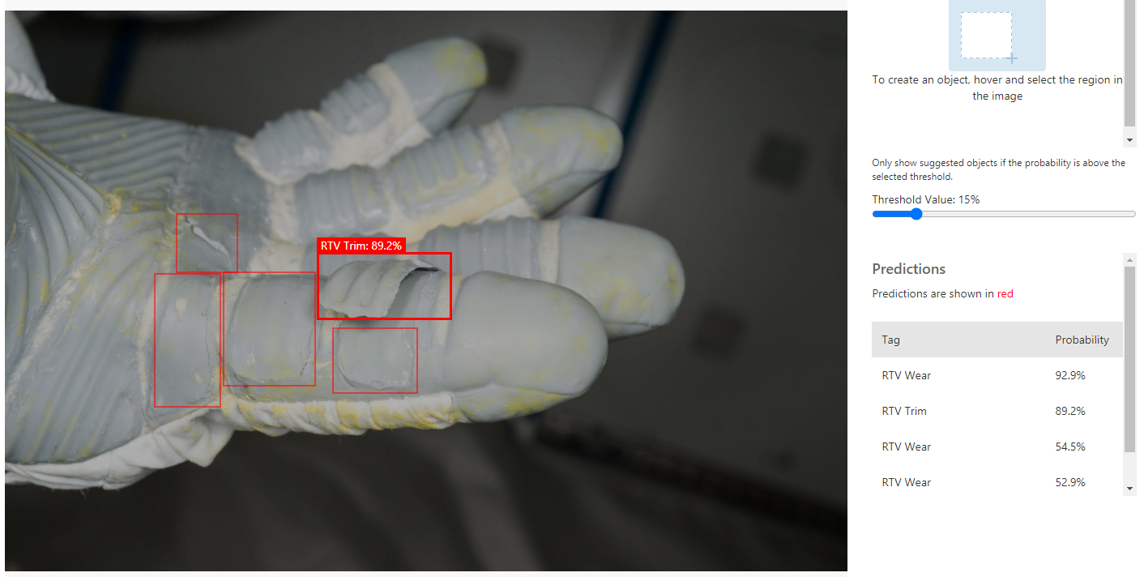
Ground based results
Ground based analysis of post EVA glove photo using object detection model
For this specific image, the model can identify various damage areas and the associated probability of that being a particular damage type

Slide 12
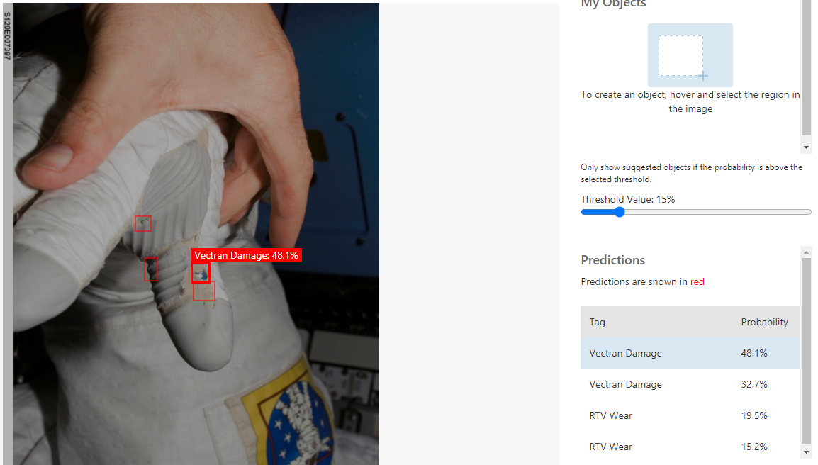
Ground based results
Ground based analysis of post EVA glove photo using object detection model. The results shown are based on a compact model in early testing.
Notes:
The obj det model can identify a given area as suspect, attach a tag and given confidence in that tag prediction
This will need to be improved, it identified the Vectran damage, but is not real confident in its prediction

Slide 13
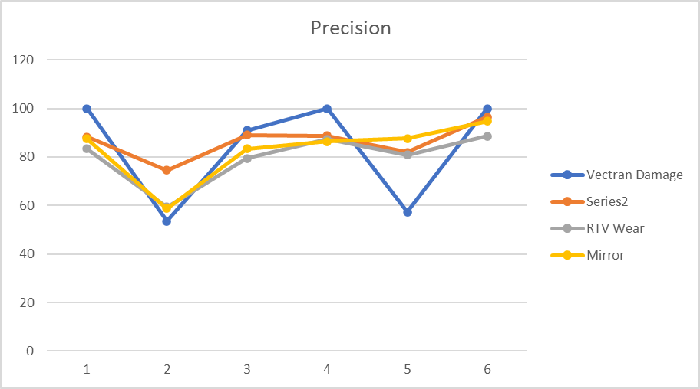
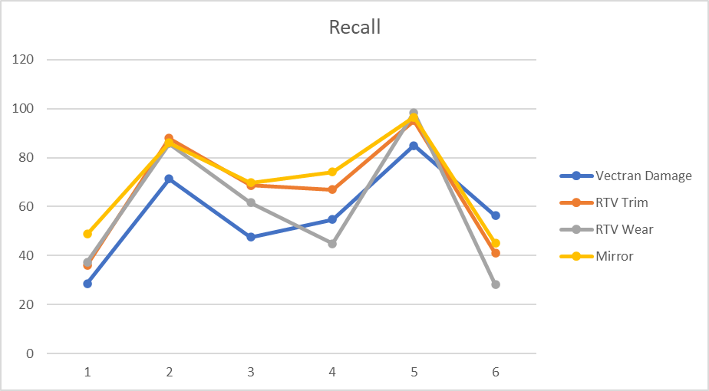
Precision vs Recall
All cases shown are set to:
Prob Threshold - 50%
Overlap Threshold - 30%
Case #5 yielded the highest recall.
Improvement from case 4 was primarily driven by using a different Azure Custom Vision model (General vs A1).
Recall is significantly higher in case 5 and for relatively small drops in recall the precision of damage types like Vectran Damage can be increase by 10 percentage points
Azure allows Probability and Overlap Thresholds to be changed, allowing for the recall/precision tradeoff to occur
Increase in the default Probability and Overlap Threshold values resulted in a recall decrease and precision increase

Slide 14
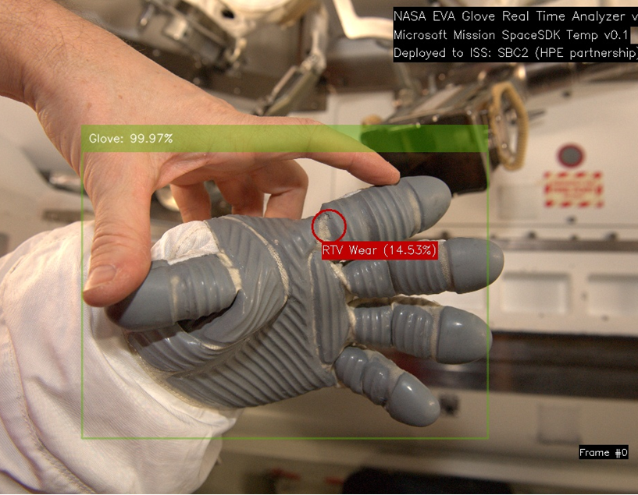
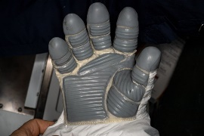
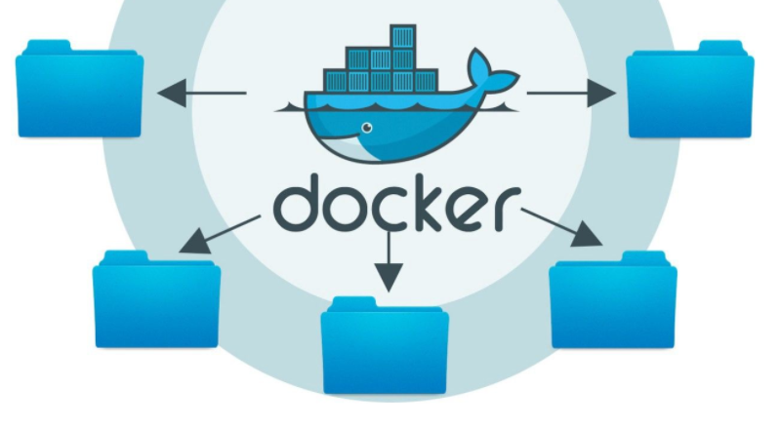
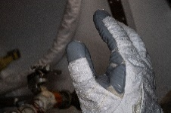
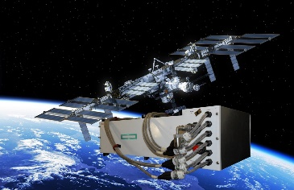
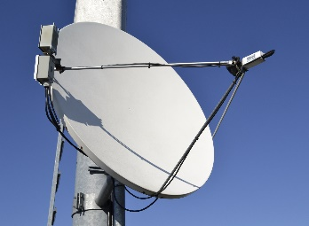
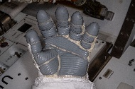
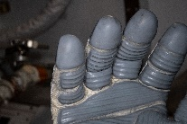
ISS SBC-2 Azure Sample Workflow
Machine Learning EMU Glove prediction
Post EVA Glove Photos on Payload NAS
MCC-H
Compares ground analysis, time taken to complete
Probability output file .csv
Ground Station
Azure Blob
Downloads from BLOB
script
ML Model
Agnostic ML Model
V. Low bandwidth network
Trained AutoML model (TF)
Dev & Test: ISS SBC2, HPE Ground station, and 2MB/s downlink simulator on Azure
Prod: ISS & HPE Ground station
DB
Dr. Fernandez (HPE)
HPE SpaceBorne Computer 2
International Space Station
HPE Ground Station
Notes:
Updated; showing SBC2 retrieving data from Payload NAS. No longer uplinking photos
Agnostic ML Model:
Developing process to use SBC-2 to do AI/ML on ISS, not just post EVA photo analysis
Possible to develop a model for CBM inspections prior to VV docking or other data analysis that could happen on ISS to help increase crew/vehicle autonomy prior to Artemis and Gateway.

Slide 15
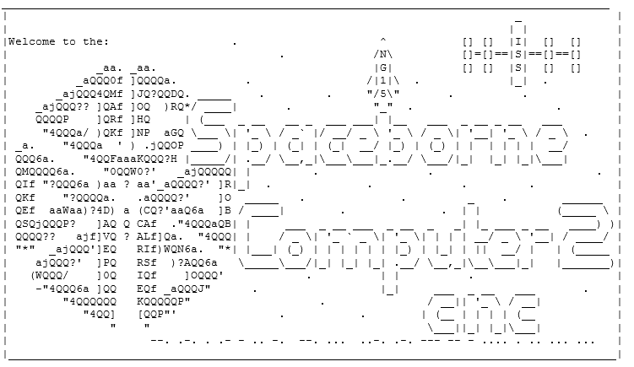
Results from ISS SBC-2
Deployed preliminary ML model for EMU glove inspections on ISS 16 DEC 2021.
Space Borne Computer 2 (SBC-2) completed the analysis of 61 images in 28 seconds.
Ground based takes 45 seconds to complete on an Intel i5 laptop
Used US EVA 76 images as a test set, all in jpeg format.
The results matched the predictions of the ground based analysis.
Second test to compare model iterations and show SBC-2 support multiple models executing at the same time.
Notes:
Utilized US EVA 76, cause at the time of packaging for the docker container being used, that was the latest EVA
For this test, the team had to uplink post EVA glove photos that were already downlinked; basically, had to round trip photos
Therefore we are asking for a shared folder on the Payload NAS, more about that later in the presentation.
We are discussing with SBC-2 the possibility of a second test to look at different iterations of our model, and different model architectures.
This second test would happen prior to the Spring EVA series

Slide 16
US EVA 78 Test results
Prior to SBC-2 test with “real-time” EVA data, the team realized all the testing up to now has used jpeg format images.
Ensure SBC-2 could handle the larger format images (~20mb)
Ensure Azure model would read larger images (cloud 6mb max)
Review for any differences from model output (NEF vs JPEG)
34 test Images analyzed
17 NEF format images – wanted to ensure SBC-2 could handle raw images prior to US EVA 79
17 JPEG format images – corresponding to the 17 NEF images, testing to see if there are differences between 2 formats; there are differences!
All 34 images were identified correctly to contain a glove – 100% on Glove detection model.

Slide 17
ML Approach

Slide 18
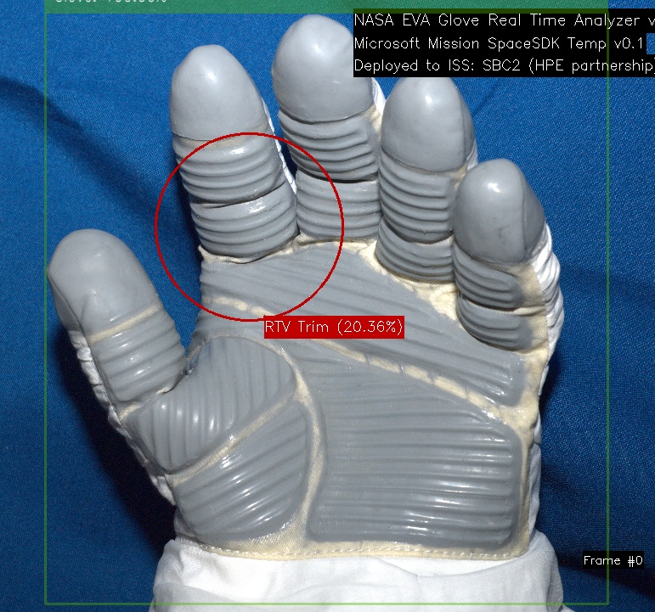
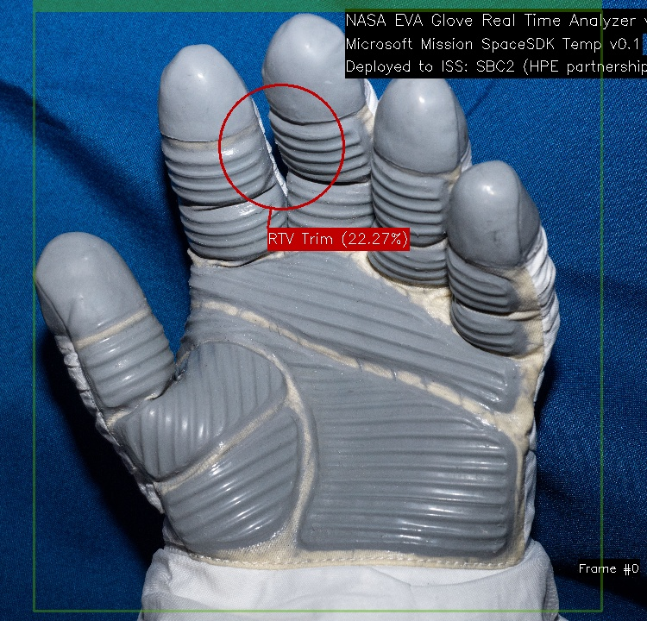
US EVA 78 Test results
Reminder: Due to upload image size (6MB) limitation, the model has been built using JPEG images. The NEF photo, with more data, was still a new form of photo, causing some discrepancies in the output.
ISS-GloveMonitor_iss066e085194_NEF_frame0
Note: This is a false positive case, there is no detectable damage in these photos.
ISS-GloveMonitor_iss066e085194_jpg_frame0

Slide 19
US EVA 79 Results
5.5GB of images, totaling 290 images (the download has 330 images, 34 US EVA 78, 6 turtle)
>6x the expected imagery (normally ~60 images, <1GB of images)
SBC-2 took 20 minutes to complete the analysis of the images (*NEF format) running compact model
Ran on 1 node in SBC-2, using 4 of 20 CPU's available for this analysis
290 images total in the analyzed set
82 images not EMU glove, or no EMU Glove visible in the image (helmet, boots..)
138 images false negative, missed by the Glove/No-Glove Model
14 false positive images – identified damage on a boot or some non-EMU glove item
178 images to analyze for damage (54%)
73 images reported some amount of damage

Slide 20
US EVA 79
The green box is the first model (object detection) to identify if there is an EMU Glove in the photo.
If the output of the Glove/No-Glove model passes a threshold, it will send the photo to the second model (object detection) for damage detection processing, identified in red.
In this image, "RTV Wear" was identified correctly, but the model is not very confident in it's finding.

Slide 21
False Positives
Correctly identified the right-hand glove.
However, Glove model identified the helmet as a glove with 89% confidence. This is an issue!

Slide 22
Summary
Photos, existing data, were applied to modern Machine Learning techniques to test and construct a potential framework for Lunar and Mars missions.
This approach could be applied to more areas of the human centric systems for deep space missions, opening the possibilities for a trusted AI framework.
Developed a data pipeline utilizing a commercial Machine Learning platform to potentially improve the speed in which recommendations are made for continued use of EMU gloves on ISS; demonstrating the use of ISS as a testbed for further, deep space applications.
Forward work
Continue to iterate on models to improve accuracy and confidence in damage detection.
Test model deployment on available lower power platforms.
Test HD video of glove inspections during ISS US EVAs
Integrating into various field test for different and additional imagery sets.

Slide 23
Thank You

