Slide 1

Balancing Crew and Mission Design Parameters
Donna L. Dempsey, Ph.D.
Cynthia H. Null, Ph.D.
November 2022

Slide 2
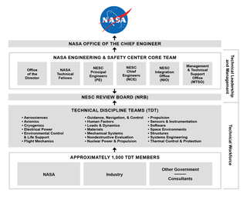
NESC Overview
Mission Statement
  The NASA Engineering and Safety Center’s (NESC) mission is to perform value-added independent testing, evaluation, and assessments of NASA’s high-risk projects to ensure safety and mission success.
Organizational Structure
  At the core of the NESC is an established knowledge base of technical specialists with a diversity of expertise pulled from NASA Centers and external partner organizations.
Technical Excellence
  NESC cultivates a safety culture focused on engineering and technical excellence across a breadth of disciplines and systems, while fostering an open environment and attacking challenges with unequalled tenacity.

Slide 3
Background
In early 2020, the office of the AA for HEO requested that the JSC Crew Health and Safety office conduct a quick assessment of crew size (number of crew) for a mission to Mars.
This NESC assessment will develop a new Agency capability for performing trade space analysis for crew size for future missions to Mars, including developing task analysis model(s) using an existing military framework, IMPRINT.

Slide 4
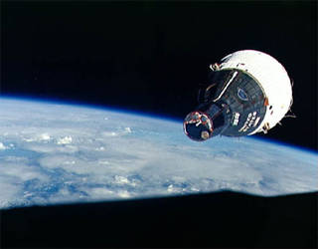
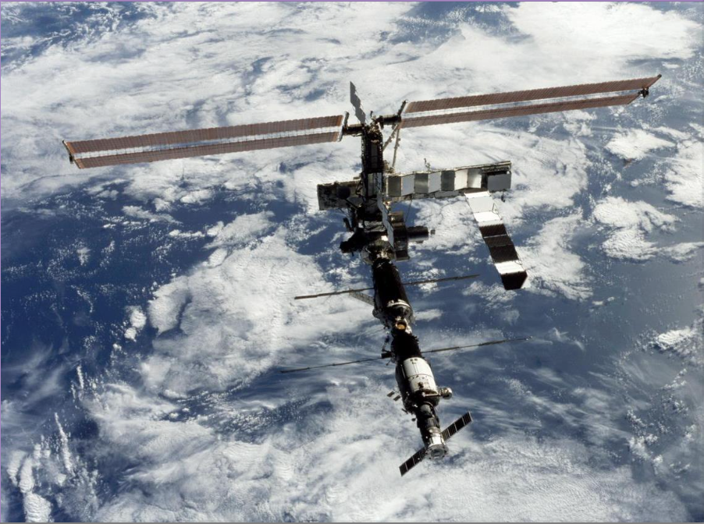
Historical Missions
Based on launch vehicle capability
Project Mercury: 1-person crew
Gemini: 2-person crew
Apollo: 3-person crew
Skylab: 3-person crew
Shuttle: 2-to-8-person crew
International Space Station: 6-or-7-person crew
Credits: NASA

Slide 5
Mars Mission Plans
Based mostly on vehicle capability with some thought given to roles of astronauts
1952: Wernher von Braun and collaborators publish a plan for a mission with a 70-person crew, scaling down to a 12-person crew in a later paper
1959-1971: Studies at multiple NASA centers suggest crews of 5 to 15 people
1970’s,80’s,90’s, and 2000’s : Sparse (mostly external) proposals for a crew of 4 to 6 and Mars Design Reference Missions propose crews of 4 to 6
Current guidance: crew of 4

Slide 6
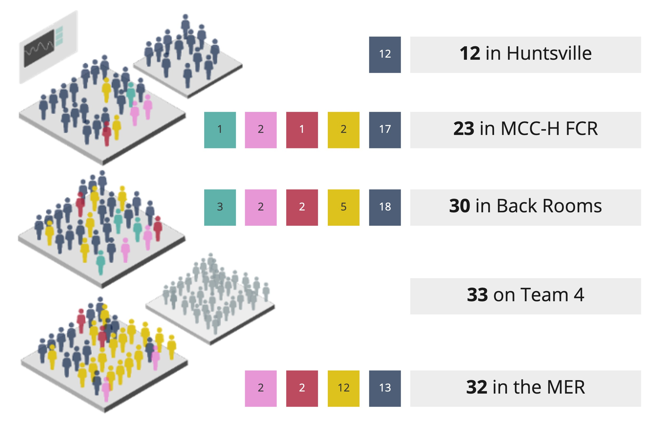
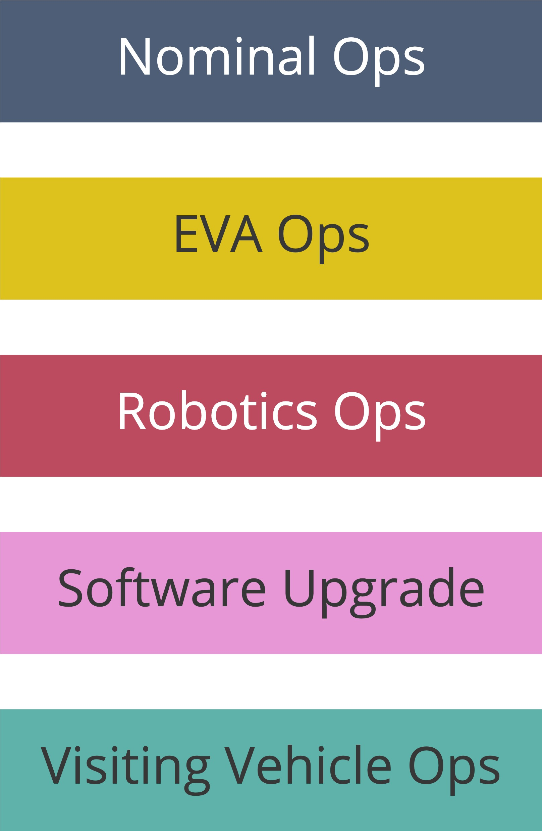
Mission Control Center (MCC)
Panontin, T. L., Wu, S. C., Parisi, M. E., McTigue, K. R., & Vera, A. H. Human-Systems Integration Architecture Needs Analysis: On-Board Anomaly Resolution During Autonomous Operations.

Slide 7
NESC Approach: Human Performance Modeling
Task and model-based approach to develop a systematic, repeatable process for trade space analysis using the IMPRINT human performance modeling platform to study human systems integration concerns, such as:
  Given critical mission tasks, what is the mental workload associated with these tasks?
  What level of manpower or level of engagement is associated with longer mission segments?
  How effective are the interactions of human operators with automated systems?
  What level of expertise and associated training is needed for successful operations?

Slide 8
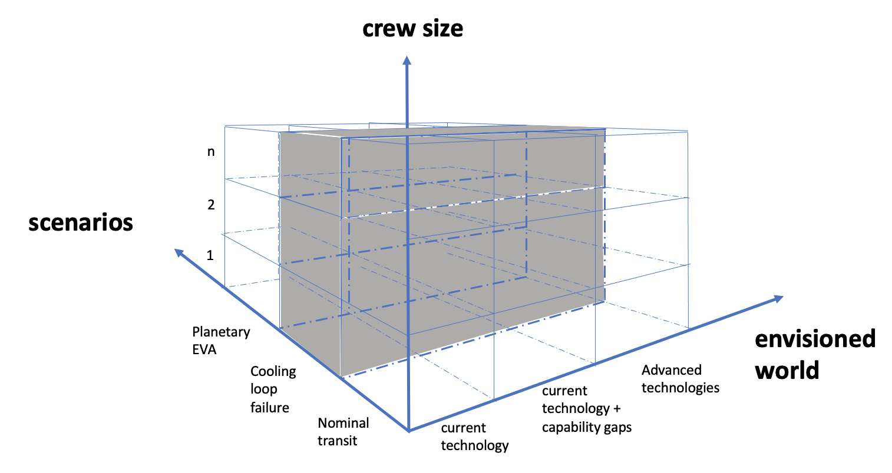
NESC Approach: Methodology
The approach for performing trade space analysis for crew size for future missions to Mars is based on work by Militello et al. (2018, 2019, 2020) and can be framed by considering the following:
The Envisioned World*
  A description “intended to provide the necessary contextual knowledge about the future environment” when considering the crewing configuration for future missions (specifically, the spaceflight environment (incl. communication infrastructure), vehicle capabilities, and mission objectives).
Mission Tasks
  Especially considering tasks or mission segments that likely require high mental workload, high manpower, or a high level of expertise in such a way that may drive crew size requirements.
Crew Size (as part of the Crewing Configuration)
  Where a “crewing configuration” is an allocation of functions among different agents in a complex system.
(as part of the crewing configuration)
mission
tasks
Robotics Operations
Upgraded comm.
Transit
Current technology plus capability gaps
The crewing configurations for each mission task or segment modeled allow for informed decision-making in the trade space.
*The envisioned world may also be referred to as the projected operational environment.

Slide 9
Envisioned World
Spaceflight Environment | Deep Space and Planetary Surface Spaceflight Hazards Five main hazards identified by NASA’s Human System Risk Board (HSRB) are: 1) Altered gravity, 2) radiation, 3) isolation and confinement, 4) hostile, closed environment, and 5) distance from Earth. The distance from Earth is the most relevant for this assessment. Communication Infrastructure (as described on the next slide)
Vehicle Capabilities | HEO Documentation, Exploration Capability Gaps, with ISS and Other Current Vehicles as a Baseline (We are modeling planetary surface EVA and transit to Mars timelines. We are not modeling ascent/entry, Surface Rover operations, or Surface Habitat operations.)
Mission Objectives | Mission Goals for First Mission SAC21 Mars ADD To land humans on the surface of Mars and return them, and their return cargo, safely to Earth Science Goals SAC21 Mars ADD To land humans on the surface of Mars to search for signs of extant life (i.e., life that still exists today) (Detailed goals such as utilization hours will be baselined from ISS and Apollo.)

Slide 10

Envisioned World: Communication Infrastructure
not always continual
24x7 continual comm.
dedicated Mars relay
daily one-way comm. windows
24x7 continual comm.
dedicated Earth assets
dedicated Mars to Earth relay
Current Infrastructure
No 24x7 comm. with Earth; instead, a dedicated window of time daily (~4 to 8 hours), delayed between ~4 to ~22 min.
Not always continual comm. between crew in orbit and crew on surface
Complete comm. blackout for a 1-to-2-week period when Mars passes through superior conjunction (Mars is on the opposite side of the Sun from Earth)
Upgraded Infrastructure
Dedicated Earth assets providing 24x7 comm., delayed between ~4 to ~22 min.
Relay in Mars orbit for continual comm. between crew in orbit and crew on surface
Dedicated relay between Earth and Mars allowing for low data rates when Mars passes through superior conjunction
Per interviews with personnel from SCaN (Space Communication and Navigation).
Notes:
Image credit: https://mars.nasa.gov/all-about-mars/facts/

Slide 11
Mission Tasks: Crew Master Task List
Compile list from ISS Training Needs Analysis (TNA), Generalizable Skills and Knowledge for Exploration Missions, other sources, additions from NESC team
Interview Mission Control Center (MCC) personnel to understand what duties they currently perform that would have to be transferred to the crew configuration*.
Sources:
  Generalizable Skills and Knowledge for Exploration Missions NASA/CR-2018-220455
  ISS Training Needs Analysis (16 ISS Systems)
  Artemis Training Needs Analysis
  Gateway Master Task List
  Reference Surface Activities for Crewed Mars Mission Systems and Utilization HEOMD-415 Version 1
  Mission Control Center (MCC) flight control interviews
*where a “crewing configuration” is an allocation of functions among different agents in a complex system

Slide 12
Mission Tasks: Critical Tasks or Mission Segments
Tasks or mission segments that likely require high mental workload, high manpower, or a high level of expertise in such a way that may drive crew size requirements.
Scenarios selected were based on previous research by Holden et al., and interviews with SMEs. The scenario list was down-selected considering the criticality of the task or mission segment and the IMPRINT modeling requires of a timelines to model level of engagement and detailed procedures to model mental workload. The following critical mission tasks or mission segments are included in this effort:
  Conduct Transit to Mars
  Conduct Planetary Surface EVA
  Respond to Automation Failure
  Respond to Unanticipated Major Malfunction
Holden, K., Munson, B., Russi-Vigoya, N., Dempsey, D., Adelstein, B. (2019). Human Capabilities Assessment for Autonomous Missions (HCAAM) Phase II: Development and Validation of an Autonomous Operations Task List Final Report.

Slide 13
Conduct Transit to Mars Model
Background | ISS crew scheduling is well understood Mars Transit crew will need to perform ISS tasks as well as MCC tasks reallocated to the crewing configuration for both nominal and off-nominal scenarios Include likely maintenance and repair, baselined from ISS Include likely medical events and their impact on the crew What crewing configuration is needed for for the Mars transit?

Slide 14
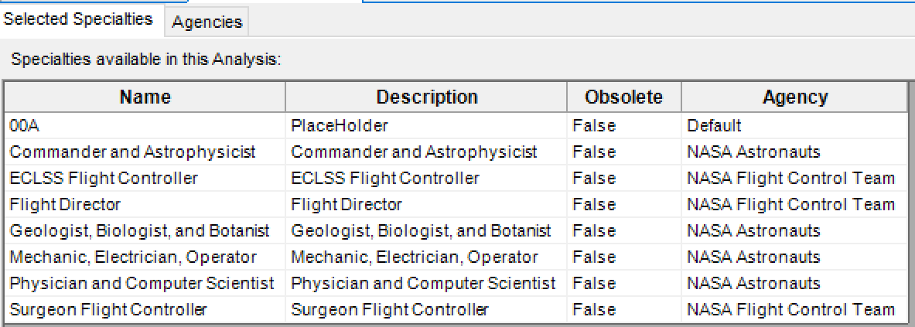
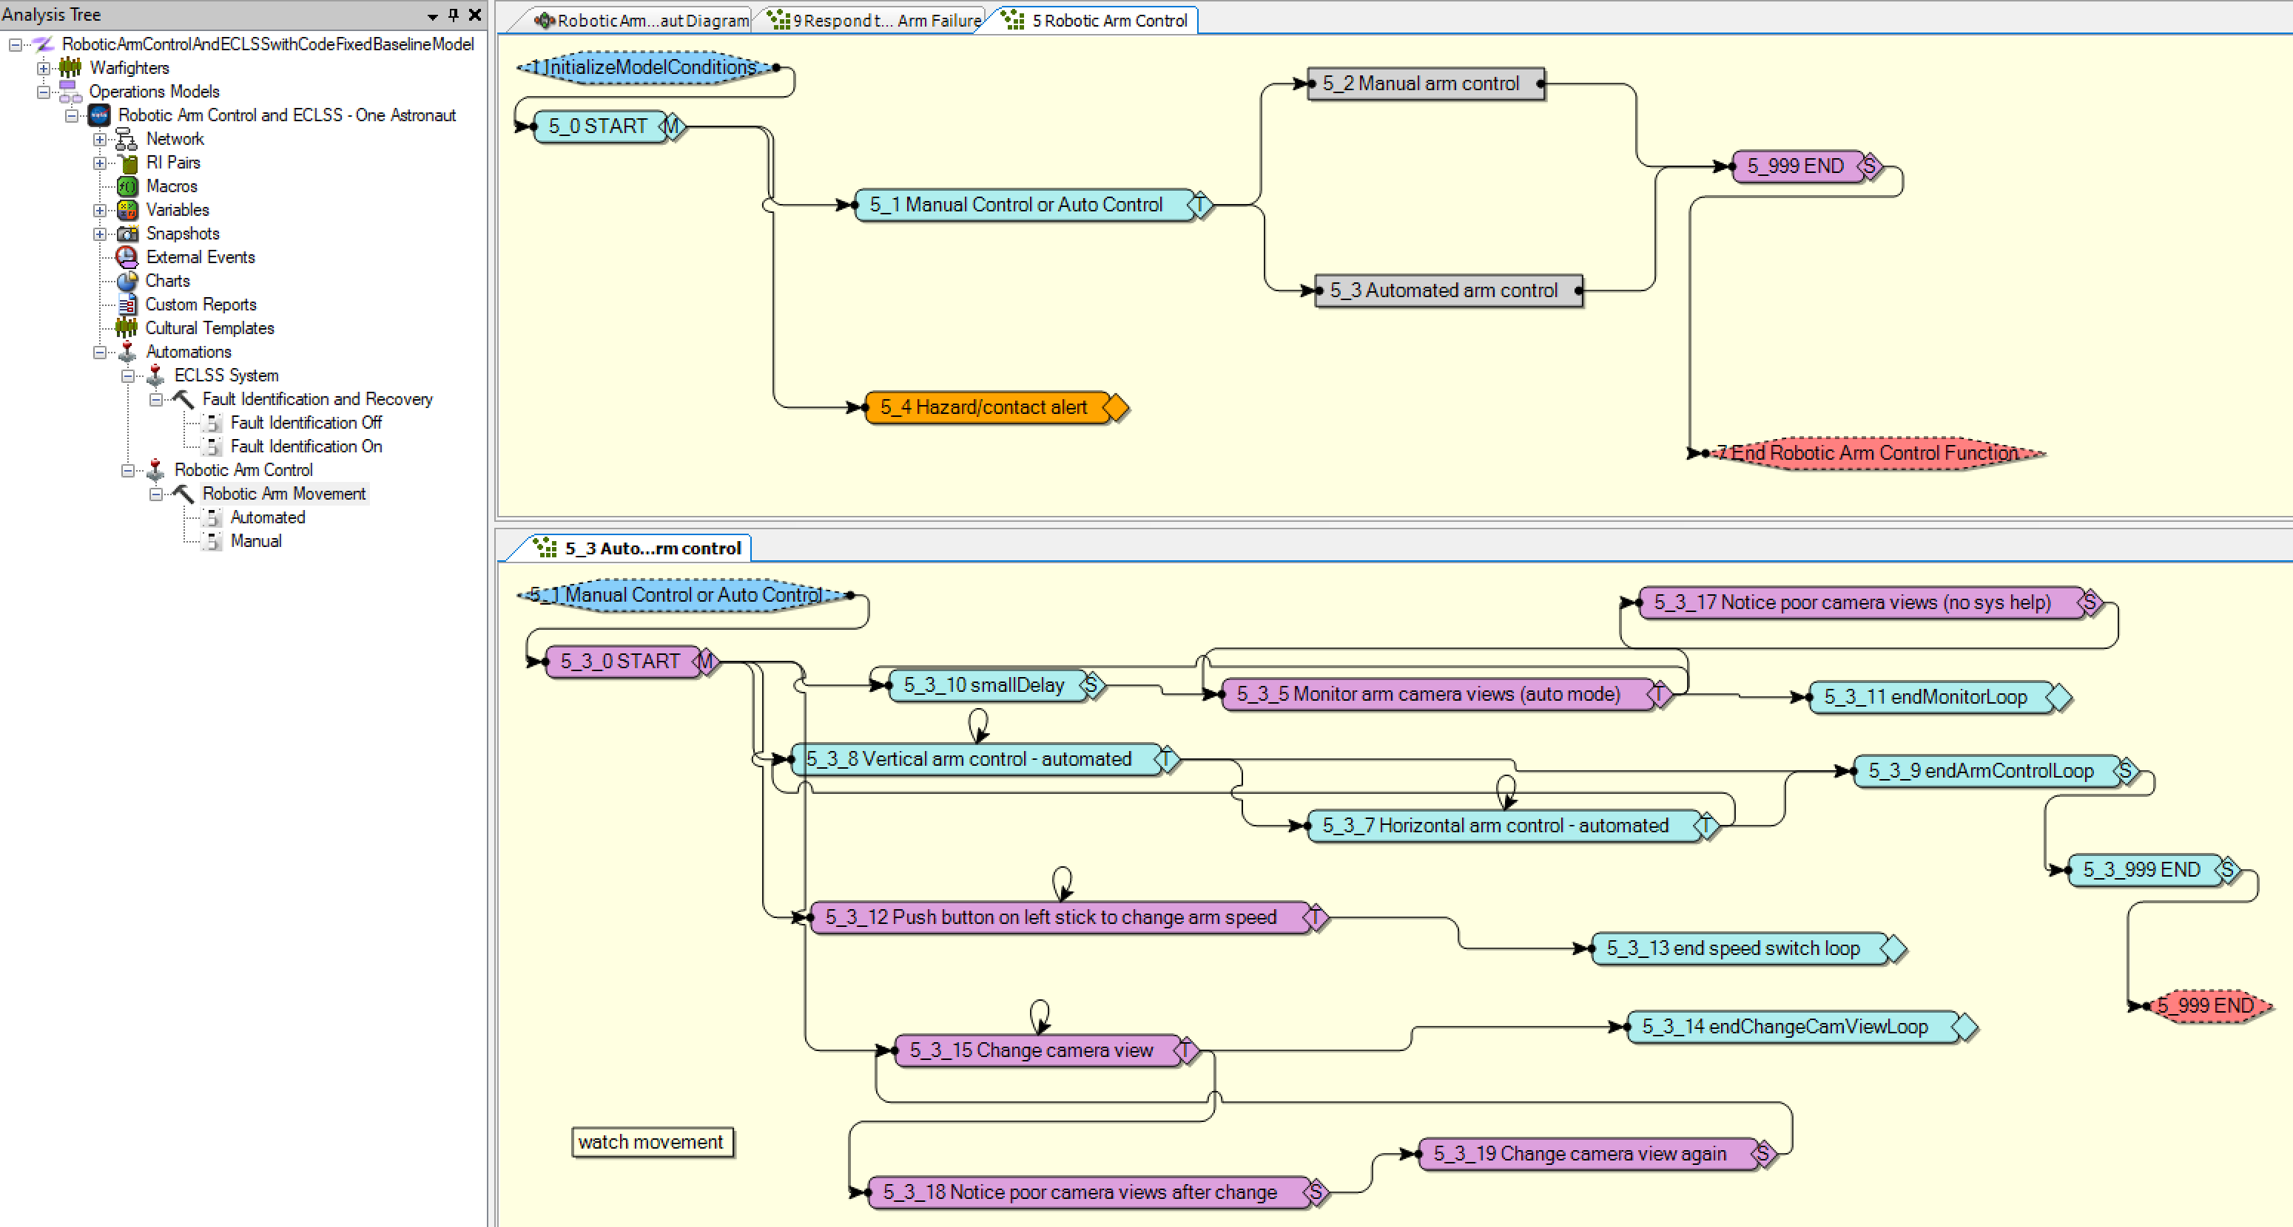

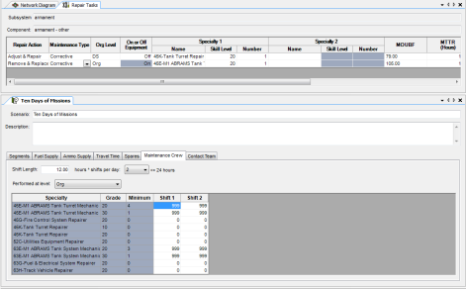
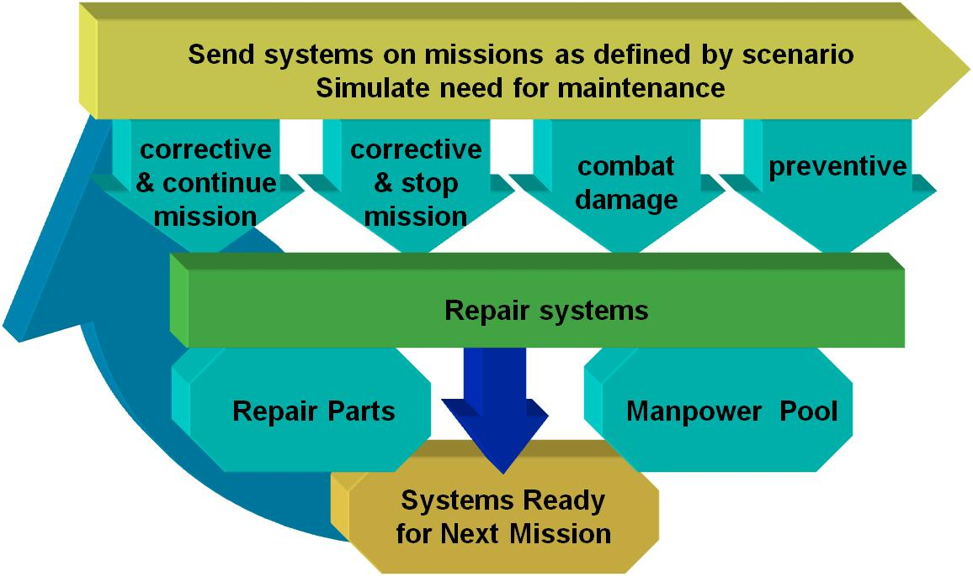
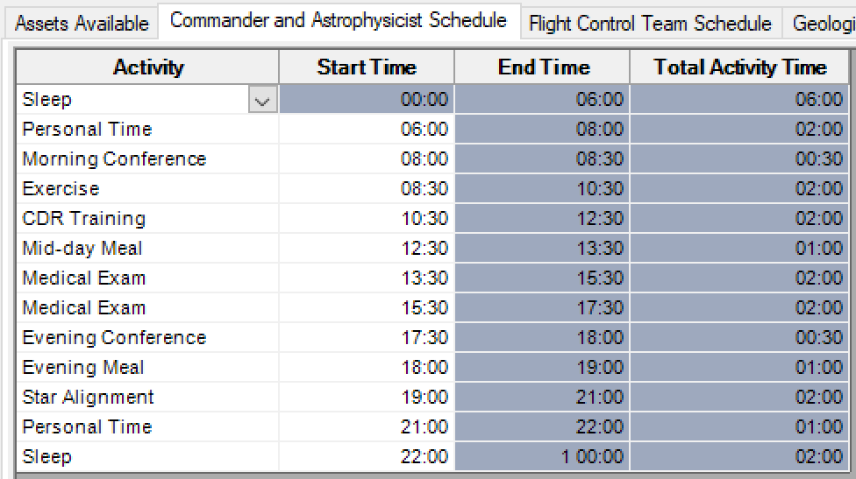
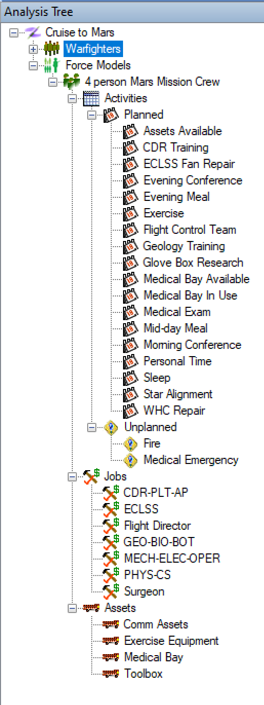
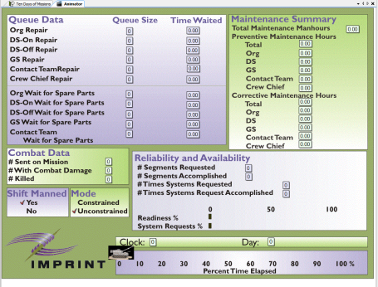
Modeling Using IMPRINT
IMPRINT consists of four modules. This assessment will focus on the Operations and Manpower modules.
IMPRINT Force Model
Models level of engagement
Personnel Modeling Operators
Operations Modeling
Missions
Maintenance Modeling
Equipment
Manpower Modeling
Forces

Slide 15
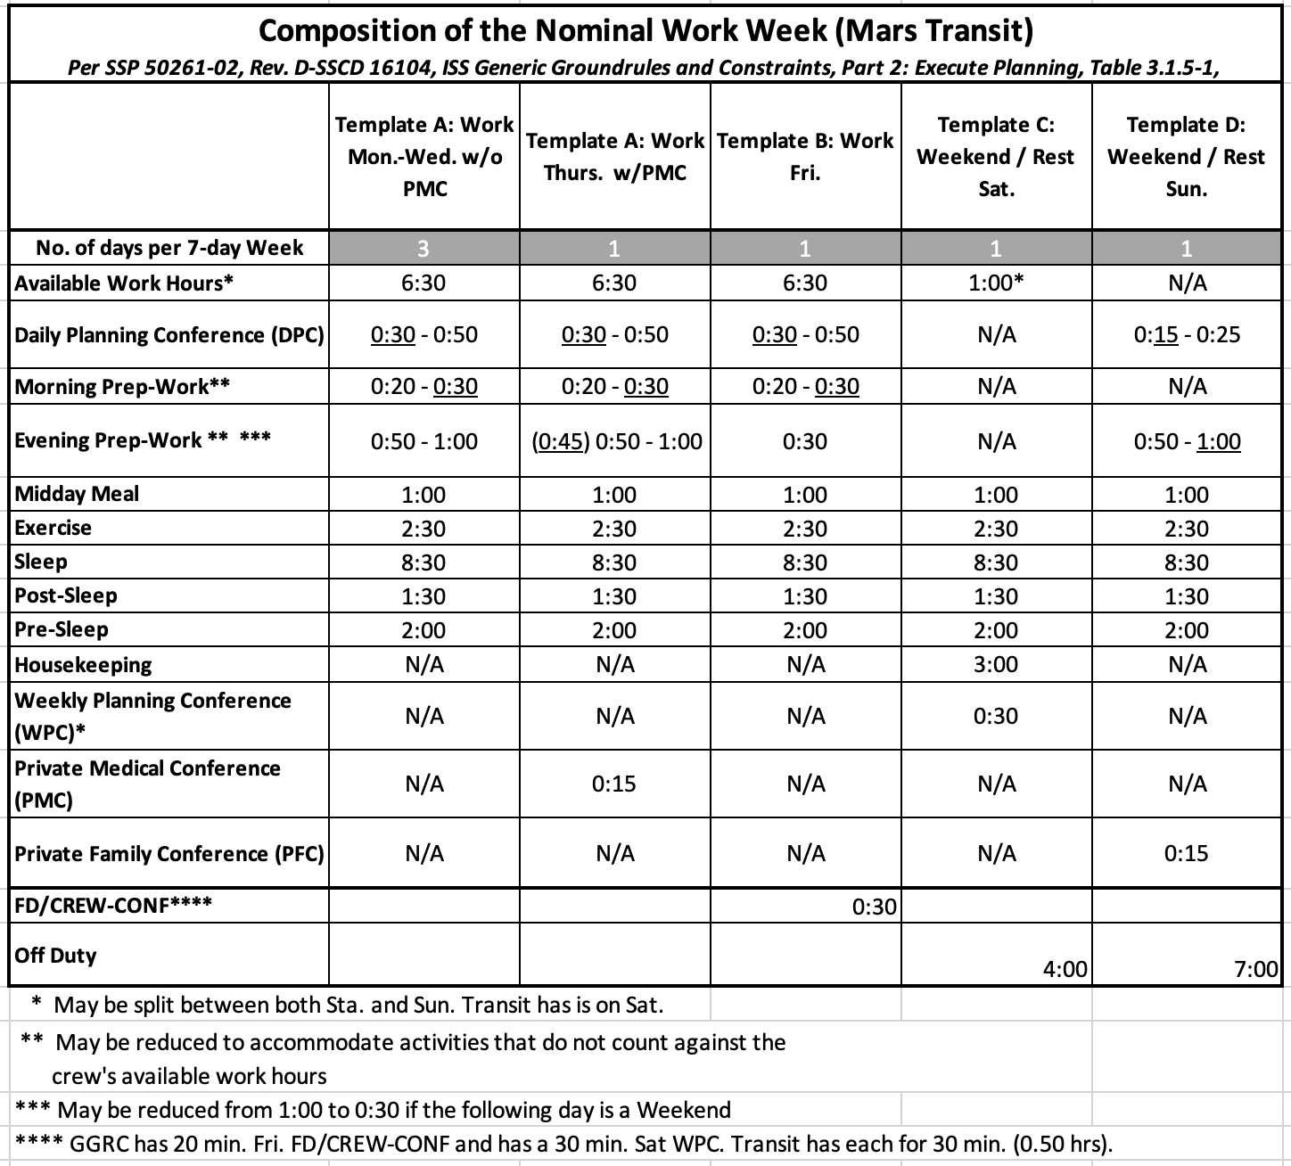
Data Collection
Baseline schedule for Mars transit crew
Developed from the ISS GGR&C crew and from the Mars Architecture Team (MAT) composition of work week tables

Slide 16
Data Collection
Assumptions for Mars:
MCC is prime for nominal planning (alternately, for crew behavioral health, some planning to crew).
MCC is prime for nominal commanding with a comm. delay.
MCC is prime for resource allocation (e.g., power, thermal, bandwidth, data, 0₂, N₂ vacuum access, …).
MCC is prime for console analytic tools that can be performed with a comm. delay.
Crew is prime for commanding for tasks requiring real-time or near real-time verification.
Crew is prime for tasks with time constraints.
Crew is prime for go-no-go calls requiring real-time data (e.g., crew lock depress).
Crew is prime for tasks requiring real-time monitoring (e.g., some robotics operations).
Crew is prime for tasks requiring real-time communication (e.g., IV crew).
Crew is prime for tasks with bandwidth limitations.
Crew is prime for console analytic tools impacted by the comm. delay or bandwidth limitations.
Crew is prime for emergencies, warning, and all cautions.
Crew is prime for cleanup steps that match the nominal task assumptions (e.g., requires real-time data, has a time constraint).
All crewmembers will stay on the same sleep schedule, unless one of the above requires them to be awake.

Slide 17
Conduct Transit to Mars Model
Objectives | Perform 40 hours (from ISS baseline) of science during nominal transit Maintain 8.5 hours of sleep at the same time each night (level of engagement)
Trade Space (in addition to number of crew) | Capabilities / technologies to consider in the trade space: Allocate human functions to automation (Agency capabilities gaps) Allocate human functions to advanced technologies
Data Sources | ISS Program Office as-run ISS mission timeline data Structured interviews with SMEs and scaled survey responses LaRC sustainability modeling data Integrated Medical Model (IMM) data ISS Generic Ground Rules & Constraints

Slide 18
Conduct Planetary Surface EVA Model
Background | EVA crew scheduling is well understood Martian surface EVAs and possibly transit vehicle maintenance EVAs will occur during these missions Martian EVAs will need to be primarily supported by intravehicular (IV) crew due to communication delay What crewing configuration is needed for an IV crew to support an EVA?

Slide 19
Modeling Using IMPRINT
IMPRINT Operations Model
Models mental workload
Personnel Modeling Operators
Operations Modeling
Missions
Maintenance Modeling
Equipment
Manpower Modeling
Forces

Slide 20
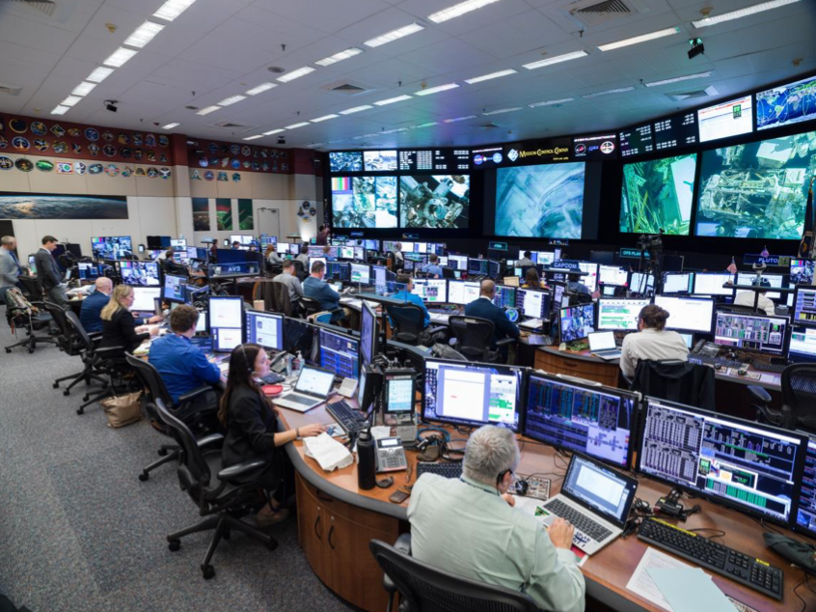
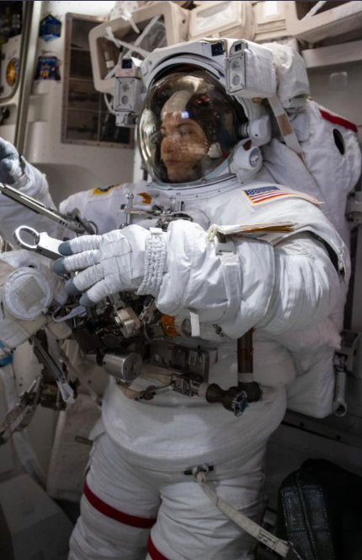
Data Collection
Interview MCC Personnel working EVA 79
Analyze Voice Loops for EVA 79
Analyze Timeline and Procedures
Duration and frequency of tasks
Difference during nominal and off-nominal operations
Credits: NASA

Slide 21
Conduct Planetary Surface EVA Model
Objectives | Maintain mental workload of IV crew below overload threshold
Trade Space (in addition to number of crew) | Capabilities / technologies to consider in the trade space: Allocate human functions to automation (Agency capabilities gaps) Allocate human functions to advanced technologies Discussion on communication assets
Data Sources | ISS EVA 79 ISS Program as-planned and -executed ISS EVA timeline data Structured interviews with SMEs SMA Flight Safety Office Significant Incidents & Close Calls in Human Spaceflight: EVA Operations

Slide 22
Respond to Automation Failure Model
Background | ISS flight controllers monitor vehicle systems The Mars crew may be tasked to perform robotic arm operations using various levels of automation while also monitoring vehicle systems such as the environmental control and life support system (ECLSS). How does human-automation- interaction inform the crewing configuration?

Slide 23
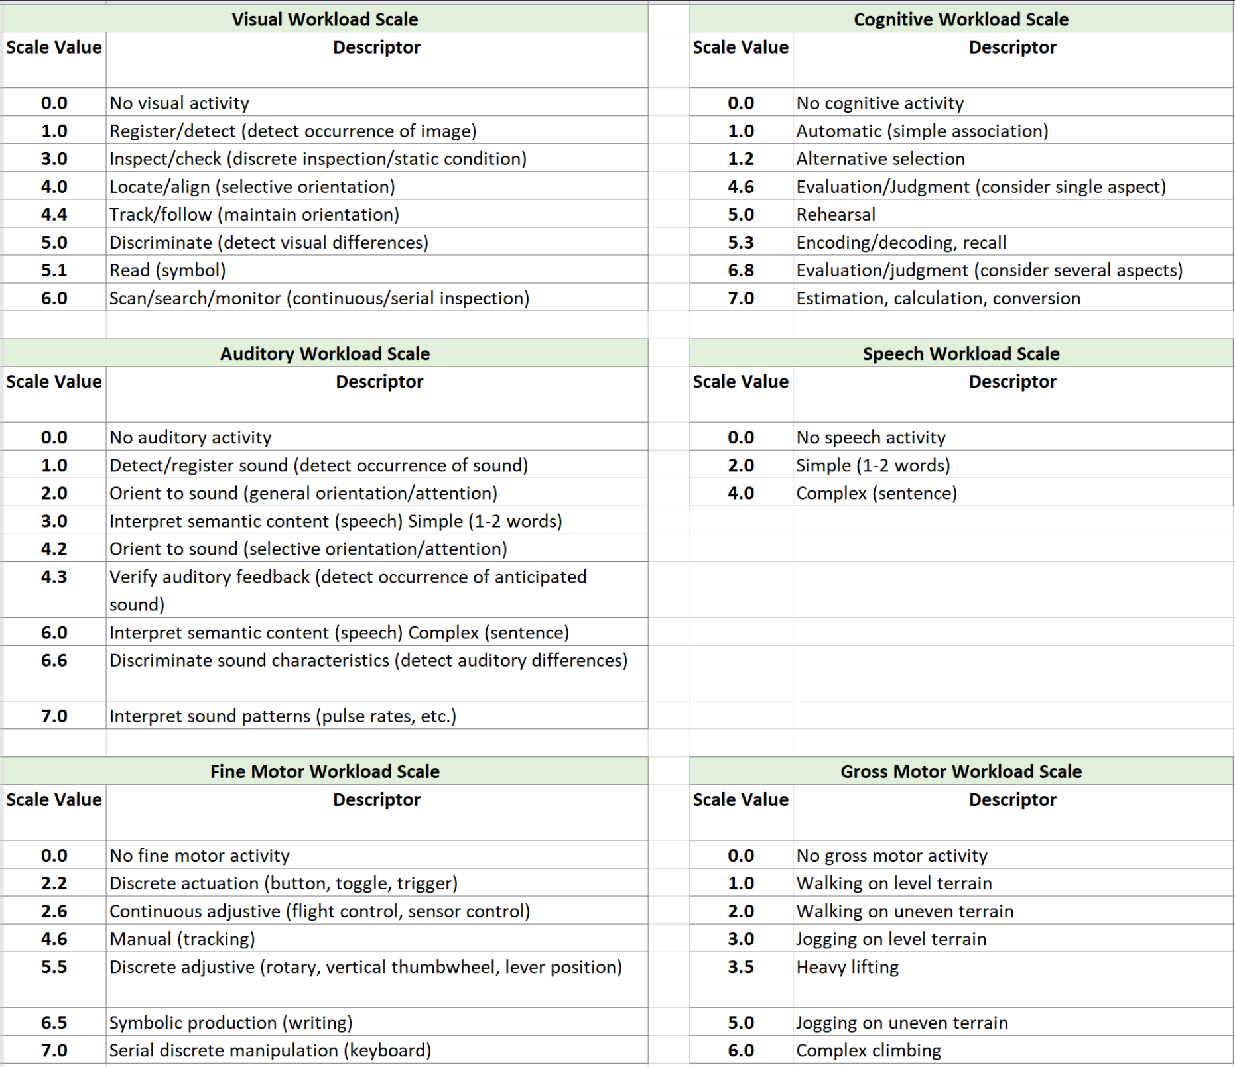
Modeling Using IMPRINT
IMPRINT Operations Model
Models mental workload based on multiple resource theory using sensory/movement benchmarks

Slide 24
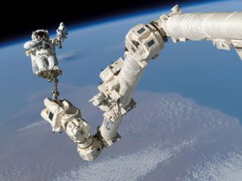
Data Collection
Interview On-Orbit Crew working EVA 80
Analyze Voice Loops for EVA 80
Analyze Timeline and Procedures
Duration and frequency of tasks
Difference during nominal and off-nominal operations
Assess Mental Workload
Visual workload and complexity of visual stimuli
Cognitive workload
Fine Motor workload (writing or typing)
Auditory workload
Amount of different overlapping stimuli
Credits: NASA

Slide 25
Respond to Automation Failure Model
Objectives | Conduct external Robotic Arm operations within a specified time and without damaging incidents, both with automation assistance and without automation assistance Maintain ECLSS parameters within normal limits. Maintain mental workload robotic arm operator below overload threshold
Trade Space | Capabilities / technologies to consider in the trade space: Level of Robotic Arm control assistance provided Level of ECLSS fault identification and recovery automation assistance provided Crew sleep profile
Data Sources | ISS EVA 80 ISS Program as-planned and -executed ISS EVA timeline data Structured interviews with SMEs S-PRINT: Development and Validation of a Model-Based Tool to Predict Astronaut Performance in Workload Transitions NASA Grant NNX12AE69G

Slide 26
Crew Size (as part of the crewing configuration)
Modeling Outputs
Model outputs are mental workload (IMPRINT Operations Modeling)
Level of engagement (IMPRINT Forces Modeling)
Modeling Process
Model scenarios for a crew of 4**, based on the anticipated technologies in the envisioned world and the allocation of tasks for a given scenario
For outputs that exceed the mental workload or level of engagement thresholds, then model the scenario for an increased crew size
Model advanced technologies that may offload crew tasking and potentially reduce crew size
Crewing Configuration Recommendations
Conduct SME review of crewing configurations for each scenario and set of assumptions about the envisioned world
* Crewing Configuration - an allocation of functions among different agents in a complex system, where an agent can be a human (crew, ground support), hardware (e.g., vehicle systems, robotic agents), or software (e.g., automation or intelligent systems).
** Based on HEO-DM-1002

Slide 27
Respond to Unanticipated Major Malf. Model
Background | ISS flight controllers are trained for years as experts on vehicle systems and with real-time comm. for ISS missions, MCC is readily available to respond to unanticipated failures The HSIA Risk custodian has determined that there are ~1.7 unanticipated failures per year on ISS Mars crew will likely need to respond to an unanticipated failure without the real-time support provided by MCC How does the necessary level of expertise needed to respond to such failure real-time inform crew size?

Slide 28
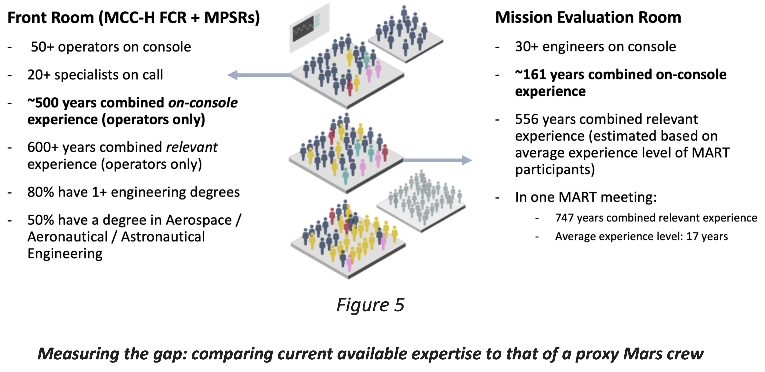
Mission Control Center – Houston (MCC-H)
Panontin, T. L., Wu, S. C., Parisi, M. E., McTigue, K. R., & Vera, A. H. Human-Systems Integration Architecture Needs Analysis: On-Board Anomaly Resolution During Autonomous Operations.

Slide 29
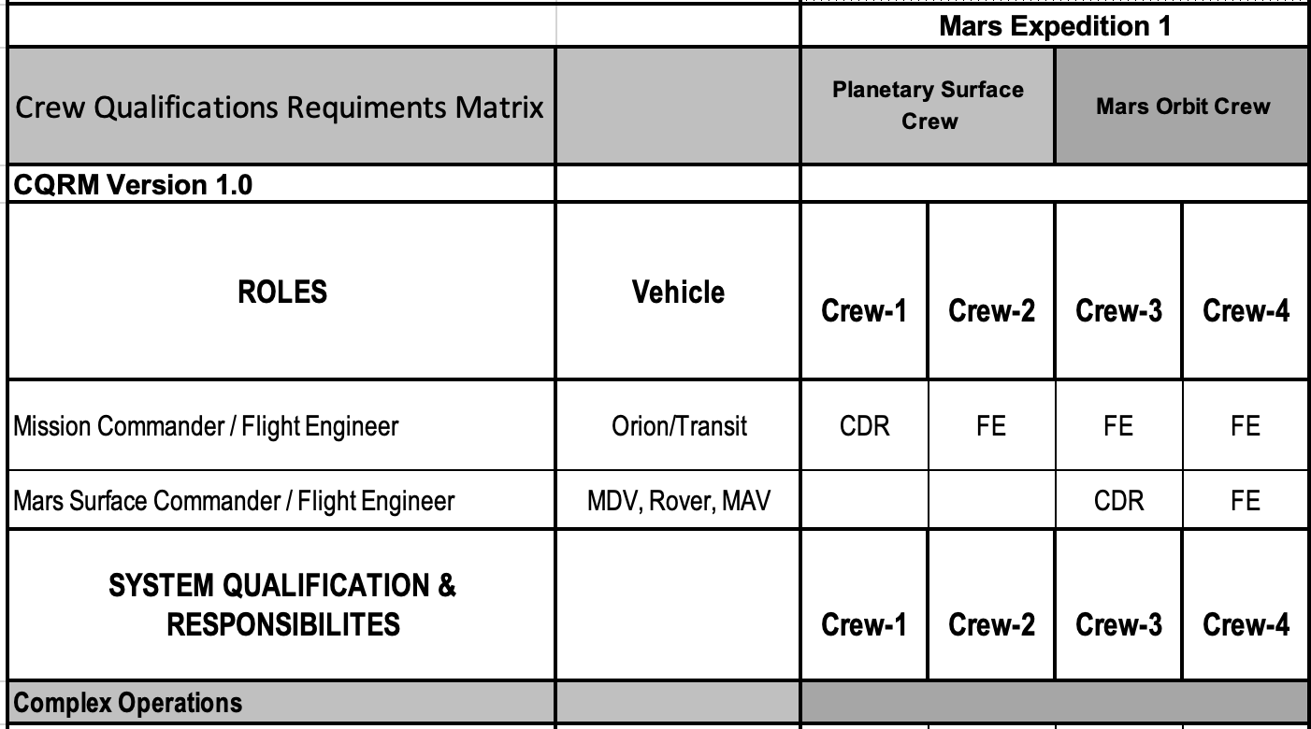
Data Collection
Mars Crew Task List
ISS Crew Training Data
MCC Flight Controller Training Data
Crew Qualification Requirements Matrix
ISS Program Timeline Data

Slide 30
Respond to Unanticipated Major Malf. Model
Objectives | Determine a recommended crew size given the allocation of duties and tasks across the crewing compliment that supports the expertise required to successfully complete the missions and most critically respond to unanticipated failures
Trade Space (in addition to number of crew) | Capabilities / technologies to consider in the trade space: Allocation of duties and tasks given crew workday Allocation of expertise given training time(s) Additional comm. assets (during comm. blackout) Operational considerations (level of real-time expertise)
Data Sources | Mars Master Task List ISS Training Data Panontin, T. L., Wu, S. C., Parisi, M. E., McTigue, K. R., & Vera, A. H. (2022). Evidence Base Building for the Risk of Inadequate Human-Systems Integration Architecture. Valinia, A., Allen, J. R., Francisco, D. R., Minow, J. I., Pellish, J. A., & Vera, A. H. (2022). Safe Human Expeditions Beyond Low Earth Orbit (LEO). NASA/TM-20220002905, NESC-RP-20-01589.

Slide 31
Discussion
The final crewing configuration recommendations allow for informed decision-making in the trade space, including decisions on
  Crew size and expertise
  Communication infrastructure
  Prioritization of technologies that support human task performance
This trade space analysis capability may be informed by or inform Mars mission designs as well as Human System Risk Board (HSRB)-managed risks, including the HSIA, Team, Medical, EVA, and Behavioral Health risks.

Slide 32
Summary
The NESC is conducting an assessment to develop a new Agency capability to conduct trade space analysis for future missions to Mars based on human performance task analysis modeling.
Deliverables include:
  A methodology for systematic, repeatable trade space analyses
  An initial set of task analysis models for critical SME-identified mission segment, including assumptions for each model
  A trade space framework for assessing the trade space
  The first trade space analysis, with findings, observations, and recommendations (FORs) on crewing configurations for future missions to Mars

Slide 33
Assessment Team
Assessment Core Team
  Dr. Cynthia Null, NESC Technical Fellow for Human Factors
  Dr. Donna Dempsey, Technical Lead
  Dr. Alan Hobbs
  Dr. Zhaofeng Carl Huang
  Dr. John Karasinski
  Dr. Kara Latorella
  Dr. Ruthan Lewis
  LCDR Amanda Lippert (USN)
  Chris Niemann
  Peter Robinson
  Robert Sargent (HII)
  Thera Shear-Tungol
  Terence Tyson
NESC Business Management and Assessment Support Team
  Becki Hendricks
  Melissa Strickland
  Jenny Devasher
FOD and HHPD SME Support
In addition to core team members, JSC’s Flight Operations Directorate (FOD) and Human Health and Performance Directorate (HH&PD) are providing SME support for each of the models.

