Slide 1

Fostering Open Science Through Analysis Working Groups (AWGs)
Lovorka Degoricija, PhD
GeneLab Science Communications Lead
KBR
NASA Ames Research Center
Notes:
Good afternoon, everyone. My name is Lovorka and I am the Science Communications Lead for NASA’s GeneLab project. Today I will be providing a brief introduction to GeneLab’s Analysis Working Groups and how GeneLab is able to foster open science through these AWGs.

Slide 2
Connecting the World Through Science
2014
GeneLab is born
2018
2021
GeneLab AWGs created with 200+ volunteer international scientists
AWGs keep expanding to include 400+ volunteer international scientists
Created ALSDA AWG
2022
AWGs grow to 600+ volunteer international scientists
AWGs include Animal, Plant, Microbes, Multi-Omics
Create AI/ML AWG
Monthly meetings to analyze data in the GeneLab repository
Attend annual meetings and workshops
Notes:
In 2018, GeneLab formed a space biology community, called the Analysis Working Groups, of around 200 international scientists. The aim of the AWGs is to provide feedback on processing pipelines and essential metadata, while maximizing scientific return on space experiments to quicken the pace of new knowledge and discovery. With a focus on molecular “omics,” the original four AWGs organized into separate animal, plant, microbes and multi-omics AWGs. In 2021, a new community of researchers formed the ALSDA (Ames Life Science Data Archive) AWG to standardize phenotypic data. Since then, the AI/ML (Artificial intelligence/machine learning) AWG has formed, bringing the total number of volunteer international scientists to over 600.
Each individual AWG meets on a monthly basis to analyze data in the GeneLab repository and attend annual meetings and workshops to promote the work being done in their groups and provide feedback on data system improvements.

Slide 3
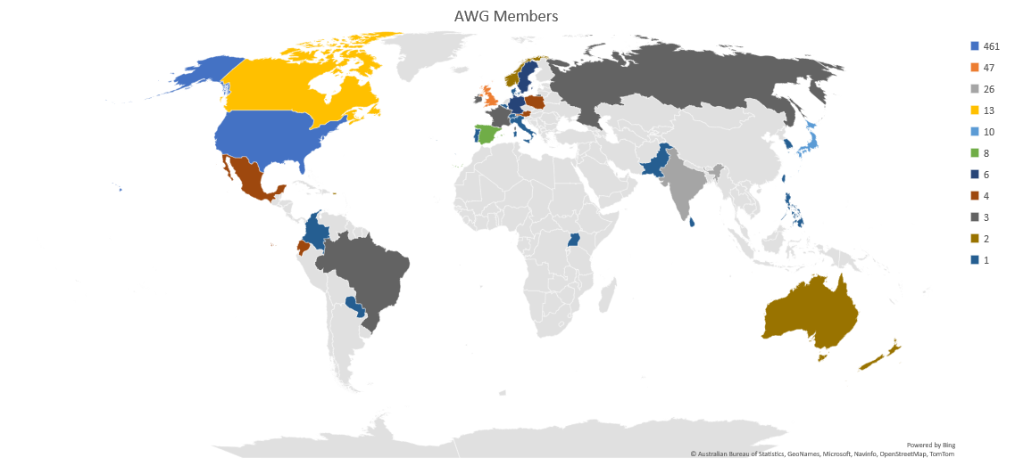
Who are the AWGs?
Notes:
The AWG community is a collection of volunteer international scientists that stem from 37 countries around the world with most coming from the US, UK, India, Canada, and Japan.

Slide 4
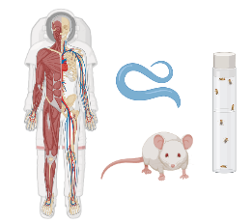
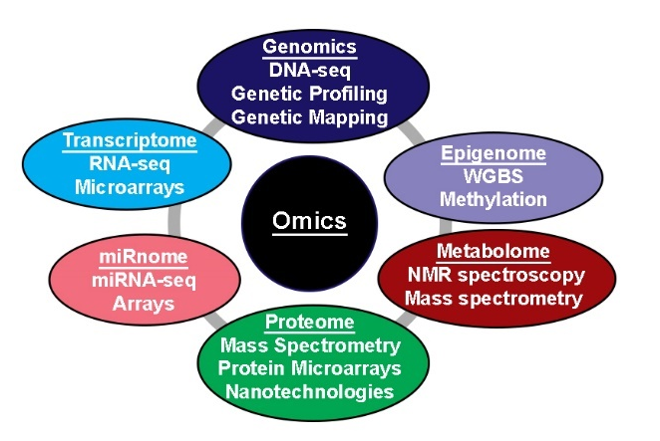
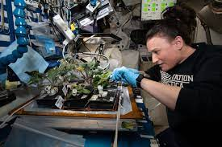
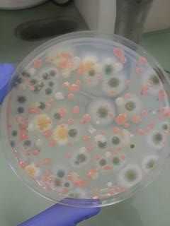
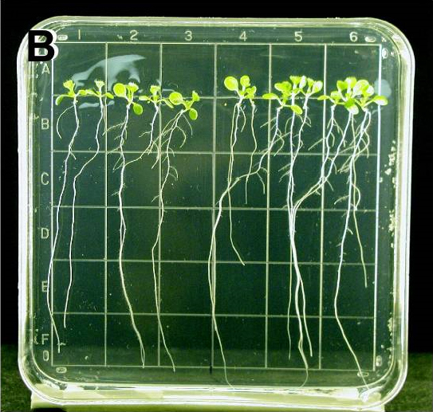
Original AWGs
ANIMAL
MULTI-OMICS
79 members
Facilitates the use of omics in understanding basic mechanisms by which animals and constituent tissues and cells adapt to the spaceflight environment.
259 members
Interactions between the different omics to provide a better understanding of the systemic response.
PLANTS
MICROBES
66 members
Share and discuss the latest developments in AstroBotany – the discipline of botany concerned with interactions between plant biology and space environment.
61 members
Focuses on analyzing microbial datasets within GeneLab that includes gene-expression, proteomic, metabolomic and environmental metagenomic datasets.
Notes:
It is well known that the space environment poses many risks for space faring humans. Understanding how the space environment affects biology is crucial for safe and effective crewed space exploration. To help expedite this knowledge, the AWGs help analyze GeneLab omics data to make novel discoveries and develop new hypothesis. As mentioned in an earlier slide, the original four AWGs which are organized into separate animal, plant, microbes and multi-omics AWGs, focus on molecular “omics.” The animal AWG facilitates the use of omics to understand the mechanisms by which organisms adapt to the space environment, while the plant AWG focuses on understanding plant growth in spaceflight which is important as a food source, for recycling life support systems, and from a phycological perspective. Additionally, the spacecraft itself can pose harm to the astronauts. Understanding the types of bacteria that grow in the space environment, their antimicrobial resistance and the connection between the astronauts’ health and their gut microbiome are just some of the activities the microbes AWG focuses on. To really understand the complete picture of how the space environment affects biology, the multi-omics AWG focuses on combining multiple types of omics data (genomics, transcriptomics, proteomics, metabolomics, epigenomics, etc) to provide a better understanding of the systemic response to the space environment.

Slide 5

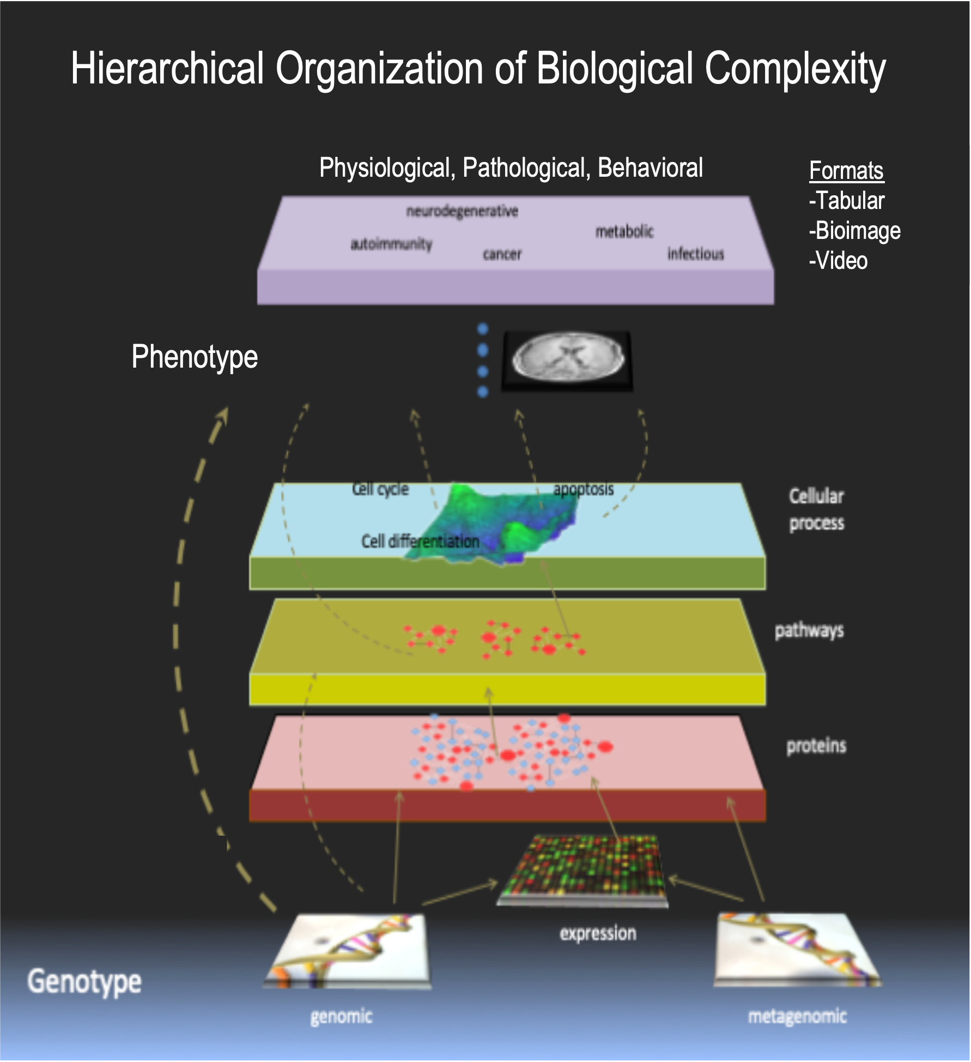
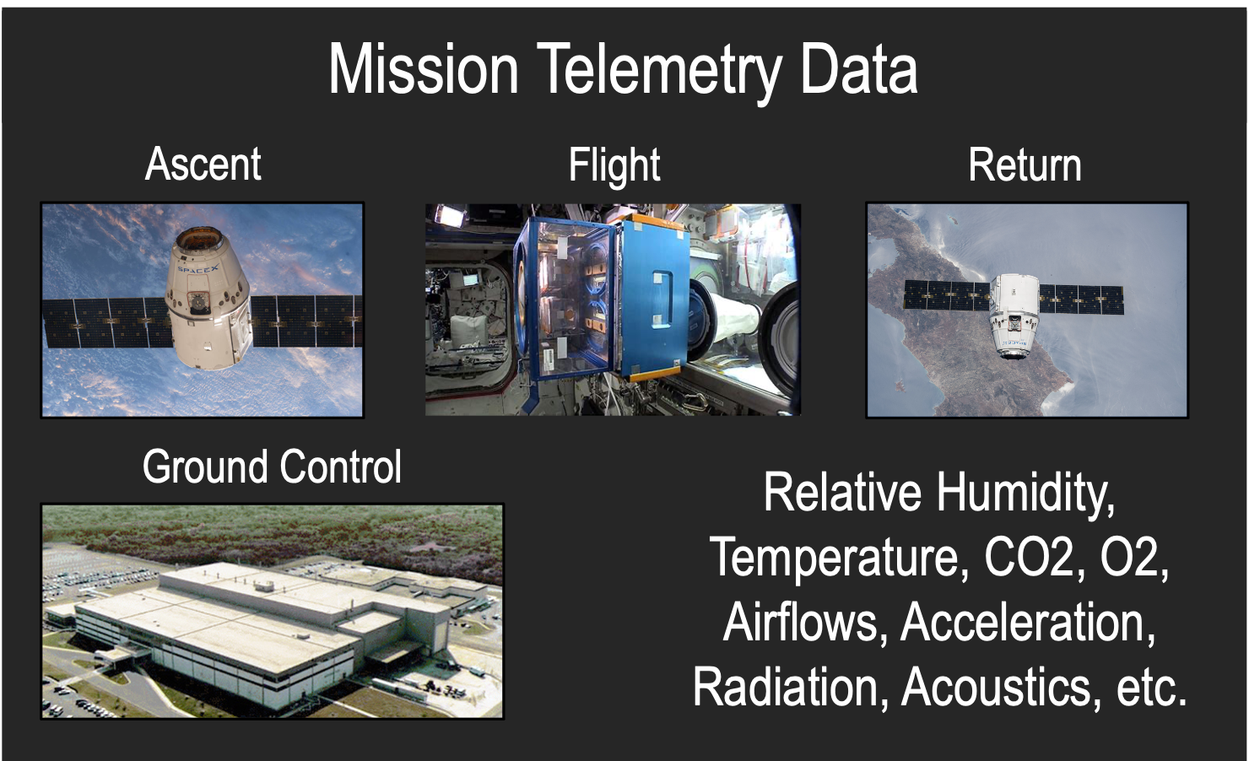

Expanded AWGs
ALSDA
AI/ML
110 members
Feedback on science data and metadata standards for physiological, phenotypic, and behavioral datasets to be reusable. Datasets span from raw to processed-results data, and across tabular, bioimaging, and video formats.
56 members
Focuses on developing data AI-readiness guidelines, algorithm and automation development, and developing ethical guidelines to increase trust and explainability surrounding AI in space biology.
Notes:
In 2021, a new community of researchers formed the Ames Life Science Data Archive (ALSDA) AWG that focuses on standardizing phenotypic data. Just this past month, the Artificial Intelligence/machine learner (AI/ML) AWG was recently created and is currently discussing focus areas of the AWG and feasible action items for the next 1-3 years.

Slide 6
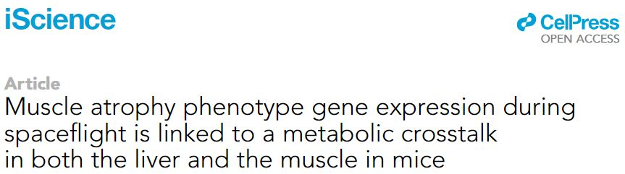
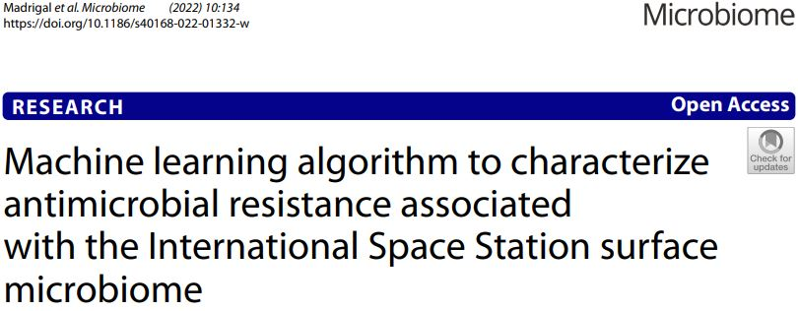
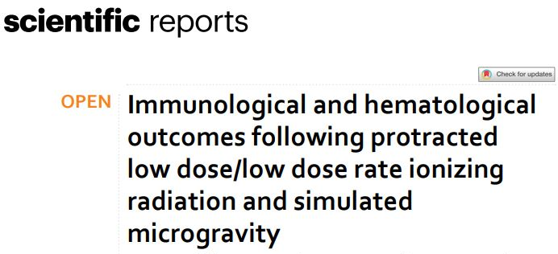
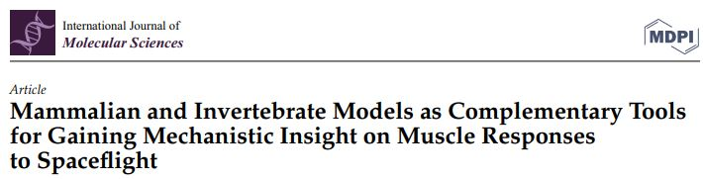
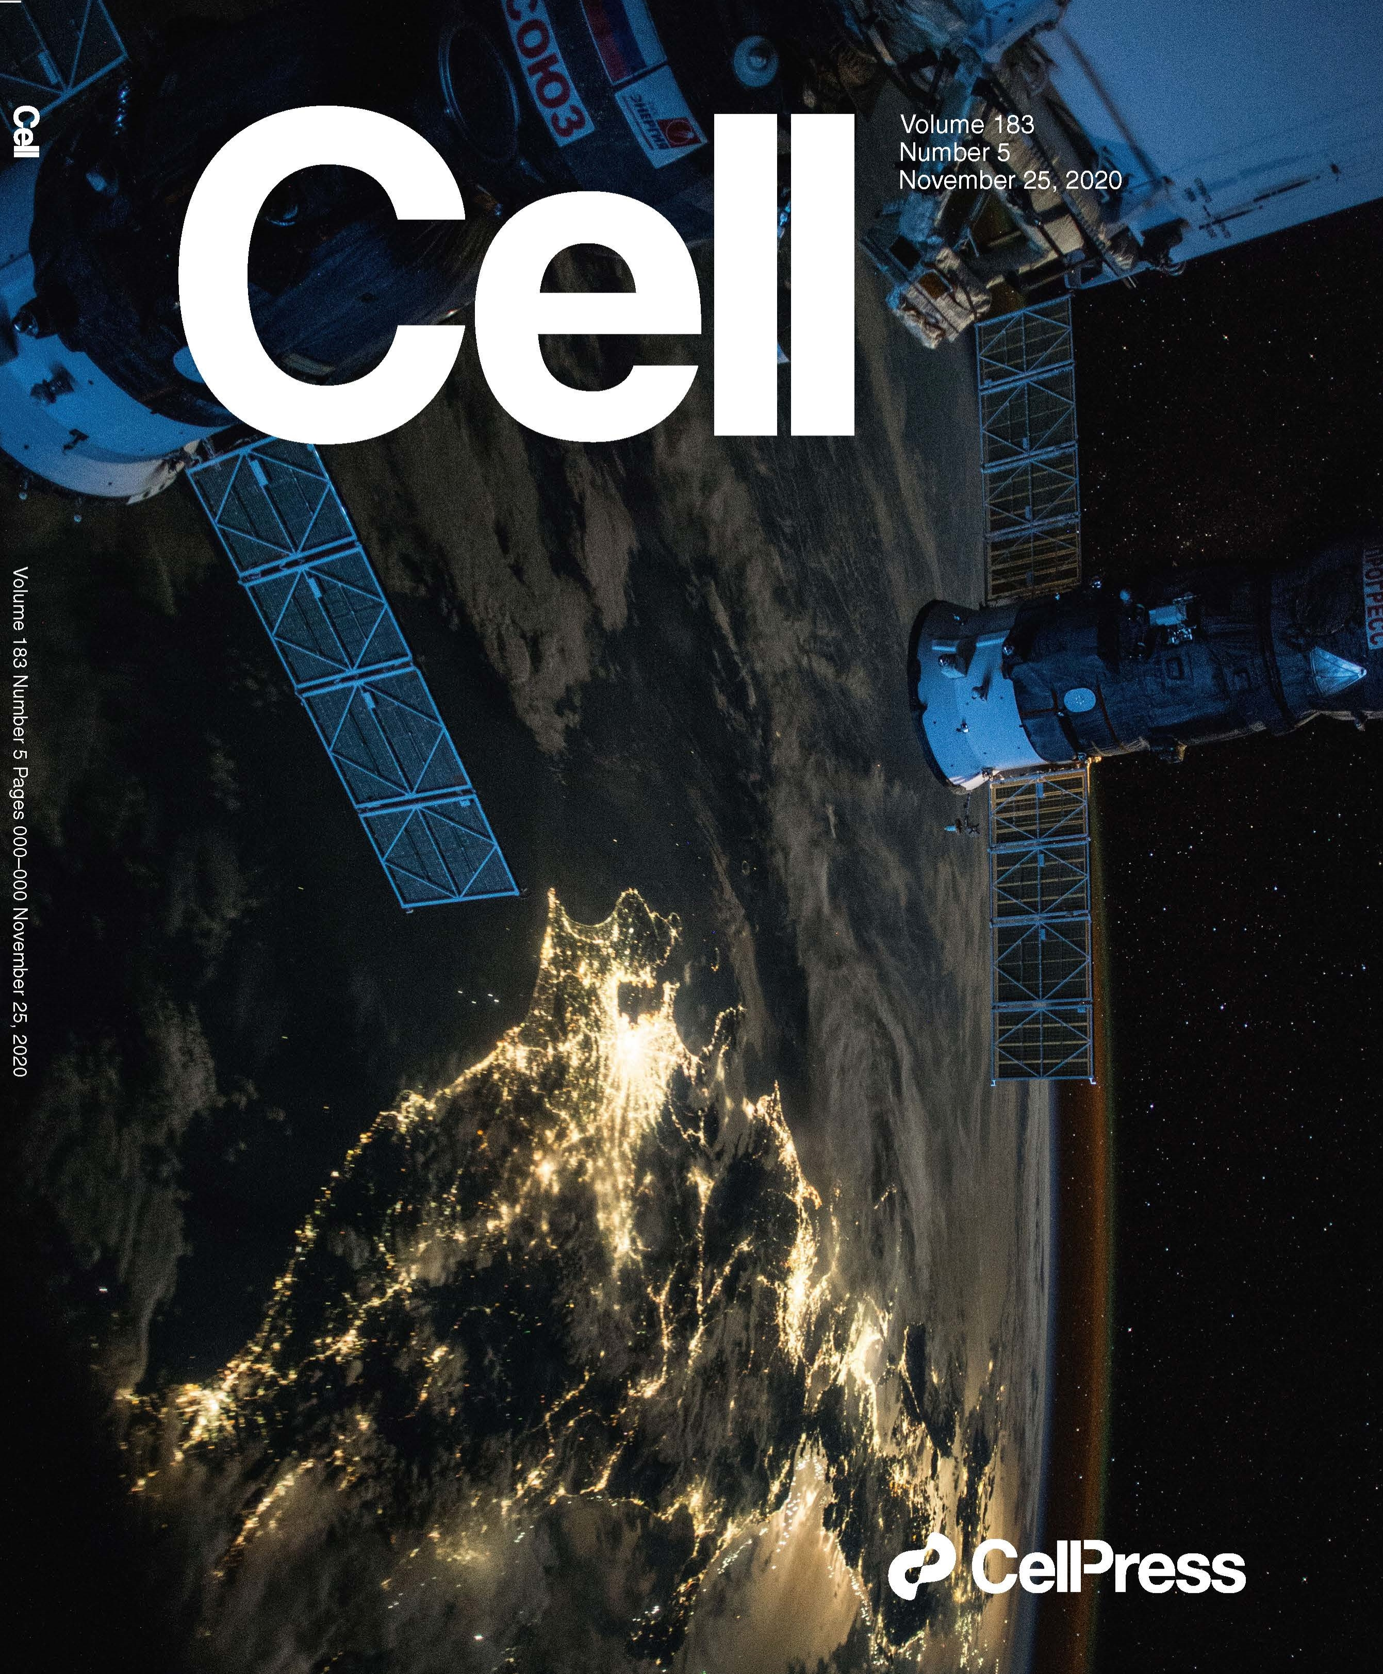
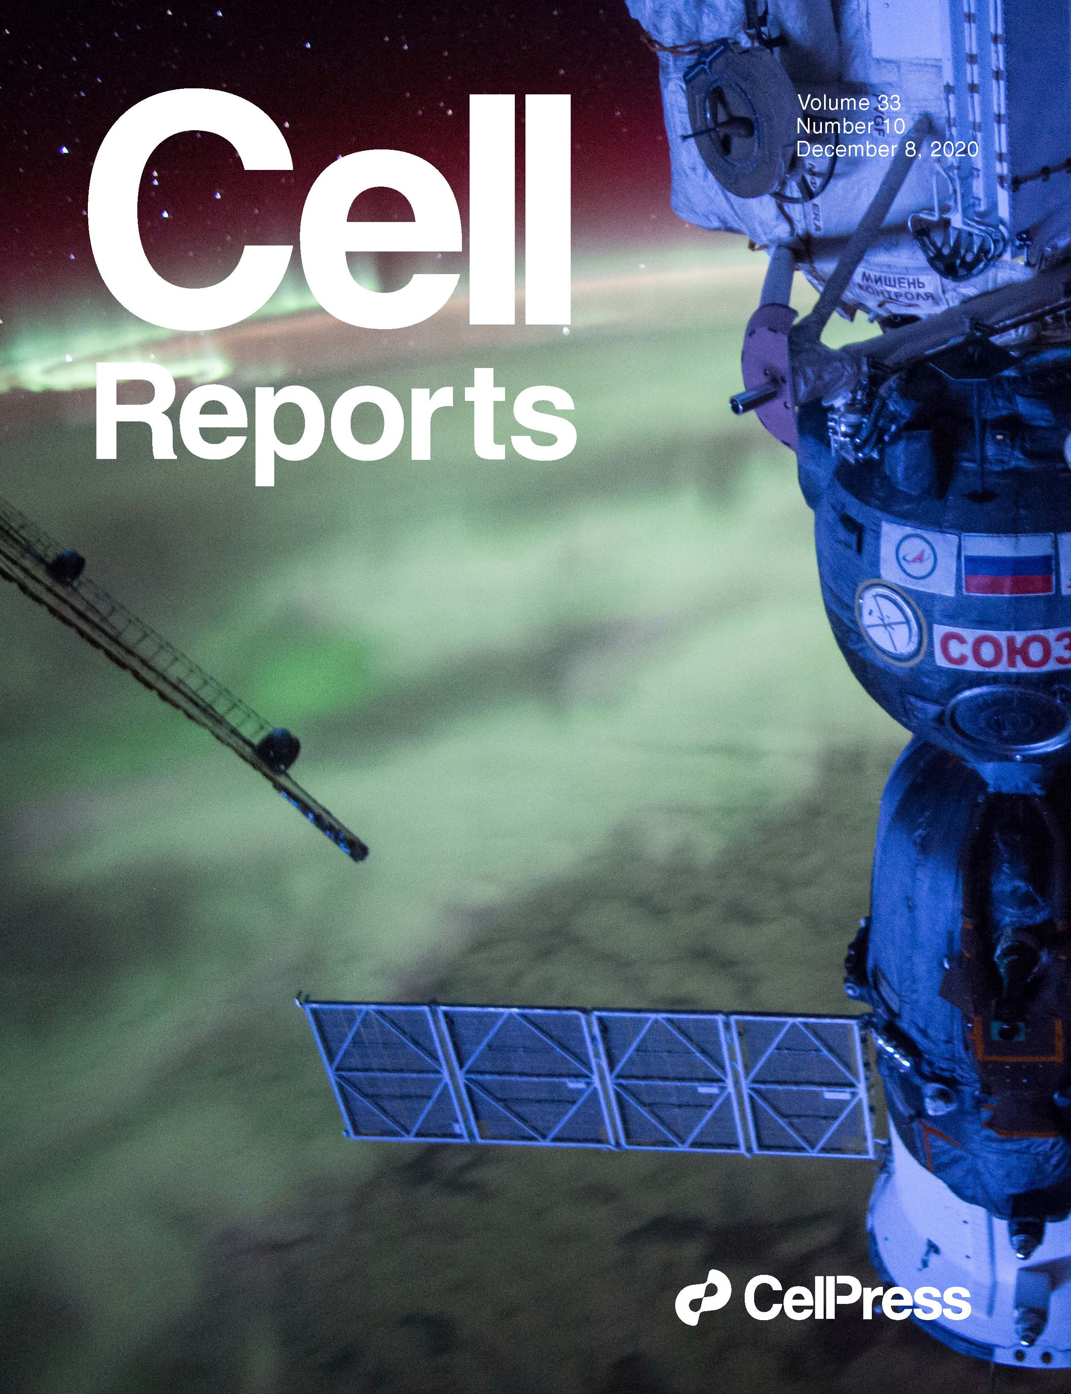
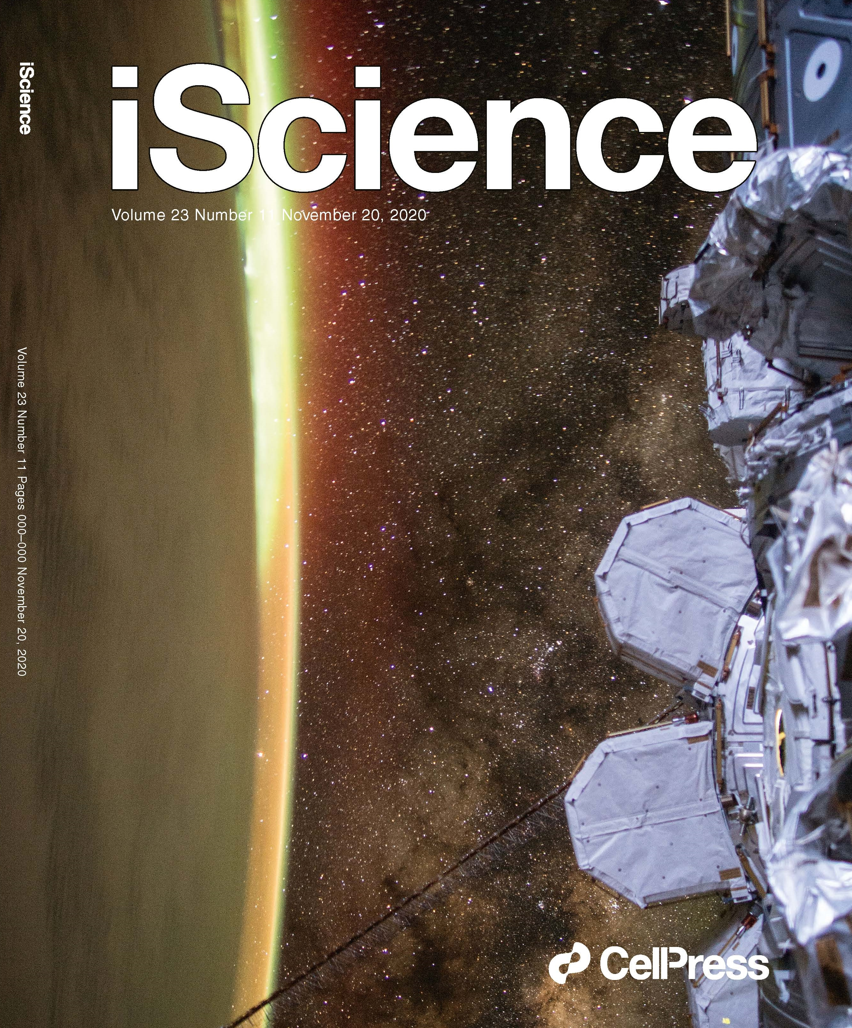
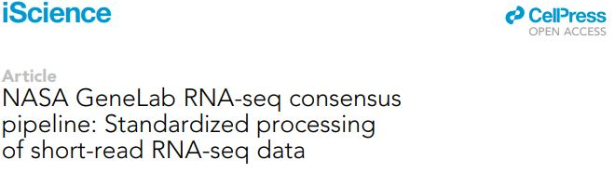
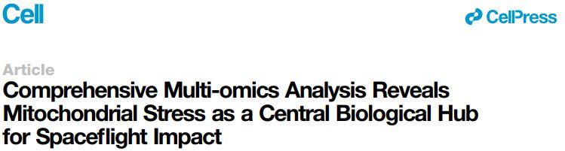
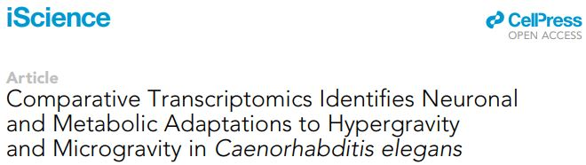
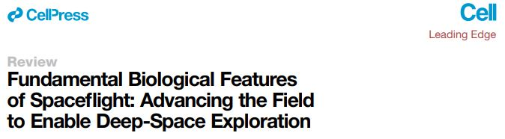
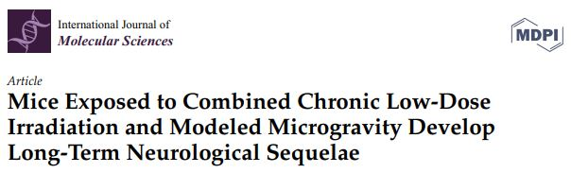
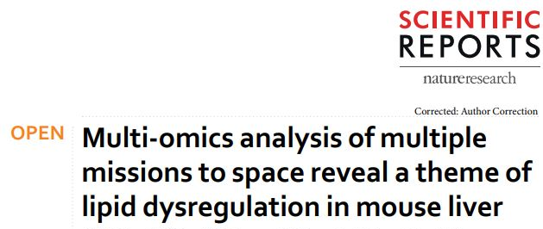
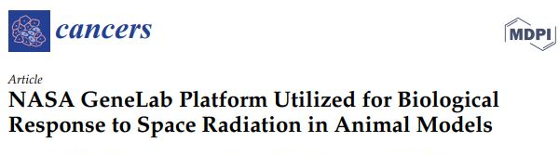
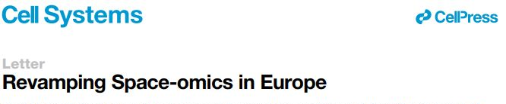
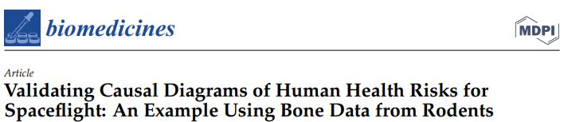
Publications
50 publications (12 publications produced by the AWGs) using data available in GeneLab.
Cell: The biology of spaceflight package
  A coordinated package of 29 scientific papers published in five Cell Press journals featuring 9 papers utilizing data or resources in GeneLab.
Notes:
Since the inception of the AWGs in 2018, the groups have published 12 peer-reviewed scientific papers that re-using data that is publicly available in GeneLab. Were there any cell pubs that are AWG pubs?

Slide 7
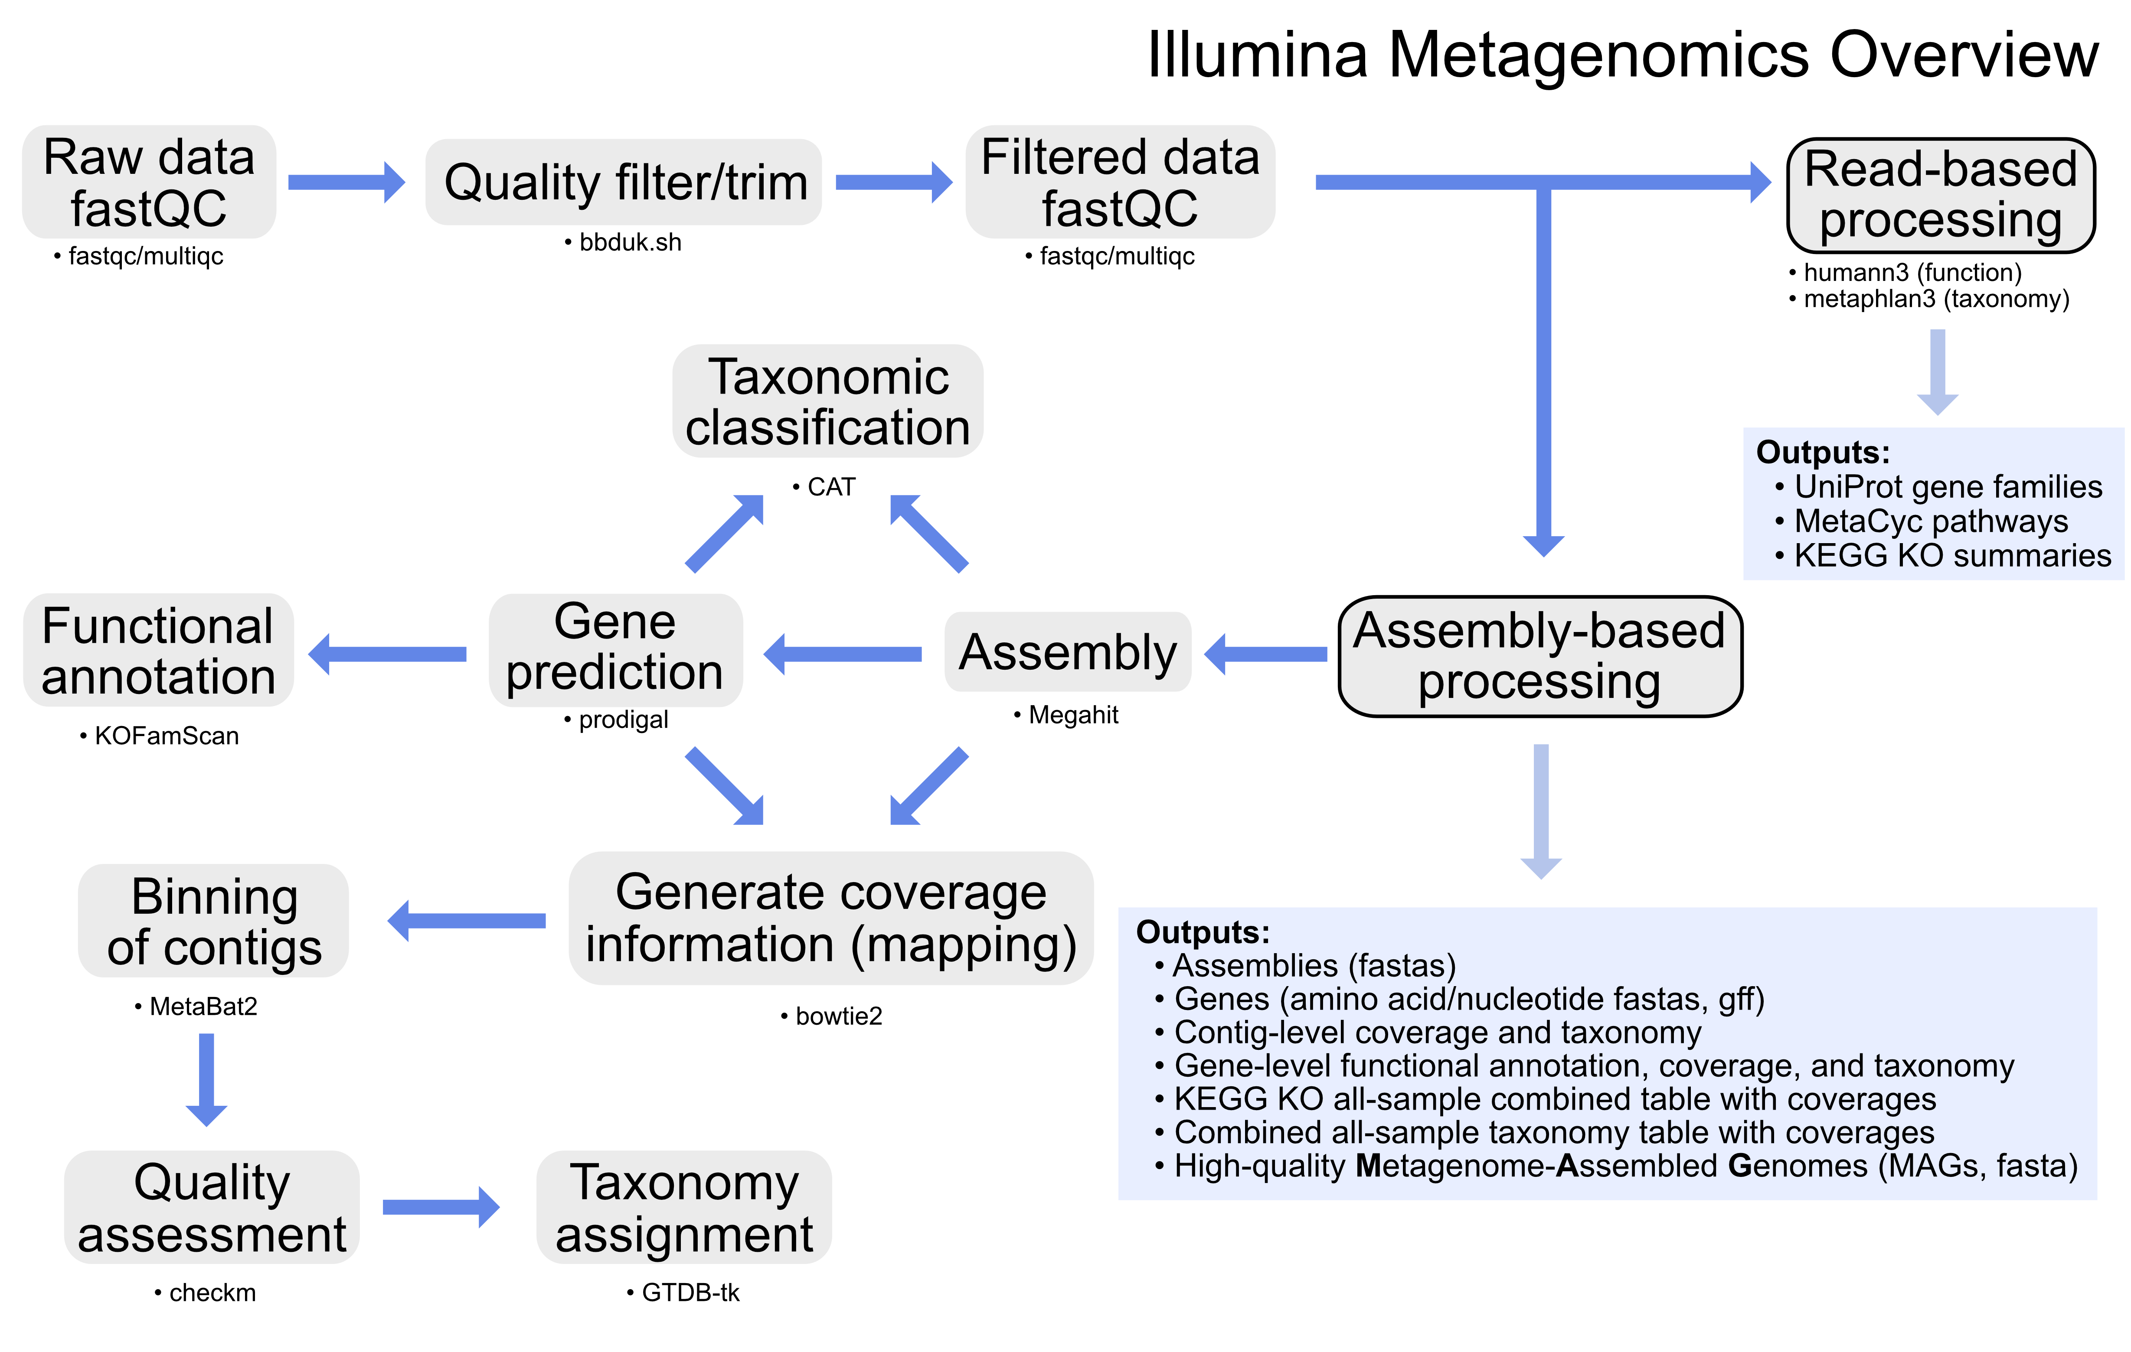
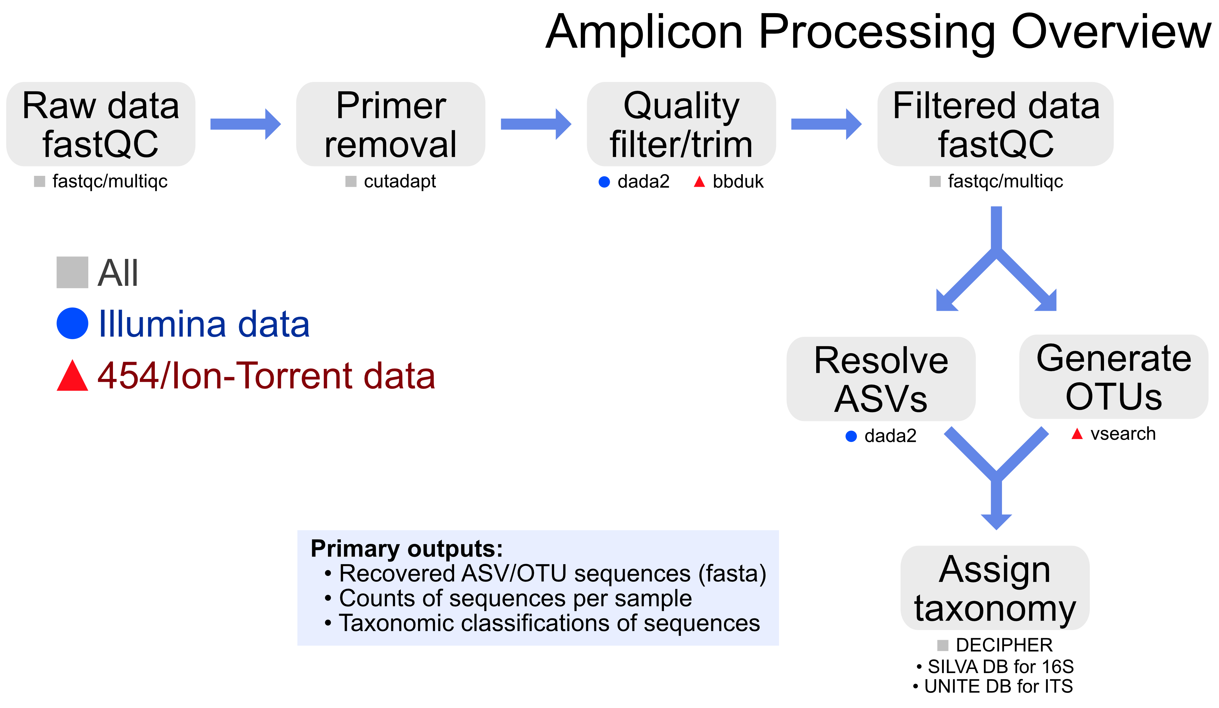
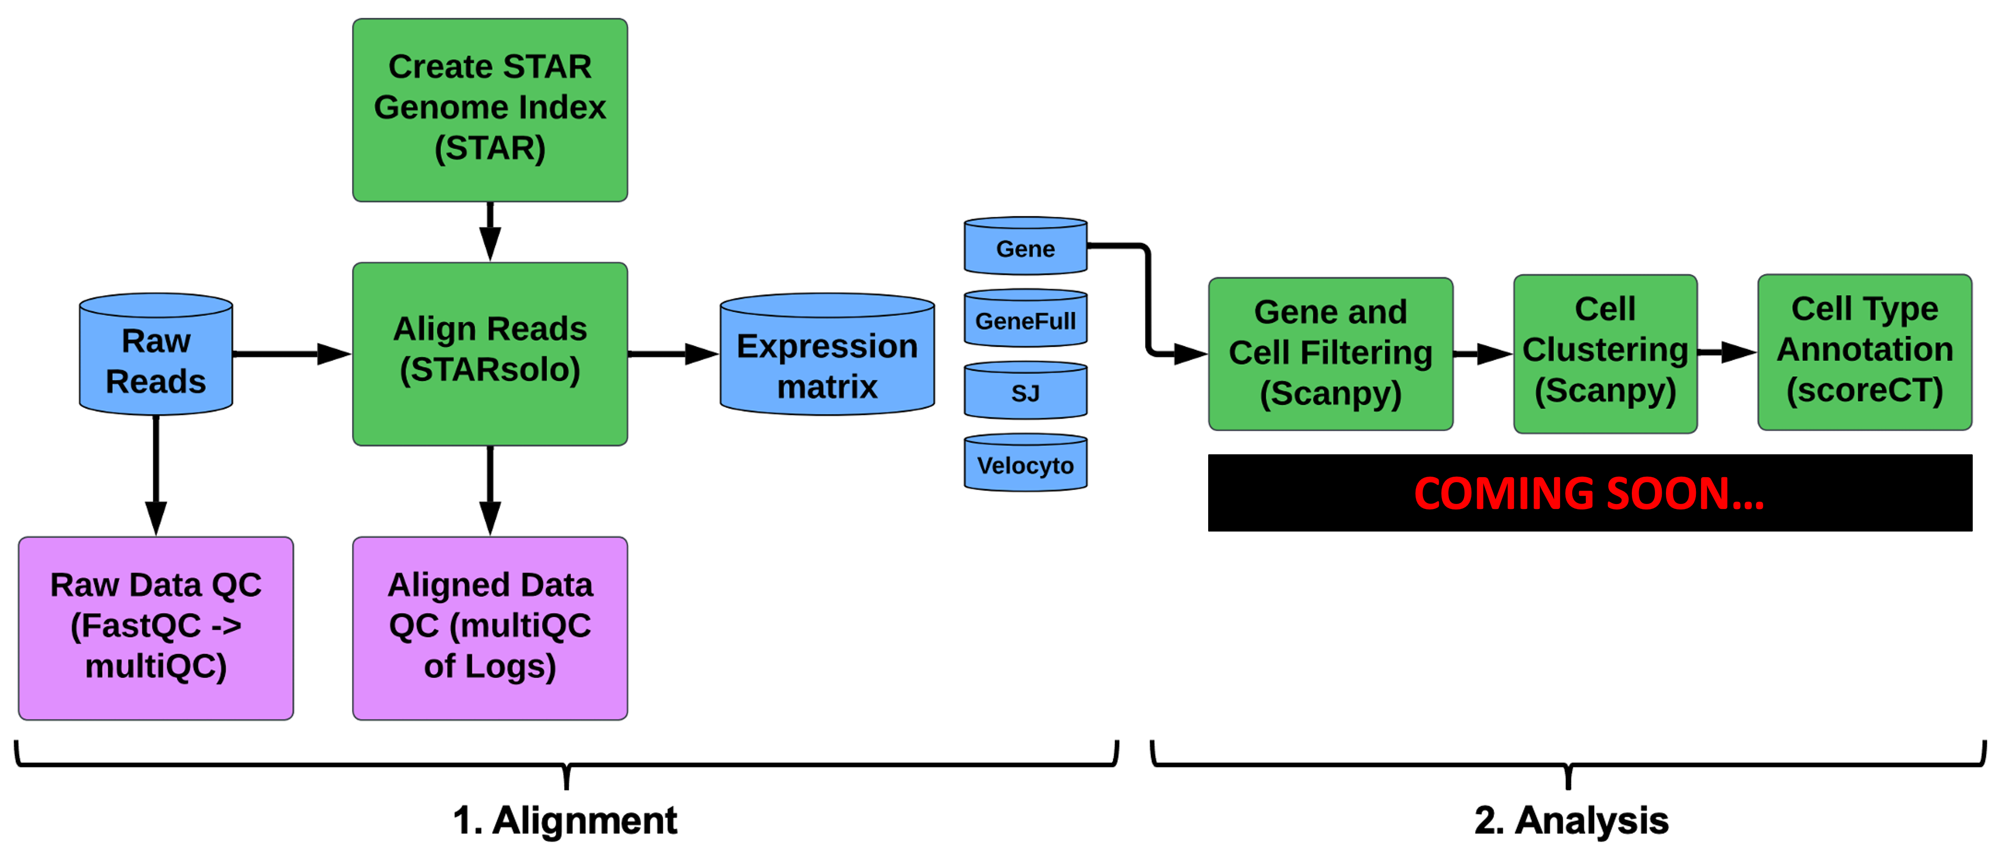
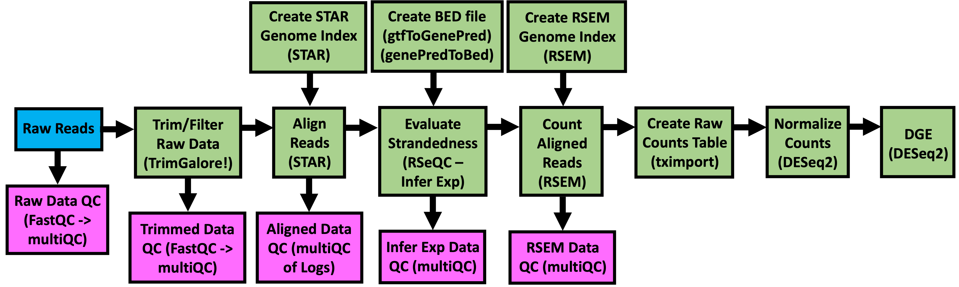
GeneLab Standard Omics Processing Pipelines
Metagenomics (Illumina) Pipeline
Amplicon Pipeline
(bulk) RNAseq Pipeline
single cell RNAseq Pipeline
Notes:
In addition to analyzing GL data and generating new knowledge as evidenced by the publications in the previous slide, the AWGs also contribute to developing and standardizing omics processing pipelines that are used to process the omics data hosted on GL. Currently, we have four pipelines, Metagenomics, amplicon, bulk RNAseq, and sing cell RNSseq. All these pipelines are available on GitHub, which our data processing lead, Amanda, will go over a little later in the session.

Slide 8
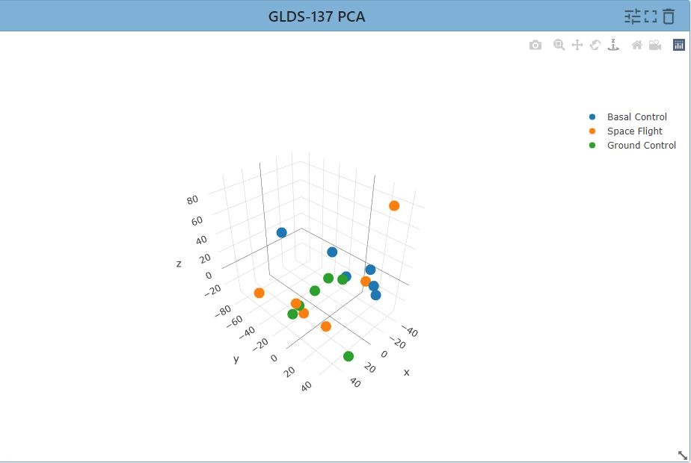
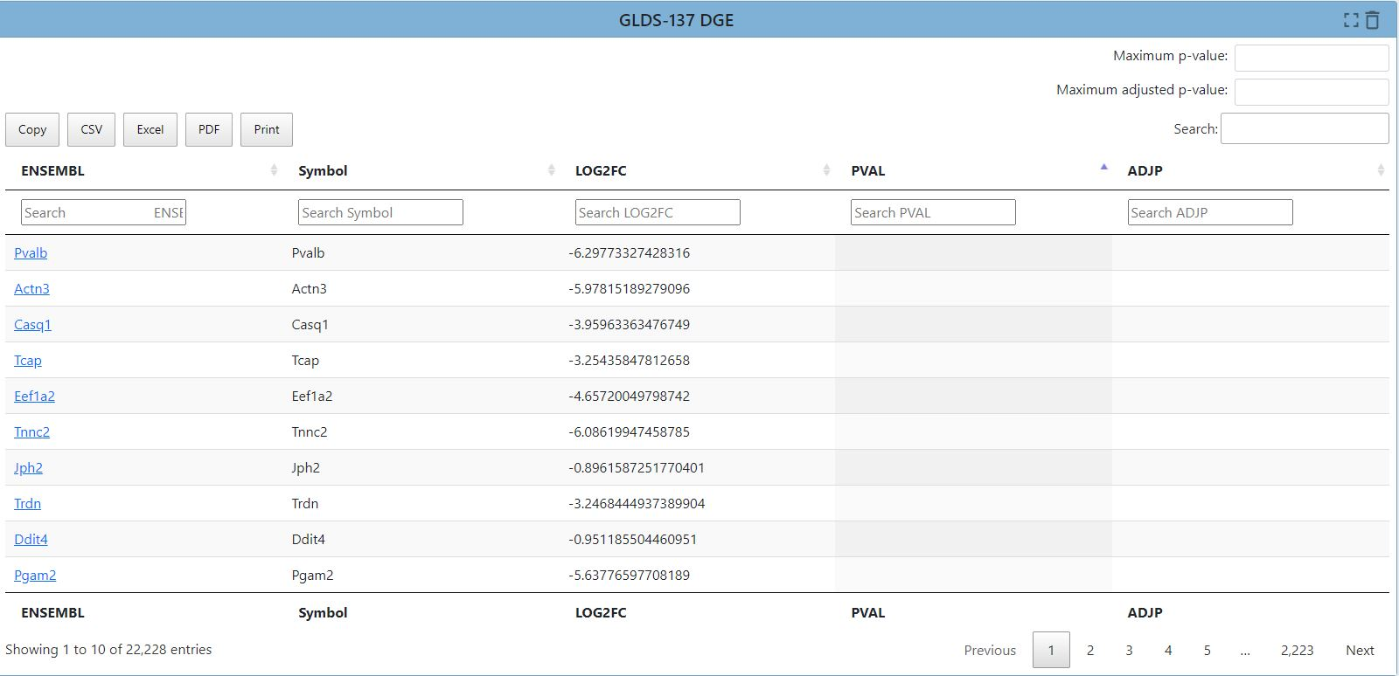
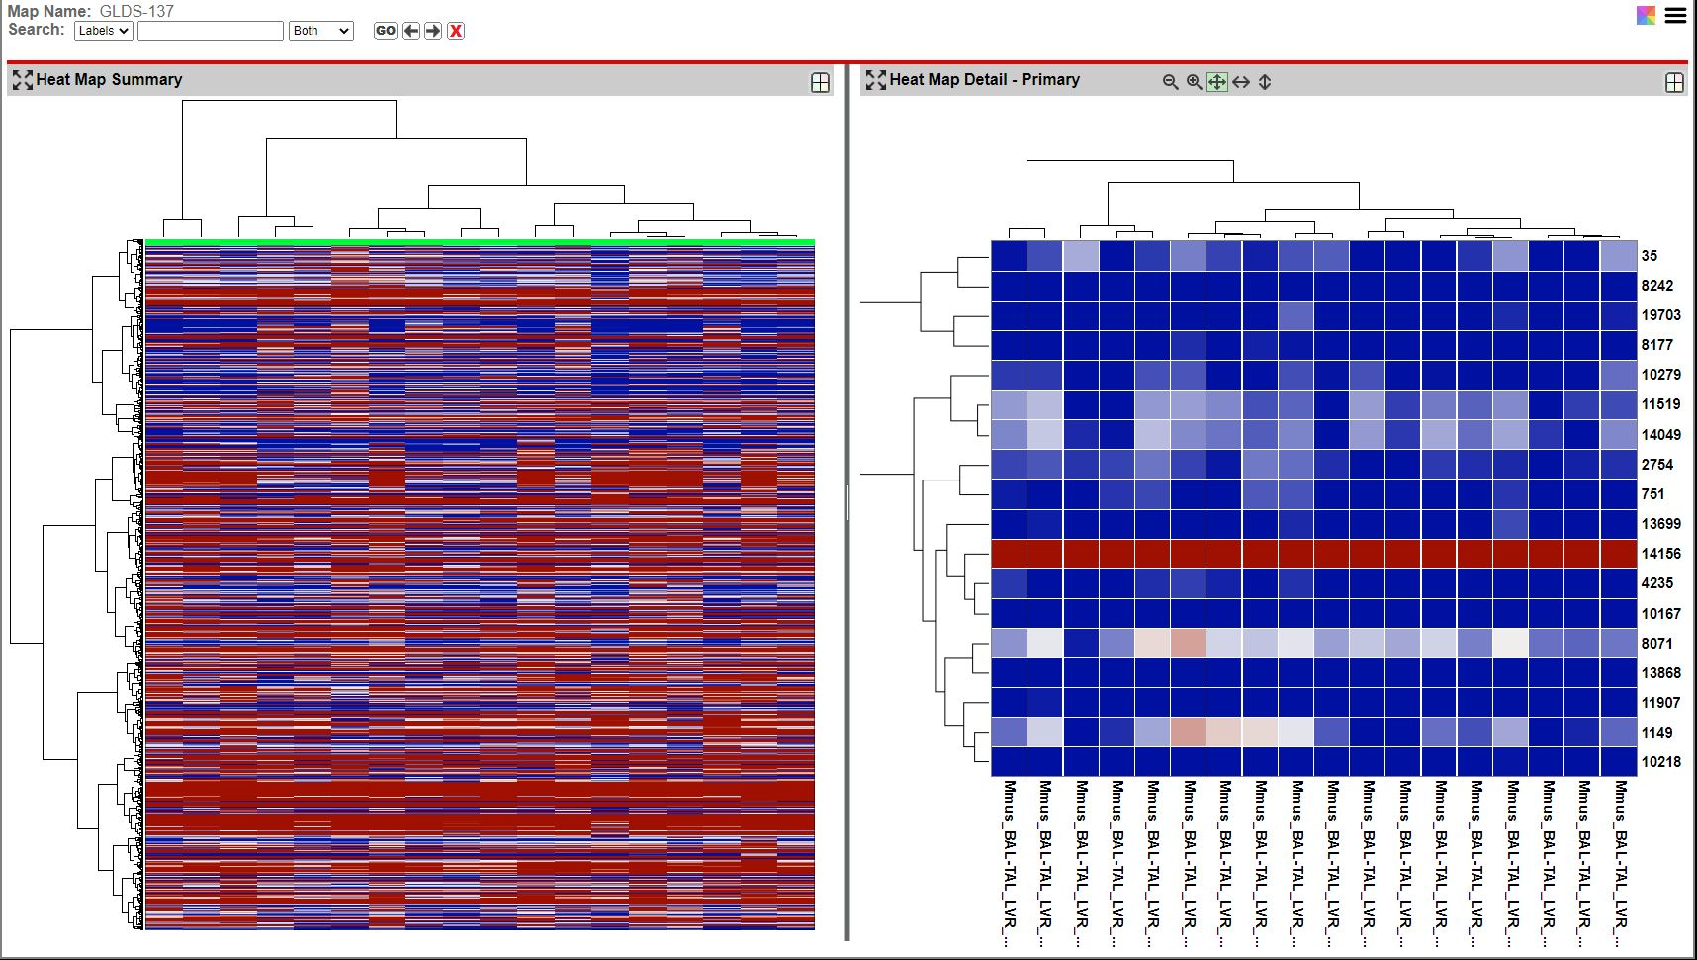
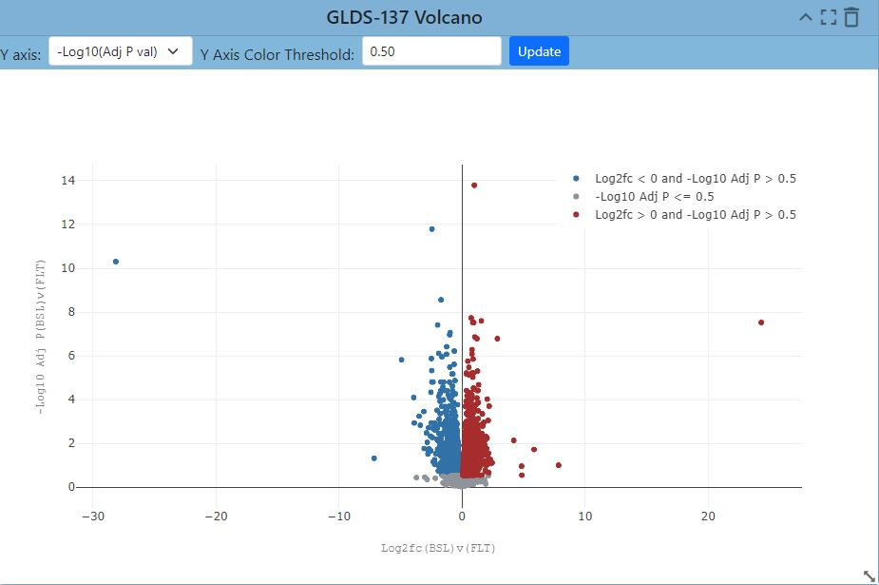
GeneLab Data Visualization Portal (Transcriptomics)
Notes:
Furthermore, GeneLab not only provides processed data as described in the previous slide, but also hosts a visualization platform to help visualize those processed data. The AWGs play an integral role in helping us decide which types of visualization plots are most useful and help with beta testing. In this slide you are viewing some of the transcriptomic visualizations available on our website, including a PCA plot, interactive table to identify differentially expressed genes, interactive heat maps and a volcano plot.

Slide 9
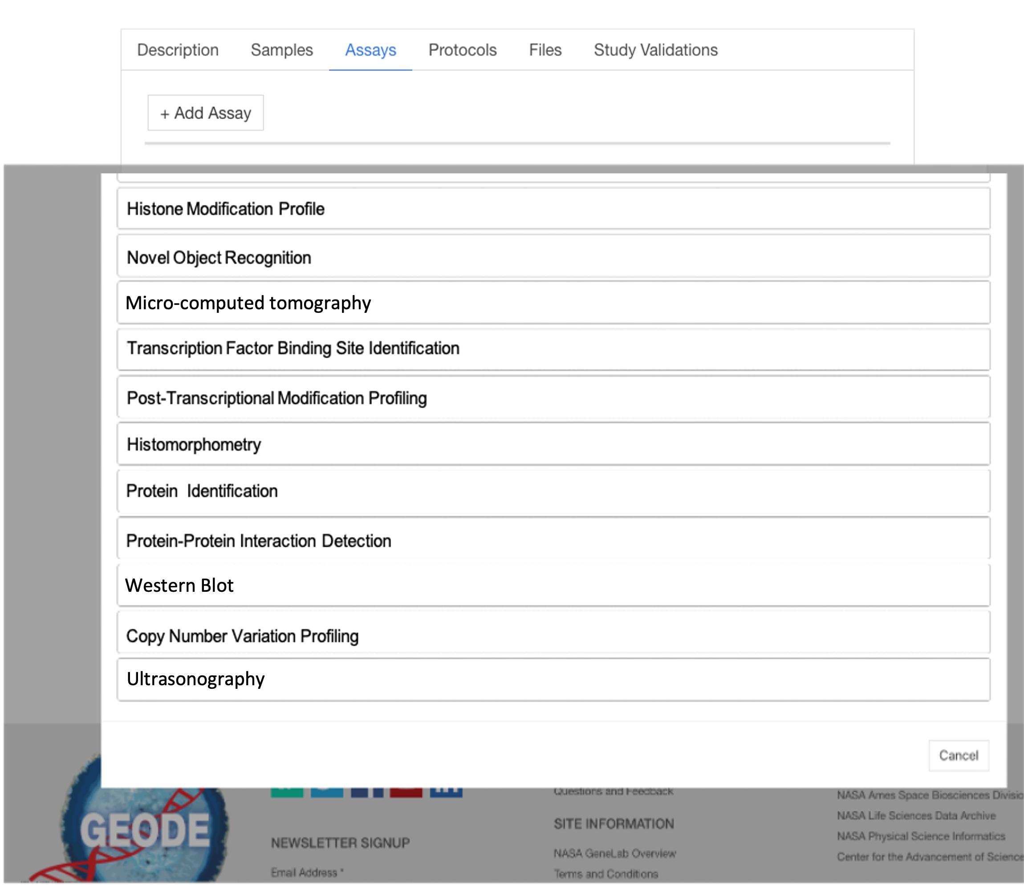
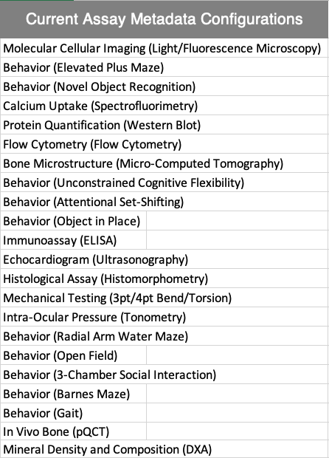
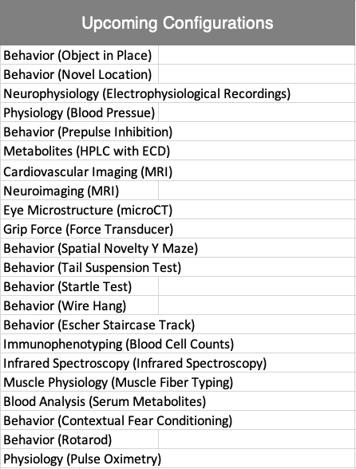
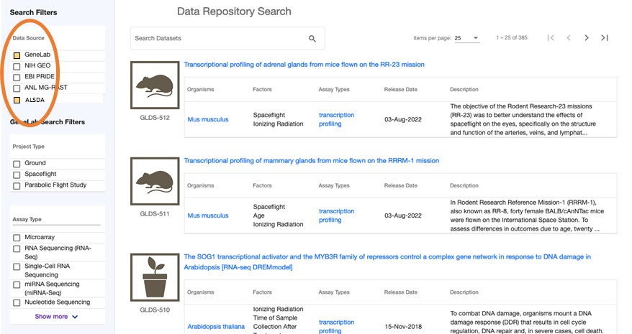
Ames Life Science Data Archive (ALSDA) AWG
SME Feedback on Assay Metadata “Configurations”
Detailed Sample and Assay Metadata Crucial
Configs Used to Add Phenotypic Assays to Submission Portal
This Enables Common Search of
Omics & Phenotypic Datasets
22 Configs Created
Feedback on Tabular Data Templates for Reuse Standards per Assay
Notes:
Continuing with the AWG
SME feedback on assay metadata configs
AWG provided science feedback on the data-results formats and on the metadata

Slide 10
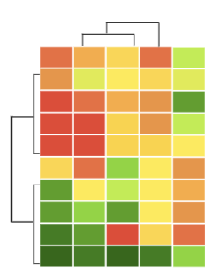
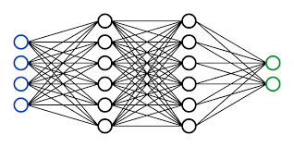
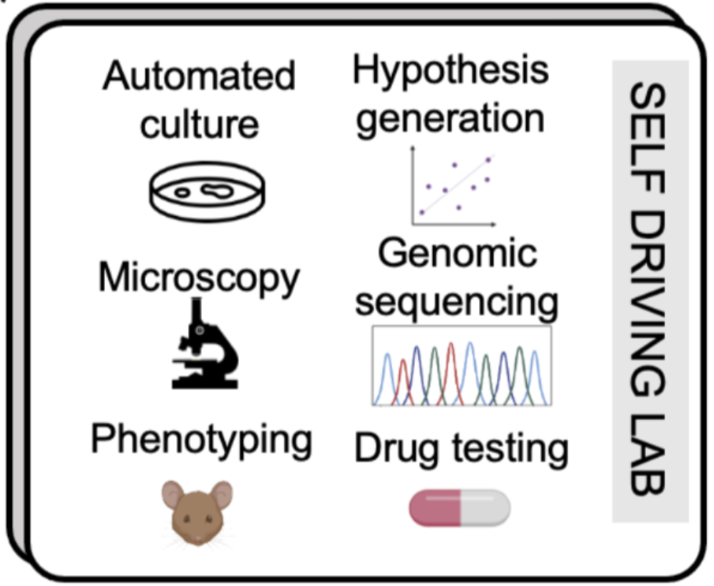

Artificial Intelligence and Machine Learning (AI/ML) AWG Goals
Focus Area 1: AI-Readiness
Pre-processed datasets ready for AI model training
Focus Area 2: Algorithms for Space Biology
Address specific space biology data challenges
(low n, high-dim)
Action items:
Prioritize research questions: Decadal Survey on Life and Physical Sciences Research in Space 2023-2032
Focus on gaps in current capabilities
Develop benchmarking tasks for new algorithms
Action items:
AI-readiness data and metadata guidelines for the Open Science Data Repositories (OSDR)
Standardized AI-ready dataset structure
AI-readiness “score”
Focus Area 3: Self-Driving Labs
Automate space biological experiments
Focus Area 4: Trust, Ethics & Explainability
Ethical AI guidelines for space biology
Action items:
Prioritize physiological biological questions for automation
Integrate several automated experimental platforms for comprehensive experimental readout
In-situ analysis capabilities
Action items:
Education of next generation of AI scientists
Consensus document for ethical standards for AI in space biology
Guidelines for experimental design, metadata, and data
Notes:
The AI/ML AWG had its first meeting on September 12. Members met in breakout rooms to discuss and strategize the four focus areas of the AWG and feasible action items for the next 1-3 years. First, the group discussed how to support AI-readiness of datasets on the OSDR, by providing guidelines and feedback and possibly developing an AI-readiness score for each dataset. Second, the group discussed developing algorithms to address specific space biology data challenges including low sample number and high dimensionality. This will include prioritizing specific research questions or capability gaps and developing performance benchmarks. Third, the group discussed how to support the automation of space biology experiments, including prioritizing physiological questions and developing software for in situ analysis capabilities. Finally, the group discussed how to increase trust and explain ability surrounding AI for space biology, including education initiatives and publishing guidelines.

Slide 11

Interested in becoming a member?
Here’s how to join:
Notes:
If you are interested in contributing to this effort by becoming an AWG member, please use your phone’s camera to scan the QR code and sign up for an AWG.

