Slide 1
Mars Sample Return – Earth Entry System
Overview & TS Division Support
Zion Young
Acting Deputy Chief, Entry Systems and Technology Division
November 4, 2022

Slide 2












SRR/MDR Program Architecture
Mars
Mars 2020
Tube Delivery
SRL/MAV
Mars Ascent
Vehicle
Tube Collection & Depot
Tube Retrieval
Helicopter
Orbiting Sample
Retrieve OS
Relay Support
ERO
Break-the-Chain
Avoid Earth
Earth Entry Vehicle
Earth
Mars2020
Earth Return Orbiter
Sample Retrieval Lander
Sample Return and Science

Slide 3
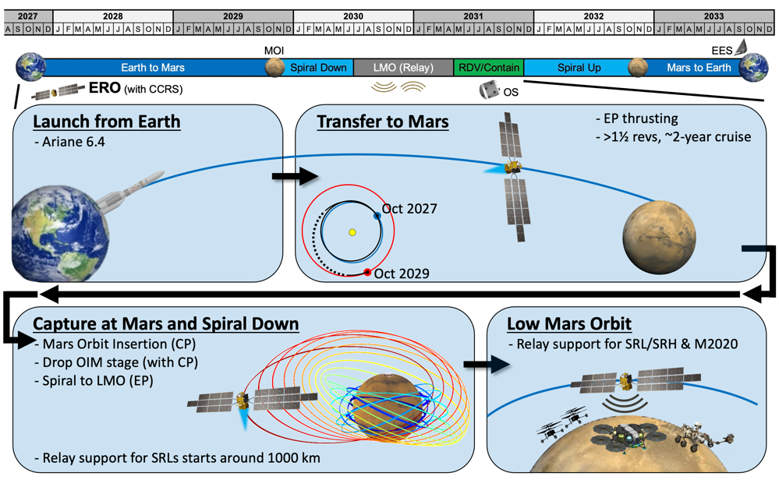

ERO Cruise and Mars Operations

Slide 4
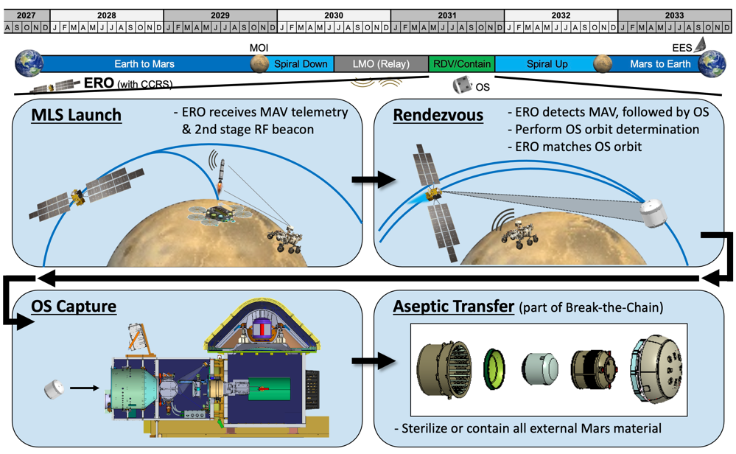
ERO Rendezvous, Capture, and Containment

Slide 5
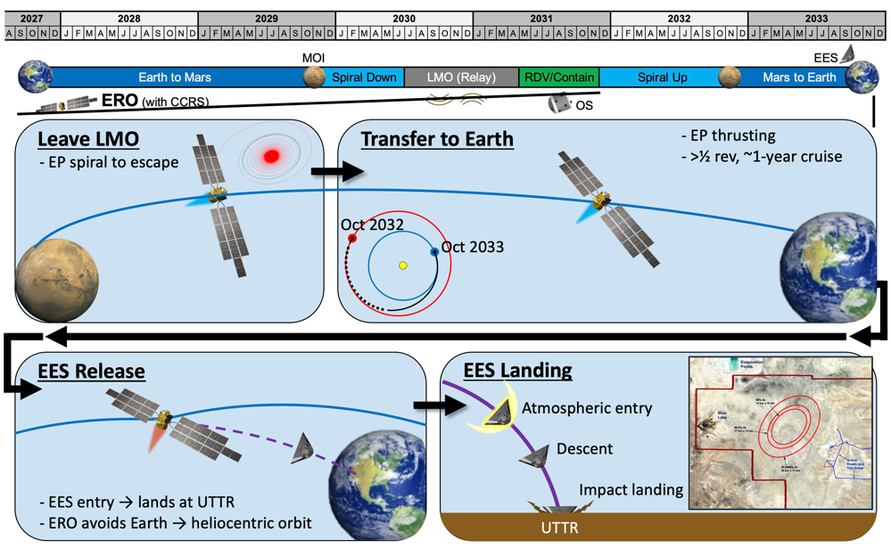
Earth Return and EES Delivery

Slide 6
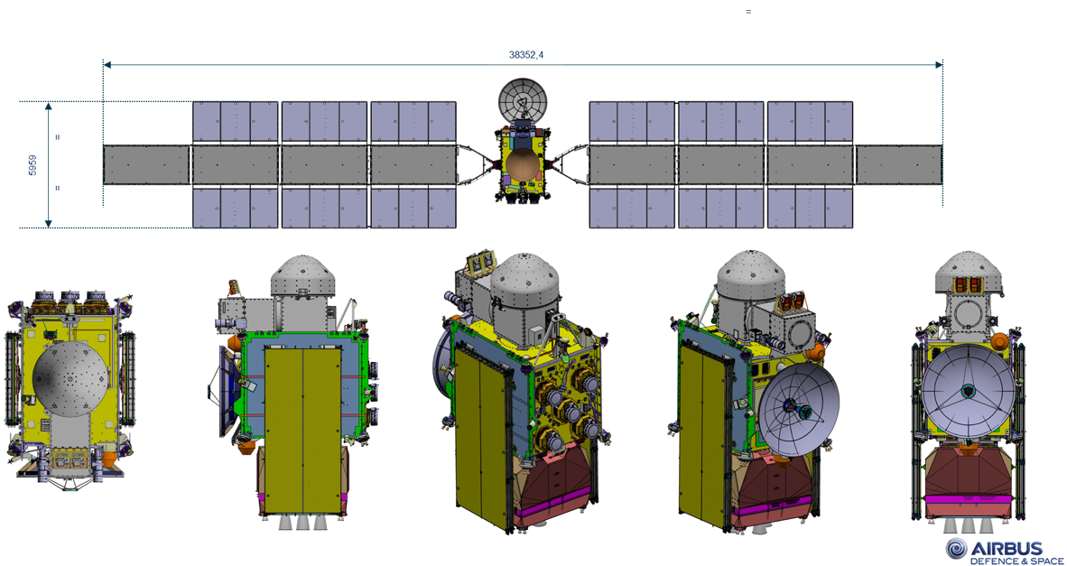
ERO Spacecraft

Slide 7
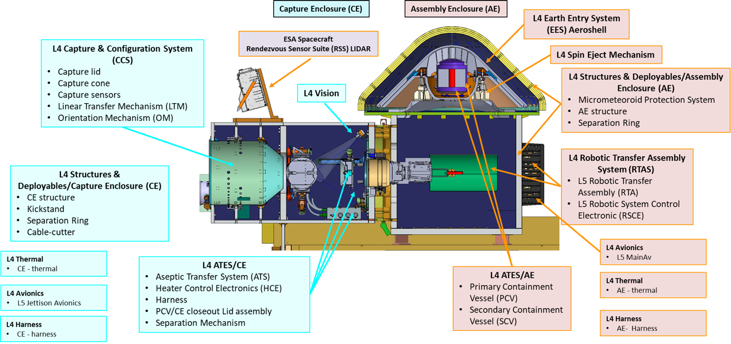
CCRS Flight System Overview
7

Slide 8
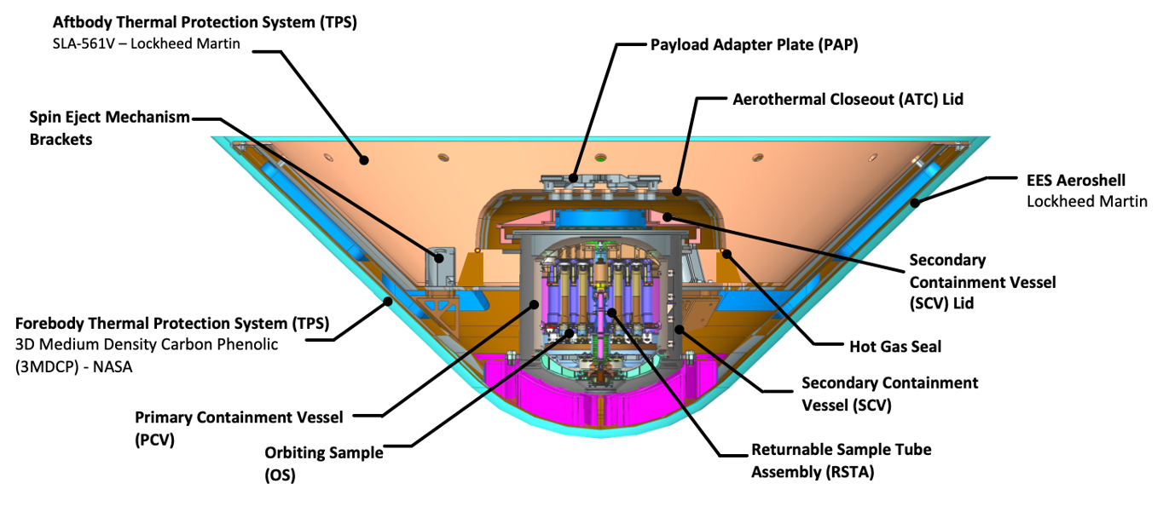
EES System Design

